Slide 1
The American Foster Care System:
A Broken Solution,
A Broken Society
How the system does not serve American children, families, or communities
By Shawanna Vaughn, Silent Cry, Inc.

Slide 2
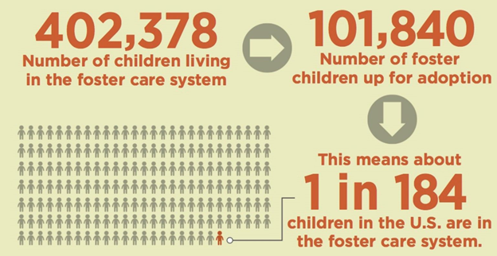
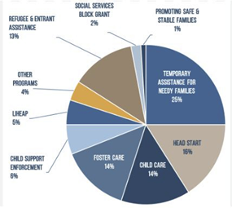
Foster Care System Basics and Statistics
One in three children in the US will be part of a child welfare investigation by age 18.
83% of child removals are due to allegations of "neglect," which are usually tied to poverty, and charges are rarely filed.
The average stay in foster care is two years.
 | Group A | Group B
Class 1 | 82 | 95
Class 2 | 76 | 88
Class 3 | 84 | 90

Slide 3
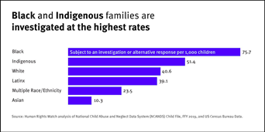
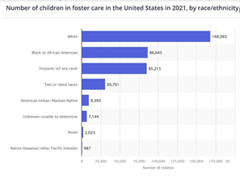
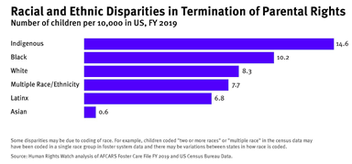
What Happens to BIPOC and Other “Undesirable” Children—Racial and Other Disparities in the Foster Care System
BIPOC children are represented disproportionately in the system
BIPOC families are targeted by the system

Slide 4
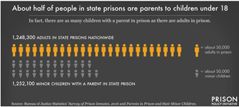
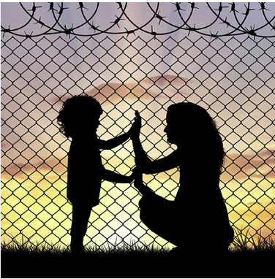
The Child Welfare System and Incarceration
Women are the fastest-growing incarcerated population, and most women in prison are mothers.
1 in 8 incarcerated parents have their parental rights terminated
Black children are more likely to have an incarcerated parent.

Slide 5
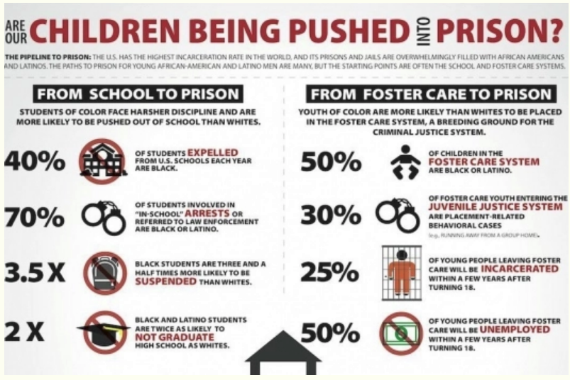
The Foster Care-to-Prison Pipeline
About 15-20% of children entering the foster care system have an incarcerated parent, Children with corrections-involved parents are at the highest risk of becoming involved in either the child welfare or criminal justice systems.

Slide 6
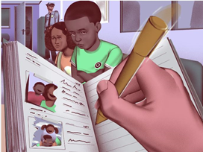
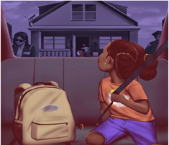
The Impact of Child Removals on Children, Families, and Communities

Slide 7
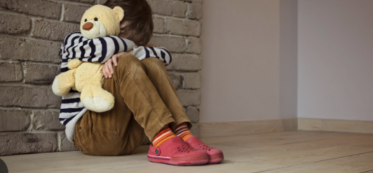
Specific Effects of Foster Care on Kids Ages 3-6

Slide 8

Specific Effects of Foster Care on Kids Ages 7-12

Slide 9

Slide 8: Specific Effects of Foster Care on Kids Ages 13-18

Slide 10
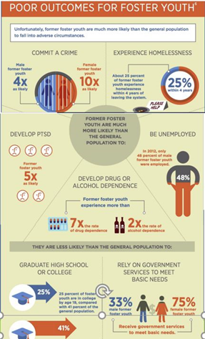
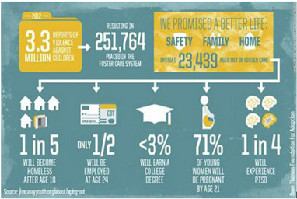
Ageing Out: Poor Outcomes

Slide 11
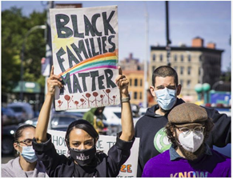
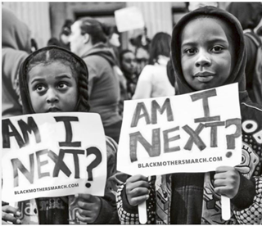
The Future of Foster Care in America

