Slide 1
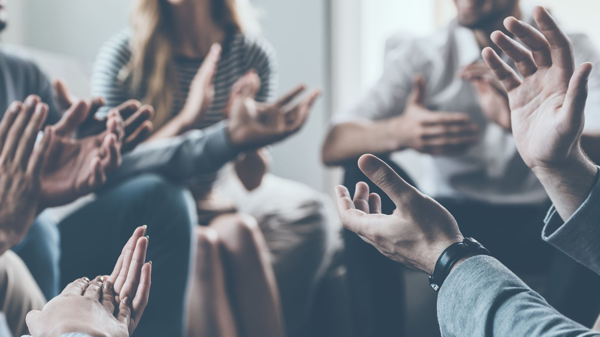
Trauma and BIPOC Communities
"A Deep Dive into Cold Waters"
by Shawanna Vaughan

Slide 2
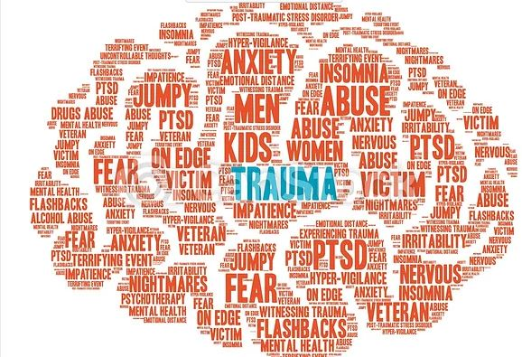
What is Trauma?
A general look at a complex, complicated problem

Slide 3
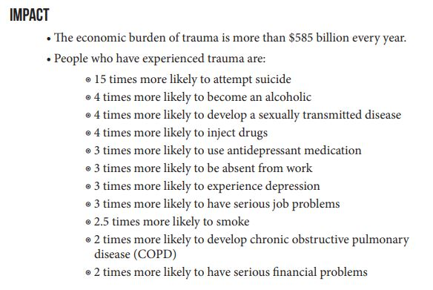
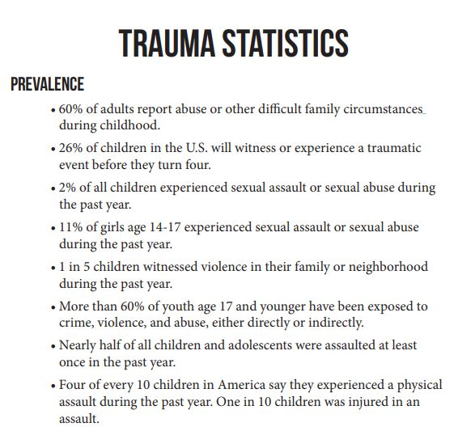
Effects of Trauma
The Bad, the Ugly, and the Uglier

Slide 4
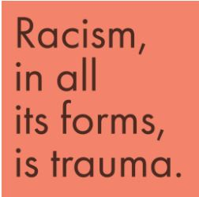
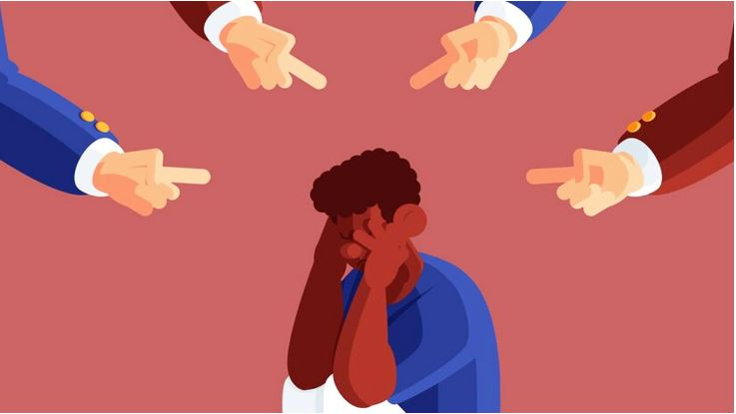
Racial trauma
The Elephant in the Room

Slide 5
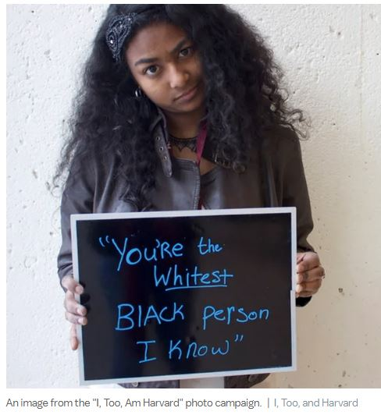
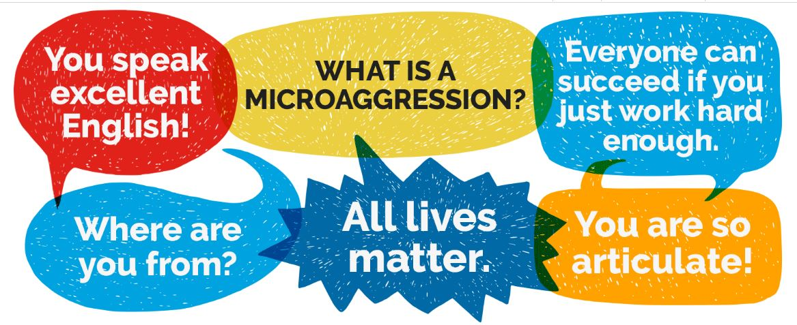
What Causes Racial Trauma?
Micro and Macro: It's All Bad

Slide 6
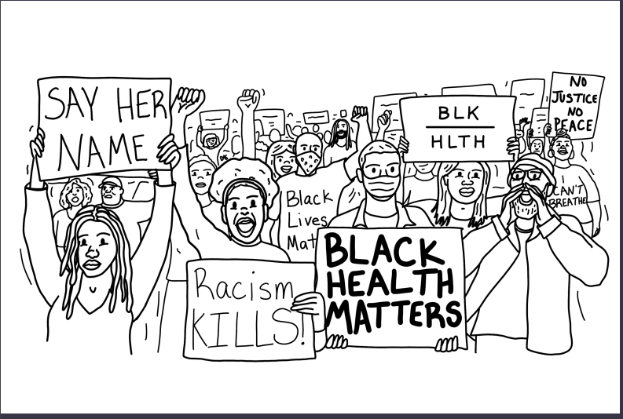
Physical Effects of Racial Trauma on BIPOC Communities
It Touches Every Aspect of Our Lives and Existence

Slide 7
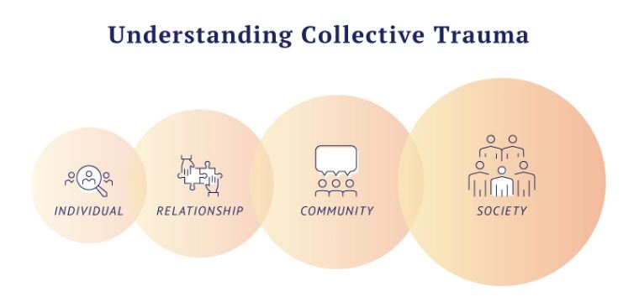
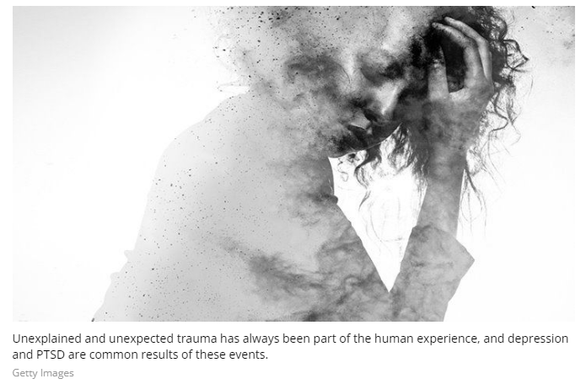
Emotional and Behavioral Trauma effects in BIPOC individuals
This is Why

Slide 8
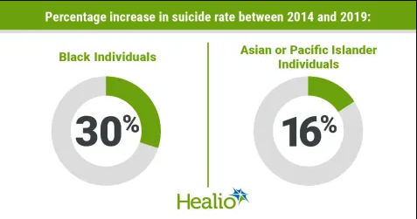
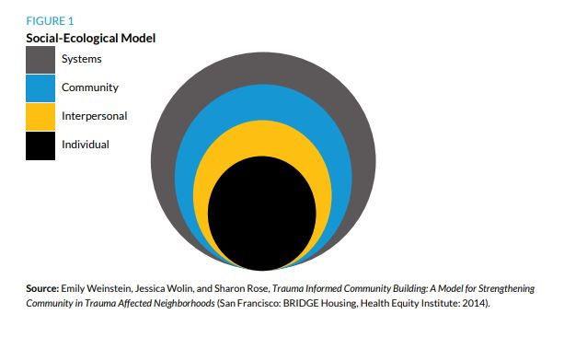
Community and Societal Effects of Racial Trauma
What Affects One, Affects Us All

Slide 9
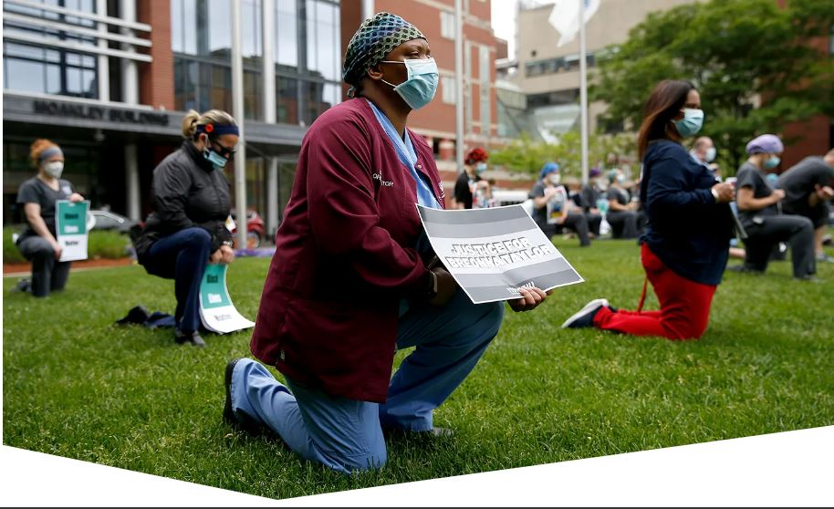
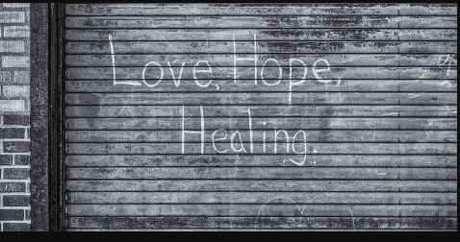
What to do About Racial Trauma in Your Community
Helping Ourselves Help Ourselves

Slide 10
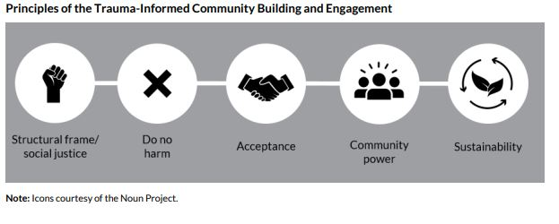
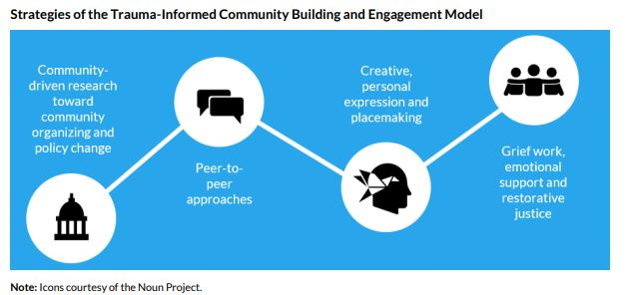
Focusing on Mental Health in BIPOC Communities
Healing from the Inside Out

Slide 11
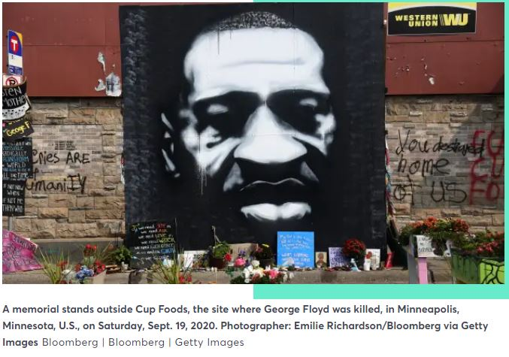
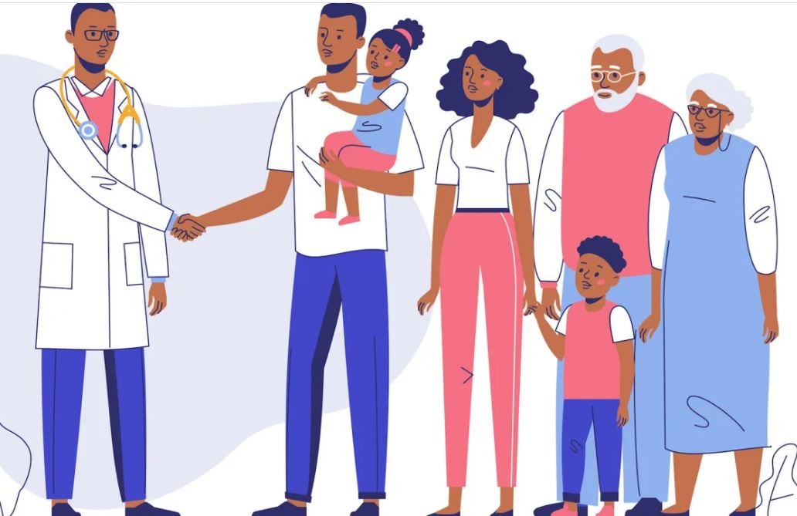
Taking it To The Streets
Get Out There and Make a Difference

