Slide 1
CRISIS INTERVENTION TEAM TRAINING
Legal Issues
Andy Feller Edwardsville PD
618 447-4288
andyfeller618@gmail.com

Slide 2
Objectives
Define key definitions under the Mental Health and Developmental Disability Code
Identify when law enforcement can take an adult into custody to transport to a Mental Health Facility

Slide 3
Objectives
Identify when law enforcement can take a minor into custody to transport to a Mental Health Facility
Explain the exceptions provided by the Confidentiality Act

Slide 4
Mental Health Law
The rights of the individual
  Because liberty rights of an individual are involved, the courts have held that there must be a strict compliance with the mental health code when a person is to be placed in a facility against his/her will for treatment

Slide 5
The Mental Health and Developmental Disabilities Code
405 ILCS 5/
Is the exclusive means by which a person is hospitalized
Regulates how a person is detained, transported, admitted, transferred, and discharged from a hospital

Slide 6
The Mental Health Code
405 ILCS 5/
“Person subject to involuntary admission”
  a person with mental illness who: because of his or her illness is reasonably expected, unless treated on an inpatient basis, to engage in conduct placing such person or another in physical harm or in reasonable expectation of being physically harmed

Slide 7
The Mental Health and Developmental Disabilities Code
405 ILCS 5/
“Person subject to involuntary admission”
  a person with mental illness who: because of his or her illness is unable to provide for his or her basic physical needs so as to guard himself or herself from serious harm without the assistance of family or others, unless treated on an inpatient basis

Slide 8
The Mental Health and Developmental Disabilities Code
“Person subject to involuntary admission”
  a person with mental illness who: refuses treatment or is not adhering adequately to prescribed treatment; because of the nature of his or her illness is unable to understand his or her need for treatment; and if not treated on an inpatient basis, is reasonably expected based on his or her behavioral history, to suffer mental or emotional deterioration and is reasonably expected, after such deterioration, to meet the criteria of either paragraph one or paragraph two above

Slide 9
Law Enforcement Scenarios
Family, friends, or citizens contact police for assistance during a crisis
Threatened by unusual behavior
Street encounter with a person with a mental illness
Court Order
Physician certification to detain/transport
Victim/perpetrator of a crime
Suicidal subject

Slide 10
Voluntary Admissions
Goal is always:
voluntary admission
“Voluntary” admission
  16 years or older may request for self
  No court proceedings
  Signs in freely and able to give informed consent for treatment
  5-day notice required to discharge

Slide 11
The Mental Health and Developmental Disabilities Code
405 ILCS 5/1-129 Mental Illness.
  "Mental illness" means a mental, or emotional disorder that substantially impairs a person's thought, perception of reality, emotional process, judgment, behavior, or ability to cope with the ordinary demands of life, but does not include a developmental disability, dementia or Alzheimer's disease absent psychosis, a substance abuse disorder, or an abnormality manifested only by repeated criminal or otherwise antisocial conduct

Slide 12
The Mental Health and Developmental Disabilities Code
405 ILCS 5/1-114 Mental Health Facility.
    "Mental health facility" means any licensed private hospital, institution, or facility or section thereof, and any facility, or section thereof, operated by the State or a political subdivision thereof for the treatment of persons with mental illness
      Does NOT include emergency rooms

Slide 13
The Mental Health and Developmental Disabilities Code
405 ILCS 5/1- Developmental Disability.
  “Developmental Disability” means a disability (with onset prior to 18 years old) that is attributable to :
    Intellectual Disability
    Cerebral Palsy
    Epilepsy
    Autism Spectrum Disorder

Slide 14
Petition for Involuntary Admission
MUST be 18 years old to petition another
Requires a detailed statement of the reason that the respondent is subject to involuntary admission to include:
  Signs and symptoms of MI
  Description of any acts, threats, behaviors, or patterns of behavior
  Place and time of occurrence
    Behaviors must have occurred within last 72 hours

Slide 15

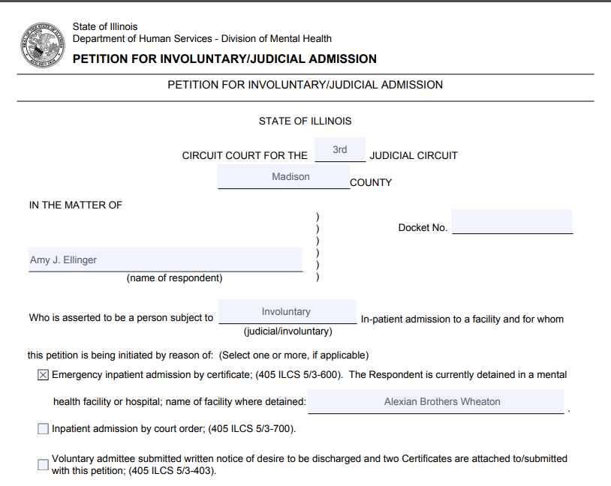

Slide 16
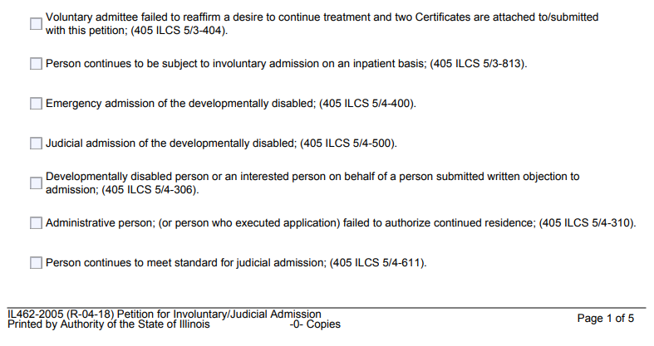

Slide 17
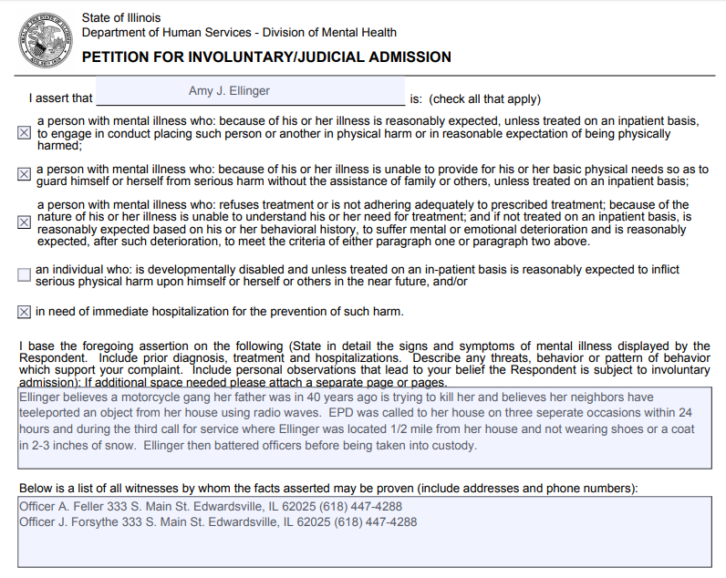
Harm to self or someone else
Harm to self of someone else

Slide 18
Harm to self or someone else
Harm to self or someone else
Unable to care for self
Unable to care for yourself

Slide 19
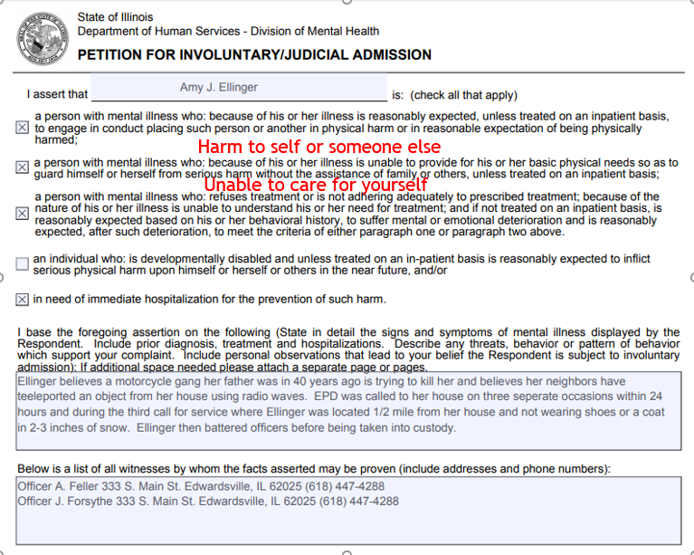
Refuse treatment but because of history, will meet 1st or 2nd

Slide 20
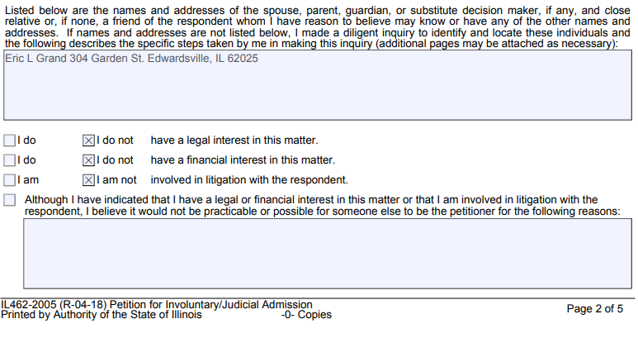
Done to provide aftercare upon release
Done to provide aftercare upon release

Slide 21
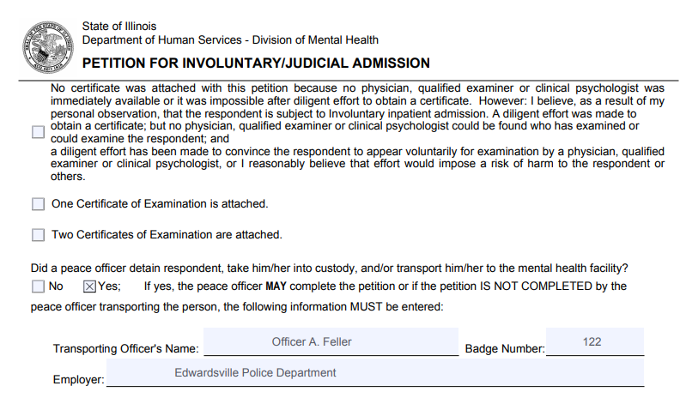
NOTE: Supervisors may not be able to leave venue but can still complete a petition and have an officer deliver the person to the hospital
X
X

Slide 22
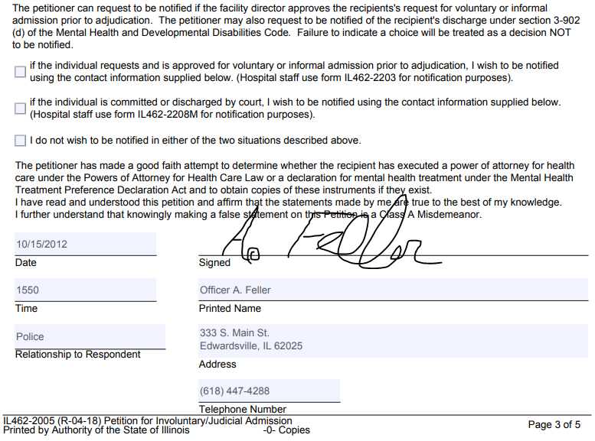
Used if you have a witness to interview or for the purpose of arrest

Slide 23
Petition for Involuntary Admission
Process for Involuntary Admission
  Complete the petition
  Examination at hospital to determine status
  Completion of 1st certificate by qualified examiner
  Completion of 2nd certificate by psychiatrist
  Consumer receives admission documents
  All documents filed with the court
  Court proceedings required, subpoenas if necessary

Slide 24
When may law enforcement take an adult into custody and transport to the hospital?
When a court order commands
When an officer encounters a person with MI who, in his/her opinion, meets the requirements for involuntary admission
LE officer is returning an involuntary patient to a facility following an elopement

Slide 25
When may law enforcement take an adult into custody and transport to the hospital?
LE recognizes of signs of MI and (has probable cause) that person meets criteria for involuntary
Determines that immediate hospitalization is needed to prevent harm from occurring
The officer shall complete a petition
The transporting officer does NOT have to be the petitioner

Slide 26
When may law enforcement take a minor into custody and transport to the hospital?
Who is allowed to admit a minor?
  Parent and guardian
  Loco Parentis
  Any “interested person” who is at least 18 years old if no one else can be located
  Application by an adult for a minor (Kiddie Petition)

Slide 27
Standard for Involuntary Admission of a Minor Under 17
Minor has a MI or emotional disturbance of such severity that:
  Hospitalization is medically necessary, and
  Minor has the capacity to benefit from treatment
  Physician, psychologist or clinical social worker states in writing that he/she has personally examined the minor, and
  Minor meets standard for admission

Slide 28
Mental Health and Developmental Confidentialities Act 740 ILCS 110/12(d)
The Confidentiality Act imposes the duty to safeguard the privacy of people who have a mental illness and/or developmental disabilities
  Includes information that identifies that the person is a recipient of services
  Mental Health professionals may disclose, usually to law enforcement
    If there is a clear, imminent risk of serious physical or mental injury

Slide 29
Mental Health and Developmental Confidentialities Act 740 ILCS 110/12(d)
Law Enforcement may obtain disclosure in certain circumstances without first retaining a release
  When a consumer elopes from a facility
  When a missing person report is made, authorized to receive whether or not the missing person is/was a patient

Slide 30
Mental Health and Developmental Confidentialities Act 740 ILCS 110/12(d)
  Continued:
    During the investigation of a forcible felony can receive information on:
    Any person found unfit to stand trial, or not guilty by reason of insanity who may have been away from the facility at the time the offense was committed
                And
    Whose description reasonably matches the offender, or whose past behavior matches that of the offender

Slide 31
Confidentiality of Students
  FERPA
  (Family Educational Rights and Privacy Act)
  Mandates confidentiality of student information
  (Exceptions)
      To comply with a judicial order or lawfully issued subpoena
      Appropriate officials in cases of health and safety emergencies

Slide 32
Immunity and Indemnification
No officer shall be personally liable and no cause of action may be brought for damages resulting from the exercise of judgment or discretion in connection with the performance of Program duties or responsibilities, unless the act or omission involved willful or wanton conduct

Slide 33
FOID Revocation
430 ILCS 65/1
Convicted of poss. of Cannabis or Controlled Sub.
Determined to be addicted to narcotics (not prescriptions)
Adjudicated: Mentally ill, Condition or Disease
Clear and Present Danger (self/others)
Unable to manage own affairs
Subject to involuntary/judicial admission
NOTE: Numerous other conditions apply for revocation

Slide 34
Revocation of FOID
Letter sent to FOID card holder notifying them of the revocation
FOID card surrendered to local LE agency within 48 hours
Revoked person must complete “Firearms Disposition Record”
LE required to forward FOID card and Firearms Disposition Record to ISP
If revoked person is also a sponsor of a minor, then the minor’s card must also be surrendered

Slide 35
50 ILCS 725/7.2
Possession of a FOID Card.
An employer of an officer shall not make possession of a FOID Card a condition of continued employment if the officer's FOID Card is revoked or seized because the officer has been a patient of a mental health facility and the officer has not been determined to pose a clear and present danger to himself, herself, or others as determined by a physician, clinical psychologist, or qualified examiner. (Nothing is this Section shall otherwise impair an employer's ability to determine an officer's fitness for duty).

Slide 36
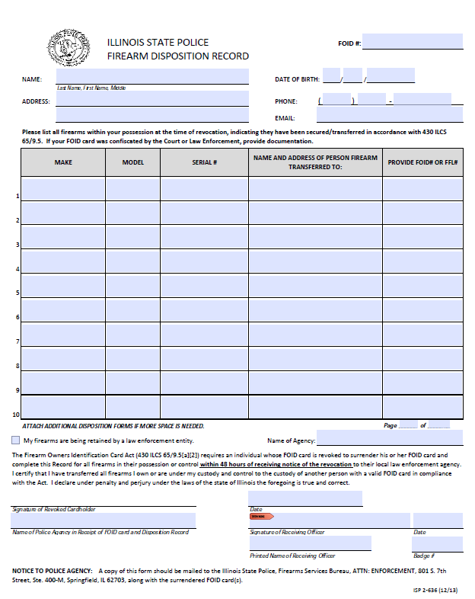

Slide 37
“Clear and present danger” means a person who:
Communicates a serious threat of physical violence against a reasonably identifiable victim or poses a clear and imminent risk of serious physical injury to himself, herself, or another person as determined by a physician, clinical psychologist, or qualified examiner; or
Demonstrates threatening physical or verbal behavior, such as violent, suicidal, or assaultive threats, actions, or other behavior, as determined by a physician, clinical psychologist, or qualified examiner, school administrator, or law enforcement official.

Slide 38
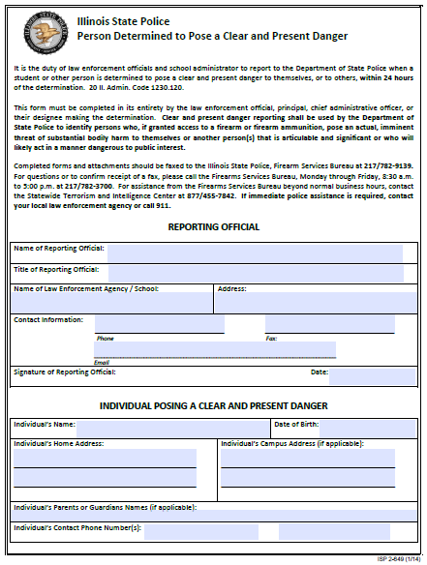

Slide 39
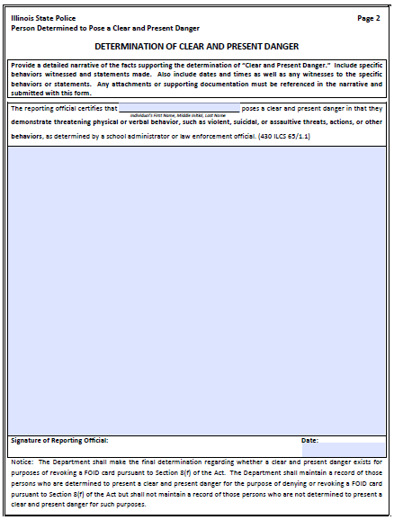

Slide 40
Conceal/Carry
430 ILCS 66
Within 30 days of submitting an application, Any law enforcement agency may submit an objection to a license applicant based upon a reasonable suspicion that the applicant is a danger to himself or herself or others, or a threat to public safety. The objection shall be made by the chief law enforcement officer of the law enforcement agency, or his or her designee, and must include any information relevant to the objection

Slide 41
Conceal/Carry
430 ILCS 65/8.1
Illinois State Law (430 ILCS 65/8.1) now requires
Law Enforcement Officials and other persons to make timely notification to the Illinois State Police (ISP) when there is a determination that a person poses a “Clear and Present Danger”.
This reporting process is intended to prevent individuals determined to pose a clear and present danger from having access to firearms or firearm ammunition by denying or revoking the individual’s FOID Card.

Slide 42
The statute requires that,
If a person is determined to pose a clear and present danger to himself, herself, or to others:
By a law enforcement official or school administrator,
then the law enforcement official or school administrator shall, within 24 hours of making the determination, notify the Department of State Police that the person poses a clear and present danger.
The Department of State Police shall adopt rules to implement this section.

