Slide 1
Module 6 SABA CARE UNDER FIRE

Slide 2
Overview
Reality is that Law Enforcement is Most likely to be FIRST on scene during an Emergency.
Officers must have a basic understanding and knowledge of how to provide medical aid/interventions to themselves and or their fellow officers.
2009 there was an increase of 63% of officers killed by gunshot wounds.

Slide 3
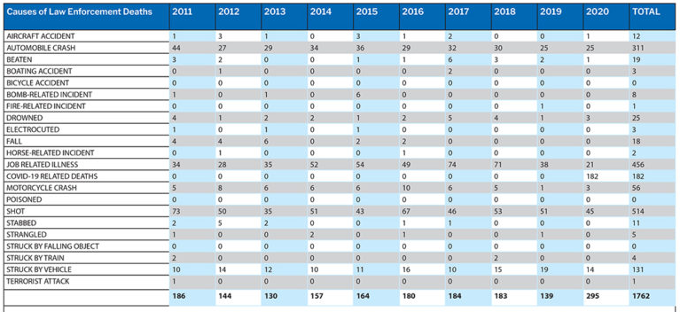

Slide 4
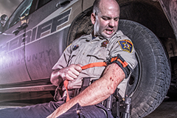
Self Aid
Self Aid- Is that of care provided to one’s self until helps arrives. Generally limited to hemorrhage control, self rescue, and cover / concealment.

Slide 5
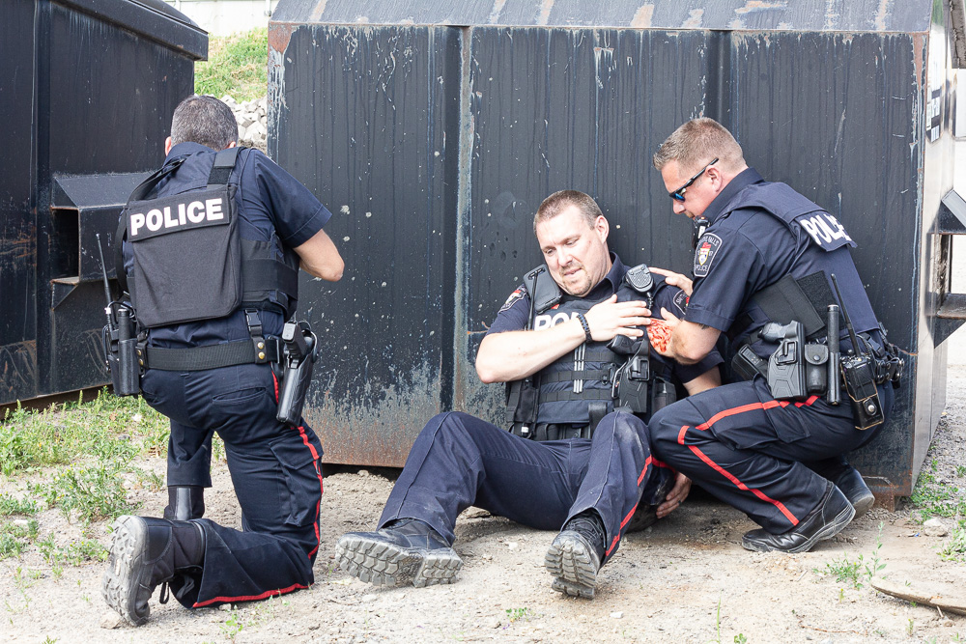
Buddy Aid
Buddy Aid – Is that of care rendered by a fellow officer or officers. Generally limited to providing return / cover fire hemorrhage control, emergency extraction, and CPR.

Slide 6
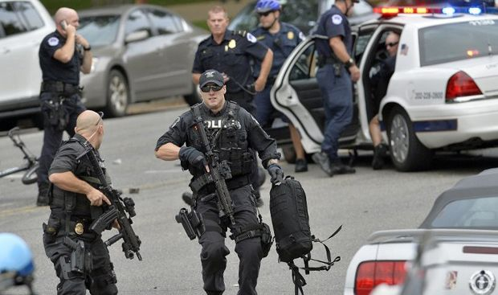
STAY CALM
Self Rescue / Self Contain
Call for Medical Assistance and Back-up Immediately
- Neutralize the THREAT
Return fire if required before providing medical care
ADMINISTER ONLY LIFE-SAVING HEMORRHAGE CONTROL WHILE UNDER FIRE

Slide 7
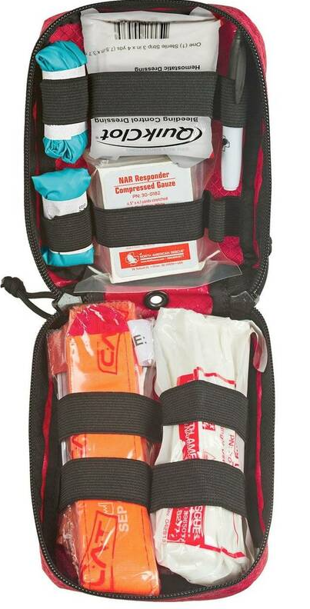
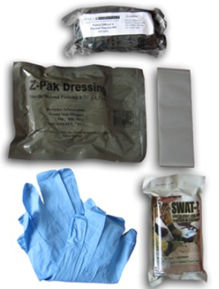
SABA KITS
At Minimum, Kit should contain:
Tourniquet
Pressure Bandage
Tape
Gloves
Occlusive dressing (If available)

Slide 8
Casualty Movement Rescue Plan
If you must move a casualty under fire, consider the following:
Location of nearest cover
How best to move him to the cover
The risk to the rescuers
Weight of casualty and rescuer
Distance to be covered
Use suppression fire to best advantage!
Recover casualty’s weapons if possible

Slide 9
Types of Carries for Care Under Fire
One-person drag
Two-person drag
SEAL Team Three Carry
Hawes Carry

Slide 10
Drags
May be safest, simplest technique
Pull patient along long axis of body.
Keep spinal column in line.
Grasp inside collar of officer’s vest.
Support officer’s neck with your forearms.
Limit motion of head and neck.

Slide 11
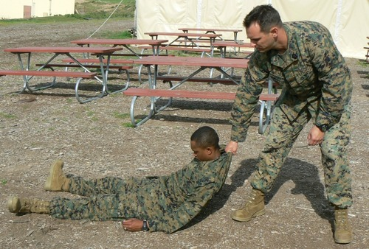
One-Person Drag

Slide 12
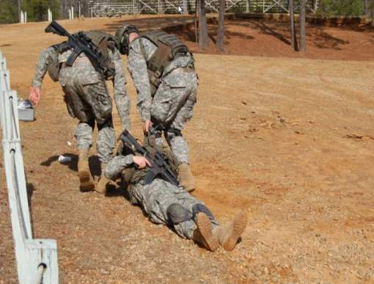
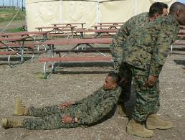
Two-Person Drag

Slide 13
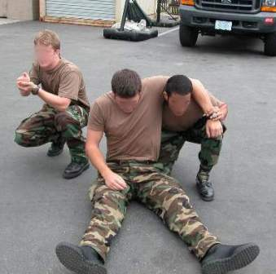
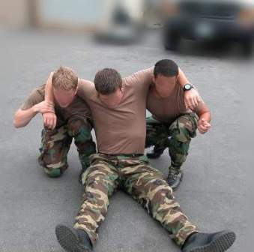
SEAL Team Three Carry

Slide 14
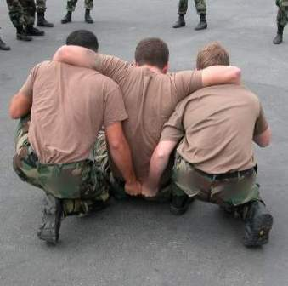
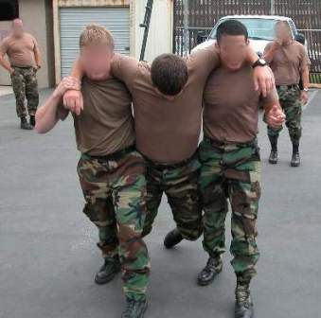
SEAL Team Three Carry

Slide 15
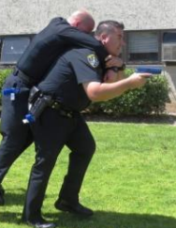
Hawes Carry

Slide 16
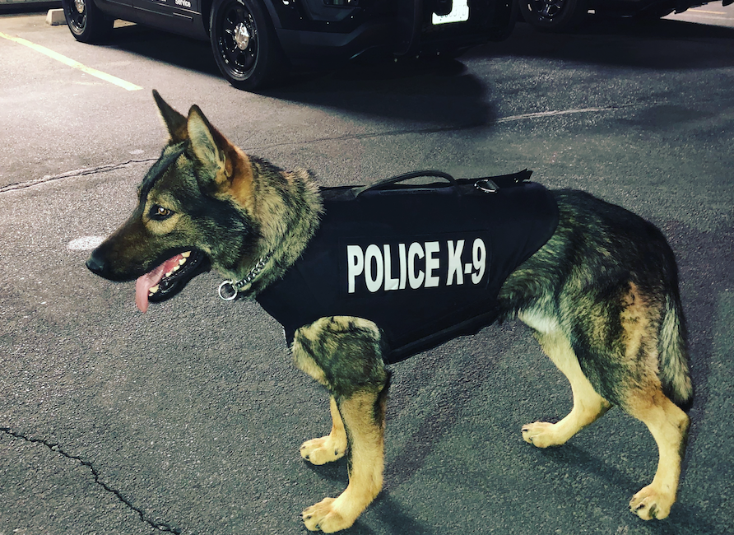
K9 Care

Slide 17
Reference List:
American Heart Association
Heartsaver First Aid Student manual, 2020
Friends and Family CPR Student Manual, 2015
Stop the Bleed Course - https://www.stopthebleed.org/
NAEMT TECC Course Manual 2ND EDITION
ITLS : International Trauma Life Support
Emergency Medical Responder 11th Edition, 2019
Google Images

