Slide 1
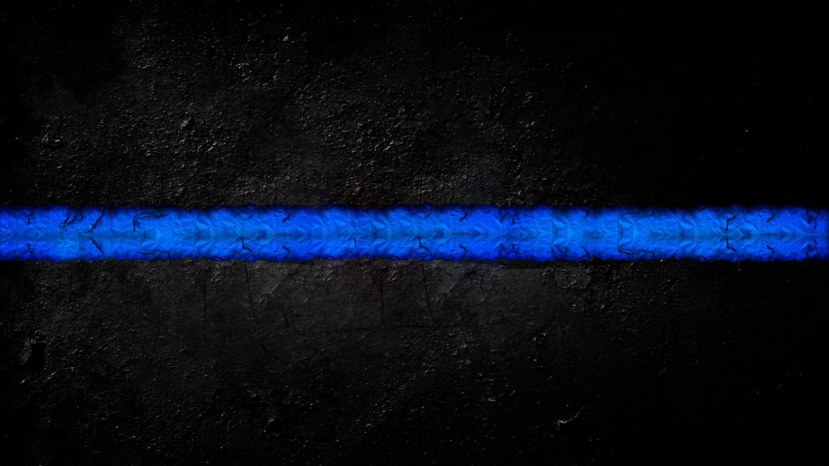
MODULE 1 First Aid Basics

Slide 2
OBJECTIVES
Explain the role of the Medical Responder in the medical response situation.
Review the need for scene size-up and communication techniques
Review when to Request Air Medical Transport
Review Laws and regulations pertaining to Law Enforcement and medical care. i.e. Good Samaritan, LE HB 3653
Explain the importance of using proper body mechanics.
Explain the hazards of not using proper body mechanics when lifting and moving patients.
Demonstrate the proper technique for standard moves, urgent moves, and emergent moves.

Slide 3
OBJECTIVES
Define the following terms:
Personal Protective equipment PPE
Standard precautions
Mass Causality Incident MCI
Triage
SALT triage system
START triage system
Emergent move
Non-Emergent move

Slide 4
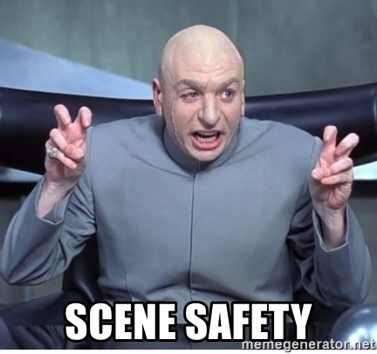
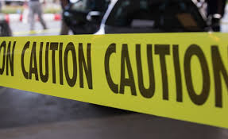
FIRST THINGS FIRST
IS IT SAFE?
Do YOU See, Smell, Hear Anything Abnormal ?
Is there Smoke, Sparks, or Fuel coming from the vehicle?
Ensure scene safety for yourself, patient, and bystanders.
- You can’t Help if you’re a victim!!

Slide 5
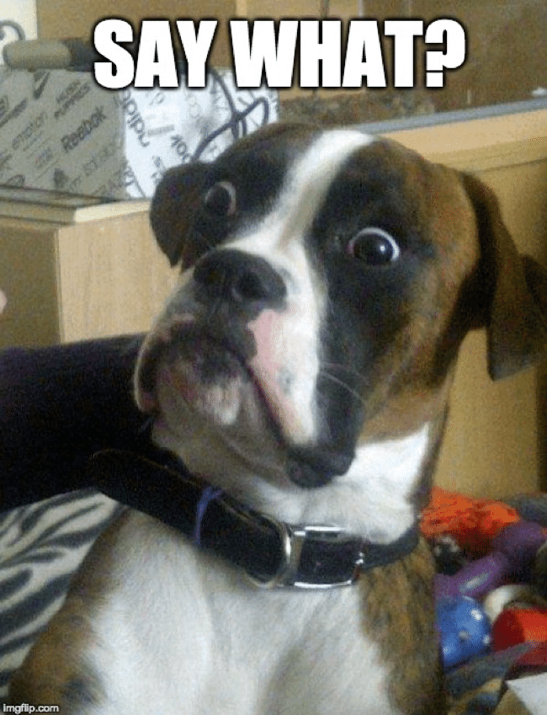
Size Up
CAN REPORT
-CONDITIONS
-ACTIONS
-NEEDS
WIN
-WHAT’S
-IMPORTANT
-NOW
IF YOU WERE RESPONDING WHAT
WHAT WOULD YOU WANT TO KNOW??

Slide 6
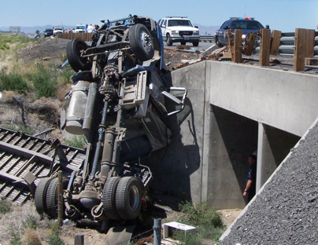
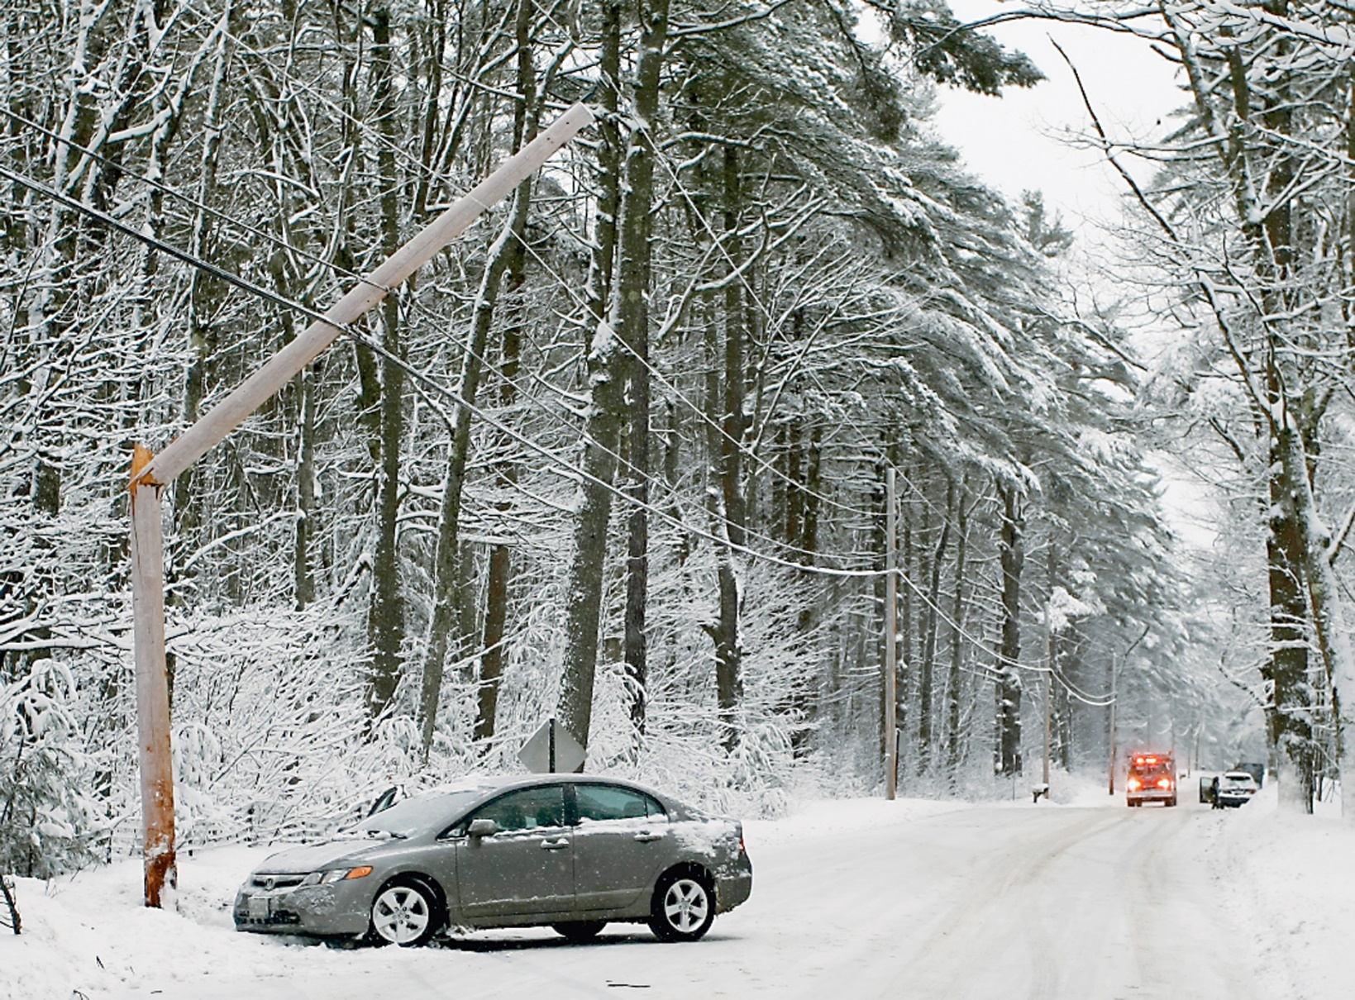
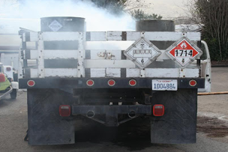
Where Do You Park ?

Slide 7
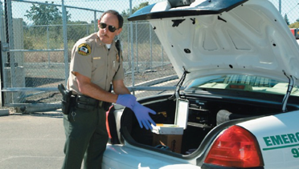
Body Substance Isolation
BSI precautions include wearing personal protective equipment
- Gloves, Masks, Gowns, and Eyewear
Standard precautions
Guidelines recommended by CDC
Reduces risk of disease transmission
All patients considered infectious until proven otherwise

Slide 8
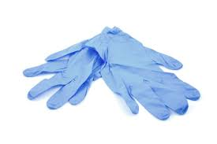
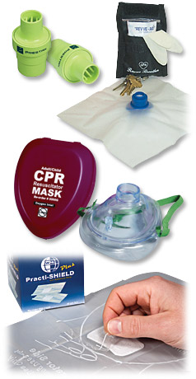
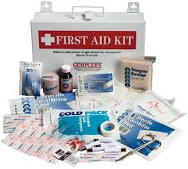
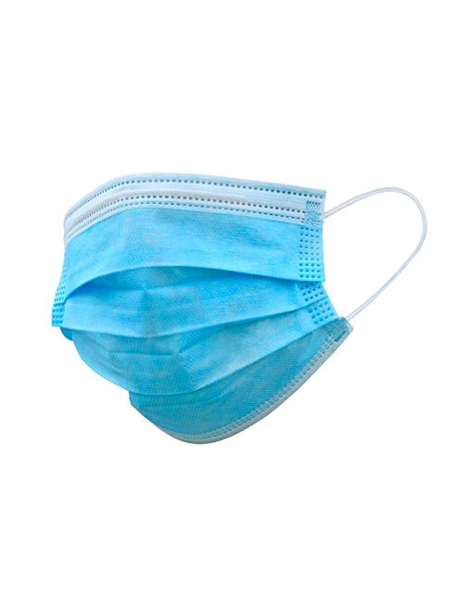
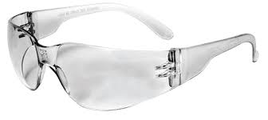
Personal Protective Equipment

Slide 9
Air Medical
Who can Call?
When to Call?
What Information do they need?

Slide 10
Area Services
Arch 1 - Granite City, Illinois
Arch 2 - Litchfield, Illinois
Arch 3 - Effingham, Illinois
Arch 4 - Sparta, Illinois
AirLife 1 - Carle Foundation Hospital Urbana, Illinois
Airlife 2 - Carle Foundation Hospital Olney, Illinois
Saints Flight - Springfield, IL
Rescue Flight - Highland, IL
AE145- Mattoon, IL
AE28- Effingham, IL
AE137- Greenville, IL
AE35- Marion, IL
AE150- Olney, IL
AE11- Mt. Vernon, IL
AE27- Jacksonville, IL
AE39- Brazil, IN

Slide 11
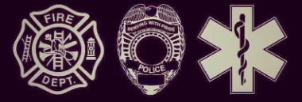
Who can call
Call Early, Call Often

Slide 12
When to Call
Prolonged extrication for a high-priority
The patient is in a remote area.
Stabbing or Gunshot wound to abdomen, back, chest or neck (stable)
MVC (motor vehicle crash) with ejection
MVC (motor vehicle crash) Highway speeds
Death of occupant in same passenger compartment
Falls ≥ 20 ft (Children: >10 ft or 2- 3 x height of the child)
Separation of rider from motorcycle
Pedestrian / bicyclist struck by vehicle and thrown or run over
Vehicle rollover with unbelted passengers
Crush Injuries
Field Tourniquet Use

Slide 13
What Information do they need?
Type of Event
Type of Injury
Location

Slide 14
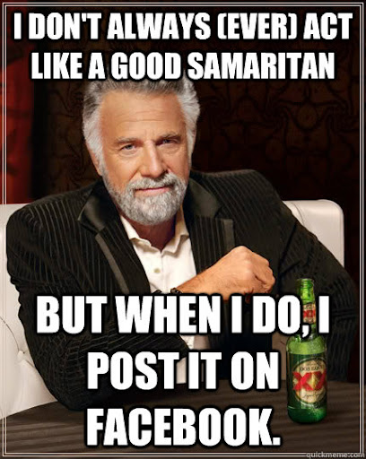
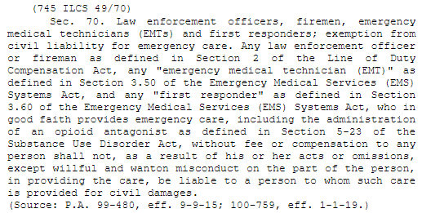
(745 ILCS 49/) Good Samaritan Act.

Slide 15
Goals:
To encourage responders to provide potentially life-saving care to those in need
To protect responders from civil liability for any acts, omissions, or injuries occurred when delivering emergency care to victims
For Good Samaritan Laws to be Applicable…
The situation must be an Emergency
The services rendered must be Voluntary
The victim receiving care must be accepting of it - obtain Consent whenever possible
The care provided must be rendered Free of charge
The care performed must be done “in good faith” to help

Slide 16
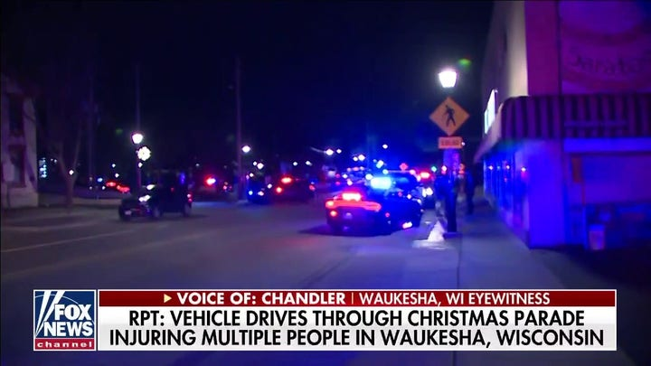
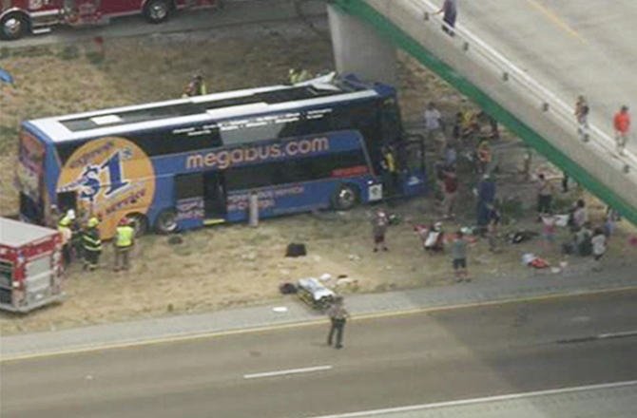
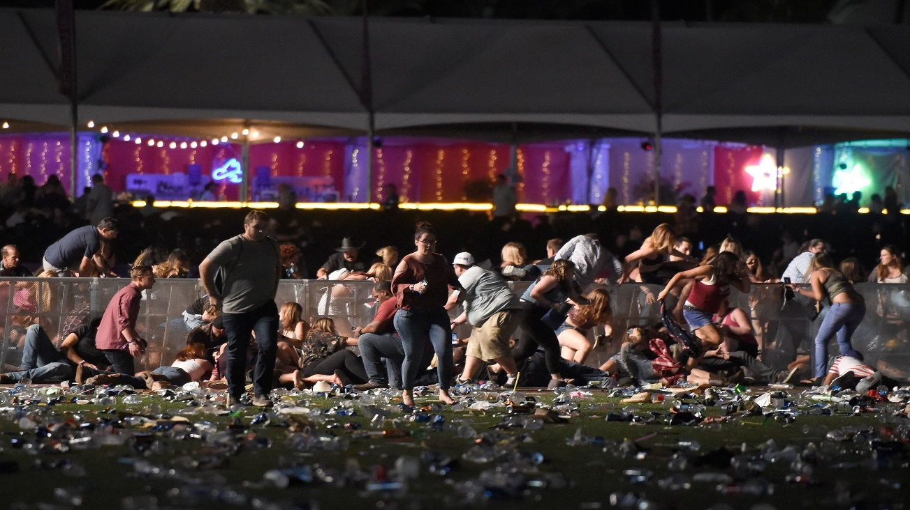
Mass Casualty Incident (MCI)
Definition
An incident which produces multiple casualties such that emergency services, medical personnel and referral systems within the normal catchment area cannot provide adequate and timely response and care without unacceptable mortality and/or morbidity.
https://youtu.be/ZvRQ1StsYGw

Slide 17
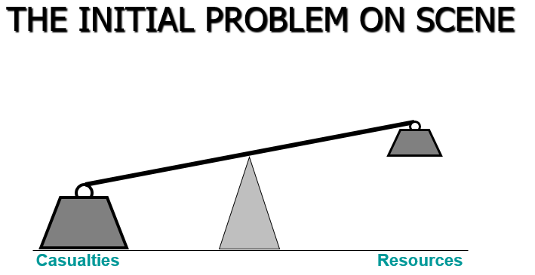
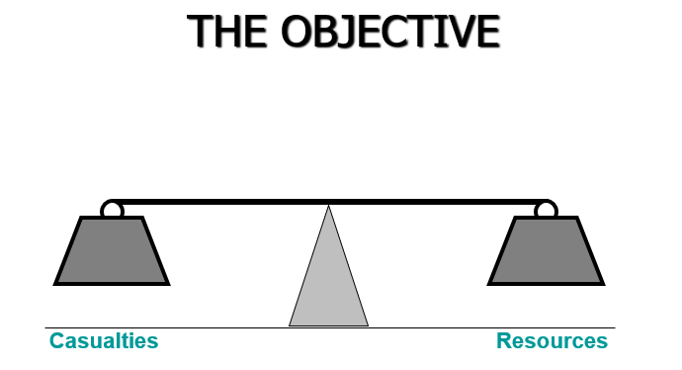
GOAL
To save the largest number of people of a multiple casualty incident
V
S

Slide 18
Triage
When do we need to triage ?
When the incident out ways the number of rescuers!!

Slide 19
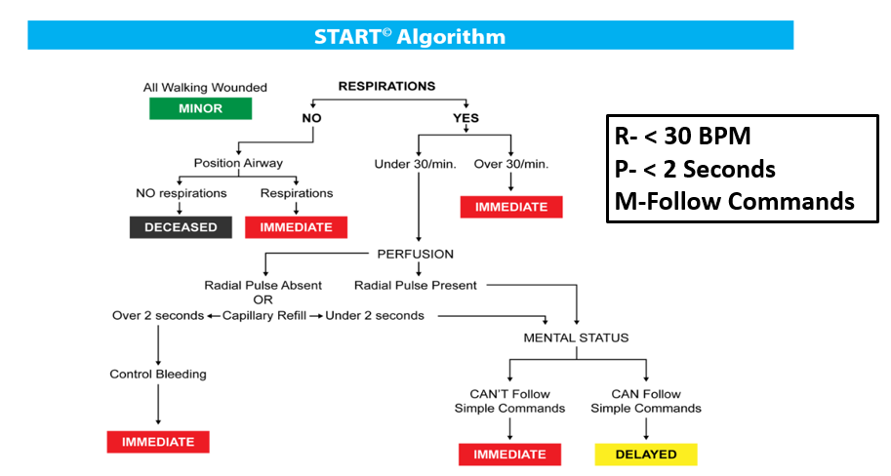
Triage Protocol (START) Simple Triage And Rapid Treatment

Slide 21
JUMP START

Slide 22
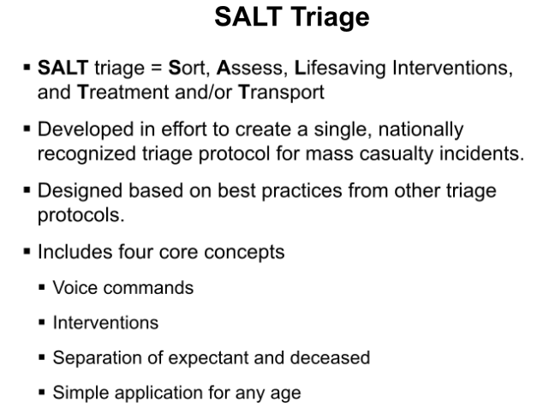
SALT TRIAGE

Slide 23
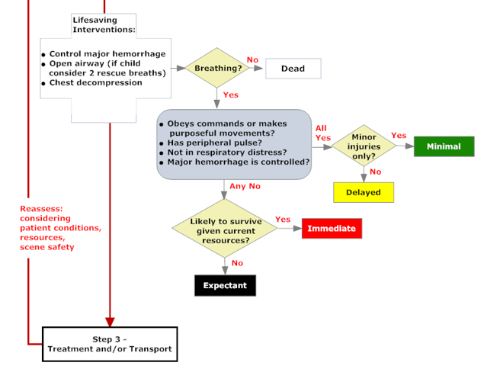
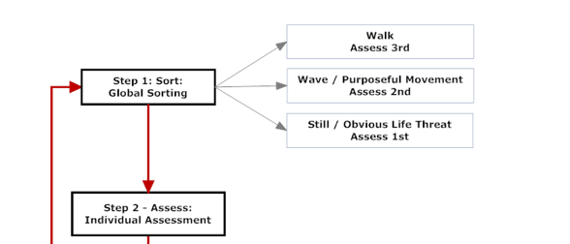

Slide 24
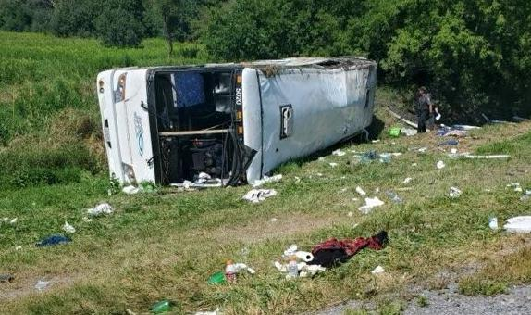

Slide 25
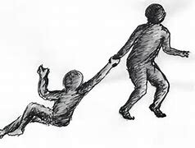
Principles of Moving Patients Safely
First is your SAFETY
Lifting / Moving is the # 1 cause of off the job injuries
Body Mechanics
Proper and efficient use of your body to facilitate lifting and moving
Estimate the weight.
Make a plan.
Know YOUR physical limitations.

Slide 26
Principles of Moving Patients Safely
Proper and efficient use of your body to facilitate lifting and moving
Position your feet properly.
Lift with your legs.
When lifting object with one hand, avoid leaning to either side.
Keep weight as close to your body as possible.
Minimize twisting during lift.
Only move patient when absolutely necessary.

Slide 27
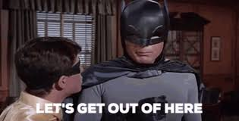
Types of Moves
EMERGENT MOVES – VS- NON- EMERGENT MOVES

Slide 28
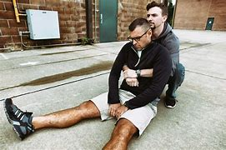
EMERGENT MOVES
An emergent move, also called an emergency move
When scene is hazardous
When patient requires immediate repositioning
When you must reach another patient who requires lifesaving care
Most common Emergency move is a Drag
Patients pulled by their clothes, feet, or shoulders or by using a blanket
Initiated from shoulders by pulling along the long axis of body
Avoid dragging patient sideways.

Slide 29
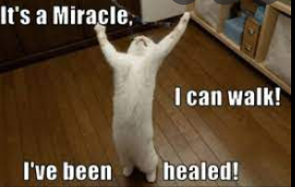
NON- Emergent Moves
Extremity Lift
Two rescuers
One lifting patient’s arms
One lifting patient's legs
Ideal for moving patient from ground
Do not perform if head, neck, spine, shoulder, hip, or knee injury, or suspected fractures to extremities.
If they can walk, LET Them!!

Slide 30
Reference List:
American Heart Association
Heartsaver First Aid Student manual, 2020
Friends and Family CPR Student Manual, 2015
Stop the Bleed Course - https://www.stopthebleed.org/
NAEMT TECC Course Manual 2ND EDITION
ITLS : International Trauma Life Support
Emergency Medical Responder 11th Edition, 2019
Google Images

