Slide 1
MODULE 4 ENVIRONMENTAL EMERGENCIES

Slide 2
OBJECTIVES
Explain the four ways the body loses excess heat.
Explain the appropriate assessment and care for a patient experiencing a heat-related emergency.
Differentiate the signs and symptoms of heat exhaustion and heat stroke
Describe the signs and symptoms of a cold-related emergency.
Explain the appropriate assessment and care for a patient experiencing a cold-related emergency.

Slide 3
OBJECTIVES
Explain the appropriate assessment and care for a patient experiencing an emergency related to a bite or sting
Describe common methods used for water-related rescue.
Explain the hazards related to water rescue.
Describe the safety concerns involving ice-related incidents.
Value the importance of proper training when attempting to conduct a water rescue.

Slide 4
OBJECTIVES
Define the following terms:
Frostbite
Heat cramps
Heat exhaustion
Heat stroke
Hyperthermia
Hypothermia

Slide 5
Temperature and the Body
Temperature regulation
Process of maintaining proper body temperature
Hyperthermia – High Body Temp
When heat gain occurs faster than body can shed heat.
Hypothermia – Low Body Temp
When body loses heat faster than it can produce heat

Slide 6
Temperature and the Body
Radiation
Body heat is emitted into environment.
Conduction
Loss of body heat through direct contact with object or ground
Convection
Loss of body heat when air close to skin moves away, taking body heat with it
Evaporation
Loss of body heat through evaporation of moisture in form of sweat on skin
Respiration
Heat leaves body with each breath.

Slide 7
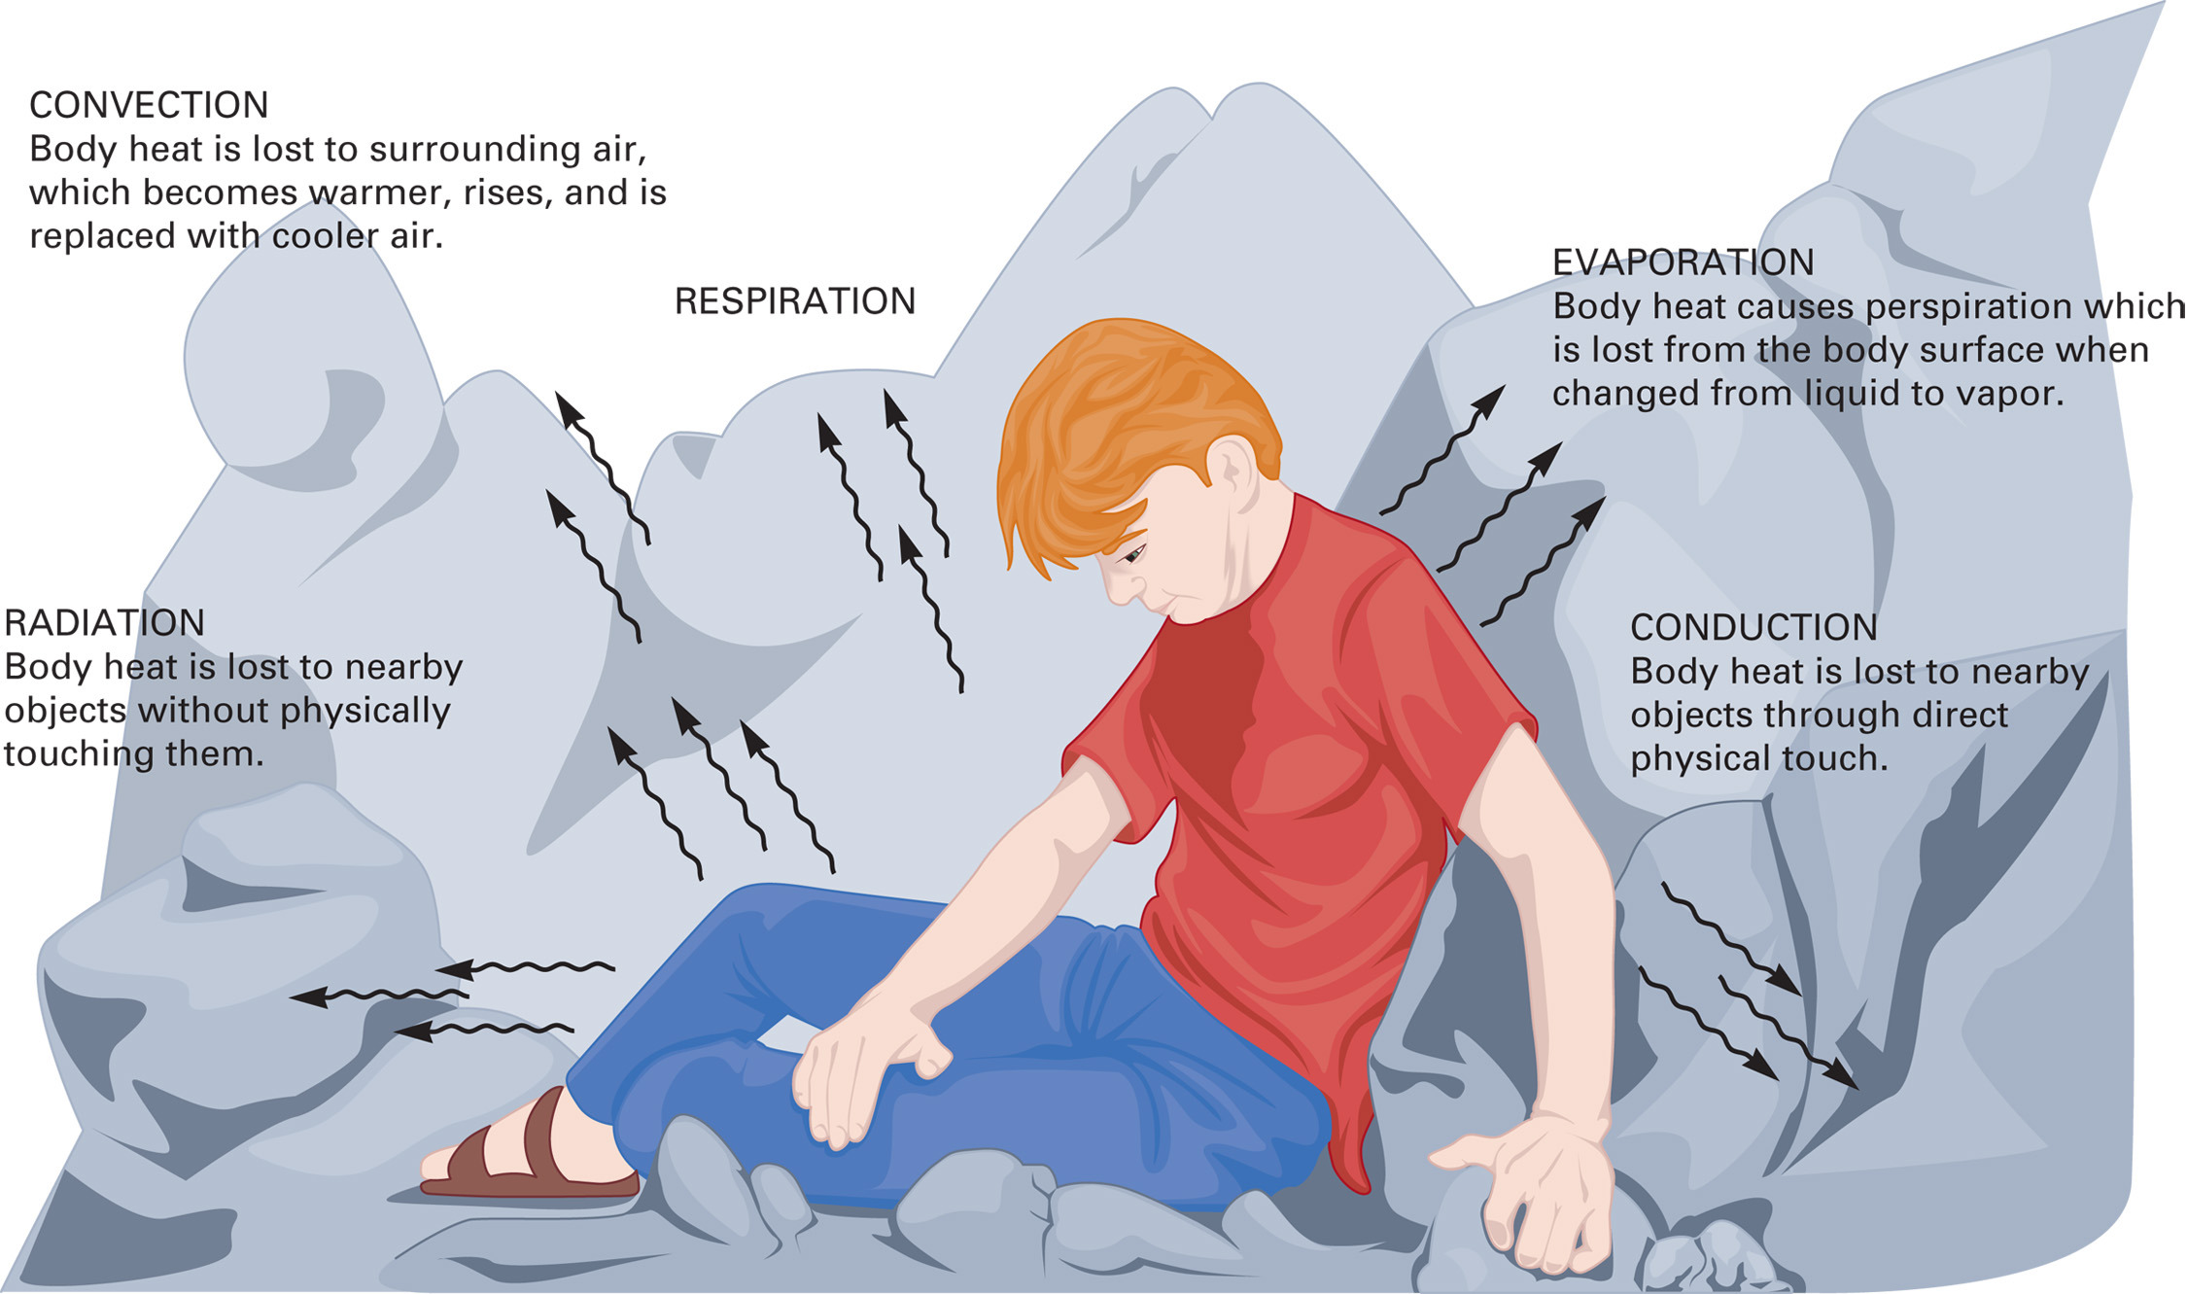

Slide 8
Heat Emergencies
Heat Cramps
Signs and Symptoms
Painful muscle spasms following strenuous activity in hot environment
Usually caused by electrolyte imbalance
Patient fully alert and sweaty with normal to warm skin temperature
Heat Exhaustion
Signs and Symptoms
Mild to moderate perspiration
Warm or cool skin temperature
Skin color may be normal to pale.
Weakness, exhaustion, dizziness
Nausea and vomiting
Muscle cramps
Rapid, shallow breathing
Rapid, weak pulse

Slide 9
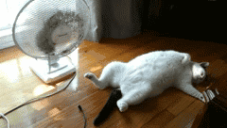
Heat Emergencies
Emergency Care for Heat Exhaustion
Take appropriate BSI precautions.
Ensure breathing is adequate.
Move patient to cool area.
Loosen or remove excess clothing.
Cool patient by fanning or applying small amounts of cool water
Encourage them to drink water or an electrolyte based drink

Slide 10
Heat Emergencies
Heat Stroke
Temperature-regulating mechanisms fail.
Unable to get rid excess heat.
Core temperature allowed to rise uncontrolled, causing body to overheat
It is a life-threatening emergency.
Signs and Symptoms
Confusion
Lack of sweating
Skin red, hot and dry
Rapid, shallow breathing
Rapid pulse
Weakness, exhaustion, dizziness
Nausea and vomiting
Convulsions (Seizures)

Slide 11
Heat Emergencies
Emergency Care for Heat Stroke
Take appropriate BSI precautions.
Ensure breathing is adequate.
Move patient to cool area.
Loosen or remove excess clothing.
Cool patient by fanning or applying small amounts of cool water
Encourage them to drink water or an electrolyte based drink
Emergency Care for Heat Stroke
Wet the skin or immerse the patient in cool water.
Do not induce shivering.

Slide 12
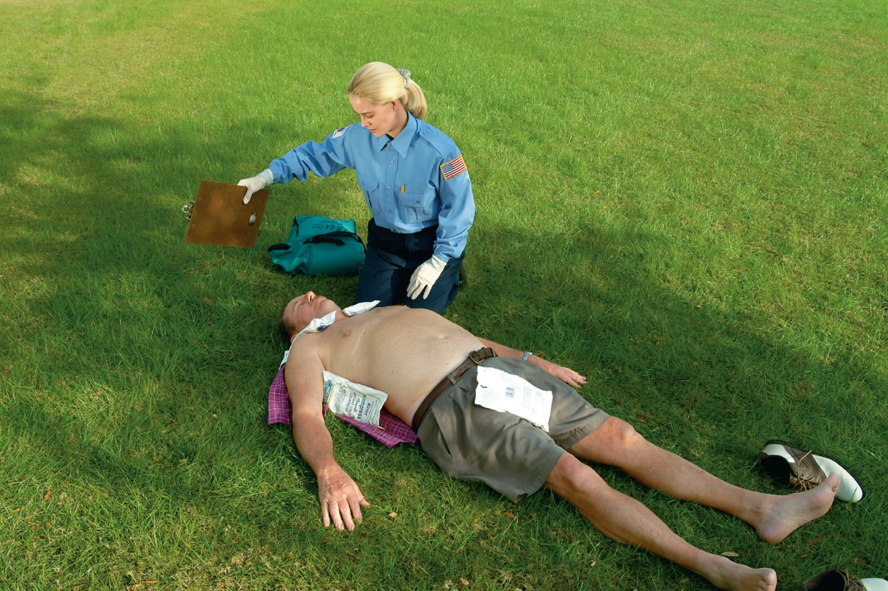
Heat Emergencies
Place cold packs or ice bags in pulse points.
Under armpits
On groin
Each side of neck

Slide 13
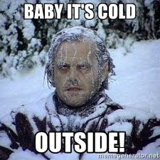
COLD EMERGENCIES
Hypothermia
Body loses heat faster than it can be generated.
Young children and elderly more susceptible
Blood is shunted from the extremities to the body's core.
Protects the vital organs
Signs and Symptoms
Cool or cold skin temperature
Shivering (Absence of shivering is a late sign.)
Altered mental status
Lack of coordination
Muscle rigidity Complaints of joint/muscle stiffness
Impaired judgment / Confusion

Slide 14
COLD EMERGENCIES
Emergency Care for Hypothermia
Take appropriate BSI precautions.
Ensure adequate breathing.
Remove patient from cold environment.
Do not allow patient to walk or exert himself/herself in any way.
Protect patient from further heat loss.
Remove wet clothing and place blanket over and under patient.

Slide 15
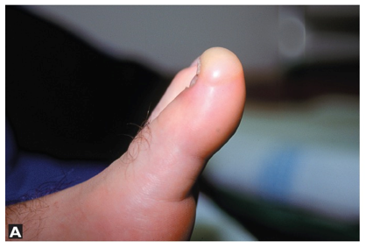
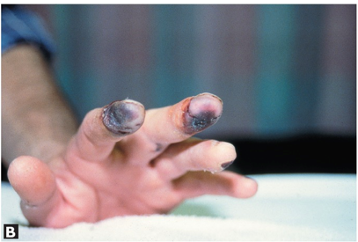
COLD EMERGENCIES
Localized Cold Injury
Cold injury or frostbite
Freezing or near freezing of body part
Typically occurs first in the extremities
Fingers and toes
Ears
Face
Nose
Late Signs and Symptoms
White, waxy skin
Firm to frozen feeling upon palpation

Slide 16
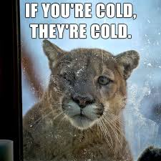
COLD EMERGENCIES
Emergency Care for Cold Injury
Take appropriate BSI precautions.
Ensure adequate breathing.
Remove patient from cold environment.
Remove wet or constrictive clothing.
Cover affected part.
Remove jewelry from injured part.
Do not rub or massage it.
Do not rewarm or apply heat.
Do not re-expose part to cold.

Slide 17
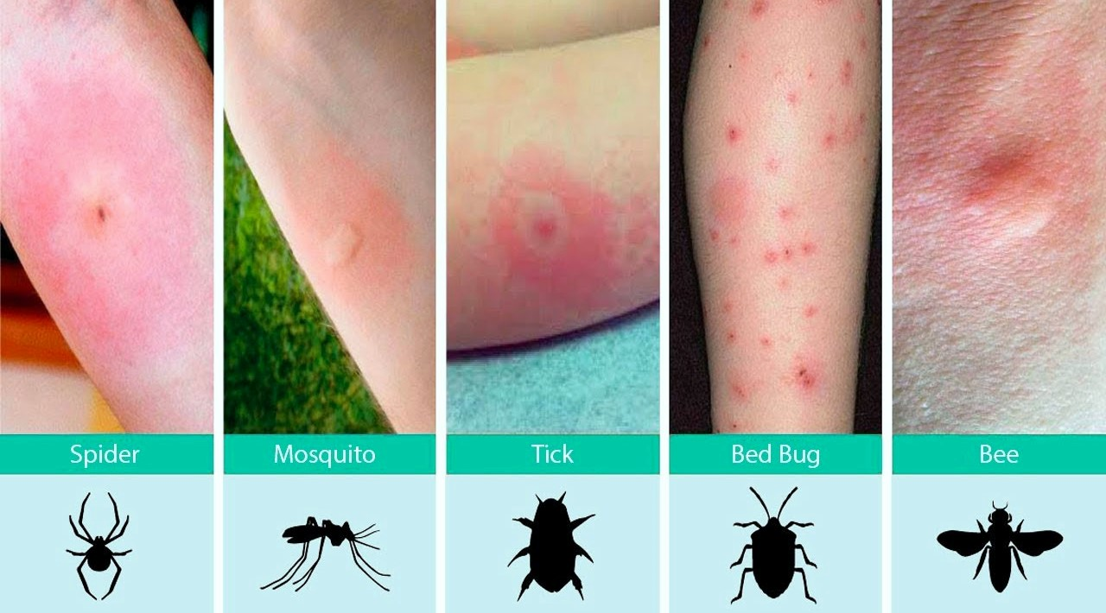
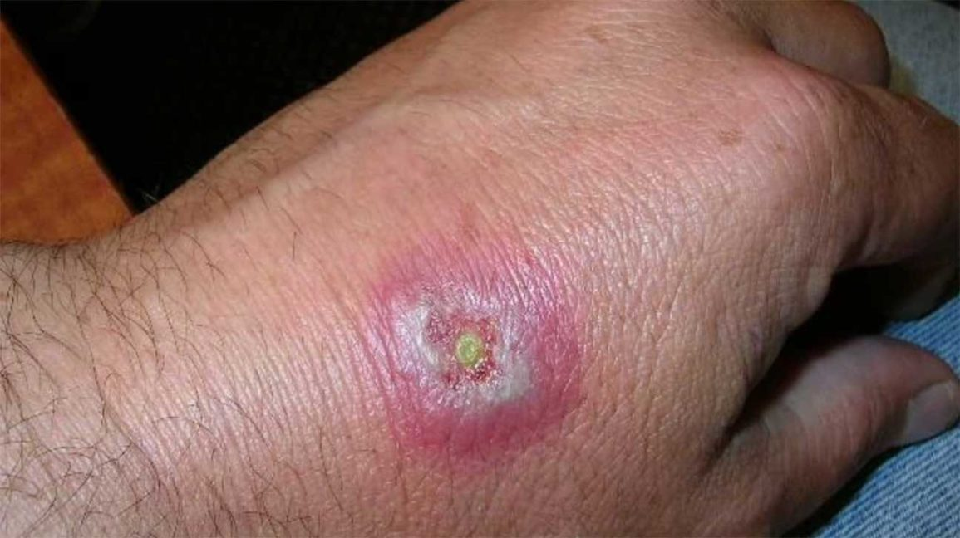
BITES AND STINGS
Signs and Symptoms of Localized Reaction
Noticeable puncture marks on skin
Pain at or around injury site
Redness, itching at injury site

Slide 18
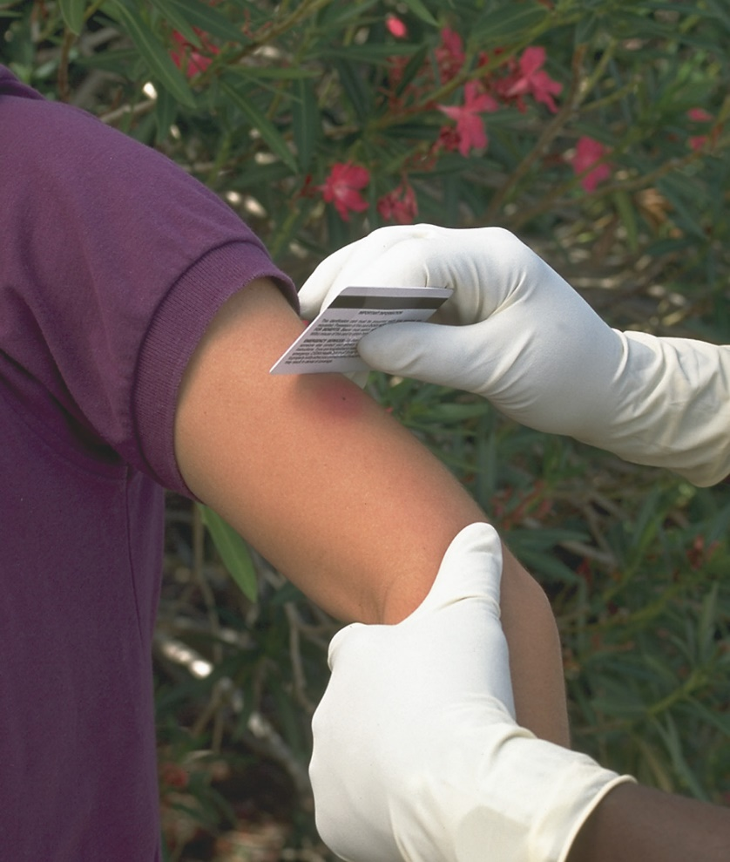
BITES AND STINGS
Emergency Care for Localized Reaction
Take appropriate BSI precautions.
Perform scene size-up.
Ensure adequate breathing.
Scrape away bee and wasp stingers and venom sacs.
Do not attempt to pinch or pull out stingers.
Plastic credit card
Place cold pack over injury site.
Monitor for Allergic reaction / Anaphylactic Shock

Slide 19
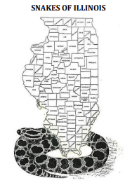
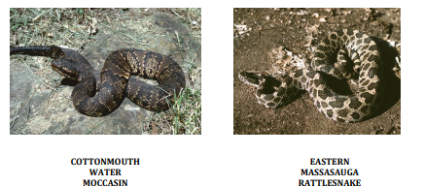
Snakebites
4 species of venomous snakes native to Illinois.
Cottonmouth
Copperhead
Massasauga Rattlesnake
Timber rattlesnake
IDNR-October 2017

Slide 20
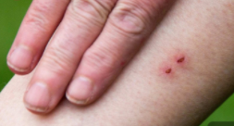
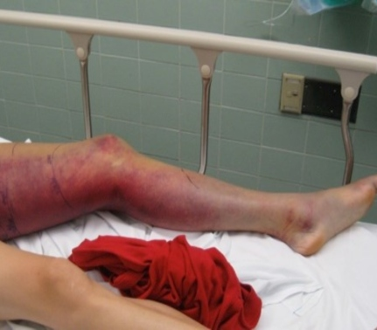
Snakebites
Signs and Symptoms
Fang Bite Marks
Labored breathing
Weakness
Vision problems
Nausea and vomiting
Swelling to the area

Slide 21
WATER-RELATED INCIDENTS
Illinois officers investigated 36 injuries were reported in FFY 2020, which decreased from the previous year (42).
Illinois officers investigated 81 reportable boat accidents, which was an increase over FFY 2019 (72).
A total of 21 fatalities were reported in FFY 2020, increased over the previous period (14).
https://www2.illinois.gov/dnr/safety/Documents/BoatingAccidentReport2020.pdf

Slide 22
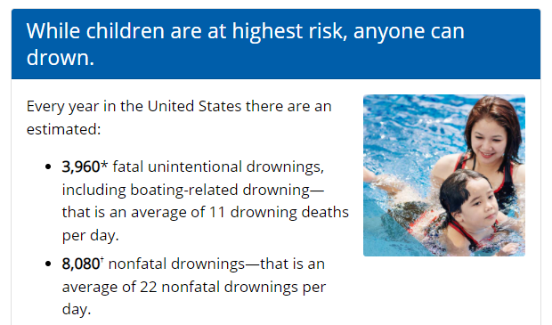
WATER-RELATED INCIDENTS

Slide 23
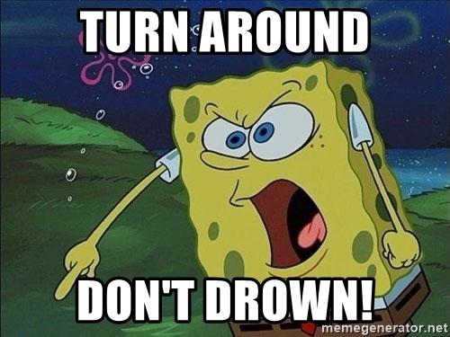
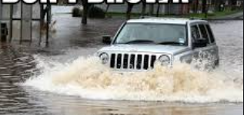
SUBMERSED VEHICLES
Car crashes where water submersion was the main factor make up less than 1% of traffic fatalities nationwide, according to National Highway Traffic Safety Administration
Again there are about 5.5 million reported crashes per year. If there are 1,500 (high estimate) vehicles that end up submerged in water; that means 0.0273% of all car crashes result in vehicle submersion.
2004 to 2007 there was an annual average of 384 traffic fatalities in which accidental drowning was listed as one of the causes of death

Slide 24
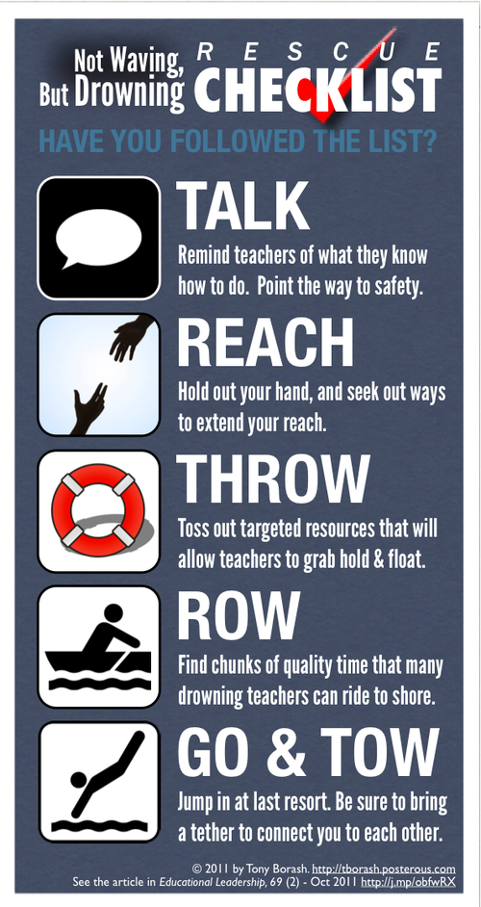
WATER-RELATED INCIDENTS
Reaching the Victim
Major problem is reaching victim.
Secure your position so you will not be pulled into water.
Throw objects that will float.
Throw flotation devices attached to line.
Never attempt water rescue by yourself.
Unless trained to work in the water, do not attempt rescue

Slide 25
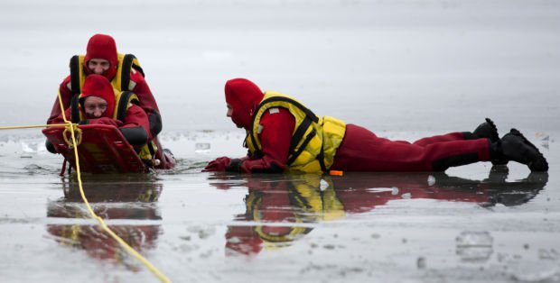
ICE-RELATED INCIDENTS
Unless trained to work on ice, do not attempt rescue.
Never attempt ice rescue by yourself.
Never go onto ice that is rapidly breaking up.
Throw line to victim or reach out with stick or pole.
Ice rescues require special training, protective clothing, rescue equipment.
Broken legs and hypothermia are often problems.

Slide 26
Reference List:
American Heart Association
Heartsaver First Aid Student manual, 2020
Friends and Family CPR Student Manual, 2015
Stop the Bleed Course - https://www.stopthebleed.org/
NAEMT TECC Course Manual 2ND EDITION
ITLS : International Trauma Life Support
Emergency Medical Responder 11th Edition, 2019
Google Images
Youtube video

