Slide 1
Module 2- Medical Emergencies

Slide 2
Define the following terms:
ABCs
AVPU scale
Nature of illness (NOI) -v- Mechanism of injury (MOI)
Primary assessment
Pulses- Where to find?
Signs
Symptoms

Slide 3
Module 2 - Objectives
Discuss common Medical Emergencies and there Treatment.
Demonstrate how to use an Epi-Pen
Demonstrate and discuss how and when to administer Narcan.

Slide 4
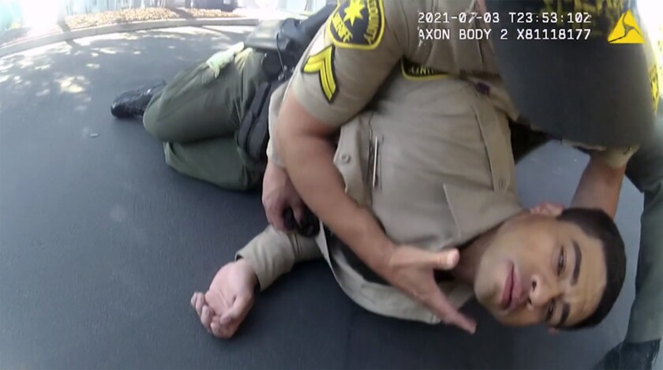
Finding the Problem Assessment
NOW WHAT?
A- Airway…is it open or is it blocked?
B- Breathing… Is he breathing (chest rise & fall)
C- Circulation… Does he have a pulse?
1..2..3
Any major life threats that could kill him in the next
3 seconds?

Slide 5
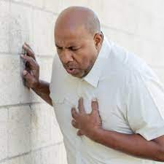
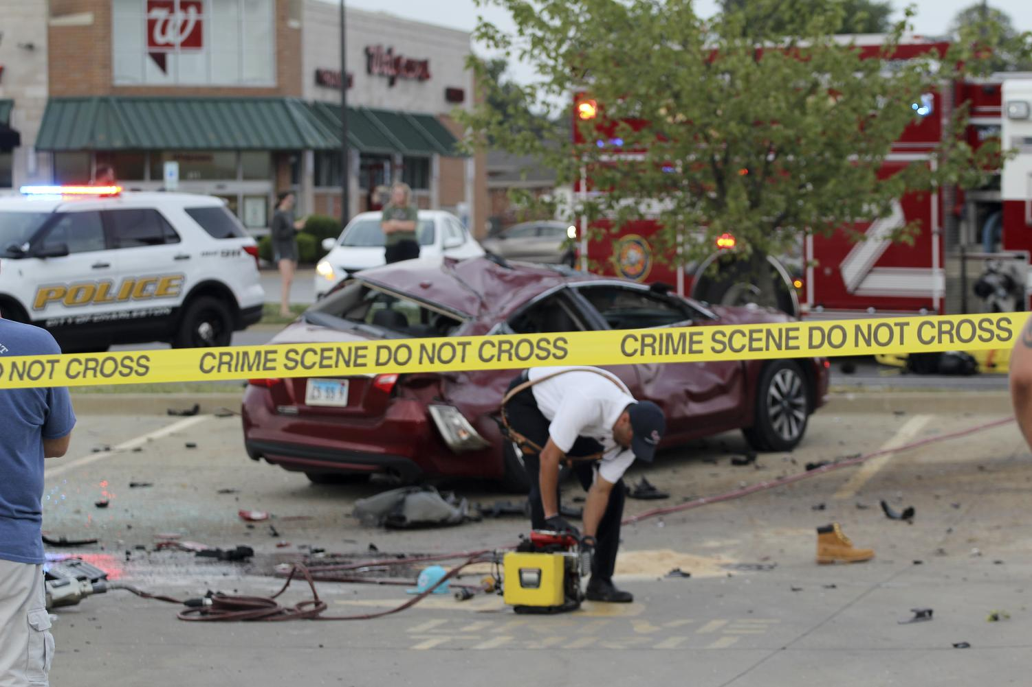
Nature of Illness
Outside physical force causing injury
-V-
Illness/ Health condition
Not caused by force
Mechanism of Injury

Slide 6
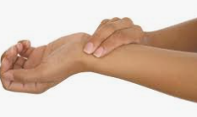
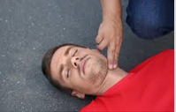
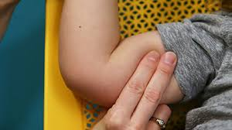
Common pulse points
Radial Pulse- Inside of wrist (Most common)
Carotid Pulse- On either side of the neck
Brachial Pulse- Just above the bend of the elbow
*Most common for children*

Slide 7
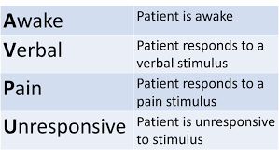
Determining level of consciousness

Slide 8
Breathing Problems
Understanding Adequate Breathing:
Sufficient to support life?
Easy and effortless?
Able to speak full sentences without having to catch breath?

Slide 9
Breathing Problems
Signs of normal breathing
-Rise and fall of chest
-Listen for air entering and leaving nose and mouth.
-Observe skin color.
-Observe level of responsiveness.
-Feel for air moving into and out of nose and mouth in unresponsive patients.
Signs of abnormal breathing
-Increased work of breathing
-Absent or shallow rise and fall of chest
-Little or no air heard or felt at nose or mouth
-Noisy breathing or gasping sounds

Slide 10
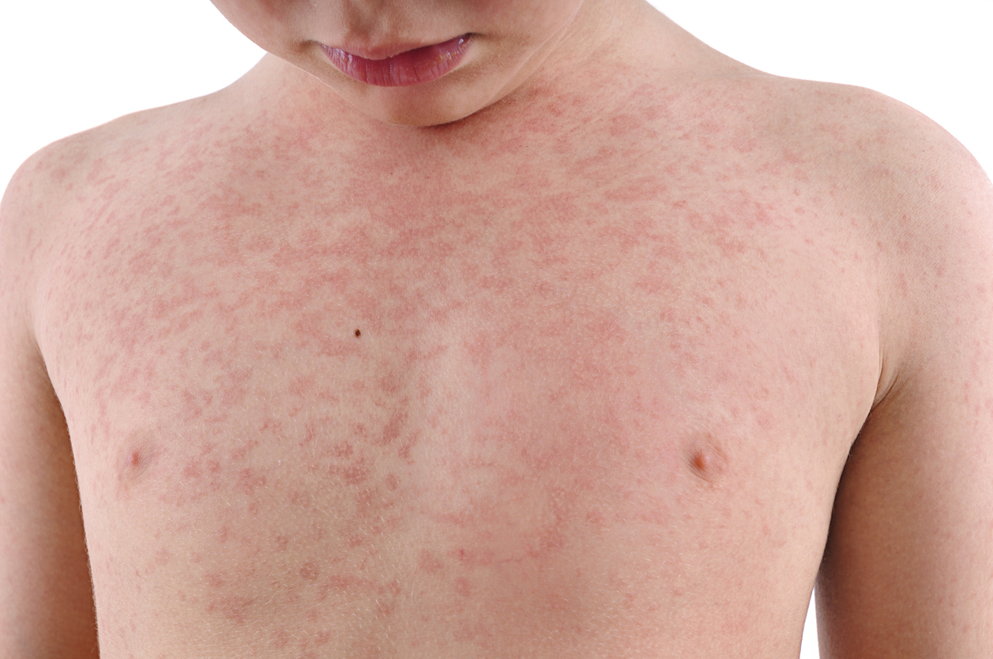
Allergic Reactions
SIGNS / SYMPTOMS
- Breathing Difficulty
- Reddening of skin or rash
- Swelling
- Difficulty Speaking
TREATMENT
- Scene Safety
- Remove from exposure
- Call for EMS (If not already enroute)
- Monitor for SIGNS of Multiple body systems
- Provide Supportive Care
- MONITOR FOR THE NEED FOR CPR

Slide 11
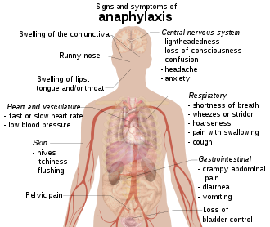
Anaphylaxis
SIGNS / SYMPTOMS
- Breathing Difficulty
- Reddening of skin or rash
- Swelling
- Difficulty Speaking
TREATMENT
- Scene Safety
- Remove from exposure
- Call for EMS (If not already enroute)
- Assist with patient’s Epi-Pen if trained to do so
- Provide Supportive Care
MONITOR FOR THE NEED OF CPR

Slide 12
Just another routine traffic stop right?
NOTHING IS ROUTINE!
ARE YOU PREPARED?

Slide 14
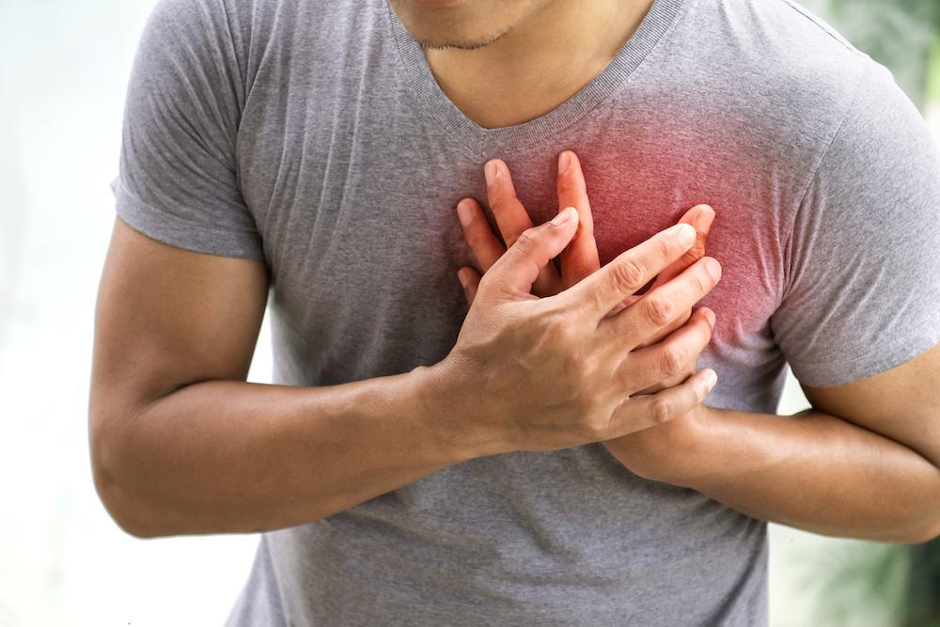
Heart Attack
Typical signs and symptoms
-Pain, pressure, tightness, or heaviness to the chest/upper abdomen
-Pain or discomfort behind the sternum
-Pain radiating to the shoulders or arms
-Pain to the back, neck, jaw or upper abdomen
Atypical signs and symptoms
-"Flu-like" signs and symptoms such as nausea and vomiting
-Indigestion
-Feeling of general weakness

Slide 15
Heart Attack
Emergency Care
-Provide emotional support and reassure the patient.
-Allow the patient to maintain a position of comfort
-Monitor ABCs
-If patient looses consciousness Check for a signs of life, Start CPR if needed.
- Notify EMS in change of patients condition

Slide 16
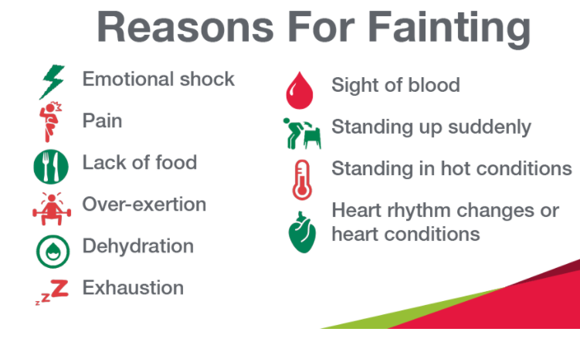
Fainting
Passing out, blacking out, a sudden loss of consciousness. This partial or complete loss of consciousness is caused by a temporary reduction of blood flow to the brain. The person usually falls or slumps over.
It can be a minor, temporary occurrence or it can be caused by a medical condition

Slide 17
Fainting
Position the person on his or her back.
-If there are no injuries and the person is breathing, raise the person's legs above heart level about 12 inches - if possible.
-To reduce the chance of fainting again, don't get the person up too quickly.
Check for breathing.
If the person isn't breathing, begin CPR. Advised EMS enroute.
If they are breathing but still unresponsive roll them on their side Recovery Position
If the person was injured in a fall associated with fainting, treat bumps, bruises or cuts appropriately.
Control bleeding with direct pressure.

Slide 18
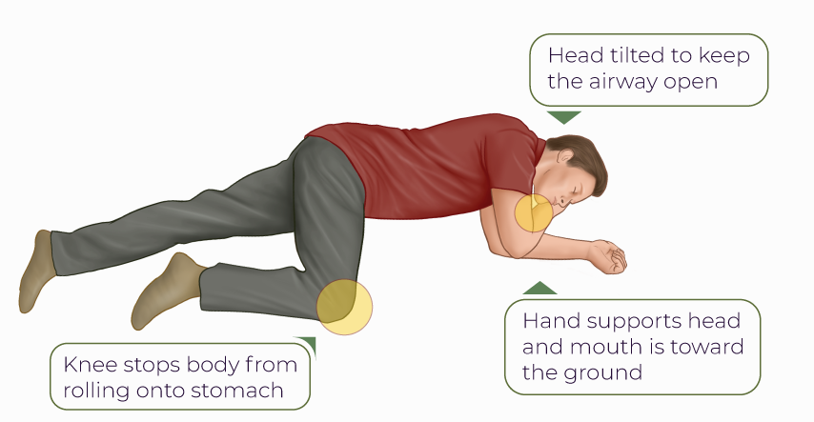
Recovery Position

Slide 19
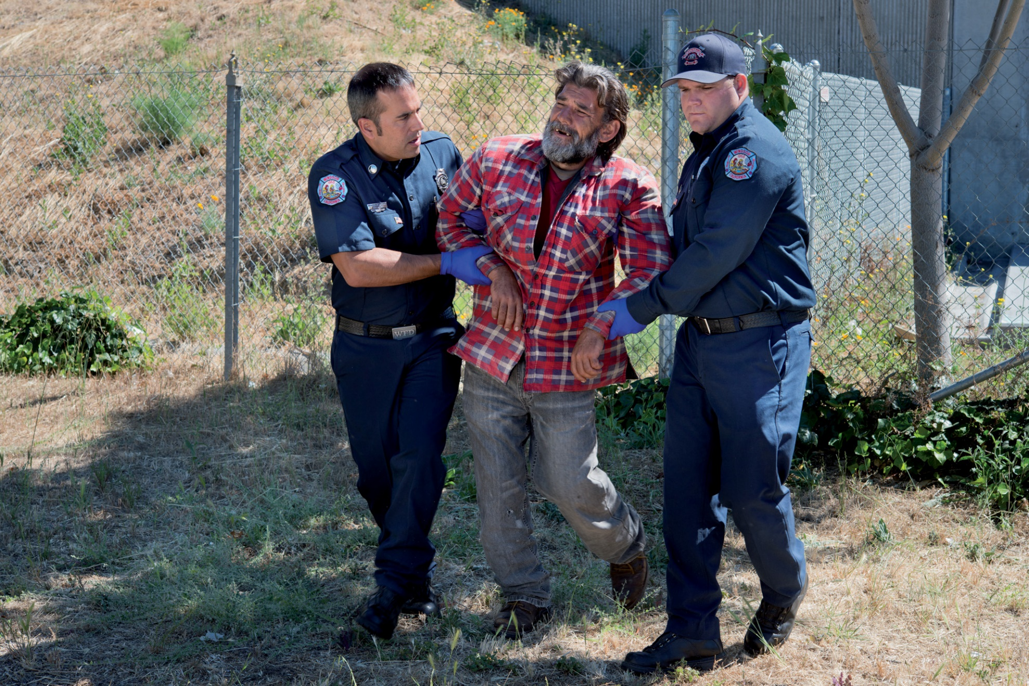

Slide 20
Diabetic Emergencies
Diabetes
Disease that prevents individuals from producing enough insulin or from using insulin effectively
Insulin
Hormone released by pancreas
Allows glucose (blood sugar) to enter cells to be used as energy
Hyperglycemia = High Blood Sugar
Gradual onset
Causes of high blood sugar
- Not taking enough insulin
- Eating too much sugar
Hypoglycemia = Low Blood Sugar
Rapid onset
Causes of low blood sugar
- Taking too much insulin
- Eating too little sugar
- Overexertion
- Excessive emotional stress

Slide 21
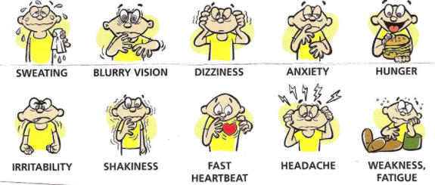
Diabetic Emergencies

Slide 22
Diabetic Emergencies
Emergency Care
If patient is able to check their blood sugar, Have them do it. If trained you may assist.
If in the Emergent setting with Altered Mental status treat as Hypo – Low Blood Sugar
If the patient is able to swallow encourage the to eat or drink something that contains sugar. Such as Candy or Orange juice, Soda
If the patient is not alert, do NOT give them any anything by mouth
This may cause an airway obstruction!

Slide 23
Stroke
Balance
Eyes
Face
Arms
Speech
Time

Slide 24
Seizures
Types of Seizures
Tonic- Jerking Movements
Clonic- Rigid, Muscle Stiffness
Tonic Clonic- Rigid Full body Jerking Movements
Absence- Blank Stare, Gaze
Atonic – Loss of Muscle tone
Signs and Symptoms
Jerking Movements Full or partial
Blank Stare, Blank Gaze
Confusion
Nausea / Vomiting
Loss of muscle control
Loss of bowl or bladder

Slide 25
Seizures
Questions
Do they have a Seizure History?
Any Trauma to the head ?
Drug History ?
How long do they last ?
What do they look like ?
How many have they had?
TREATMENT
- PPE
- PROTECT IN PLACE
- ADVISE DISPATCH OF NEED FOR EMS
- PROVIDE SUPPORTIVE CARE
- MONITOR FOR THE NEED OF CPR

Slide 26
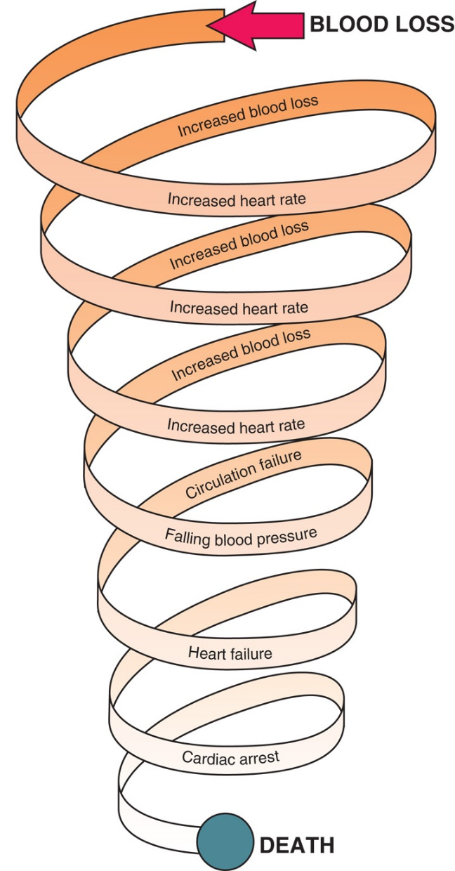
Shock
Signs and Symptoms of Shock
-Increased pulse
-Increased breathing rate
-Restlessness or combativeness
-Pale, cool, and moist skin
-Thirst
-Weakness
-Nausea and vomiting
-Loss of responsiveness
Care for Shock
-Support the ABCs.
-Keep patient lying flat.
-Control all external bleeding

Slide 28
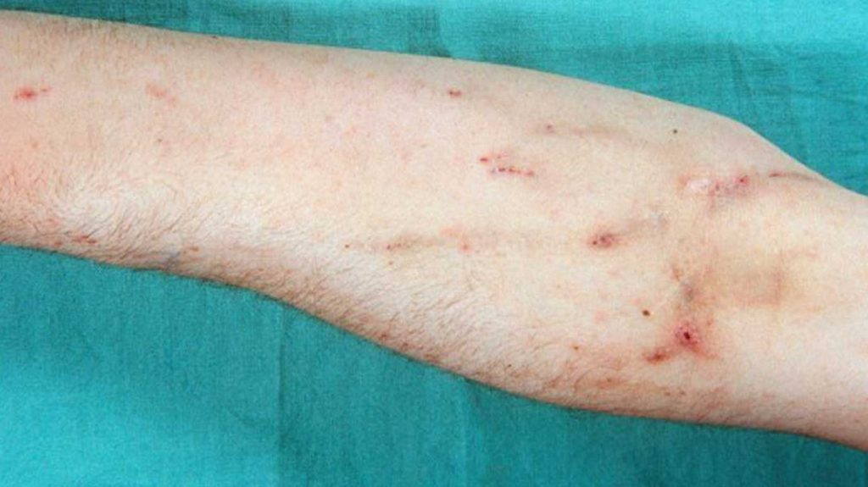
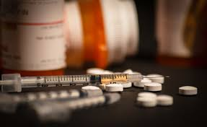
Overdose
-Patient may not be forthcoming with information.
-Withdrawal from drugs varies patient to patient and drug to drug.
-Signs and symptoms of use and overdose may mimic other medical conditions.
-shaking, anxiety, nausea, confusion, irritability, sweating, increased pulse and breathing rates
-Look for Track marks on patients arm, drug paraphernalia on scene

Slide 29
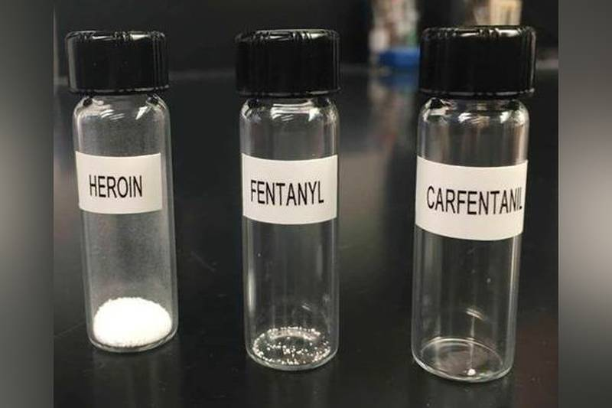
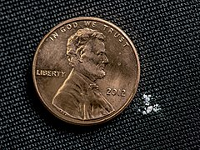
Lethal Doses

Slide 30
Using NARCAN Naloxone

Slide 31
720 ILCS 570/414
A person who, in good faith, seeks or obtains emergency medical assistance for someone experiencing an overdose shall not be arrested, charged, or prosecuted for a violation of Section 401 or 402 of the Illinois Controlled Substances Act, Section 3.5 of the Drug Paraphernalia Control Act, Section 55 or 60 of the Methamphetamine Control and Community Protection Act, Section 9-3.3 of the Criminal Code of 2012, or paragraph (1) of subsection (g) of Section 12-3.05 of the Criminal Code of 2012 if evidence for the violation was acquired as a result of the person seeking or obtaining emergency medical assistance and providing the amount of substance recovered is within the amount identified in subsection (d) of this Section. The violations listed in this subsection (b) must not serve as the sole basis of a violation of parole, mandatory supervised release, probation, or conditional discharge, or any seizure of property under any State law authorizing civil forfeiture so long as the evidence for the violation was acquired as a result of the person seeking or obtaining emergency medical
Assistance in the event of an overdose (c) A person who is experiencing an overdose shall not be arrested, charged, or prosecuted for a violation of Section 401 or 402 of the Illinois Controlled Substances Act, Section 3.5 of the Drug Paraphernalia Control Act, Section 9-3.3 of the Criminal Code of 2012, or paragraph (1) of subsection (g) of Section 12-3.05 of the Criminal Code of 2012 if evidence for the violation was acquired as a result of the person seeking or obtaining emergency medical assistance and providing the amount of substance recovered is within the amount identified in subsection (d) of this Section. The violations listed in this subsection
(c) must not serve as the sole basis of a violation of parole, mandatory supervised release, probation, or conditional discharge, or any seizure of property under any State law authorizing civil forfeiture so long as the evidence for the violation was acquired as a result of the person seeking or obtaining emergency medical assistance in the event of an overdose.

Slide 32
Reference List:
American Heart Association
Heartsaver First Aid Student manual, 2020
Friends and Family CPR Student Manual, 2015
Stop the Bleed Course - https://www.stopthebleed.org/
NAEMT TECC Course Manual 2ND EDITION
ITLS : International Trauma Life Support
Emergency Medical Responder 11th Edition, 2019
Google Images
Youtube video

Slide 33
QUESTIONS?

