Slide 1
Module 3- Injury Emergencies

Slide 2
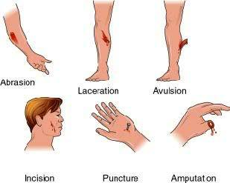
Module 3 - Objectives
Closed wounds
Open wounds
Treating Specific types of open wounds
Abrasions & Lacerations
Puncture Wounds
Wound packing
Impaled objects
Avulsions
Amputations

Slide 3
Module 3 - Objectives
Open chest injuries
Occlusive and Flutter- Valve Dressings
External Bleeding
CAT Tourniquet (How & When)
Hemostatic Agents- Quick Clot
Burns
Dressing and Bandaging

Slide 4
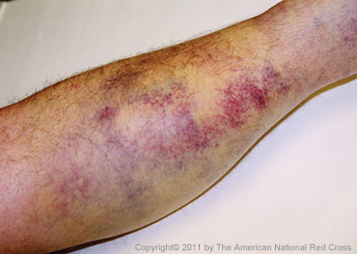
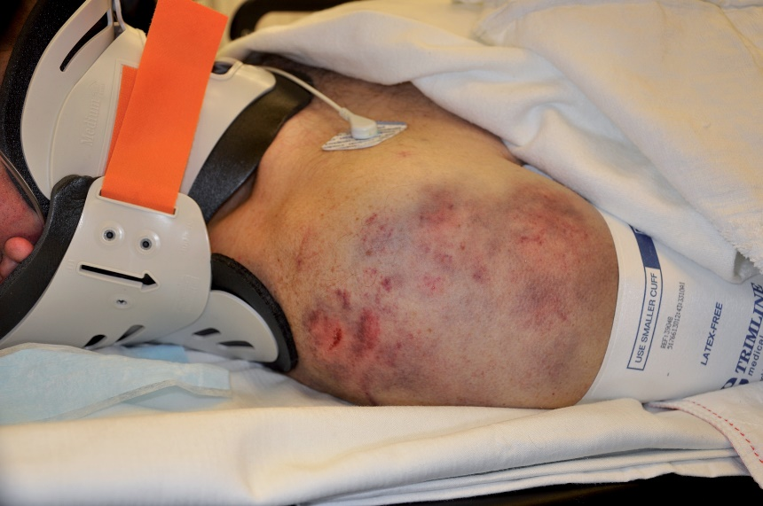
Closed Wounds
-Injury in which skin not broken
-Presence of swelling and/or bruises
-Large bruises can mean serious blood loss.
Fractures or extensive tissue damage under site of bruise

Slide 5
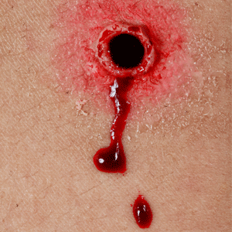
Open Wounds
-Skin has been damaged
-Obvious bleeding

Slide 6
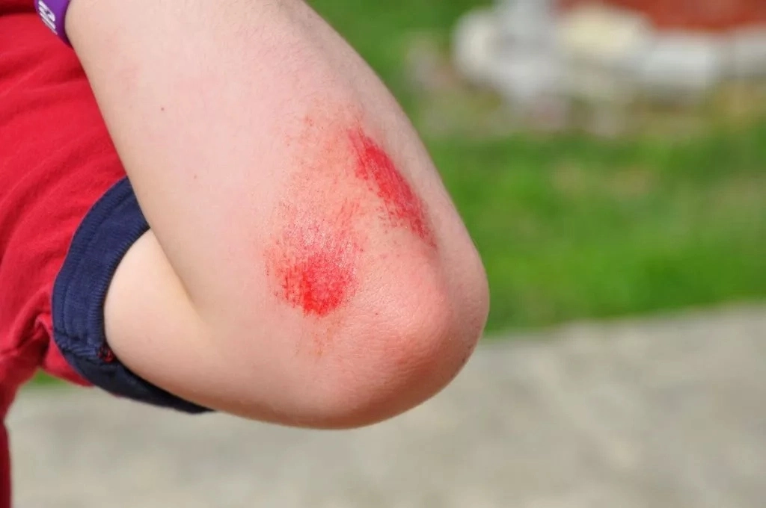
Abrasions
-Minor open wounds
-Skinned elbows and knees
”road rash,” and “rug burns”

Slide 7
Lacerations
Smooth cuts, or incisions
-The edges of a smooth cut appear straight.
-Deep incisions can cause severe tissue damage and life.
Razor blades, knives, and broken glass
Jagged cuts
-These are tears with rough edges.
-Usually, they occur when the skin is cut by an object that does not have a very sharp edge.
-May be produced from the impact of a blunt object

Slide 8
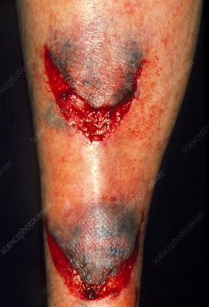
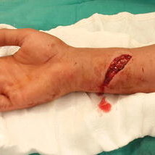
Lacerations
-V-
Jagged
Smooth

Slide 9
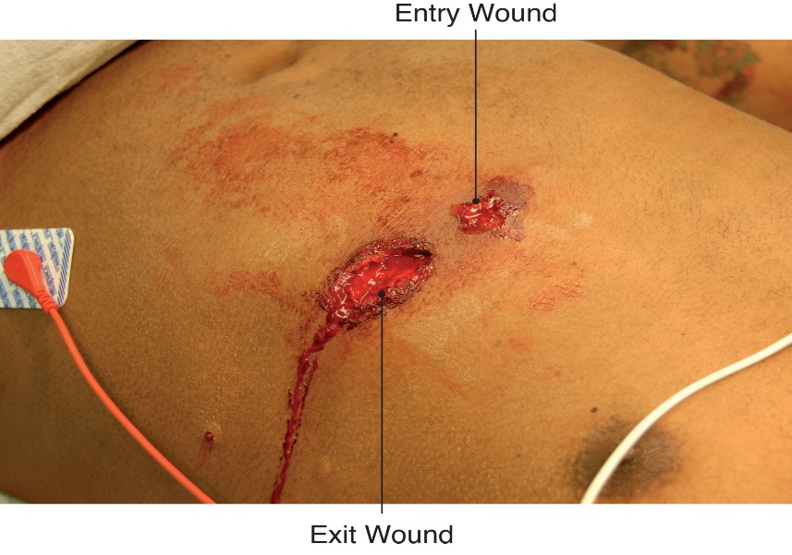
Puncture Wounds
Objects such as knives, nails, and ice picks produce puncture wounds.
Object puncturing body will tear through skin and usually proceed in straight line, damaging tissues.
When dealing with puncture wound, assume extensive internal injury and internal bleeding.
Always check for an exit wound.

Slide 10
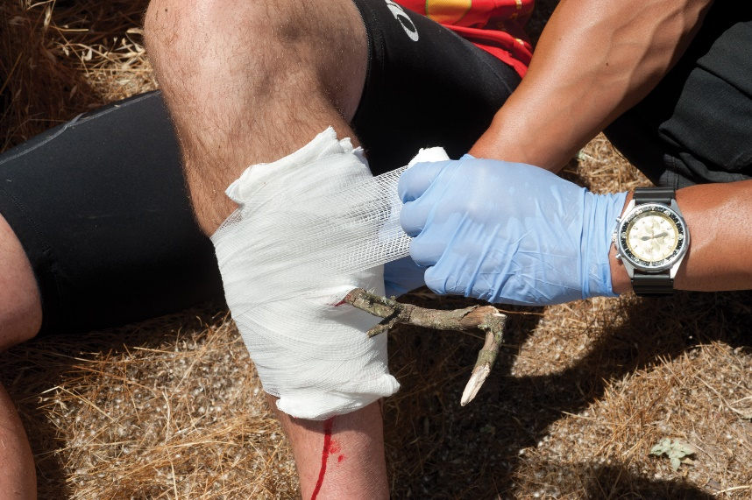
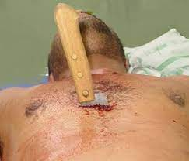
Impaled Objects
Impaled objects are treated the same as puncture wounds except you:
-Stabilize impaled object by using bulky dressings.
-Do not remove the object unless the object is an airway obstruction or prevents CPR from being performed when needed.

Slide 11
Avulsions
-Tearing loose or tearing off of large flaps of skin
-If avulsion occurs, gently fold skin back to normal position prior to applying direct pressure.
-Save and preserve avulsed or amputated part.
-Wrap body part in sterile dressing.
-Place into plastic bag or wrap in plastic wrap

Slide 12
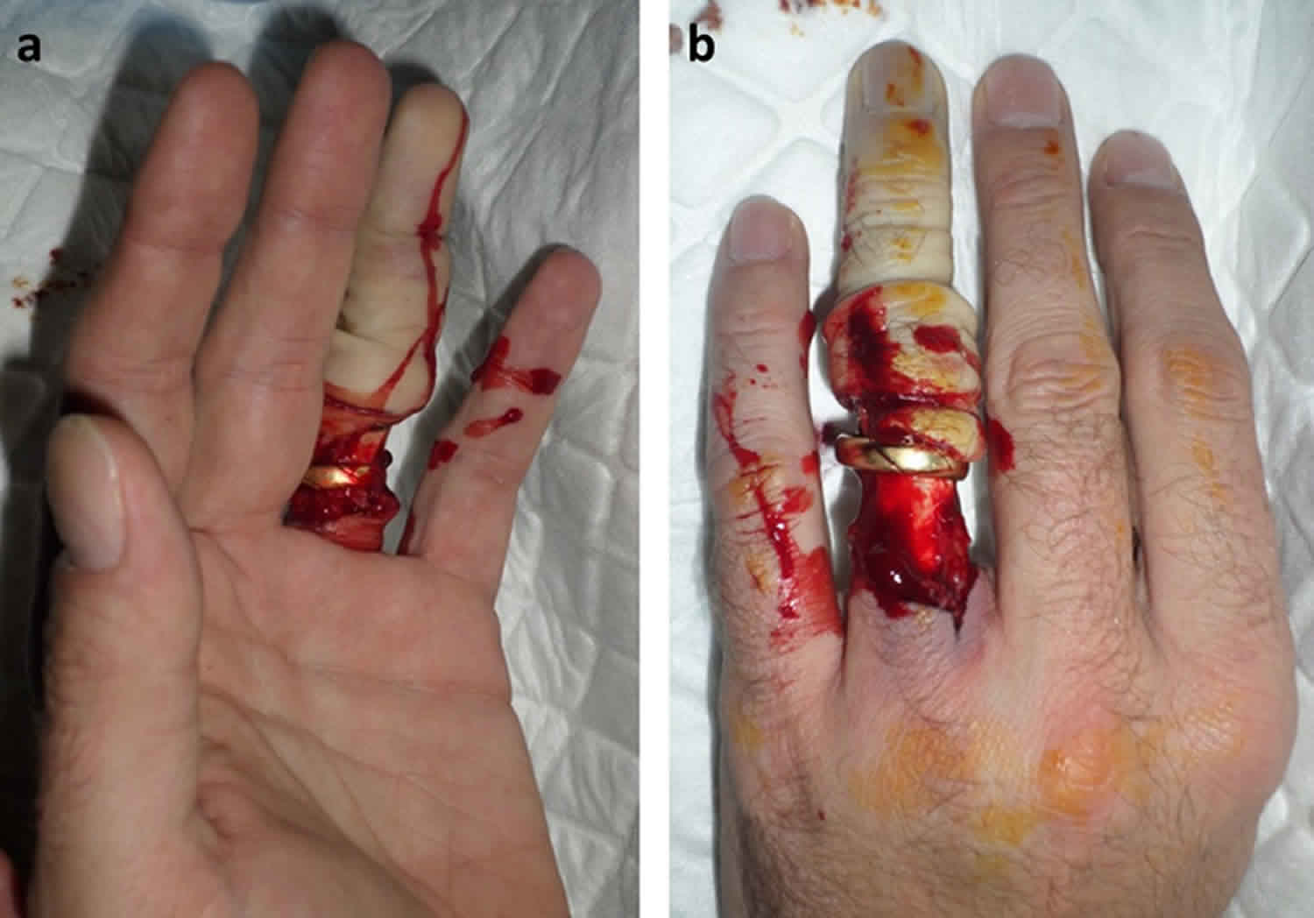
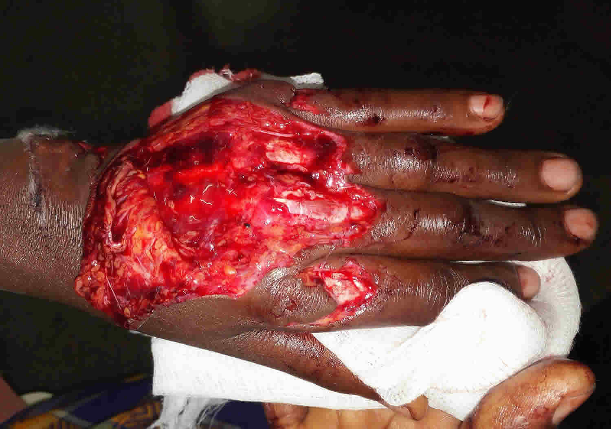
Avulsions

Slide 13
Amputations
Loss or removal of a body part
Common amputated body parts
-Finger, toe, hand, foot, arm & leg
Treatment
-Expose the wound
-Control bleeding and provide care as you would for open wound
-Provide care for shock
-Treat amputation the same way as an avulsed part.
- Save and preserve part
- Make sure body part is taken to hospital with patient

Slide 14
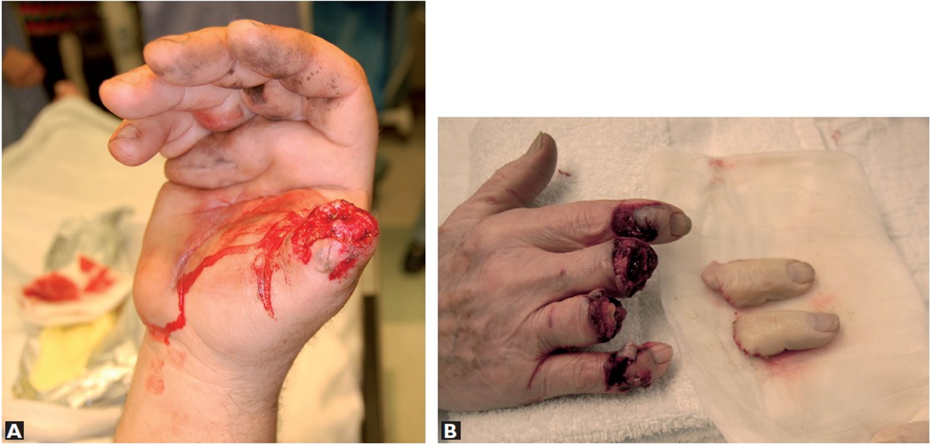
Amputations

Slide 15
Open Chest Injuries
Penetrating injury
-Penetrate chest wall, damaging internal organs and impairing respiration.
-Bullet, Knife, Glass, Steel rods, Pipes
Sucking chest wound
-Open chest wound characterized by sucking sound each time patient inhales.
Tension pneumothorax
-Air builds up inside chest cavity, causing excessive pressure on one side of chest.

Slide 16
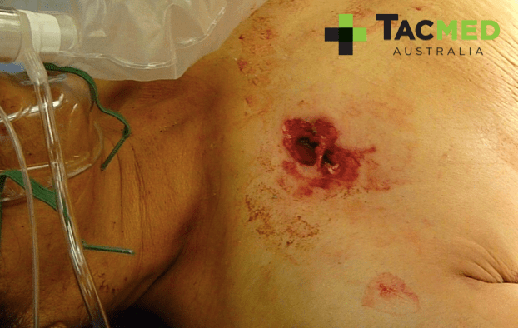
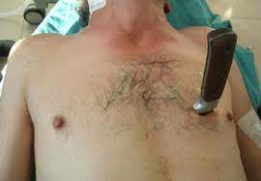
Open Chest Injuries
Penetrates chest wall, likely causing internal damage and creating airway compromise

Slide 17
Open Chest Injuries
Treatment of open chest injuries

Slide 18
Wound Packing

Slide 19
CAT Tourniquet
Two Handed Application

Slide 20
CAT Tourniquet

Slide 21
CAT Tourniquet

Slide 22
CAT Tourniquet

Slide 23
CAT Tourniquet

