Slide 1

School Resource Officer Training
Day One
Gail P. Sullivan, MA
Patricia Binfa, JD
David Rednour

Slide 2
Introduction
Let’s get to know each other….
State your name and your jurisdiction

Slide 3
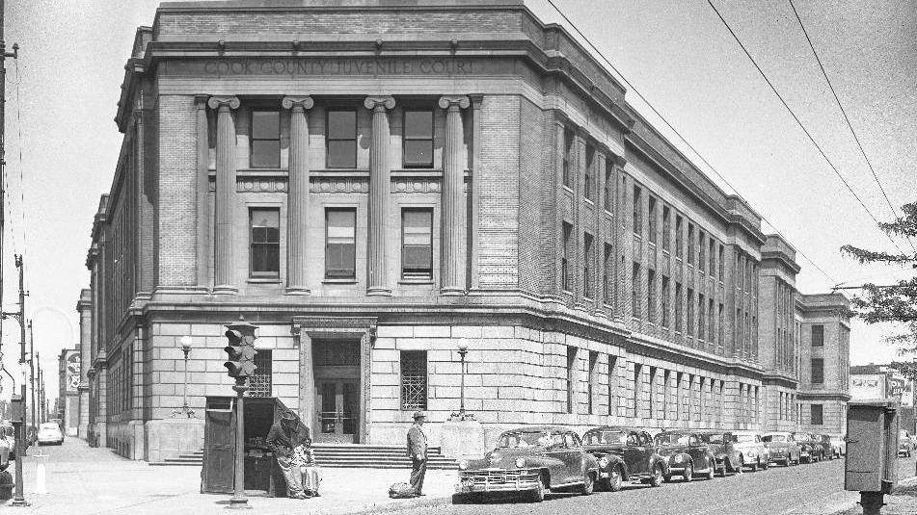
In the beginning….

Slide 4
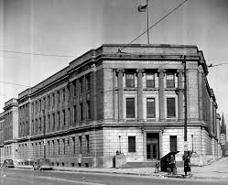
History of the Juvenile Court
"Kindness and love for the children must be used in this work if we would hope to receive the benefits which we should from this court, from which so much is expected." - Judge Richard Tuthil
Henry Campbell, an eleven year old boy, was brought before Judge Richard Tuthill on a charge of larceny on July 3, 1899, but a new way of adjusting the court system for young offenders were to be demonstrated in Chicago.
Before the establishment, Henry would have been called a “defendant” and his case would have been heard alongside the others of much older, many hardened criminals. But because he was a “delinquent,” Campbell appeared in the nation’s first juvenile court system.

Slide 5
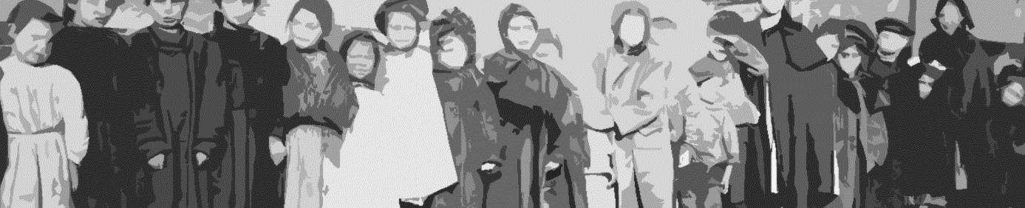
The Proceedings
Originally, the court process was informal—often nothing more than a conversation between the youth and the judge—and the defendant lacked legal representation.
Proceedings were conducted behind closed doors with little public or community awareness of how the juvenile court operated or what happened to the children who appeared before it.

Slide 6
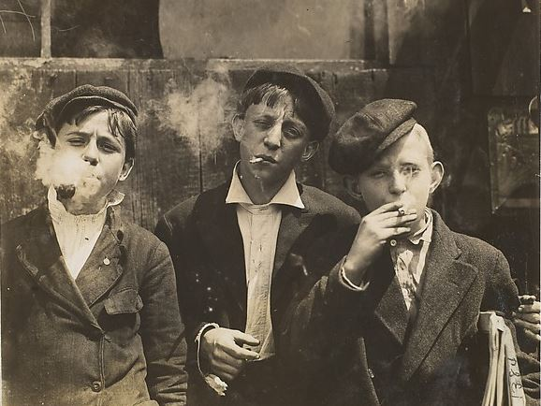
Children in Custody
In 1882, by one count, there were more than 250 children age 14 and under being held in the Cook County jail, at least 20 of them under the age of 11.
Children and youth were seen as "miniature adults" and thus tried and punished as adults.

Slide 7
Juvenile Court History
Before the 19th century, children were considered to be adults
Reformers advocated for new justice rules for children because of child in the labor force
New child labor laws began the division of adults and children
In 1899 the U.S. made legal history when the world's first juvenile court opened in Chicago.
The court was founded on two basic principles….

Slide 8

Responsibility

Slide 9
Juvenile Court Act To Be Addressed Today
Delinquency
Confidentially
Purpose
Policy Procedure

Slide 10
Juvenile Court Act
705 ILCS 405
The Juvenile Court Act, (JCA) consists of 6 articles:
General Provisions
Abused, Neglected and Dependent Minors
Minors Requiring Authoritative Intervention
Addicted Minors
Delinquent Minors
Administration of Juvenile Services

Slide 11
Juvenile Court Act General Provisions
(705 ILCS 405/1-2) (from Ch. 37, par. 801-2)
Sec. 1-2. Purpose and policy.
(1) The purpose of this Act:
is to secure for each minor are and guidance, preferably in his or her own home, the safety and moral, emotional, mental, and physical welfare of the minor and the best interests of the community;
to preserve and strengthen the minor's family ties whenever possible, removing him or her from the custody of his or her parents only when his or her safety or welfare or the protection of the public cannot be adequately safeguarded without removal;
if the child is removed from the custody of his or her parent, the Department of Children and Family Services immediately shall consider concurrent planning,

Slide 12
1) The purpose of this act is to:
*Secure for each minor subject hereto to such care and guidance, preferably in his or her own home,
*As will serve the safety and moral, emotional, mental, and physical welfare of the minor and
*The best interests of the community;
*To preserve , strengthen the minor’s family ties whenever possible,
*Removing him or her from the custody of his or her parents ONLY when his or her safety or welfare or the protection of the public cannot be adequately safeguarded without removal;
Purpose and Policy
705 ILCS 405/1-2 and 705 ILCS 405/5-101

Slide 13
General Provisions Definitions
(705 ILCS 405/1-3) (from Ch. 37, par. 801-3)
Sec. 1-3. Definitions. Terms used in this Act, unless the context otherwise requires, have the following meanings ascribed to them:
(1) "Adjudicatory hearing" means a hearing to determine whether the allegations of a petition under Section 2-13, 3-15 or 4-12 that a minor under 18 years of age is abused, neglected or dependent, or requires authoritative intervention, or addicted, respectively, are supported by a preponderance of the evidence or whether the allegations of a petition under Section 5-520 that a minor is delinquent are proved beyond a reasonable doubt.
(2) "Adult" means a person 21 years of age or older.

Slide 14
General Provisions Definitions
(4.1) "Chronic truant" shall have the definition ascribed to it in Section 26-2a of the School Code.
  A "truant" is defined as a child who is subject to compulsory school attendance and who is absent without valid cause, as defined under this Section, from such attendance for more than 1% but less than 5% of the past 180 school days.
  "Chronic or habitual truant" shall be defined as a child who is subject to compulsory school attendance and who is absent without valid cause from such attendance for 5% or more of the previous 180 regular attendance days.
(6) "Dispositional hearing" means a hearing to determine whether a minor should be adjudged to be a ward of the court, and to determine what order of disposition should be made in respect to a minor adjudged to be a ward of the court.

Slide 15
General Provisions Definitions
(7) "Emancipated minor" means any minor 16 years of age or over who has been completely or partially emancipated under the Emancipation of Minors Act or under this Act.
(8) "Guardianship of the person" of a minor means the duty and authority to act in the best interests of the minor, subject to residual parental rights and responsibilities, to make important decisions in matters having a permanent effect on the life and development of the minor and to be concerned with his or her general welfare

Slide 16
General Provisions Definitions
(8.2) "Juvenile law enforcement record" includes records of arrest, station adjustments, fingerprints, probation adjustments, the issuance of a notice to appear, or any other records or documents maintained by any law enforcement agency relating to a minor suspected of committing an offense, and records maintained by a law enforcement agency that identifies a juvenile as a suspect in committing an offense,
but does not include records identifying a juvenile as a victim, witness, or missing juvenile and any records created, maintained, or used for purposes of referral to programs relating to diversion as defined in subsection (6) of Section 5-105
(9) "Legal custody" means the relationship created by an order of court in the best interests of the minor which imposes on the custodian the responsibility of physical possession of a minor and the duty to protect, train and discipline him and to provide him with food, shelter, education and ordinary medical care, except as these are limited by residual parental rights and responsibilities and the rights and responsibilities of the guardian of the person, if any.

Slide 17
General Provisions Definitions
(10) "Minor" means a person under the age of 21 years subject to this Act.
(11) "Parent" means a father or mother of a child and includes any adoptive parent. It also includes a person (i) whose parentage is presumed or has been established under the law of this or another jurisdiction or (ii) who has registered with the Putative Father Registry in accordance with Section 12.1 of the Adoption Act and whose paternity has not been ruled out under the law of this or another jurisdiction. It does not include a parent whose rights in respect to the minor have been terminated in any manner provided by law.

Slide 18
General Provisions Definitions
(14.05) "Shelter placement" means a temporary or emergency placement for a minor, including an emergency foster home placement.
(15) "Station adjustment" means the informal handling of an alleged offender by a juvenile police officer.
(17) "Juvenile police officer" means a sworn police officer who has completed a Basic Recruit Training Course, has been assigned to the position of juvenile police officer by his or her chief law enforcement officer and has completed the necessary juvenile officers training as prescribed by the Illinois Law Enforcement Training Standards Board, or in the case of a State police officer, juvenile officer training approved by the Director of the Department of State Police.

Slide 19
Custody 705 ILCS 405/1-4.1
(705 ILCS 405/1-4.1) (from Ch. 37, par. 801-4.1)
Sec. 1-4.1. Except for minors accused of violation of an order of the court, any minor accused of any act under federal or State law, or a municipal ordinance that would not be illegal if committed by an adult, cannot be placed in a jail, municipal lockup, detention center or secure correctional facility. Confinement in a county jail of a minor accused of a violation of an order of the court, or of a minor for whom there is reasonable cause to believe that the minor is a person described in subsection (3) of Section 5-105, shall be in accordance with the restrictions set forth in Sections 5-410 and 5-501 of this Act.

Slide 20
Rights of the Parties
Sec. 1-5. Rights of parties to proceedings.
The following parties: minor, parents, guardian, legal custodian,
responsible relative have the following rights:
To be present
To be heard
To present evidence
To cross examine witnesses,
To examine court files
To examine records
Right to be represented

Slide 21
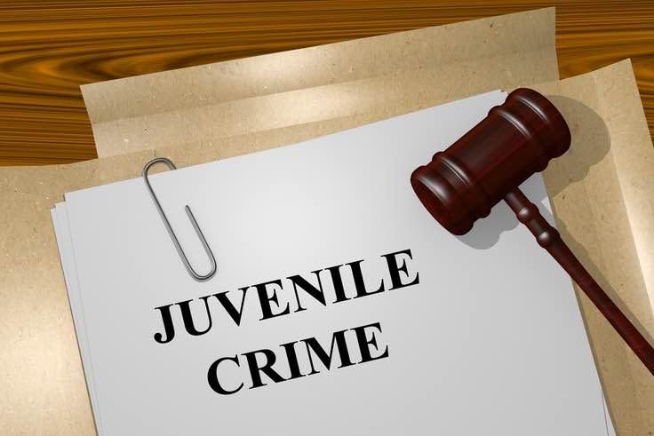
Juvenile Record and Confidentiality
705 ILCS 405/1-7

Slide 22

What is a Juvenile Record
Any documentation of a youth’s interactions with law enforcement and/or the juvenile court
Records are kept by the law enforcement agency
Every youth arrested has a juvenile record regardless if it leads to charges or adjudication

Slide 23
Juvenile Records
(8.2) "Juvenile law enforcement record“
Records of:
Arrest
Station Adjustments
Fingerprints
Probation adjustments
Notice to appear
Any other record maintained by any law enforcement

Slide 24
Juvenile Records
Law enforcement may not disclose the identity of a minor in releasing information relating to arrest, investigation or disposition
Records relating to minors under 18 must remain separate and apart from those of adults and may not be open to public inspection
Witnesses and victims may be shown photographs of minors when necessary for identification or apprehension
Law enforcement may communicate with each other if there are reasonable grounds to believe minor is a threat

Slide 25
Confidentiality of Law Enforcement Records
720 ILCS 405/1-7
*
Intent is to protect minors from the stigma of delinquency and afford them confidentiality
**
The general rule is that juvenile court personnel will have access to all juvenile records
***
If minor is tried as an adult, the records will follow. Expungement is often an option
Juvenile court records are generally NOT available to the public
****

Slide 26

Records are not available except….
Law enforcement can review juvenile records if:
  If inspecting a juvenile record is essential to executing an arrest
  Search warrant or other compulsory process
  Conducting an ongoing investigation or relating to a minor who has been adjudicated delinquent with gang affiliation.

Slide 27
Confidentiality of Court Records 705 ILCS 405/ 1 - 8
Sec. 1-8. Confidentiality and accessibility of juvenile court records.
(A) A juvenile adjudication shall never be considered a conviction nor shall an adjudicated individual be considered a criminal. Unless expressly allowed by law, a juvenile adjudication shall not operate to impose upon the individual any of the civil disabilities ordinarily imposed by or resulting from conviction. Unless expressly allowed by law, adjudications shall not prejudice or disqualify the individual in any civil service application or appointment, from holding public office, or from receiving any license granted by public authority. All juvenile court records which have not been expunged are sealed and may never be disclosed to the general public or otherwise made widely available. Sealed juvenile court records may be obtained only under this Section and Section 1-7 and Part 9 of Article V of this Act, when their use is needed for good cause and with an order from the juvenile court. Inspection and copying of juvenile court records relating to a minor who is the subject of a proceeding under this Act shall be restricted to the following:
(1) The minor who is the subject of record, his or her parents, guardian, and counsel.
(2) Law enforcement officers and law enforcement agencies when such information is essential to executing an arrest or search warrant or other compulsory process, or to conducting an ongoing investigation or relating to a minor who has been adjudicated delinquent and there has been a previous finding that the act which constitutes the previous offense was committed in furtherance of criminal activities by a criminal street gang.

Slide 28
Expungement of Law Enforcement and Juvenile Court Records 705 ILCS 405/ 1-9
(705 ILCS 405/1-9) (from Ch. 37, par. 801-9)
Sec. 1-9. Expungement of law enforcement and juvenile court records.
(1) Expungement of law enforcement and juvenile court delinquency records shall be governed by Part 9 of Article V of this Act.
(2) This subsection (2) applies to expungement of law enforcement and juvenile court records other than delinquency proceedings. Whenever any person has attained the age of 18 or whenever all juvenile court proceedings relating to that person have been terminated, whichever is later, the person may petition the court to expunge law enforcement records relating to incidents occurring before his 18th birthday or his juvenile court records, or both, if the minor was placed under supervision pursuant to Sections 2-20, 3-21, or 4-18, and such order of supervision has since been successfully terminated.
(3) The chief judge of the circuit in which an arrest was made or a charge was brought or any judge of that circuit designated by the chief judge may, upon verified petition of a person who is the subject of an arrest or a juvenile court proceeding pursuant to subsection (2) of this Section, order the law enforcement records or juvenile court records, or both, to be expunged from the official records of the arresting authority and the clerk of the circuit court. Notice of the petition shall be served upon the State's Attorney and upon the arresting authority which is the subject of the petition for expungement

Slide 29
Community Service 705 ILCS 405/1-13
(705 ILCS 405/1-13) (from Ch. 37, par. 801-13)
Sec. 1-13. No minor assigned to a public or community service program by either a court or an authorized diversion program shall be considered an employee for any purpose, nor shall the county board be obligated to provide any compensation to such minor.

Slide 30
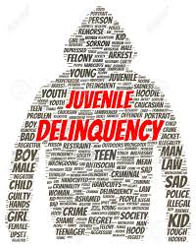
Delinquency

Slide 31
General Provisions
Definitions
Sec. 5-105. Definitions. As used in this Article:
(1) "Aftercare release" means the conditional and revocable release of an adjudicated delinquent juvenile committed to the Department of Juvenile Justice under the supervision of the Department of Juvenile Justice.
(2) "Community service" means uncompensated labor for a community service agency as hereinafter defined.
(3) "Delinquent minor" means any minor who prior to his or her 18th birthday has violated or attempted to violate, regardless of where the act occurred, any federal, State, county or municipal law or ordinance.

Slide 32
General Provisions Definitions
(5) "Detention" means the temporary care of a minor who is alleged to be or has been adjudicated delinquent and who requires secure custody for the minor's own protection or the community's protection in a facility designed to physically restrict the minor's movements, pending disposition by the court or execution of an order of the court for placement or commitment. Design features that physically restrict movement include, but are not limited to, locked rooms and the secure handcuffing of a minor to a rail or other stationary object. In addition, "detention" includes the court ordered care of an alleged or adjudicated delinquent minor who requires secure custody pursuant to Section 5-125 of this Act.
(6) "Diversion" means the referral of a juvenile, without court intervention, into a program that provides services designed to educate the juvenile and develop a productive and responsible approach to living in the community.
(7) "Juvenile detention home" means a public facility with specially trained staff that conforms to the county juvenile detention standards adopted by the Department of Juvenile Justice.

Slide 33
General Provisions Definitions
(8) "Juvenile justice continuum" means a set of delinquency prevention programs and services designed for the purpose of preventing or reducing delinquent acts, including criminal activity by youth gangs, as well as intervention, rehabilitation, and prevention services targeted at minors who have committed delinquent acts, and minors who have previously been committed to residential treatment programs for delinquents. The term includes children-in-need-of-services and families-in-need-of-services programs; aftercare and reentry services; substance abuse and mental health programs; community service programs; community service work programs; and alternative-dispute resolution programs serving youth-at-risk of delinquency and their families, whether offered or delivered by State or local governmental entities, public or private for-profit or not-for-profit organizations, or religious or charitable organizations. This term would also encompass any program or service consistent with the purpose of those programs and services enumerated in this subsection.
(9) "Juvenile police officer" means a sworn police officer who has completed a Basic Recruit Training Course, has been assigned to the position of juvenile police officer by his or her chief law enforcement officer and has completed the necessary juvenile officers training as prescribed by the Illinois Law Enforcement Training Standards Board, or in the case of a State police officer, juvenile officer training approved by the Director of State Police.

Slide 34
General Provisions Definitions
(10) "Minor" means a person under the age of 21 years subject to this Act.
(12) "Public or community service" means uncompensated labor for a not-for-profit organization or public body whose purpose is to enhance physical or mental stability of the offender, environmental quality or the social welfare and which agrees to accept public or community service from offenders and to report on the progress of the offender and the public or community service to the court or to the authorized diversion program that has referred the offender for public or community service. "Public or community service" does not include blood donation or assignment to labor at a blood bank.

Slide 35

What is a Minor?
Delinquent minor: means any minor who, prior to his or her 18th birthday has violated or attempted to violate, regardless of where the act occurred, any federal, State, county or municipal law or ordinance.

Slide 36
Purpose and Policy
(705 ILCS 405/5-101)
Sec. 5-101. Purpose and policy.
The intent is to promote a juvenile justice system capable with dealing with the problem of:
  Juvenile Delinquency
  A system that will protect the community
  Impose accountability for violations
  Equip juvenile offenders with competencies to live responsibly

Slide 37
Purpose and Policy Juvenile Delinquency
The purpose of this article is to:
Protect citizens from juvenile crime
Hold each offender accountable for his/her acts
Provide an individualized assessment of each alleged and adjudicated delinquent juvenile
Rehabilitate and prevent further delinquent behavior
Provide due process

Slide 38
This is accomplished through
Promotion and implementation of community base programs
Provide secure confinement for those minors who prove to be a danger
Protect the community
Provide programs that are community based near the juvenile home
Reside in the home, whenever possible
Base probation plans on individual case management plans
Include the minor’s family in the case management

Slide 39
Accomplished through
Provide supervision and service coordination where appropriate; implement and monitor the case management plan
Provide supervision and service coordination where appropriate; implement and monitor the case management plan in order to discourage recidivism
Provide post-release services to minors
Hold minor accountable for their unlawful behavior and not allow minors to think their delinquent acts have no consequence for themselves

Slide 40
Juvenile Justice Reform Provisions of 1998
Accountability
Community Safety
Competence Development
Closure
Making Amends
Encounter Other Side
Reintegration for All

Slide 41
General Provisions Juvenile Delinquency
(705 ILCS 405/5-115)
Sec. 5-115. Rights of victims. In all proceedings under this Article, victims shall have the same rights of victims in criminal proceedings.
(705 ILCS 405/5-110)
Sec. 5-110. Parental responsibility. This Article recognizes the critical role families play in the rehabilitation of delinquent juveniles. Parents, guardians and legal custodians shall participate in the assessment and treatment of juveniles by assisting the juvenile to recognize and accept responsibility for his or her delinquent behavior. The Court may order the parents, guardian or legal custodian to take certain actions or to refrain from certain actions to serve public safety, to develop competency of the minor, and to promote accountability by the minor for his or her actions.

Slide 42
Juvenile Court Act Jurisdiction
Excluded Jurisdiction
1)(a) The definition of delinquent minor under Section 5-120 of this Article shall not apply to any minor who at the time of an offense was at least 16 years of age and who is charged with: (i) first degree murder, (ii) aggravated criminal sexual assault, or (iii) aggravated battery with a firearm as described in Section 12-4.2 or subdivision (e)(1), (e)(2), (e)(3), or (e)(4) of Section 12-3.05 where the minor personally discharged a firearm as defined in Section 2-15.5 of the Criminal Code of 1961 or the Criminal Code of 2012.
These charges and all other charges arising out of the same incident shall be prosecuted under the criminal laws of this State.

Slide 43
Excluded Jurisdiction
16 years of age and above who commit classified offenses qualify for excluded jurisdiction
No motion needed to transfer to the criminal court
  No hearing in Juvenile Court, the case proceeds directly to the adult criminal court on the assigned charges.

Slide 44
Juvenile Court Act Jurisdiction
(705 ILCS 405/5-125)
Sec. 5-125. Concurrent jurisdiction. Any minor alleged to have violated:
a traffic, boating, or fish and game law
a municipal or county ordinance, may be prosecuted for the violation.
If found guilty punished under any statute or ordinance relating to the violation, without reference to the procedures set out in this Article, except that:
Confidentiality of records apply

Slide 45
Juvenile Court Act
Jurisdiction
Sec. 5-120. Exclusive jurisdiction.
Proceedings may be instituted under the provisions of this Article concerning any minor:
who prior to his or her 18th birthday
has violated or attempted to violate, regardless of where the act occurred, any federal, State, county or municipal law or ordinance.
Except as provided in Sections 5-125, 5-130, 5-805, and 5-810 of this Article, no minor who was under 18 years of age at the time of the alleged offense may be prosecuted under the criminal laws of this State.

Slide 46

Juvenile Arrest

Slide 47
Detention
“Detention” means the temporary care of a minor who is alleged to be or has been adjudicated delinquent and who requires secure custody for the minor’s own protections or the community’s protection in a facility designed to physically restrict the minor’s movements, pending disposition by the court or execution of an order of the court for placement or commitment. Design features that physically restrict movement include, but are not limited to, locked rooms and the secure handcuffing of a minor to a rail or other stationary object.

Slide 48
Juvenile Delinquency Arrest
                (1) A law enforcement officer may, without a warrant,
(a) arrest a minor whom the officer with probable cause believes to be a delinquent minor; or
(b) take into custody a minor who has been adjudged a ward of the court and has escaped from any commitment ordered by the court under this Act; or
(c) take into custody a minor whom the officer reasonably believes has violated the conditions of probation or supervision ordered by the court.

Slide 49
Juvenile Delinquency Arrest
When taking a minor into custody, a law enforcement officer MUST
1. make reasonable attempt
2. to contact the minors’ parents or legal guardian
3. and if unable to contact the minor’s parent or legal guardian, the juvenile officer MUST act as the juvenile advocate

Slide 50

Talking to In Custody Minors
  Make reasonable attempt
  Do not have to wait for mom/dad/guardian to arrive.
  If no parent present, the juvenile officer MUST act as the advocate

Slide 51
Custodial Interrogation
Requirements
Limits of Admissibility
Representation by Counsel

Slide 52
Attorney Representation
Sec. 5-170. Representation by counsel.
(a) In a proceeding under this Article, a minor who was under 15 years of age at the time of the commission of an act that if committed by an adult would be a violation of Section 9-1, 9-1.2, 9-2, 9-2.1, 9-3, 9-3.2, 9-3.3, 11-1.20, 11-1.30, 11-1.40, 11-1.50, 11-1.60, 12-13, 12-14, 12-14.1, 12-15, or 12-16 of the Criminal Code of 1961 or the Criminal Code of 2012 must be represented by counsel throughout the entire custodial interrogation of the minor.
(b) In a judicial proceeding under this Article, a minor may not waive the right to the assistance of counsel in his or her defense.

Slide 53
Juvenile Interrogation Requirements
When a minor is accused of a certain offense, the minor must have legal representation or video taping of such interrogation.
A delinquent minor who was under 15 years of age at the time of the offense and is accused of:
  Any sex offense
  All types of murder
  The minor MUST have legal counsel present during the entire length of the interrogation.
  The minor CANNOT waive with requirement, nor can the parent or legal guardian.

Slide 54
Statements by Minor 705 ILCS 405/5-401.5
Custodial interrogation means any interrogation (i) during which a reasonable person in the subject's position would consider himself or herself to be in custody and (ii) during which a question is asked that is reasonably likely to elicit an incriminating response.
Electronic recording" includes motion picture, audiotape, videotape, or digital recording.
Place of detention" means a building or a police station that is a place of operation for a municipal police department or county sheriff department or other law enforcement agency at which persons are or may be held in detention in connection with criminal charges against those persons or allegations that those persons are delinquent minors.

Slide 55
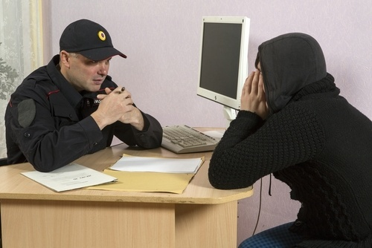
New Juvenile Miranda

Slide 56
Miranda Warnings
When a minor is being detained, the law enforcement officer, states attorney MUST:
CONTINOUSLY read to the minor, in its entirety and without interruption the following statement:
You have the right to remain silent. That means you do not have to say anything. Anything you do say can be used against you in court. You have the right to get help from a lawyer. If you cannot pay for a lawyer, the court will get you one for free. You can ask for a lawyer at any time. You have a right to stop this interview at any time.
At the completion of reading the statement, the public official MUST ask the minor TWO questions PRIOR to proceeding with the interrogation:

