Slide 1
Formal Station Adjustment
Total number of station adjustments, formal and informal, may not exceed 9 without the State’s Attorney’s approval
The JPO making a station adjustment shall ensure that information about any offense which would constitute a felony if committed by an adult (and may assure that information about a misdemeanor) is transmitted to the Department of State Police.

Slide 2
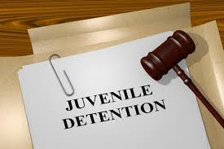
Detention Screening 705 ILCS 405/5-410

Slide 3
Detention Screening 705 ILCS 405/5-410
Screeners determine whether minor will be held in custody
Screening may be done by police, probation officer, detention facility or state’s attorney
Some use a scorable instrument
Screening will determine whether minor held in secure detention facility based on points

Slide 4
Detention 705 ILCS 405/5-410
A minor may not be detained in a county jail for more than 12 hours
No minor under 12 can be detained in a county jail for more than 6 hrs.
If the crime is one of violence, the minor may be detained for 24 hours
Minor must be under periodic supervision
Minor must be kept separate from adults (no contact by sight or sound)
Sight and sound provisions do not apply during line-ups
Minor must be supervised by JPO during line-ups

Slide 5
Detention Alternatives
Home Confinement
Electronic Monitoring
Day and Evening Reporting

Slide 6
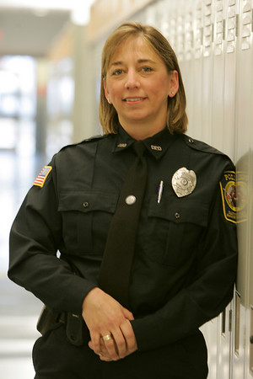
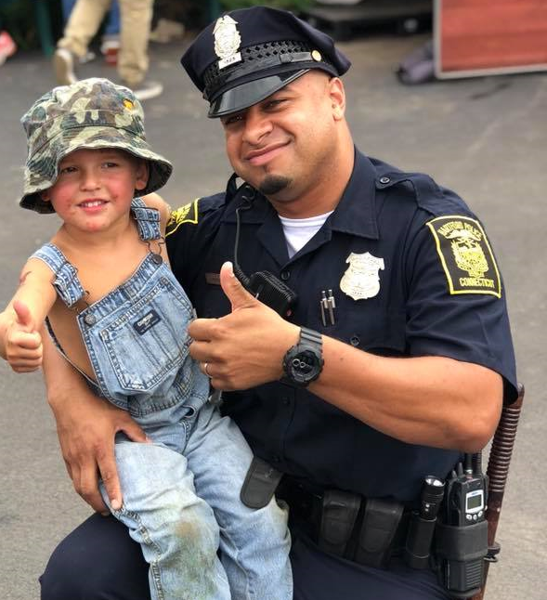
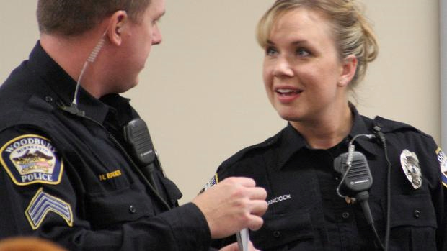
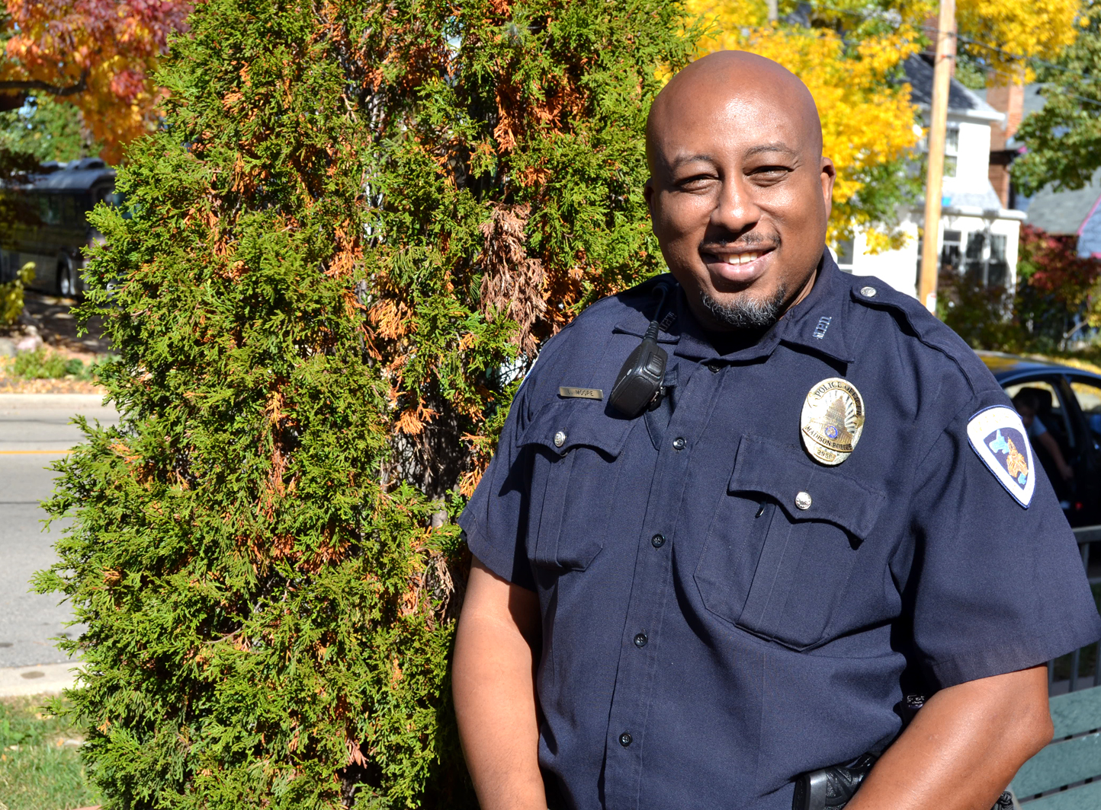

Role of the Juvenile Police Officer

Slide 7
Role of a Juvenile Officer
Youth officer should not have played an active part in the arrest of the delinquent minor:
1.Play an active role, not a passive role
2. Confer alone with the minor, explain your role
3. Make sure the minor is advised of his or her Miranda rights
4. Make sure the minor is advised that they may be tried as an adult
5. Make sure the minor is treated properly and fairly
6. Contact the minor’s parent, guardian or interested adult
7. Be present during any and all questioning

Slide 8
Reasonable Time
How long can a juvenile be held under arrest?
The juvenile's age determines how long police can hold his or her under arrest. If the juvenile is under 12 years old, police can only hold he or she for 6 hours. If the juvenile is between 12-16 years old, they can be held for:
  12 hours for a non-violent crime; or
  Up to 24 hours for a violent crime.

Slide 9

Restorative Justice

