Slide 1
Lineup and Photo Spread Procedures - Consequences 725 ILCS 5/107A
Consequences for Failure to Comply with Procedures
Factor to consider by court when adjudicating a motion to suppress eyewitness identification or motion to bar eyewitness identification
Jury may be instructed to consider all facts and circumstances when weighing eyewitness identification, including compliance or non-compliance with the procedures set forth

Slide 2
Let’s get back to the implications of failure to record that interview
People v. Clayton 2014 IL App (1st) 130743
17 year old girl rousted from her home in the middle of the night, without a parent, taken to police station
First interview -not recorded
Second interview-given Miranda warnings and the recording started
Holding: 1) The first interview was custodial interrogation and should have been recorded and
2) The state failed to meet its burden that subsequent statement was voluntary and reliable.

Slide 3
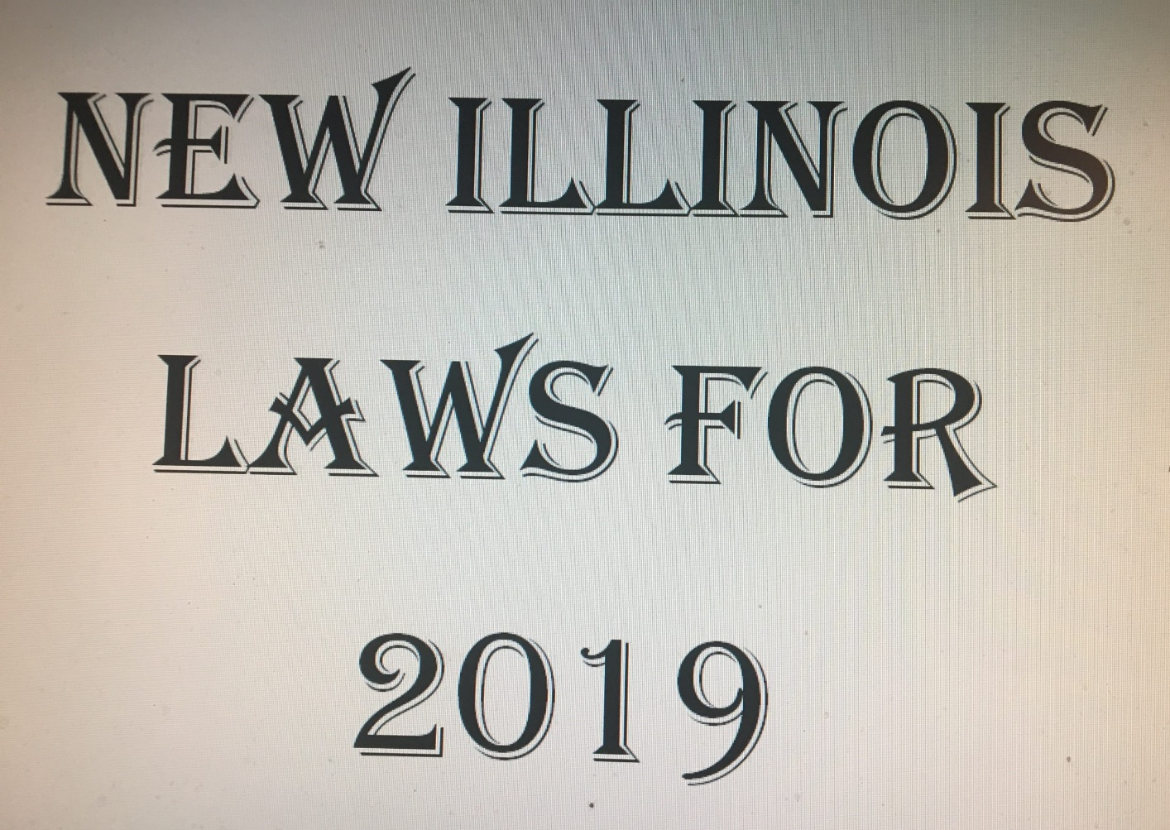
New Laws 2019/2020/2021

Slide 4
Special Placement of Trafficked Minors New Law: July 2019
DCFS Specialized Placement Trafficked Youth (SB 2461/PA 100-0705): Provides that before July 1, 2019, the Department of Children and Family Services shall develop or enter contracts with agencies to provide specialized placements for youth who are victims of sex trafficking. Specialized placements may include but are not limited to: licensed foster homes; group homes; residential facilities; and secure residential facilities that specialize in providing treatment to children who are victims of sex trafficking.

Slide 5
School Resource Officers New Law July 2019
Enforcement Training (SB 2925/PA 100-0984): Requires the Law Enforcement Training Standards Board to develop a program for school resource officers, and establishes requirements and determine if existing local police agency training meets requirements.

Slide 6
School Safety Drills New Law July2019
(SB 2350/PA 100-0996): Requires active shooter/threat school safety drills to be conducted within 90 days of the start of the school year. Requires the drills to be conducted on days and times when students are present in the building. Requires participation from all school personnel and students present. Requires law enforcement to observe the drill.

Slide 7
Truancy Fines New Law July 2019
(SB 3466/PA 100-0810): Prohibits a school district from referring a truant, chronic truant, or truant minor to any other local public entity for the purpose of issuing a fine or a fee. Allows a school district to refer a person having custody or control of a truant, chronic truant or truant minor to another local public entity or municipality if certain conditions are met, including the offer of appropriate and available supportive services. A school district is required to document any support services that were offered. For homeless children, children with IEPs and children with 504 plans or those who are being evaluated for a disability, more specific conditions must be met before the custodian of the child can be referred to a municipality.

Slide 8
Home-Schooling
Teach the required subjects
Instruction must be done in English
Know what to call your homeschool program
Compulsory attendance law:
Child who is 6 by September 1, must comply with the attendance law
Exemption when the child turns 17 or graduates from high school

Slide 9
Sex Education
HB 3550: Sex education courses and instruction in grades 6 through 12 will now be required to include an age-appropriate discussion on the meaning of consent.
This includes teaching that consent is a freely given agreement to sexual activity, that consent to one activity does not include consent to others, that a person’s clothing, past activity, lack of resistance and more do not constitute consent, that a person can withdraw consent at any time, and that a person cannot consent to sexual activity if the person is unable to understand due to incapacitation from drugs and alcohol, being asleep or unconscious, having a mental disability or being a minor.

Slide 10
DCFS
HB 1551: Among the reforms, this new law requires DCFS to follow several new guidelines when a child is returned to the custody of a parent or guardian. The agency must complete a home safety checklist within the 24 hours before the child is discharged from foster care, as well as again within five days of the child’s return, plus every month thereafter until the case is closed. DCFS must also provide a minimum of six months of aftercare services beginning when the child returns home, as well as ensure that the child is up to date on well-child visits. And when a person who is legally required to report child abuse allegations (known as mandated reporter, a category that includes people like teachers, law enforcement, medical professionals, etc.) makes an allegation using the telephone hotline, about a home with prior contact with the agency, the department is required to accept it as a referral.

Slide 11
DCFS
SB 1239: Under this new law, DCFS is required to immediately report to local law enforcement any allegation that a child is being abused or neglected by a person who is not the child’s parent, immediate family, person responsible for the child’s welfare or paramour of the child’s parent for a possible criminal investigation.

Slide 12
Pending
Juvenile Subsequent Firearm Offense Status: Pending - House Rules Committee Date of Last Action:* 1/11/2019 Author: DeLuca (D) Additional Authors: Cabello (R) Topics: Miscellaneous, Probation Summary: Amends the Juvenile Court Act, provides that if a minor has previously been placed on probation for an offense that involves the use or possession of a firearm, the court may not place the minor on probation for any subsequent offense involving the use or possession of a firearm.

Slide 13
Pending
IL S 1280 2020 Juvenile Repair of Property Damage Status: Pending - Senate Committee on Assignments Committee Date of Last Action:* 2/7/2019 Author: Weaver (R) Topics: Disposition Options/Sentencing/Length of Stay, Restorative Justice Summary: Amends the Juvenile Court Act, provides that a minor found to be guilty for reasons that include a violation of criminal damage to property, criminal damage to government supported property, and institutional vandalism shall be ordered to perform community service for not less than 30 and not more than 120 hours, provides that the minor's sentence shall not be considered discharged until the cleanup and repair of the damage caused by the minor is complete

Slide 14
Current Change to Juvenile Court Act
IL S 1302 2020 Juvenile Detention Facility Screening
Amends the Juvenile Court Act of 1987. Provides that on and after July 1, 2021, a detention screening instrument shall be used for referrals to all authorized juvenile detention facilities in this State prior to a judicial hearing. Provides a minor alleged to be a delinquent minor taken into temporary custody must be brought before a judicial officer within 48 hours (rather than 40 hours, excluding Saturdays, Sundays and court designated holidays). Provides that if an appearance is required of any minor taken and held in a place of custody or confinement operated by the State or any of its political subdivisions

Slide 15
Current Change to Juvenile Court Act
including counties and municipalities, the chief judge of the circuit may permit by rule for the minor's personal appearance to be made by means of two-way audio-visual communication, including closed circuit television and computerized video conference, in the following proceedings: (1) the initial appearance before a judge; (2) a detention or shelter care hearing; or (3) any status hearing. Amends the Probation and Probation Officers Act. Provides that the Division of Probation Services of the Supreme Court shall adopt a statewide juvenile detention screening instrument that has been verified through evidence-based and data-based practices that is to be used by all authorized juvenile detention facilities. Makes other changes. Effective immediately.

Slide 16
The End
Thank you very much for your kind attention. If I can provide further assistance, please contact gpsllvn@yahoo.com
Patricia A. Binfa, JD

