Slide 1
Restorative Justice
Crime is Injury
Crime hurts individual victims, communities
Offenders are obligated to make things right
All parties need be part of response to crime

Slide 2
Restorative Justice
Including the victim if they wish
Victim’s perspective is central to deciding repairs
Accountability – Responsibility - Harm Repair
Community is responsible for well-being of all

Slide 3
Restorative Justice
Types of Remedies
Therapy
Education Support
Community Service
Teen Court
Conflict Resolution
Repair Harm
Drug Screen

Slide 4
Lets Look at The Law

Slide 5
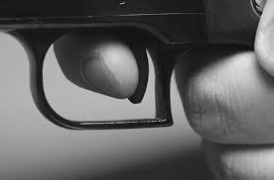
Minors with Firearms 705 ILCS 405/5-407

Slide 6
Minors with Firearms 705 ILCS 405/5-407
If a law enforcement officer detains a minor pursuant to Section 10-27.1A of the School Code, the officer shall deliver the minor to the nearest juvenile officer, in the manner prescribed by subsection (2) of section 5-405 of this Act.

Slide 7
Minors with Firearms 705 ILCS 405/5-407
The juvenile officer shall deliver the minor without unnecessary delay to the court or the place designated by rule or order of court for the reception of minors. In no event shall the minor be eligible for any other disposition by the juvenile police officer, notwithstanding the provisions of subsection (3) of Section 5-405 of this act.

Slide 8
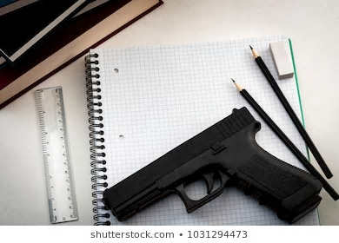
Firearms in Schools - School Code 105 ILCS 5/10-271A

Slide 9
Schools and Guns
(a) All schools' officials, including teachers, guidance counselors and support staff shall immediately notify the office of the principal in the event that they observe and individual in the possession of a firearm on school grounds; providing that taking such immediate action to notify the office of the principal would not immediately endanger the health, safety, or welfare of students who are under the direct supervision of the school official or the school official.

Slide 10
Schools and Guns
If the health, safety, or welfare of students under the direct supervision of the school official or the school official is immediately endangered, the school official shall notify the office of the principal as soon as the students under his or her supervision and he or she are no longer under immediate danger.

