Slide 1
Child And Adolescent Disorders
(2020)
John FS Williams, M.Ed., LCPC.
JFSW, Inc., 708 471-2000
jfsw@sbcglobal.net

Slide 2
Application by an Adult for Admission of A Minor
Form Ref:
IL462-2206M (R-08-17)
Formerly MH-6
Search “NEW IL MH-6

Slide 3
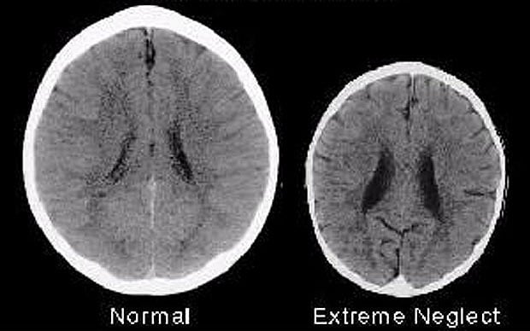
What is the difference between these two brains? http://www.telegraph.co.uk/news/health/children/9637682/Whats-the-difference-between-these-two-brains.html

Slide 4
InBrief: The Science of Neglect
Center on the Developing Child at Harvard University
Published on Oct 31, 2013
neglect video

Slide 5
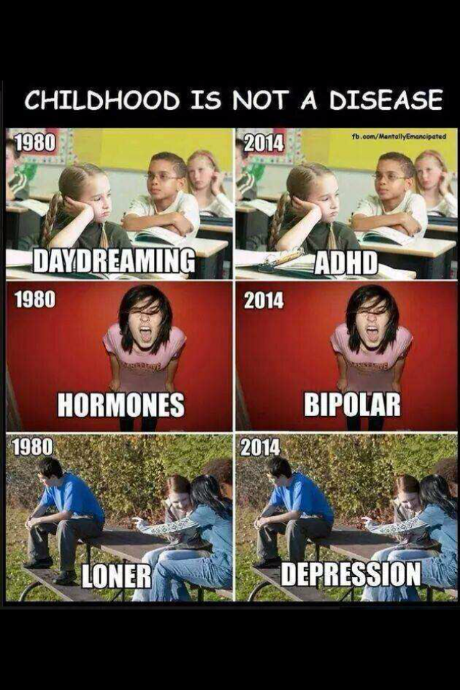

Slide 6
Session Focus on Mental Health
Issues That Are Specific to Children and Adolescents
Including but not limited too:
Conduct disorder
Oppositional defiant disorder
ADHD
Depression
Bipolar disorder
DMDD

Slide 7
DSM 5.0
Diagnostic and Statistical Manual Updated May 2013
Goal to be an aid in understanding human behavior.
A few comments regarding changes in Child and Adolescent Issues.

Slide 8
Types of Issues
Power ability to influence the world around you
Intimacy closeness too/distance from those around you
Competency what are you good at, not good at doing

Slide 9
Power
Intimacy
Competency

Slide 10
What we all want
Competency - what you are good at/not good at
Intimacy - who you are close to/distant from
Power - ability to influence your environment
JFSW,inc
Notes:
10

Slide 11
Types of Feelings
Glad
Sad
Mad
Scared

Slide 12
Depression Versus Sadness
Time
Intensity
Ability to change own mood
Biochemistry

Slide 13
Acting In
Acting Out
Anger turned outwards - violence towards others,
Anger turned inwards – violence towards self (cutting, overdose, suicidal ideation/attempts)

Slide 14
Anger
Anger is a second feeling.
Experience fear or pain and react with anger.
Tip of the iceberg: see anger on surface.

Slide 15
Fight, Flight, and Freeze
PTSD and exposure to trauma
80% “Norm” none/TX
15% “Learn to hide” single w/o
05% “Learn to fight” Chronic w/o

Slide 16
Childhood Exposure to Trauma
ACE Study Adverse Childhood Experiences
PTSD Post Traumatic Stress Disorder

Slide 17
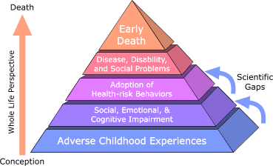
ACES Study
Centers for Disease Control and Prevention,
Adverse Childhood Experiences Study
Pyramid
Notes:
17
The ACE Pyramid represents the conceptual framework for the Study. During the time period of the 1980s and early 1990s information about risk factors for disease had been widely researched and merged into public education and prevention programs. However, it was also clear that risk factors, such as smoking, alcohol abuse, and sexual behaviors for many common diseases were not randomly distributed in the population. In fact, it was known that risk factors for many chronic diseases tended to cluster, that is, persons who had one risk factor tended to have one or more others.
Because of this knowledge, the ACE Study was designed to assess what we considered to be “scientific gaps” about the origins of risk factors. These gaps are depicted as the two arrows linking Adverse Childhood Experiences to risk factors that lead to the health and social consequences higher up the pyramid. Specifically, the study was designed to provide data that would help answer the question: “If risk factors for disease, disability, and early mortality are not randomly distributed, what influences precede the adoption or development of them?” By providing information to answer this question, we hoped to provide scientific information that would be useful for the development of new and more effective prevention programs.
The ACE Study takes a whole life perspective, as indicated on the orange arrow leading from conception to death. By working within this framework, the ACE Study began to progressively uncover how childhood stressors (ACE) are strongly related to development and prevalence of risk factors for disease and health and social well-being throughout the lifespan.

Slide 18
ACES
Adverse Childhood Experiences Study
CDC 1995-1997
26,000 adults invited to the research
17,337 accepted and involved
Series of questionnaires.
“ACE Score” – counts total amount of stress during childhood.
More ACE = increase in risk for health problems.
Reflects that childhood abuse, neglect and exposure to other traumatic stressors are common.

Slide 19
Adverse Childhood Experiences are common
Recurrent and Severe Psychological abuse (11%)
Recurrent Physical abuse (28%)
Contact Sexual abuse (21%)
Violence against the respondent’s mother (13%)
Living with substance abuse (27%)
Living with mentally ill or suicidal parents (19%)
Living with individuals who had ever been incarcerated (3%)
Both biological parents not present (23%)

Slide 20
Major Finding ACES - CDC
liver disease
risk for intimate partner violence
multiple sexual partners
sexually transmitted diseases (STDs)
smoking
suicide attempts
unintended pregnancies
alcoholism and alcohol abuse
chronic obstructive pulmonary disease (COPD)
depression
fetal death
health-related quality of life
illicit drug use
ischemic heart disease (IHD)
Notes:
20
Major Findings
Childhood abuse, neglect, and exposure to other traumatic stressors which we term adverse childhood experiences (ACE) are common. Almost two-thirds of our study participants reported at least one ACE, and more than one in five reported three or more ACE. The short- and long-term outcomes of these childhood exposures include a multitude of health and social problems. The ACE Study uses the ACE Score, which is a count of the total number of ACE respondents reported. The ACE Score is used to assess the total amount of stress during childhood and has demonstrated that as the number of ACE increase, the risk for the following health problems increases in a strong and graded fashion:
In addition, the ACE Study has also demonstrated that the ACE Score has a strong and graded relationship to health-related behaviors and outcomes during childhood and adolescence including early initiation of smoking, sexual activity, and illicit drug use, adolescent pregnancies, and suicide attempts. Finally, as the number of ACE increases the number of co-occurring or “co-morbid” conditions increases.
Page last reviewed: January 10, 2008
Page last modified: December 12, 2005
Content source: Division of Adult and Community Health, National Center for Chronic Disease Prevention and Health Promotion

Slide 21
Cumulative impact of ACEs
The higher the number of ACEs, the greater the risk of behavior problems.
For example, an individual with an ACE score of 4, is 12 times more likely to attempt suicide than those with none.

Slide 22
Other conditions
STDs – 240% increase with an ACE of 4 vs. and ACE of 0
Male with ACE score of 6 is 46 times (4,600%) more likely to become IV drug user than an ACE of 0
78% of drug injection by women can be attributed to adverse childhood experiences.

Slide 23
The following categories all occurred in the participant's first 18 years of life.
  Abuse/Neglect:
  Emotional Abuse
  Physical Abuse
  Sexual Abuse
  Emotional Neglect
  Physical Neglect
Household Dysfunction
  Mother Treated Violently
  Household Substance Abuse
  Household Mental Illness
  Separation/Divorce
  Incarcerated Household member
Notes:
In your experience, how many juvenile offenders have some or all of these issues?

Slide 24
Risk Factors
Economic instability
Inconsistent parenting
Severe punishment
Resource poor community
Hyperactivity as child

Slide 25
Other Indicators
Family History M.I./S.A.
Substance Abuse
School Behavior Problems
Witness to/victim of violence
Bullying
Runaway
Station Adjustments: Limited Custody

Slide 26
What is the Olweus
Definition of Bullying?
“A person is bullied when he or she is exposed, repeatedly and over time, to negative actions on the part of one or more other persons, and he or she has difficulty defending himself or herself.” Olweus et al., 2007
Notes:
26
BPCC Coordinating Committee Training
© 2007 The Olweus Bullying Prevention Group
26
Important to begin with a common understanding of what bullying is—& what it isn’t.
Dan Olweus defines bullying as… (SLIDE)
(See SWG, p. xii; TG, p. 11; SWG DVD Pt. II)

Slide 27
Effects of Being Bullied
Lower self-esteem
Depression & anxiety
Absenteeism & lowered school achievement
Thoughts of suicide
Illness
Notes:
27
BPCC Coordinating Committee Training
© 2007 The Olweus Bullying Prevention Group
27
Bullying may seriously affect: (1) psychosocial functioning, (2) academic work, (3) health of children who are targeted—effects can be both short & long-term
Being bullied related to lower self-esteem, higher depression, loneliness, anxiety
Victims more likely to report wanting to avoid school, higher absenteeism rates (Rigby, 1996)
Report disliking school & received lower grades (Eisenberg et al., 2003)
Early peer exclusion (Kindergarten) leads to decreased classroom participation, & in turn to lowered academic achievement in 5th grade. (Buhs, et al., 2006)
Report more suicidal ideation than non-bullied peers. Though relatively rare, suicide has been linked to persistent bullying.
Suicidal ideation & depression appear more common among children experiencing indirect bullying (e.g., being ignored) than direct bullying (van der Wal et al., 2003)
Depression & low self-esteem can persist into adulthood.

Slide 28
Health Consequences of Bullying
(Fekkes et al., 2004)
Bullied Not bullied
Headache 16% 6%
Sleep problems 42% 23%
Abdominal pain 17% 9%
Feeling tense 20% 9%
Anxiety 28% 10%
Feeling unhappy 23% 5%
Depression scale
moderate indication 49% 16%
strong indication 16% 2%
Notes:
28
Children who are frequently bullied report a variety health problems
Example: In recent study of Dutch school children (ages 9-12), found that bullied children (i.e., bullied a few times a month or more), were more likely than peers to experience a variety of physical ailments: (SLIDE)
3x as likely as peers to have headaches,
2x as likely to have problems sleeping, abdominal pain, & to be tense
3x as likely to be anxious
5x as likely to be unhappy & MUCH more depressed

Slide 29
What Roles Do Students Play In
Bullying Situations?
G
Start the bullying and take an active
part
A
Students Who Bully
Student Who Is Bullied
Defenders
Dislike the bullying, help or try to help the bullied student
Take an active
part, but do not start the bullying
B
Followers
H
The one who is being bullied
Support the bullying, but do not take an active part
C
Supporters
Possible
Defenders
F
Passive
Supporters
Dislike the bullying and think they ought to help, but don’t do it
D
Like the bullying,
but do not display
open support
Disengaged
Onlookers
E
Watch what happens, don’t take a stand
Notes:
29
BPCC Coordinating Committee Training
© 2007 The Olweus Bullying Prevention Group
29
Peer group plays an important role in motivating and encouraging bullying in many situations.
As this continuum shows, students who bully often get various types of support—from followers (hench boys or hench girls), supporters, & passive supporters.
Shows group phenomenon: roles vary among participants & observers. Some are much more active than others.
This “Bullying Circle” is an important OBPP tool to illustrate roles in bullying situations & to build understanding about how the program helps shift behavioral norms & attitudes.
Engage participants in Bullying Circle Exercise (TM Tab 11, Doc. 7) using the large role play cards (TM Tab 11, Doc. 8)
TG, pp. 23-25; SWG CD Doc. 1, pp. 15-16.

Slide 30
Bullying/Harassment
105 ILCS 5/27-23.7 (2010)
requires each school district and non-public, non-sectarian elementary or secondary school to create and maintain a policy on bullying. The policy must be communicated to the students and their parent or guardian annually, updated every 2 years and filed with the State Board of Education. The statute also creates the School Bullying Prevention Task Force and outlines its responsibilities.

Slide 31
PSVA 2010
First, it explicitly prohibits bullying in schools.
Second, the PSVA comprehensively defines bullying behavior, as well as where and when it is prohibited.
Third, the PSVA expands the reach of the bullying law to include all private, non-sectarian schools in Illinois.
Fourth, the PSVA creates the Illinois School Bullying Prevention Task Force (Task Force).

Slide 32
Illinois Definition of Bullying
bullying is an umbrella term that includes a broad range of conduct and behavior. The PSVA cites harassment, threats, intimidation, stalking, physical violence, sexual harassment, sexual violence, theft, public humiliation, destruction of property, or retaliation for asserting or alleging an act of bullying as examples (and is clear that the list is not meant to be exhaustive).

Slide 33
Conduct Disorder
<18 y/o Males 6%-16% Females 2%-9%
Anti-social leanings
High correlation alcoholic family systems
Aggression to people and animals
Destruction of property
“Jiminy Cricket”

Slide 34
Conduct Disorder
Fights, truancy, runaway, bullying, fire, weapons, violent crimes
TX requires multiple coordinated interventions family, school, community, and law enforcement/legal system

Slide 35
Oppositional Defiant Disorder
2%-16%
Anti-authority leanings
Disruptive childcare/inconsistent care taking
Often loses temper
Often argues with adults
Often actively defies or refuses to comply with adults request or rules
Often deliberately annoys people

Slide 36
Oppositional Defiant Disorder
Often blames others for his/her mistakes or misbehavior. “Not Me”
Is often angry and resentful
Often spiteful or vindictive
TX Individual, Family TX, Parenting Support

Slide 37
ADHD
Attention Deficit Hyperactivity Disorder
3%-5% school age children/M:F 4:1 – 9:1
Inattention.
Impulsivity.
Hyperactivity.
Tx: can involve medication; Family and school based support very important.

Slide 38
Depression
F:M 2:1 10%-25%: 5-12%
15% suicide (rule of thirds)
Poor appetite
Insomnia or hypersomnia

Slide 39
Depression
Low energy/fatigue
Low self esteem
Poor concentration or difficulty making decisions
Feelings of hopelessness
TX may involve medication, therapy, plus

Slide 40
Bipolar Disorder
10-15% of Depressed Adolescents
Manic episodes
Mixed episodes (manic/depressive)
TX medication, family support, therapy, community/school support

Slide 41
DMDD: Disruptive Mood
Dysregulation Disorder
an angry or irritable mood
verbal or aggressive outbursts that are out of proportion to the trigger
occur at least 3 times each week.
must occur both at two different locations, such as both home and school
Between outbursts, the child’s mood is pervasively irritable and unhappy.
<1% general pop.
Comorbidity common
Notes:
Note;
Newer Diagnosis.
Interesting to see how it reveals itself in clinical practice and in treatment models in terms of effectiveness.
Often presents as recurring tantrums – but without an intention or goal.
Previously was considered to be BiPolar
You may begin hearing about this diagnosis in the coming months/years.
NEXT SLIDE

Slide 42
Co Morbidity
Package of 2 or more disorders at same time.
Co-occurring substance abuse in order of commonality: Conduct Disorder, Oppositional Disorder, Depression, ADHD.

Slide 43
De-escalation Considerations
Weapons availability?
Is youth currently using medications and/or other drugs/alcohol?
Receiving TX?
What has been tried/helped in past?
Substance Abuse HX?
Suicidal Ideation, past attempts? (females attempt more, males complete more)

Slide 44
De-escalation Considerations
Clinical Depression
Manic Episode
High
Medication imbalance

Slide 45
De-escalation Considerations
Familial Resources
  Internal (Parental ability and stability, extended family, economic stability, etc.)
  External (access to community resources, school, SW, insurance, friends, religious community supports etc..)

Slide 46
Resources
Mental Health Center
Social Services Crisis Team
MRAI
Hospitals
Family Doctor
Therapist, Psychiatrist, Psychologist, Counselor, Social Worker, etc.
LIMITED CUSTODY

Slide 47
References
Adverse Childhood Experiences www.acestudy.org
http://www.cdc.gov/nccdphp/ace/about.htm
American Psychiatric Association. (2000). Diagnostic and statistical manual of mental disorders (4th ed., text rev.). Washington, DC: Author.
Dr. Dennis Embry “the Science of Violence” Paxis Institute www.paxis.org/
Jasmin Lee Cori, MS, LPC Healing from Trauma a survivors guide to understanding your symptoms.
Olweus Bullying Prevention Program www.clemson.edu/olweus

