Slide 1

The Muslim Brotherhood/Jihadi Mosque: Islamic Society of Tulsa

Slide 2
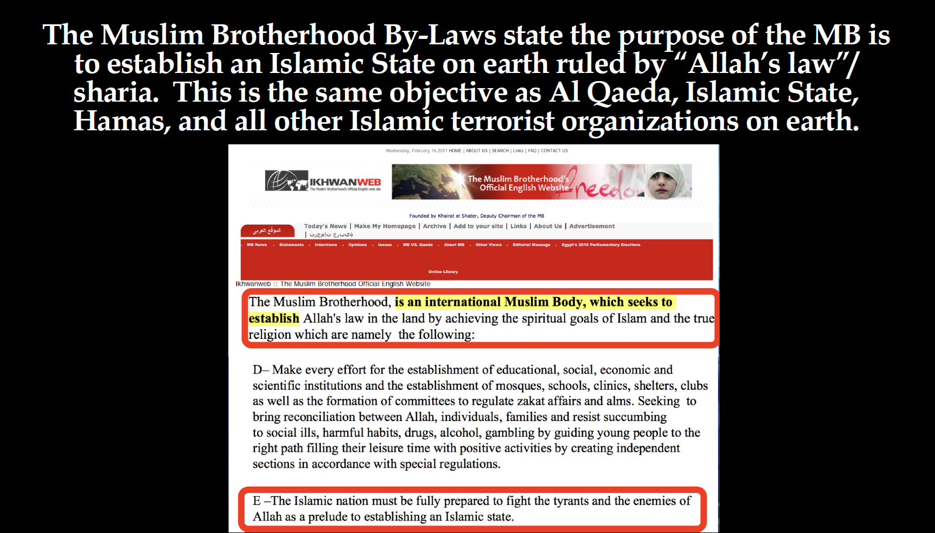

Slide 3
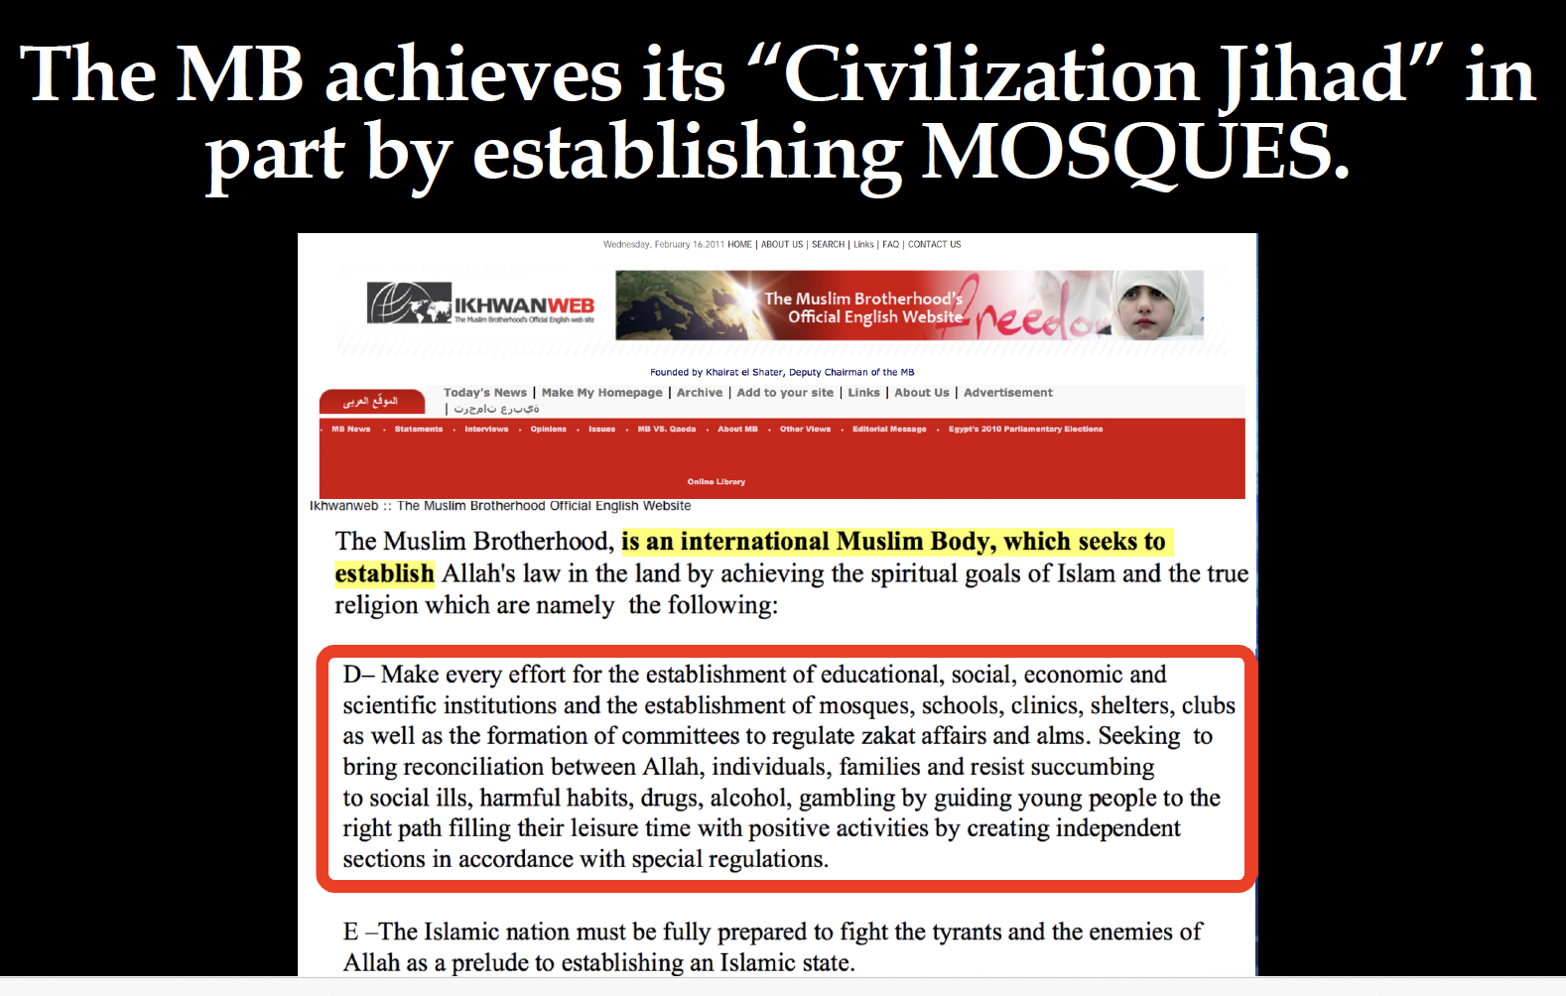
The Islamic Society of Tulsa is a Muslim Brotherhood masjid/mosque.

Slide 4
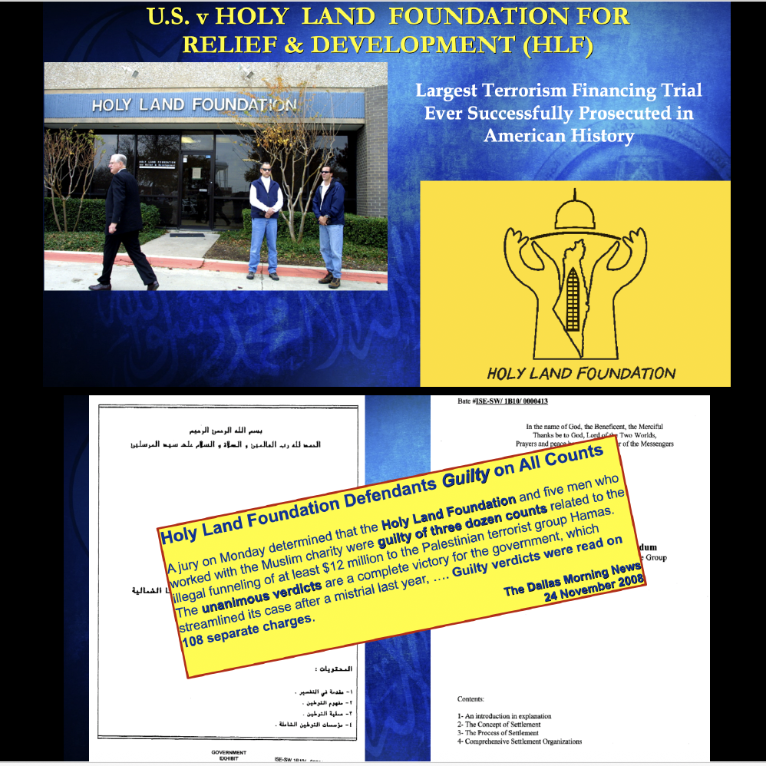
The United States v Holy Land Foundation for Relief & Development (“HLF”) was the largest terrorism trial ever successfully prosecuted in American history. Evidence in this case reveals ISNA (Islamic Society of North America) and NAIT (North American Islamic Trust) are Muslim Brotherhood organizations whose stated purpose is to wage jihad in America to establish an Islamic State under sharia (Islamic Law). The Islamic Society of Tulsa (OK) is owned by NAIT, a subsidiary of ISNA, and was founded by the first national Islamic organization founded by the U.S. Muslim Brotherhood - the Muslim Students Association.

Slide 5
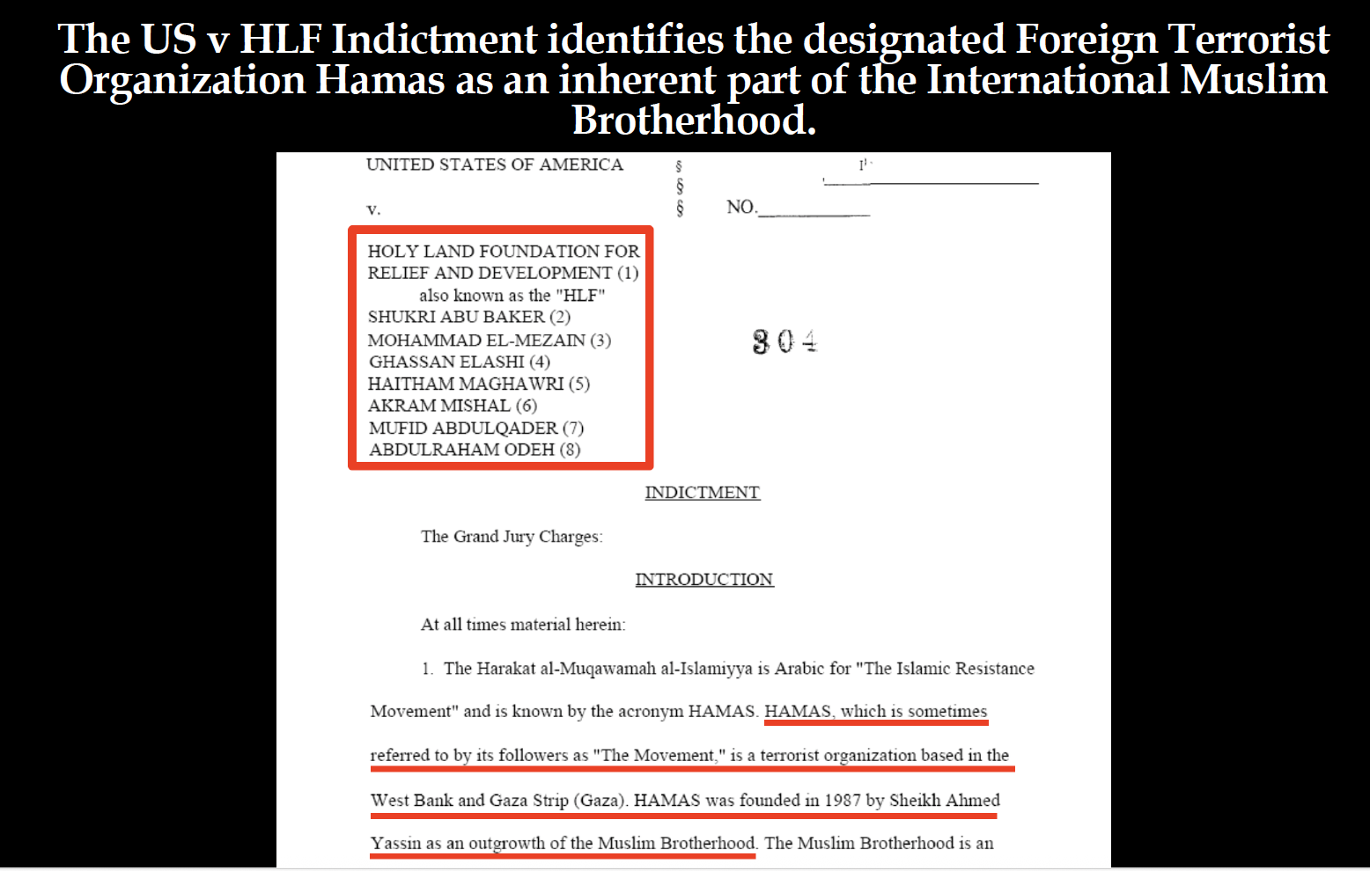

Slide 6
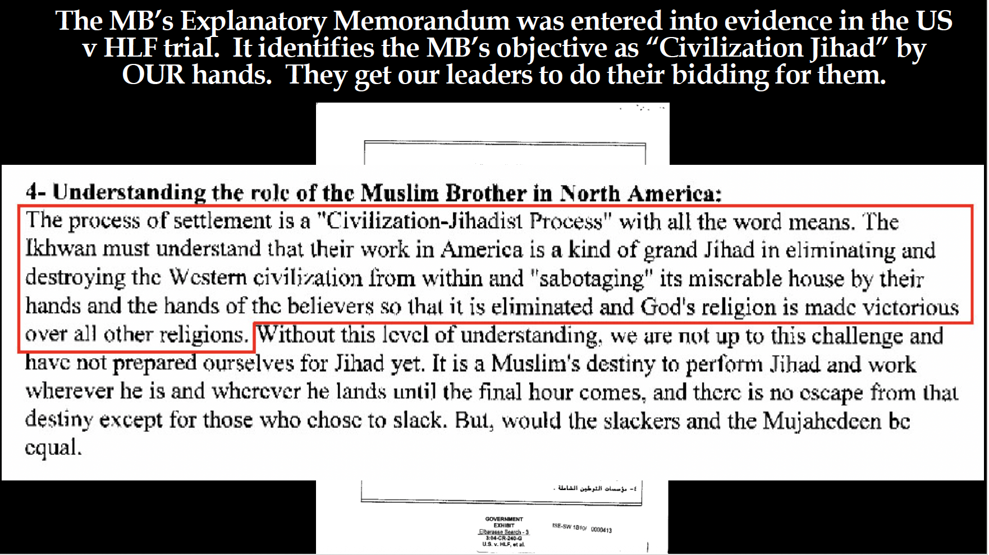

Slide 7
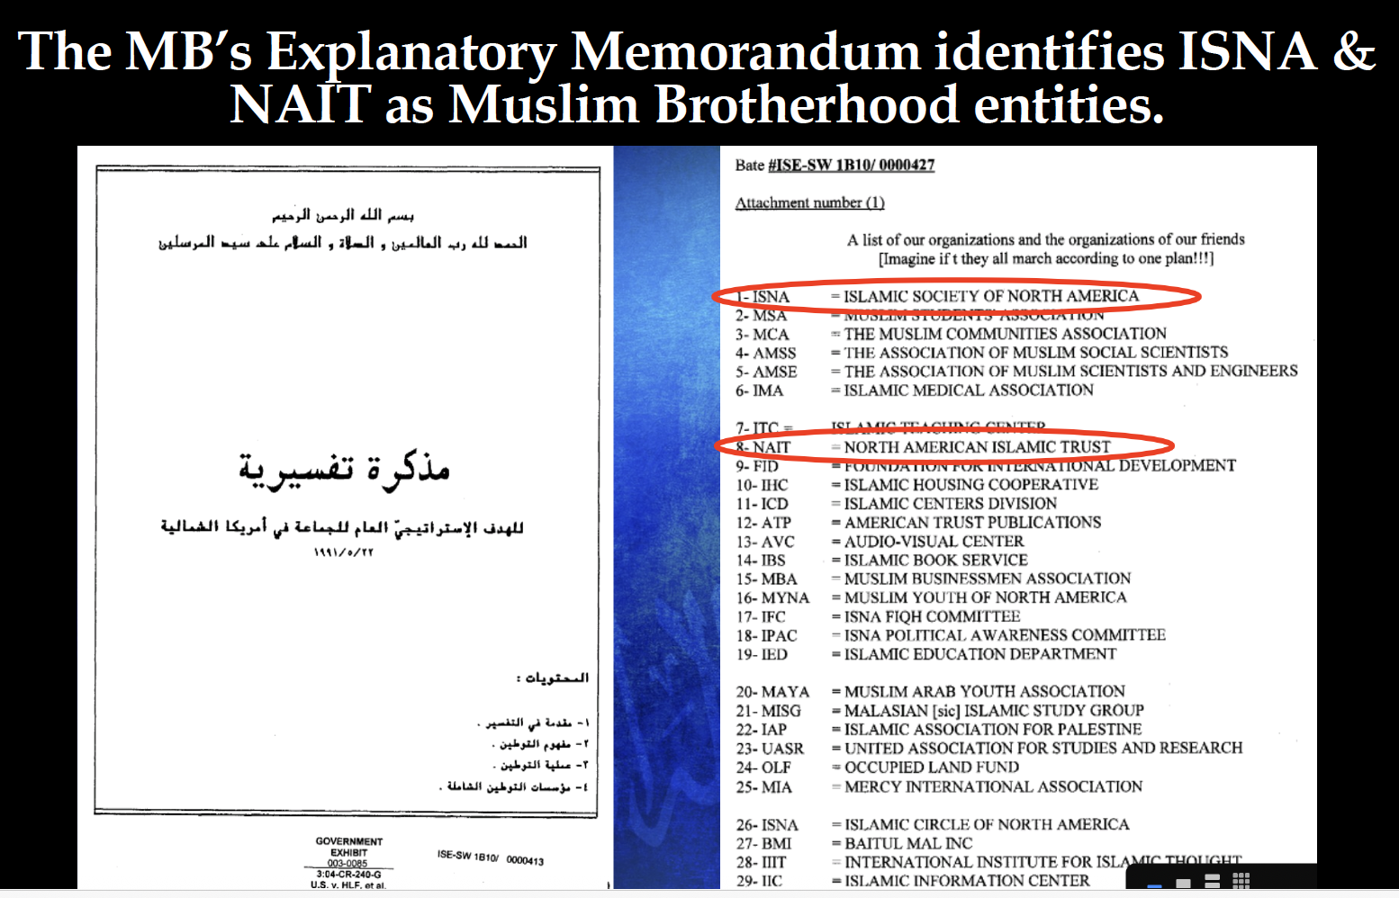

Slide 8
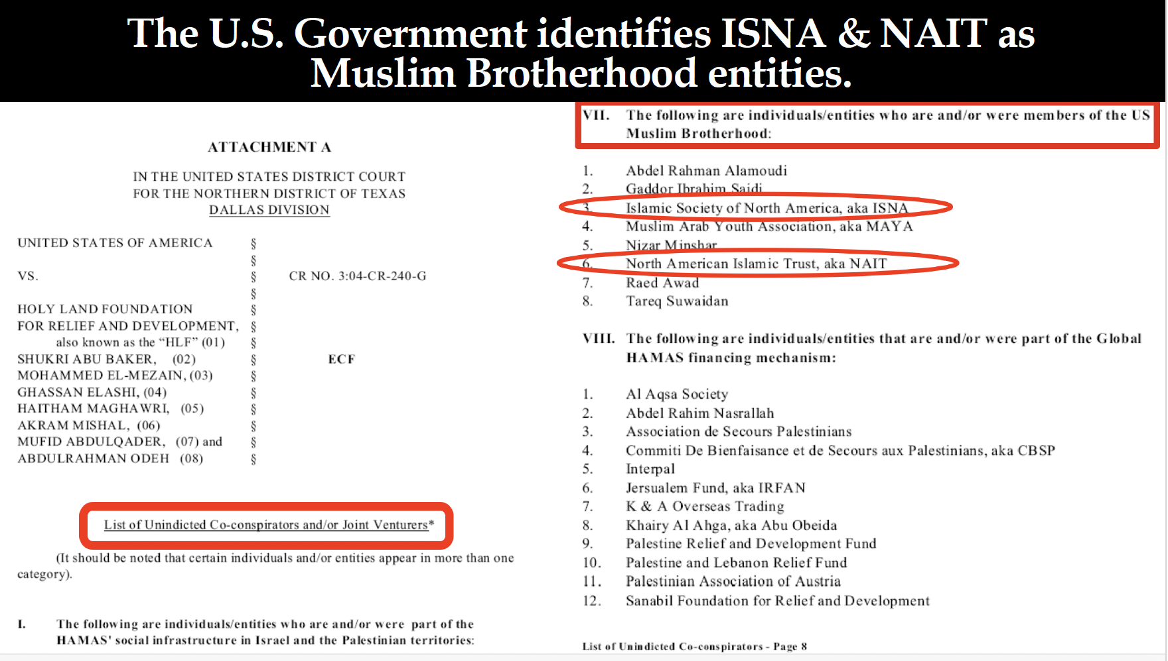

Slide 9
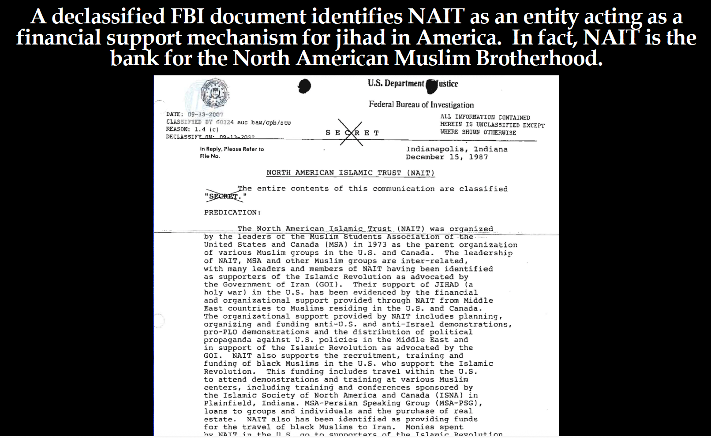

Slide 10
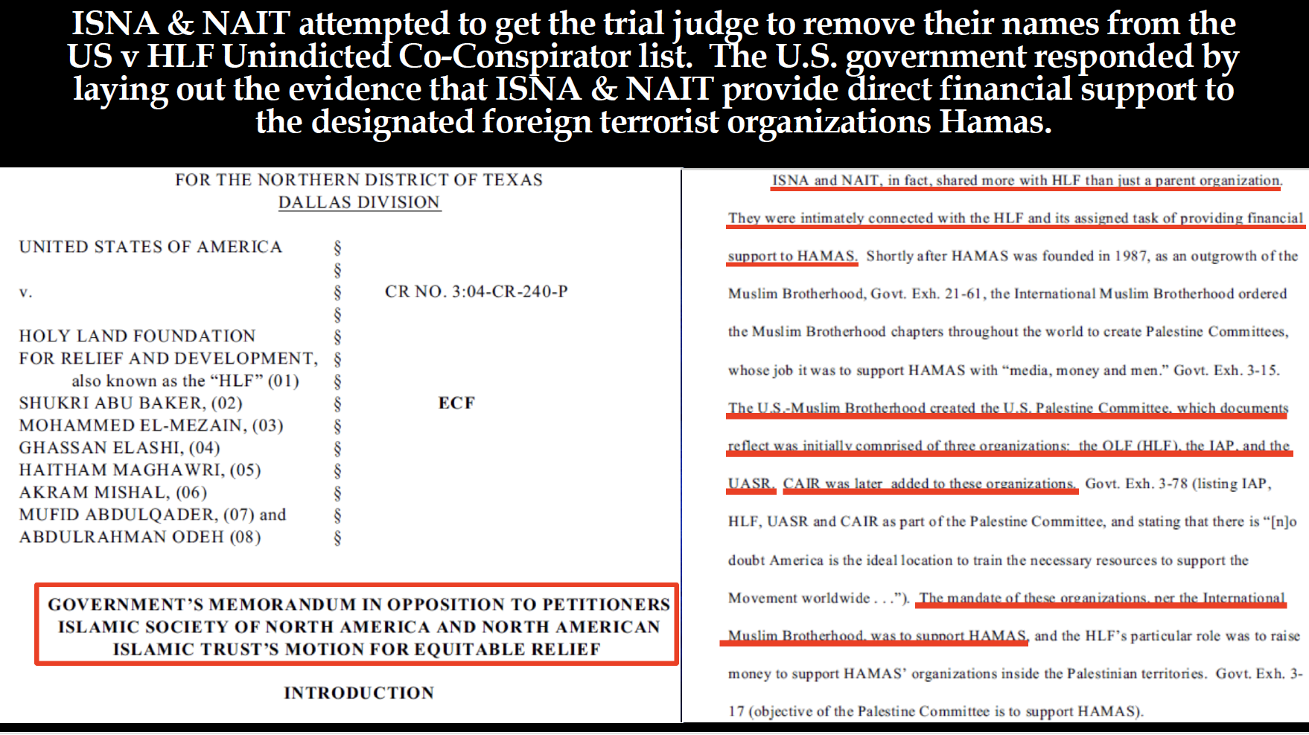

Slide 11
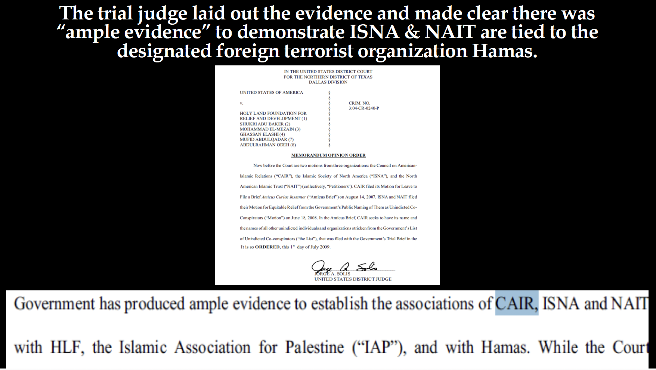

Slide 12
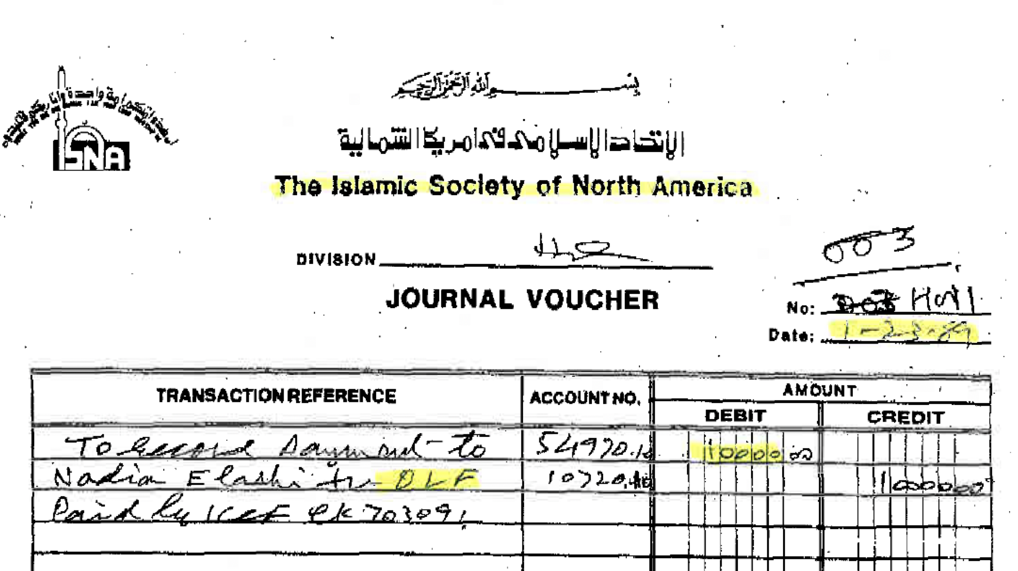
Money from ISNA’s Bank Accounts were sent directly to Hamas leaders and organizations overseas

Slide 13
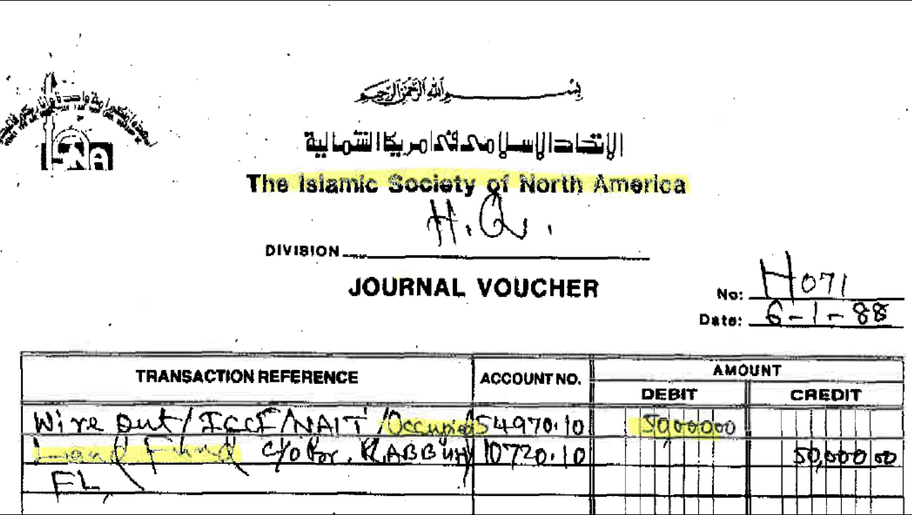

Slide 14
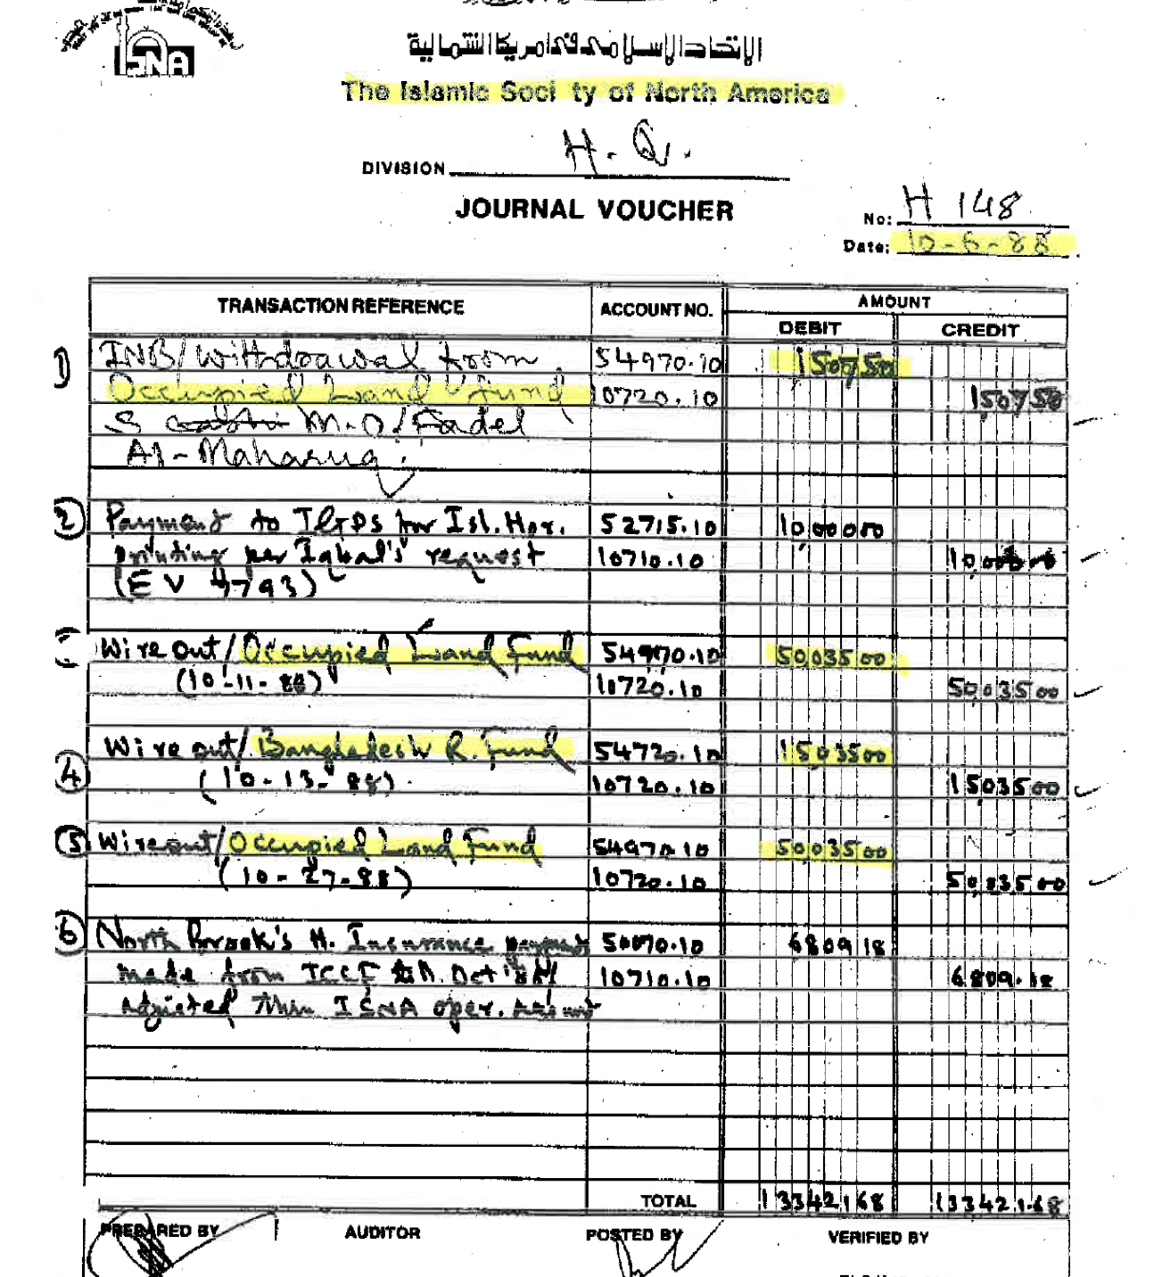
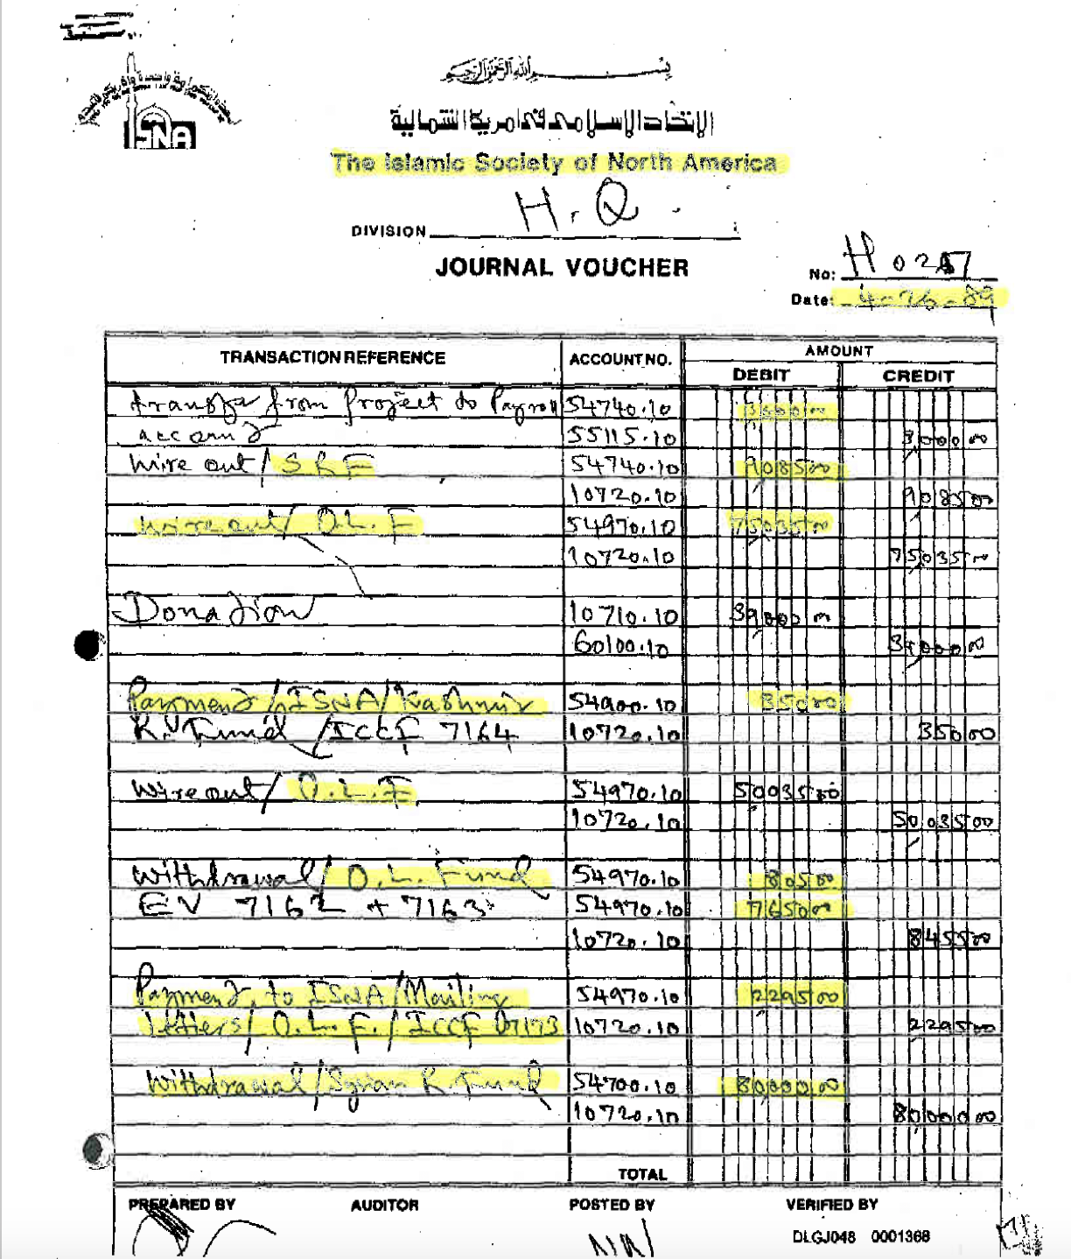
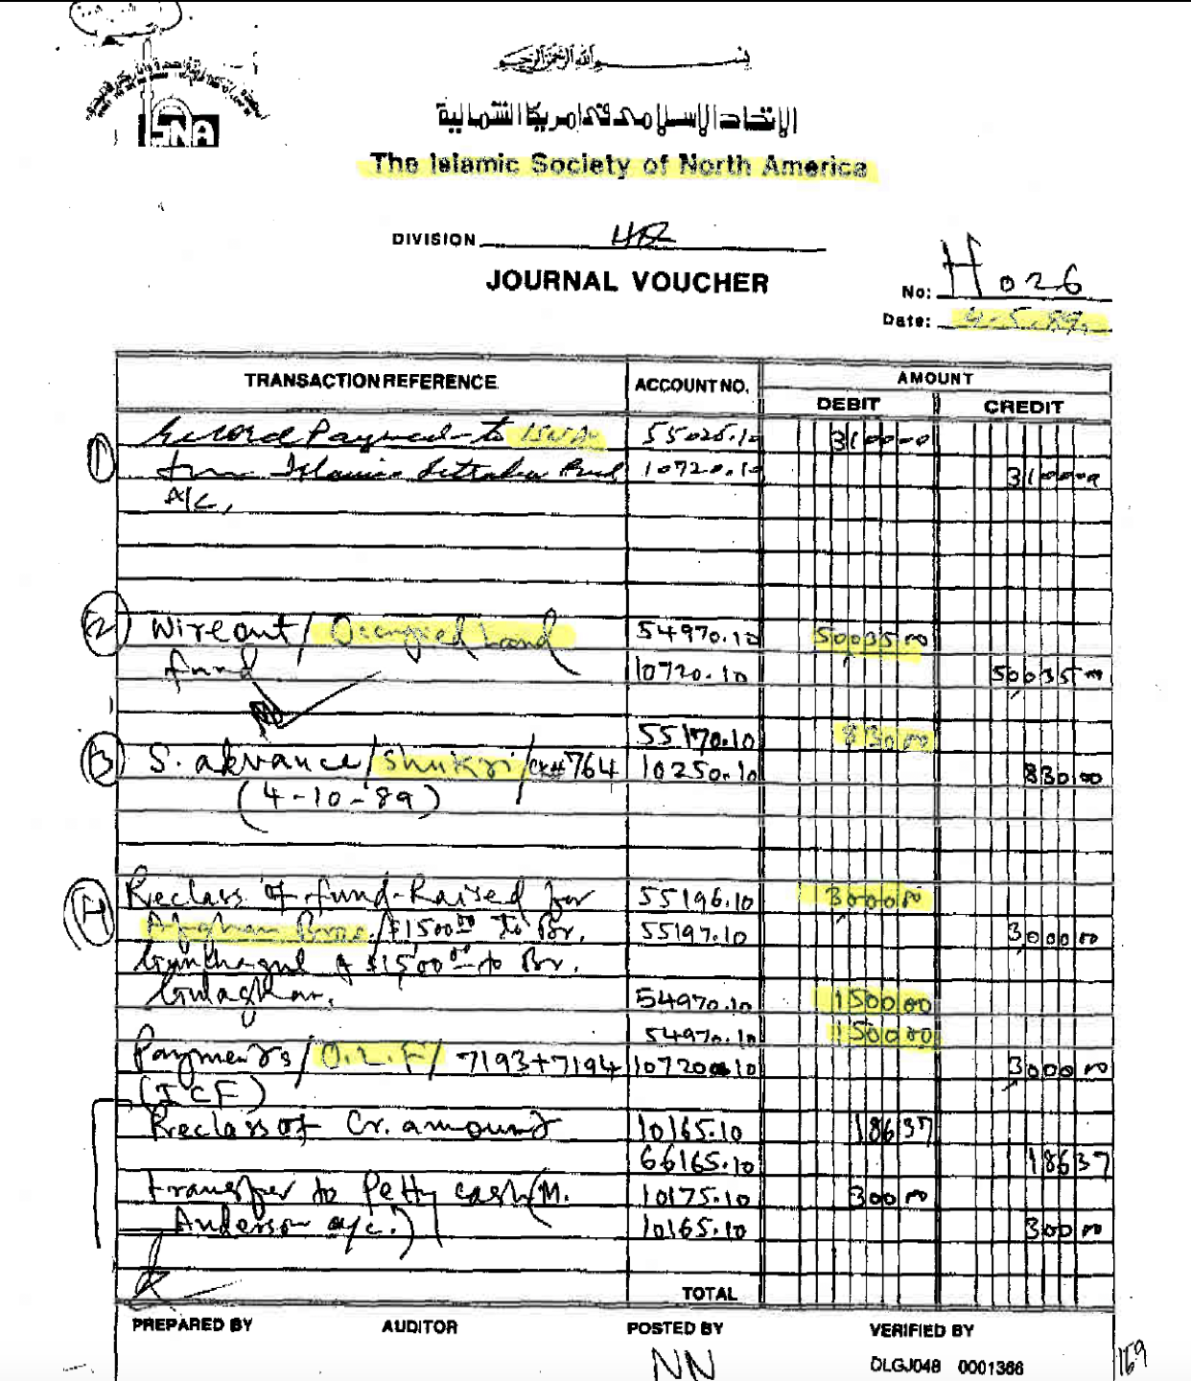

Slide 15
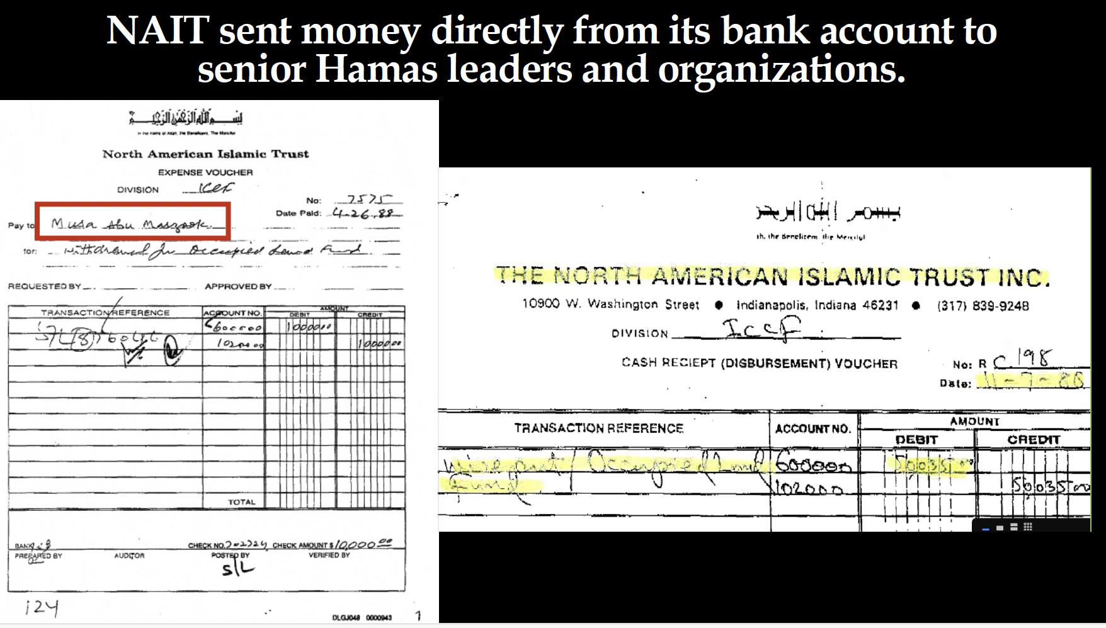

Slide 16

https://istulsa.org/home

Slide 17
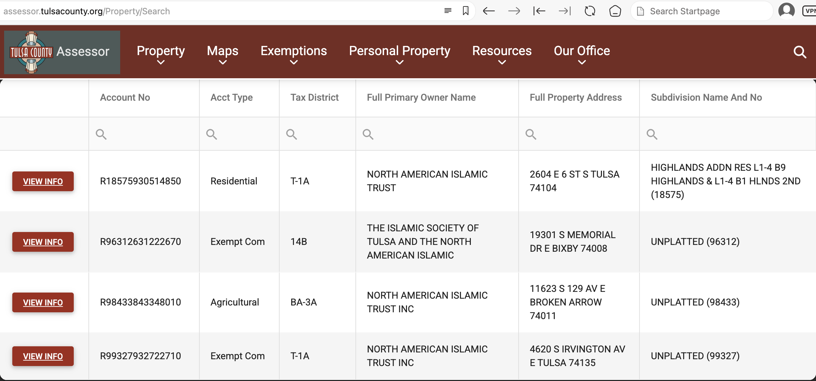
Property records for Tulsa County Oklahoma reveal the Islamic Society of Tulsa is owned by NAIT.

Slide 18
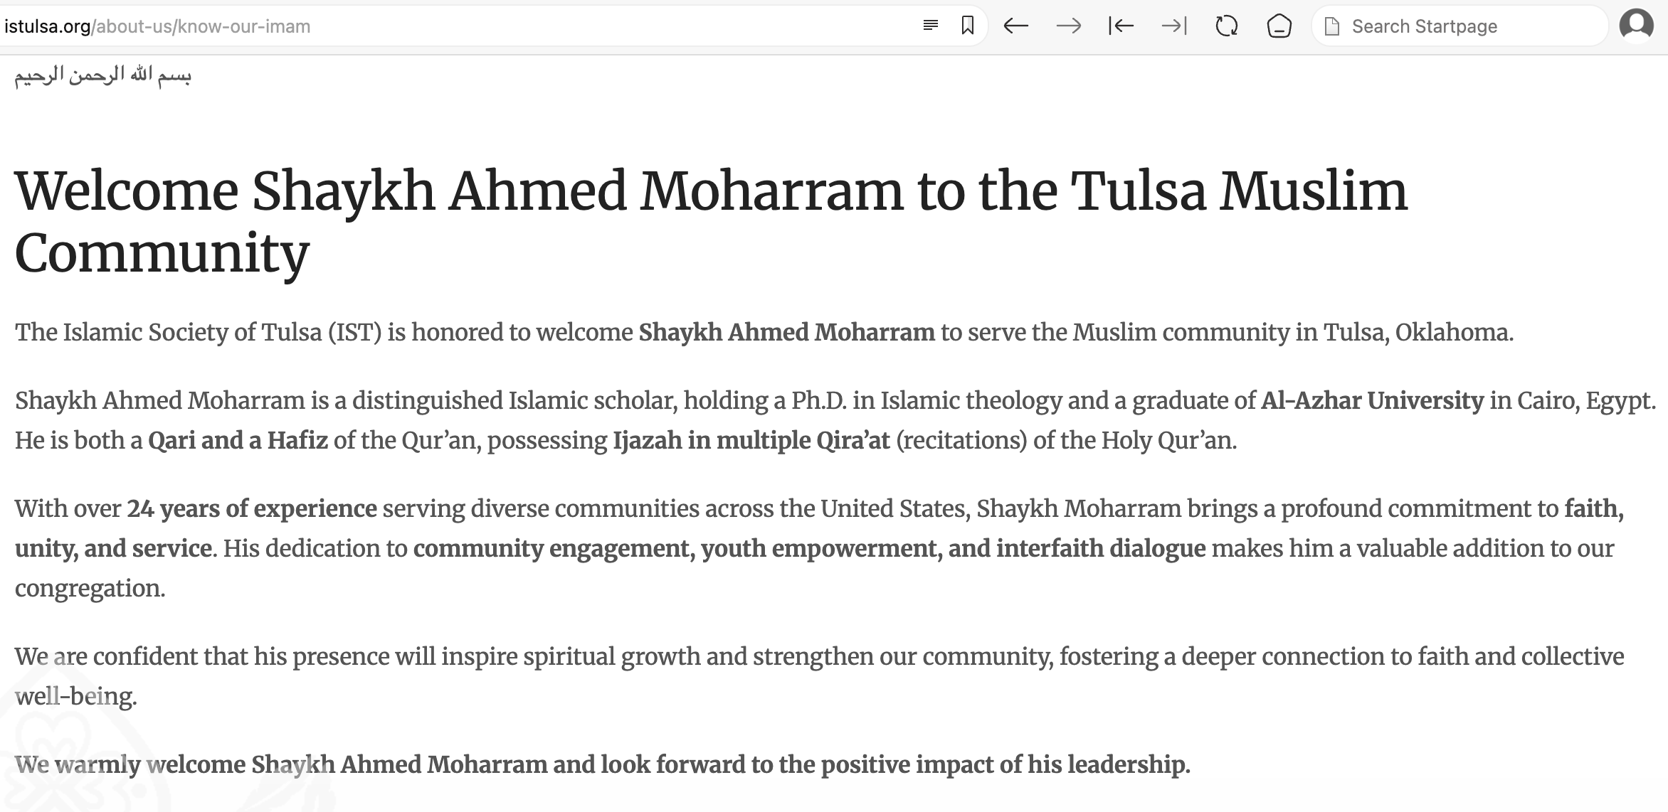
The Imam of the IST is a “distinguished Islamic scholar” and graduate of Al Azhar University in Egypt - the most prestigious and oldest school of Sunni Islamic Jurisprudence on earth.

Slide 19
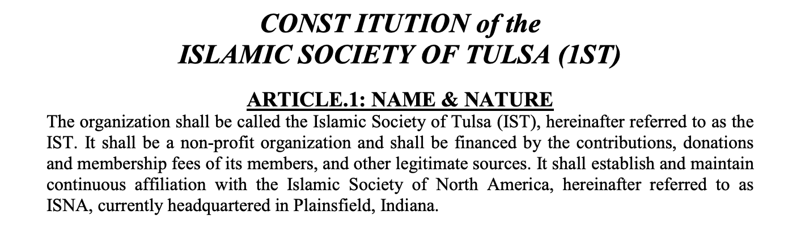
The Constitution for IST reveals it is a subsidiary of the Muslim Brotherhood & Hamas financing ISNA.
https://istulsa.org/public/istconstitution.pdf

Slide 20
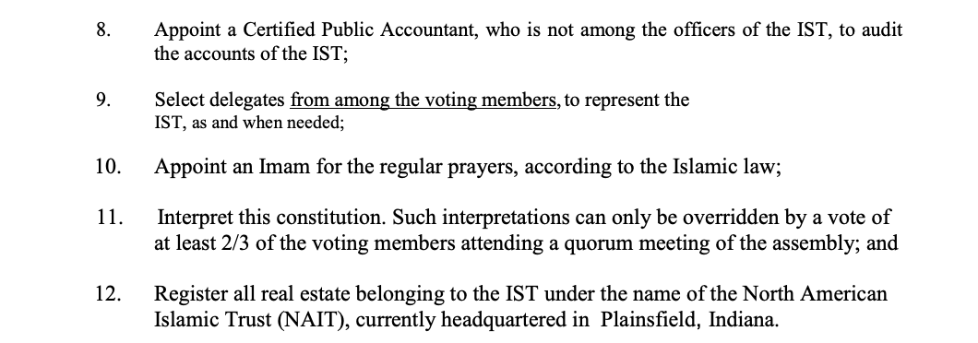
Page 4 Paragraph 12 of the IST Constitution reveals all property associated with IST is held as interests of NAIT - the bank for the Muslim Brotherhood in North America which funds the terrorist group Hamas.

Slide 21
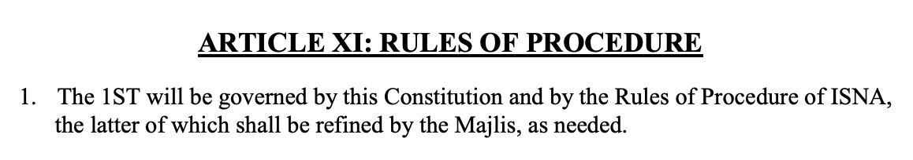
Article X of the IST Constitution reiterates it is controlled by ISNA.

Slide 22
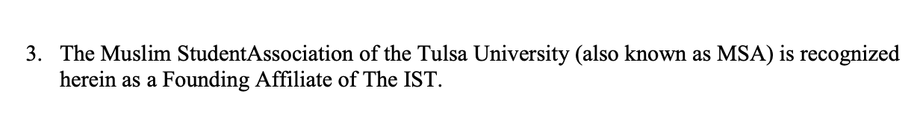
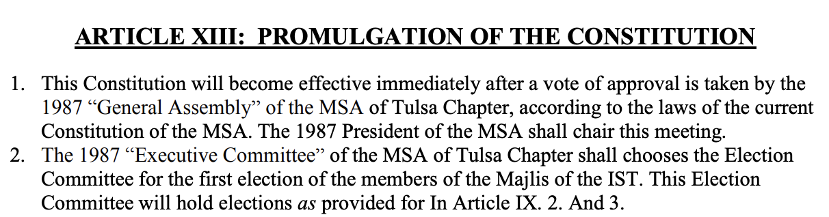
The IST Constitution reveals it was founded with the Muslim Students Association, which is the first national Islamic organization created in America & created by the U.S. Muslim Brotherhood.

Slide 23
The Islamic Society of Tulsa is, as a matter of fact and evidence, a hostile organization which seeks and advocates for the overthrow of the Oklahoma state government and constitution, materially supports terrorism, and conspires with hundreds of other Muslim Brotherhood organizations in Oklahoma to do the same. Any individual whose duties include security of the people of Oklahoma who has sworn an Oath to the U.S. Constitution to “protect and defend” has a legal duty to know all enemies and ensure these hostile Movements and organizations are vanquished. Failure to do so constitutes malfeasance and unprofessional conduct.
For more information you may use www.JohnGuandolo.com as a resource. Citizens are encouraged to bring the INTO ACTION training to their county to deal with these threats at the local level since state and federal officials continue to fail to do so.

