Slide 1
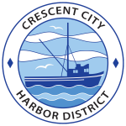
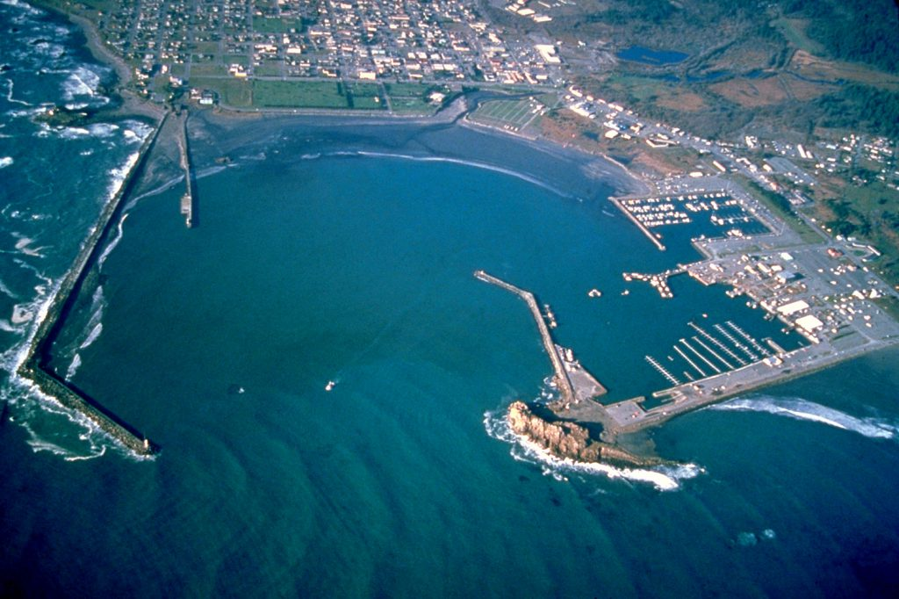
DRAFT
SEAWALL AND CITIZENS’ DOCK
Harbor Commission Meeting
March 15, 2024

Slide 2
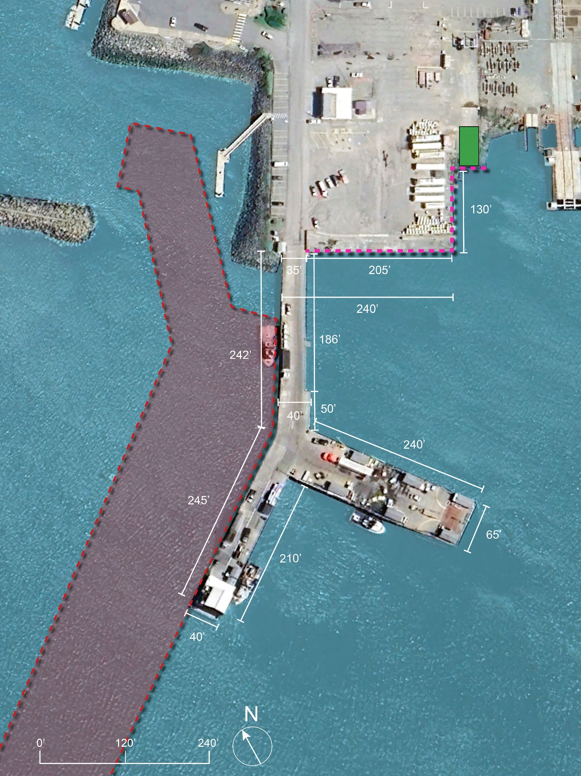
EXISTING
*1,270’ of berth space along dock 205’ of berth space along seawall
34,600 SF of over-water coverage
639 Existing piles, 1380 sf
LEGEND
Federal Navigation Channel Boundary Boat Ramp
Seawall*

Slide 3
Functional Criteria for Rebuilding Citizens Dock – Seawall
Main concerns / must have’s:
Maintaining operation during re-building of seawall and Citizens Dock
Flexibility to support multiple industries / generate additional revenue
Improving public access
Nice to have’s:
Improving commercial fishing:
having a public hoist (owned/maintained by District) preferably with a min capacity of 2 to 4 ton. Additionally
Making the pier 10 ft wider to have more space for semi-trucks to pass each other (Add line striping)
Additional power plugs for bait/fish freezers
Additional LED lighting on the citizens dock
Short-term haul out
Keeping fuel and ice building separate for the new Citizens Dock
Positives (current operation/configuration):
Quality of ice
Access to fuel (expanded operating hours / very accommodating)
Good amount of workable space for staging
Safe entrance
Room for improvement (w.r.t. current operation/configuration):
Harbor District managing ice
Harbor District managing fuel

Slide 4
California Coastal Conservancy Grant Funding Requirements
Resilience and adaptability to expected SLR, 100-year floods and 50-year tsunami.
Explore the feasibility of including habitat features.
The dock will include an ADA accessible pedestrian walkway, seating, lighting, informational signage, and educational and community opportunities. The new public access will connect to the coastal trail.
Include a wide variety of voices in the design visioning so that fishing, tourism, local residential use, conservation, historic considerations, education, and other elements are all part of these conversations considered in the final design.

Slide 5
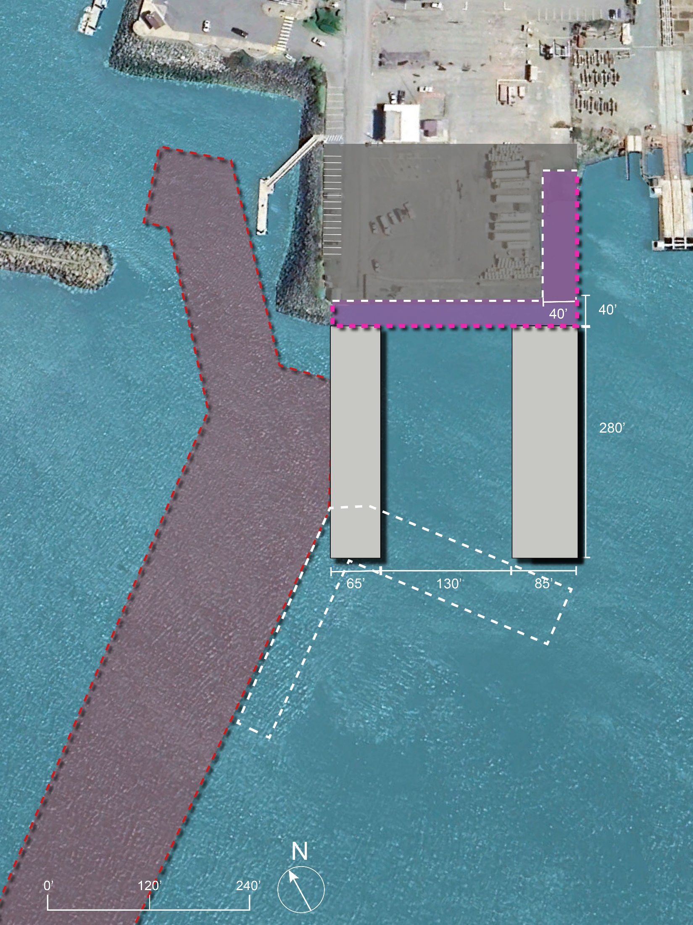
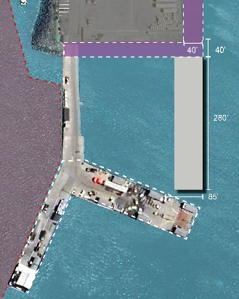
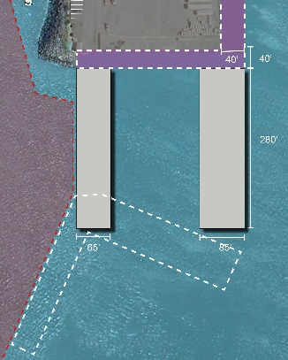
Construction Sequence
1
Landside improvements not shown on these diagrams
Phase 1: Summer 1
2
Phase 2: Summer 2
Alternative 1
*1,270’ of berth space along dock 130’ of berth space along seawall
42,000 sf of over-water coverage
16,400 sf of benthic fill
16,880 sf of benthic fill with piles
LEGEND
Federal Navigation Channel Boundary New Pier
Apron
Pier Demolition

Slide 6
Construction Sequence
1
Landside improvements not shown on these diagrams
Phase 1: Summer 1
2
Phase 2: Summer 2
Alternative 2
*917’ of berth space along dock 200’ of berth space along seawall
35,200 sf of over-water coverage
16,400 sf of benthic fill
16,824 sf of benthic fill with piles
LEGEND
Federal Navigation Channel Boundary New Pier
Apron
Pier Demolition

Slide 7
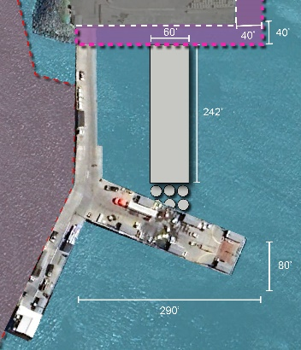
Construction Sequence
1
Landside improvements not shown on these diagrams
Phase 1: Summer 1
2
Phase 2: Summer 2
Alternative 3
*1,290’ of berth space along dock 220’ of berth space along seawall
41,800 sf of over-water coverage
16,400 sf of benthic fill
16,921 sf of benthic fill with piles
LEGEND
Federal Navigation Channel Boundary New Pier
Apron
Pier Demolition

Slide 8
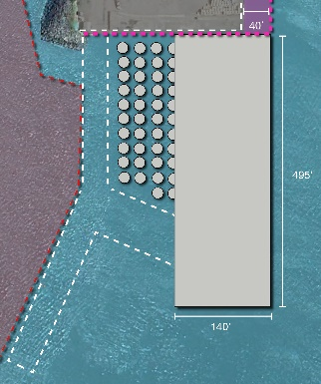
Construction Sequence
1
Landside improvements not shown on these diagrams
Phase 1: Summer 1
2
Phase 2: Summer 2
Alternative 4
*1,270’ of berth space along dock 0.0’ of berth space along seawall
138,600 sf of over-water coverage
5,920 sf of benthic fill
7,521 sf of benthic fill with piles
3
LEGEND
Federal Navigation Channel Boundary New Pier
Apron
Pier Demolition
Phase 3: Summer 3

Slide 9
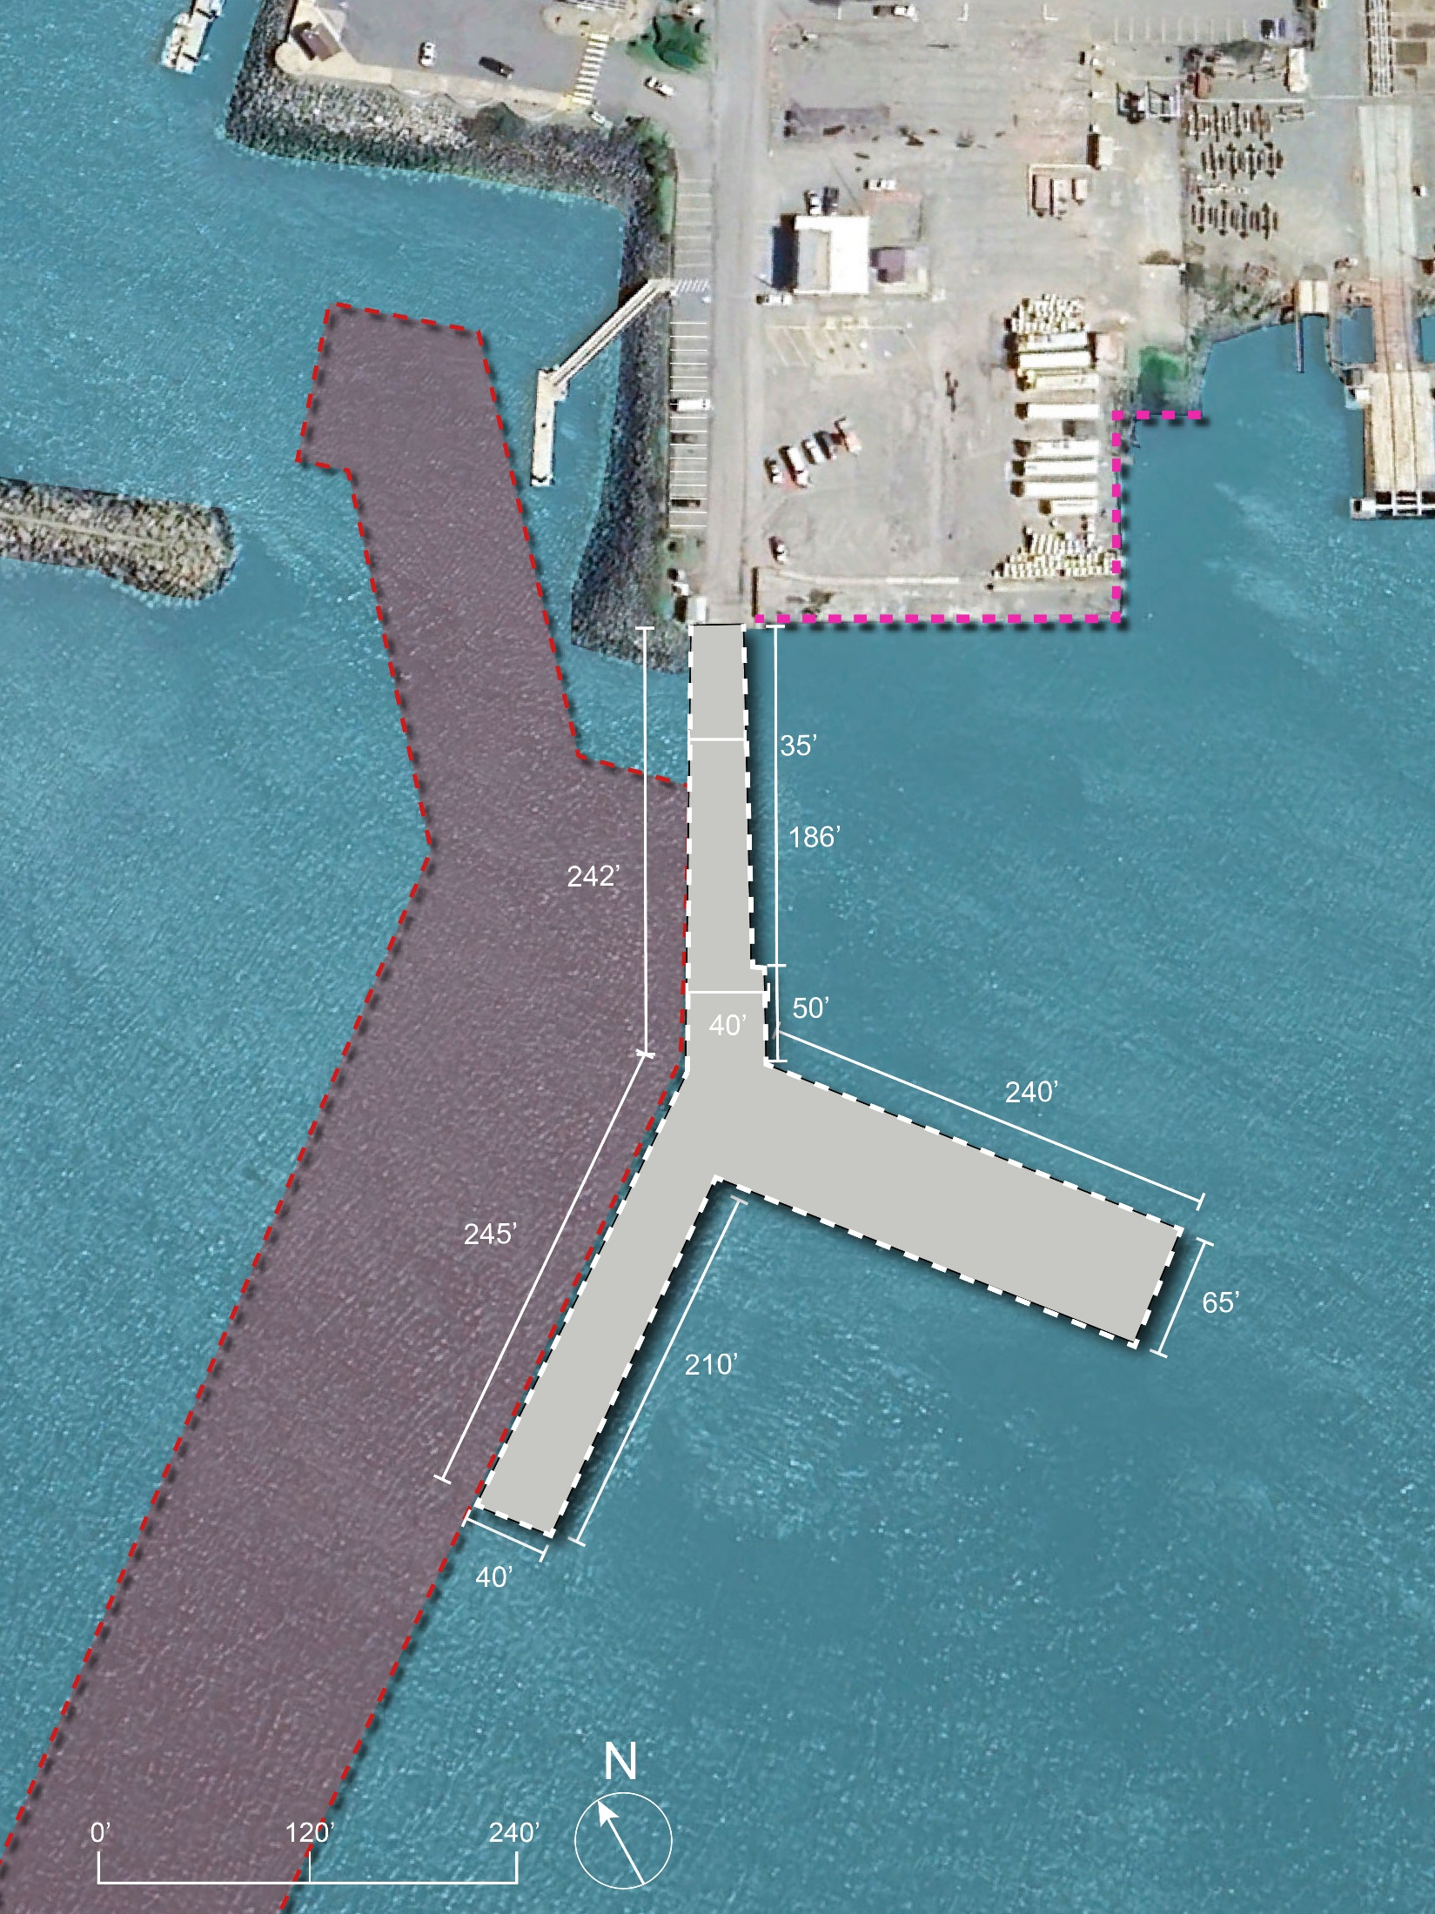
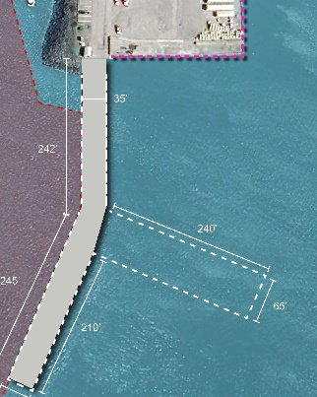
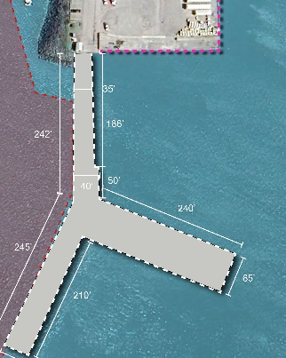
Construction Sequence
1
Phase 1: Summer 1
2
Phase 2: Summer 2
Alternative 5
*1,270’ of berth space along dock 205’ of berth space along seawall
34,600 sf of over-water coverage
1,110 sf of benthic fill
1,553 sf of benthic fill with piles
LEGEND
Federal Navigation Channel Boundary New Pier
Apron
Pier Demolition

Slide 10
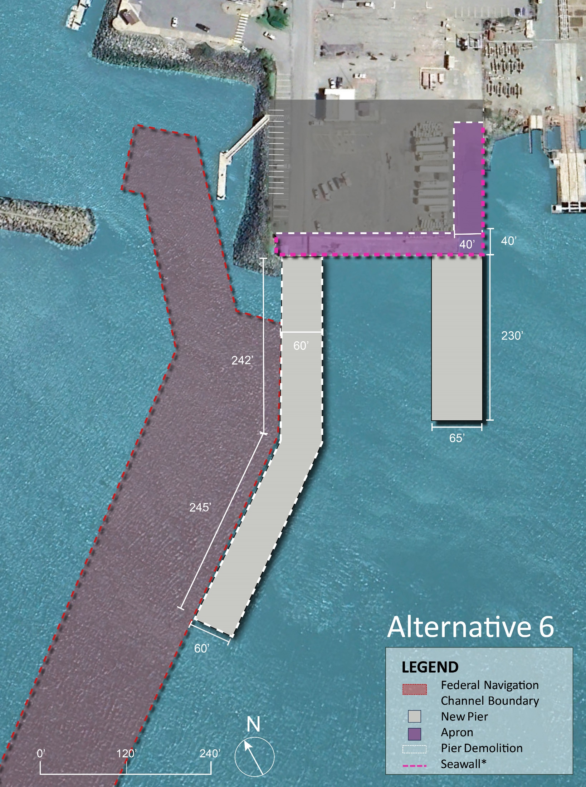

Slide 11
Selection Criteria for Alternative Analysis (1 of 2)*
Risk of Disruption to Commercial Fishing During Construction
Commercial fishing relies on having year-round access to a minimum berth space with functional hoists/ice house/fuel station. The demand for these facilities peaks during the start of the crab season (Nov-Jan). Longer construction schedule can also be a high risk. Construction activities limit access to the existing pier (less berthing space) Highest risk of disruption: the existing pier is demolished first before construction of a new pier starts. Lowest risk of disruption: a new pier with functional hoists/ice house/fuel station has been constructed before the existing pier is demolished.
Supporting Multiple Uses/Industries
Crescent City may be able to support other industries during off-season for commercial fishing and generate other revenue sources by having a multi-purpose dock. Having a wide/open upland area and having multiple piers provides the flexibility to support multiple uses/industries. Highest Flexibility: multiple piers with largest open upland area. Lowest Flexibility: single pier with smallest open upland area.
Construction Cost
Construction cost is approximately proportional to footprint of the new citizens dock. Highest Construction cost: new pier with highest footprint (square feet) for a given berth space in addition to expanding the landside by 40’. Lowest construction cost: new pier and seawall with same exact footprint or smallest footprint (square feet) for a given berth space.
Construction Risk
There are known challenges about pile driving in crescent city. More pile driving can trigger more risk. And in general, shorter construction schedule means lower risk. Highest Construction Risk: assuming a fast pace for construction and longer construction period. Lowest construction Risk: assuming a conversative pace for the construction.
Flexibility to Allow Potential Expansion in Future
Crescent City may be able to support other industries during off-season for commercial fishing and generate other revenue sources by having a multi-purpose dock. Having a wide/open upland area and having multiple piers provides the flexibility to support multiple uses/industries. Highest Flexibility: multiple piers with largest open upland area. Lowest Flexibility: single pier with smallest open upland area.
*General Note: All alternatives were developed to
provide an optimized harbor operation involving a balance of areas devoted to upland staging and circulation, pier operating area and berthing space, and vessel maneuvering
provide flexibility to accommodate both current commercial fishing industry needs and potential expansion for new opportunities that may arise

Slide 12
Selection Criteria for Alternative Analysis (2 of 2)*
Maintenance Dredging Needs
The existing federal navigation channel (FNC) runs along the trestle and west side of the west wharf. US Army Corps of Engineers performs regular monitoring and maintenance of existing federal navigation channel to the authorized dredge depth. Aligning the new pier in a way to maximize use of FNC will reduce the dredge burden on Harbor District. Highest Need for dredging: a new pier that does not run along the existing federal navigation channel. Lowest need for dredging: a new pier that runs along the existing federal navigation channel.
Environmental Mitigation Cost
Increasing overwater coverage of the new (pile supported) pier compared to the existing pier in addition to permanent fill of benthic habitat for expansion of upland area will likely require environmental mitigation. Mitigation needs to be identified and included in CEQA (The California Environmental Quality Act). Highest Environmental Mitigation Cost: a new pier with largest footprint and 40’ of seaward expansion for the upland areas by permanent fill of benthic habitat. Lowest Environmental Mitigation Cost: a new pier and seawall with same exact footprint as that of existing (no upland expansion).
Improve Fishing Operation
Wider (than 65-ft) pier will provide a better circulation/truck passing space for the commercial fishing operation. Multiple entry points to the pier will eliminate the need for trucks for backing up to the pier. Highest Improvement: a new wider pier and multiple entries to the pier Lowest Improvement: a new pier with same width as existing and one entry point to the pier.
Minimizing Downtime (Sheltering from Southerly Wind Waves)
Locally-generated waves (wind waves) from south can result in excessive vessel motions and downtime for berthing especially for vessels berthing beam seas (the vessel is broadside to oncoming waves). Highest Improvement: Orienting the new pier such that vessels are head seas (waves are running directly against the course of the ship) Lowest Improvement: a new pier with same alignment as existing requiring beam seas berthing for some vessels
Improving public access to Citizens Dock
During peak of commercial crab season, it is not safe for public to access the dock given frequent passing of trucks, forklifts, and operation of hoists. Highest Improvement: having multiple and wider piers with largest open upland area will allow dedicating a space for public access Lowest Improvement: a new pier with single entry to the pier.
*General Note: All alternatives were developed to
provide an optimized harbor operation involving a balance of areas devoted to upland staging and circulation, pier operating area and berthing space, and vessel maneuvering
provide flexibility to accommodate both current commercial fishing industry needs and potential expansion for new opportunities that may arise

Slide 13
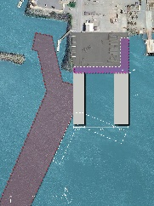
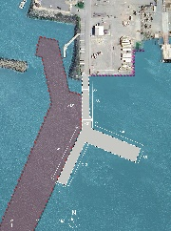
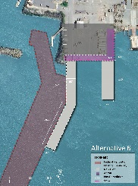
Criteria | Weight (1 to 5) | Alternatives
 |  | 1 | 2 | 3 | 4 | 5 | 6
Risk of Disruption to Commercial Fishing During Construction
Supporting Multiple Uses/Industries
Construction Cost
Construction Risk
Flexibility to Allow Potential Expansion in Future
Maintenance Dredge Needs
Environmental Mitigation Cost
Improve Fishing Operation
Enhancing Public Access to Citizens Dock
TOTAL
1
2
3
4
5
6

