Slide 1
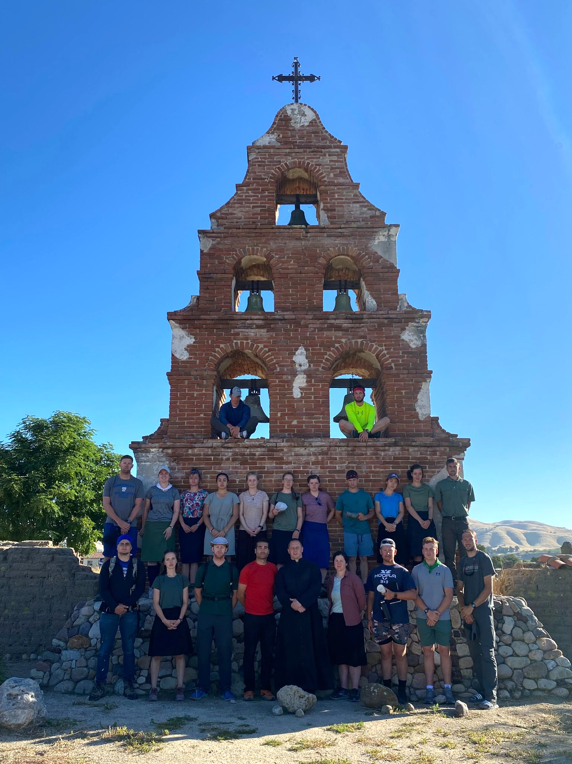
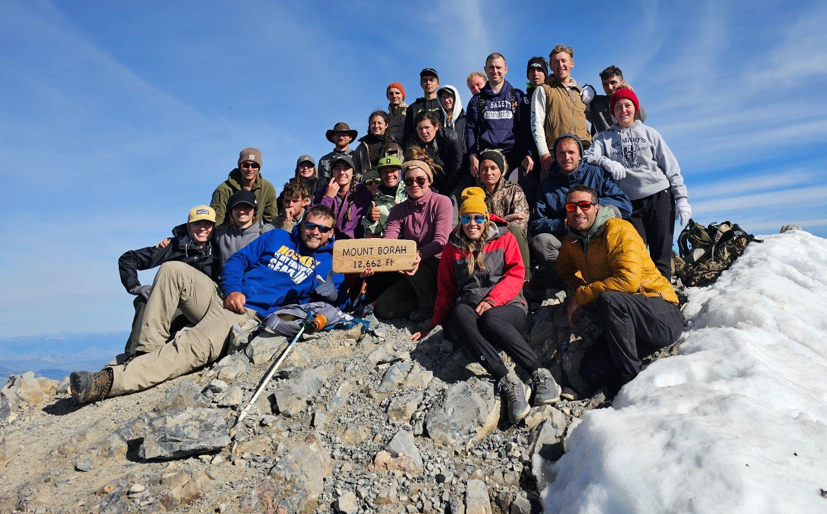
ADELANTE PILGRIMAGE

Slide 2
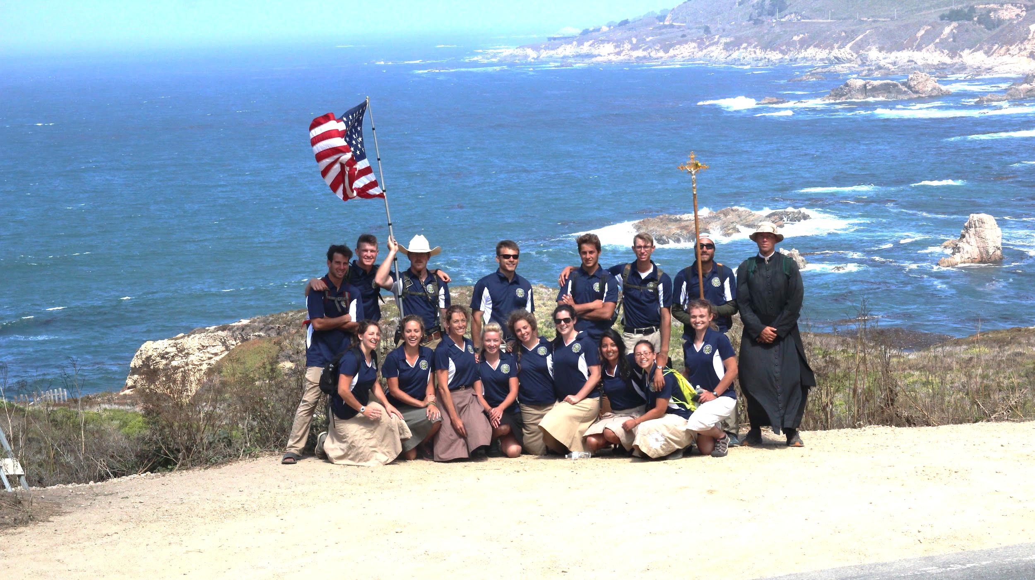
History…
2017 - California Pilgrimage led by Joe LaMothe and Fr. Gardner - over 250 miles in 2 weeks.
2018 & 2019 - California Recon years and the birth of the “California Missions Pilgrimage” Non Profit under the leadership of Andrew Latham. Fall of 2019 all set for the next summer debut of California Missions Pilgrimage in 2020 and then…..Covid – remember that?
2021 - Idaho Wilderness Expedition – trial run led by Albert and Joanna Darakjy with Fr. Gardner – Bruneau to Sawtooths to Mt. Borah, infamous “Campdemic” of 2021.
2022 - Adelante Pilgrimage Inc. becomes an official non profit 501(c)3 under leadership of Albert Darakjy. June of 2022 sees the Idaho Wilderness Expedition camp in snow, whitewater rafting, and the first summit of Mt. Borah, in addition to the birth of the Adelante mentorship program under the direction of Fr. Gardner.
2023 - Idaho Wilderness Expedition sees all but 2 participants summit Mt. Borah, addition of “LRC’s” and overnight backpacking in the Sawtooth wilderness, 1st draft of Adelante handbook from Father Gardner utilized with improvements to the follow-up mentorship program.
2024 - Back to California - Mission Challenge from Santa Barbara to Carmel, pilgrims and leadership team are awakened to the “missionary spirit” of Fr. Serra and its application to their own lives today. The first year of Adelante where all expenses for the respective year were covered by pilgrim registrations and donations.

Slide 3
Mission of Adelante
Mission Statement of Adelante Pilgrimage Inc
“A Catholic Apostolate that challenges young adults spiritually, mentally, and physically, by way of a pilgrimage walking the California Missions along the El Camino Real and an Idaho Wilderness Expedition; with follow up mentorship, for the purpose of forming leaders for our communities today.”
“Adelante, Siempre Adelante” Motto of Father Serra, our patron.

Slide 4
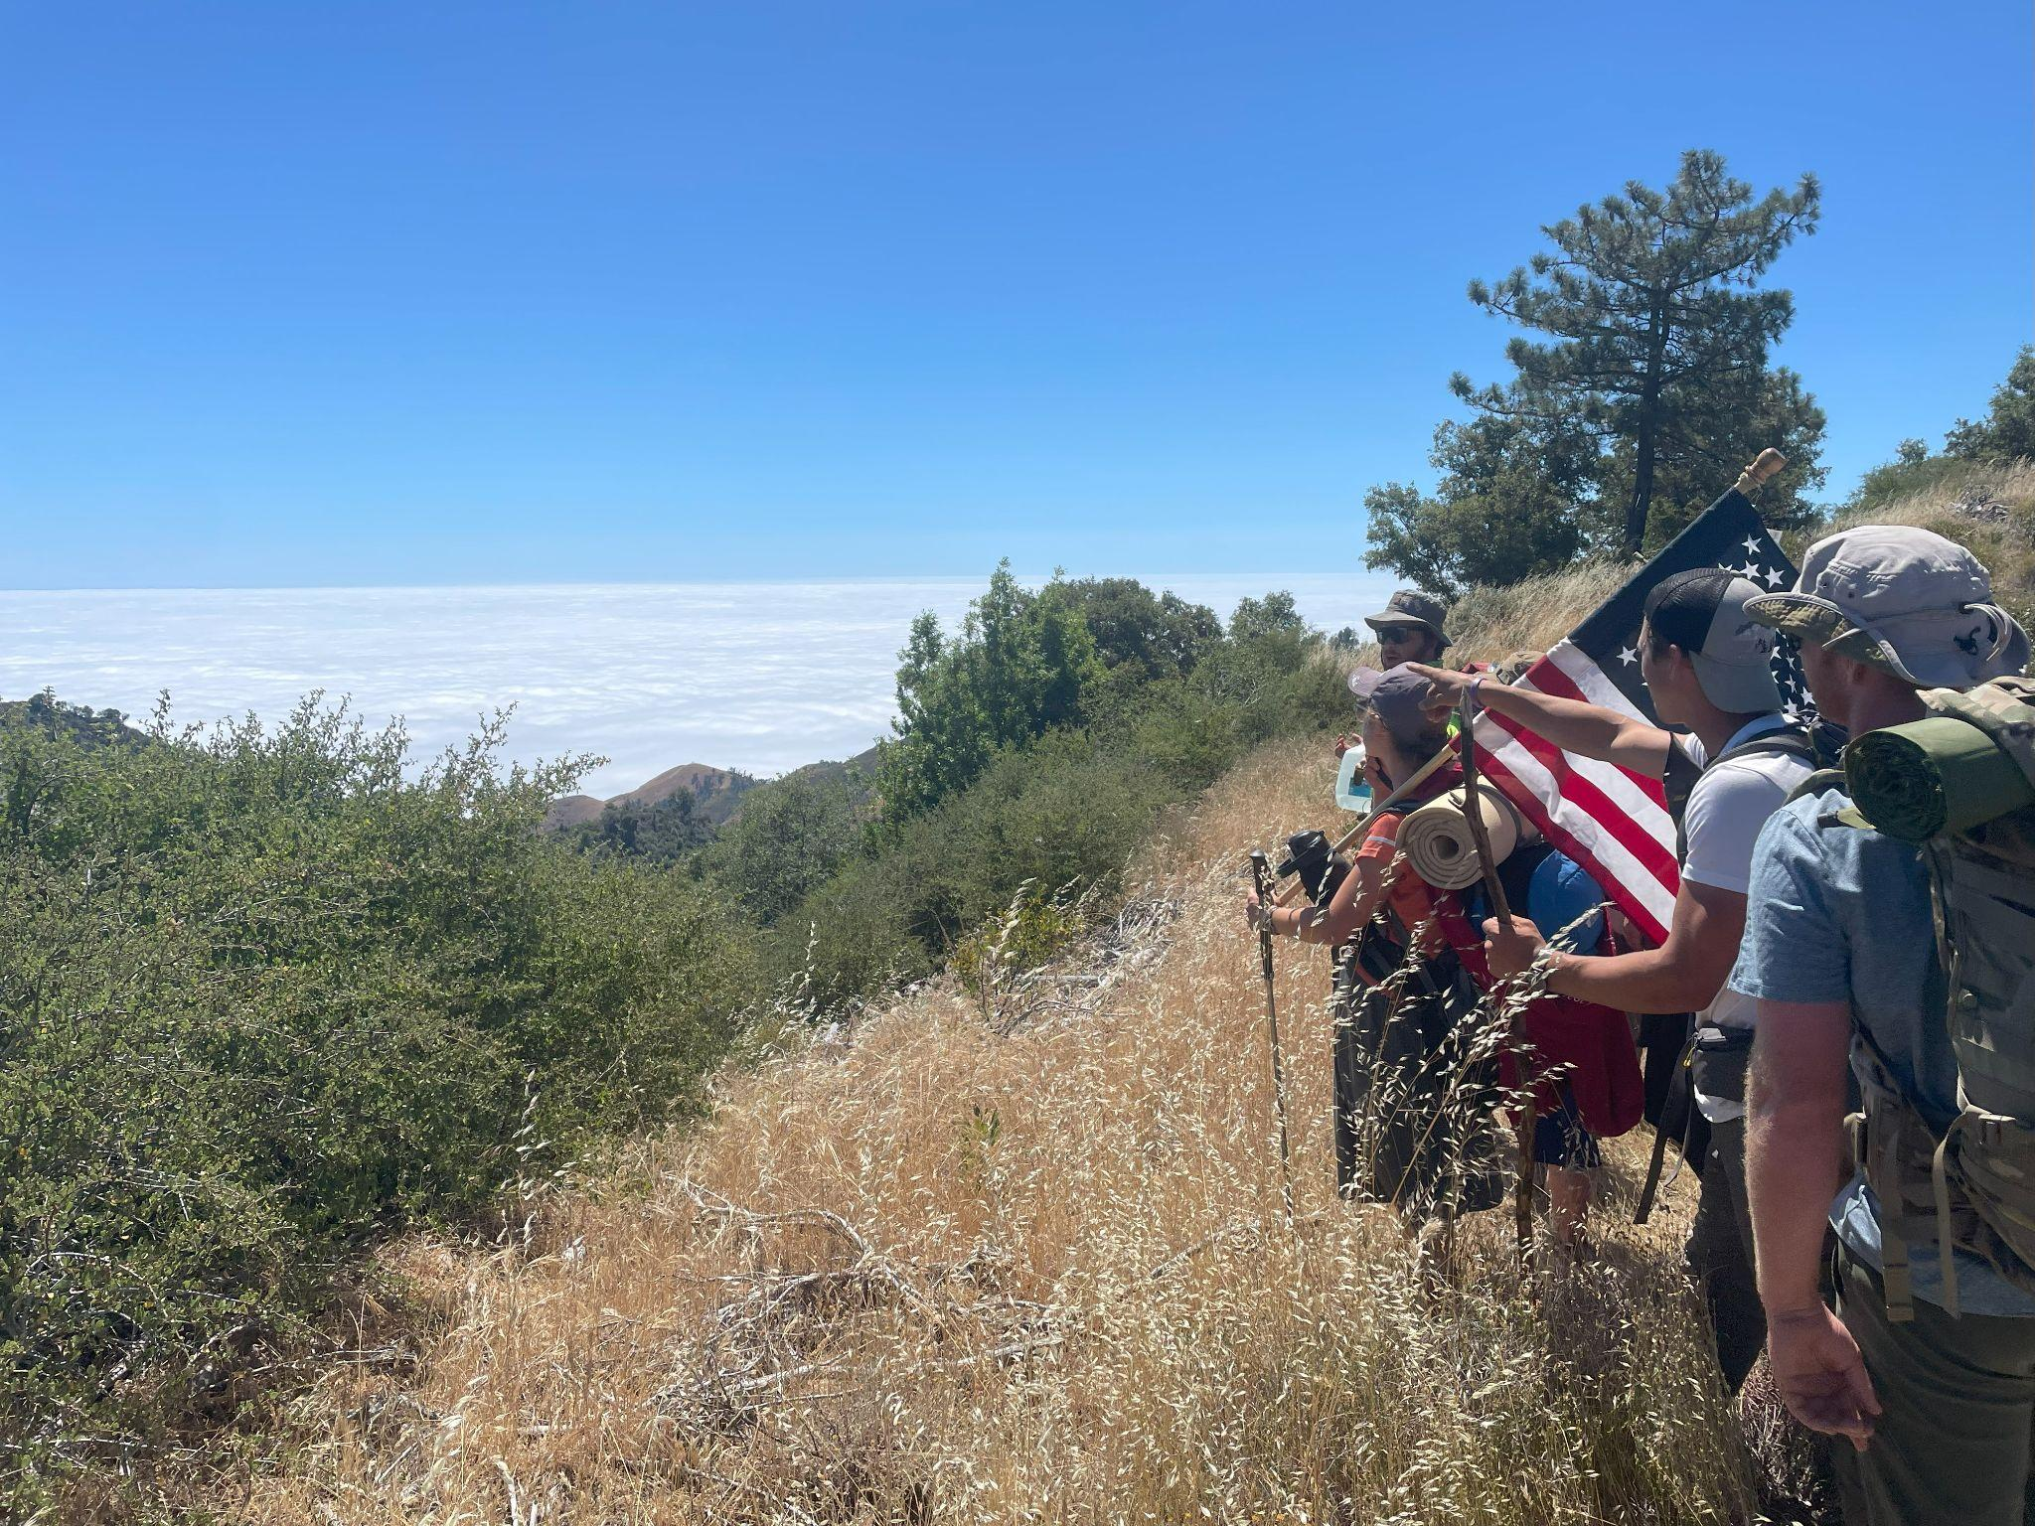
Importance of Adelante
Why we think Adelante Pilgrimage Inc is important
We see a need for leaders
To support our young adults who live in a most challenging time
Pleasure vs Preparation – what/who are young adults living for?
Technology use and misuse – a fine line
Critical time in a person’s life – decisions young adults make in their late teens and twenties will affect their whole life

Slide 5
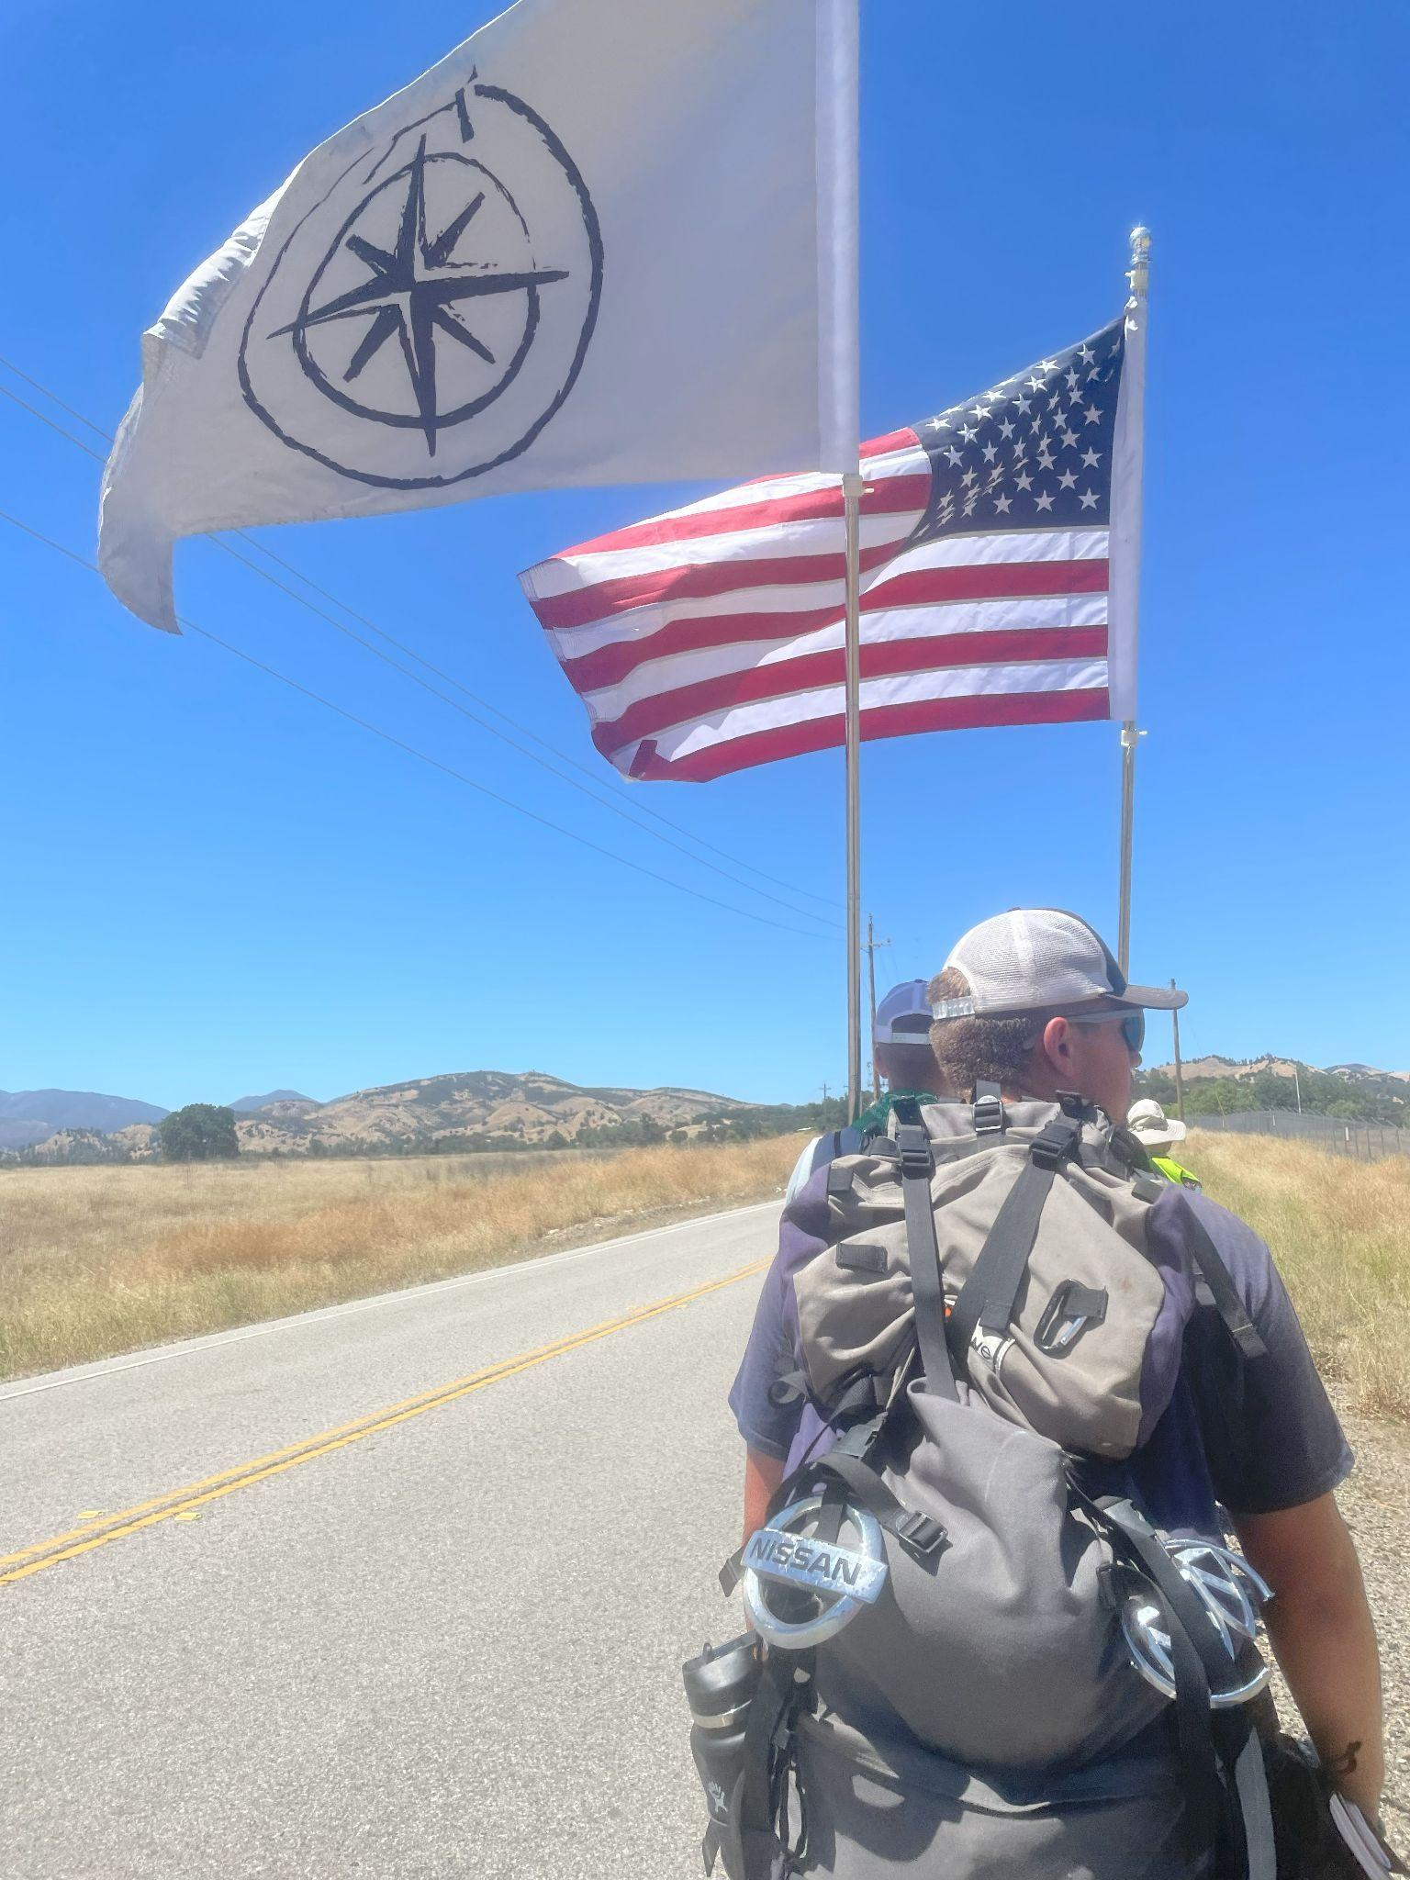
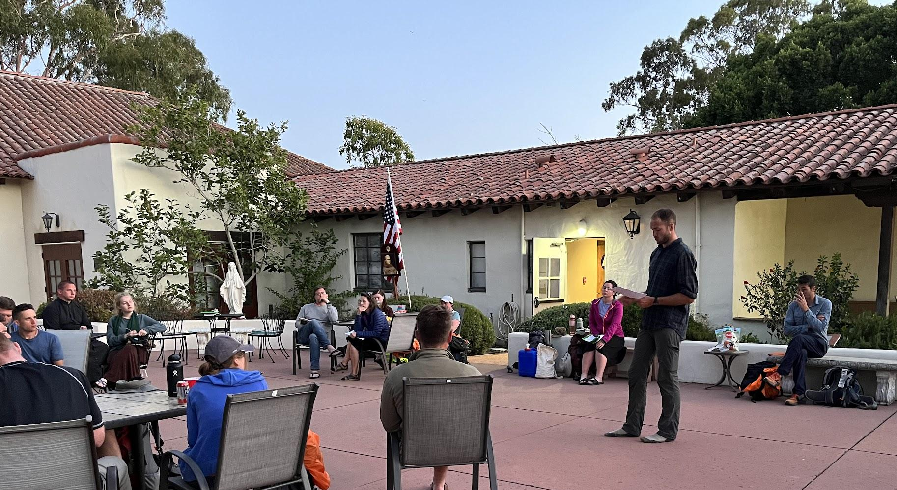
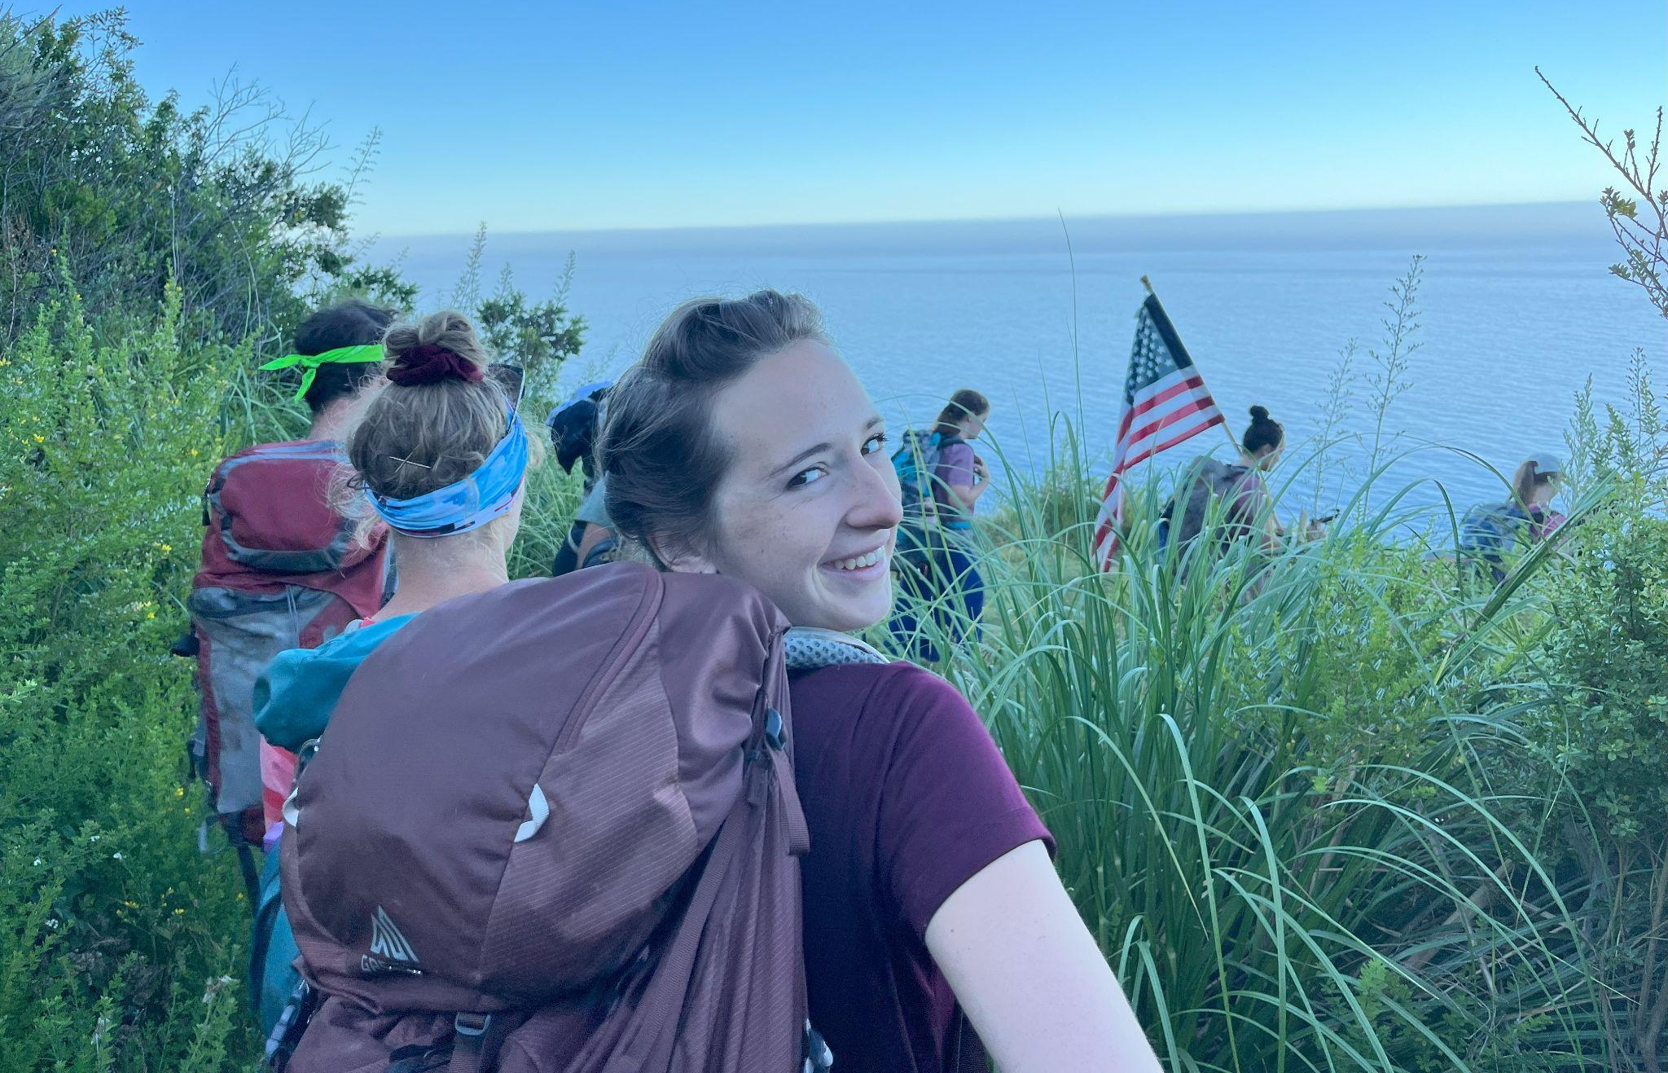
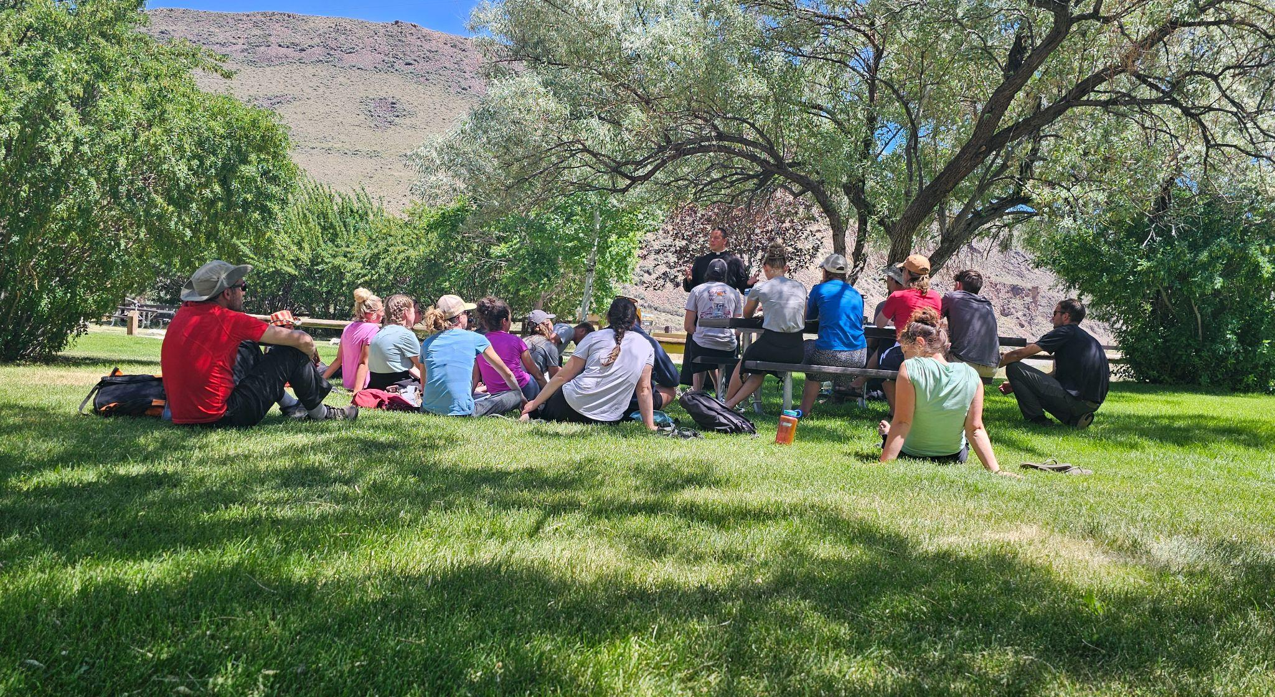
Idaho & California
Spiritual – Daily mass, Confessions, Mental Prayer, Spiritual Direction, Dante Purgatorio Meditations,
Mental – Self Assessments, “DGPA”, Campfire Discussions, Leadership exercises/opportunities, Action Tools
Physical – Demanding schedule, Backpacking, Mt Borah and Big Sur Climb

Slide 6
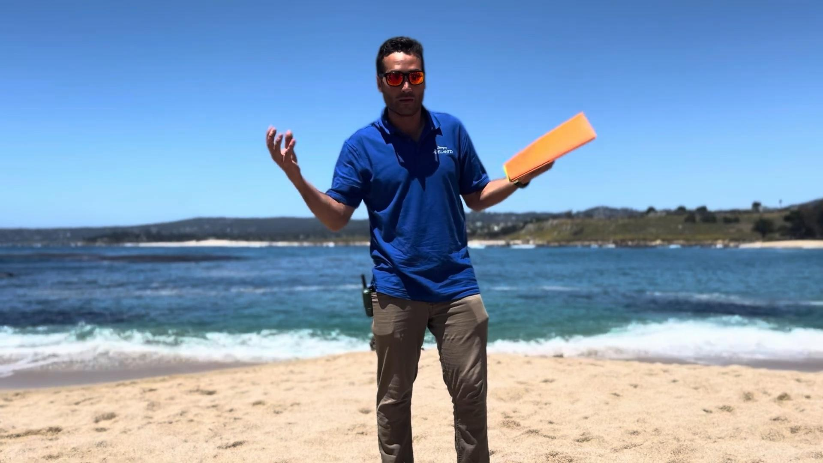
The Focus
Divine Comedy: Purgatorio Dante Alighieri
Extreme Ownership Jocko Willink
“Jonte” – Merging of Jocko and Dante for the purpose of self assessment and leadership.
Dreams. Goals. Plans. Action. “DGPA”
Action Tools
Mental Prayer
Study/Reading
Techfreedom
Other

Slide 7
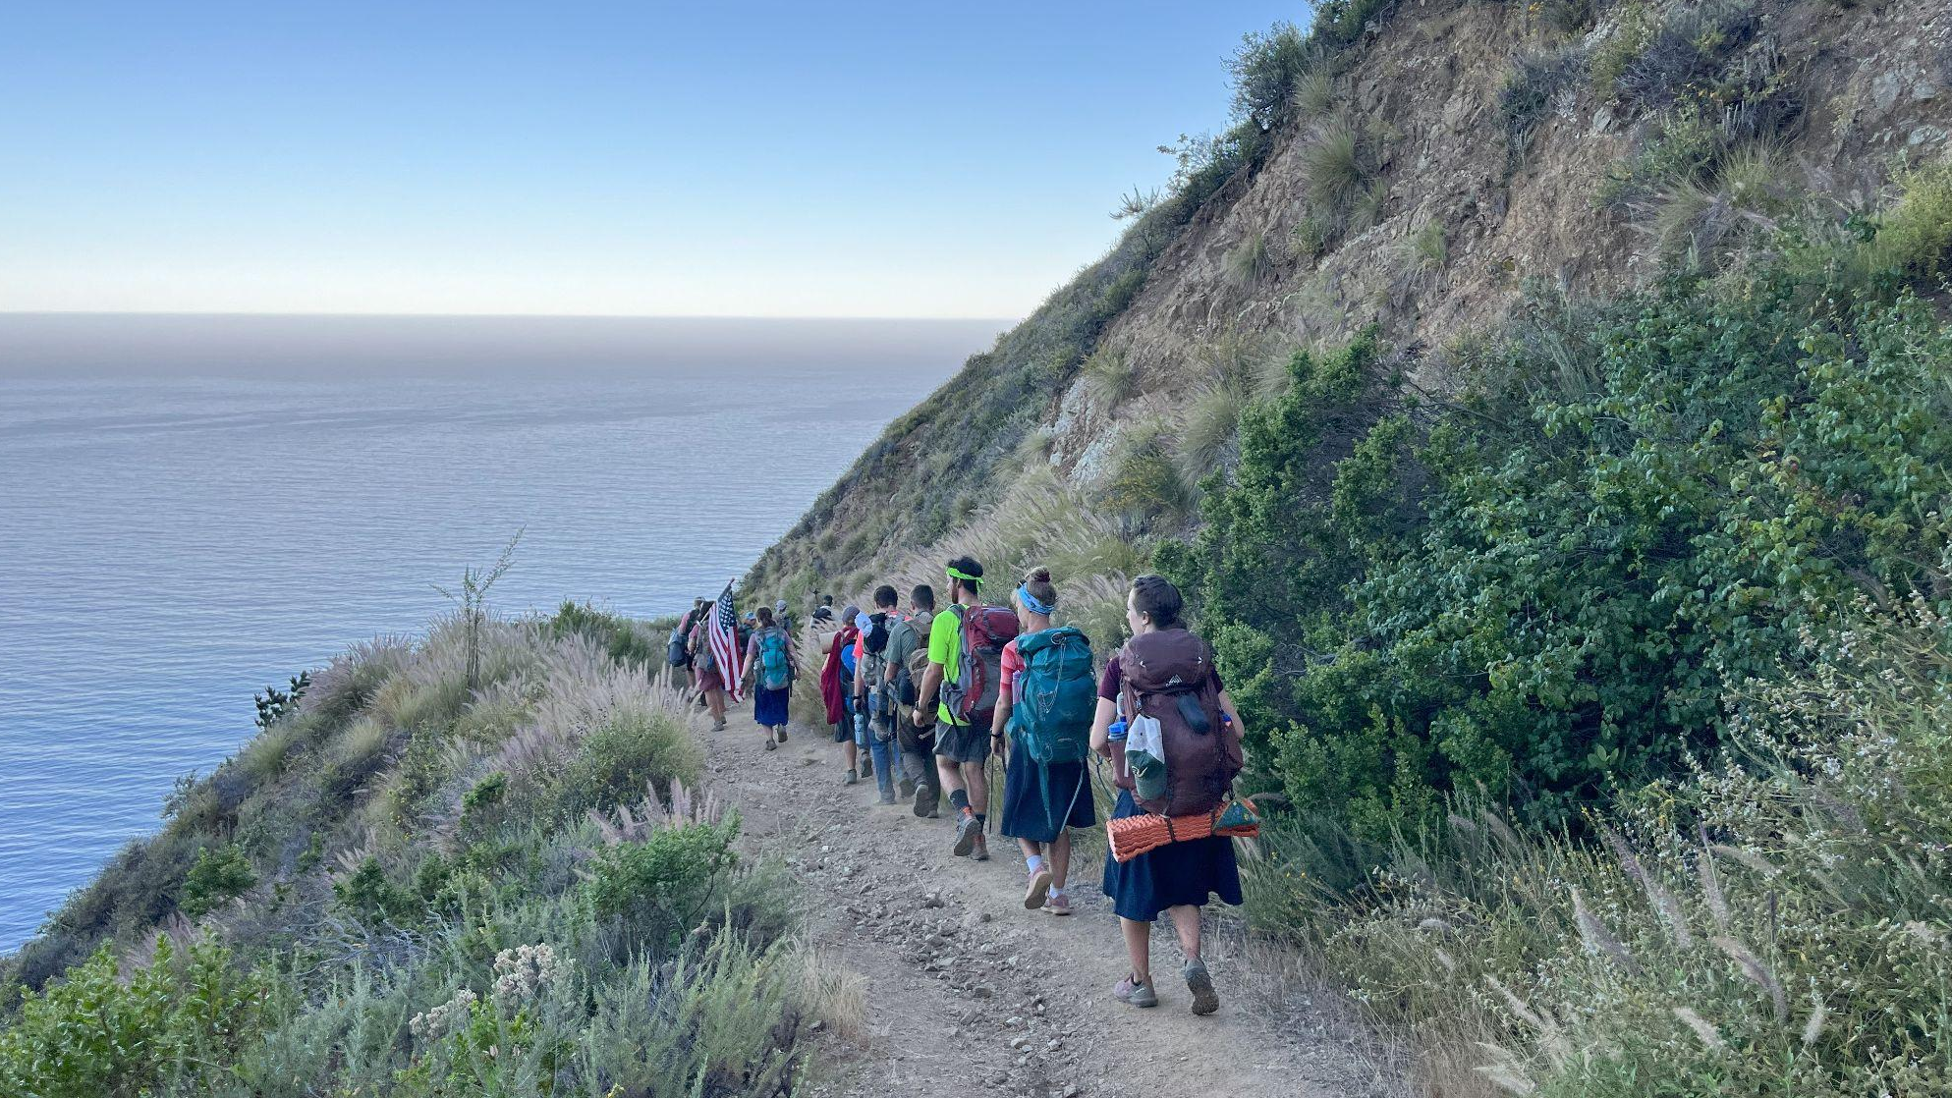
Leadership Opportunities
During Pilgrimage/Expedition
Leadership Reaction Courses - “LRCs”
After Pilgrimage/Expedition
Parish community involvement
Politics secular involvement
Pro-Life movement

Slide 8
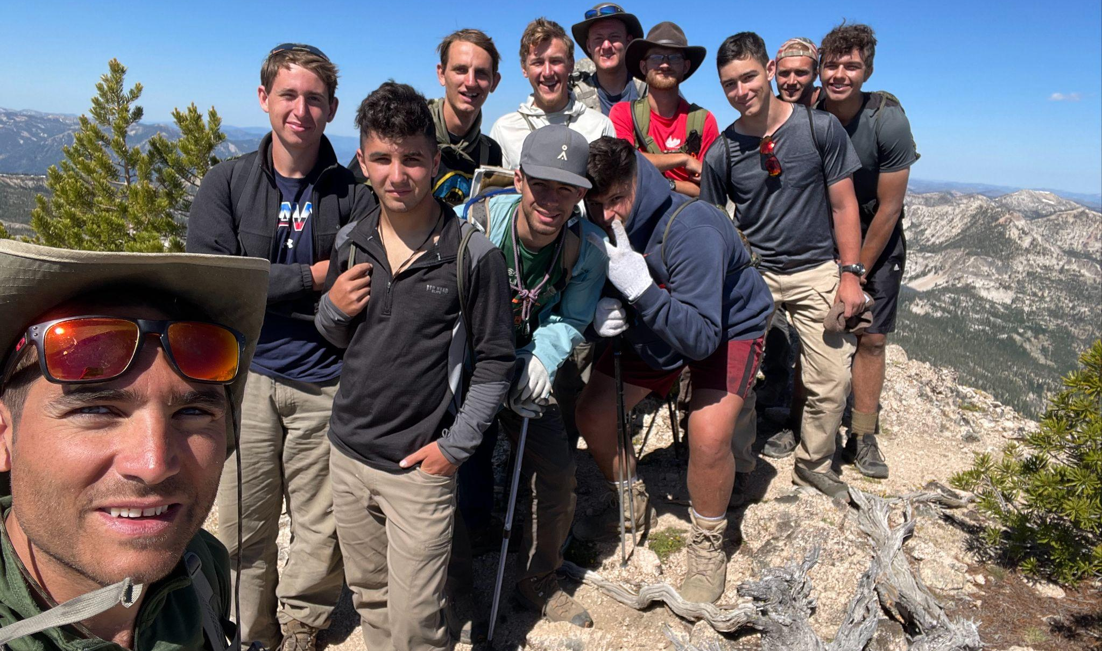
Mentorship
Guides lead pilgrims through challenges
physical, emotional, intellectual, and moral challenges
Guides assist the Pilgrims in elucidating dreams, goals, and plans “DGPA” which they are to pursue in life. Remember the leadership opportunities in previous slide?
Pilgrims follow up with Guides individually to mark progress on DGPA, actions steps, and faithfulness to commitments.

Slide 9
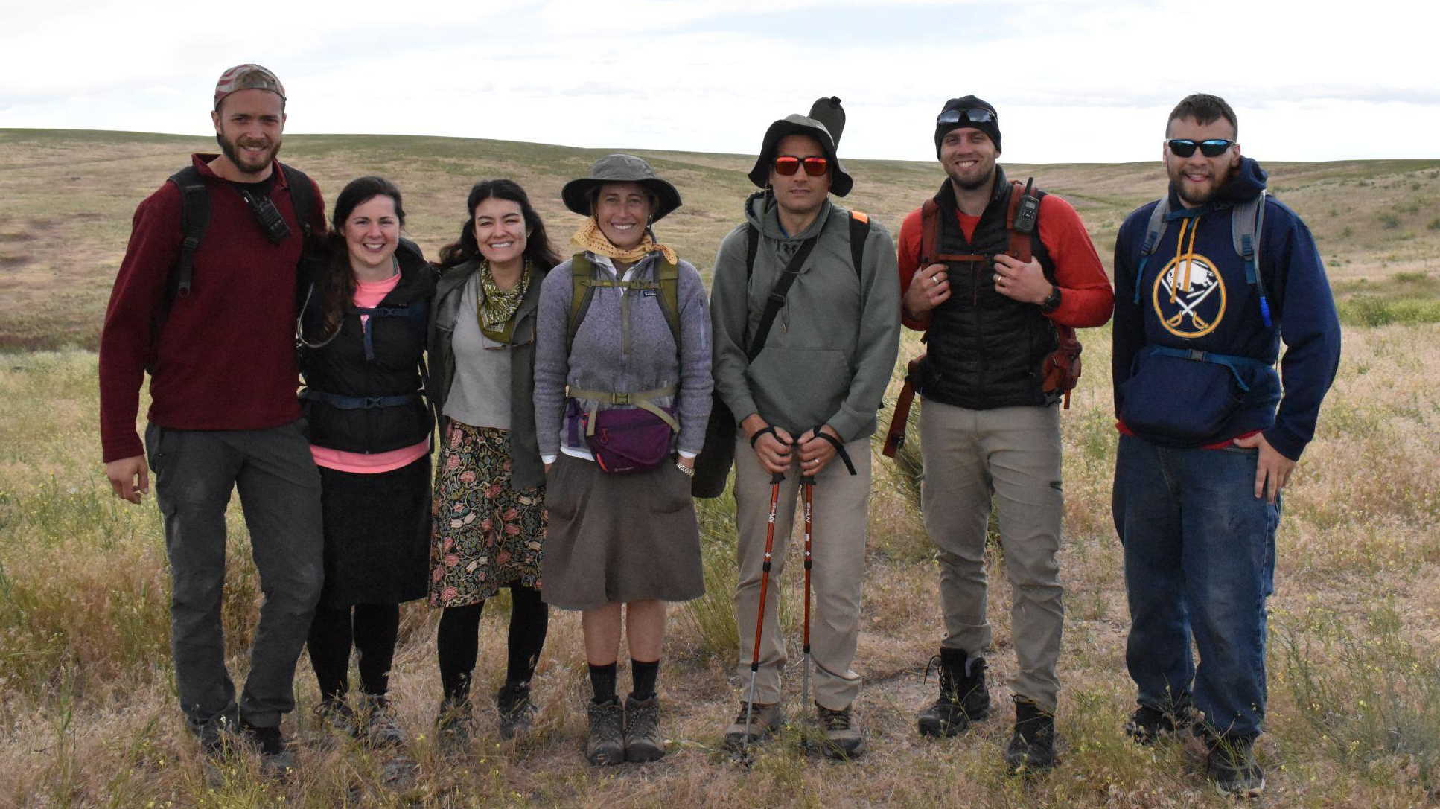
Adelante Leadership Team
Guides and Jr Guides - Mentorship, Discussion Leaders, Program Development
Support Crew - Drivers, Cook, Camp oversight
Outfitters - Climbing instructors, Recon, Support
Chaplains - Sacraments, Spiritual Direction, Discussion confirmation

Slide 10
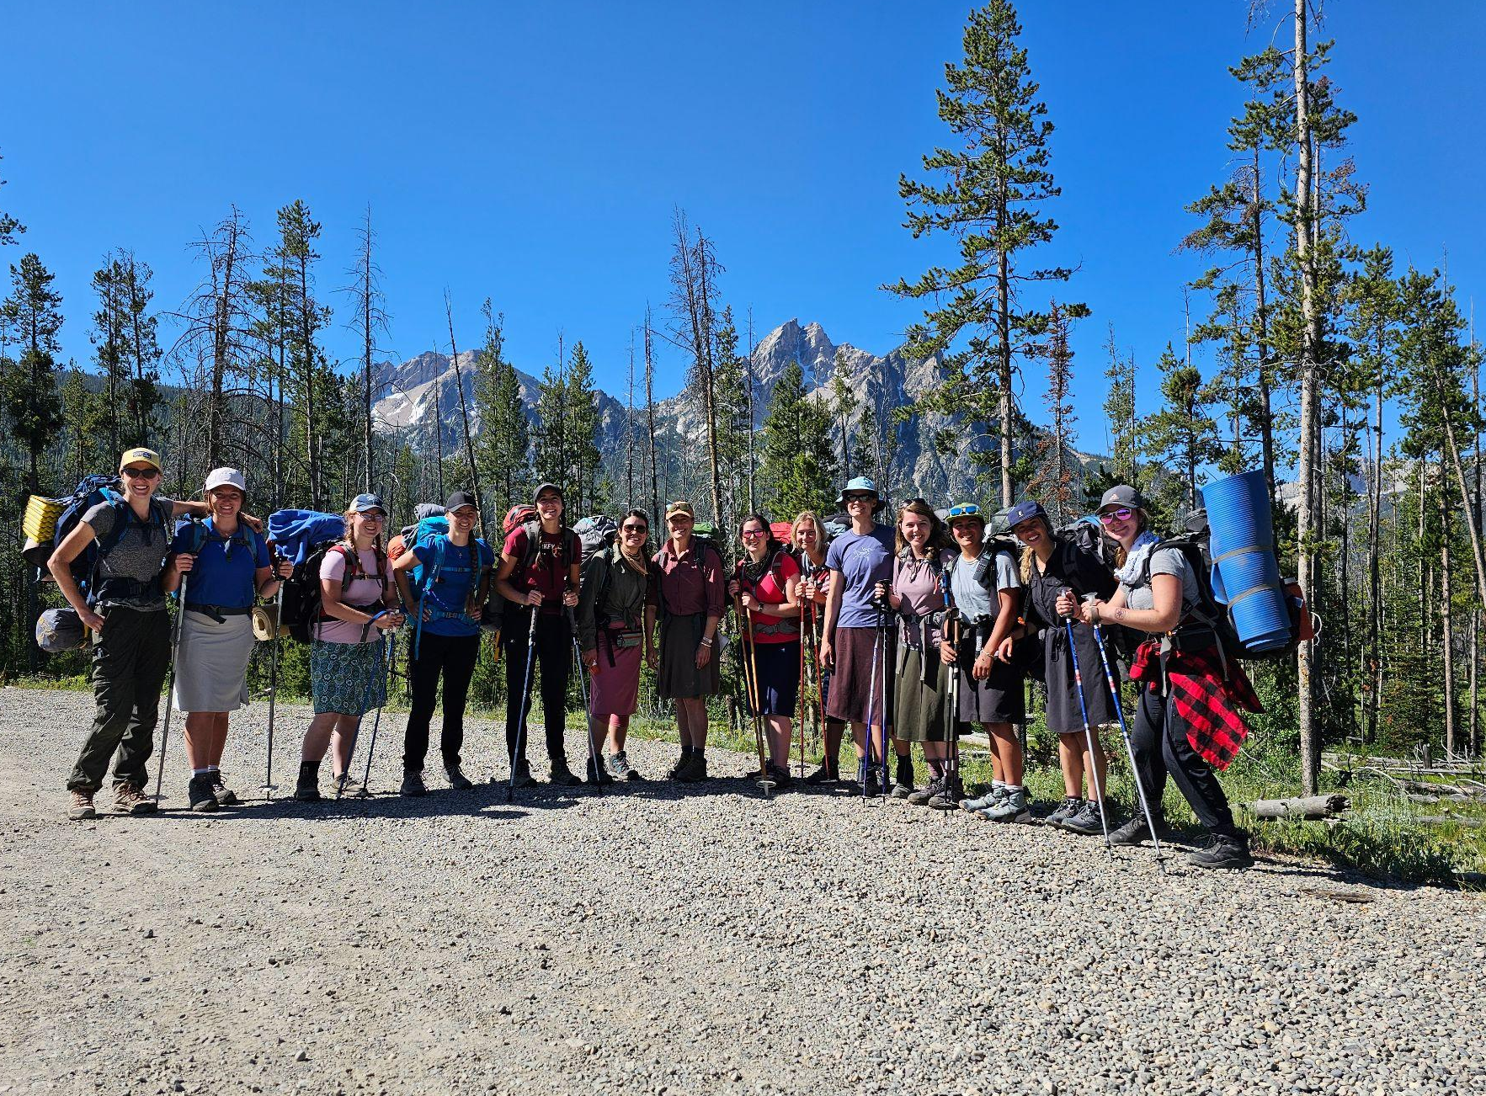
Network
Discord
Social Share
Study Share
Question Answer Share
Photo Share
Virtual Meeting Platform for Pilgrims and Leadership Team

Slide 11
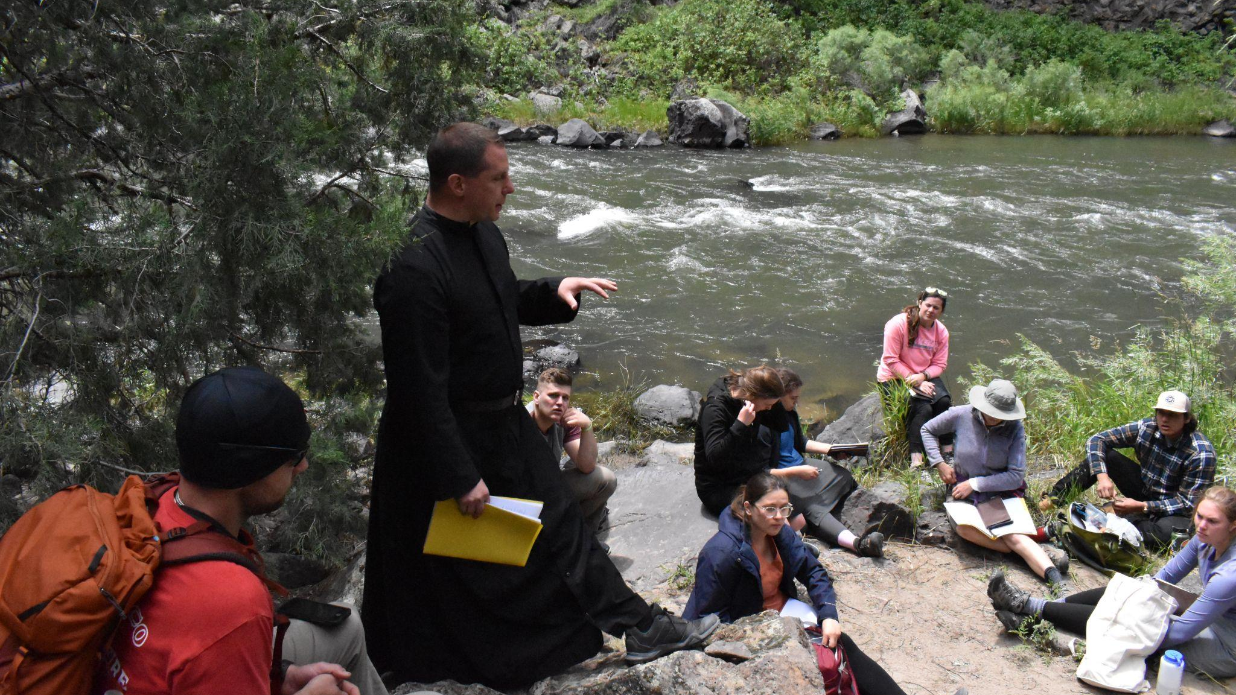
Support Us
Prayers & sacrifices
Material - Vehicles, trailers, food/supplies
Financial - Donate through our website adelantepilgrimage.org

Slide 12
Contact Us
adelantepilgrimage.org
secretary@adelantepilgrimage.org
albert@adelantepilgrimage.org
joanna@adelantepilgrimage.org

Slide 13
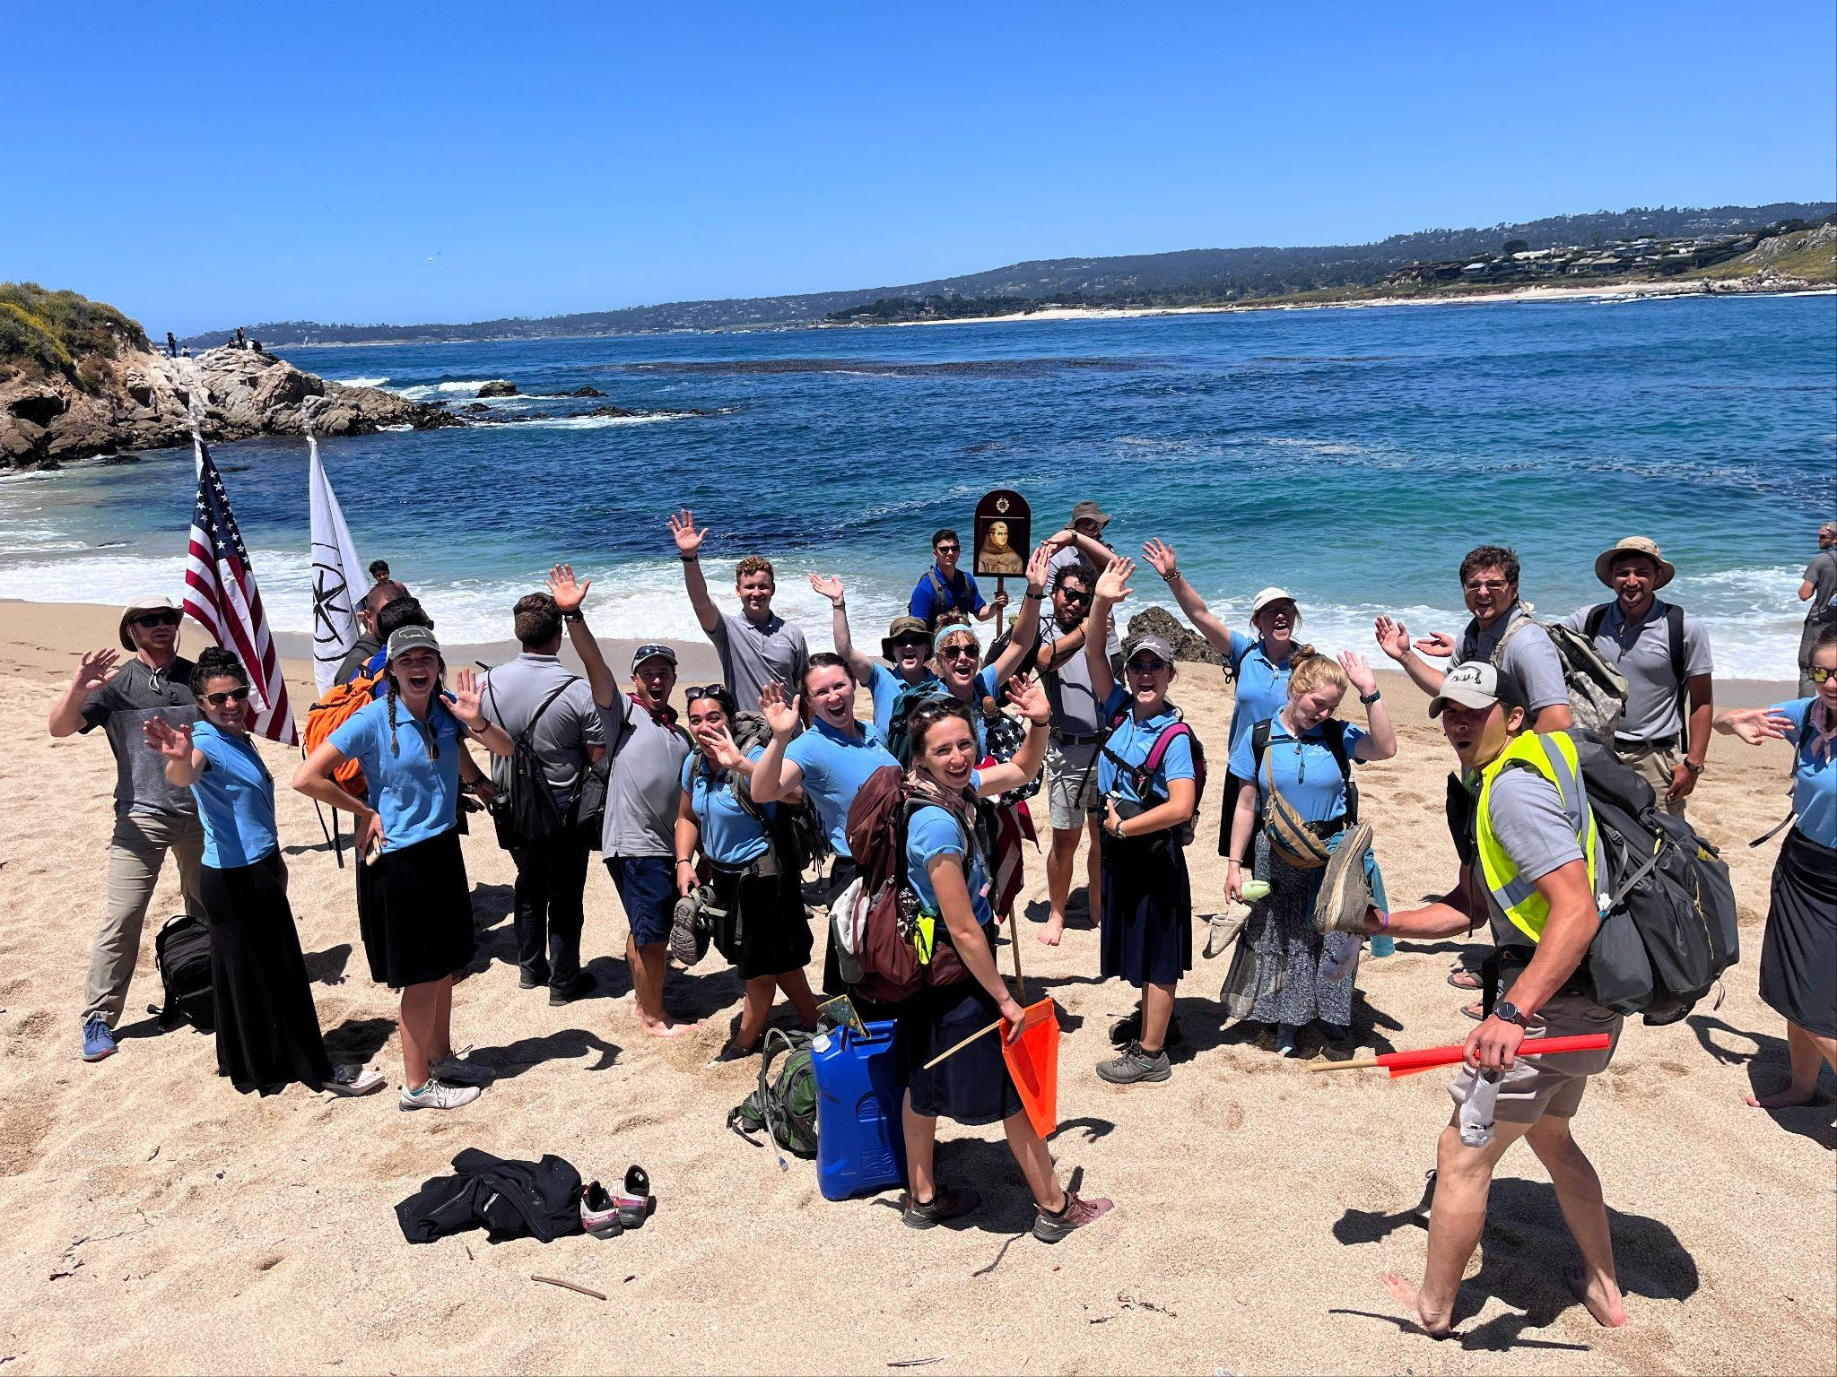
Questions ?

