Slide 1
Palpitations: VT or SVT?
Dr Qurban Hussain Khan
Assistant Professor Electrophysiology
Medical Superintendent
Rawalpindi Institute of Cardiology

Slide 2
What shall we cover?
Easy way to diagnose VT: the A-B-C-D-E approach
Practice ECGs

Slide 3
Key Facts
70% of regular wide complex tachycardia (WCT) is VT.
History of MI, structural heart disease, and/or old age makes VT even more likely.
No single ECG feature is “diagnostic” of VT
However, the presence of any of the following five ECG features is highly specific for VT (90-100%)

Slide 4
A is for Axis
Presence of a Northwest axis (-90 to -180 degrees) is highly specific for VT (90%).
Look for a dominant R wave in aVR for quick reference.

Slide 5
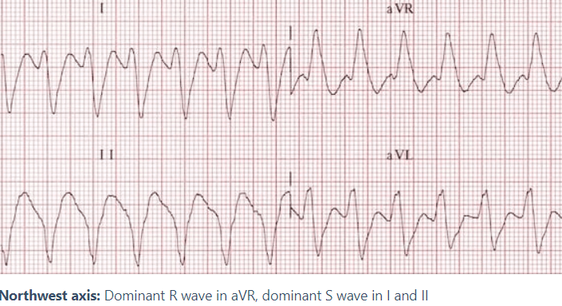
A is for Axis

Slide 6
B is for Broad Complexes
Use a cut-off of > 200ms, which has a specificity of 85-90% for VT.
Below this, there is too much overlap between VT and SVT with aberrancy.

Slide 7
C is for Concordance
Precordial concordance (a lack of RS complex in V1-6) is 97% specific for VT.
Positive concordance refers to entirely positive complexes in lead V1-6, with no rS complexes seen.
Negative concordance is entirely negative (QS) complexes in V1-6.

Slide 8
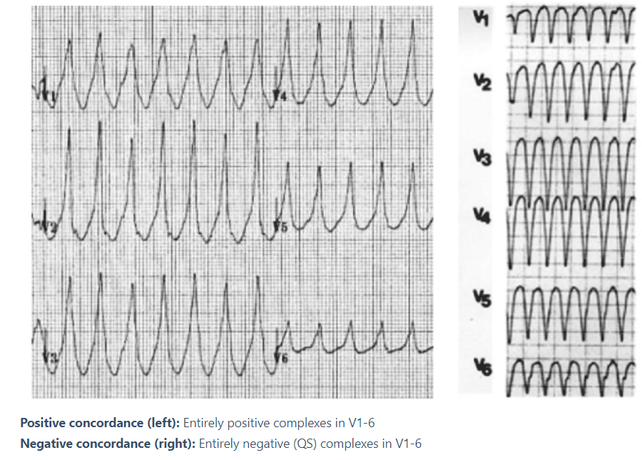
C is for Concordance

Slide 9
D is for Dissociation
Any evidence of AV dissociation is highly specific for VT:
P and QRS complexes at different rates
Capture beats: where the SA node transiently “captures” the ventricles, producing an isolated normal QRS complex
Fusion beats: Occur when a sinus and ventricular beat coincide to produce a hybrid complex

Slide 10
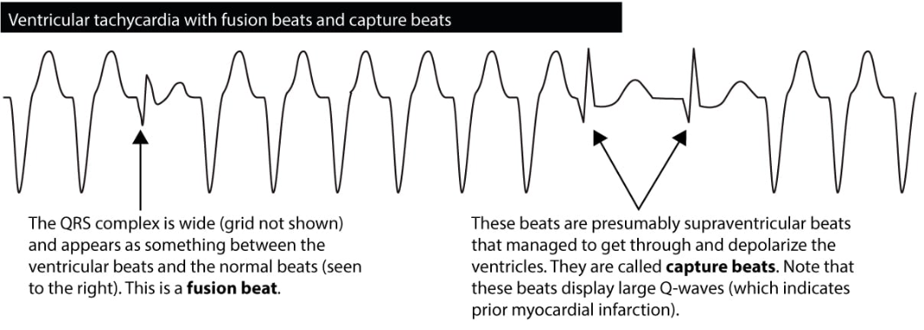
D is for Dissociation

Slide 11
E is for Early part of QRS: fast or slow?
VT propagates from ventricular muscle, with initial slow myocyte-to-myocyte conduction time. This causes a delayed/slurred initial QRS component
SVT with aberrancy displays initial sharp QRS deflections that arise from the preserved bundle branch

Slide 12
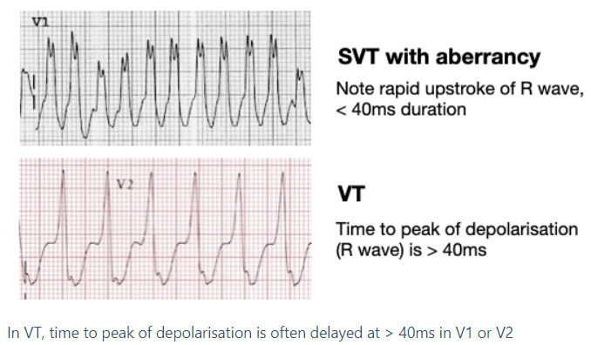
E is for Early part of QRS: fast or slow?

Slide 13
Mini Quiz
Good Luck!

Slide 14
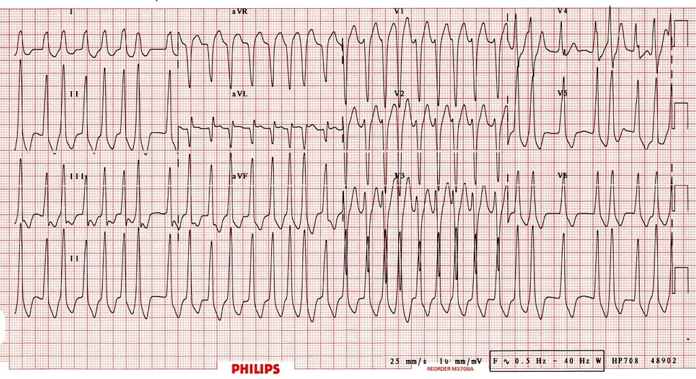
Question 1

Slide 15
SVT with Aberrancy
Pre-excitation
Drug overdose
Electrolyte abnormality
Ventricular Tachycardia

Slide 16
Answer
Pre-excitation

Slide 17
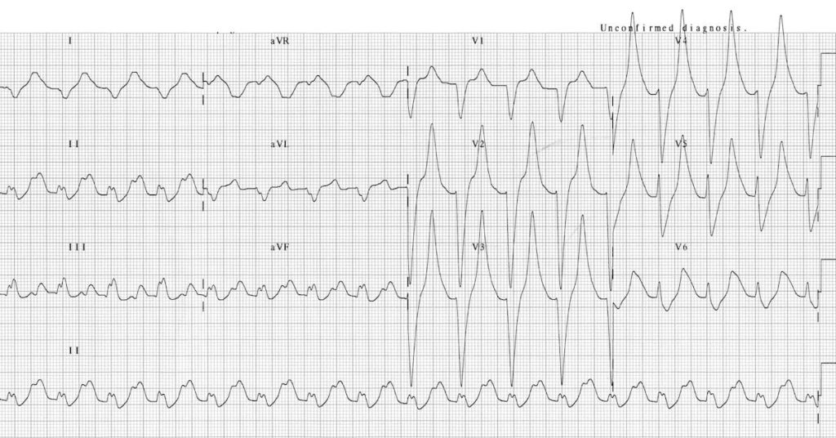
Question 2

Slide 18
SVT with Aberrancy
Pre-excitation
Drug overdose
Electrolyte abnormality
Ventricular Tachycardia

Slide 19
Answer
Electrolyte abnormality

Slide 20
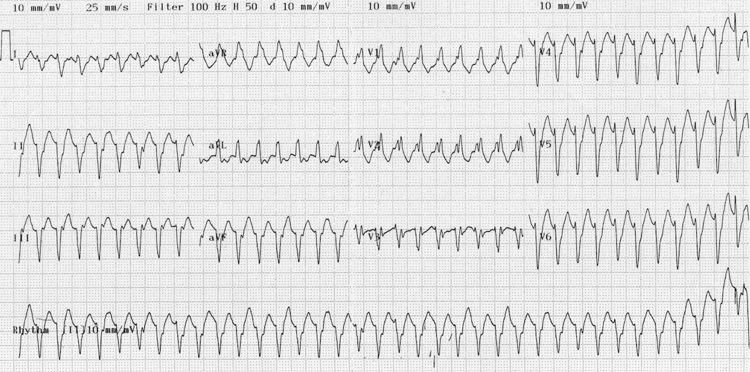
Question 3

Slide 21
SVT with Aberrancy
Pre-excitation
Drug overdose
Electrolyte abnormality
Ventricular Tachycardia

Slide 22
Answer
Ventricular Tachycardia

Slide 23
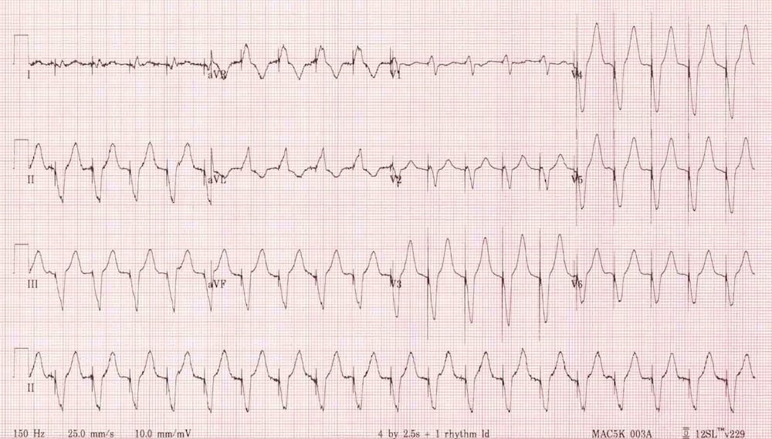
Question 4

Slide 24
SVT with Aberrancy
Pre-excitation
Pacing
Electrolyte abnormality
Ventricular Tachycardia

Slide 25
Answer
Pacing

Slide 26
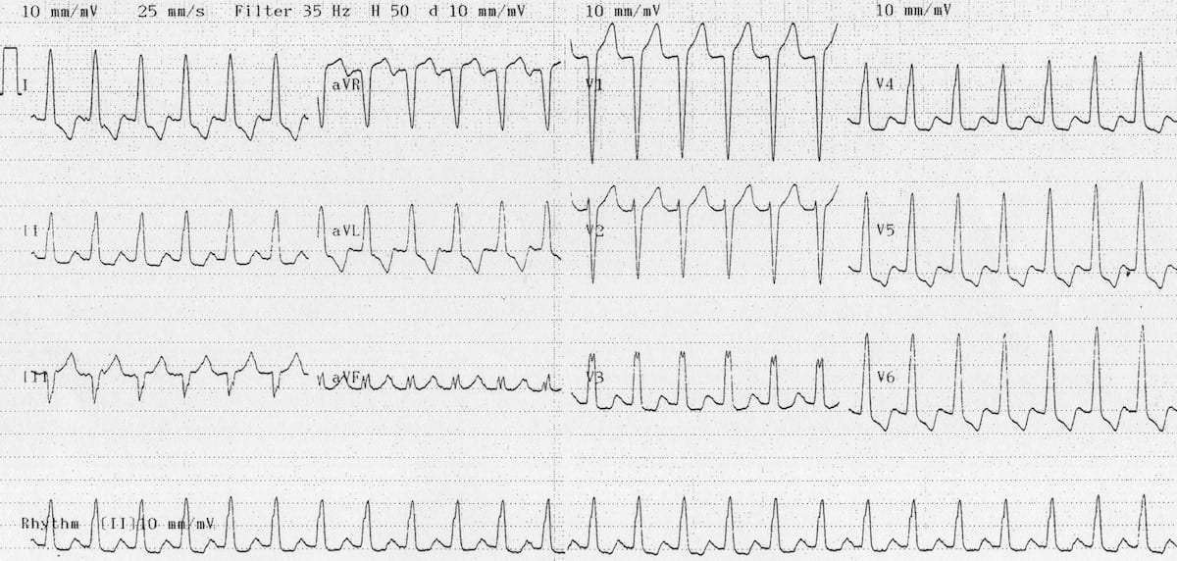
Question 5

Slide 27
SVT with Aberrancy
Pre-excitation
Pacing
Electrolyte abnormality
Ventricular Tachycardia

Slide 28
Answer
SVT with aberrancy

Slide 29
Thank you for your attention

