Slide 1
Trend Journal
By: Ella Howard
FASM 245
Spring 2026

Slide 2
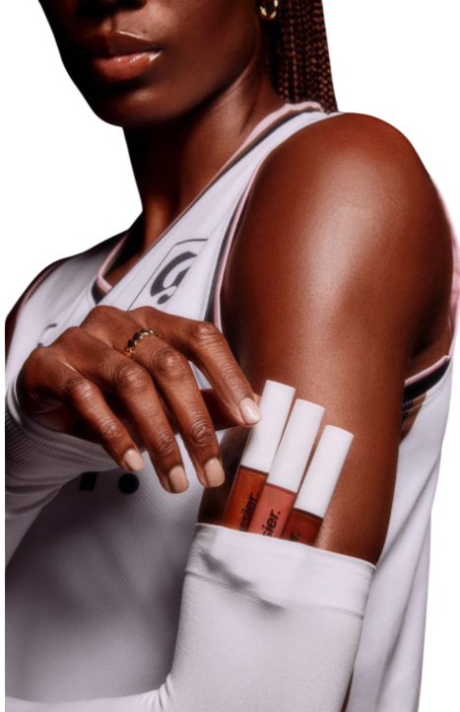
Table of Contents
03 Inclusivity in Beauty
05 Body Positivity and Size Inclusivity
07 Ageism in Beauty
09 Unisex Fragrances
11 Makeup Dupes
13 Beauty Tech
15 Works Cited

Slide 3
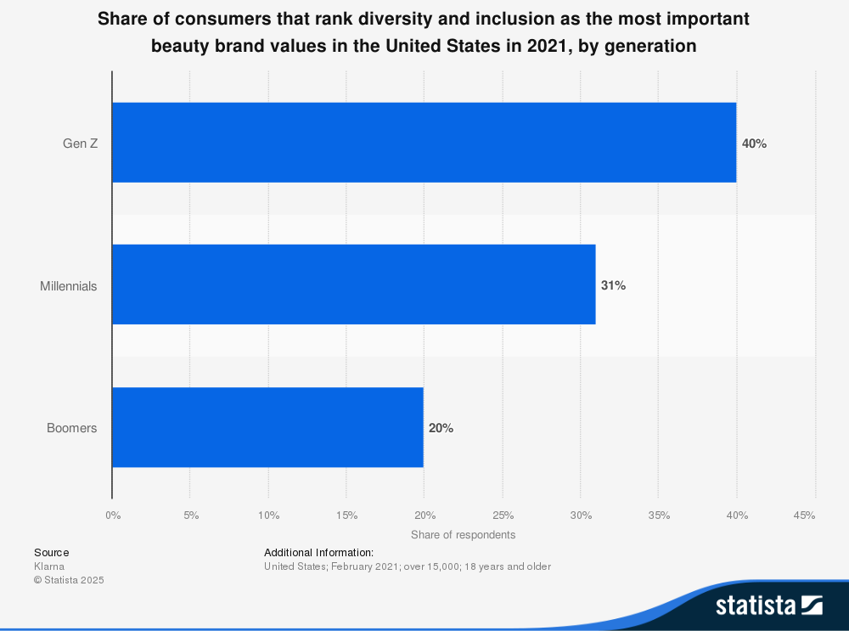
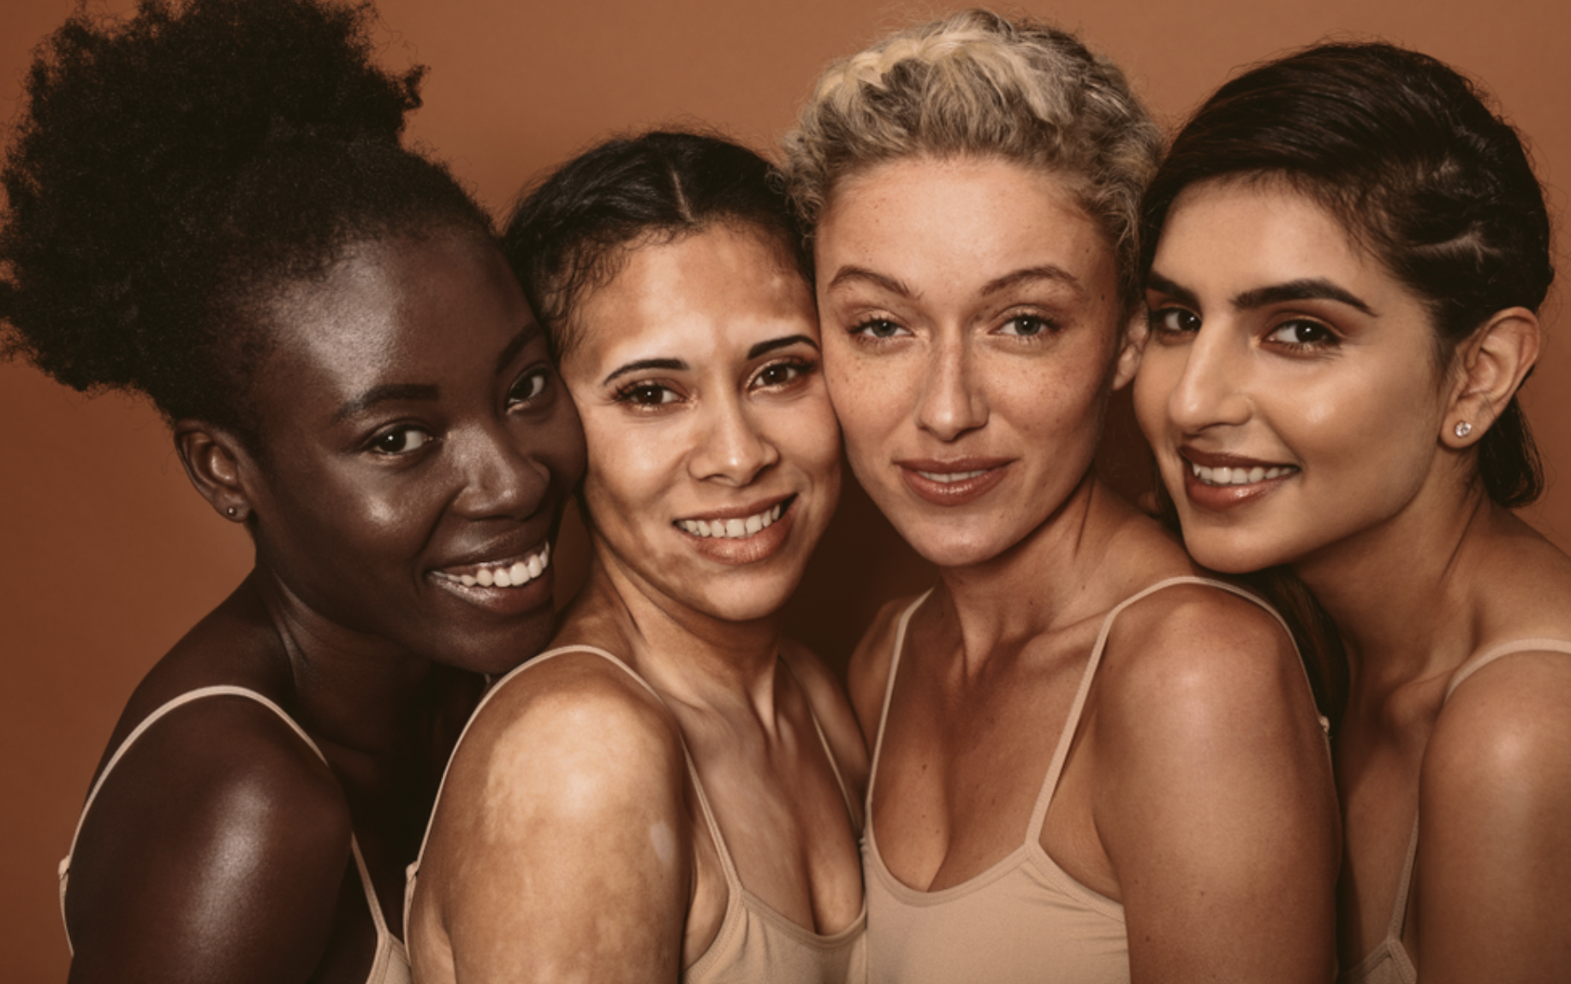
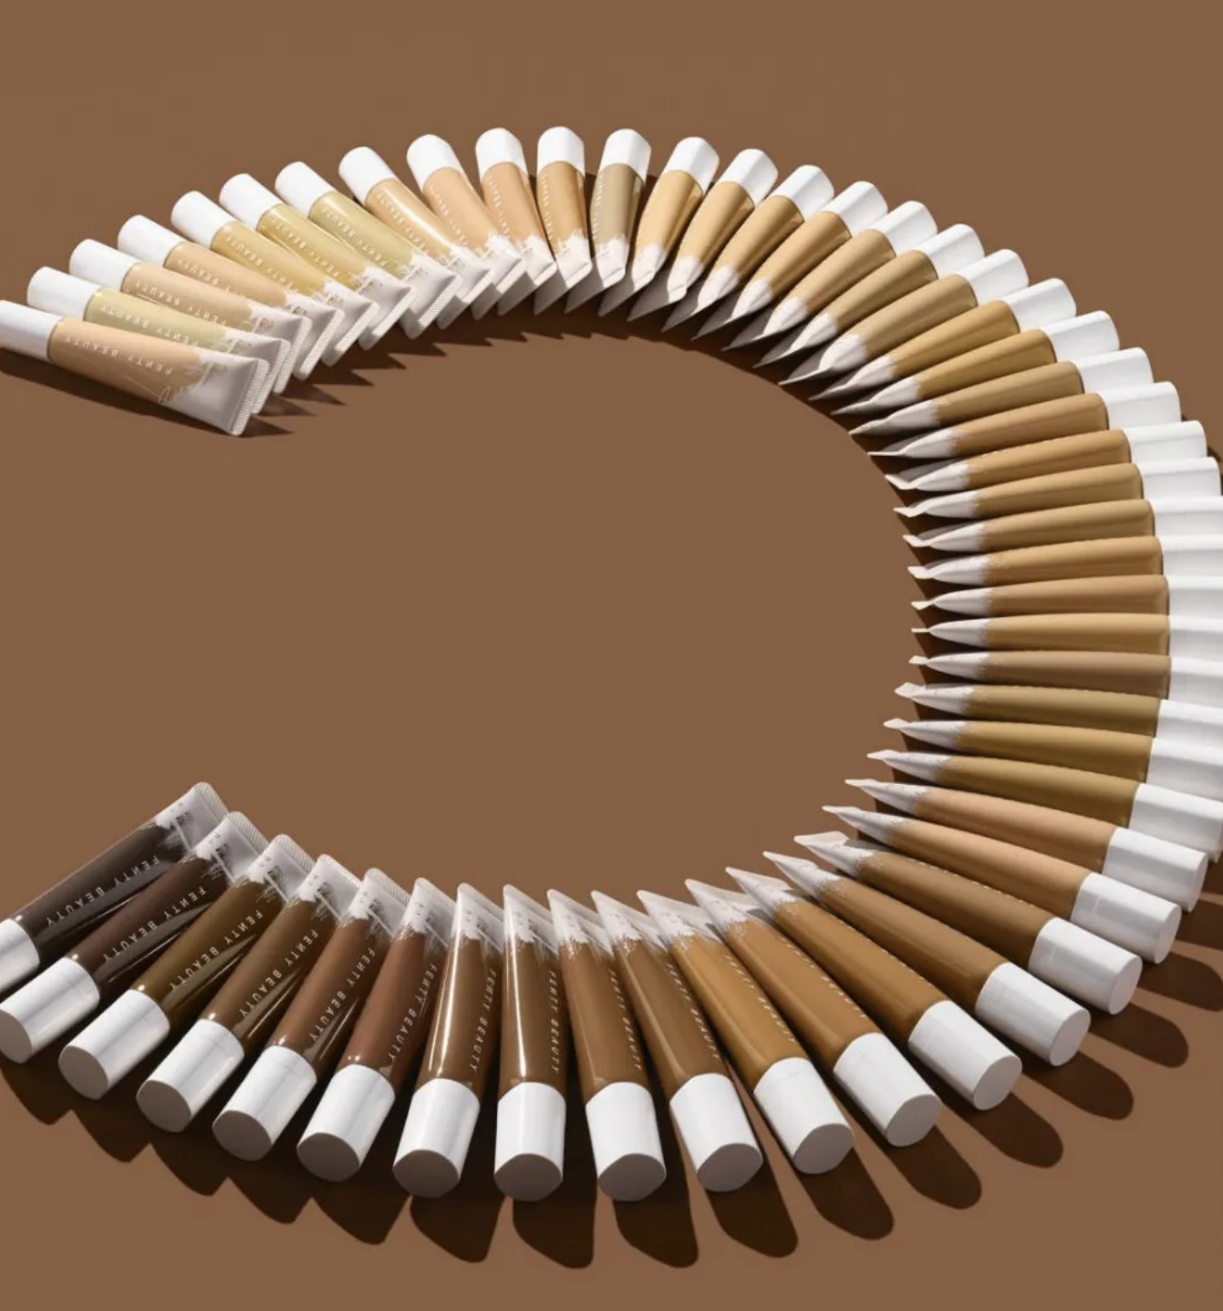
Inclusivity in Beauty
In terms of the beauty industry, there has been a consistent lack of diversity and inclusivity that brands are offering. Companies have been historically known to lack shade ranges, lack marketing towards a mass audience, and formulate products for a diverse group. According to Statista, in 2021, 40% of Gen-Z consumers, 31% of Millennials, and 20% of Boomers ranked diversity and inclusion as the most important brand value. There has been a rise in demand for a more inclusive and diverse beauty industry in the last few years. People of color have long struggled with finding their perfect shade. There is a huge opportunity for beauty brands to commit to this underserved group and expand their audience.
The beauty industry in the past has been very focused on providing for a narrow demographic. Beauty companies have offered limited shades in the color cosmetics industry, and have only provided for people with lighter skin tones. This has caused a huge frustration among consumers that do not fit into that limited scope. This is a huge social issue as well as a gap in the market. According to an article, Shades of Beauty: A Comprehensive Analysis of Diversity and Inclusion Initiatives in the Beauty Industry, 64% of women in the U.S. expect beauty brands to implement more diversity into their marketing.
In September of 2017, Rihanna's brand, Fenty Beauty, revolutionized the beauty industry by launching a line with 40 shades of foundation. This was a pivotal unveiling for the beauty empire, and top beauty brands followed in Fenty's footsteps to offer more shades for their consumers. Other brands started seeing the business expansion opportunity as well as answering the frustrations of the previous lack of diversity.

Slide 4
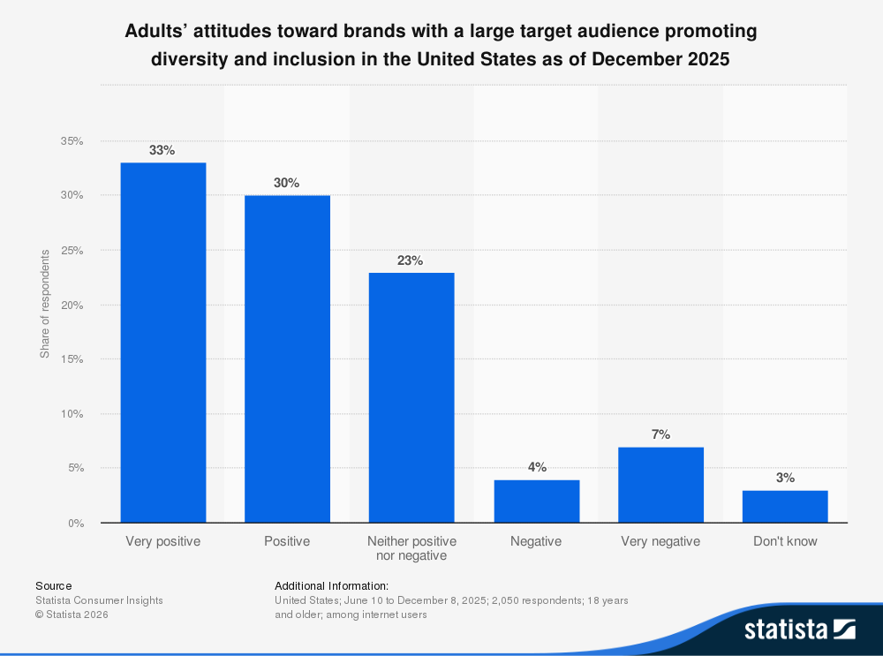
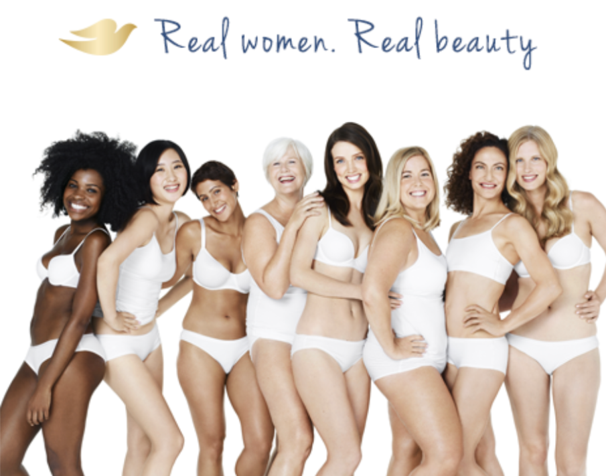
Inclusivity in Beauty
Fenty's line set a standard for the industry and competitors began to go beyond marketing for only paler skin tones. Fenty changed the beauty industry by fostering a safe space for women of color and made it into a multi-billion dollar business platform.
As of 2025, over half of the adult U.S. population has a positive attitude towards brands promoting diversity and inclusivity. The beauty industry still has a long way to go in terms of nurturing a safe space where women (and men) of all colors and ethnicities feel seen and provided for. With frustration growing and the rise of attitudes shifting towards the demand for diversity representation, beauty companies are expected to revolutionize and change where they have fallen short in the past.
In 2004, Dove launched its "Real Beauty Campaign". Dove was estimated to be a
6- billion dollar brand in 2025 and is a personal care brand known for its hygiene products and commitment to their customers. Their campaign for "Real Beauty" called out the hypocrisy of the beauty industry and offered a solution by showcasing women of color in their campaign instead of models. The campaign was a success and one of the first cosmetic brands that made a notable change on this social issue. Dove changed the script by marketing to women of color and redefining what the industry has claimed as "beautiful".
As consumers continue to voice their demands for diversity in the beauty industry a change will be expected to incur. And as successful companies stand up to the social issue it will become the standard for other brands to follow and appeal to a wider audience. Companies will take advantage of this business opportunity and their brand value will increase because of their commitment to an underserved group.

Slide 5
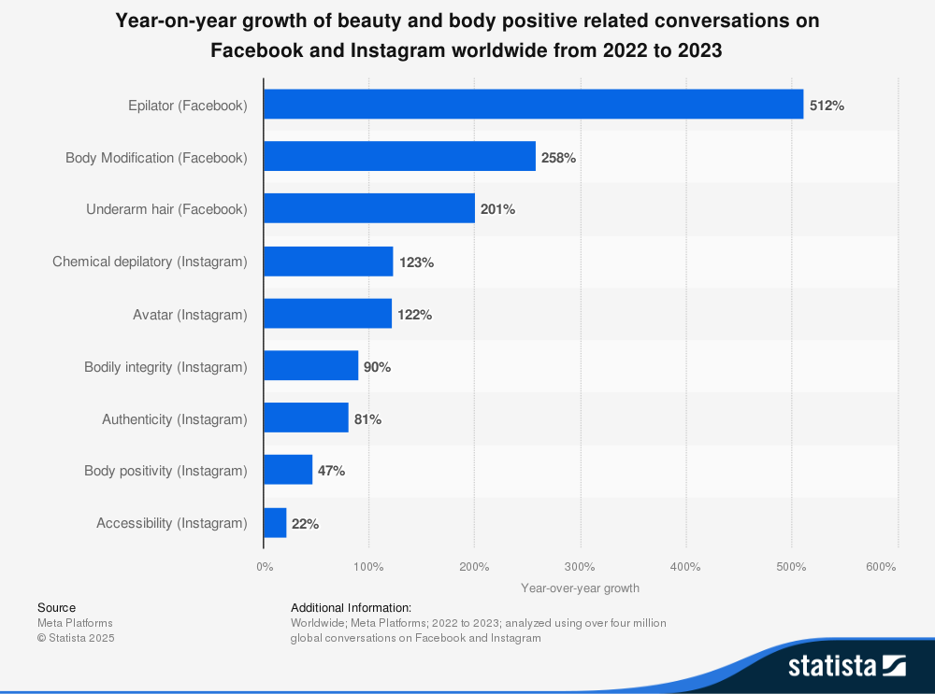
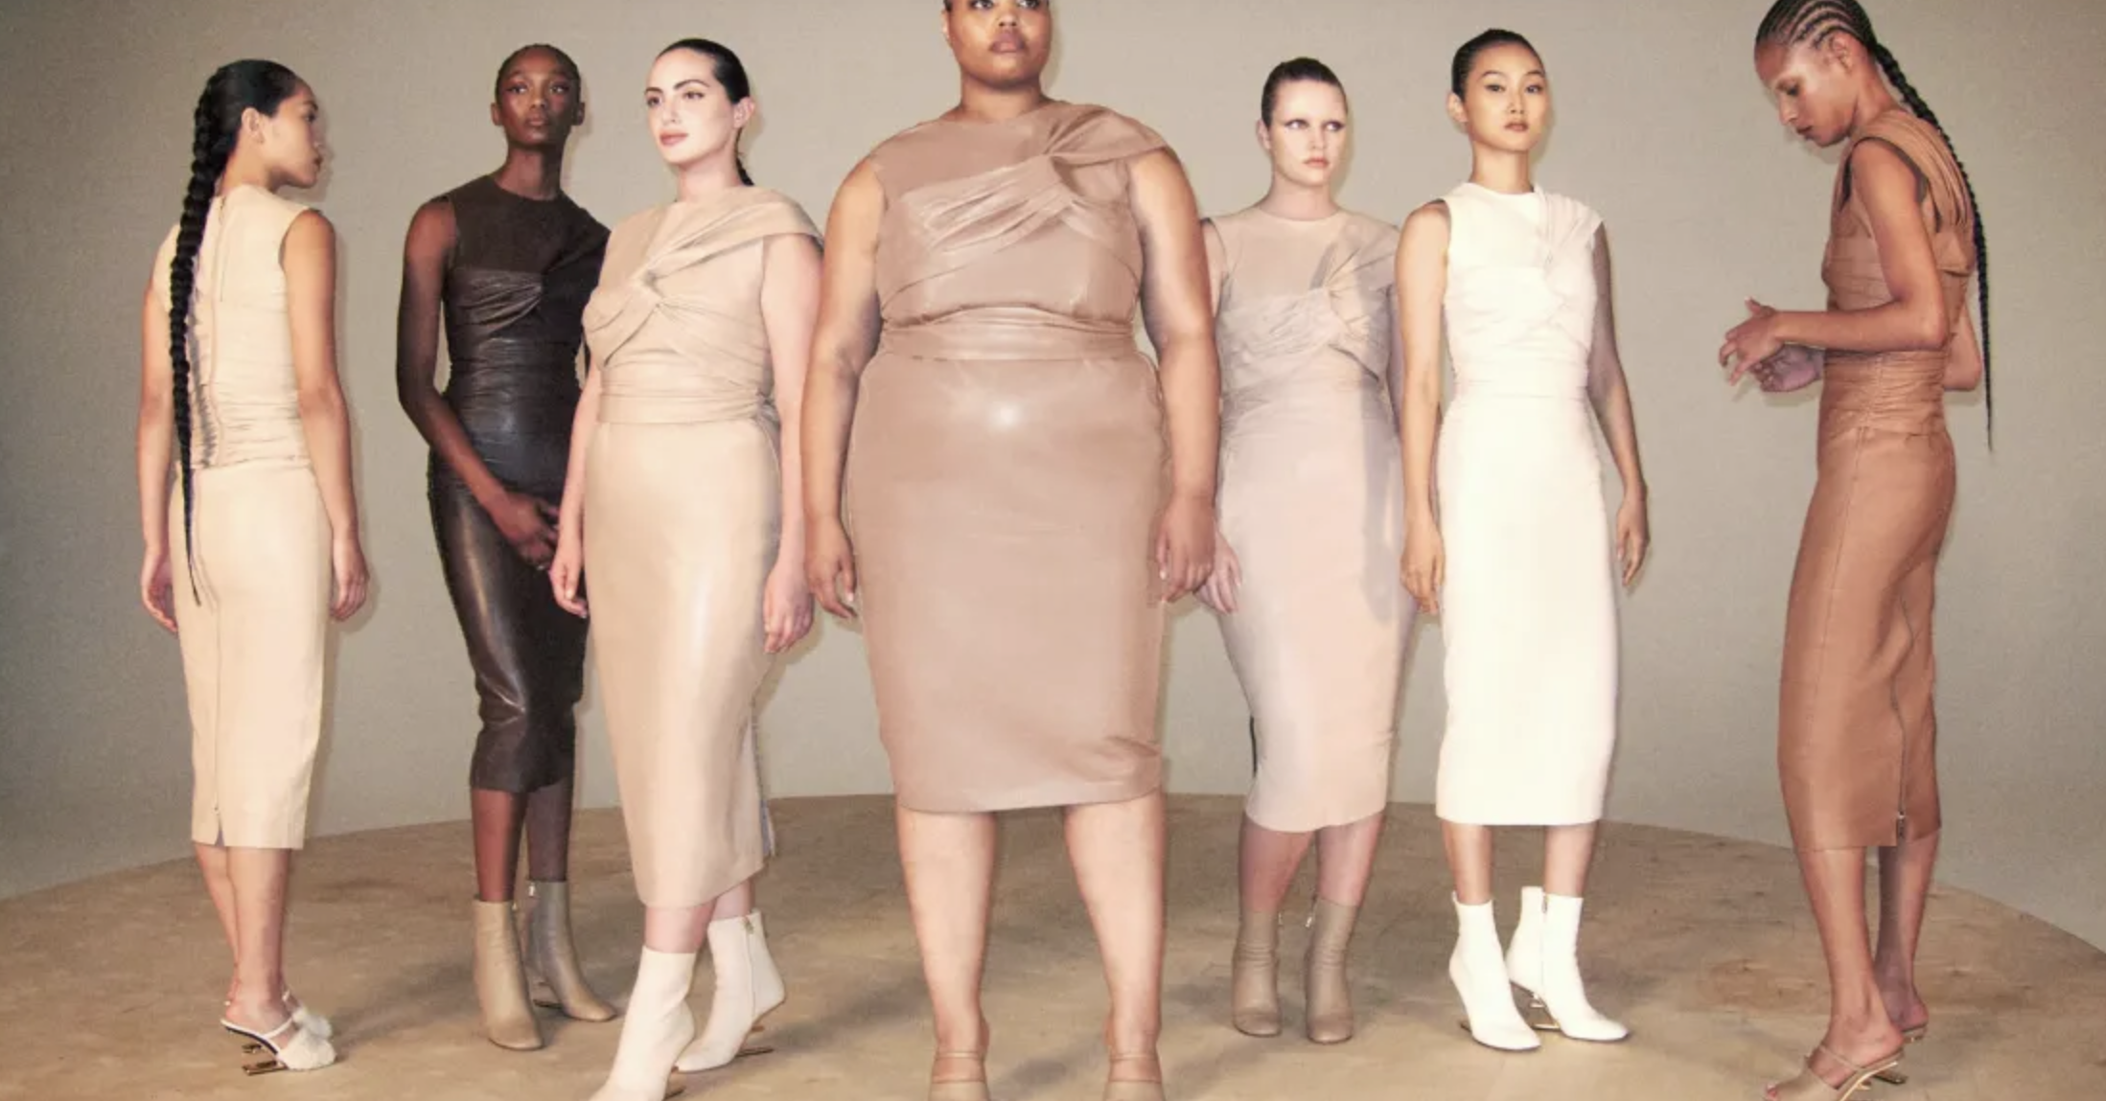
Body Positivity and Size Inclusivity
The fashion industry has been known to cater towards a thinner audience and limited sizing. For decades people have been told and shown by clothing companies that the thinner you are, the more idealized you are. People have adopted the mindset that you should fit the clothes and not the other way around. But through the rise of social media and influencer culture, attitudes are shifting.
According to Statista, there has been a worldwide recorded growth recorded for body and beauty positive related conversations from 2022 to 2023. There is a gap in the industry due to previous unrealistic and idealized standards. The plus-size and in some cases the mid-size community desire a brand and marketing that will provide for their needs and represent them in a positive light.
According to Refinery 29, in the 2020 Spring/ Summer season, "86 plus-size models walked runways across all four major cities". Seeing this community get recognized in the fashion industry is helping make amends with this mass social issue and giving brands the opportunity to expand beyond their traditional practices. Unfortunately, there has been a drop from 2.8% plus-size runway models in 2020 to .8% plus-size runway models in Spring/ Summer 2025. It is frustrating and discouraging to see fashion brands stray away from selecting plus-sized runway models when body positivity is a relevant topic across many facets of social media- namely Instagram, Facebook, and Tik Tok.

Slide 6
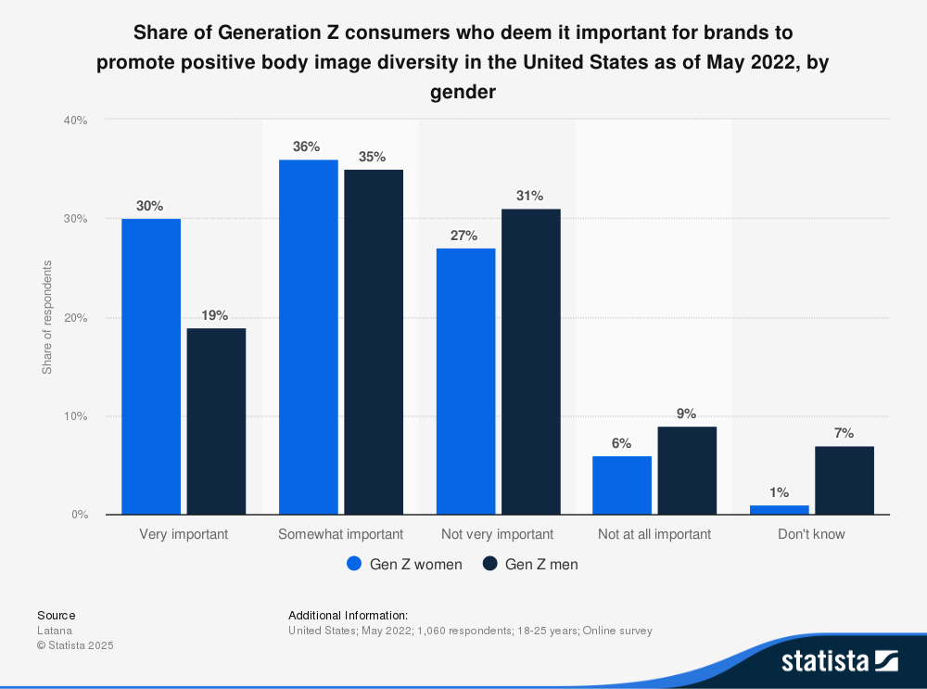
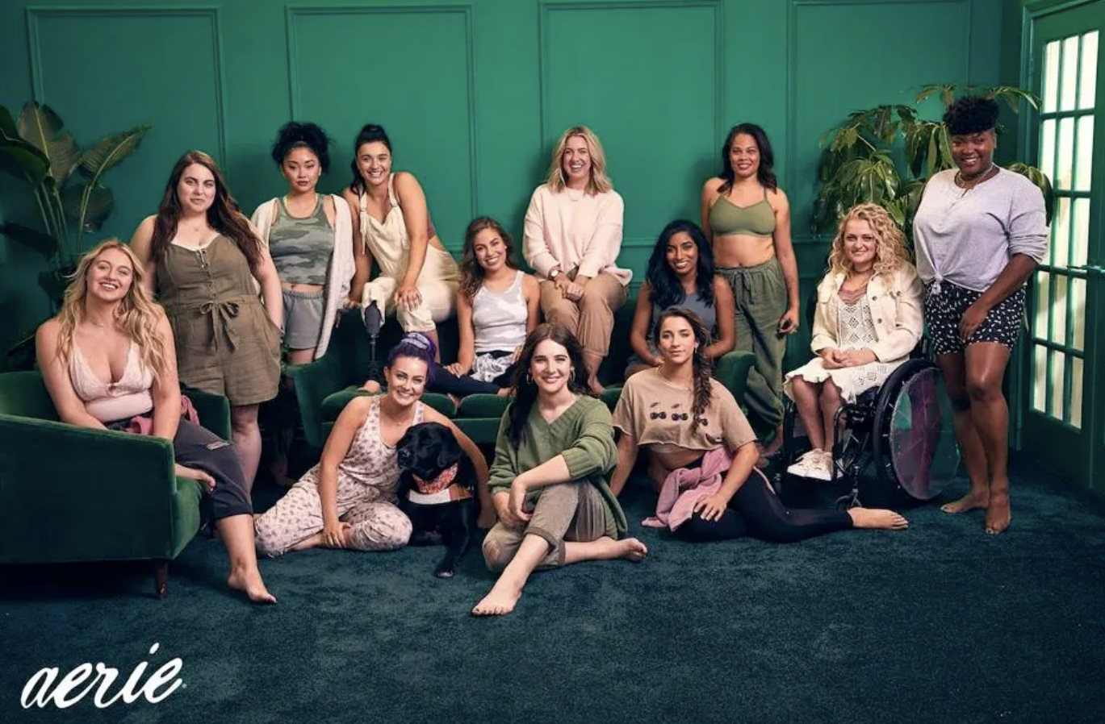
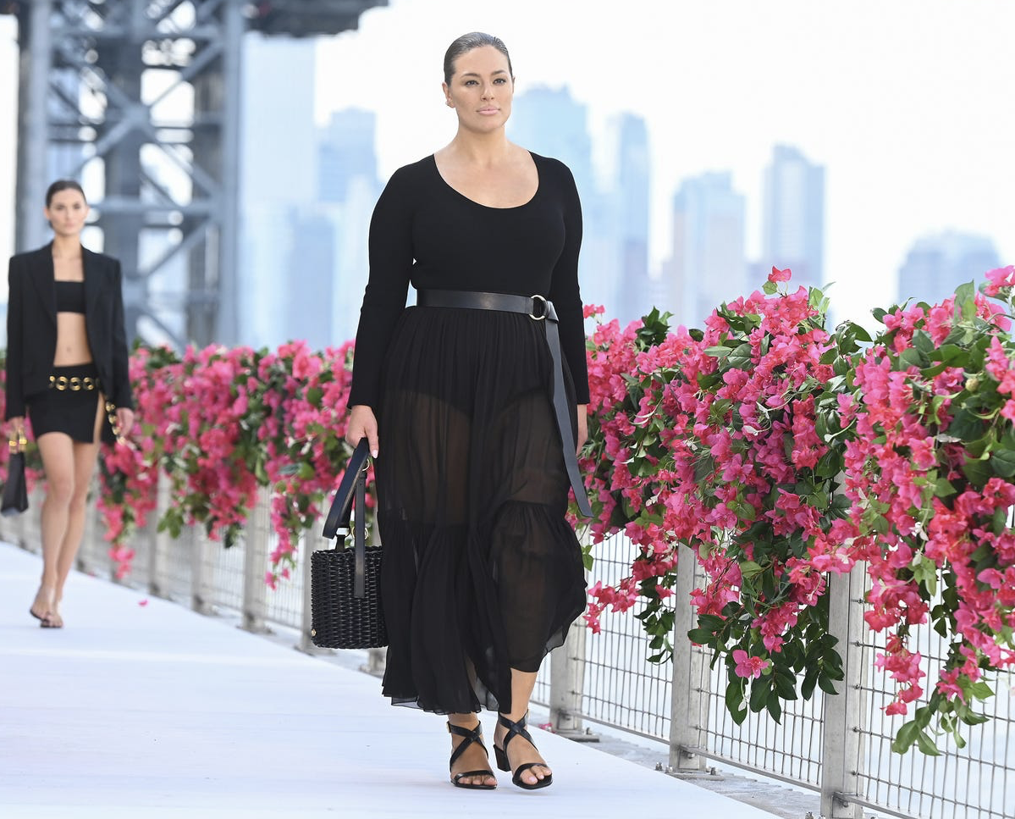
Body Positivity and Size Inclusivity
According to Statista, a survey documented that 30% of female participants deemed it very important to them that brands promote positive body image. 36% of female participants deemed it somewhat important. 54% of the male participants deemed it very important or somewhat important to them. 60% of the surveyees in the U.S. agreed that brands should encourage body positivity and yet there is a recorded decline in opportunities for plus-sized models.
With success stories from plus sized models such as Ashley Graham and $1 Billion brand, Aerie focused on encouraging body positivity and challenging the fashion industry, there is no excuse for brands not following and taking away opportunities from plus-sized models and limiting their consumer base. Aerie opened in 2014 with the mission to boost authenticity and body positivity. Their marketing features women of all sizes and defies what the existing marketing is doing showcasing limited sizing. Aerie is an excellent example of a fashion brand bridging the gap between consumer sizing frustration and a successful
clothing brand.
With the demand for positive body image and inclusivity fashion brands will be expected to market this for their consumers. Size discrimination and limited accessibility should not be tolerated and therefore fashion brands should adopt philosophies similar to Aerie. This will offer engagement from an underrepresented community, strengthen the brand's reputation, and grow revenue.

Slide 7
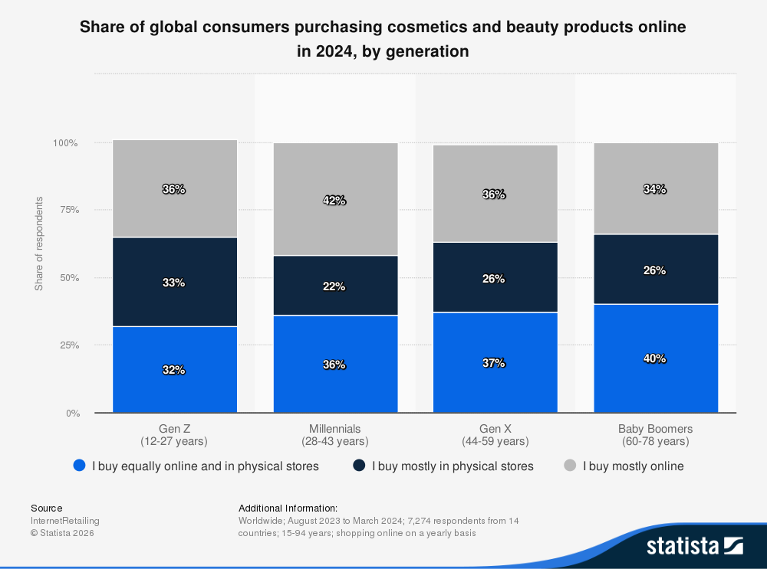
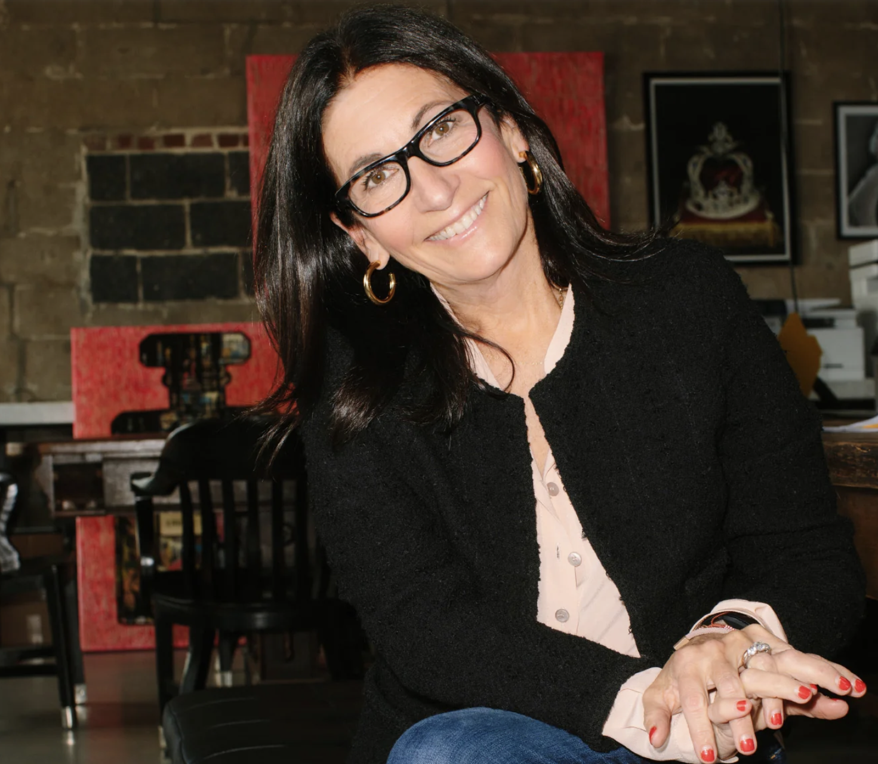
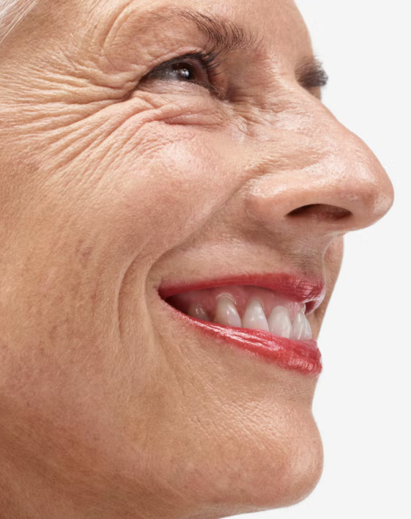
Ageism in Beauty
The beauty industry has primarily focused on marketing towards a younger audience. In addition to marketing towards a younger audience, the industry also markets and sells products that claim to enact radiating youthfulness. According to Statista, 33% of Gen-Z shoppers mostly buy beauty products in store; this percentage drops to 22% to Millennials and 26% to Gen-X. There is a gap in the market for how these beauty brands are marketing their products to an older audience. Beauty companies are missing out on a business opportunity and increased revenue by not strengthening their consumer connection with their older female (and male) audience.
One example of a cosmetics brand that has successfully acquired an older audience is Jones Road Beauty. The brand was founded by makeup artist Bobbi Brown with a core pillar to make makeup for everyone- no matter the age. According to Vogue, Jones Road Beauty reached an $1 million revenue in 2023 and a $160 million revenue in 2024; having just launched in 2020 this is beyond impressive. The products are designed to work on every skin type which means they are designed to work on every age. The company's success is credited to their inclusivity and welcoming atmosphere. Their customers are getting their needs met and there is no disconnect and ageism behind the product formulation and marketing.
If more brands were able to adopt a similar mentality of Jones Road Beauty, the Millennial, Gen-X, and even Baby Boomer audience would boost sales and strengthen the brand value and reputation. Brands are not taking advantage of this audience and providing for them, despite this audience having more financial stability and freedom than a younger demographic.

Slide 8
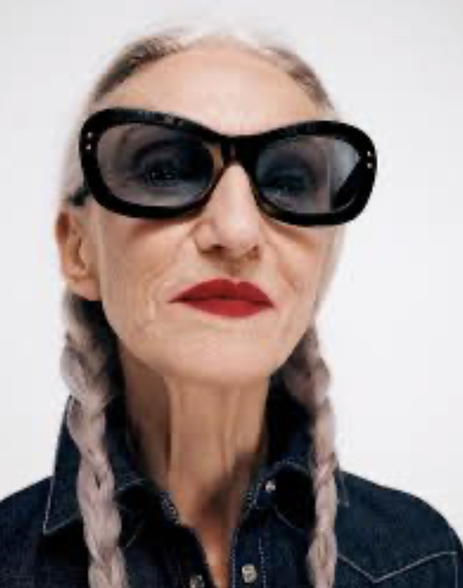
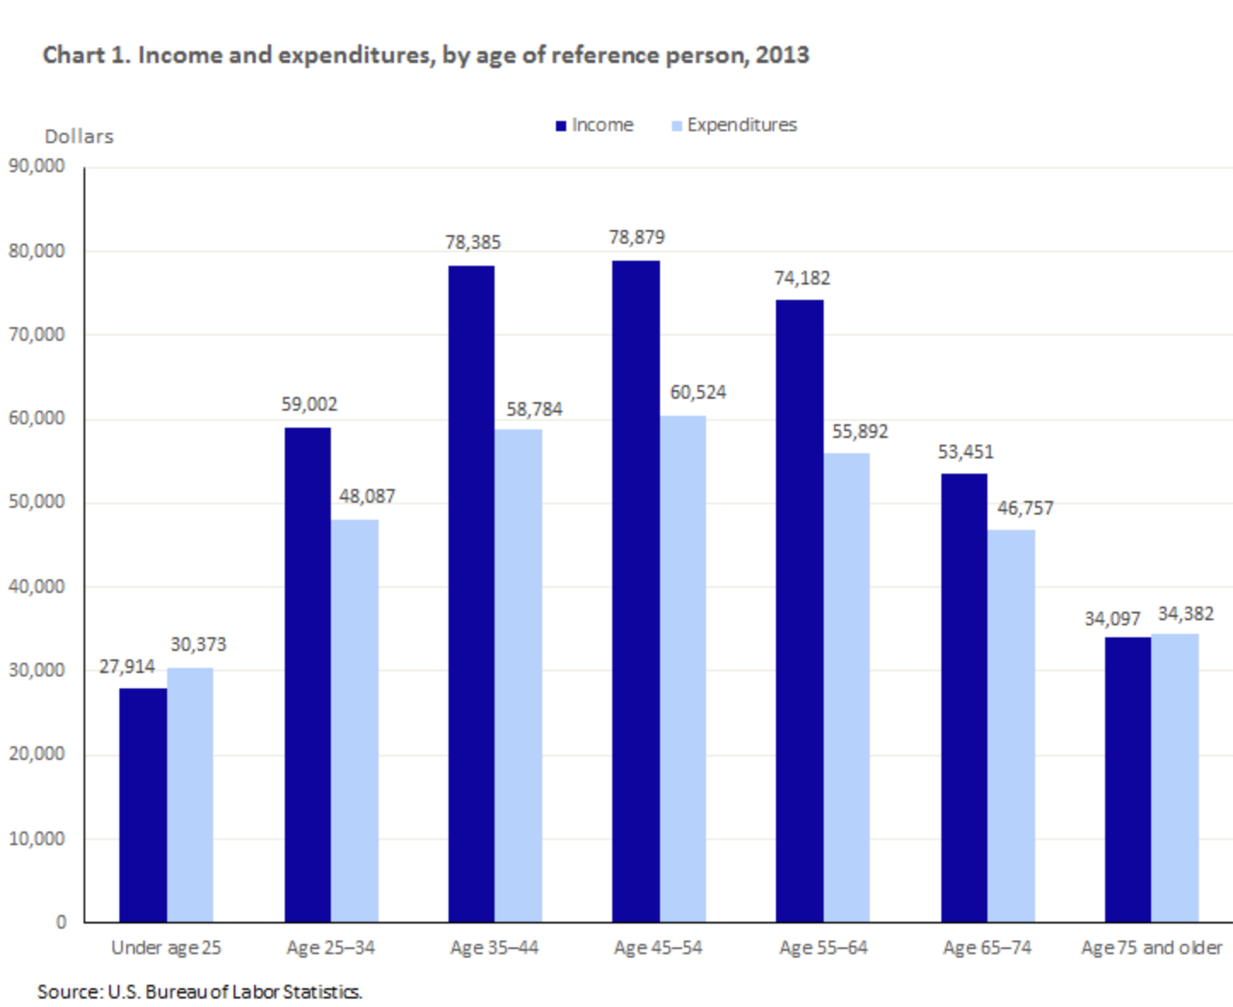
Ageism in Beauty
Glossier is a beauty brand that was founded in 2014 that started as a beauty blog called "Into the Gloss". It was the first notable beauty brand that was founded on the idea that consumers should have input in products and voice what they want to see in the market. The brand features people of all ages, races, genders, and backgrounds in their marketing and focuses on embracing rather than concealing.
The brands priority is authenticity and this has earned itself a loyal consumer base. Glossier had at estimated $1.8 billion revenue in 2021, which is only 7 years after it launched. Its success I attributed to its positive messaging and easy-to-use products. The formulas are high-quality and their marketing is engaging. Glossier has in-person shopping opportunities in major cities that are enjoyed by all ages because of the compelling designs and welcoming atmosphere. The brand has done a great job of stretching the horizons for a wide audience and encapsulates what an inclusive beauty brand should be.
According to Statista, ages 35-64 have the highest incomes and expenditures. From this data it is safe to assume that this age range is also investing in more wants and has more financial freedom than any other age. In addition to beauty brands focusing of marketing towards youth, they should also be focused on marketing towards their 35-64 aged audience. These are the people that can afford to invest the most in the company, therefore this audience should be the primary consumer stakeholder for cosmetics brands.
These companies could do a multitude of things to heal this disconnect with this audience including: enhancing their in-person shopping atmosphere, focusing on embracing the beauty of aging instead of "anti-aging", and educating consumers on how to use these skincare and makeup products. Additionally, brands should formulate products compatible with older skin types and this will give them a differentiating factor.

Slide 9
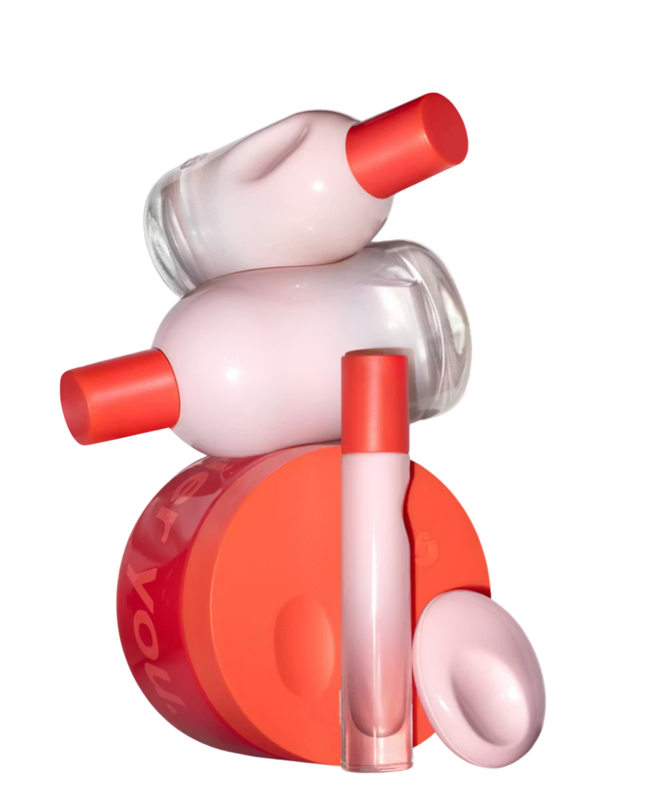
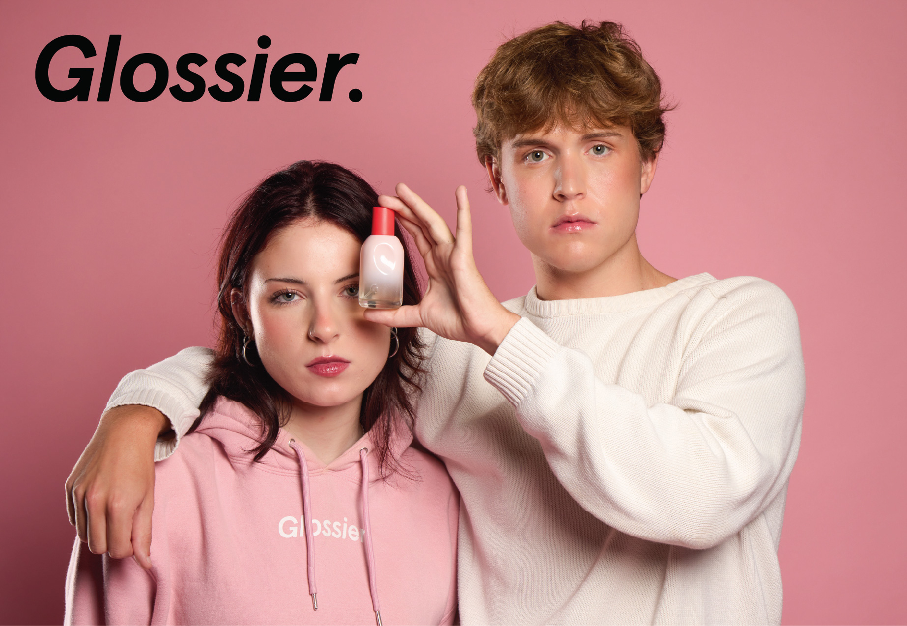
Unisex Fragrances
In more recent years, the fragrance industry has been less strict on labeling fragrances for a certain gender. Fragrance companies have started marketing perfumes as genderless. It is not uncommon for a singular perfume to be marketed towards a female and male audience. Regardless of gender identity, one fragrance can now be worn and popularized by both a females and males.
Fragrance companies are able to make their perfumes genderless by being intentional about the fragrances base notes. Fragrances are made up of top notes, heart notes, and base notes. Base notes are what last the longest and top notes are the most minor, meaning the fragrance particles are smallest and what someone smells first. Perfumers develop gender neutral perfumes by implementing base notes that will appeal to the masses. For example: using notes that are earthy and clean.
One brand that has set the scene for genderless fragrances is Glossier. Glossier's signature "You" fragrance has the following base notes: Ambrette and Ambrox. These are notes that are described as woody, warm, and clean. This makes it possible for every gender to wear and use this fragrance.
"Glossier You is a soft, warm and familiar skin-scent enhancing fragrance. Sparkling Pink Pepper opens into earthy Iris, settling into a strong, slightly-sweet base of Ambrette and Ambrox that wears close to skin–so it smells a little different on everyone!​"

Slide 10

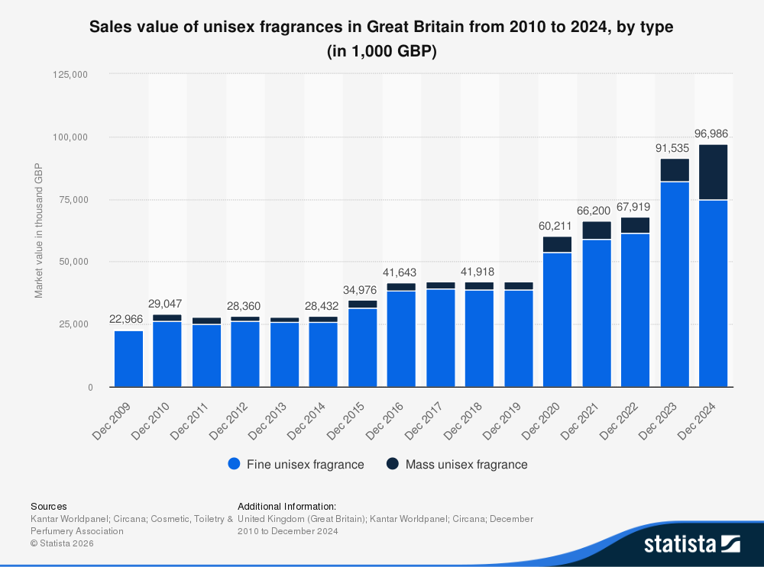
Unisex Fragrances
Unisex fragrances are particularly growing popular among the Gen-Z and Millennial age range. This consumer group has a growing desire for self-expression and individuality. Genderless fragrances are helping to bridge this gap because there is no restriction of which genders can wear one fragrance. According to Statista, from December of 2014 to December of 2024 the sales of fine unisex fragrances grew by 48.811 British pounds. Most of this growth came from more recent years.
According to the Business of Fashion, Gen-Z is straying away from just one signature scent and is leaning towards more versatile fragrances. Fragrance layering has transformed the fragrance industry because now brands are more focused on formulating a product that can be worn by anyone, and with other products. This has added to the rise of unisex fragrances and the breaking down gender restrictions and limitations in the market.

Slide 11
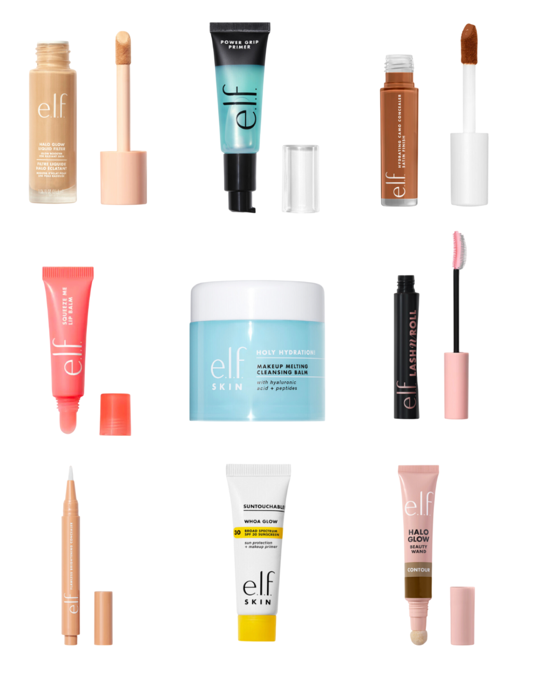
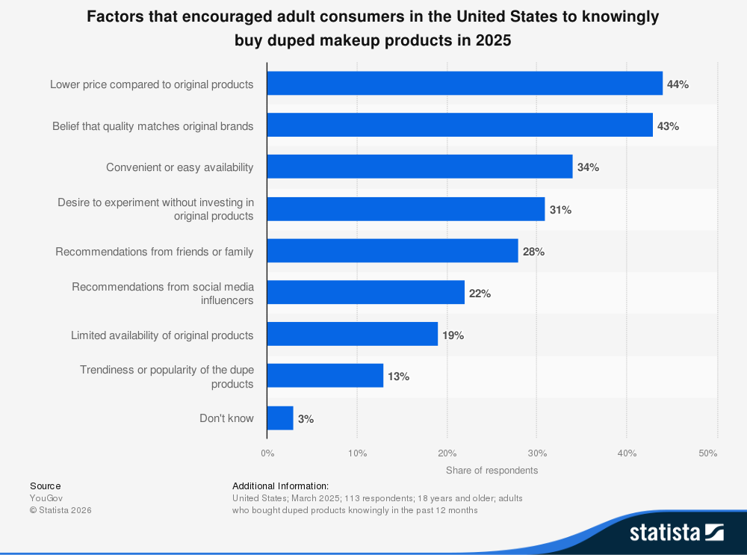
Makeup Dupes
'Duping' a product refers to when a brand creates a less expensive product alternative to a popular or mainstream product. In more recent years, consumers (especially Gen-Z) have been more concerned with quality and results than luxury products. Consumers are leaning more towards affordable alternatives that give them the same results and benefits as prestige brands. 'Duping' is very popular in makeup, skincare, and fashion. According to Statista, half of American shoppers that purchase dupes found them to be just as effective as the original brands.
The rise of social media has also spread dupe culture. Content creators spread knowledge of better priced makeup alternatives to their following on platforms such as Tik Tok and Instagram.
Through these social media facets, these content creators will share "get ready with me" videos expressing how a drugstore product can give them the same results and radiance as a prestige-grade brand/ product.
This is imperative for consumers today because this can mean the difference between a $15 product and a $50 product. One notable dupe is E.l.f.'s 'Halo Glow Liquid Filter' that retails for $15 comparatively to Charlotte Tilbury's 'Hollywood Flawless Filter' that retails for $50. This is a $35 price difference and customers have claimed they have similar, if not the same results. A $35 difference for a repeat makeup product over time will save a consumer hundreds, potentially thousands. E.l.f. is just one example of a brand that is into duping culture.

Slide 12
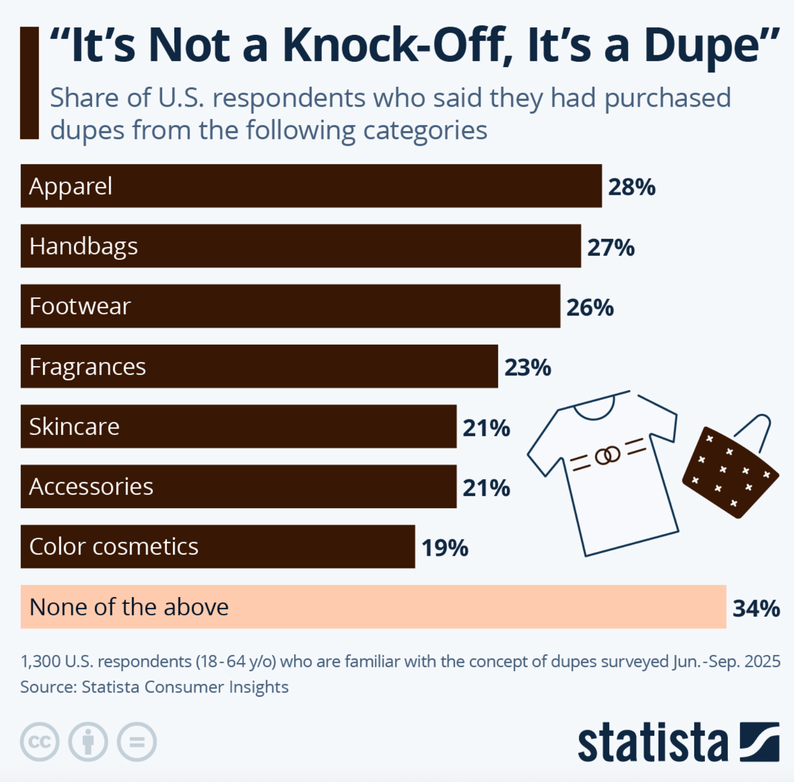
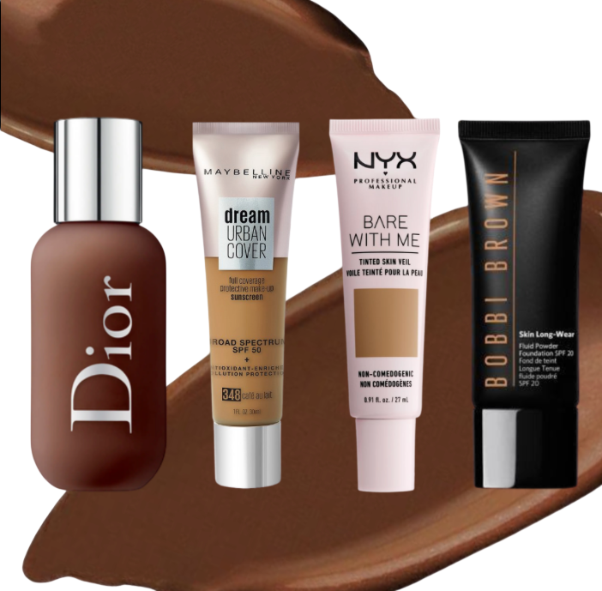
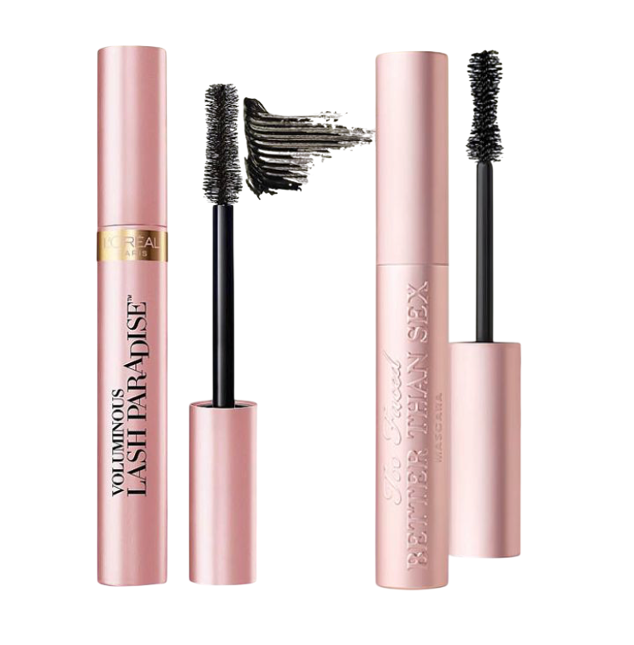
Makeup Dupes
There is no sign of makeup dupes slowing down. In fact, many luxury and prestige brands have had to shift their marketing. They have had to further deviate themselves from the market so they maintain a point of differentiation and consumer value. "Dupe" brands cater to a middle-class consumer who do not want to invest in luxury products, but that want the high-quality formulation that those brands offer.
Dupe brands are open about the cost it takes to formulate their products according to the Business of Fashion. This is a huge positive to consumers because they appreciate the brand transparency and authenticity opposed to other corporations.
According to this chart, 2/3 of the surveyed Americans that understood the meaning of what a 'dupe' is had purchased one from the above categories and 19% of that group had purchased a dupe makeup product.

Slide 13
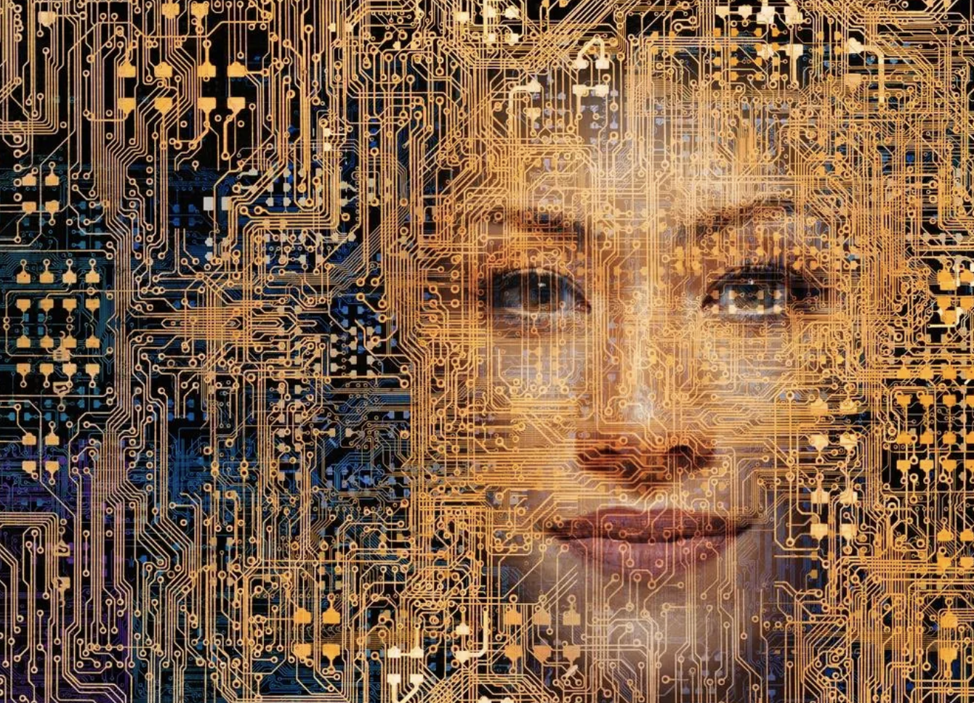
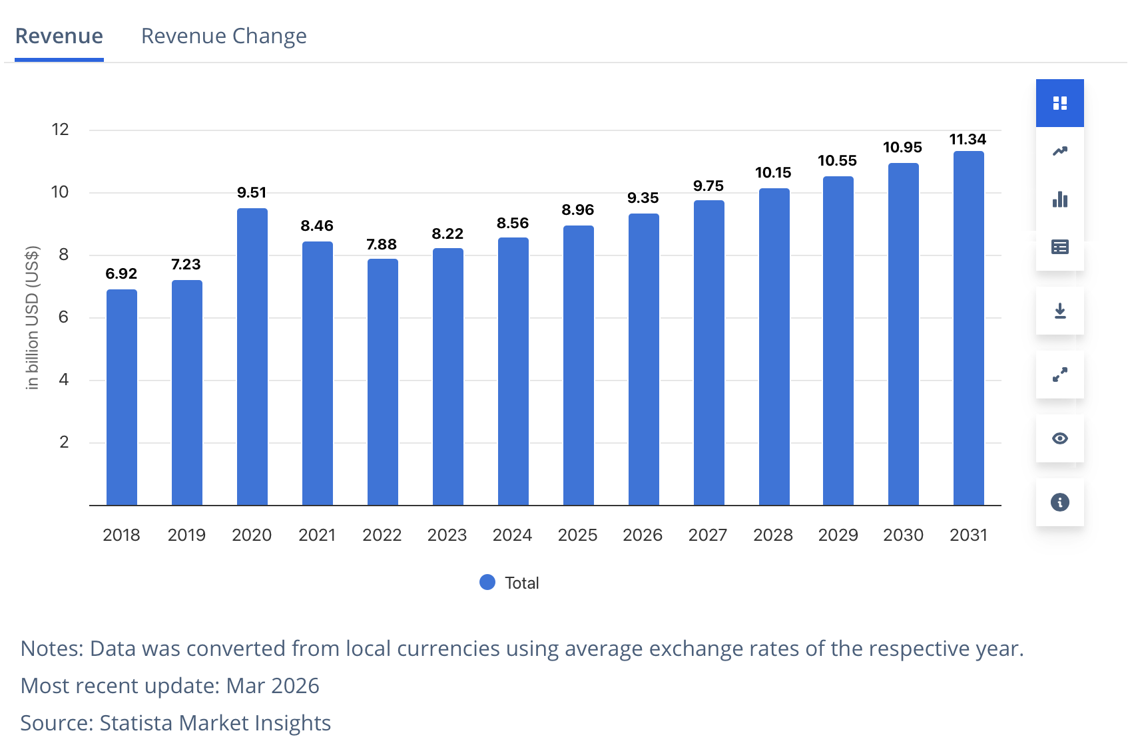
Beauty Tech
The beauty industry has really been advanced in the past couple of years with the implementation of AI. Artificial intelligence in the realm of beauty is helping companies reach a larger audience by eliminating the need or in-person expertise to go into a physical store and have to try on products. These technological advancements make it possible for people to try on products and experiment without having to leave their homes.
This is beneficial to both consumers and retailers. Consumers are able to confidently make choices on products without ever having to leave the comfort of their homes. Retailers are able to more accurately calculate what inventory they need to have on-hand because there is less returns and greater customer satisfaction.
There are now tools that corporations implement for their customers to get a skin analysis, try on different shades of color cosmetics, and get recommendations from live bot chats. All of these tools are classified as a form of beauty tech. This is extremely efficient because consumers can now get an expert opinion on a beauty-related subject 24/7 without leaving their phone screen
According to Statista, "In 2026, the revenue in the Beauty Tech market worldwide reaches a staggering US$9.35bn and it is projected to experience an annual growth rate of 3.93% (CAGR 2026-2031)."

Slide 14

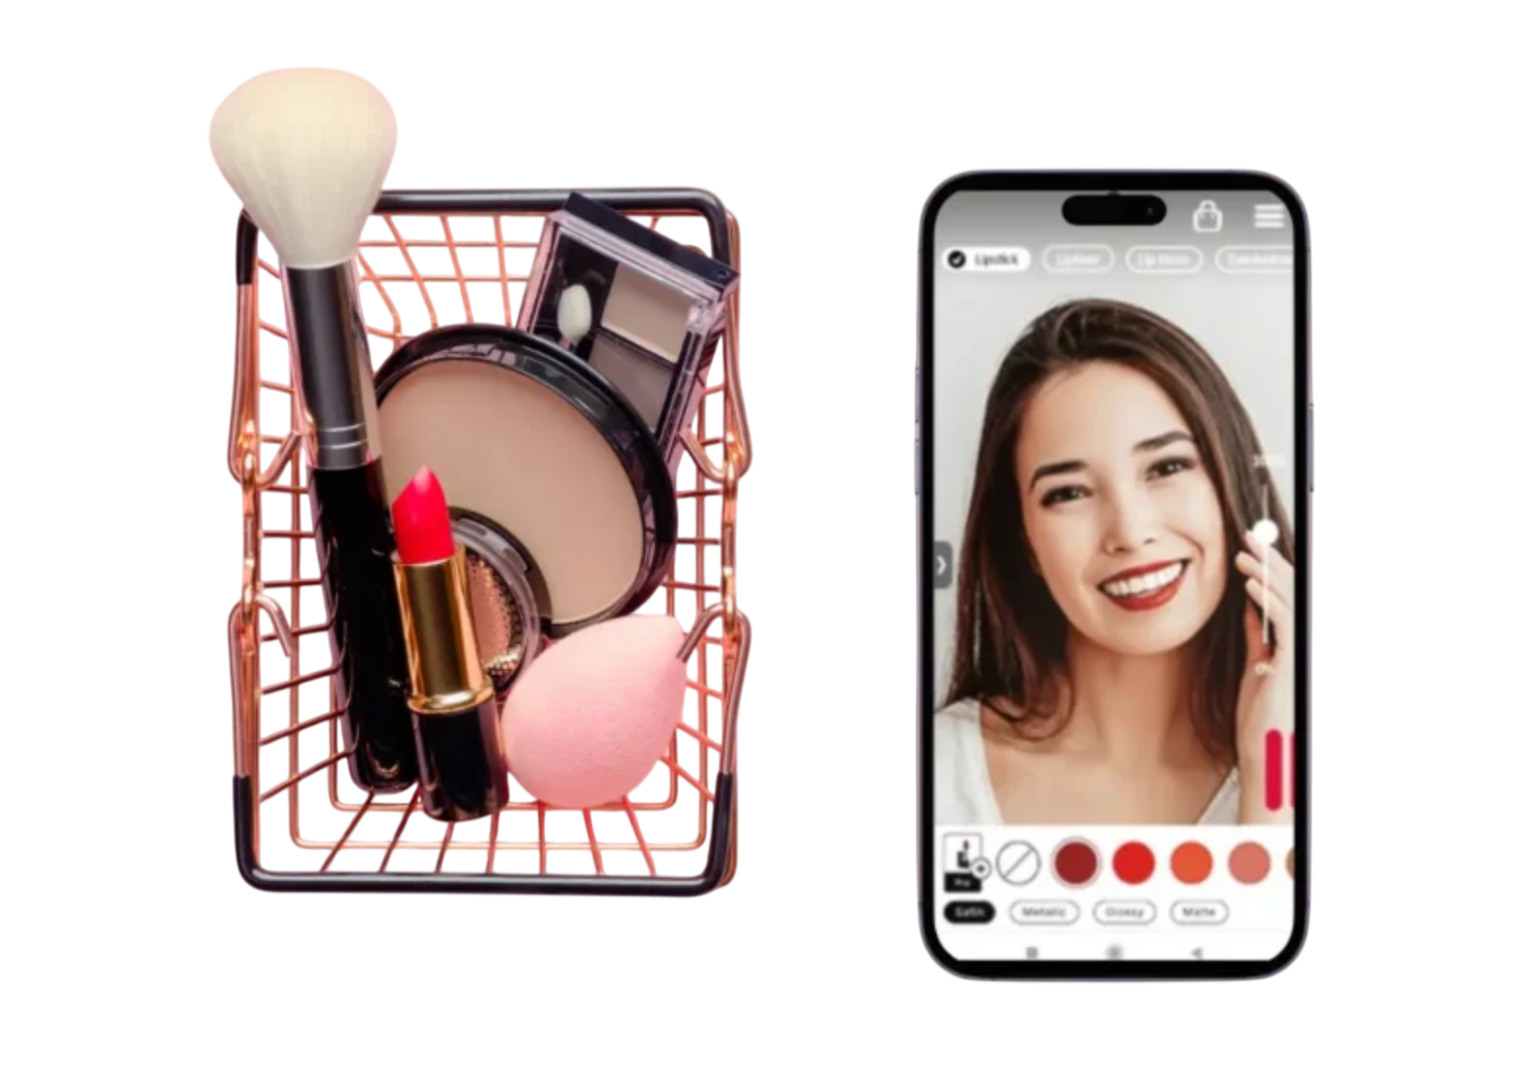
Beauty Tech
As beauty technology continues to advance, beauty companies such as Sephora and Ulta will offer more "phygital" experiences. This refers to when a digital and physical shopping experience is combined. Consumers will try out a beauty product and select it online and then collect it in-person. This is a good combination for consumers to interact online and in-person. Retailers get the benefits of having traction via ecommerce and brick and mortar.
Technology is advancing the health and beauty industry and revolutionizing the way that brands are able to connect and communicate with their consumers. L'oreal is one brand that is a good example of utilizing this up and coming technology. According to their website, they are using AI and offering digital services to engage their customer base and "delivering "Beauty for Each", powered by Beauty Tech"

Slide 15
Works Cited
Inclusivity in Beauty
Petruzzi, D. “Share of Consumers Who Rank Diversity and Inclusion as the Most Important Beauty Brand Values in the United States in 2021, by Generation.” Statista, 26 June 2025, https://www.statista.com/statistics/1289101/diversity-and-inclusion-as-the-most-important-beauty-brand-values-in-the-us/.
“Beauty & Personal Care - Worldwide.” Statista, https://www.statista.com/outlook/cmo/beauty-personal-care/worldwide.
“Research Day 2024: All.” Georgia College Knowledge Box, https://kb.gcsu.edu/researchday/2024/all/167/.
Siegel, Elizabeth. “Fenty Fragrance Fenty Eau De Parfum Is Cozy Like a Cashmere Sweater.” Allure, 1 Nov. 2024, https://www.allure.com/story/fenty-beauty-pro-filtr-hydrating-longwear-foundation.
“How Fenty Revolutionized the Beauty Industry.” Vogue France, https://www.vogue.fr/beauty-tips/article/how-fenty-revolutionized-the-beauty-industry.
“Dove Brand Value Worldwide.” Statista, https://www.statista.com/statistics/1010915/dove-brand-value-worldwide/.

Slide 16
Works Cited
Body Positivity and Size Inclusivity
Faria, Julia. “Share of Generation Z Consumers Who Deem It Important for Brands to Promote Positive Body Image Diversity in the United States as of May 2022, by Gender.” Statista, 25 June 2025, https://www.statista.com/statistics/1356280/gen-z-attitudes-brands-promoting-body-image-diversity-us/.
Parisi, Danny. “How New Brands Are Reconciling the Contradiction of ‘Body-Positive Shapewear.’” Glossy, 21 Apr. 2022, https://www.glossy.co/fashion/how-new-brands-are-reconciling-the-contradiction-of-body-positive-shapewear/.
McCall, Tyler. “What Happened to Body Inclusivity in Fashion?” Refinery29, 31 Jan. 2025, https://www.refinery29.com/en-us/body-inclusivity-in-fashion-2025.
“Facebook and Instagram Beauty and Body-Positive Conversation Trends.” Statista, https://www.statista.com/statistics/1374777/facebook-instagram-beauty-body-positive-related-conversation-trends/.
Kohan, Shelley E. “AE’s Aerie Brand Built on Body Positivity and Inclusion Is Slowly Edging Out Sexy Supermodel Juggernaut Victoria’s Secret.” Forbes, 28 June 2020, https://www.forbes.com/sites/shelleykohan/2020/06/28/aeos-aerie-brand-built-on-body-positivity-and-inclusion-is-slowly-edging-out-sexy-supermodel-juggernaut-victorias-secret/

Slide 17
Works Cited
Ageism in Beauty
American Psychological Association. “Ageism Is One of the Last Socially Acceptable Prejudices.” Monitor on Psychology, Sept. 2022, https://www.apa.org/monitor/2022/09/older-adults-ageism.
“Consumers Purchasing Beauty Products Online by Generation.” Statista, https://www.statista.com/statistics/1339362/consumers-purchasing-beauty-products-online-generation/.
U.S. Bureau of Labor Statistics. “Consumer Expenditures Vary by Age.” Bureau of Labor Statistics, https://www.bls.gov/opub/btn/volume-4/consumer-expenditures-vary-by-age.htm.
“About.” Jones Road Beauty, https://www.jonesroadbeauty.com/pages/about.
Valloppillil, Sindhya. “South of a Billion: Why Glossier’s Era of Unicorn Hype May Be Over.” Forbes, 11 Apr. 2025, https://www.forbes.com/sites/sindhyavalloppillil/2025/04/11/south-of-a-billion-why-glossiers-era-of-unicorn-hype-may-be-over/.
“The Jones Road to Growth.” Vogue, https://www.vogue.com/article/the-jones-road-to-growth.
“Forbes Business Council.” “In-Store Branding and the Psychology of Shopping.” Forbes, 4 Mar. 2024, https://www.forbes.com/councils/forbesbusinesscouncil/2024/03/04/in-store-branding-and-the-psychology-of-shopping/.

Slide 18
Works Cited
Unisex Fragrances
Manso, James. "The New Art of Fragrance Layering." The Business of Fashion, 16 Oct. 2023, www.businessoffashion.com/articles/beauty/fragrance-layering-kayali-mona-kattan-ds-durga-david-moltz/.
"Glossier You Eau de Parfum." Glossier, www.glossier.com/products/glossier-you?variant=44056890540277. Accessed 23 May 2024.
"Market Value of Unisex Fragrances in Great Britain from 2015 to 2022." Statista, Jan. 2024, www.statista.com/statistics/350654/market-value-unisex-fragrances-great-britain-uk/.

Slide 19
Works Cited
Makeup Dupes
Smith, Noah. "Primary Reasons Why Consumers Purchased Dupe Makeup Products Worldwide as of June 2024." Statista, June 2024, www.statista.com/statistics/1621885/reasons-consumers-bought-duped-makeup-products/.
"The Debrief: How ‘Dupe Culture’ Is Challenging Traditional Luxury." The Business of Fashion, 1 Nov. 2023, www.businessoffashion.com/podcasts/direct-to-consumer/the-debrief-how-dupe-culture-is-challenging-traditional-luxury/.
Ulta Beauty, www.ulta.com/. Accessed 22 May 2024.
Richter, Felix. "Where U.S. Consumers Buy the Most Dupes." Statista, 14 May 2024, www.statista.com/chart/35434/us-respondents-purchased-dupes-following-categories/.

Slide 20
Works Cited
Beauty Tech
Schiffer, Suki. "Advanced AI: The Next Frontier In Beauty Technology." Forbes, 17 Nov. 2023, www.forbes.com/councils/forbestechcouncil/2023/11/17/advanced-ai-the-next-frontier-in-beauty-technology/.
Morgan, Blake. "The Rise Of The Phygital Experience." Forbes, 16 May 2022, www.forbes.com/sites/blakemorgan/2022/05/16/the-rise-of-the-phygital-experience/.
"Beauty Tech - Worldwide." Statista, 2024, www.statista.com/outlook/cmo/beauty-personal-care/beauty-tech/worldwide. Accessed 23 May 2024.
"Beauty Tech Champion." L’Oréal Finance: 2023 Annual Report, 2024, www.loreal-finance.com/en/annual-report-2023/beauty-tech-champion/.

