Slide 1
Educator, Social Entrepreneur, Author, Publisher and Podcaster
www.voiceofdestiny.org
www.prayfastdaily.org

Slide 2
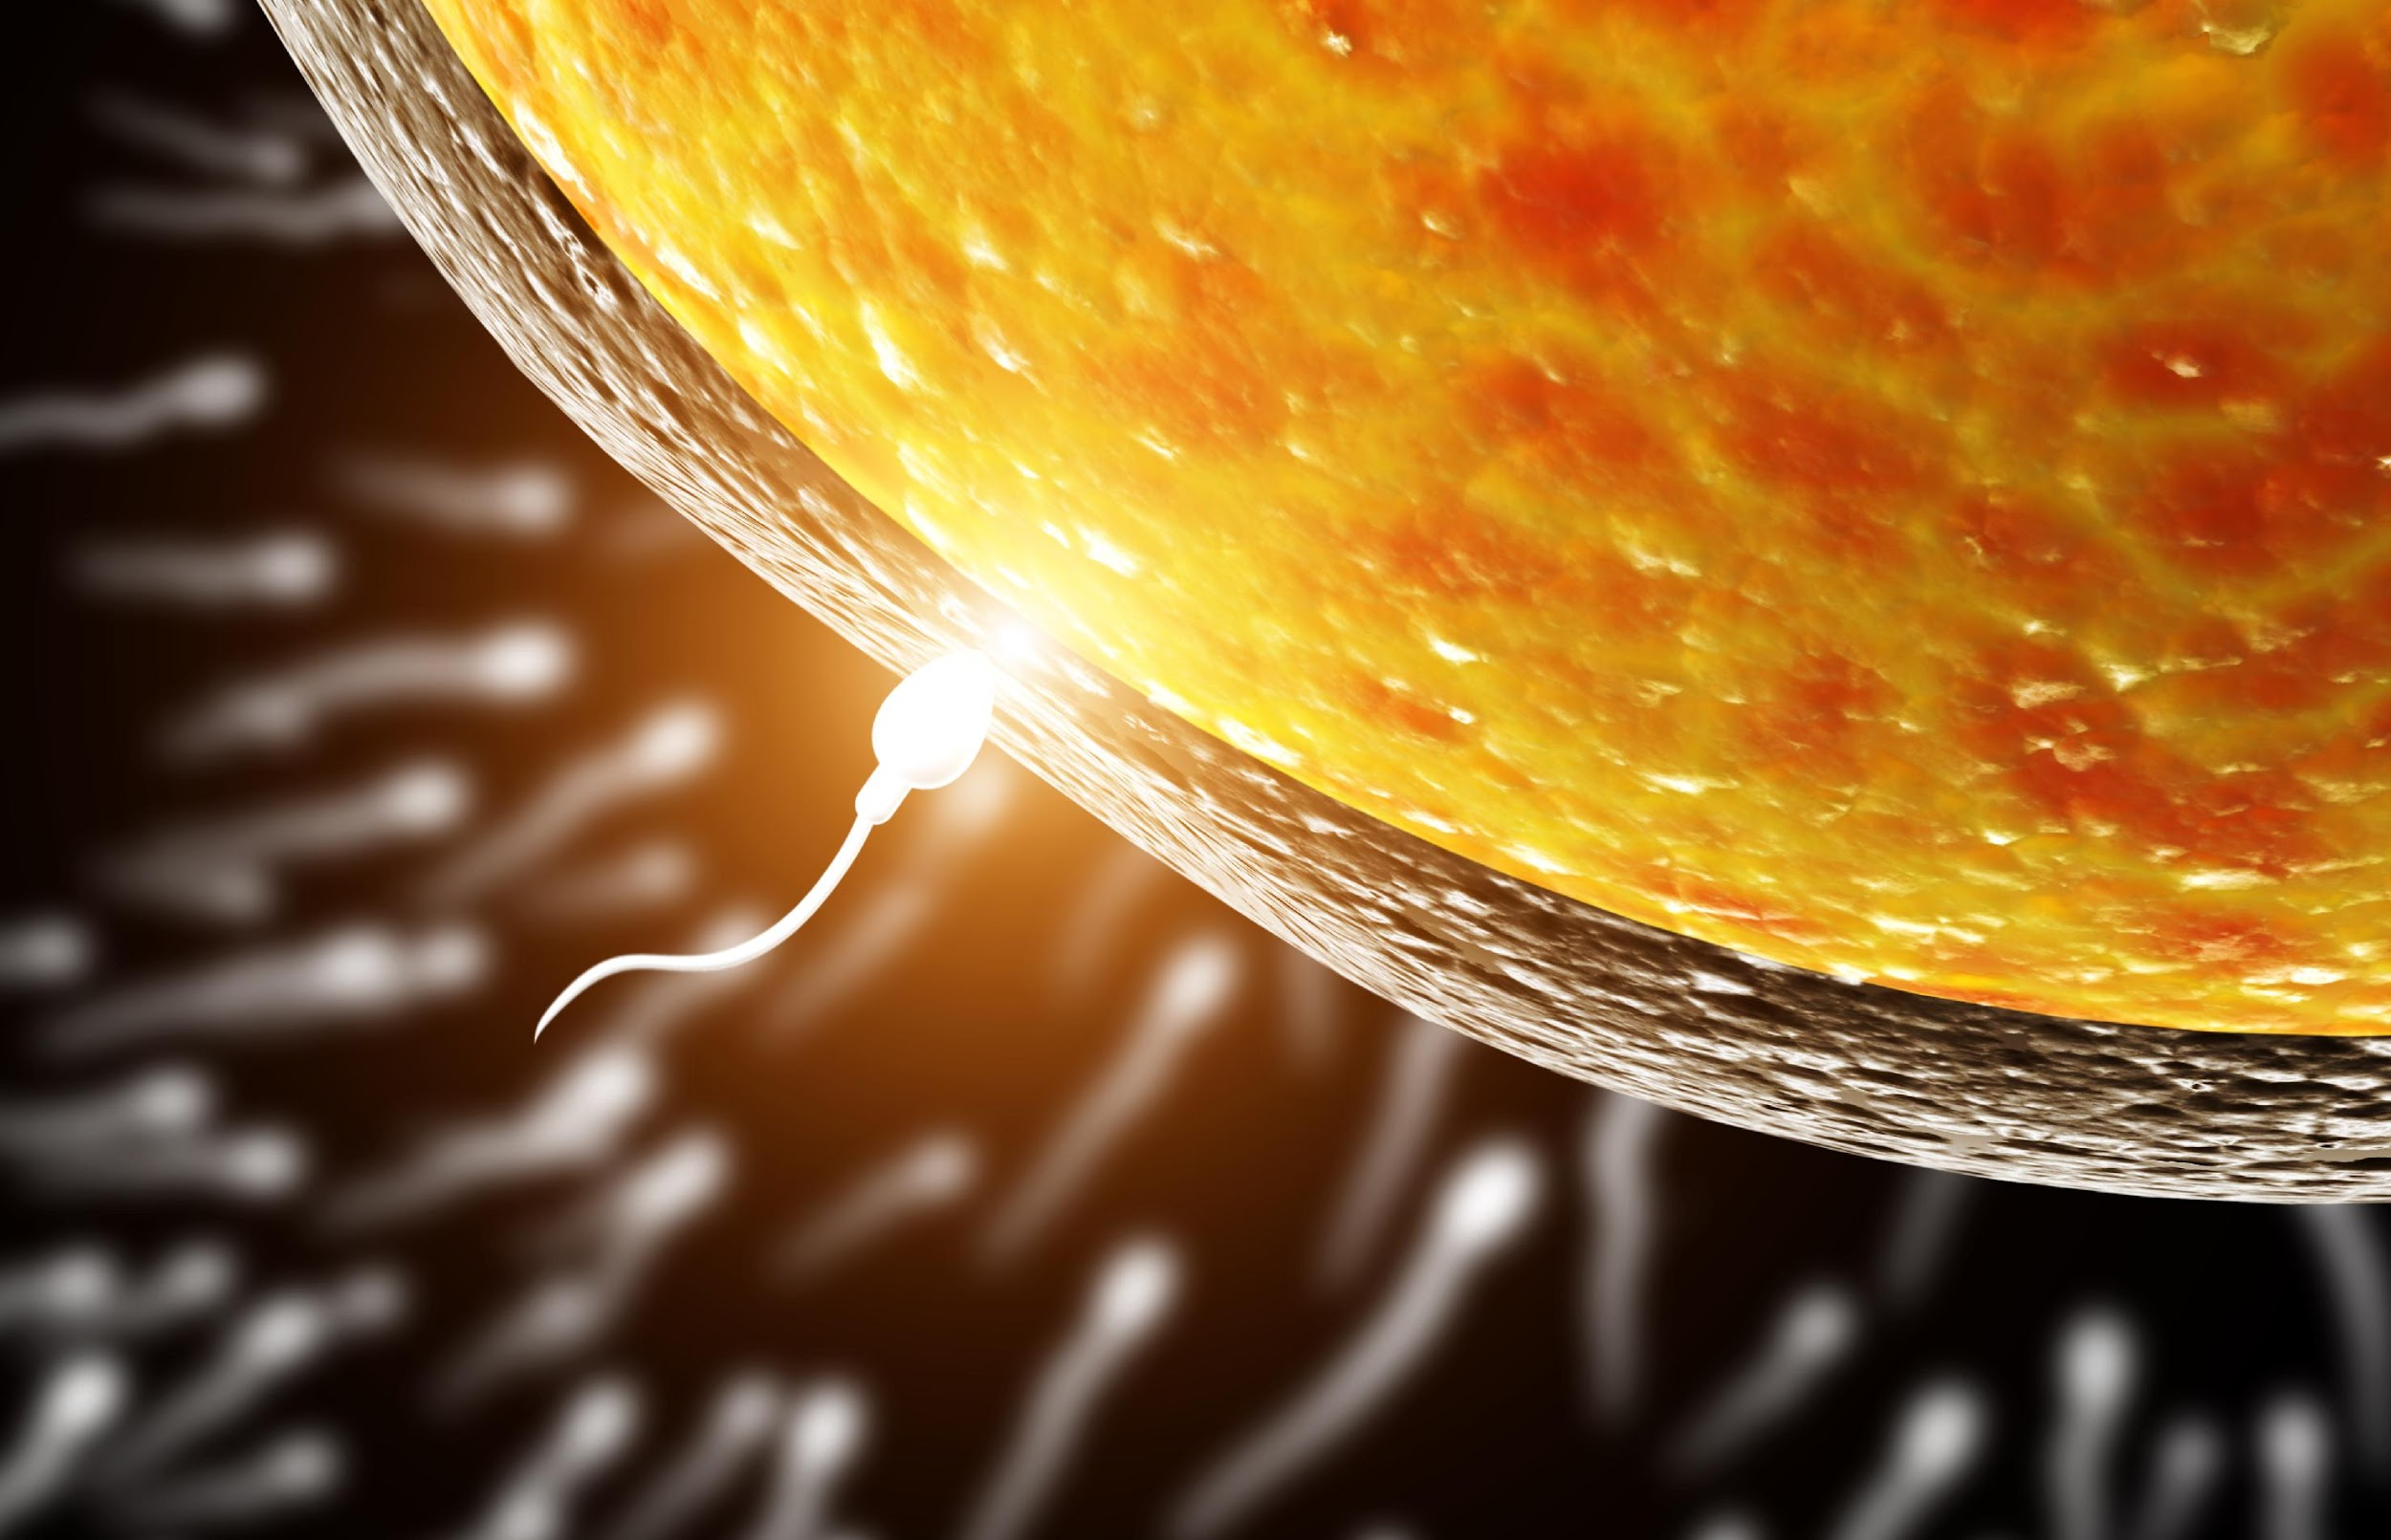

Slide 3
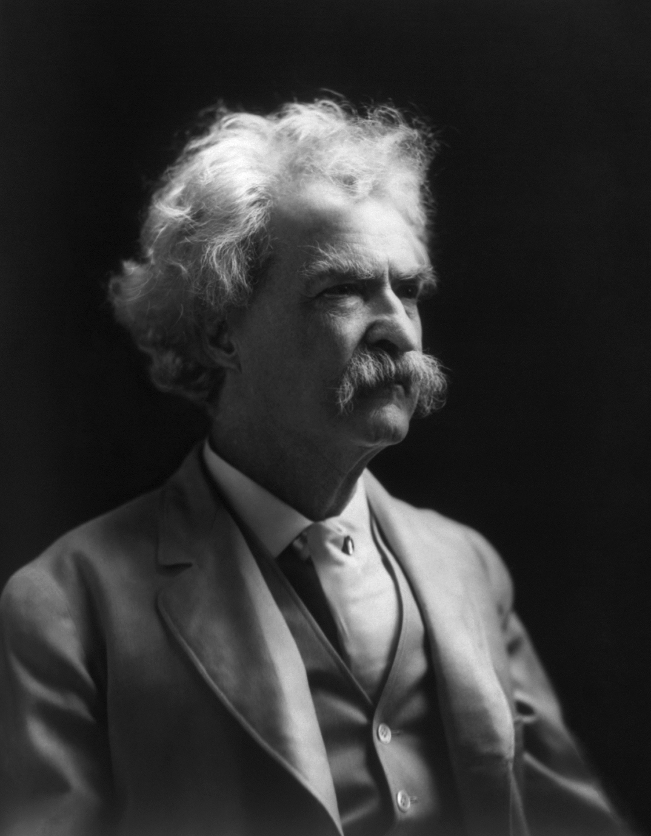
Myles Munroe
Mark Twain
“Keep you head and you heart going in the right direction, and you will not have to worry about your feet“
-Dr. Myles Munroe
There are 2 most important days in your life: "The day you were born and the day you discover Why"

Slide 4
You were made on purpose for a purpose
Psalm 139: 13 For you created my inmost being, you knit me together in my mother’s womb.

Slide 5
Five or Maybe Fifteen Strategies to Take Down the Giants Among Us
Dr. Daniel E. Haupt Sr.
Voice of Destiny Ministries www.voiceofdestiny.org
Pray Fast Daily www.prayfastdaily.org
Facebook.com/4voiceofdestiny
Destiny Community Development Center www.destinycommunitycenter.org

Slide 6
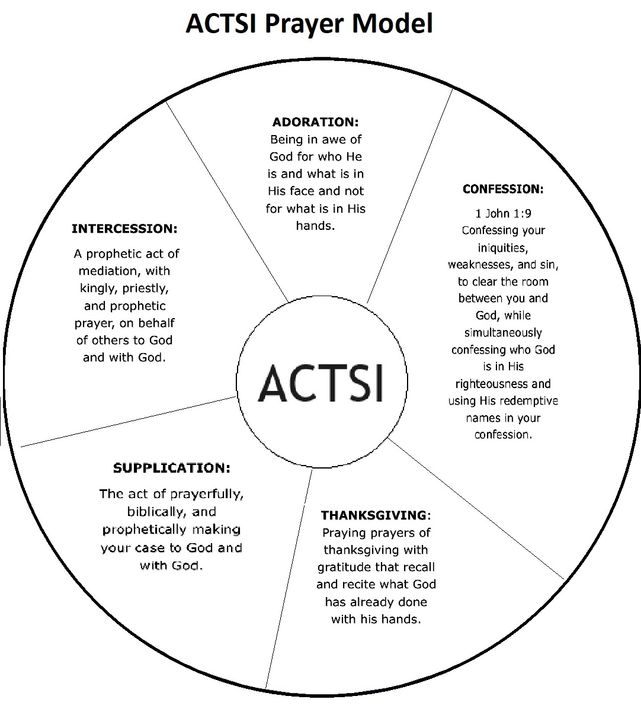
Prayer
Is an intimate and solemn; meeting, connecting, collaboration or dedication to a special purpose of service to God. A prophetic process of waiting on God until you connect, and/or something happens.

Slide 7
Strategies to Take Down the Giants Among Us
Prayer
Genesis 1:26-27
Faith
Hebrews 11:1 KJV/AMP
Courage
Joshua 1:9 AMP
Service
Matthew 20:26 ,
Ezekiel 36:37
2 Chronicles 7:14
Luke 18:1-2
Ephesians 6;17-18
Matthew 16:19-20
Matthew 9:29 KJV
Luke 7:9 KJV
Deuteronomy 31:6 AMP
2 Timothy 1:7 AMP
read v 23-28
Matthew 5:41

Slide 8
Strategies to Take Down the Giants Among Us
Discern & Act
Fight Your Giant With Vision
Fight with God’s Weapons
Cast Down Imagination
Job 32:8
1 Corinthians 2:9-10
Genesis 15:5
Habakkuk 2:2
Proverbs 19:21
2 Corinthians 10:4
1 Samuel 17: 38-40
(Read v 23-25)
Matthew 6:27, 34
1 Samuel 17:23-25
Jeremiah 18:12

Slide 9
Strategies to Take Down the Giants Among Us
Use the Power of Your Testimony
1 Samuel 17:34-37
Wisdom
Prophetic Self Talk (speak truth)
Leave the Comfort Zone
Fight with God’s Weapons
Deuteronomy 19:15
Acts 14:3
Exodus 35:31 read 31-35
Proverbs 1:7
1 Kings 4:29-34
Psalms 42:5
Ephesians 4:29
Ephesians 5:19 read 18-20
2 Corinthians 10:4
1 Samuel 17: 38-40
(Read v 23-25)

Slide 10
Strategies to Take Down the Giants Among Us
Don’t Set
Don’t Set Goals, Set Habits
Romans 12:2
1 Corinthians 6:19-20
Matthew 19:26
Hide
Hide from the Giants in the Gates of Praise
Matthew 6:9
Proverbs 18:12
Ephesians 5:18-19
Unearth
Unearth Your Potential
Genesis 1:12
Matthe 13:8
Matthew 25:15-30
Tap in
Tap in God’s Inspired Desire
Psalms 37:4
Mark 11:23-24
1 Corinthians 12:31

Slide 11
Early Morning Prayer 5:00 am (MT) www.prayfastdaily.org

Slide 12
Voice of Destiny Devotional Bible College
80 plus downloadable study guides
www.voiceofdestiny.org

Slide 13
Books by Dr. Haupt

