Slide 1

Early Morning Prayer
5:00 am (MT) www.prayfastdaily.org

Slide 2
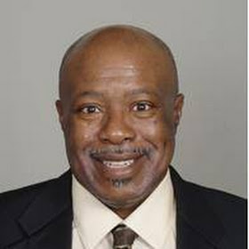



DR. DANIEL HAUPT
Educator, Social Entrepreneur, Author, Publisher and Podcaster
2
Destiny Community Development Center www.denverdestinycommcenter.org
Voice of Destiny Ministries www.voiceofdestiny.org Facebook.com/4voiceofdestiny
Pray Fast Daily www.prayfastdaily.org Facebook.com/prayfastdaily.org

Slide 3
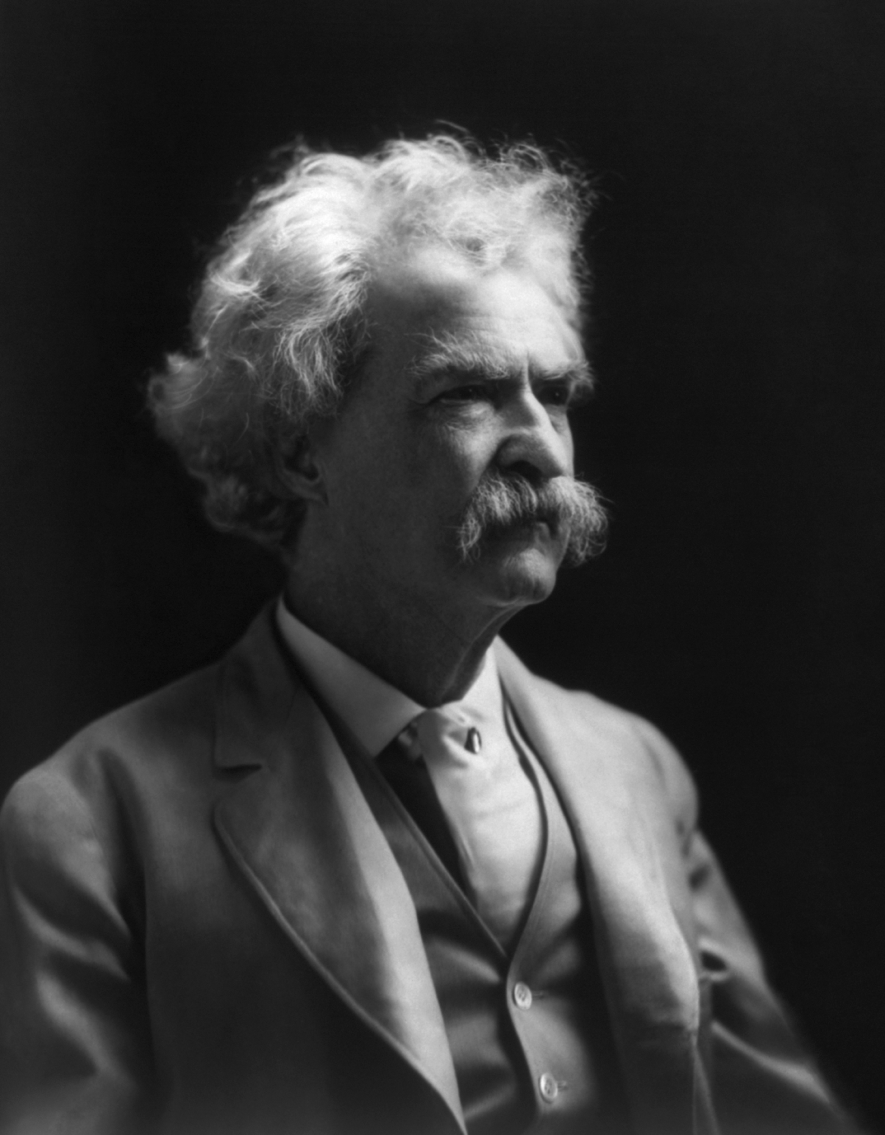
Mark Twain
Two important days in your life: "The day you were born and the day you discover why"

Slide 4
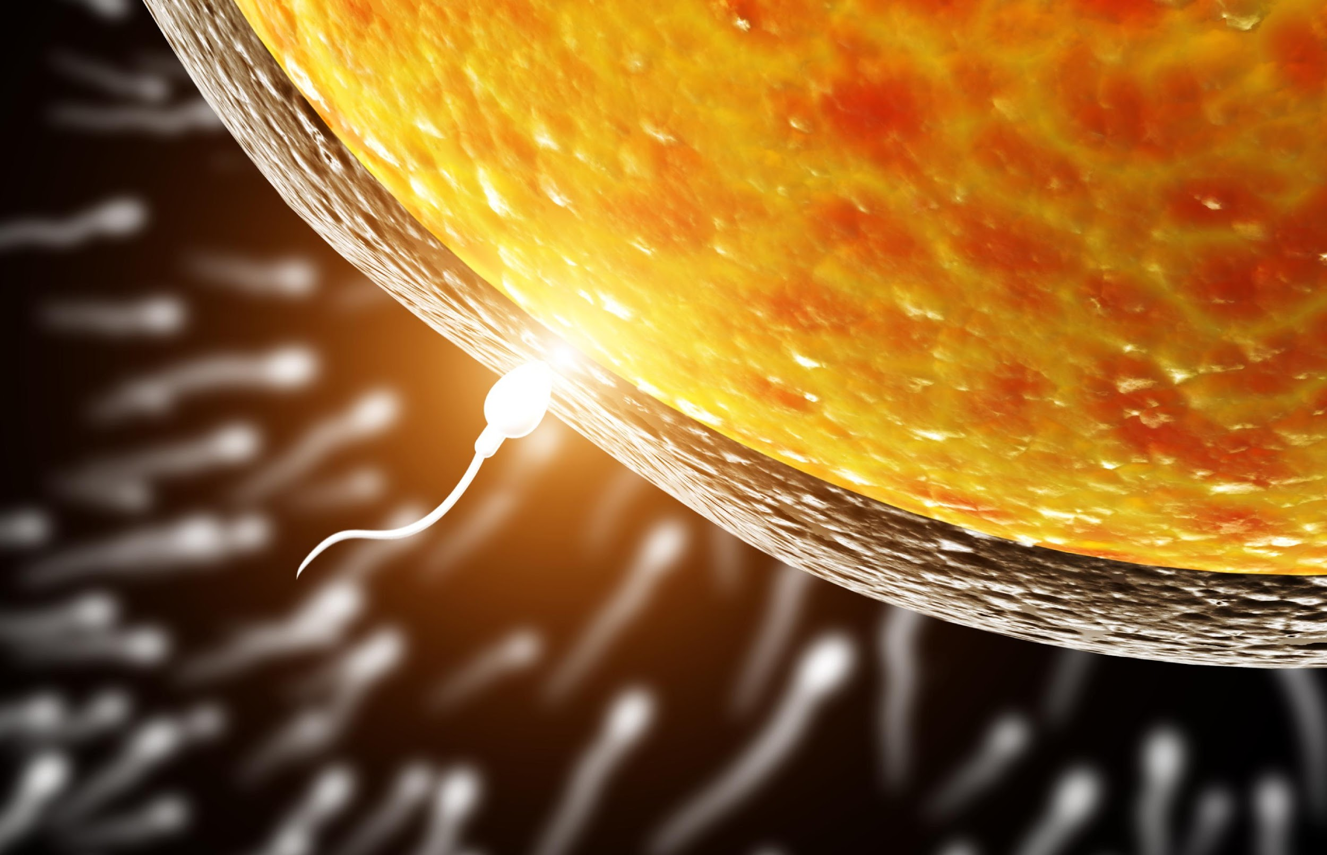
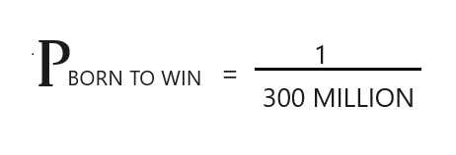
yOU

Slide 5

You were made on purpose for a purpose
Psalm 139: 13 For you created my inmost being, you knit me together in my mother’s womb.

Slide 6
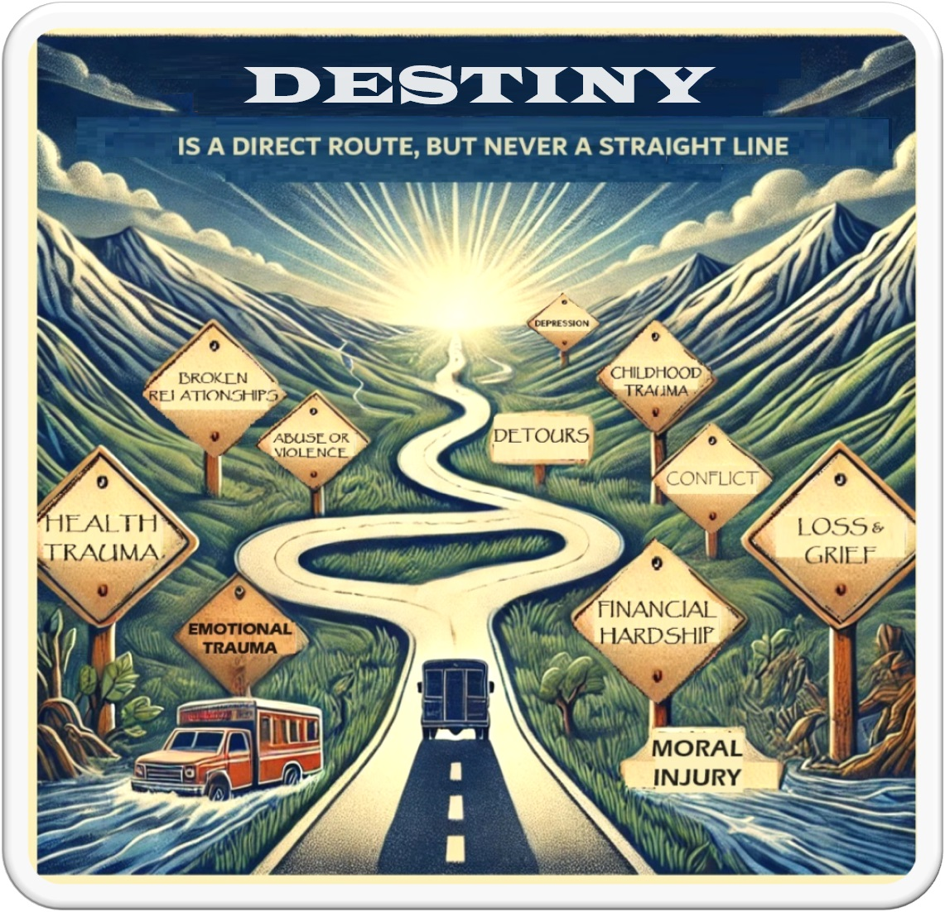

Slide 7
I am your constant companion.
I am your greatest helper or your heaviest burden.
I will push you onward or drag you down to failure.
I am completely at your command.
Half the things you do, you might just as well turn over to me,
and I will be able to do them quickly and correctly.
I am easily managed; you must merely be firm with me.
Show me exactly how you want something done, and after a few lessons I will do it automatically.
I am the servant of all great men.
And, alas, of all failures as well.
Those who are great, I have made great.
Those who are failures, I have made failures.
I am not a machine, though I work with all the precision of a machine.
Plus, the intelligence of a man.
You may run me for profit, or run me for ruin; it makes no difference to me.
Take me, train me, be firm with me and I will put the world at your feet.
Be easy with me, and I will destroy you.
Who am I?
I am HABIT!

Slide 8
Biblical Case Studies
Matthew 6:5-18
Genesis 1:26-28
Psalm 8:6
Psalm 115:16
Luke 18:1-8
Ephesians 6:18
Ezekiel 36:37
2 Chronicles 7:14
Isaiah 62:6-7
Ephesians 1:9
Ephesians 3:10-12
1 John 5:14
Psalm 119:147-148
Job 32:8
Matthew 26:44/2 Corinthians 12:8
Hebrews 11:1 (AMP)
Matthew 16:19-20
Note: This list is available at prayfastdaily.org

Slide 9
Prayer is a Habit
P h = m a p
Prayer Habit
happens
when
Motivation & Ability & Prompt converge at the same moment
Psalms 144:1 Praise be to the lord my rock, who trains my hands for war, my fingers for battle.

Slide 10


Slide 11
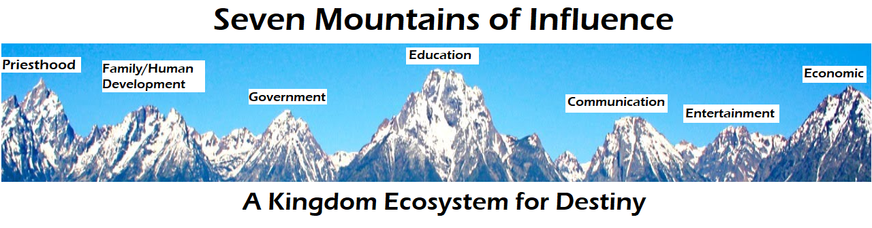
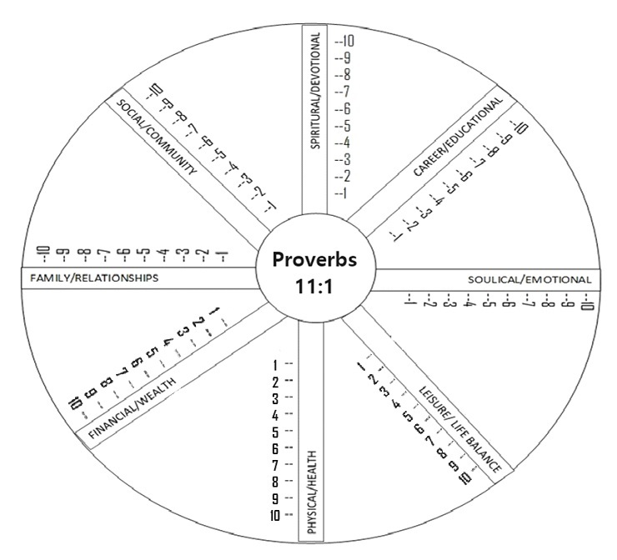

Slide 12
To Create a life balance wheel
Draw a large circle and divide it into equal segments like a pie chart. Each segment represents one of the key areas of your life.
Label each segment with the following categories: Spiritual/Devotional, Career/Education, Soulical/Emotional, Leisure/Entertainment, Physical/Health, Financial/Wealth, Family/Relationships, Social/Community.
For each segment, rate your current level of satisfaction on a scale of 1 to 10, where 1 means very dissatisfied and 10 means highly satisfied. Mark each segment accordingly.
Draw a line across each segment at the corresponding satisfaction level. Connect the marks to form an inner circle. This gives you a visual representation of your current life balance.
Look at the shape of the wheel. Ideally, the wheel should be round, indicating a balanced life. Areas with lower satisfaction levels indicate where you might need to focus more attention.
Identify the areas that need improvement and set specific, actionable goals for each. Make sure your goals are SMART (Specific, Measurable, Achievable, Relevant, Time-bound).
Develop a plan to achieve your goals. Break down each goal into smaller steps and set deadlines for each step.
Regularly review your life balance wheel and adjust your goals and action plans as needed. Life circumstances change, and it's important to reassess and realign your goals periodically.

Slide 13
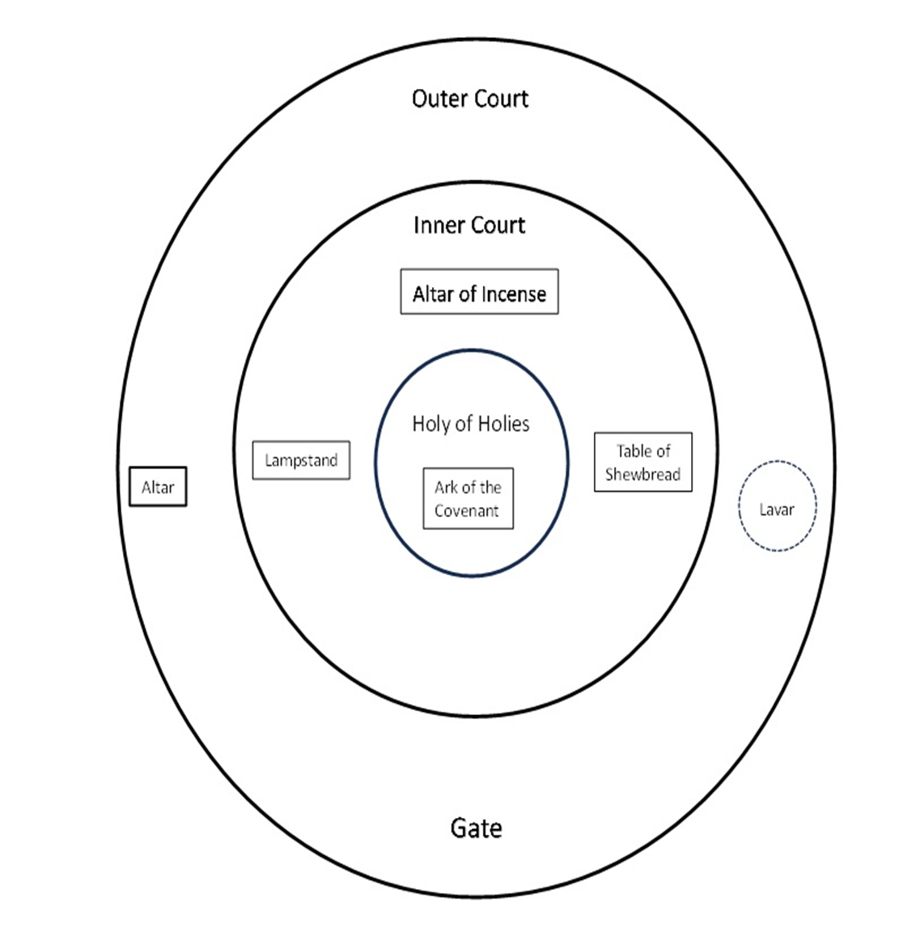
The Tabernacle Prayer Model

Slide 14
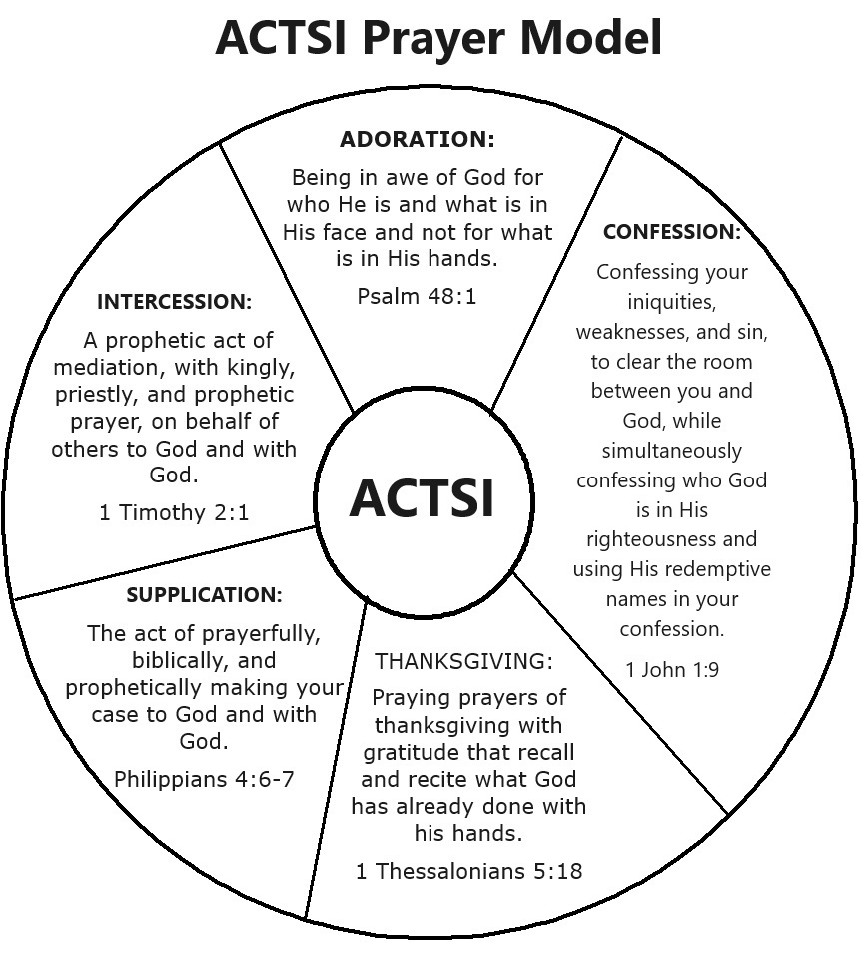
Prayer
Is an intimate and solemn; meeting, connecting, collaboration or dedication to a special purpose of service to God. A prophetic process of waiting on God until you connect, and/or something happens.

Slide 15

Voice of Destiny Devotional Bible College
80 plus downloadable study guides
www.voiceofdestiny.org
Email: prayingforyou@prayfastdaily.org

Slide 16




Books by Dr. Haupt

