Slide 1
Anxiety and Teenage Brain Development
Larissa Bateman, M.S., PPS, LMFT
Marriage & Family Therapist
School Counselor

Slide 2
12-17 yo: strong desire for independence though still dependent on parents. Social aspects become the focus. Who am I? Who do my friends think I am, what values do my parents want me to have? This stage opens the most opportunity for conflicts b/t parents and teens.
Very emotional, feelings become very strong.
As much development happening in the brain as infancy
Notes:
What do you remember about your child between 6 months old to two years of age? crawling, attachment, walking, talking, eating alone, fits, same process happening in the brain, thousands of connections and “pruning” out neurons that are unnecessary, allowing others to become stronger

Slide 3
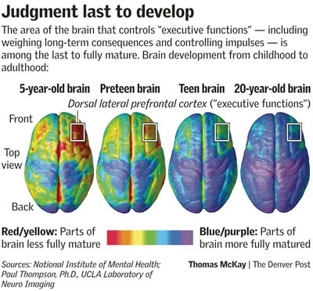
Judgment (If/Then, Impulses)
Notes:
That frontal lobe is the last to be activated and is responsible for impulse control and goal oriented thinking/ dissemination of steps to accomplish goals. The center of the brain, which is responsible for many functions, also holds the amygdala, which, as you can see activates early and is responsible for emotions/ anger/ fear/ happiness etc. The fact that it develops so early without the impulse control can lead to the fits you see in young children, and the strong anxiety that can develop as a result of stress and biological functioning in teenagers.

Slide 4
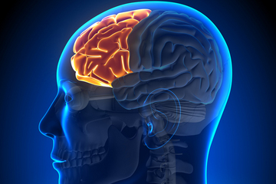
Brain Development
Frontal Lobe
Executive functions:
Organization
Time management
If/Then ‘causal’ thinking
Attention Span
Anger/Emotional connections become more intense
Notes:
what does it do and why is it important?
Regulates impulses, is considered “executive functions mecha” of the brain, 25 years to develop fully, myelination, 5 additional years with ADD or ADHD

Slide 5
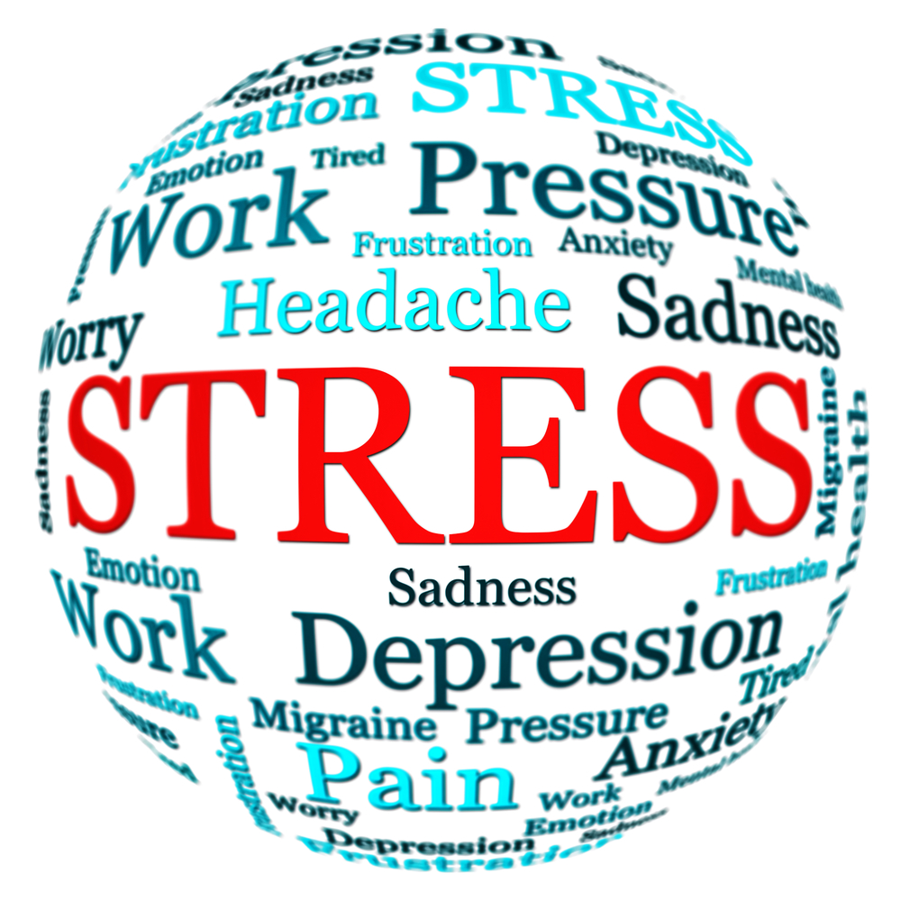
Stress: Eliminate or Manage?
“Good” stress: moving to a bigger home, first dates, winning a tournament, motivation for positive changes, promotions at work
Other stressors: homework, work, relationships, changes (example: death in the family, move, divorce etc)
Stress can lead to anxiety and in some cases compromise health if it is not managed (headaches, loss of sleep, poor immune system etc)
Notes:
everyone experiences some degree of anxiety and that it is actually a survival impact that we were designed to experience. However, we need to learn how to manage the anxiety and figure out if the anxiety is a signal (something that alerts or motivates us) or a noise (something that isn't useful and just distracts us).t is actually a survival impact that we were designed to experience. However, we need to learn how to manage the anxiety and figure out if the anxiety is a signal (something that alerts or motivates us) or a noise (something that isn't useful and just distracts us).

Slide 6
Home, School, Friends, Chores, after school activities, testing, College, Noise of the school Day, etc
Notes:
Kids have a lot of responsibilities on top of trying to grow up and understand their world. They should have chores, school/academics, friendships, and family connections. How much is too much though? Are they managing? Do they have “me” time or is there entire day scheduled?

Slide 7
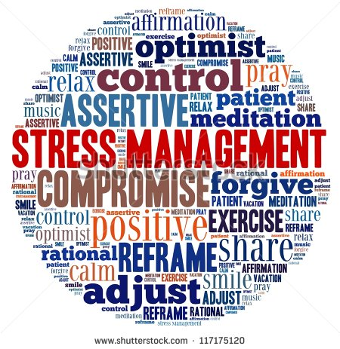
Resiliency Vs Withdrawal/ Disorder
“manage” stress
Breakdown obligations and schedules so that they aren’t so monumental
Staying here/now not “next week I have..” “what if ____ happens”
Build tolerance and ability to cope with daily stressors, recognizing some kids can handle more than others
Teachers can help with this in the classroom (Elise training)

Slide 8
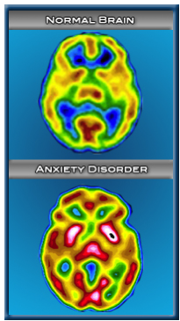
Very Real Physical Changes/Symptoms
Excessive worry
Restlessness, feeling keyed up or on edge.
Being easily fatigued
Difficulty concentrating
Irritability
Muscle tension
Sleep disturbance
The anxiety, worry or physical symptoms cause clinically significant distress or impairment in important areas of functioning;
The disturbance is not due to the physiological effects of a substance or medical condition;
The disturbance is not better explained by another medical disorder (American Psychiatric Association, 2013).

Slide 9
Anxiety Disorder and the aftermath
Quick Startle Reflex: Anxiety is also your body on high alert. The more stress and anxiety you experience, the more you create a higher natural baseline of stress inside you. If that anxiety level gets too high, you'll be more prone to startling, because your body will be quicker to reaching the startle phase of stress.
Irritation: Anxiety causes immense irritation. Sounds/noise/bright lights irritate
Stress Related Tension:
Inability to cope with day to day stressor and being triggered to panic attacks or outbursts or shutting down.
Notes:
cortisol is released during anxiety and that having it released for an ongoing amount of time can result in the inability to recall old memories or lay new memories, therefore interfering with learning. Paying close attention to the startle reflex, we can see that increased sensitivity to light or sound can be a symptom of anxiety and is certainly more difficult to manage in schools, where bright lights, loud bells, 30-35 students and socratic seminars are the norm.

Slide 10
Brain Development and Sleep
Basic needs for all living creatures include: Food, Water, Sleep and Warmth/Touch
Without these needs met, higher levels of success cannot be achieved.
Teenagers need 8-10 hours of sleep each night. Sleep cycles are ‘off’ for teens as circadian rhythms are later.
Lack of sleep:
Limits your ability to learn, listen, concentrate and solve problems. You may even forget important information like names, numbers, your homework or a date with a special person in your life;
Lack of sleep can contribute to acne, poor diet, symptoms of depression and anxiety
Leads to aggressive or inappropriate behaviors
High School Later Start?
Notes:
Typically, teenagers aren’t tired until 11pm or later, and so getting a full 9 hours of sleep is very difficult on school nights, it is additionally important to continue a similar schedule on the weekends. During adolescence, the body's circadian rhythm (an internal biological clock) is reset, telling a teen to fall asleep later at night and wake up later in the morning. This change in the circadian rhythm seems to be due to the fact that the brain hormone melatonin is produced later at night in teens than it is for kids and adults. So, teenagers have a harder time falling asleep.
Sometimes this delay in the sleep-wake cycle is so severe that it affects a teen's daily activities. In those cases it's called delayed sleep phase syndrome, also known as "night owl" syndrome. And if your sleep-deprived teen brings mobile devices into bed, surfing or texting late into the night, the light exposure could also disrupt circadian rhythm and make it harder to sleep.

Slide 11
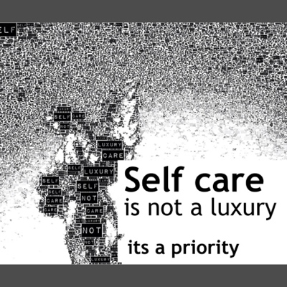
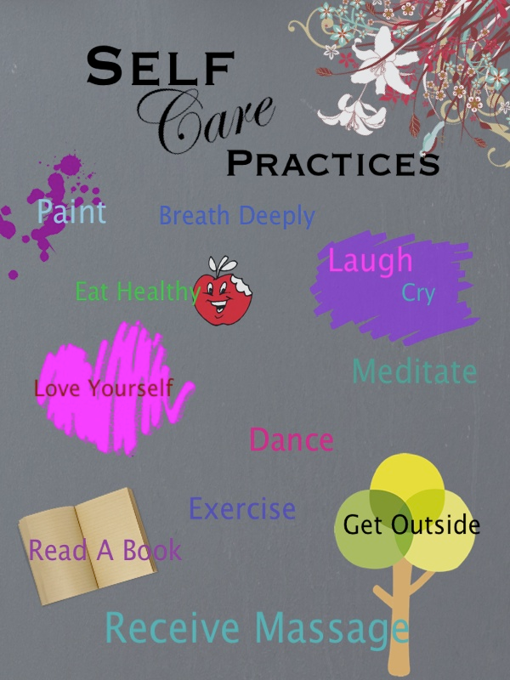
Taking care of yourself is essential to reducing stress
Notes:
and teachers, coaches, administration, and counselors can model how to manage stress for health and happiness

Slide 12
What are we doing to support our students?
Counselor support groups (not as many as needed) approximately 1:450-500 students middle school, 450:1 High School
Drop in deep breathing and relaxation at lunch Thursdays(Pleasanton Middle School)
Teacher support training for anxiety/ mindfulness in the classroom
Conversations with parents and students on stress management
Peer advocates in High School (Foothill)
Pause and Peace in the classroom (Pleasanton Middle School and some at other sites, could be district wide)
Parent Education (Parent University, Parent Project)
Notes:
Observations of changes in classroom and performance with students: Unanimously students ask for the 3 minutes of quiet in the beginning of class (mindfulness), students are more relaxed, focused, kids super anxious around tests and SBAC seems to allow a break from the stress, students report they “wish” other classes did this. Quiet is so important for many students. Choices in the classroom help and the transition. Noise, students, bells, bright lights, all contribute to heightened nervous system activity, leading to symptoms of anxiety

Slide 13
Student Supports
School social workers and parent liaisons can work with family to support anxious students.
Referral for outside counseling (up to 6 paid sessions)
Implementation of Positive Behavior Intervention System (PBIS) in schools

Slide 14
Resources
Smart but Scattered Teens, Peg Dawson, EdD
Parenting Children with ADHD: 10 Lessons that Medicine can’t teach, Vincent Minostra
Parenting with Love and Logic, Foster Cline and Jim Cay
National Institute of Mental Illness: www.nami.org
Contra Costa Public Health: http://devshrub.bravesites.com (this site is age specific and can address a variety of parenting concerns and child development)

