Slide 1



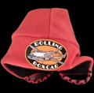
BOXCAR BULLETIN
EDITION
January, February, March, 2023
PRICE 5¢
☆☆☆☆☆☆☆☆☆☆☆☆
Spring time is arriving here in northern California and with it the trade show season. RBC California will start the year by attending the Redding Sportsmans Expo at the Redding Civic center.
The show dates and times are Saturday, April 1st: 9am – 5pm, and Sunday, April 2nd: 9am – 4pm. We’ll be in booth 63. This will be the 7th year of this show and it is growing each year. Last year there were 8000 attendees.
We will be running an informative slide show and we will have several finished components of the Boxcar on display.
Of course we will be offering a selection of “Donation Rewards” in order to entice the public to support our efforts. We will have memberships at several donation levels as well as Kaladi Brothers “Boxcar Blend” coffee, tee shirts, and mugs.
Let’s hope for a great show.
Then in May we will once
We also intend to be at Mat-Su Senior Services for the “Aging Healthy Walk and Mini Vender Fair”. Also in Palmer. Last year was the first year for this event and we believe the second year will be even bigger. This is an outdoor event so be prepared for weather. And bring your walking shoes.
We are also interested in several other Alaska events so check our website and Facebook page for the latest updates.
The big show will be held June 10th in California where Rolling Boxcar, in conjunction with the United Bikers of Northern California, will be sponsoring a motorcycle ride. The ride is called “The Boxcar Bike-In CA 2023”. Registered riders will travel from the Northern California Veterans Cemetery in Igo Ca. to the Boxcar build site in McArthur, CA. where they will tour the site and the boxcar then motor back to Fall River Mills CA. for an after party. Registered participants will be treated to burgers and brats at the after party as well as other goodies. So, if you ride, and want to join in, be at the cemetery June 10th at 10 AM for registration.
again be at the Great Alaska Aviation Gathering. This event is held each year at the Alaska State Fair Grounds and the Palmer Airport. Lots of great airplanes on static display. We will be setup in
the last airworthy C-119 on the planet. What an honor. I don’t have attendance number from last year for the entire show but we had almost 2000 nice folks come through our booth. It was a great show, a bit cool and windy, but that’s Alaska. Bring your coat and come on out.
We’ll have a Boxcar helmet for your head at the $10.00 donation level.

Slide 2
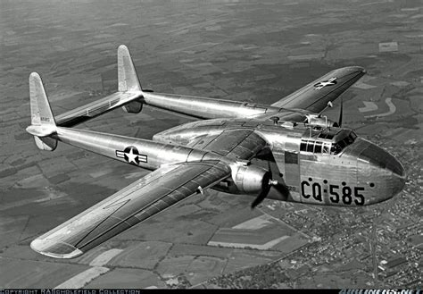
Registration donation will be $40.00 for a driver and $20.00 for a passenger. As part of the registration packet the first 100 registered riders get free lunch, an armband, which also serves as your meal chit at the after party, 1 Boxcar Bike-In embroidered patch for each rider, and 4 drawing tickets.
Then, it’s back home to Alaska and more fun in the midnight sun.
We’ll pass along more events as they are confirmed. Stay tuned.
WHAT WERE THEY THINKING?
If airplanes could understand what we say about them, they would be probably be horrified. Then again, if people understood how airplanes are designed, maybe they would be more respectful. …maybe….
The very first thing we need to know in designing an airplane, is to define just what we want this new flying machine to do. And this first step is where many projects begin to go off the rails. You *think* you know what you need, and write your specification accordingly. If you’re lucky, when your design is finished and ready for production, it can meet the new, requirements that have evolved. Your offering will hopefully have excellent growth potential that can be tapped for follow-on development. To see how this works, let’s take a look at our Boxcar.
The course of the Second World War gave rise to a military requirement for transport aircraft more
capable than the C-46 and C-47 series. Planning for the invasion of the Japanese home islands foresaw massive paratroop and equipment drops – easy enough to unload troops from side doors, but equipment is a whole different deal – especially when people are shooting
at you. To ease the problem, full height, full width, clamshell doors were selected for the back of the fuselage pod of Fairchild’s ground-breaking C-82 Packet.
Those big doors that gave full access to the cavernous hold of the Packet were among the most important parts of the layout. Chief designer Armond Thieblot chose a high wing configuration, which allowed the fuselage to be lower to the ground and gave excellent propeller ground clearance. While this made loading and unloading easier, it in turn required longer and heavier landing gear legs.
Twin engine aircraft are cheaper than four engine types, IF there are engines of sufficient output. For the Packet, Pratt & Whitney’s classic 2,100 hp R-2800 two row 18 cylinder radials were selected. But how did Fairchild know that 4,200 hp was going to be adequate?
That’s it for Part One. Check out the next newsletter to see how much more fun the art of aircraft design can be!
2023 Great Alaska
Aviation Gathering
Alaska State Fairgrounds
and the
Palmer Municipal Airport
Palmer, AK
May 6th & 7th, 2023

Slide 3
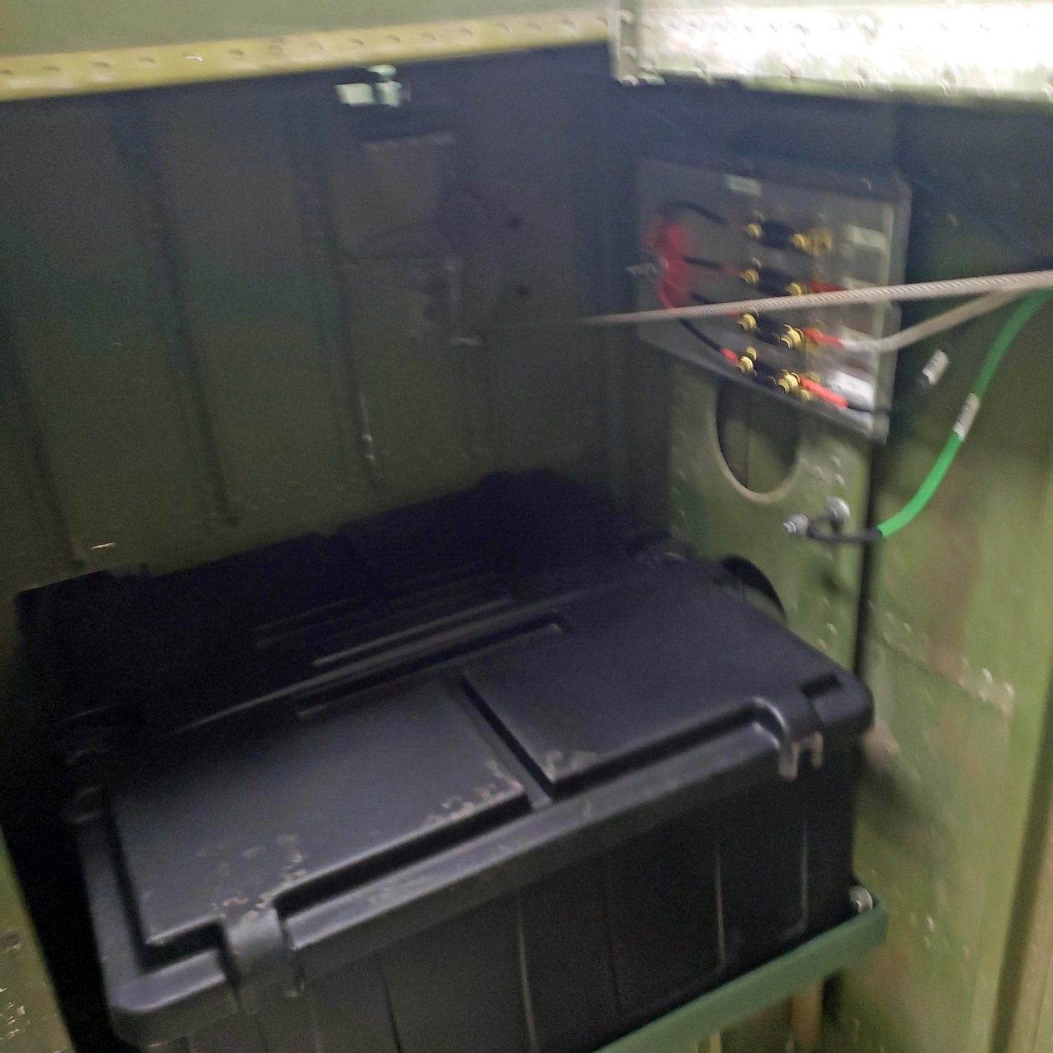
Electrical Heavy Weights
Batteries are categorized by groups based on their physical size. Typically, the larger a battery is the more capacity and power it can deliver. Rolling Boxcar has two 8D batteries that are some of the largest 12-volt batteries available and have rough dimensions of about 21″x11″x10″ and typically weigh about 150 pounds,
The large size of these batteries allows them to have more, and thicker, lead plates inside them. The added plates giving more capacity, typically 230-300 amp-hours and can provide upwards of 1,500 cold-cranking amps (CCA). RBC needs two of these 8D batteries to turn her 24 volt starter to crank up her DT-466 diesel engine.
The large capacity and high cranking amps make these batteries the best for both starting and house power for lighting and other systems. A single 8D battery can replace three smaller lead-acid batteries reducing the overall battery footprint with the only drawback being their size and weight.
RBC’s two 8Ds live just
in front of the front axle opposite the 100 gallon
fuel tank. They are completely enclosed in a
plastic acid proof
box with a vacuum fan to vent off the flammable hydrogen gas created while charging.
So when it comes time to head down the road or just flip on a light, RBC has the power to deliver thanks to her two 8Ds.
SAND
All of you have heard of, and some of you own, a sander. You might have a belt sander or random orbital sander. Folks that live in snow country can’t wait for the sander to come around in the morning to sand the icy roads. There is a Colonel Sanders and currently a Sanders in Washington. So to keep up with the Jones’s, Rolling Boxcar has its own sander.
It’s known as a Traction Sander. It’s an ingenious device which consists of a tank of sand, mounted just in front of the drive axle/tires, one on each side, on the rear of RBC. Under this tank is a rubber upside down “Y” shaped hose that points strait down to the road surface. It’s rubber so it can take the occasional rock or small obstruction and not be damaged.
When the road gets icy and traction is in question, RBC’s driver can push a button in the cockpit and a vibrating/auger motor will activate inside the sand storage tank and distribute a small amount of sand on the road just in front of the drive tires. Just a little sand is all it takes to get the traction RBC needs to keep on rolling.
So on a snowy morning when RBC’s mobile classroom is headed to your school, thank the sanders for giving us the traction to get there.

