Slide 1
Roles and Responsibilities of County Officials

Slide 2
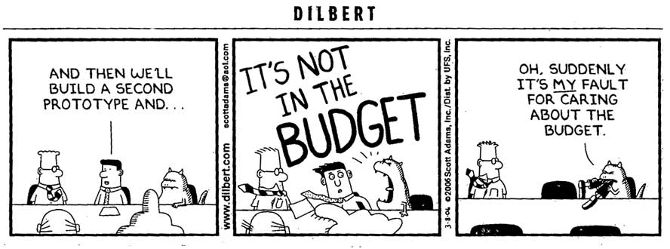
budgeting BASICS
The budget is a document that sets county priorities through the allocation of county funds.
Elected officials and department heads all have important roles in developing the county budget.

Slide 3
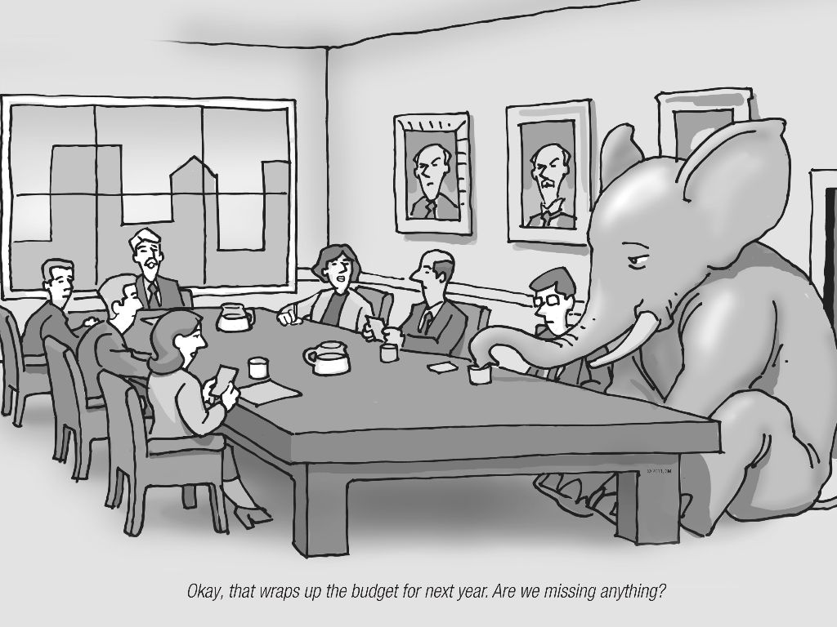
Whose budget is it?
The budgeting and financial process of the county involves every elected and appointed county official.
The county auditor and the board of county commissioners are generally the most directly involved in the county budget process.

Slide 4
What about Intergovernmental & nonprofit partners
District Court
Health Districts
Community Colleges
MPO’s
Regional Transit Authority
Shared Jurisdiction (cities, highway districts, state)
Social service partners (hospital districts, community crisis centers, substance abuse treatment, homeless/transitional housing, etc.)

Slide 5
6 Steps of County Budgeting
Notice of budget hearing by Aril 30th (§63-802A)
Notify elected officials and department heads by 1st Monday in May to submit budget requests
Preliminary budget requests filed to clerk by 3rd Monday in May
Auditor presents recommended budget to BOCC by 1st Monday in August
Auditor publishes tentative budget by third week in August with notice of budget hearing
Budget hearing and adoption of budget in early September

Slide 6
County Clerk (Auditor)
Chief Budget Officer (Section 31-1602, Idaho Code)
Provides budget forms to county offices and departments to collect:
Detailed revenues and expenditures from previous two years,
Amounts received and expended in the current year, and
Estimates for the ensuing year.

Slide 7
County Auditor is Budget Officer
Prepare preliminary budget for BOCC
Oversees compliance with adopted budget
First Monday in May – get estimates of revenue from officials
Third Monday in May – estimates of expenditures due to Auditor
Departments should ask for what is needed
Avoid “directives” such as “no more than 3% over last year”
List future year and prior 2 years

Slide 8
Tentative Budget Preparation
Clerk/Auditor prepares a suggested budget to be submitted to BOCC by 1st Monday in August (Section 31-1603, Idaho Code).
Budget should include the following classifications:
A Budget: “Salaries”
B Budget: “Detailed Other Expenses” or “Detailed Other Expenses and Benefits”
C Budget: “Capital Expenses” (not required)
D Budget: “Benefits” (if not included in ”B” budget)

Slide 9
Suggested Budget
Submitted by Auditor to BOCC by first Monday in August
BOCC develops tentative budget after considering info from Auditor
Auditor publishes tentative appropriations by 3rd week in August
Expenditures listed by category
BOCC conduct public hearing (after notice published in official newspaper)

Slide 10
Board of county commissioners
Meet with County Auditor to assist with financial planning.
Best practice: Meet with each elected official and department head to review budget and discuss revenues and expenditures.
Adopt tentative budget to be published by 3rd week of August (Section 31-1603, Idaho Code)
Hold a public budget hearing before the first Tuesday following the first Monday of September (Section 31-1605, Idaho).
Any taxpayer may appear and be heard upon any part or parts of said tentative budget.
Adopt the budget.

Slide 11
Tentative Budget Basics
Reflects setting of property tax levy rates, county fees for service, etc.
Reflects levels of service provided by county (maintenance budget, growth budget, hold backs, etc.)
Should support the county’s future growth demands
Once published, a tentative budget can’t be increased (unless republished)

Slide 12
OTHER ELECTED OFFICIALS & DEPARTMENT HEADS
Provide budget requests and revenue estimate to Auditor in a timely manner.
Penalty of up to $50 for noncompliance (Idaho Code Section 31-1602)
Provide justification for budget requests.
Attend public budget hearing to answer any questions (Idaho Code Section 31-1605).
Work with Auditor throughout the year to keep them notified of unusual expenses or windfalls.

Slide 13
Publication of Tentative Budget
Once the BOCC has approved a tentative budget, the County Clerk/Auditor is required by law to publish the tentative budget in the newspaper no later than the 3rd week in August (Section 31-1604, Idaho Code).

Slide 14
Budget Implementation

Slide 15
Basic Rule
The aggregate of expenditures authorized against any fund shall not exceed the estimated revenues to accrue to such fund during the ensuing fiscal year from sources other than taxation together with any balances (and) plus revenues to be derived from taxation for such ensuing fiscal year.

Slide 16
The basics
Each official has a fiduciary responsibility to safeguard public money.
Communicate throughout the year to keep elected officials, appointed officials, and the public informed.

Slide 17
Steps to Implement Budget
Fix levies to raise authorized revenue – subject to statutory limits
So then it’s over – right? Not really.
You can adjust budget during fiscal year to reflect receipt of unscheduled revenue, grants or donations but you follow budget procedure prior to doing so.
General Reserve Appropriation – 5% of current expense fund – not designated – requires unanimous vote of BOCC (Section 31-1605, Idaho Code).

Slide 18
Year-to-Year
Appropriations expire at end of year, except designated incomplete improvements.
Claims may be paid until first Monday in November.
Incomplete improvements in progress of construction can be carried forward and shown in subsequent budget.
Quarterly reports are required.

Slide 19
Some Realities
Budgets are not-to-exceed estimates.
County budgets often face obligations that are outside of county control.
Changes that increase appropriations need to follow the budget adoption process.
You can not increase property taxes during a tax year.
Cooperation among all elected officials is essential.

Slide 20
Emergency Expenditures
More likely for counties because counties perform duties, often driven by actions of others
Adopt resolution by unanimous vote to meet emergency need
May spend all funds in treasury to meet emergency
If exhaust funds, may borrow to meet needs

Slide 21
Claims Against the County
BOCC to examine, settle, and allow legal claims against the county (Section 31-809, Idaho Code).
Claims must be accompanies by receipt (Section 31-1501, Idaho Code).
BOCC approves checklist of allowed bills/claims (Section 31-1502, Idaho Code).
Treasurer to only issues warrants for allowed bills/claims.

Slide 22
Limitation on Spending
Each and every county official or employee shall be limited in making expenditures or the incurring of liabilities to the respective amounts of such appropriations (Section 31-1606, Idaho Code).

Slide 23
Financial accountability

Slide 24
Government Accounting: GASB
What is GASB?
Government Accounting Standards Board establishes accounting reporting standards at the state and local level (Section 31-1509, Idaho Code).
GASB’s purpose is to assist governing bodies to evaluate their operation and provide the public with easier to read reports due to the standardization of reporting.
Each department must keep track of all assets/inventory according to the county policy.

Slide 25
ANNUAL AUDITS
The county must have an audit performed by outside auditors (Section 67-450B, Idaho Code).
Other audits by outside entities:
Waterways/Snowmobile
Grants
PERSI
Worker’s Compensation

Slide 26
Checks and Balances
Role of the Board of County Commissioners
31-809: Examine and audit accounts
31-1701: Full and complete external audit
31-810: Examine and settle allowable claims
Role of the County Clerk/Auditor
31-1602: Ensure budget compliance
31-1611: Quarterly financial statements to BOCC
31-1511: Jointly issue and sign warrants with the clerk/auditor
31-2304: Keep accounts current with the county treasurer
Role of the County Treasurer
31-2113: Detailed report to BOCC
31-2112: Monthly/annual settlement of accounts
31-1511: Jointly issue and sign warrants with the clerk/auditor

Slide 27
Fraud risks
Credit card use – monitor use and identify misuse of public funds (Section 18-5701, Idaho Code).
Borrowing lunch money from a cash drawer.
Easy/unsupervised access to petty cash.
Pocketing cash as it comes in.
Accounts payable – watch for fake invoices or companies, double billing, etc.

Slide 28
Fraud Prevention
Make sure to comply with annual outside audit and other financial reporting requirements.
Follow recommendations of outside auditor.
Develop, adopt, and update county policies to prevent fraud (credit card policy, travel policy, county vehicle use policy, establish internal financial controls, etc.).

