Slide 1
COUNTY EXPENSES

Slide 2
EVALUATING COMPETING BUDGET PRIORITIES
What is the overall financial health of the county?
Is it mandated?
Will it create efficiencies?
Will it require more staffing?
Does it have a dedicated revenue source?
Will one-time money be used for a potentially ongoing expense?
Does it meet current and future growth projections?

Slide 3
SPECIAL CONSIDERATION IN 2022
Expenses funded by ARPA
Impact of House Bill 316
Reduced expenses for medically indigent and involuntary commitment proceedings
Increased assessments from public health districts
Transportation funding
Budgeting of one time surplus distribution
Open budget this year vs projects in 2022
Estimating ongoing enhancements
House Bill 362

Slide 4
THE ABC’S OF COUNTY BUDGETS
What are “A,” “B,” “C,” and “D” budgets?
“A” budgets are for salaries and wages only.
“B” budgets are for everything else (unless your county has a C budget).
“C” budgets are for capital expenses (not always used).
“D” Budget are for employee benefits (retirement, FICA, insurance, etc).

Slide 5
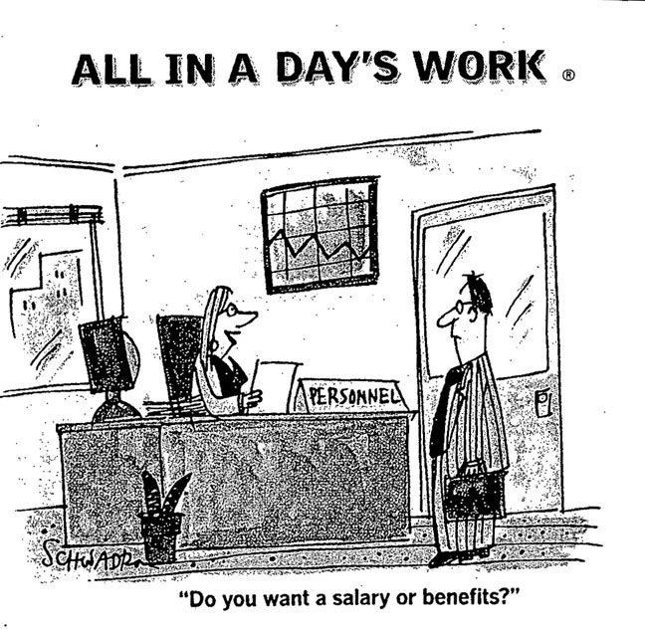

Slide 6
THE A BUDGET: EMPLOYEE COMPENSATION
How to compute employee wage/salary increases?
Straight percentage across the board.
Set dollar amount across the board.
Step & Grade system or market longevity system.
Distribute a set dollar amount for elected officials and department heads to handout as merit.
IMPORTANT: Make it equitable and don’t get sued!
NOTE: Salaries are set by BOCC (Section 31-3106, Idaho Code).

Slide 7
ELECTED OFFICIAL SALARIES
What is in the budget is “full compensation” for their service.
Not to be raised or lowered during the fiscal year.
No bonuses and no reductions other than as required by law.
Idaho Code sections: 32-3101, 31-3106, and 31-816.

Slide 8
EMPLOYEE BENEFITS
Health, accident, and life insurance
Vacation, sick leave, and personal holiday
PERSI
Social Security
Worker’s Compensation
Unemployment

Slide 9
“B” BUDGET EXPENSES
Annual county operating expenses including office equipment and supplies.
Be sure to review the previous years expenditures.
Take into consideration any upcoming onetime projects/costs.
Equipment replacement schedules can be helpful for identifying when items should be budgeted for replacement.
Remember to plan for the unexpected (within reason).
Know what you can and can’t afford.

Slide 10
“C” BUDGET EXPENSES
Funding for buildings, special capital equipment/machinery, vehicles, etc.
Generally requires long-term planning.
Funding options:
Annual appropriation lease,
Save up and pay-as-you go,
General obligation bonding (66 2/3 voter approval),
Revenue bonding (50% + 1 voter approval), or
Judicial confirmation (ordinary and necessary).

Slide 11
“D” BUDGET EXPENSES
Used only if benefits are not included in a county’s “B” budget.
Funding for employee benefits, including:
Payroll Taxes (Social Security, Medicare)
Health Insurance (dental, medical, vision, etc.)
Employee Retirement (PERSI, 401(k), 457(b), etc.)
Unemployment Insurance
Workers Compensation
Not all counties have a “D” budget.

Slide 12
BUDGET AMENDMENTS
What if the budget looks like it will be overdrawn?
Open budget and make adjustment in public hearing with proper notice (Section 31-1605, Idaho Code).
Expenditures made in excess of any of the budget appropriations could result in a misdemeanor (Section 31-1607, Idaho Code).

Slide 13
GENERAL BUDGET RESERVES
BOCC has the right to make general reserve appropriations, not to exceed 5% of the Current Expense and Justice Fund Budget (Section 31-1605, Idaho Code).
This may be used in the event of unforeseen contingencies requiring money not placed in the budget to be expended. Requires a unanimous vote of the BOCC.

