Slide 1
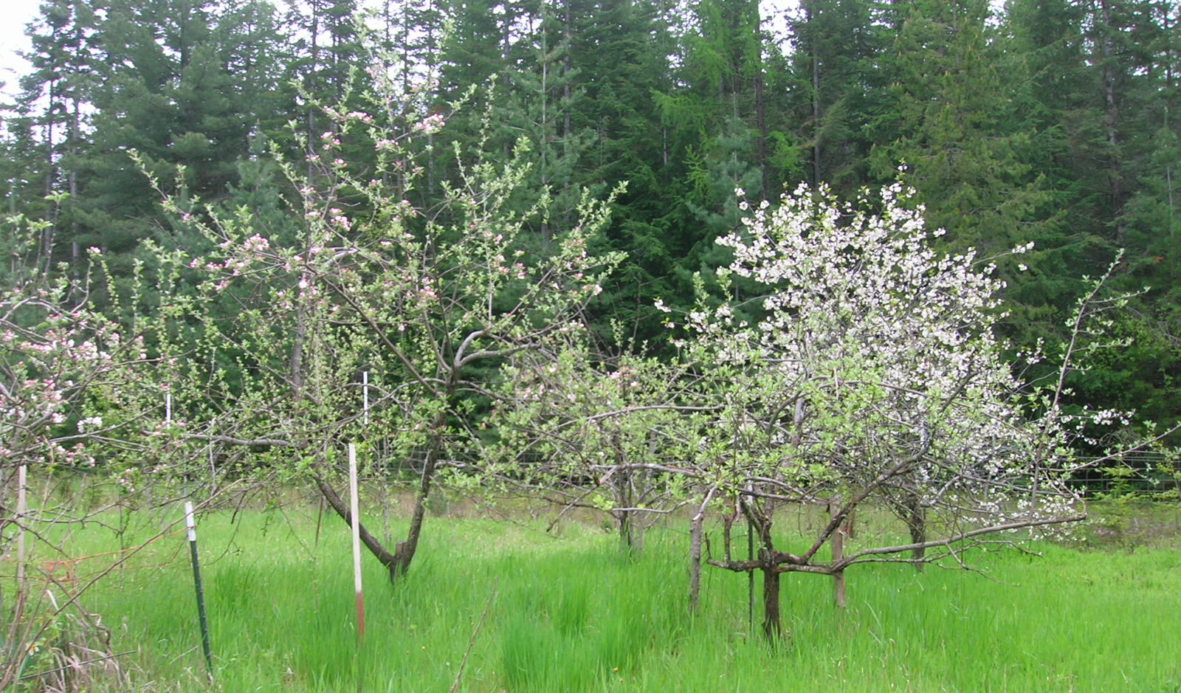
8 Serious PROBLEMS and 8 Serious SOLUTIONS to 4G/5G Cell Towers in Residential Neighborhoods Wire Idaho 2024
Notes:
Hi. I’m Anne Wilder and I am representing Wire Idaho. Today I will bring you up to date on 8 serious problems we face with “small” (in size, not power output), cell towers, and 8 solutions municipalities have, that are within the law.
1

Slide 2
1. Proven Harm to Human Health Including Cancer, Sleep Disruptions, Heart Problems, Infertility, DNA Damage Over 20,000 published studies: 2,300 in Bioinitative Report; 11,000 pages in CHD v FCC federal case won by Children’s Health Defense on August 13, 2021
“Microwave radiation can have 4,500 different neurological and physiological symptoms in your body which may not manifest themselves for hours, months, even years.” Barrie Trower, PhD Physics, Weapons Expert, Ministry of Defense, Microwave Warfare
https://bioinitiative.org/rf-color-charts/ http://www.oymradio.com/images/barrietrower/Dangerous%20EMF%20Radiation.pdf
https://childrenshealthdefense.org/defender/landmark-5g-case-against-fcc-hearing-set-jan-25/
“A minimum of 57.7% of schoolgirls exposed to low-level microwave radiation (Wi-fi) are at risk of suffering stillbirth, foetal abnormalities or genetically damaged children when they give birth. Any genetic damage may pass to successive generations.” Barry Trower
“Of the microwave-exposed women, 47.7% had miscarriages prior to the 7th week of pregnancy....” John R Goldsmith, MD MPH
https://ec.europa.eu/health/scientific_committees/emerging/docs/emf_117.pdf
Notes:
Problem #1 is our health. Thousands of peer reviewed scientific studies have documented harmful health effects including cancer, sleep disruptions, heart disease, fetal abnormalities, infertility, DNA damage and more. These health issues have been set in stone by the recent court victory EHT/CHD v FCC, August 13, 2021, case # 20-1138, where the DC Court of Appeals ruled that the FCC must address documented health issues, especially to children.
2

Slide 3
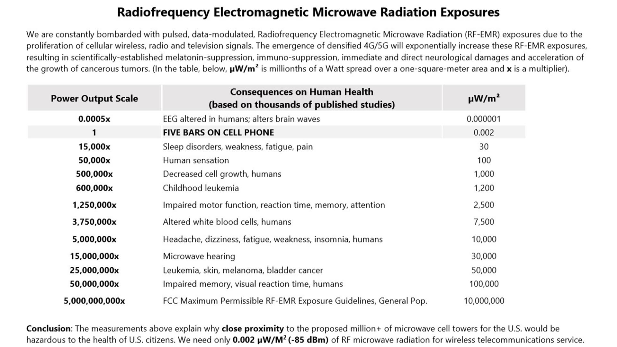
Notes:
This chart shows documented adverse effects of all RF-EMR exposures over .002 microwatts per meter squared, the amount necessary to provide 5 bars on a cell phone. As few as 1200 cause childhood leukemia. A normal macro tower puts out 50,000, and without an ordinance to limit power output, “small cells,” AKA “distributed antenna systems” or DAS, proposed for residential neighborhoods all over the country, can put out 10,000 microwatts/m2, 10 times that which causes leukemia in children.
3

Slide 4
24 hours of cell phone use = 1600 x-rays in terms of biological damage
4
Notes:
The Wireless Industry claims that cell tower radiation is non-ionizing, and therefore safe, in spite of not a single study proving safety. As a result of the Aug. 13, 2021 federal ruling, the FCC will now have to update its testing procedures to include landmark studies such as the 1999- 2018 NTP Study which showed clear evidence of cancer, heart disease, and DNA damage. This photo shows healthy DNA on the left. The middle photo shows damage to the DNA helix caused by harmful IONIZING radiation. In fact, researchers had to use the equivalent of 1,600 chest X-rays to get this much damage.
But look at the photo on the right. You can see for yourself the very same type of DNA damage from NON-ionizing radiation – the same type coming from exposure to cell phones 24/7 – which is what neighborhood cell towers do.
4

Slide 5
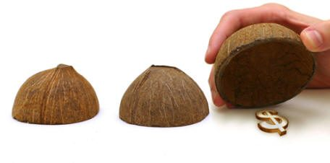
2. Cities Liable for Potential, Devastating Lawsuits Big-Tech wireless companies use local “shell companies” that do not have insurance or assets to cover claims, leaving cities liable.
Notes:
The second serious problem is local liability. Although the shell companies Big Tech use to install local towers claim to have insurance, what’s not being revealed is that every policy has what’s called a “pollution exclusion”, meaning they will NOT cover any claims for injury from microwave radiation, as it is a documented pollutant. These shell companies are designed to go bankrupt, leaving our Cities holding the bag for liability from lawsuits.
5

Slide 6
Current General Liability Insurance has RF-EMR Pollution Exclusion (link)
Insurers and Wireless Cos. categorize RF-EMR exposures as a hazardous pollutant.
Lloyd’s of London, Swiss Re, AM Best and other insurance cos. exclude coverage for injury and death claims from RF-EMR exposures:
"Lloyd’s excludes any claims arising out of, resulting from or contributed to by electromagnetic fields, electromagnetic radiation, electromagnetism, radio waves or noise."
RF-EMR exposures are a scientifically-established health hazard
https://scientists4wiredtech.com/what-are-4g-5g/insurance-underwriters-refuse-to-cover-wireless-industry/
Notes:
Lloyd’s of London, a common insurer for the telecoms “EXCLUDES any claim” caused by electromagnetic fields from cell towers.
6

Slide 7
3. 20% or More Decrease in Property Values
Local cities cannot afford to lose these taxes!
“Based on 3G/4G infrastructure alone, Realtor Magazine cited a 20% price decrease for properties near cell towers, as did Appraisal Journal. Furthermore, a survey by the National Institute for Science, Law & Public Policy (NISLAPP) found that 94% of homeowners are ‘less interested and would pay less’ for a property located near a cell tower or antenna.”
7
Notes:
The 3rd serious problem is the average 20% or higher decrease in property values. This hurts not only homeowners, but also entire cities that stand to lose 20% of property tax revenue. With the economic losses the COVID lockdowns have already inflicted on our economy, this would be devastating.
7

Slide 8
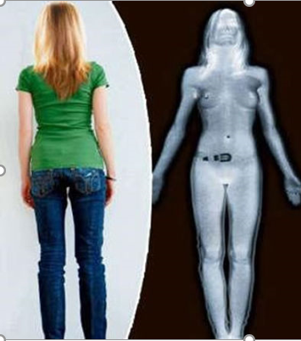
4. Privacy and Security Violations in Neighborhoods
Personal data is being harvested and sold to 3rd parties!
Loss of privacy: 24/7 surveillance, just like in airports, mm waves "see" through clothes & bounce off skin VentureBeat: body scanners show nearly nude images of people trying to board flights Security Disaster: In both 4G/5G, a user-plane integrity flaw; heightened risk of hacking
Millimeter-Wave Body scanners allow routine digital strip searches of individuals who are not suspected of any crime.
For more info, see EPIC: Radiation Risks lawsuit and EPIC: ATR lawsuit, and EPIC: Suspension of Body Scanner Program
8
Notes:
The 4th problem is an unconstitutional 24/7 surveillance of law-abiding citizens. Millimeter wave technology can capture nearly nude images. Additionally, our personal data is being harvested and sold to 3rd parties. 4G/5G is a security threat, as wireless data is more easily hacked than the more secure option of wired fiber optic cables, and cameras and listening devices are easily added to these “small” wireless telecommunication facilities.
8

Slide 9
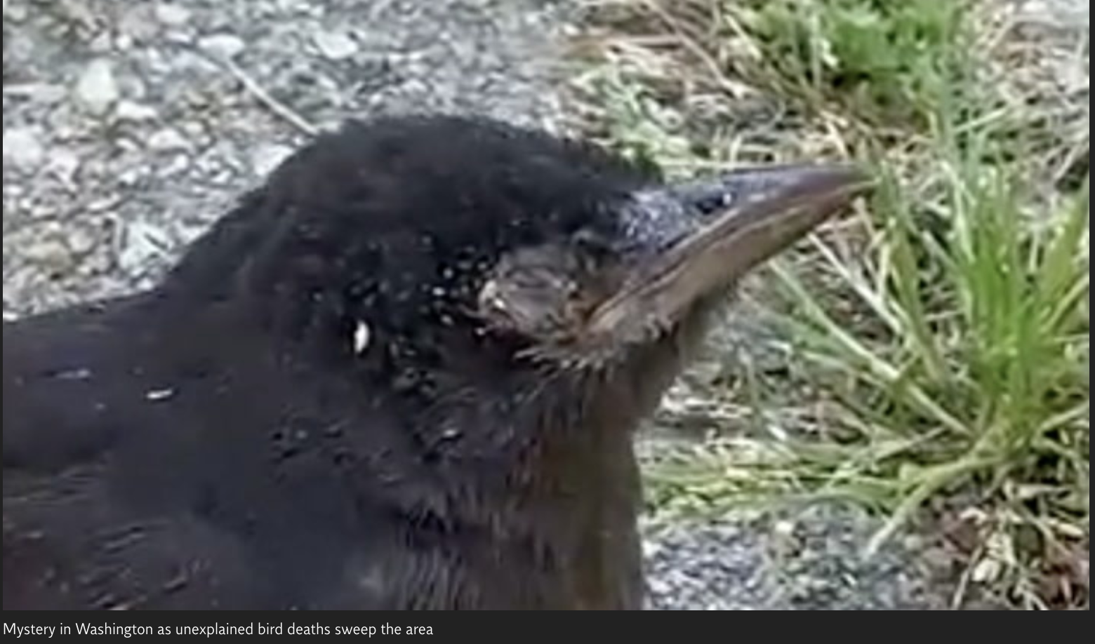
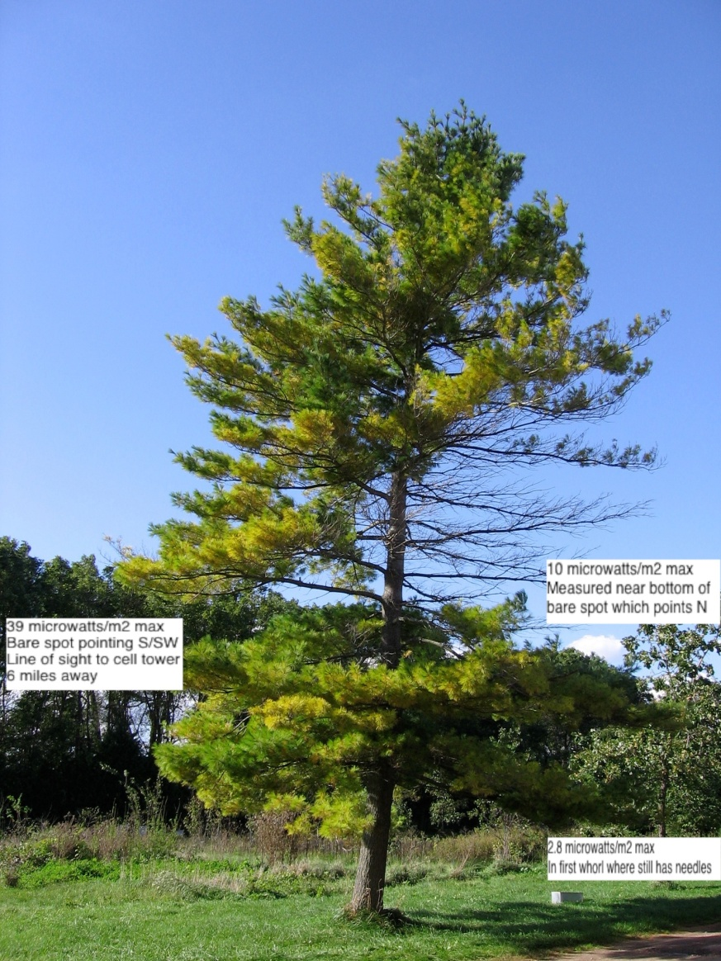
5. Threatens Natural Habitats, Ecology, Agriculture Pulse-modulated microwave radiation harms people, animals, plants, and insects, Including Pollinators https://patents.google.com/patent/US6192598B1/en
https://www.independent.co.uk/climate-change/news/birds-blind-washington-dead-grackles-b1855180.html
9
Notes:
Fifth, cell tower radiation harms plants, animals and insects, including pollinators. And if we lose our pollinators, we stand to lose our agriculture. The DC Court of Appeals ruled in EHT/CHD v. FCC, 8/13/2013, the FCC must now address the impacts on radiation on the environment.
9

Slide 10
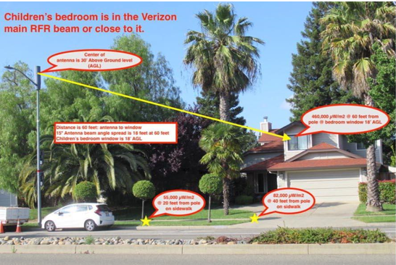
6. Up To 25 Million Times More Power Than Needed
1/10 of a watt (.002 radiation units) is all that’s needed for 5 bars on cell phone, but radiation into homes can exceed 50,000 units. This waste of resources goes against Sustainability and Public Safety.
Children aged 3 and 6 diagnosed with Radiation Sickness within 3 weeks of Verizon powering on facility in front of home. Family forced to spend $25,000 to shield home.
10
Notes:
Problem #6 is TOO MUCH POWER! Only 1/10 of a watt provides the legally required telecom services, yet levels on the streets and, more importantly, in bedrooms, are millions of times higher. The children in this particular home became ill with radiation sickness within 3 weeks of Verizon turning on the facility in front of their home, and the family spent over $25,000 to shield from this tower. Immediately after the Aug. 13 ruling, the family called for a power output test, and Verizon came out and turned it off.
10

Slide 11
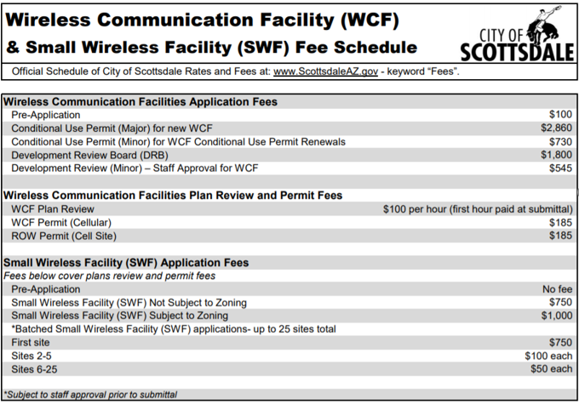
7. Most Permit Applications Are Missing NEPA Reviews.
There are ZERO studies proving 5G is safe, and federally-required Environmental Protection Reviews are missing on practically all permits!
See sample application from Arizona, below.
11
Notes:
Problem #7 is incomplete permit applications. As of August 9, 2019, every wireless telecom facility in the country must complete a National Environmental Policy Act review, yet no permits in Boise have this. What about Coeur d’Alene? What about Sandpoint? What about Your town?
11

Slide 12
NEPA = National Environmental Policy Act (United Keetoowah v. FCC; 8-9-19)
Act that empowers local communities to protect themselves and their environment from dangerous, rushed, or poorly planned utility projects.
NEPA requires government agencies to engage in a review process intended to discover any significant environmental and public health impacts before a decision is made and construction is begun.
Erika Rosenberg, FCC NEPA-Specialist Attorney:
“Every single [WTF*] requires NEPA review.”
National Historic Preservation Act (NHPA) requirements also remain.
Towns can delay WTF Installations with NEPA Strategies
*(WTF = Wireless Telecommunication Facility)
Notes:
The FCC NEPA-Specialist Attorney, Erika Rosenberg, stated in this court case, “Every single [WTF] requires NEPA review.” City ordinances should require this on receipt of the permit application. The DC Appellate Court judges in EHT/CHD v FCC ruled that the FCC can no longer ignore United Keetoowah v FCC and telecom companies can now lose their licenses if they place wireless facilities without file a NEPA as required by law.
12

Slide 13
8. Wireless Industry Tells Cities “Your Hands Are Tied!” Actually… Cities can regulate the operations of WTFs, including maximum Effective Radiated Power output (noise)and hours of operations
Notes:
Finally, the most challenging problem is that the wireless industry has given false information to cities and city attorneys across the country for over 20 years, telling them their hands are tied when it comes to protecting our public safety by regulating cell towers. This is preposterous, and must be stopped. The good news is that there are solutions!
13

Slide 14
Solution #1: Update your community’s Telecom Ordinance
EHT/CHD v FCC Case 20-1025 Ruling states that the FCC must:
address the impacts of RF radiation on children, the health implications of long-term exposure to RF radiation, the ubiquity of wireless devices, and other technological developments that have occurred since the Commission last updated its guidelines, and
address the impacts of RF radiation on the environment.
With the FCC now being forced to update its safety guidelines – which it has not done …we must protect ourselves. That would include denial of frequencies for wireless information service (Internet).
The Idaho Local Land Use Planning Act, 67-6502 requires local governments to promote the health, safety and general welfare of the people of Idaho.
Dalton Gardens has adopted a protective ordinance. So can we all:
https://daltongardens.govoffice.com/vertical/sites/%7B2A1D181A-7B34-4883-A1BB-6811ACC2E6DF%7D/uploads/EXECUTED_Ord_278.pdf
Notes:
The nation's wireless broadband agenda significantly changed on Friday the 13th in August 2021 due to the US Court of Appeals ruling in Case 20-1025, Environmental Health Trust/Children's Health Defense et al. v the FCC. the DC Circuit Court ruled that the decision by the FCC in 2019 to retain its 1996 wireless radiation safety limits for human exposure to wireless radiation was “arbitrary and capricious.” Specifically, the agency had ignored research showing damage to memory and reproduction and indications that children are more vulnerable to wireless radiation. We are all now waiting for the FCC to complete credible, thorough environmental review before continuing to expand wireless service beyond telecommunications. That will take time -- a year or longer.
14

Slide 15
Solution #2: Require NEPA Reviews, Names of full board of directors, and Adequate insurance, on Permit Applications
When federally-mandated National Environmental Policy Act reviews and other required information are missing from permit applications, cities have the right to refuse the permit.
Notes:
Every municipality’s ordinance should have a NEPA requirement for all telecommunications facilities, and a requirement for companies to provide sufficient identifying information to show they have the funds to cover any liability claims that may come as a result of any loss a resident suffers from placement of such facilities near their property. Again, in the Aug. 13, 2021 ruling, the judges re-asserted the FCC HAS to comply with NEPA.
15

Slide 16
Solution #3: New Towers ONLY Where Service Is NEEDED
New cell towers should only be erected where there’s a Significant Gap in personal wireless service that must be objectively proven by an independent engineer.
According to Mozilla et al. v. FCC, Case 18-1051, 10-1-19, the “Exemption Clause” in the 1996 Telecom Act refers ONLY to wireless phone service, NOT internet.
Bonner County can include a “WE-WANT-IT” clause in their ordinance: Written Evidence – Wireless Antenna Need Test – In Telecommunications
Every six months: a Comprehensive Wireless Signal Strength Test by an independent RF Engineer, who will …
Log, second-by-second, the Wireless signal-strength levels in dBm (decibel-milliwatts) of every carrier-specific licensed and unlicensed wireless frequency that is being transmitted to the city streets.
The full data file for each WE-WANT-IT test will be placed in the public record for anyone to view, analyze and verify
Link to sample language
16
Notes:
Solution #3: Cities can easily pass an ordinance requiring written evidence that there’s actual NEED for new antennas, this is achieved by drive-by need tests. Because of the Oct 1, 2019 DC Appellate court ruling, the FCC gave up its control over internet (streaming, gaming, etc) and now that can be fully regulated by local municipalities. Does your town’s current ordinance address any of the above?
16

Slide 17
Solution #4: Develop a Better Broadband Plan New legislation can balance the needs for
Large Data (Internet) via fiber optic, and “Small Data” (wireless calls) via cell towers
WIRELESS Broadband
Internet, Video, Gaming = BIG data Requires Enormous Amounts of Power
Should be wired!
WIRELESS Telecom
Wireless Phone Calls
= small data Requires Very Little Power
17
Notes:
#4: Legislate a better broadband plan. In order to be both fiscally and environmentally responsible, it makes sense to use wireless only to transmit phone calls and texts, considered “small” data, while using faster, more efficient fiber optics to transmit very big data such as internet and video. Idaho has no restriction on how the new COVID broadband funds are used, and per the Irregulators v FCC (3-13-20) we should have even more $$$ available to apply to wired telecommunications infrastructure. We already have wired internet available virtually everywhere. We do not need wireless internet in our neighborhoods at all.
17

Slide 18
Solution #5: Turn Down the Power to SAFER Levels This satisfies both FEDERAL LAW and the requirement of public safety.
Federal Government Mandate for Cities:
“In all circumstances . . . all [licensed] radio . . . shall use the minimum amount of power necessary to carry out the communication desired.” 47 U.S. Code § 324
18
Notes:
#5: Turning down the power on wireless facilities to a safe level not only protects resources, neighborhoods and local ecology, but it is also in line with the 1934 Telecommunications Act, federal law that mandates the use of the minimum amount of power necessary for communications.
18

Slide 19
Solution #6:
Regulate Vertical and Horizontal Distance of Antennas
Placing facilities high enough and far enough away that they don’t radiate residences with excessive power can protect neighborhoods AND provide excellent service.
Vertical: antenna is 200 feet from ground
Horizontal: antenna is 2,500+ feet from homes/schools
Power: Can be 50,000 Watts of Effective Radiated Power
Result: -85 dbm = 0.002 RF radiation units in your bedroom provides 5-bars on a cell phone (link), full Telecommunications Service
19
Notes:
#6 is proper placement, or offset, of towers. Not only can we regulate the power, but we can also legislate safe vertical heights and horizontal distances, or offsets, placing towers far enough away from residences and businesses for public health AND excellent cell phone service. The FCC only regulates towers over 200 feet high. Doesn’t it make sense for the city have the FCC assist in forcing the Telecommunications companies to comply with the law?
19

Slide 20
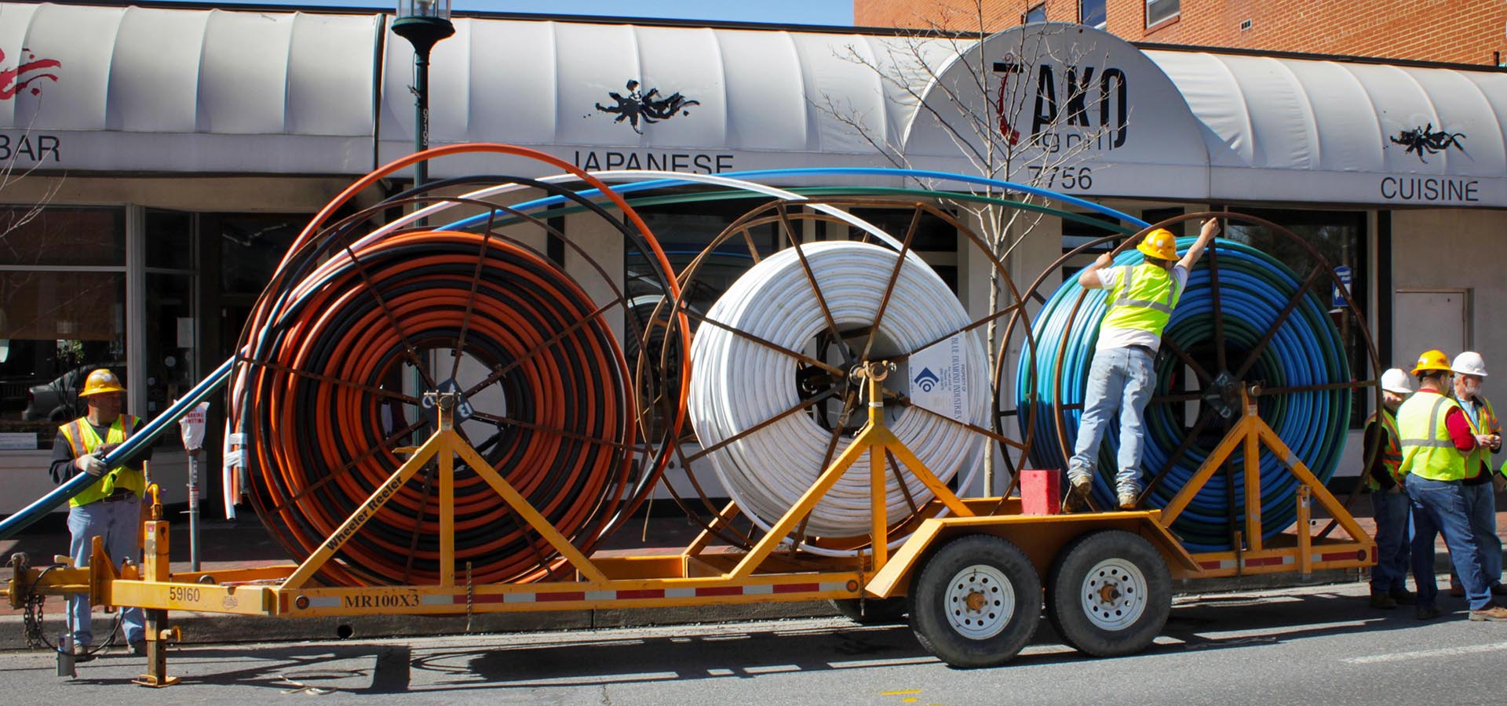
Solution #7: Fiber Optics to the Premises
Fiber is faster, safer, and more secure, and can be brought directly to homes and offices.
20
Notes:
Solution #7 is fiber optic cables brought directly to the premises. This is the superior choice for big data, and much of the fiber infrastructure already exists. There should be NO cell towers of any size or “G” in residential or school districts.
20

Slide 21
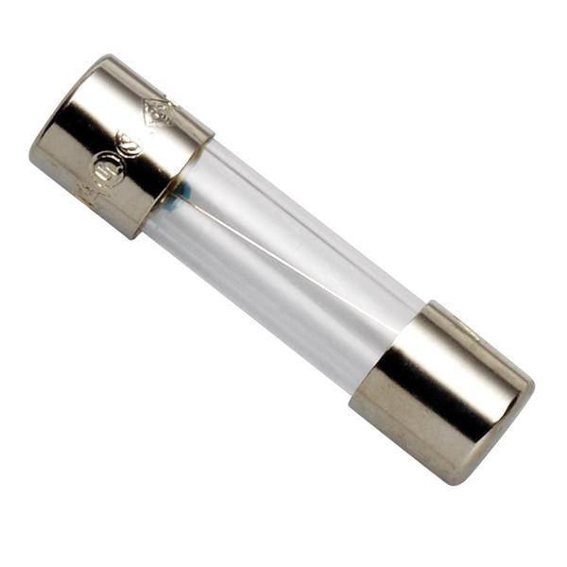
Solution #8:
Use Cities’ “Policing Powers” to Charge Fines for Excess Power Violations
Cities can legally set AND enforce safe power levels, charging fines for violations to bring much needed revenue — a much more attractive option than losing money through devalued properties and lawsuits.
Cap Effective Radiated Power at 0.1 Watt of ERP
Or the equivalent of -85 dBm (5 bars on a cell phone)
21
Notes:
And finally, not only can we, and should we, cap the power to safer levels, but we can also generate significant income by charging fees when these safety limits are violated. The limit provided by the telecom company on the permit application should be strictly enforced and randomly tested (at their expense) and if violations are found, fines should be assessed, just like for any other business.
21

Slide 22
WHAT WE WANT: We are asking the county to create an ordinance to:
Regulate all wireless telecom facilities, esp. in residential and school districts. This would include requiring a NEPA review on all individual WTFs, and keeping WTFs sufficiently away from homes through VHP: Vertical/horizontal/power balance. Remember: Distance is your friend.
Require all WTF owners to provide $10 million aggregate and $1,000,000 per occurrence Liability Bond with NO exclusions for adverse biological effects.
NEEDS TEST. Require all applicants to provide a needs test by using an independent 3rd party using meters to determine if there is a gap in personal wireless service i.e. ability to make an outdoor phone call.
Cap on Power. Cell phones only need .002 microwatts (-85 dBm) for 5 bars.
Put in fiber optic cable, coming available to virtually every residence via Ziply and Mi Fiber. Safe and secure and blazing speeds compared to wireless 5G.
Even better, let’s adopt Dalton Gardens’ ordinance: https://wireamerica.org/id/model-wireless-ordinance/
Notes:
Tell your city council: this is what we want. No One wants a cell tower in front of their house. It is the job of our cities and counties to write ordinances to keep our neighborhoods clean of noise (definition electromagnetic radiation that travels through the air). Wire Idaho has, and can help you write such an ordinance.
22

Slide 23
Our Hands Are Not Tied: The Law Is On OUR Side!
Join us, and help protect neighborhoods through
better, safer technologies.
Wire Idaho
Wireidaho.com wireidaho@mailfence.com
23
Notes:
Wire Idaho is working to protect our neighborhoods through better, safer, saner technologies, and to help Idaho’s cities and counties update their ordinances, within the law. Please join us at www.wireidaho.com, or email us at wireidaho@protonmail.com. Thank you!
23

