Slide 1
Promoting Positive Relationships With Youth in Our Communities
July 15, 2020
Asha K. Unni, Ph.D.
Postdoctoral Fellow
Stress & Trauma Treatment Center
[Webinar Recorded on August 15, 2020]

Slide 2
Objectives
During this webinar, participants will:
Understand importance of positive and supportive relationships between at-risk youth and adults in the community
Learn about current research on the benefits of these relationships
Review approaches adults can use to cultivate relationships
Discuss barriers and challenges that arise in developing these relationships with these youth

Slide 3
This webinar was hosted by The Illinois Association of Juvenile Justice Councils
&
The Southern Illinois
Violence Prevention Project

Slide 4
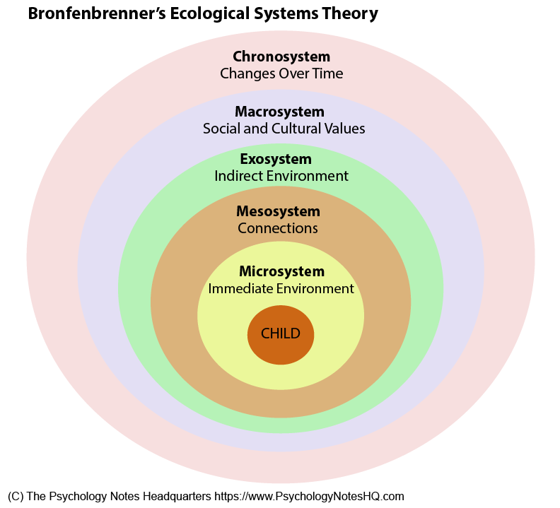
Bronfenbrenner’s Ecological Systems Theory
Notes:
Theory that humans exprience their lives in the context of multiple systems in their environment
Microsystm is their immediate environment that has a direct impact on child - child’s parents, family, friends, school, peer group, neighborhood. This usually influences beliefs, values, and culture
Mesosystem - inter relationships between environments - so school-peers interactions, school-family; parents’ relationships with each other, with teachers, friends interactions with other peers
Exosystem - no direct interaction, but something that indirectly affects child’s life. For example, parents’ jobs, parents’ friends, neighbors
Macrosystem - social and cultural values that can impact how child experiences life. Values, laws, customs in culture. Political views
Chronosystem - changes over time - economic crises, period of adolescences, major decisions/life changes

Slide 5
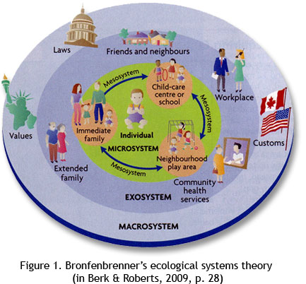
Examples of Students’ Interactions Within Ecosystems
Example:
13-year-old Latina student Anna lives in middle-class neighborhood with her parents and siblings. Parents have lived in the U.S. for 10 years, and she has a good relationship with them. She has a good friend group at school but often gets bullied for being an immigrant. Anna has good relationships with her teachers and is in after-school programs. Her parents are worried about their immigration status.

Slide 6
Common Barriers to Developing Positive Relationships with Youth
Trauma
Biases
Notes:
Two of the more common barriers that come up with developing these positive relationships with these youth. The two i’m focusing on are trauma and biases

Slide 7
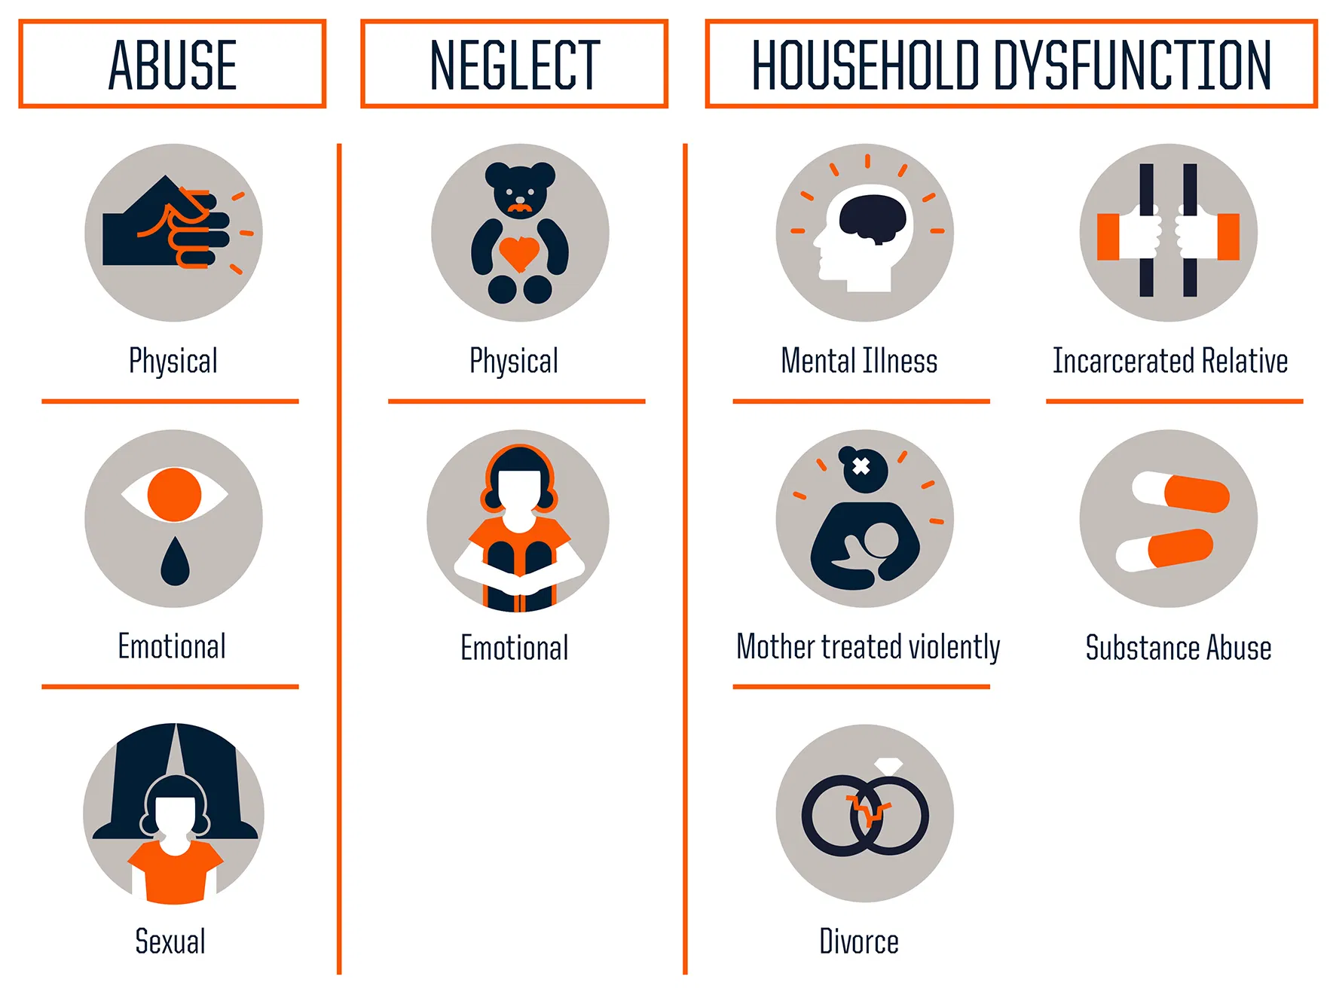
What is Trauma?
Notes:
Acute trauma- single traumatic event (death, natural disaster, car accident, witnessing violent event)
Chronic trauma - multiple traumatic events (car accident plus death plus natrual disaster)
Complex Trauma - multiple traumas from young age
So with trauma, there are different types that individuals can experience.
A large study by CDC-Kaiser in the late 1990s was the longest investigation of childhood abuse. Their findings were that adverse child experiences between 0-17 years can have a significant impact on adjustment for that individual as a child and later as an adult.
61% of all adults had experienced at least one type of ACE and 1 in 6 reported at least four or more ACES. indivdiuals of marginalized races and ethnicities are more at risk for experiecning 4 or more ACES

Slide 8
Traumatic Stress
Overwhelm capacity to cope
Feelings of terror, powerlessness, and out-of-control responses
Impact:
Sense of trust
Sense of personal safety
View of world and self
Ability to navigate stressful events/changes
Notes:
Acute trauma, chronic, and complex trauma. Research has shown trauma can have effects on the brain and body in ways that impact the child’s development and ability do process information, think through things, cope, and how they behave. This is due to an overload of stress responses on the body and creating a state of hypersensitivity and heightened arousal. As many of us know trauma symptoms canl include Intrusive thoughts, unwanted memories, flashbacks, symptoms of anxiety, depression, negative thoughts, feelings of guilt, shame, fear. And behaviorally we can observe that as impulsivity, inattention, hyperactivity, aggression, anger control issues, poor problem-solving, poor emotion control, anxiety, and frustration. So it looks like a lot of the kids we see who are at-risk of incarceration, which is difficult because we want to be able to intervene or provide services for these kiddos before they fall into the system.

Slide 9
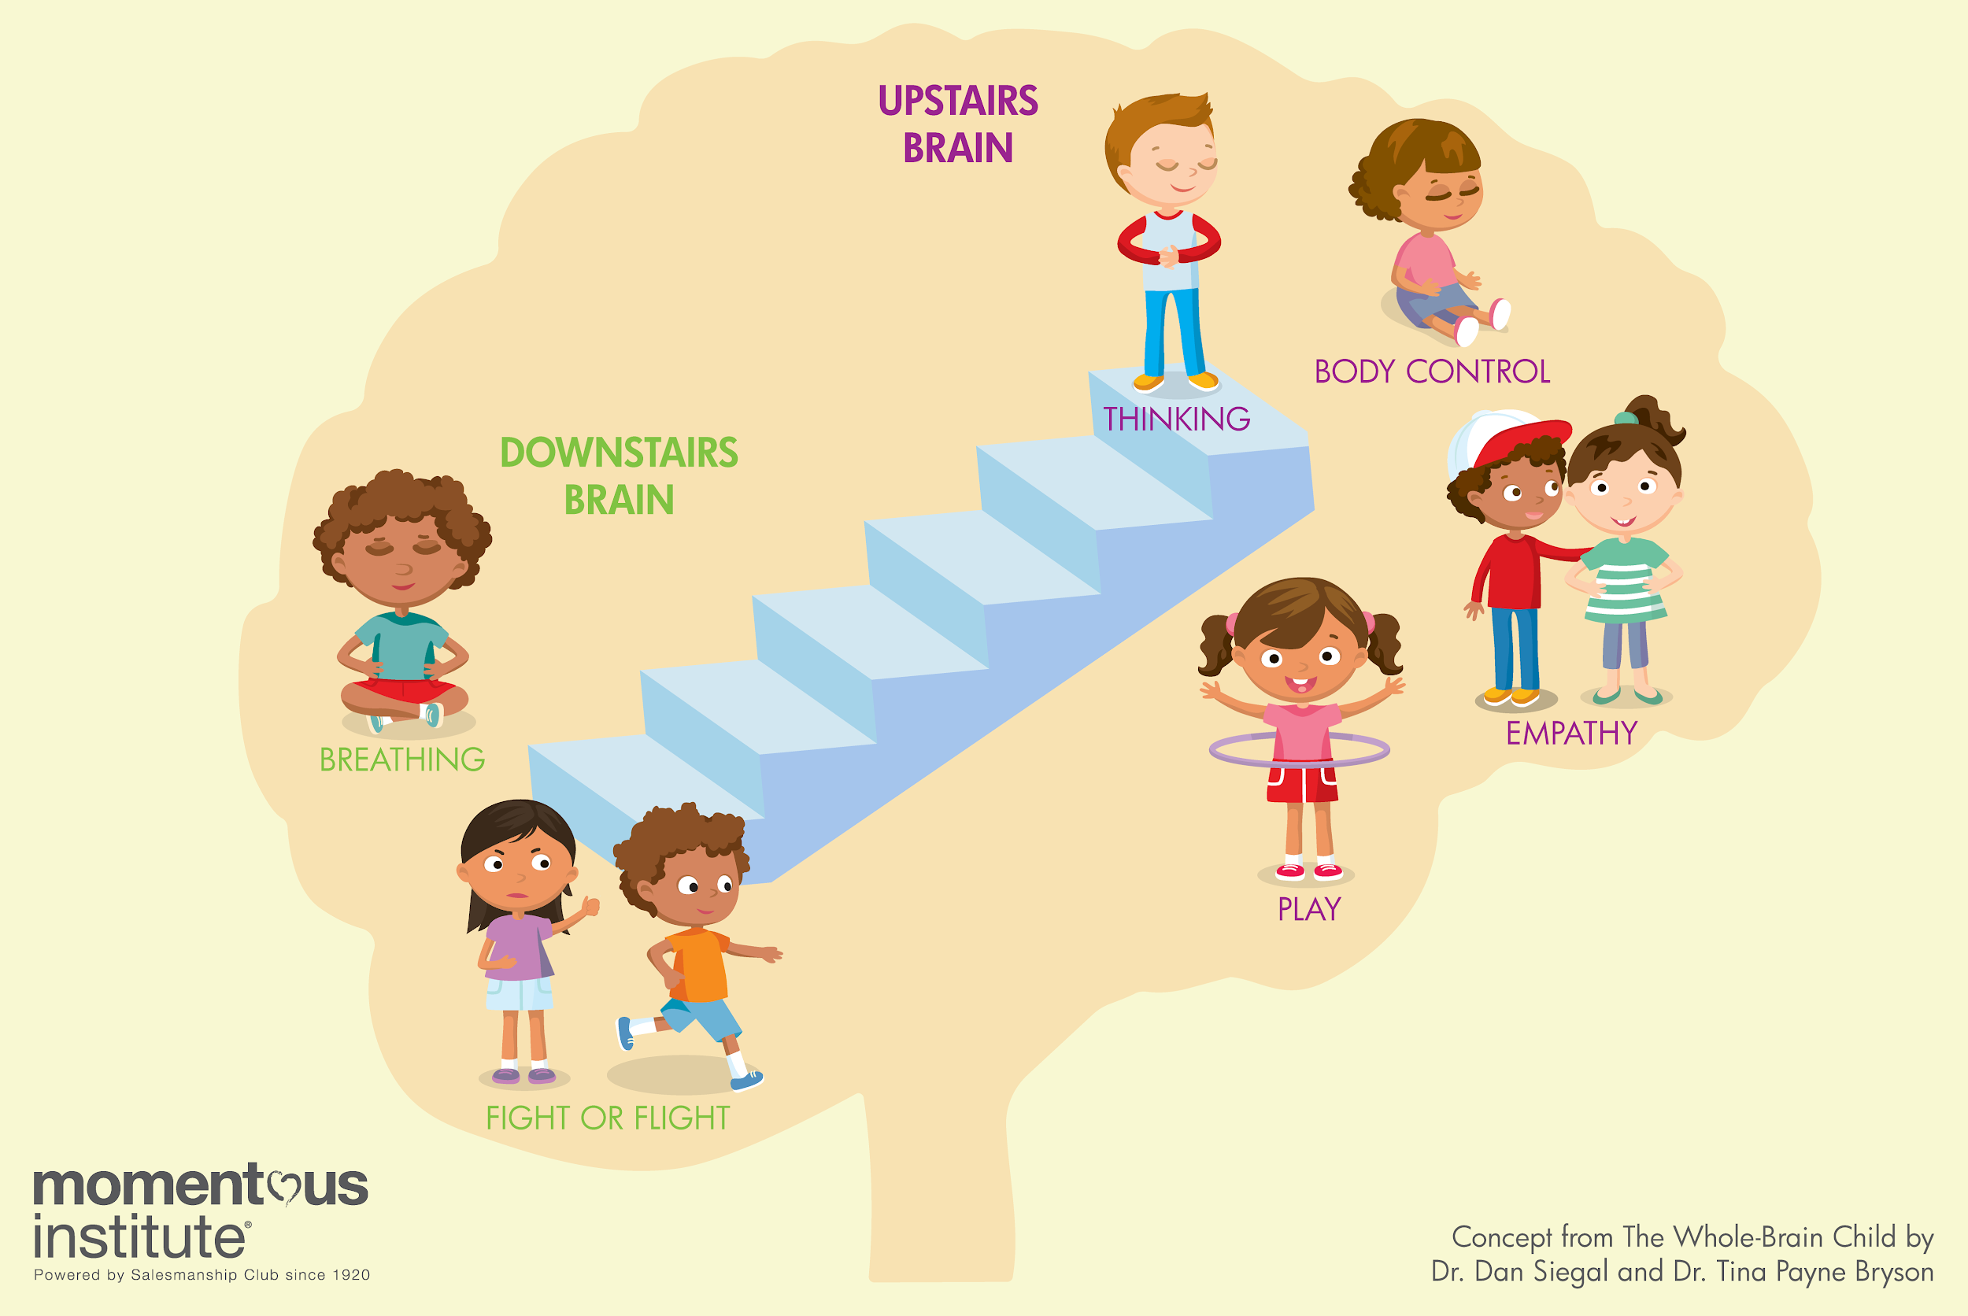
Trauma and the Brain
Notes:
Effects of Trauma on the brain - overload of stress responses on body; in a hypersensitive and heightened arousal state to respond with fight or flight
Effects of trauma on behavior - hypervigilance and hyperarousal leads to kids maladaptive behavior such as impulsivity, inattention, hyperactivity, aggression, anger control issues, poor problem-solving, poor emotion control, anxiety, frustration.

Slide 10
The excessive or prolonged activation of the physiological system in the absence of the buffering protection afforded by stable, responsive relationships.
Notes:
Toxic stress quote from american pediatric association
Treatments for trauma - include exposure based therapies such as Trauma-Focused Cognitive Behavioral Therapy or other approaches
At the same time, therapy is not accessible or available for all youth who experience adverse childhood events. There is some research however on how stable, responsive, and positive relationships the youth has can significantly impact and influence their development and experince with traumatic symptoms. CDC kaiser even mentions mentoring programs specifically. More on that later though :)

Slide 11
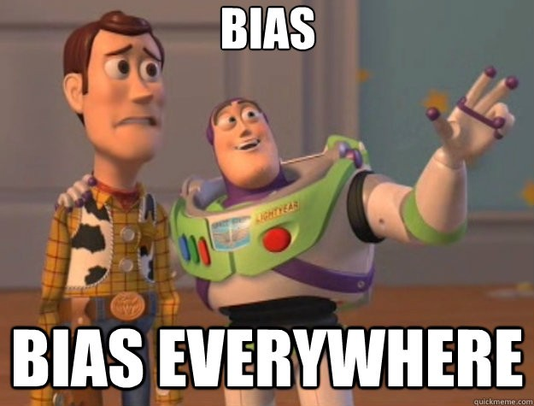
Biases - What Are They and Why Are They Important?
Racial and ethnic biases
Implicit and explicit biases
Prejudice versus discrimination

Slide 12
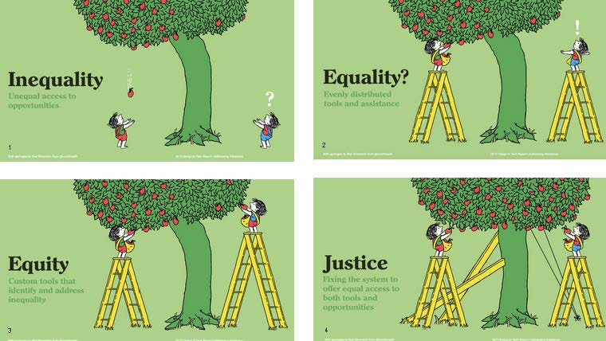
Notes:
Race and ethnicity matter because of systemic privileges and oppression that have led to students having disparate educational experiences and outcomes. As adults in these systems, we are social change agents (part of Bronfenbrenner’s micro and mesosystems), so how we consider race/ethnicity for our youth can impact their student-teacher relationship
Inequality is unequal access to opportunities.
Equality is the assumption that every youth will benefit from the same supports - evenly distributed tools and assistance
Equity is providing youth with proportional supports so that they can have equitable experiences. It considers the youths’ history, backgrounds. Using custom tools that identify and address inequality
Justice is fixing the system to offer equal access to both tools and opportunities

Slide 14
Privilege and Bias
What is privilege? What does it entail? How do we discuss privilege with our staff, our students, and others?
Activity (10 minutes)
On the next page, this is an activity that can be used with youth to help them engage in a discussion about privilege.

Slide 15
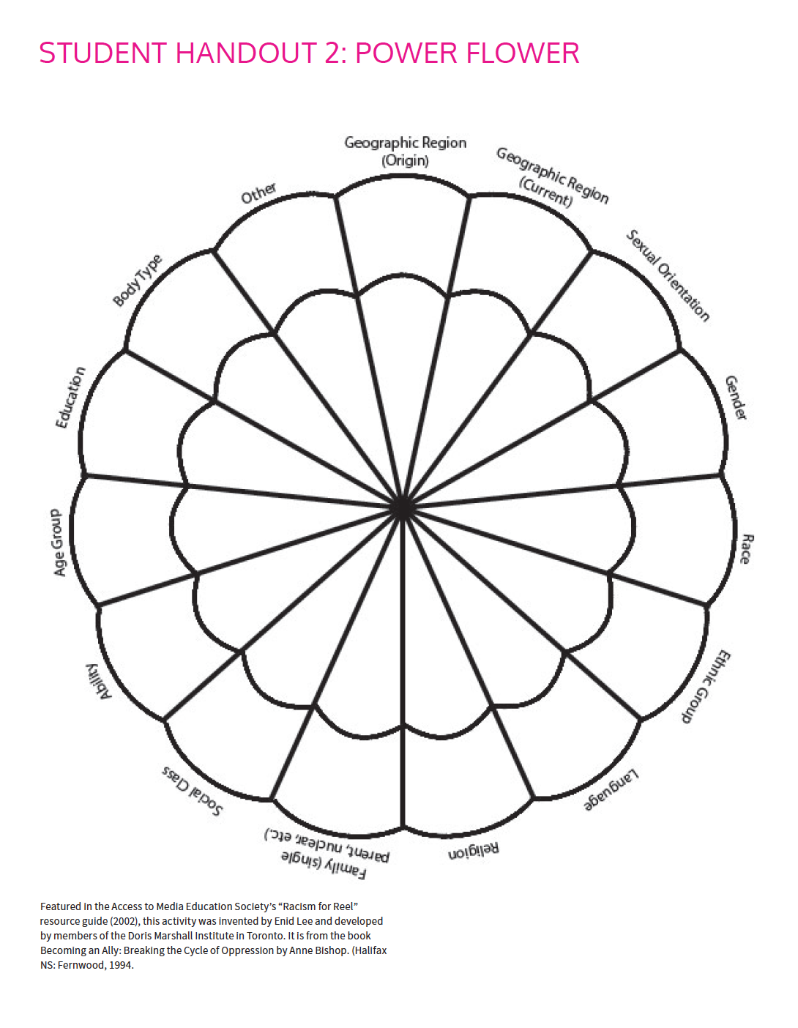
Fill out the outer section of the petals to identify the socially dominant group for each category.
https://ccdi.ca/media/1588/toolkit-2-exploring-my-power-and-privilege.pdf

Slide 16
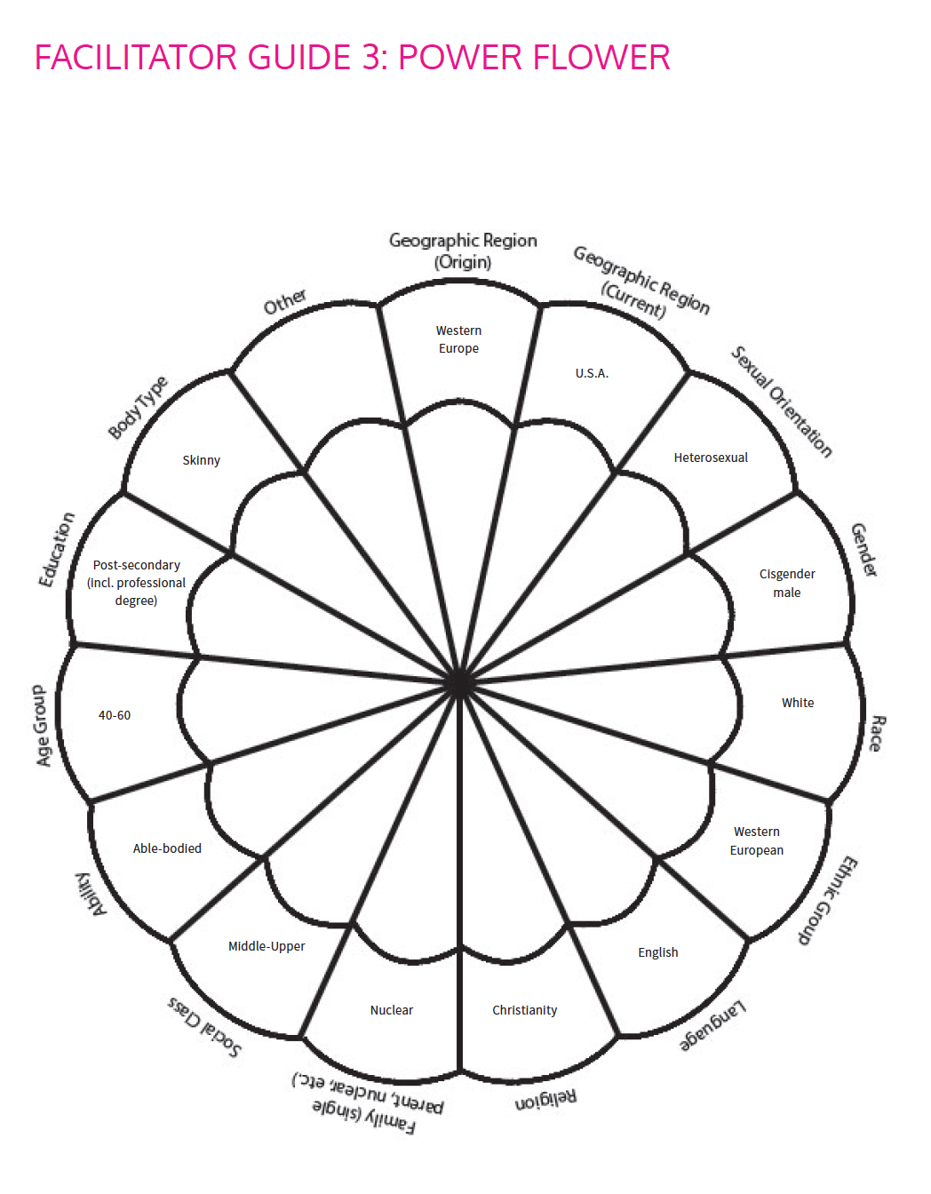
Some suggested outer petal categories (these can change!).
This time, in the inner petals: fill out your personal identity. For example, if you can speak English then you write English-speaker in the inner petal.
What are your thoughts, reactions, and/or reflections with this activity? Things you were surprised about?

Slide 17
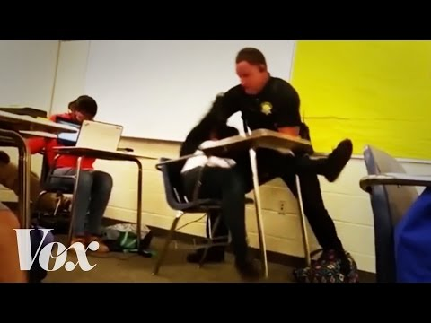

Slide 18
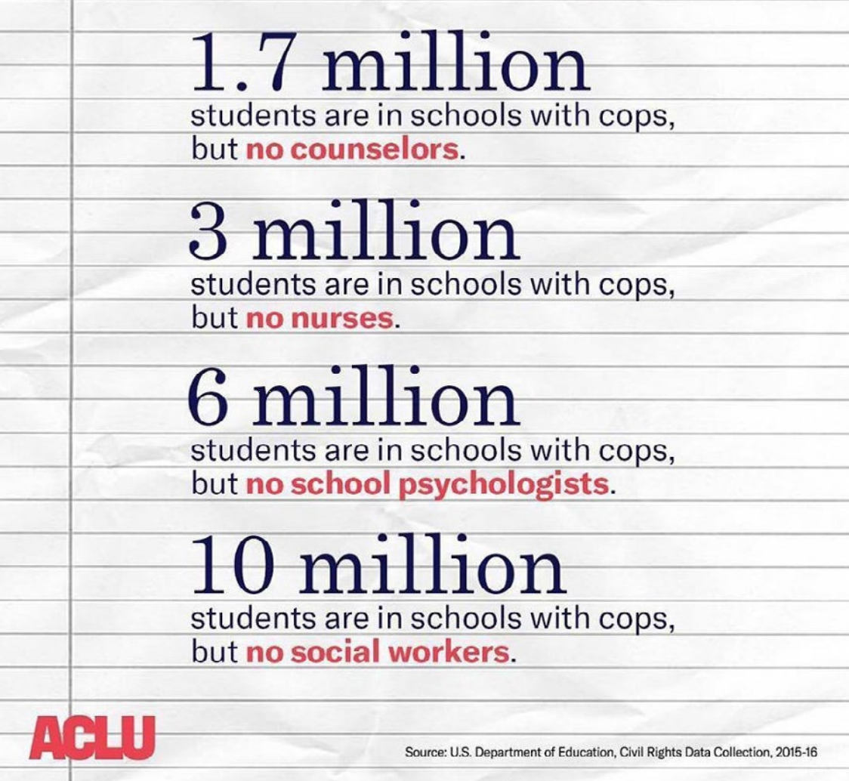
Why is the School-to-Prison Pipeline Important?
Positive student relationships can end the cycle
Promoting positive behaviors and intervening in ways that support students in alternative ways (social skills, mindfulness, anger management, and so on)
Notes:
S2PP can also help us understand some of the biases and attitudes our youth may already be bringing to the table when we work with them. Sometimes these youth may be in the system earlier than expected and so renewing their hope, challenging their biases, and providing a safe space is crucial
Fewer behaviors, fewer referrals
At the national level, Black males account for 8% of the total male student population in the U.S., and Black females comprise 8% of all female students in the nation
However, Black male and female students receive 25% and 14% of all out of school suspensions, respectively (U.S. Department of Education, 2018).
Similar patterns with Latinx youth, but slightly less severe

Slide 19
How Do We Foster Positive Relationships With Our Youth?
Brainstorm ways you personally work on improving your relationships with your youth. What works best? What methods have you wanted to try?

Slide 20
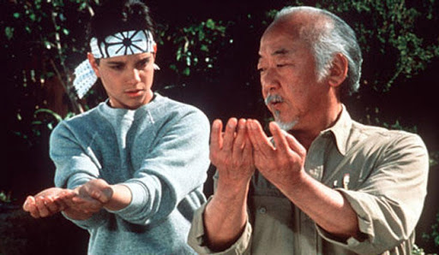
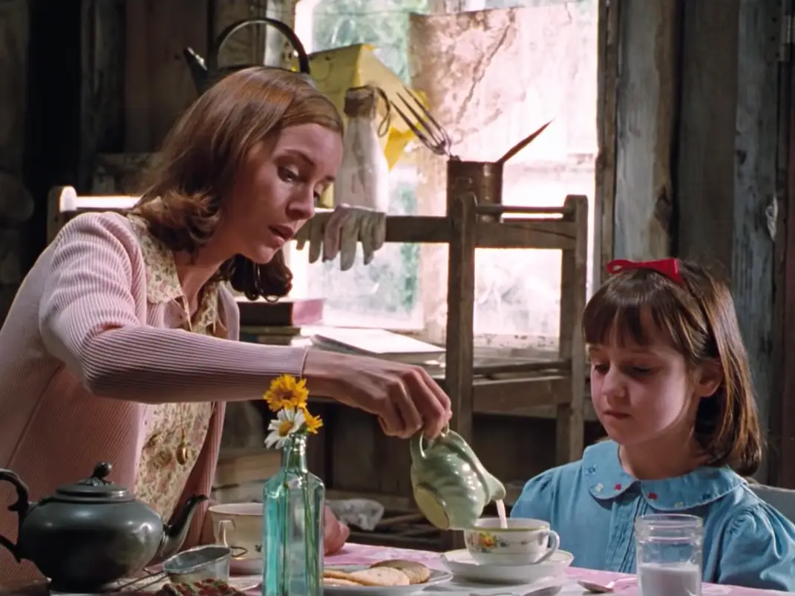
What is a Mentor???
Notes:
So this theory from Bronfenbrenner lends itself to a discussion about mentoring relationship. A mentor is a person, usually an older adult, who can work with a youth and communicate with them in a way that influences them positively. Usually they help with development in some respect. I like to highlight mentoring relationships because with the roles that we have in those systems i just mentioned, we often end up being some of the few potential positive adult influences in these kids’ lives.
By following some of the evidence based practices noted on mentoring relationships, we can hopefully find some of the positive outcomes. Some of these outcomes include (read slide)

Slide 21
Mentoring Relationships - Characteristics
Relationship Characteristics
Safe, nurturing, supportive environment to foster development of youth
Emotionally close and safe
Trusting
Instrumental and reciprocal help
Mentor Characteristics
Warm
Empathic
Encouraging
Positivite
Notes:
And the characteristics of these relationships include…
And the characteristics of the mentor include…

Slide 22
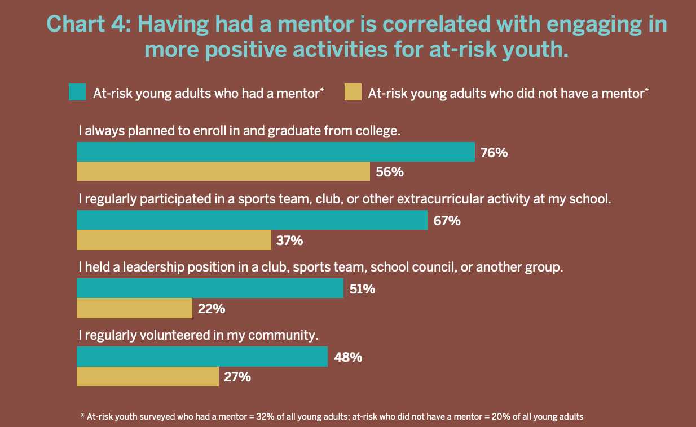
Why Should We Promote Mentoring Relationships?
Notes:
A number of studies have shown that having a mentor is associated with youth improving their sense of self-esteem, academic achievement, and peer relationships and reduce drug use, aggression, depressive symptoms, and delinquent acts.
Engage in prosocial and leadership activities
More likely to be enrolled in post-secondary schooling like college
Civic Enterprises, Hart Research, and the National Mentoring Partnership all came together - nationally representative survey with over 1000 youth ages 18-21 based on their mentoring experiences ages 8-18

Slide 23
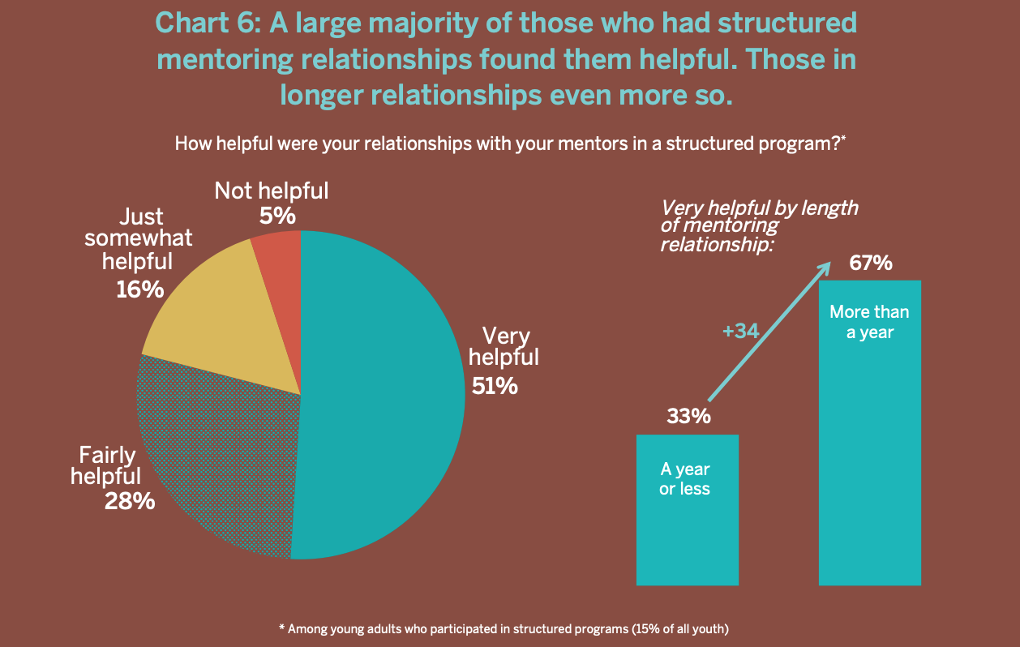

Slide 24
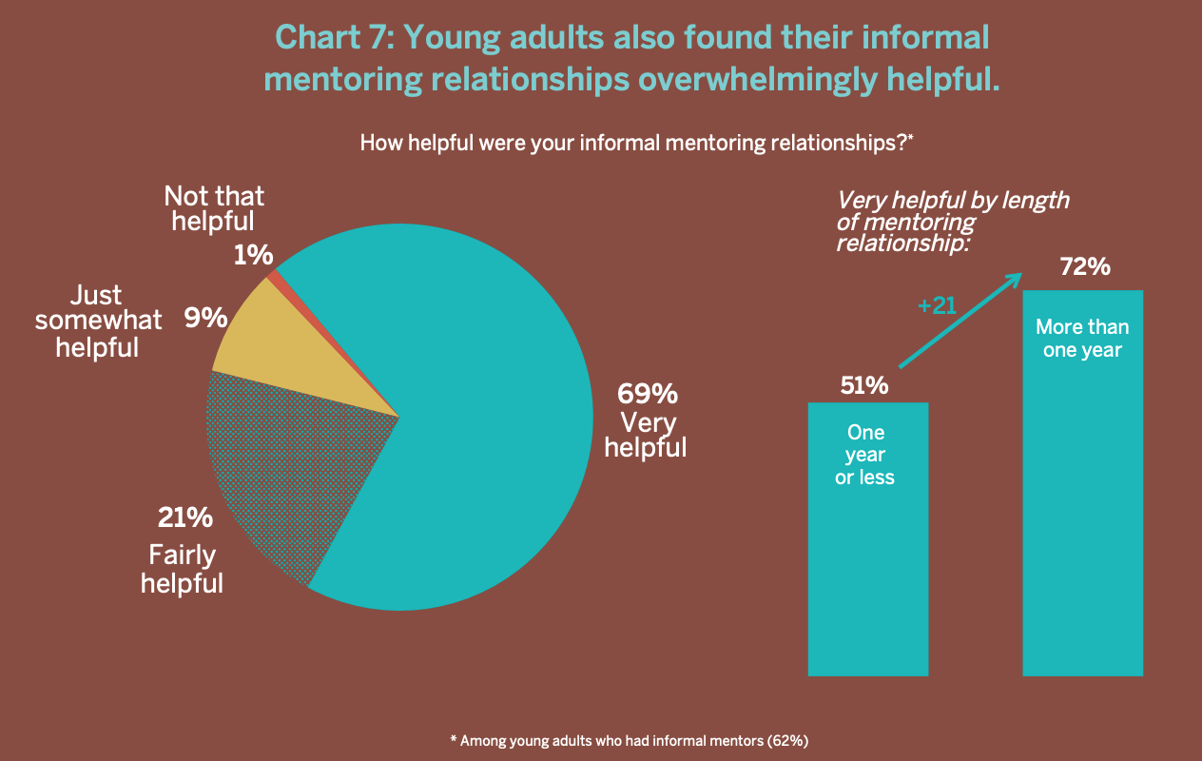

Slide 25
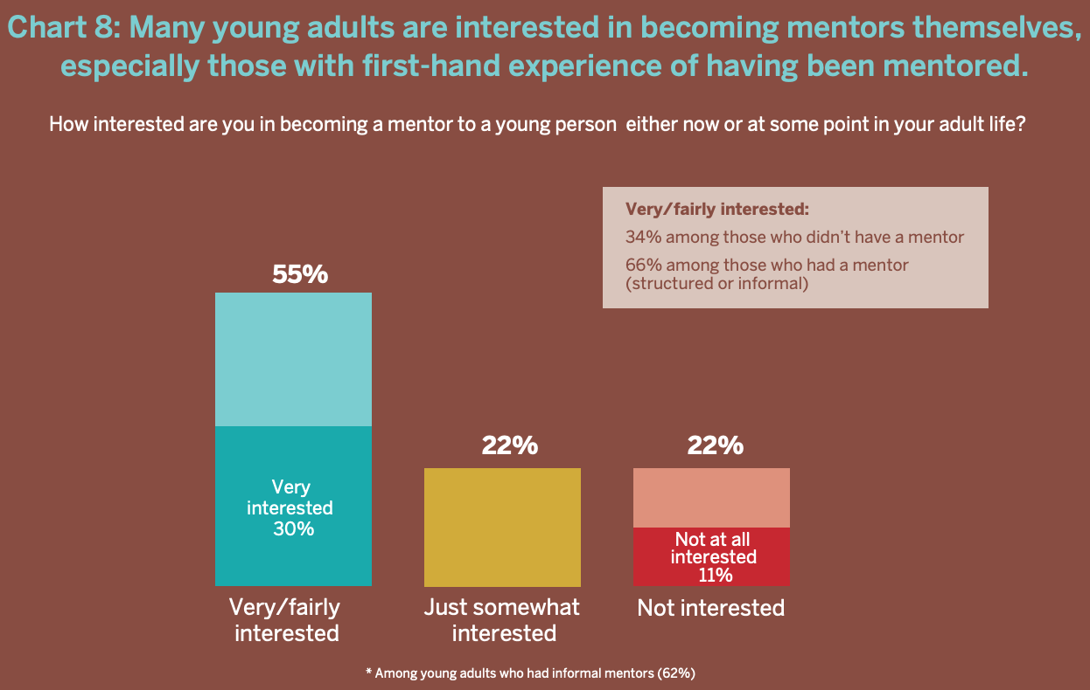
Notes:
Certainly a mentoring gap but these youth may be interested in mentoring others themselves

Slide 26
In Conclusion
At-risk youth likely experience traumatic events (which can impact their behaviors)
Historical and systemic circumstances can lead to racial and ethnic bias and discrimination
Youth interact with multiple systems in their environments, and thus “social change agents”
As social change agents, we can have significant impact on these youth through informal mentoring relationships

Slide 27
Thanks!
Any questions?
Comments and feedback:
https://forms.gle/YyYHkpKR4m7oUwBc6
You can find me at:
aunni@stressandtrauma.org

Slide 28
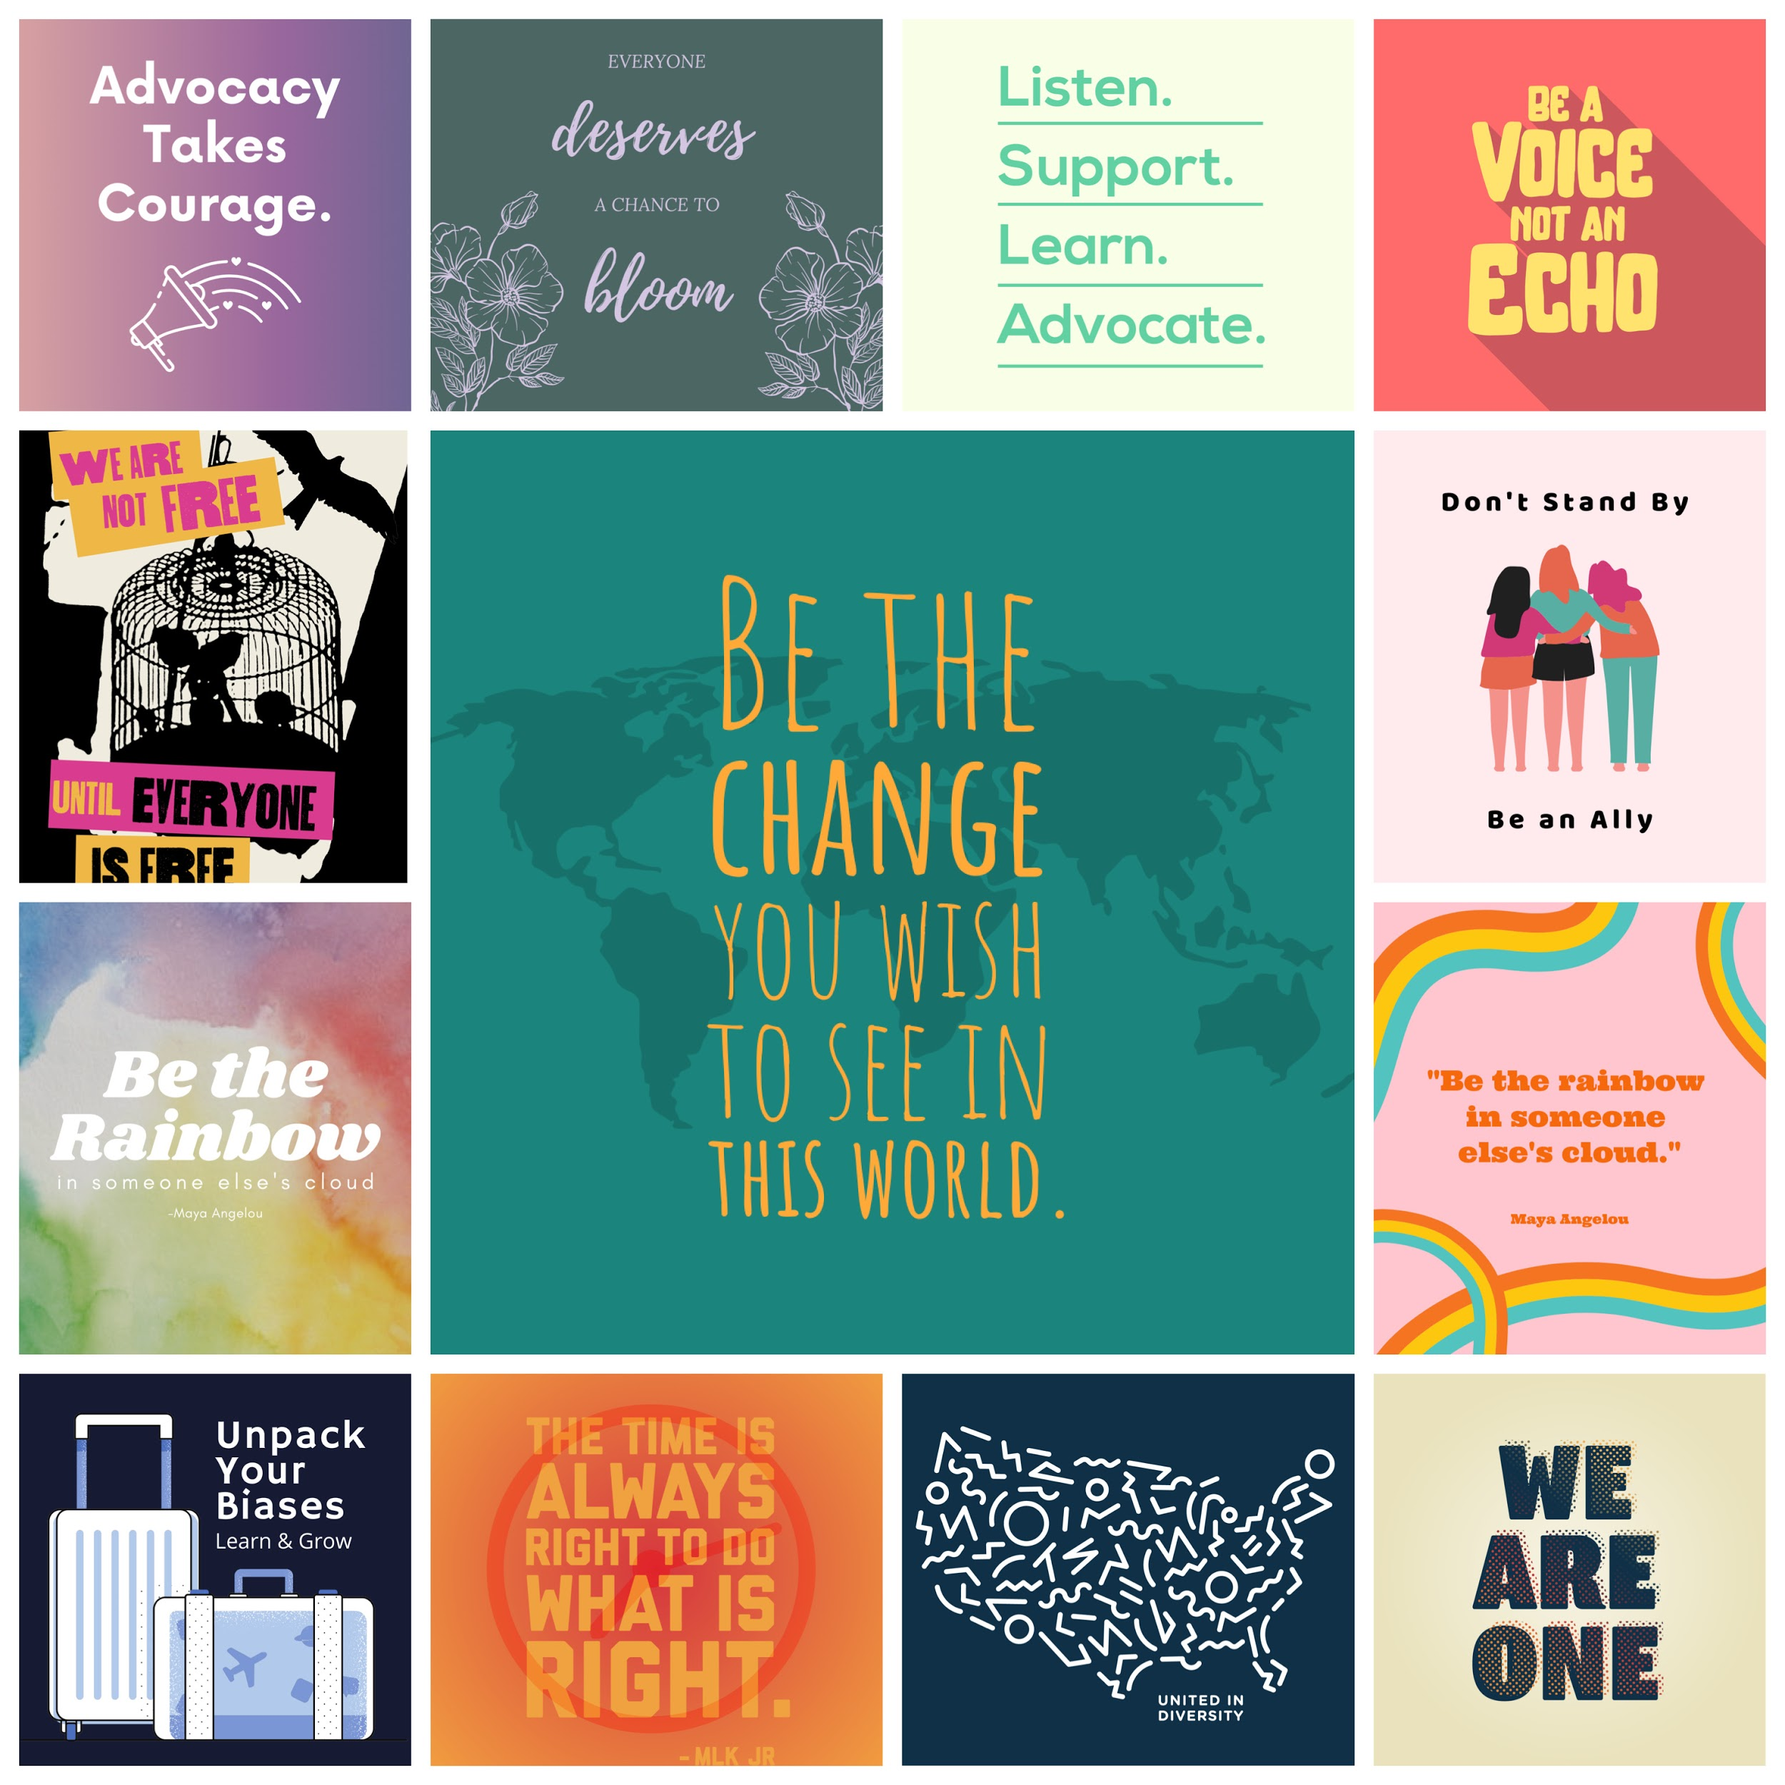
Notes:
In consideration of our discussion of social justice issues while working with at-risk youth, we’ve created several graphics that can be used on social media, shared with clients, with our youth, staff, and anyone else. They include positive messages that help us (as adults) as well as our youth to promote the idea of advocacy (advocating for youth of all backgrounds) and taking time to acknowledge and learn about our own privileges and biases so that we can support one another.
If you would like access to these graphics, i will be sending a follow-up email with a link. *****Ask Matt about adding logos/contact to the graphics****

Slide 30
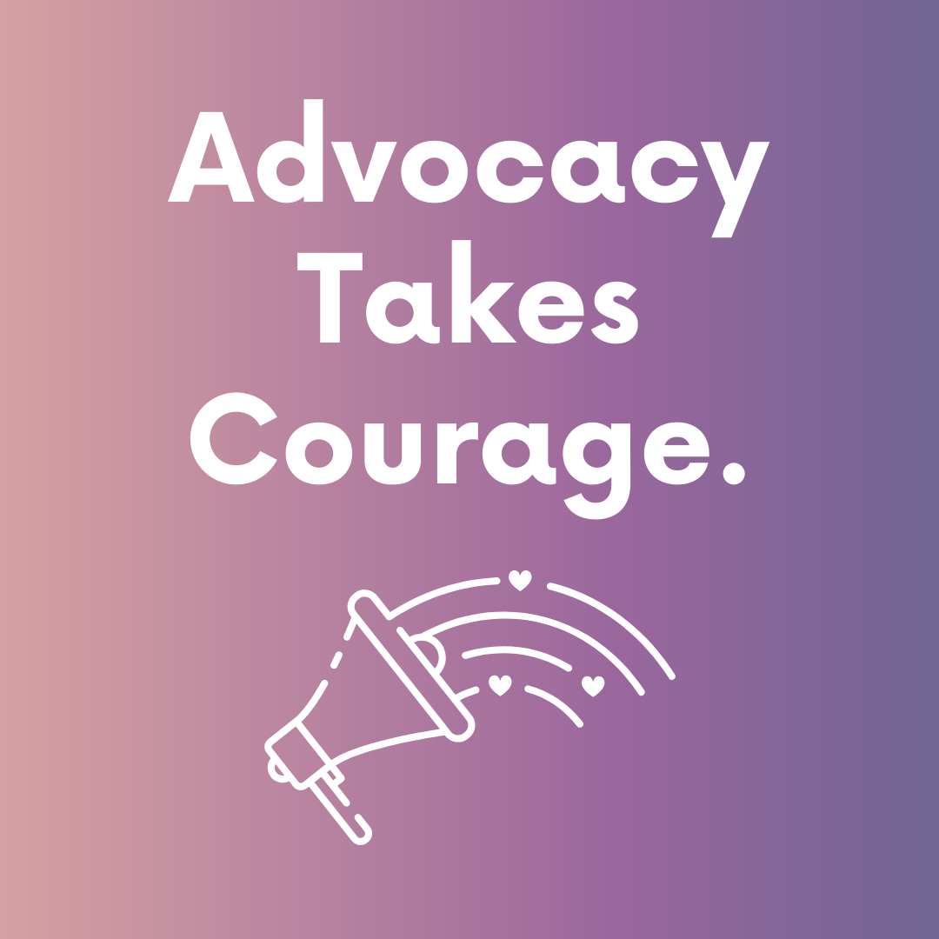

Slide 32
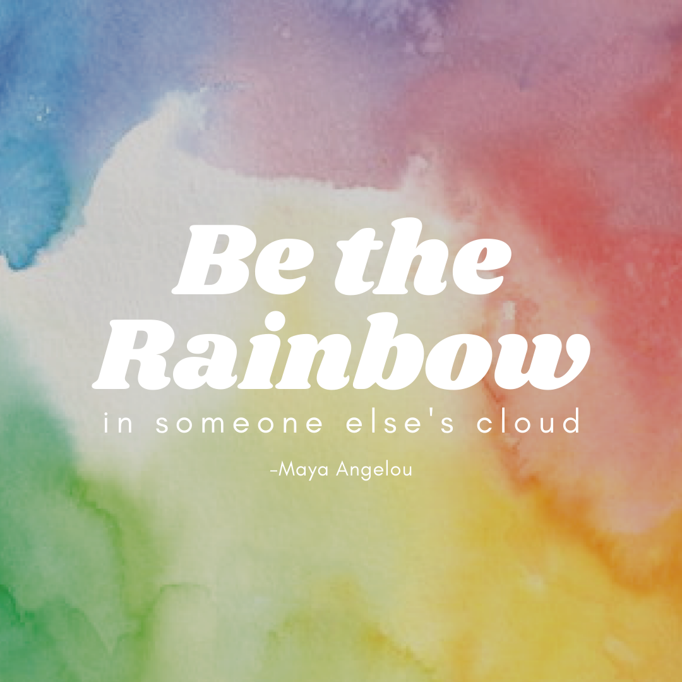

Slide 33
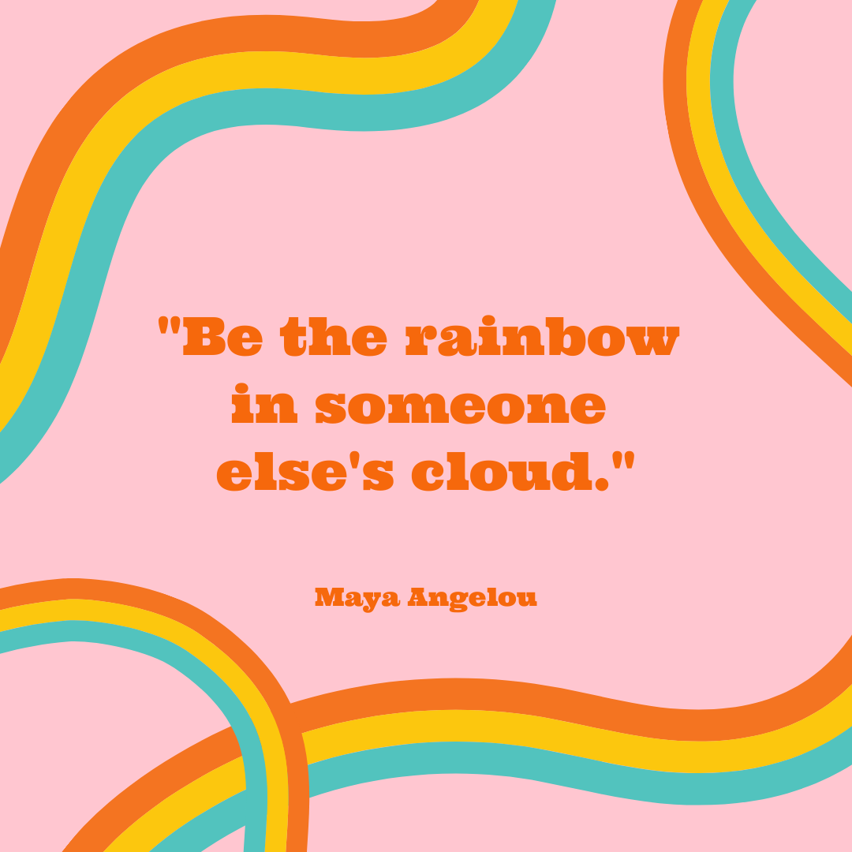

Slide 36
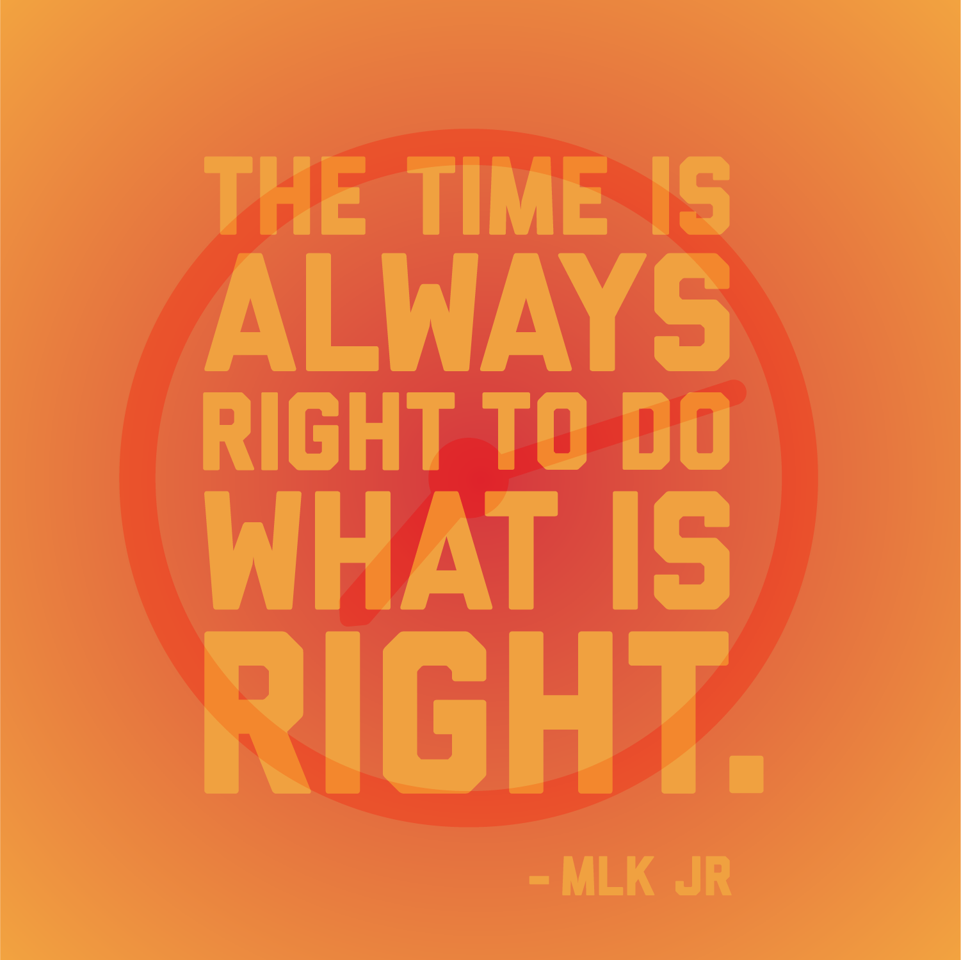

Slide 37
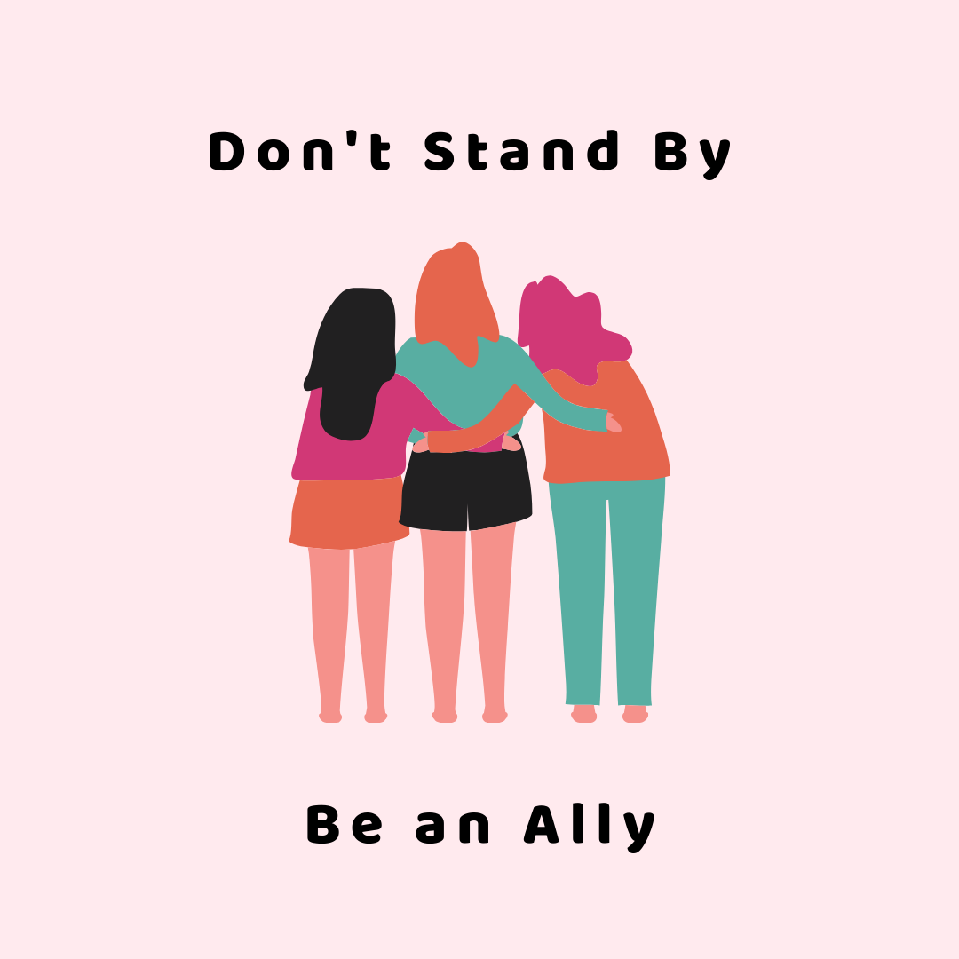

Slide 38
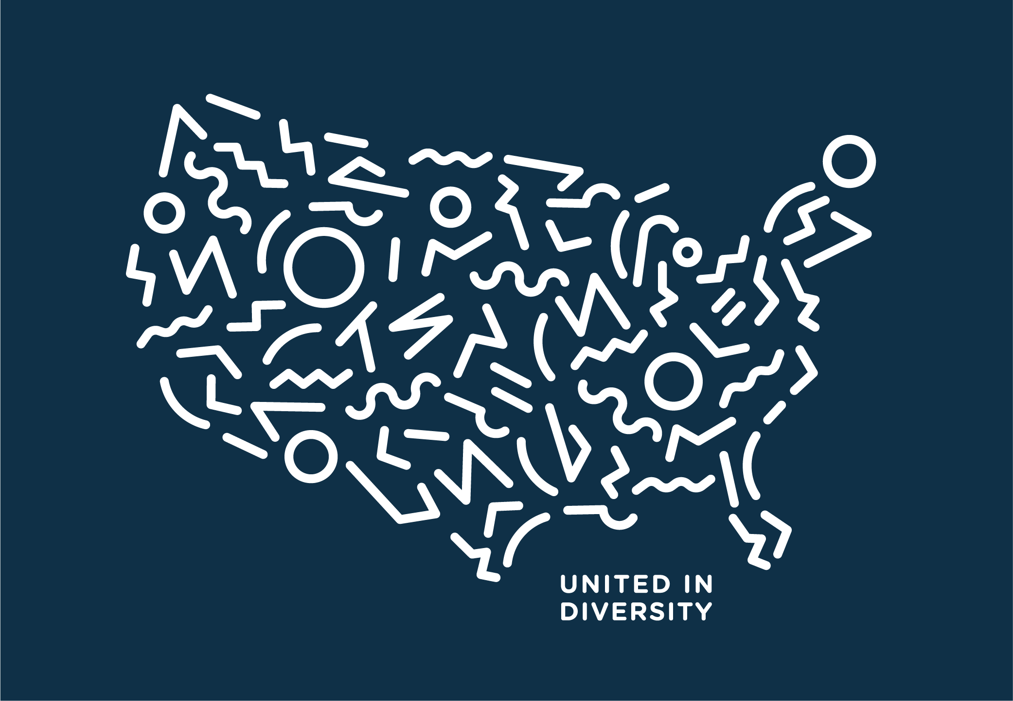

Slide 40
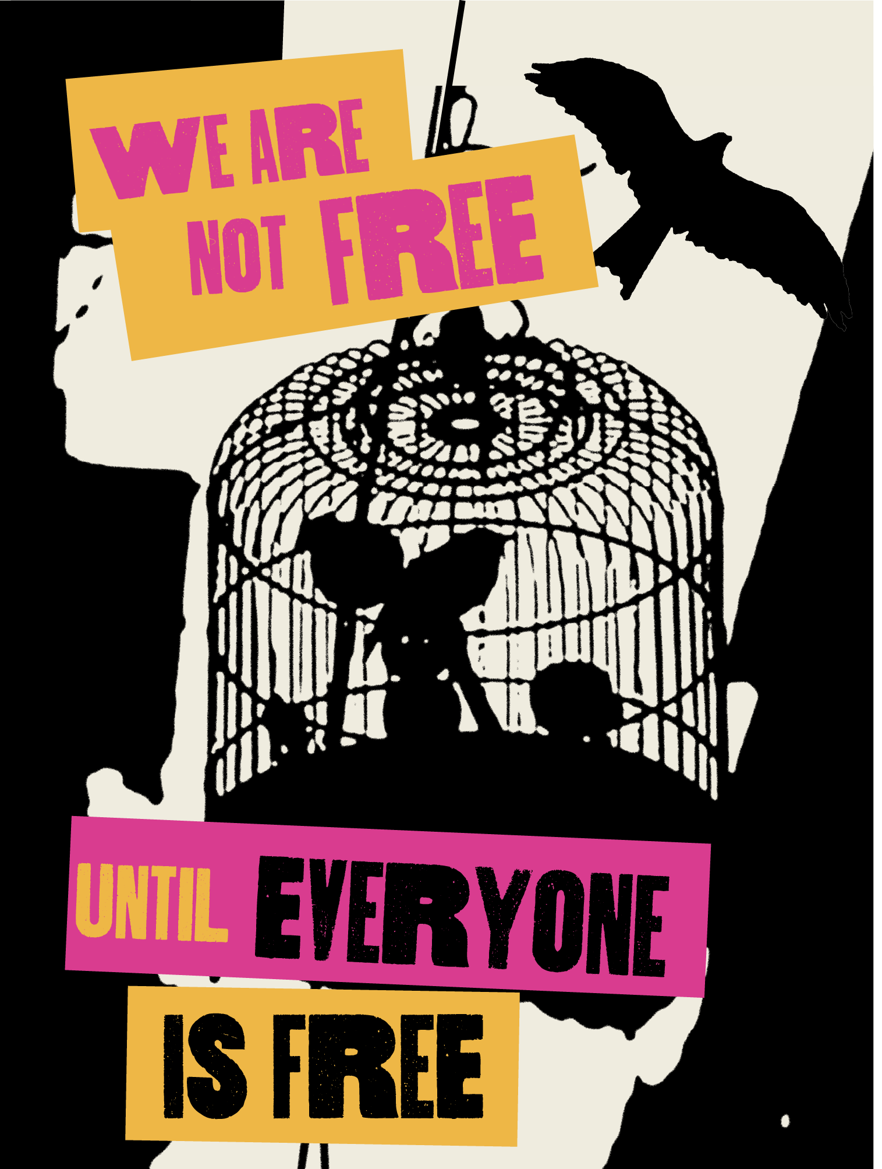

Slide 42
References
Bruce, M. & Bridgeland, J. (2014). The mentoring effect: Young people’s perspectives on the outcomes and availability of mentoring. Civic Enterprises in association with Hart Research Associates. https://www.mentoring.org/new-site/wp-content/uploads/2015/09/The_Mentoring_Effect_Full_Report.pdf
Bruch, S. K., Haynes, H., & Hylka, A. (2016). Focus area policy brief: Teacher & mentor relationships. The University of Iowa Public Policy Center. https://ppc.uiowa.edu/sites/default/files/icsb_brief1_mentors.pdf
Harbour, K. E., Evanovich, L. L., Sweigart, C. A., Hughes, L. E. (2015). A brief review of effective teaching practices that maximize student engagement. Preventing School Failure, 59(1), 5-13.
Jensen, E. (2013). How poverty affects classroom engagement. Faces of Poverty, 70(8), 24-30.
McCormick, M. P, & O’Connor, E. E. (2014). Teacher-child relationship quality and academic achievement in elementary school: Does gender matter? Journal of Educational Psychology.
Shen, B., McNauhtry, N., Martin, J., Garn, A., Kulik, N., & Fahlman, M. (2015). The relationship between teacher burnout and student teacher motivation. British Journal of Educational Psychology.
Sparks, S. D. (2019, Mar 12). Why teacher-student relationships matter. Education Week.
Taylor, R. D., & Gebre, A. (2016). Teacher-student relationships and personalized learning: Implications of person and contextual variables. In M. Murphy, S. Redding, & J. Twyman (eds.), Handbook on personalized learning for states, districts, and schools (pp. 205-220). Philadelphia, PA: Temple University, Center on Innovations in Learning. Retrieved from www.centeril.org
Zee, M., & de Bree, E. (2016). Students’ self-regulation and achievement in basic reading and math skills: The role of student-teacher relationships in middle childhood. European Journal of Developmental Psychology, 14(3).

Slide 43
Credits
Special thanks to all the people who made and released these awesome resources for free:
Presentation template by SlidesCarnival
Photographs by Unsplash

