Slide 1
Resilience Skills for Teens
Notes:
Resilience Skills for Teens V1.1
Controlled Release
For 2014-2015
2 Hour Workshop
Restricted Use to CSF2 Approved Sites Only
Point of Contact at CSF2 is Ms. Julie Broad at 703-545-9210 or julie.d.broad.ctr@mail.mil
Disclaimer: This curriculum is not intended as therapy or counseling for any mental health issues, or intended to replace therapy or counseling.

Slide 2
Resilience Skills for Teens
Notes:
Rationale: An objective of the Teen Curriculum is to offer a resilience curriculum that:
Is consistent with the language in the CSF2 current adult curriculum
Fits within the Army adolescent culture
Provides skills that get the whole Army Family speaking the same language when it comes to resilience
Approach: Units are subdivided into four areas:
Skill: Define and describe the skill. Students should be solicited for their basic understanding through simple verbal checks on learning and/or personal examples.
Hook: An interactive component near the beginning of each unit to demonstrate why the skill is important and how it is relevant to students. Hooks are characterized as low-tech (LT), requiring only basic materials to include the Participant Guide, or high-tech (HT), requiring more advanced equipment or setup (e.g., media).
Activity: Each unit contains a variety of activities that illustrate a basic teaching point and further the students’ understanding of the skill and how to use it. Activities that are essential to the unit are indicated by a *. Activities are also characterized as LT or HT.
Make it Personal: The Make it Personal page, located at the end of each lesson in the Participant Guide, provides an opportunity for students to synthesize the basic points of the lesson and identify a specific way they will incorporate the skill into their daily lives.
Instructors are encouraged to adhere to the four-part approach provided in the Instructor Guide of Skill, Hook, Activity, and Reflection. Instructors should follow the notes within the Instructor Guide to achieve and maintain an interactive and activity-based learning experience.
Differentiation: Instructors should consider the developmental level of students and select activities, videos, and discussion questions which are age-appropriate from the options provided.
Structure: Although the sequence may be adapted to fit individual circumstances, instructors are recommended to teach lessons according to the established sequence whenever possible.
Time: Each unit is designed in a 45-minute block. Units 1 and 2 should be taught together.
Resilience Skills for Teens

Slide 3
Resilience Skills for Teens
Notes:
Units 1/2 Introduction to Resilience: A basic understanding of resilience provides a rationale for the skills the students will learn.
Hunt the Good Stuff: Counteract the Negativity Bias, create positive emotion, and notice and analyze what is good.
Unit 3 Goal Setting: Understand the key components of the Goal Setting process and practice the skill so it can be used independently to plan for achieving personal and career goals.
Unit 4 ATC: Identify your Thoughts about an Activating Event and the Consequences of those Thoughts.
Unit 5 Energy Management: Modulate energy to a level that is appropriate for the task at hand and that allows optimal performance.

Slide 4
Resilience Skills for Teens
Notes:
SUPPLY/MATERIAL LIST
Units 1/2: Tennis ball, egg, saran wrap, tape, masking tape, list of myths and facts on a piece of paper, flip-chart paper, clothes pins, 2-3 hula-hoops, balloons, HTGS messages, post-it notes, pencils, index cards, pens, super hero pictures, glue stick
Unit 3: Magazines
Unit 4: Note cards with ATC scenarios written on them, relay cards for ATC, relay board for ATC, prize for winner of ATC relay

Slide 5
1) Activity Form Template
Notes:
The following section includes possible activities for each of the Units. The instructor can choose activities based on prep time, class time and age group.
Resilience Skills for Teens Activities

Slide 6
1) Activity Form Template
Notes:
Rationale: To provide a visual demonstration of what we mean by “bounce back” and that we don’t always bounce, but we can keep moving forward.
Objective: Students will be able to understand the difference between what it means to be resilient and what it may look like if we aren’t being resilient and breaking.
Age Group: Middle school and/or high school
Prep Time: 2 minutes
Class Time: 5 minutes
Materials: Egg Flip Chart with definitions of “what is resilience”
Tennis Ball
Saran wrap
Tape
Instructor Notes and Recommended Timing:
Unit 1: Resilience Overview
Name of Activity: Egg and Ball Drop

Slide 7
1) Activity Form Template
Notes:
Rationale: To provide a hands on activity that will demonstrate common myths and facts regarding resilience and what resilience means.
Objective: Students will be able to differentiate between myths and facts surrounding resilience and start to formulate their own opinions about what resilience means to them.
Age Group: Middle school and/or high school
Prep Time: 2 minutes
Class Time: 5 minutes
Materials: Gym space or classroom space where students can stand
Masking tape
Common Myths and Facts on a sheet of paper for instructor
Instructor Notes and Recommended Timing:
Unit 1: Resilience Overview
Name of Activity: Myth vs. Fact

Slide 8
1) Activity Form Template
Notes:
Rationale: To provide students a fun and interactive way to learn the different competencies that help build resilience.
Objective: Students will be able to understand that resilience is built through different areas rather than just increasing one area
Age Group: Middle school and/or high school
Prep Time: 30-90 minutes
Class Time: 30-35 minutes
Materials: Gym space or classroom space where students can run
Flip charts with each Core competency and the characteristics that make up each of the competencies (see pictures with each activity)
Clothes Pins (one for each student, extra for rewards)
Hula-hoop (2-3 depending on how many students)
30-40 blown-up balloons with printed slips of paper with HTGS messages (good and bad)
Instructor Notes and Recommended Timing:
Unit 1: Resilience Overview
Name of Activity: Competencies Review

Slide 9
1) Activity Form Template
Notes:
Instructor
Notes and Recommended Timing:
Unit 1: Resilience Overview
Name of Activity: Strengths of Character Clothespin Tag
Rationale: see above
Objective: see above
Age Group: Middle school and/or high school
Prep Time: 10-20 minutes
Class Time: 5 minutes
Materials: Strengths of Character Flip Chart
Open space for game
Clothespins (one for each student plus extra)

Slide 10
1) Activity Form Template
Notes:
Unit 1: Resilience Overview
Name of Activity: Self Regulation: Red Light-Green Light
Rationale: see above
Objective: see above
Age Group: Middle school and/or high school
Prep Time: 10-20 minutes
Class Time: 5 minutes
Materials: Self-Regulation Flip Chart
Open space for Red Light, Green Light game
Instructor Notes and Recommended Timing:

Slide 11
1) Activity Form Template
Notes:
Unit 1: Resilience Overview
Name of Activity: Hula-Hoop Activity: Self-Awareness, Mental Agility and Connection
Rationale: see above
Objective: see above
Age Group: Middle school and
/or high school
Prep Time: 10-20 minutes
Class Time: 5 minutes
Materials: Self Awareness,
Mental Agility &
Connection flip charts
2-3 Hula-Hoops
(1:10 students)
Instructor Notes and Recommended Timing:

Slide 12
1) Activity Form Template
Notes:
Unit 1: Resilience Overview
Name of Activity: Optimism: HTGS Balloon Pop
Rationale: see above
Objective: see above
Age Group: Middle school and/or high school
Prep Time: 10-20 minutes
Class Time: 5 minutes
Materials: Optimism & HTGS Flip charts
30-40 balloons
Good and Bad messages typed
and placed in the balloons
Instructor Notes and Recommended Timing:

Slide 13
1) Activity Form Template
Notes:
Unit 1: Resilience Overview
Name of Activity: Name that Competency
Rationale: Allows students to make connections between the skill and the competency that it builds to enhance resilience.
Objective: Have an understanding of the students rationale and how they are making the connections between the skill being taught and the competency they believe it builds.
Age Group: Middle school and/or high school
Prep Time: 2 minutes
Class Time: 5 minutes
Materials: Post-It Notes (2 different colors-student and instructor)
Competency flip charts
Pencils

Slide 14
1) Activity Form Template
Notes:
Unit 1: Resilience Overview
Name of Activity: HTGS Rock, Paper, Scissors
Rationale: Allows students a fun and interactive way to build optimism by starting out the day’s lesson by sharing their HTGS from the previous week.
Objective: Students are able to share their HTGS from the past week with their peers
Age Group: Middle school and/or high school
Prep Time: 0 minutes
Class Time: 5 minutes
Materials: HTGS Flip Chart as a reminder of the reflection questions if needed

Slide 15
1) Activity Form Template
Notes:
Rationale: Briefly review Hunting the Good Stuff
Objective: Students will be able to make connections with one another while sharing their “Good Stuff.”
Age Group: Middle school and/or high school
Prep Time: 5 minutes
Class Time: 10 minutes
Materials: Index cards
Pens
Super hero pictures
Glue stick
Instructor Notes and Recommended Timing:
Unit 2: Hunting the Good Stuff
Name of Activity: HTGS Icebreaker

Slide 16
1) Activity Form Template
Notes:
Rationale: Real-life examples allow students to develop effective or ineffective thoughts.
Objective: Students will become aware of their thoughts.
Age Group: High school
Prep Time: 05 minutes
Class Time: 10-15minutes
Materials: Five note cards with five different scenarios. Five facilitators to assist at each table and promote a rich discussion.
Your teacher tells you that you have to run a timed one-mile in PE on an extremely hot and humid day.
You are scheduled to take the SAT’s on Saturday morning and all your friends are going to a fun event Friday night that will end very late.
You are in the school play with a minor role. Opening night, the star of show comes down with the flu and you are told to take over her role.
It’s Drug Awareness Week and the principal of the school has asked you to give a speech to the student body.
You are at the DMV about to take your driving test when you see a classmate in the parking lot looking distraught. She tells you the instructor is super hard and she just flunked.
Instructor Notes and Recommended Timing:
Unit 4: ATC
Name of Activity: Effective or Ineffective?

Slide 17
2) Activity Form Example
Notes:
Rationale: Fun and engaging way to reinforce the components of the ATC model
Objective: Have the students understand how to clearly separate the AE, T, and C (E/R)
Age Group: Middle school, high school (examples will vary according to age)
Prep Time: 65 minutes
Class Time: 15 minutes
Materials: Relay cards
Relay board
Prize for winning team (optional)
Instructor Notes and Recommended Timing:
Unit 4: ATC
Name of Activity: ATC Relay

Slide 18
1) Resilience Overview Cover Page
Notes:
Rationale: This first unit lays the foundation for the rest of the course. A basic understanding of resilience provides a rationale for the skills the students will learn.
Objective: Grow and thrive in the face of challenges and bounce back from adversity.
Note: This unit should be taught in conjunction with Unit 2: Hunt the Good Stuff.
Unit Overview and Recommended Timing:
Resilience Training for Teens,
Unit 1: Resilience Overview

Slide 19
1) Resilience Key Terms
Notes:
Resilience The ability to grow and thrive in the face of challenges and bounce back from adversity
Resilience Overview
Key Terms

Slide 20
Resilience Training for Teens
Notes:
Trainer Instructions:
Introduction of Trainer(s). You might consider answering these questions:
Why are you interested in teaching resilience to teenagers?
When have you personally used the resilience skills?
If you have teenagers, when have they demonstrated resilience skills?
Why is it so important to teach resilience skills to teenagers?

Slide 21


Resilience Overview
Notes:
Trainer Instructions:
This slide is optional, use only if teaching the full curriculum.
You may elect to name each of the 14 skills currently covered in the Resilience Training for Teens course.
Key Points:
All of the resilience skills are conceived as a "skill set," represented by this visual.
The skills work together, in concert, to improve and sustain resilience. Thus all together, the skills form a kind of armor; that is, if you have multiple strategies, you can defend against any kind of challenge that comes your way.

Slide 22


Resilient people bounce, not break.
Resilience is the ability to grow and thrive in the face of challenges and bounce back from adversity.
You Not You
Notes:
Trainer Instructions:
Skill
Explain that resilience doesn’t result from a lucky scramble of genes. It is not just the lucky few who can be resilient; these are skills that anyone can learn.
Point out that even the most resilient people have non-resilient moments and that everyone can increase his or her resilience.
The tennis balls can serve as a visual cue for resilience throughout the course.
Refer to the visual of the tennis ball throughout the course when you talk about resilience.
Key Points:
Everyone can enhance his or her resilience.

Slide 23


Activities
DEMO
Egg/Tennis Ball
3 Words for Resilience
p. 2
Notes:
Trainer Instructions:
Hook (Low Tech)
Have two students come up to the front of the room.
One student drops an egg, the other drops a tennis ball.
Lead a short group discussion about the differences between the tennis ball and the egg, and why the tennis ball is a symbol of resilience.
Hook (Low Tech)
Refer students to the Participant Guide page 2.
Ask students to use the Egg/Tennis Ball Demo to help them complete this activity.
Have students write three words that describe resilience. Have students discuss words as a group. Record the words discussed on a large flip chart.
Flip
Chart

Slide 24

Resilience Facts
Resilience Facts
Resilient people know when and how to express emotion
Asking for help is a resilient strategy
Resilience can be messy
Everyone can develop resilience
RESILIENCE FACTS
Resilience is regulating and expressing emotion
Being resilient is about you and the people important to you
Asking for help is a resilient strategy
Resilience is knowing when to slow down
Resilience is bouncing back
Resilience is not always pretty
Everyone can develop resilience
Rejuvenation fuels resilience
Notes:
Trainer Instructions:
Resilience is not about suppressing emotions; it’s about regulating/expressing them appropriately.
Resilience is not about handling everything on your own; asking for help is a resilient strategy.
Resilience is not about always being composed and graceful; sometimes it’s just muddling through.
Resilience is not pre-determined at birth; it can be developed.
Activity (Low Tech)
Discussion: Discuss with students why asking for help is a resilient strategy. Ask students to think of people they can turn to for help (e.g., peers, family, teachers, coaches). Emphasize that seeking help is a resilient strategy.
Key Points:
Resilience is obtainable by all.

Slide 25

6 Core Competencies
Self-awareness
Self-regulation
Optimism
Mental Agility
Strengths of Character
Connection
Take a look in the mirror
Pump the breaks
Tied to reality
F.A.T. thinking
What’s right with you?
Other people matter
Record Key Words
p. 3
Notes:
Trainer Instructions:
Review the key points of the competencies.
Instruct students to record the key words for each competency.
Key Points:
It is important to be aware of your thoughts, emotions, and behavior.
Resilience requires us to control our impulses, emotions, and behaviors.
Optimism is the engine of resilience, without optimism, resilience is not possible.
Flexible, accurate, thorough (F.A.T.) thinking helps us to see things from a different perspective.
It is important to know who you are at your best.
Building strong relationships is critical for resilience.
Slide Builds

Slide 26
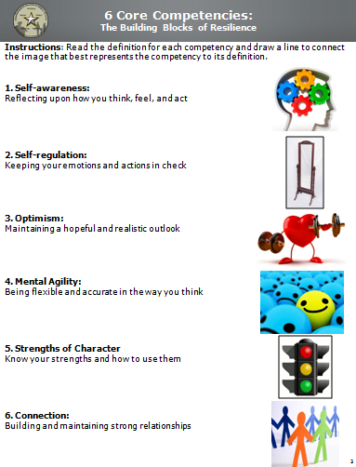
Workbook Activity (p. 3):
6 Core Competencies
Notes:
Trainer Instructions:
Activity (Low Tech)
Students draw a line matching the competency to the picture that most accurately represents that competency.
Add page number from final version of workbook to the top of the slide

Slide 27
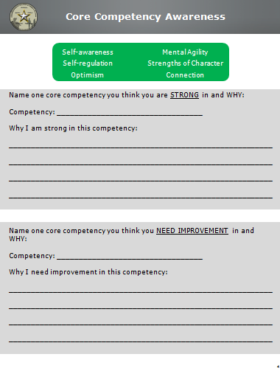
Workbook Activity (p. 4):
Core Competency Awareness
Notes:
Trainer Instructions:
[This activity is optional]
Activity (Low Tech)
Have students complete the workbook activity.
Ask a couple polling/show of hands questions (i.e. “How many of you are strong in optimism?”).
Elicit some specific examples from students.

Slide 28
2) HTGS Cover Page
Notes:
Rationale: Dr. Seligman and colleagues developed an activity to help people notice positive experiences to enhance their gratitude and positivity. Thinking about why events go well, what the positive events mean, and how to create circumstances that enable more good things to occur encourages a consciousness of blessings and molds a style of thinking that promotes optimism about the future.
Objective: Counteract the Negativity Bias, create positive emotion, and notice and analyze what is good.
Note: This unit should be taught in conjunction with Unit 1, Resilience Overview.
Note: There is a HTGS page in the Participant Guide at the beginning of each lesson so that this activity becomes regular practice during resilience training.
Unit Overview and Recommended Timing:
Resilience Training for Teens,
Unit 2: Hunt the Good Stuff

Slide 29
2) HTGS Key Terms
Notes:
Hunt the Good Stuff A resilience skill used to counter the Negativity Bias, to create positive emotion, and to notice and analyze what is good
Negativity Bias The tendency to notice and remember the negative aspects of a situation more than the positive aspects; we remember failures more readily than successes and analyze bad events more thoroughly than good events
Hunt the Good Stuff
Key Terms

Slide 30


Hunt the Good Stuff
Optimism
Notes:
Trainer Instructions:
Tell students in one sentence what they will be learning.
Provide students with the Core Competency the skill targets.
Key Points:
1. HTGS builds Optimism.

Slide 31
Benefits of Optimism
  Happier
  Healthier
  Stronger relationships
  Perform better
  More successful
Notes:
Trainer Instructions:
Skill
Define optimism.
Describe to students that the negativity bias is the tendency to pay more attention to the bad than the good, and that HTGS helps to combat this bias.
Provide an example of the negativity bias.
i.e., at the end of the day when you talk to your best friend, you are more likely to talk about the bad grade you got, the fight you got into with another friend, how bad lunch was versus the good stuff that happened.
Go over the benefits of optimism (listed in Participant Guide).
Key Points:
You can fight the negativity bias through this simple exercise.
Optimistic thoughts drive behaviors that lead to more positive outcomes.
The benefits of optimism listed on the slide result from Hunting the Good Stuff on a regular basis.

Slide 32
Hunt the Good Stuff
HOW
Record three good things each day
Write a reflection:
  Why this good thing happened
  What this good thing means to you
  How this good thing makes you feel
Notes:
Trainer Instructions:
Review the points on the slide.
Key Points:
HTGS is a daily skill.
It is important to include a reflection about each good thing because it causes the person to think more about and savor the experience.

Slide 33
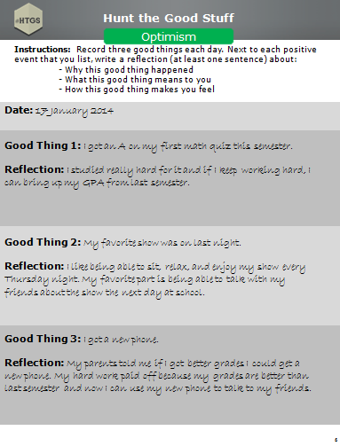
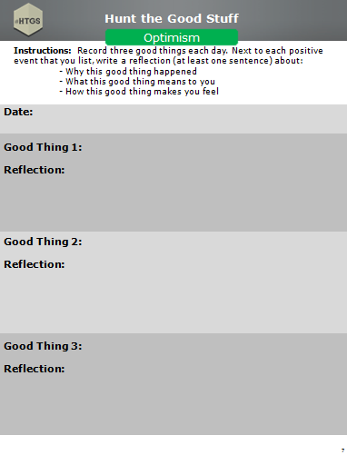
Workbook Activity (pp. 6-7):
Hunt the Good Stuff
Notes:
Trainer Instructions:
Activity (Low Tech)
Go over the HTGS example.
Have students write down one to three good things in the Participant Guide.
Tell students to share the good thing and the reflection they wrote about it.
Ask a couple students to share their “good stuff” at the group level. Remember to emphasize that the students explain why it is a good thing to them.
Key Points:
Optimism is important for resilience.
HTGS is a daily skill.
Recommendation:
It is important to have the students Hunt the Good Stuff on a regular basis. It is recommended that Hunt the Good Stuff be conducted and shared prior to the start of every lesson, time permitting.

Slide 34
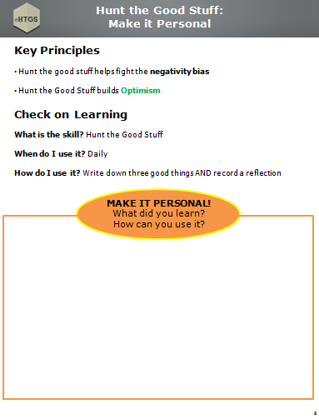
Workbook Activity (p. 8):
Make it Personal
Notes:
Trainer Instructions:
Review the Key Principles (if time permits).
Reflection (Low Tech)
Students write down what they learned and how they can use it or apply it to their own lives.

Slide 35
3) Goal Setting Cover Page
Notes:
Rationale: Goal Setting, when done correctly, can result in more optimal performance, sustained motivation, and increased effort and persistence. This model of goal setting is effective because it enhances mental toughness by accounting for thoughts and beliefs that can hinder goal achievement.
Objective: Introduce students to critical components of the Goal Setting process and practice the skill so it can be used independently to plan for achieving personal and educational goals.
Unit Overview and Recommended Timing:
Resilience Training for Teens,
Unit 3: Goal Setting

Slide 36
3) Goal Setting Key Terms
Notes:
Goal Setting A process to deliberately energize, direct, and sustain behavior to ensure progress toward a goal
Goal Setting
Key Terms

Slide 37
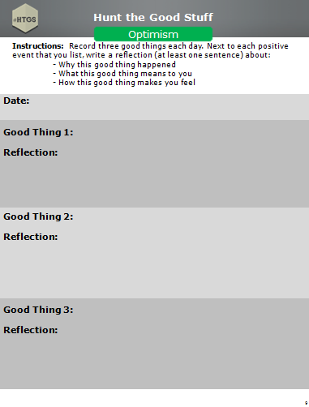
Workbook Activity (p. 9):
Hunt the Good Stuff
Notes:
Trainer Instructions:
Activity (Low Tech)
Begin the lesson with Hunt the Good Stuff.
Have students write down one to three good things in the Participant Guide.
Tell students to write the good thing and the reflection (i.e., why it’s a good thing).
Ask a couple students to share their “good stuff” at the group level. Remember to emphasize that the students explain why it is a good thing to them.
Key Points:
Optimism is important for resilience.
HTGS is a daily skill.

Slide 38


Goal Setting
Self-regulation
Notes:
Trainer Instructions:
Tell students in one sentence what they will be learning.
Provide students with the Core Competency the skill targets.
Key Points:
This skill is about planning and staying committed to goals.
Goal Setting builds Self -regulation.

Slide 39
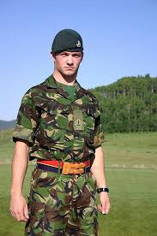

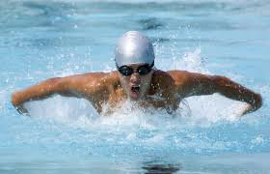



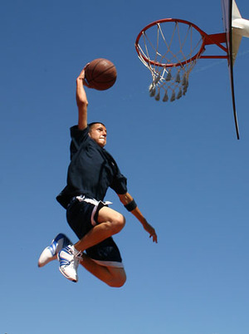

What Are Your Goals?
What do you want to achieve in your life?
What do you want to be really good at?
Notes:
Trainer Instructions:
Skill
Goal Setting facilitates resilience by giving us a process for planning to achieve our goals, which allows us to grow and thrive.
When thinking about goals, these questions on the slide are important to consider.
Key Points:
Goal Setting is difficult but essential. You will set several goals throughout your lifetime.
It is important to know what your goals are and think about them on a daily basis.

Slide 40
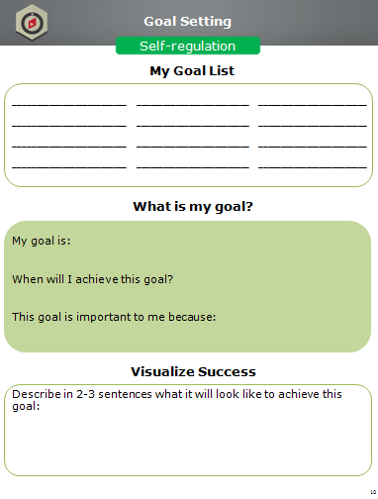
Workbook Activity (p. 10):
My Goal List
Notes:
Trainer Instructions:
Hook (Low Tech)
Have participants individually brainstorm and write down the goals they would like to achieve. Provide sample categories such as family, vacation, career, etc., if necessary.
Prompt students to consider the questions on the previous slide.

Slide 41

Define Your Goal
Pick a goal from your list
Give your goal a deadline
Identify why your goal is
important to achieve
My goal is: Get accepted to University of Kentucky
When will I achieve this goal? Fall 2017
This goal is important to me because... It will set me up for future success
Notes:
Slide Builds
Trainer Instructions:
You have to know your goal before you can make a plan for it.
Review example on the slide.
Key Points:
Writing a date you want to achieve your goal by gives you less time and room to procrastinate, even though the date may change later.
Identifying why a goal is important to you helps to energize you and keeps you motivated throughout the goal setting process.

Slide 42
Workbook Activity (p. 10):
What is my goal?
Notes:
Trainer Instructions:
Activity (Low Tech)
Have students pick a goal from their Goal List, a date they will achieve it by, and explain why it is important to them.
Have students turn to someone near them and share their goal OR have a couple students share at the large group level.

Slide 43


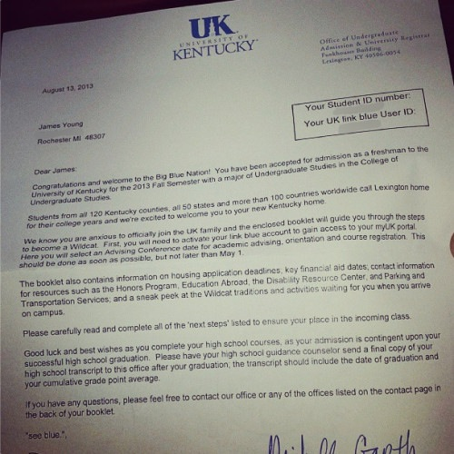
Visualize Your Success
What does it look like to achieve your goal?
Notes:
Trainer Instructions:
Once you have your end state in mind, think about what it will be like to achieve your goal. What are the benefits of getting to your final destination?
Review example (images) on the slide.
Key Points:
Visualizing success gives us energy and motivates us.
You should visualize success regularly.

Slide 44
Workbook Activity (p. 10):
Visualize Success
Notes:
Trainer Instructions:
Activity (Low Tech)
Give students 1-2 minutes to visualize what it will look like and what the benefits will be when they achieve their goal.
Next, instruct students to write 2-3 sentences of what it would look like to achieve their goal.
Have a couple students share how they visualize their success.

Slide 45
Make it Happen
How do I make my goal happen?
5 Things I Need to Accomplish My Goal
Get good grades
Participate in other activities
Do well on my ACTs
Contact someone at UK that can help me
Visit the school
Notes:
Trainer Instructions:
When setting goals it is important to have a plan. Consider this a “to-do” list to reach your goal.
Completing these accomplishments will move you closer to reaching your goal.
Review example on the slide.
Key Points:
Indicate what work you need to start doing to achieve your goal.
Successful goal setting takes a deliberate plan.
Slide Builds

Slide 46
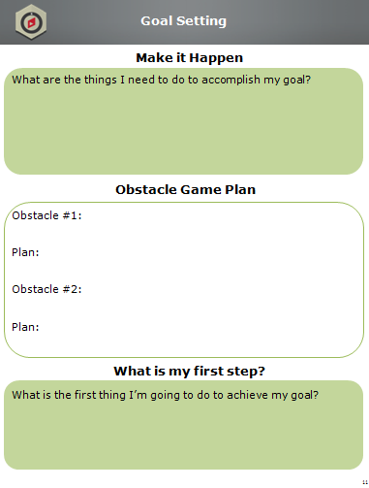
Workbook Activity (p. 11):
Make it Happen
Notes:
Trainer Instructions:
Activity (Low Tech)
Have students write down at least five things they need to do to reach their goal.
Have a couple students share what they need to accomplish in order to reach their goal.

Slide 47
Obstacle Game Plan
What is standing in my way?
What can I do about it?
Obstacle Game Plan
Obstacle #1:
My grade in science is not as good as it could be
Plan:
I can ask my teacher to stay after school for extra help and see if I can do extra credit assignments to bring my grade up
Notes:
Slide Builds
Trainer Instructions:
Explain the importance of identifying obstacles you may face with your goal and having a plan to deal with those obstacles.
Review example on the slide.
Key Points:
Knowing potential obstacles helps you come up with your Goal Setting plan.
Because obstacles are an inevitable part of pursuing goals, maintaining motivation requires planning for obstacles that we can expect to face.

Slide 48
Workbook Activity (p. 11):
Obstacle Game Plan
Notes:
Trainer Instructions:
Activity (Low Tech)
Have students identify two obstacles they may face as they pursue their goal and develop a plan for overcoming those obstacles.
Have a couple students share an obstacle and their plan for overcoming it.

Slide 49

Take the First Step
What is the first step toward accomplishing your goal?
My First Step: Turn in all my homework assignments and study for all of my tests this week.
Notes:
Trainer Instructions:
Explain the importance of putting a goal into action and taking the first step.
Review example on the slide.
Key Points:
1. If you really want to achieve the goal you set for yourself, you should do something each day to move you closer to your goal, even if it’s a small step. Your first step gets this process going.
Slide Builds

Slide 50
Workbook Activity (p. 11):
What is my first step?
Notes:
Trainer Instructions:
Activity (Low Tech)
Have students identify the first thing they are going to do to reach their goal. Instruct students to try to be specific (e.g., look up 5 colleges this weekend, practice free throws for one hour this weekend, set up an appointment with my guidance counselor next week, etc.).
Have a couple students share their first step.

Slide 51




Activity:
Make Your Goal Real
Magazine clippings activity/drawings/pictures
How will you remind yourself of your goal every day?
Where will you post your goal?
Notes:
Trainer Instructions:
Activity (Low Tech)
Give students time to make their goal come to life. The goal of this activity is for students to find/create images that relate to their goal. Some options include:
Bring in magazines or have students bring in magazines to clip out pictures that relate to their goal
Have students draw a picture related to their goal
If the students have laptops, allow them to search for images related to their goal
Discuss with students ways they can remind themselves of their goal every day (e.g., change their computer/phone background, set reminders on phone, write goal on bathroom mirror, etc.).
Discuss with students where they can post their goal (e.g., locker, bedroom mirror, athletic equipment, etc.).

Slide 52
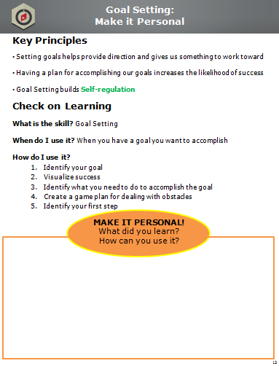
Workbook Activity (p. 12):
Make it Personal
Notes:
Trainer Instructions:
Review the Key Principles (if time permits).
Reflection (Low Tech)
Students write down what they learned and how they can use it or apply it to their own lives.

Slide 53
4) ATC Cover Page
Notes:
Rationale: The ATC Model, originally developed by Dr. Albert Ellis, highlights the link between Thoughts and Emotions/Reactions. You use the ATC model to identify the Activating Event, your Heat-of-the-Moment Thoughts, and the Consequences your Thoughts generate.
Objective: Identify your Thoughts about an Activating Event and the Consequences of those Thoughts so you can have greater control over your Emotions and Reactions.
Unit Overview and Recommended Timing:
Resilience Training for Teens,
Unit 4: ATC

Slide 54
4) ATC Key Terms
Notes:
Activating Event The “A” in the ATC model; the who, what, when, where; a situation (challenge, adversity, or positive event) that triggers Thoughts, Emotions, and Reactions
Thoughts The “T” in the ATC model; what you say to yourself in the heat of the moment during an Activating Event
Consequences The “C” in the ATC model; Emotions and Reactions that are driven by Thoughts about an Activating Event
ATC
Key Terms

Slide 55
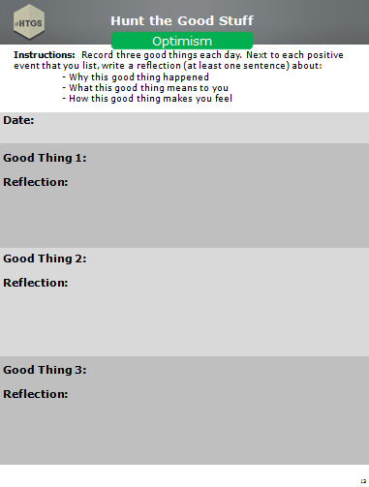
Workbook Activity (p. 13):
Hunt the Good Stuff
Notes:
Trainer Instructions:
Activity (Low Tech)
Begin the lesson with Hunt the Good Stuff.
Have students write down one to three good things in the Participant Guide.
Tell students to write the good thing and the reflection (i.e., why it’s a good thing).
Ask a couple students to share their “good stuff” at the group level. Remember to emphasize that the students explain why it is a good thing to them.
Key Points:
Optimism is important for resilience.
HTGS is a daily skill.

Slide 56


ATC
Self-awareness
Notes:
Trainer Instructions:
Tell students in one sentence what they will be learning.
Provide students with the Core Competency the skill targets.
Key Points:
ATC is all about how our thoughts impact us.
ATC builds Self-awareness.

Slide 57
ATC Model
Activating Event
The trigger: positive, negative, big or small
Thoughts
Your interpretations of the Activating Event; what you say to yourself in the heat of the moment
Something that happened to you
Uncensored
THOUGHTS
DRIVE
CONSEQUENCES
Consequences: ER
E: Emotions
R: Reactions
What you feel
What you do
Notes p. 14
Notes:
Slide Builds
Trainer Instructions:
Skill
1. Review the ATC model (note that the slide builds). Provide examples of each part of the ATC model.
Activating Event: Describe how an Activating Event is the who, what, when, and where, just the facts. Underscore that AEs can be a large adversity (death of someone you care about) or a minor issue (being grounded). Indicate that Activating Events can also be positive (graduation; winning a game). Ask students to write SOMETHING THAT HAPPENED TO YOU in their Participant Guide.
Thoughts: Underscore that these are our Heat-of-the-Moment Thoughts, or what we say to ourselves immediately following an Activating Event. Emphasize that Thoughts drive immediate Consequences and can be helpful or unhelpful. Ask students to underline HEAT OF THE MOMENT and write UNCENSORED in their Participant Guide.
Consequences: Cs are Emotions and Reactions: what we feel and do in reaction to our Thoughts about an Activating Event. Underscore that Emotions are feelings and Reactions are behaviors. Emphasize that Reactions can be what you do and what you don’t do (e.g., avoiding a person or situation). Ask students to write WHAT YOU FEEL and WHAT YOU DO in their Participant Guide.
Emphasize that thoughts (not the AE) drive consequences. Have students write THOUGHTS DRIVE CONSEQUENCES in their Participant Guide.

Slide 58
ATC Example
Activating Event
Got a B on a math test
Thoughts
Consequences: ER
E:
R:
Notes p. 14
Notes:
Trainer Instructions:
Hook (Low Tech)
Use the slide to guide students through an ATC example. Have them complete the basic ATC model in their Participant Guide.
Ask students to generate a Thought they would have about this Activating Event.
Ask students to generate the Emotions and Reactions that will follow from the Thought.
Key Points:
Although it often feels like our Emotions and Reactions (Consequences) are driven by the situation itself (the Activating Event), in fact, our Consequences are driven by what we say to ourselves (our Thoughts) about the Activating Event.
One student could think, “Woohoo, I did awesome!” while another student could think, “I did awful, I should have gotten an A.” These Thoughts lead to completely different Consequences depending on the individual.
Slide Builds

Slide 59
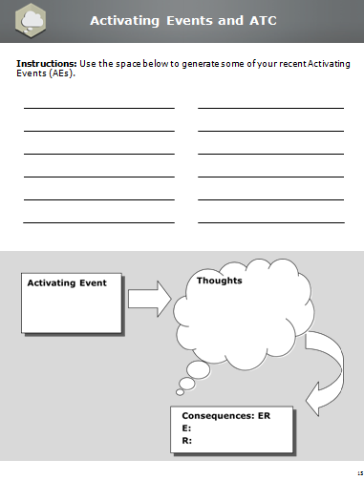
Workbook Activity (p. 15):
Activating Events and ATC
Notes:
Trainer Instructions:
Activity (Low Tech)
Refer students to their Participant Guide.
Have students write down a variety of recent Activating Events.
Remind students that Activating Events can be positive, negative, big, or small.
Get a sample of Activating Events from students.
Have students chose an Activating Event from their list to work through the basic ATC model at the bottom of the page.
Have a couple students share their ATC.

Slide 60
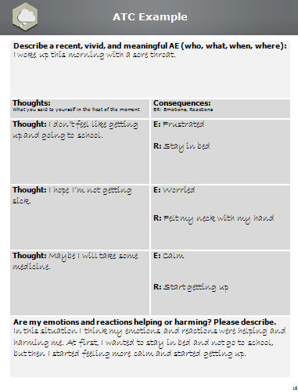
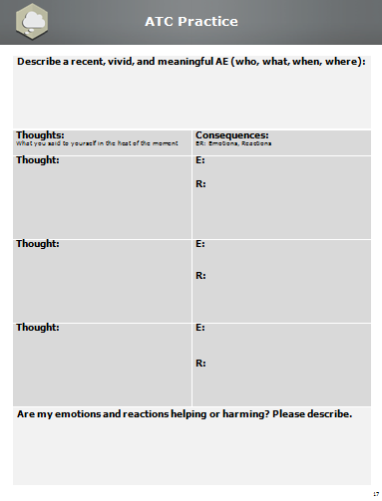
Workbook Activity (pp. 16-17):
ATC Practice
Notes:
Trainer Instructions:
[This activity is optional depending on time.]
Activity (Low Tech)
Refer students to their Participant Guide.
Inform students that we often have more than one Heat-of-the-Moment Thought about the AE.
Use the completed example in the Participant Guide to set up this activity.
Students will start by describing the AE in a sentence that includes just the facts. Students should chose an AE from the list they created.
Then, students complete each T-C couplet, including their Heat-of-the-Moment Thoughts and the Emotions and Reactions driven by those Thoughts. It is okay to capture the Emotions and Reactions before the Thoughts if they are more obvious or memorable to the participant.
After completing the ATC sections, students will think about whether their Emotions and Reactions were helpful or harmful and write a few sentences about what they discovered.
Following the activity, ask a couple students to share their example.
Discuss with students the importance of describing if Emotions and Reactions are helping or harming.

Slide 61

Activity:
ATC Relay
Notes:
Trainer Instructions:
Activity (High Tech)
Note: This activity takes approximately one hour to prepare. More specific directions can be found in the Activity Appendix.
Conduct the ATC Relay Game. Allow 15 minutes for this exercise (relay and debrief)
Split class into teams of four or five students, depending on class size.
Each team will be assigned a color-coded ATC game board located at the front of the room as well as a mixed stack of 28 Activating Events, Thoughts and Consequences (Emotions and Reactions) index cards. The A-T-C cards will match the color of the team’s game board.
Student will compete against their teammates in a five minute team relay to demonstrate the skill of A-T-C.
Each team will have to accurately place as many A-T-C cards on their board as possible in FIVE minutes.
Teams will send one team member at a time to the front of the room to draw one A-T-C card and place it in the appropriate category (A, T, or C) on the magnetic board. Team members may not ask for help from their teammates.
Once a team member places a single A-T-C card on the board, they should return to their seat. Only then can the next team member proceed to the front of the room to draw the next card.

Slide 62
Activity:
ATC Relay
Notes:
Trainer Instructions:
Once the student places the A-T-C card on the board under A, T, or C, it may not be moved by any subsequent player to approach the board.
At the end of five minutes, tally the score for each team (e.g., 2 points for each correct card, -1 point for each incorrect card).
Debrief the activity.
Key Points:
When using the skill of ATC, it is important to separate the A, T, and C.

Slide 63
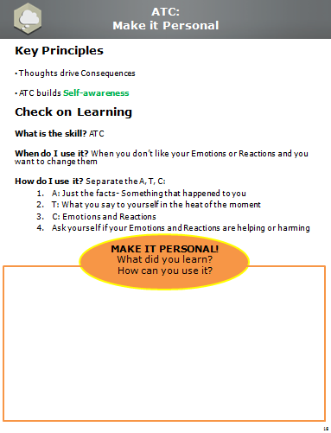
Workbook Activity (p. 18):
Make it Personal
Notes:
Trainer Instructions:
Review the Key Principles (if time permits).
Reflection (Low Tech)
Students write down what they learned and how they can use it or apply it to their own lives.

