Slide 1
Resilience Training for Teens
Full Curriculum
V2.0
Resilience Skills For Teens V2.0 AUG 2015. Adapted with permission from the Penn Master Resilience Training materials, Copyright 2013, Trustees of the University of Pennsylvania. All rights reserved.
Notes:
Instructor Notes:
Introduction of Trainer(s). You might consider answering these questions:
Why are you interested in teaching resilience to teens?
When have you personally used the resilience skills?
If you have teens, when have they demonstrated resilience skills?
Why is it so important to teach resilience skills to teens?

Slide 2
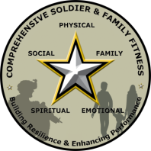
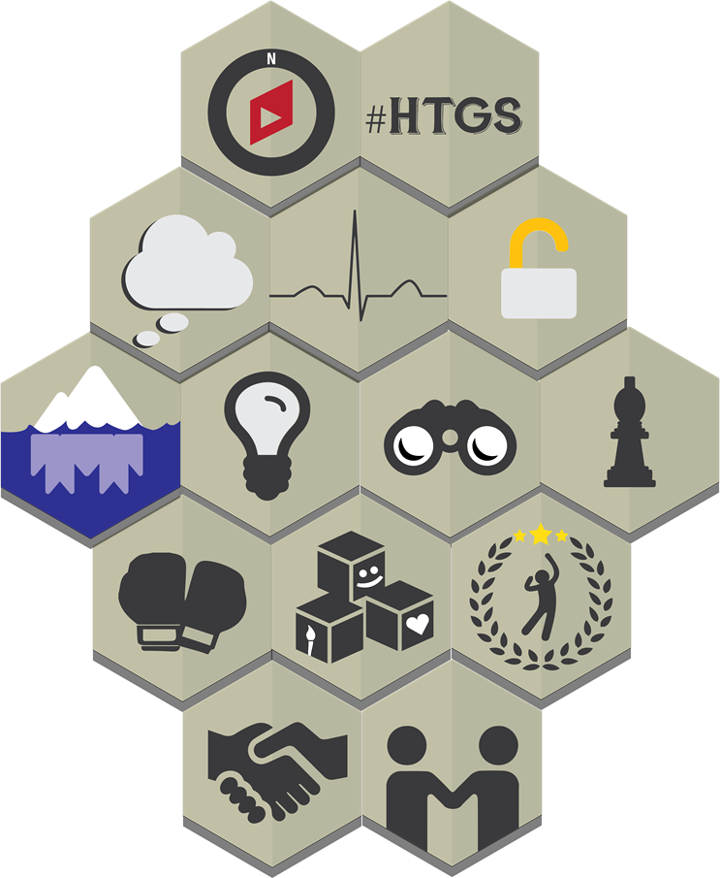
Resilience Overview
Resilience Skills For Teens V2.0 AUG 2015. Adapted with permission from the Penn Master Resilience Training materials, Copyright 2013, Trustees of the University of Pennsylvania. All rights reserved.
Notes:
Standard Resilience and Performance Skills:
Hunt the Good Stuff
Goal Setting
Activating Event, Thoughts, Consequences
Energy Management
Avoid Thinking Traps
Detect Icebergs
Problem Solving
Put It in Perspective
Mental Games
Real-Time Resilience
Identify Character Strengths in Self and Others
Character Strengths: Challenges & Leadership
Assertive Communication
Effective Praise and Active Constructive responding
Instructor Notes:
This slide is optional, use only if teaching the full curriculum.
You may elect to name each of the 14 skills currently covered in the Resilience Training for Teens course (See list on note side).
Key Points:
All of the resilience skills are conceived as a “Skill Set," represented by this visual.
The skills work together, in concert, to improve and sustain resilience. Together, the skills form a kind of armor; that is, if you have multiple strategies, you can defend against any kind of challenge that comes your way.

Slide 3
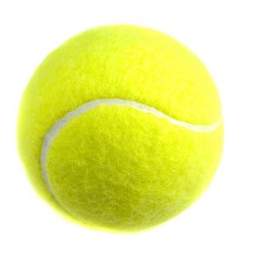
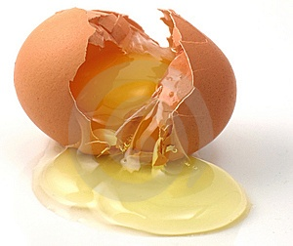
Resilient people bounce, not break.
Resilience is the ability to grow and thrive in the face of challenges and bounce back from adversity.
You Not You
Resilience Skills For Teens V2.0 AUG 2015. Adapted with permission from the Penn Master Resilience Training materials, Copyright 2013, Trustees of the University of Pennsylvania. All rights reserved.
Notes:
Instructor Notes:
Explain that resilience doesn’t result from a lucky scramble of genes, the family that you were born into (i.e. your parent’s rank, social and financial status, race, nationality, gender) the school that you attend, your religious beliefs, or your athletic ability. It is not just the lucky few who can be resilient; these are skills that anyone can learn.
Point out that even the most resilient people have non-resilient moments and that everyone can increase their resilience.
Also point out that resilience can be context specific; the captain of the football team may be resilient on the football field, but less resilient on a baseball field.
The tennis balls can serve as a visual cue for resilience throughout the course.Refer to the visual of the tennis ball throughout the course when you talk about resilience.
Key Points:
Everyone can enhance his or her resilience.

Slide 4


Activities
DEMO
Egg/Tennis Ball
3 Words for Resilience
page 2
Resilience Skills For Teens V2.0 AUG 2015. Adapted with permission from the Penn Master Resilience Training materials, Copyright 2013, Trustees of the University of Pennsylvania. All rights reserved.
Notes:
Flip
Chart
Instructor Notes:
Hook (Low-Tech)
Have two students come up to the front of the room.
One student drops an egg, the other drops a tennis ball.
Lead a short group discussion about the differences between the tennis ball and the egg, and why the tennis ball is a symbol of resilience.
Hook (Low-Tech)
Refer students to the Participant Guide page 2.
Ask students to use the Egg/Tennis Ball Demo to help them complete this activity.
Have students write three words that describe resilience. Have students discuss words as a group. Record the words discussed on a large flip-chart.

Slide 5
Resilience Facts
Resilience Facts
Resilient people know when and how to express emotion
Asking for help is a resilient strategy
Resilience can be messy
Everyone can develop resilience
Resilience Skills For Teens V2.0 AUG 2015. Adapted with permission from the Penn Master Resilience Training materials, Copyright 2013, Trustees of the University of Pennsylvania. All rights reserved.
Notes:
Instructor Notes:
Resilience is not about suppressing emotions; it’s about regulating/expressing them appropriately.
Resilience is not about handling everything on your own; asking for help is a resilient strategy.
Resilience is not about always being composed and graceful; sometimes it’s just muddling through.
Resilience is not pre-determined at birth. It is developed and reinforced through life experiences.
Activity (Low-Tech)
Discussion: Discuss with students why asking for help is a resilient strategy. Ask students to think of people they can turn to for help (e.g., peers, family, teachers, coaches). Emphasize that seeking help is a resilient strategy.
Key Points:
Resilience is obtainable by all.

Slide 6
6 Core Competencies
Self-awareness
Self-regulation
Optimism
Mental Agility
Strengths of Character
Connection
Take a look in the mirror
Pump the brakes
Tied to reality
Flexible Accurate and Thorough
(F.A.T.) thinking
What’s right with you?
Other people matter
Resilience Skills For Teens V2.0 AUG 2015. Adapted with permission from the Penn Master Resilience Training materials, Copyright 2013, Trustees of the University of Pennsylvania. All rights reserved.
Notes:
Slide Builds
Instructor Notes:
Review the key points of the competencies.
Instruct students to record the words they see as key for each competency.
Discuss the traits and characteristics of each competency including the words that the students identified.
Key Points:
It is important to be aware of your thoughts, emotions, and behavior.
Resilience requires us to control our impulses, emotions, and behaviors.
Optimism is the engine of resilience, without Optimism, resilience is not possible.
Flexible, Accurate, Thorough (F.A.T.) thinking helps us to see things from a different perspective.
It is important to know who you are at your best.
Building strong relationships is critical for resilience.
The resilience skills that we discuss today will enable each of you to develop your core resilience competencies. Skills discussed in future lessons will help you to develop additional resilience core competencies.

Slide 7
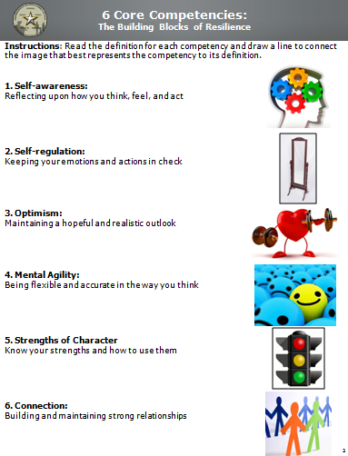
Workbook Activity (page 3):
6 Core Competencies
Resilience Skills For Teens V2.0 AUG 2015. Adapted with permission from the Penn Master Resilience Training materials, Copyright 2013, Trustees of the University of Pennsylvania. All rights reserved.
Notes:
Instructor Notes:
Activity (Low-Tech)
Students draw a line matching the competency to the picture that most accurately represents that competency.
Solution:

Slide 8
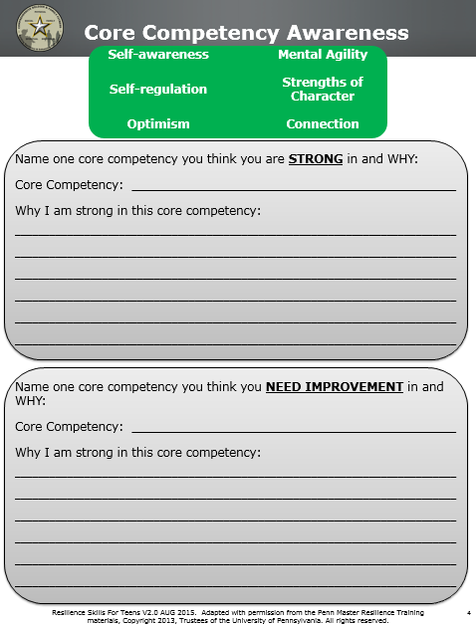
Workbook Activity (page 4):
Core Competency Awareness
Resilience Skills For Teens V2.0 AUG 2015. Adapted with permission from the Penn Master Resilience Training materials, Copyright 2013, Trustees of the University of Pennsylvania. All rights reserved.
Notes:
Instructor Notes: [This activity is optional]
Activity (Low-Tech)
Have students complete the workbook activity.
Ask a couple polling/show of hands questions (i.e. “Let’s discuss the resilience Core Competencies that some of you indicated you were strong in. Who picked Optimism?”).
Elicit some specific examples from students.

Slide 9
2) HTGS Cover Page
Resilience Skills For Teens V2.0 AUG 2015. Adapted with permission from the Penn Master Resilience Training materials, Copyright 2013, Trustees of the University of Pennsylvania. All rights reserved.
Notes:
Rationale: Dr. Seligman and colleagues developed an activity to help people notice positive experiences to enhance their gratitude and positivity. Thinking about why events go well, what the positive events mean, and how to create circumstances that enable more good things to occur encourages a consciousness of blessings and molds a style of thinking that promotes Optimism about the future.
Objective: Counteract the Negativity Bias, create positive emotion, and notice and analyze what is good.
Note: This unit should be taught in conjunction with Unit 1, Resilience Overview.
Note: There is a HTGS page in the Participant Workbook at the beginning of each lesson so that this activity becomes regular practice during resilience training.
Unit Overview and Recommended Timing:
Resilience Training for Teens,
Unit 2: Hunt the Good Stuff

Slide 10
2) HTGS Key Terms
Resilience Skills For Teens V2.0 AUG 2015. Adapted with permission from the Penn Master Resilience Training materials, Copyright 2013, Trustees of the University of Pennsylvania. All rights reserved.
Notes:
Hunt the Good Stuff A resilience skill used to counter the Negativity Bias, to create positive emotion, and to notice and analyze what is good
Negativity Bias The tendency to notice and remember the negative aspects of a situation more than the positive aspects; we remember failures more readily than successes and analyze bad events more thoroughly than good events
Hunt the Good Stuff
Key Terms

Slide 11


Hunt the Good Stuff
Optimism
Resilience Skills For Teens V2.0 AUG 2015. Adapted with permission from the Penn Master Resilience Training materials, Copyright 2013, Trustees of the University of Pennsylvania. All rights reserved.
Notes:
Instructor Notes:
Tell students in one sentence what they will be learning.
Define HTGS: HTGS is the counter to negativity bias. It is the positive emotion that focuses on goodness/the good things.
Provide students with the resilience core competency the skill targets.
Key Points:
HTGS builds Optimism.

Slide 12

Benefits of Optimism
  The “Negativity bias” is a basic survival instinct from the beginning of time.
  Science informs us that people who are Optimistic are also:
  Happier
  Healthier
  Have stronger relationships
  Perform better
  Are more successful
Resilience Skills For Teens V2.0 AUG 2015. Adapted with permission from the Penn Master Resilience Training materials, Copyright 2013, Trustees of the University of Pennsylvania. All rights reserved.
Notes:
Instructor Notes:
Skill
Define Optimism.
Discuss negativity bias with the students. Describe negativity bias as the tendency to pay more attention to the bad than the good. Make the point that negativity bias is a basic survival skill is not bad but that HTGS helps to balance this bias.
Provide an example of "the negativity bias".
i.e., at the end of the day when you talk to your best friend, you are more likely to talk about the bad grade you got, the fight you got into with another friend, how bad lunch was versus the good stuff that happened.
Go over the benefits of Optimism (listed in Participant Guide).
Key Points:
You can fight "the negativity bias" through this simple exercise.
Optimistic thoughts drive behaviors that lead to more positive outcomes.
The benefits of Optimism listed on the slide result from Hunting the Good Stuff on a regular basis.

Slide 13
Hunt the Good Stuff
HOW
Record three good things several times a week
Write a reflection:
  Why did this good thing happen?
  What does this good thing mean to you?
  How does this good thing make you feel?
Resilience Skills For Teens V2.0 AUG 2015. Adapted with permission from the Penn Master Resilience Training materials, Copyright 2013, Trustees of the University of Pennsylvania. All rights reserved.
Notes:
Instructor Notes:
Review the points on the slide.
Key Points:
HTGS is a daily skill, or at least a skill you practice several times a week to boost your Optimism.
It is important to include a reflection about each good thing because it causes the person to think more about and savor the experience.

Slide 14

Workbook Activity (pages 6-7):
Hunt the Good Stuff
Hunt the Good Stuff
Hunt the Good Stuff
Optimism
Optimism
Instructions: Record three good things each day. Next to each positive event that you list, write a reflection (at least one sentence) about:
- Why did this good thing happen?
- What does this good thing mean to you?
- How does this good thing make you feel?
Instructions: Record three good things each day. Next to each positive event that you list, write a reflection (at least one sentence) about:
- Why did this good thing happen?
- What does this good thing mean to you?
- How does this good thing make you feel?
Date: 17 January 2015
Good Thing 1: I got an A on my first math quiz this semester.
Reflection: I studied really hard for it and if I keep working hard, I can bring up my GPA from last semester.
Good Thing 2: My favorite show was on last night.
Reflection: I like being able to sit, relax, and enjoy my show every Thursday night. My favorite part is being able to talk with my friends about the show the next day.
Good Thing 3: I got a new phone.
Reflection: My parents told me if I got better grades I could get a new phone. My hard work paid off because my grades are better than last semester and now I can use my new phone to talk to my friends.
Date:
Good Thing 1:
Reflection:
Good Thing 2:
Reflection:
Good Thing 3:
Reflection:
Resilience Skills For Teens V2.0 AUG 2015. Adapted with permission from the Penn Master Resilience Training materials, Copyright 2013, Trustees of the University of Pennsylvania. All rights reserved.
Notes:
Instructor Notes:
Activity (Low-Tech)
Go over the HTGS example.
Have students write down one to three good things in the Participant Guide.
Tell students to share the good thing and the reflection they wrote about it.
Ask a couple students to share their "Good Stuff" at the group level. Remember to emphasize that the students explain why it is a good thing to them.
Key Points:
Optimism is important for resilience.
HTGS is a daily skill.
Recommendation:
It is important to have the students Hunt the Good Stuff on a regular basis. It is recommended that Hunt the Good Stuff be conducted and shared prior to the start of every lesson, time permitting.

Slide 15
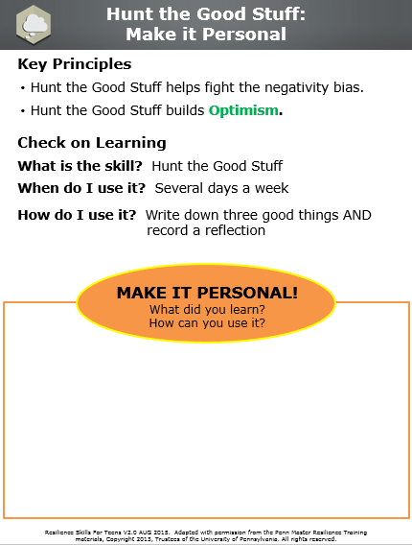
Workbook Activity (page 8):
Make it Personal
Resilience Skills For Teens V2.0 AUG 2015. Adapted with permission from the Penn Master Resilience Training materials, Copyright 2013, Trustees of the University of Pennsylvania. All rights reserved.
Notes:
Instructor Notes:
Review the Key Principles (if time permits).
Reflection (Low-Tech)
Students write down what they learned and how they can use it or apply it to their own lives.

Slide 16
3) Goal Setting Cover Page
Resilience Skills For Teens V2.0 AUG 2015. Adapted with permission from the Penn Master Resilience Training materials, Copyright 2013, Trustees of the University of Pennsylvania. All rights reserved.
Notes:
Rationale: Goal Setting, when done correctly, can result in more optimal performance, sustained motivation, and increased effort and persistence. This model of goal setting is effective because it enhances mental toughness by accounting for thoughts and beliefs that can hinder goal achievement.
Objective: Introduce students to critical components of the Goal Setting process and practice the skill so it can be used independently to plan for achieving personal and educational goals.
Unit Overview and Recommended Timing:
Resilience Training for Teens,
Unit 3: Goal Setting

Slide 17
3) Goal Setting Key Terms
Resilience Skills For Teens V2.0 AUG 2015. Adapted with permission from the Penn Master Resilience Training materials, Copyright 2013, Trustees of the University of Pennsylvania. All rights reserved.
Notes:
Goal Setting A process to deliberately energize, direct, and sustain behavior to ensure progress toward a goal
Goal Setting
Key Terms

Slide 18
Workbook Activity (page 9):
Hunt the Good Stuff
Hunt the Good Stuff
Optimism
Instructions: Record three good things each day. Next to each positive event that you list, write a reflection (at least one sentence) about:
- Why did this good thing happen?
- What does this good thing mean to you?
- How does this good thing make you feel?
Date:
Good Thing 1:
Reflection:
Good Thing 2:
Reflection:
Good Thing 3:
Reflection:
Resilience Skills For Teens V2.0 AUG 2015. Adapted with permission from the Penn Master Resilience Training materials, Copyright 2013, Trustees of the University of Pennsylvania. All rights reserved.
Notes:
Instructor Notes:
Activity (Low-Tech)
Begin the lesson with Hunt the Good Stuff.
Have students write down one to three good things in the Participant Guide.
Tell students to write the good thing and the reflection (i.e., why it’s a good thing).
Ask a couple students to share their "Good Stuff" at the group level. Remember to emphasize that the students explain why it is a good thing to them.
Key Points:
Optimism is important for resilience.
HTGS is a skill to use daily, or at least several days a week.

Slide 19


Goal Setting
Self-regulation
Resilience Skills For Teens V2.0 AUG 2015. Adapted with permission from the Penn Master Resilience Training materials, Copyright 2013, Trustees of the University of Pennsylvania. All rights reserved.
Notes:
Instructor Notes:
Tell students in one sentence what they will be learning.
Provide students with the resilience core competency and the target skills that it builds, strengthen, and support it.
Key Points:
This skill is about planning, staying committed to goals, and navigating obstacles that will present themselves along the way.
Goal Setting builds Self-regulation.

Slide 20
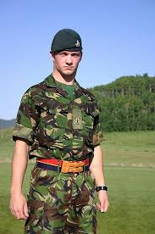





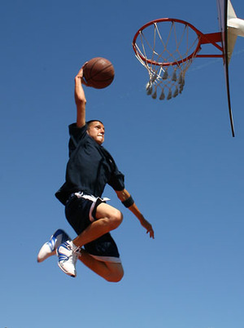

What Are Your Goals?
What do you want to achieve in the future?
What do you want to be really good at?
Resilience Skills For Teens V2.0 AUG 2015. Adapted with permission from the Penn Master Resilience Training materials, Copyright 2013, Trustees of the University of Pennsylvania. All rights reserved.
Notes:
Instructor Notes:
Skill
1) Goal Setting facilitates resilience by giving us a process for planning to achieve our goals, which allows us to grow and thrive.
2) When thinking about goals, these questions on the slide are important to consider.
Key Points:
1) Goal Setting is difficult but essential. You will set several goals throughout your lifetime.
2) It is important to know what your goals are and think about them several days a week.

Slide 21
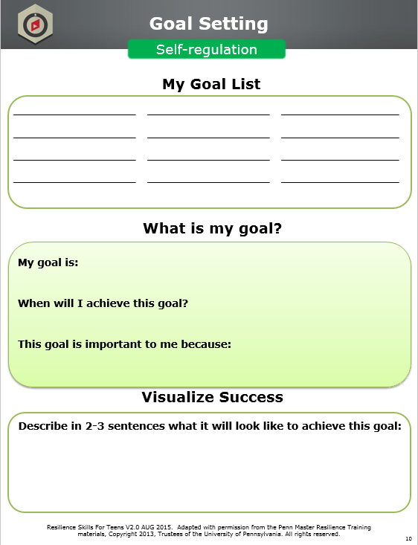
Workbook Activity (page 10):
My Goal List
Resilience Skills For Teens V2.0 AUG 2015. Adapted with permission from the Penn Master Resilience Training materials, Copyright 2013, Trustees of the University of Pennsylvania. All rights reserved.
Notes:
Instructor Notes:
Hook (Low-Tech)
Have participants individually brainstorm and write down the goals they would like to achieve. Provide sample categories such as family, vacation, career, etc., if necessary.
Prompt students to consider the questions on the previous slide.

Slide 22

Define Your Goal
Pick a goal from your list
Give your goal a deadline
Identify why your goal is important to achieve
My goal is: Get accepted to University of Kentucky
When will I achieve this goal? Fall 2017
This goal is important to me because ... It will set me up for future success
Resilience Skills For Teens V2.0 AUG 2015. Adapted with permission from the Penn Master Resilience Training materials, Copyright 2013, Trustees of the University of Pennsylvania. All rights reserved.
Notes:
Slide Builds
Instructor Notes:
You have to know your goal before you can make a plan for it.
Review example on the slide.
Key Points:
Writing a date you want to achieve your goal by gives you less time and room to procrastinate, even though the date may change later.
Identifying why a goal is important to you helps to energize you and keeps you motivated throughout the goal setting process.

Slide 23
Workbook Activity (page 10):
What is my goal?
Resilience Skills For Teens V2.0 AUG 2015. Adapted with permission from the Penn Master Resilience Training materials, Copyright 2013, Trustees of the University of Pennsylvania. All rights reserved.
Notes:
Instructor Notes:
Activity (Low-Tech)
Have students pick a goal from their Goal List, a date they will achieve it by, and explain why it is important to them.
Have students turn to someone near them and share their goal OR have several students share at the large group level.

Slide 24
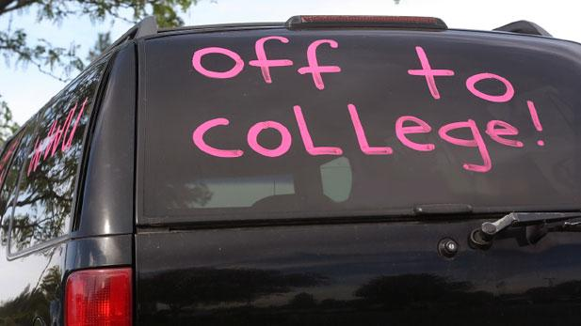

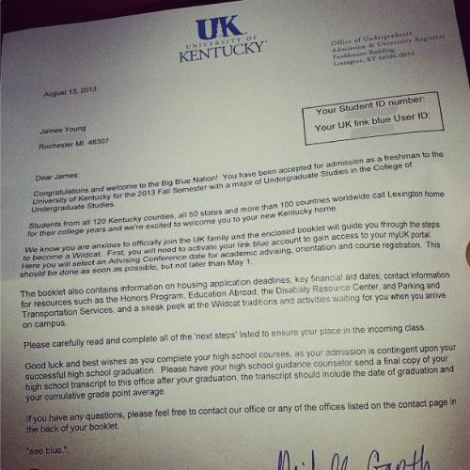
Visualize Your Success
What does it look like to achieve your goal?
Resilience Skills For Teens V2.0 AUG 2015. Adapted with permission from the Penn Master Resilience Training materials, Copyright 2013, Trustees of the University of Pennsylvania. All rights reserved.
Notes:
Instructor Notes:
Once you have your end state in mind, think
about what it will be like to achieve your goal.
What are the benefits of getting to your final
destination?
2) Review example (images) on the slide.
Key Points:
Visualizing success gives us energy and
motivates us. Helps us reduce our negativity
bias.
2) You should visualize success regularly.

Slide 25
Workbook Activity (page 10):
Visualize Success
Resilience Skills For Teens V2.0 AUG 2015. Adapted with permission from the Penn Master Resilience Training materials, Copyright 2013, Trustees of the University of Pennsylvania. All rights reserved.
Notes:
Instructor Notes:
Activity (Low-Tech)
Give students 1-2 minutes to visualize what it
will look like to achieve their goal and what
the benefits will be of that success.
Next, instruct students to write 2-3 sentences
of what it would look like to achieve their
goal.
Have a couple students share how they
visualize their success.

Slide 26

Make it Happen
How do I make my goal happen?
5 Things I Need to Accomplish My Goal
Get good grades
Participate in other activities
Do well on my ACTs
Contact someone at UK that can help me
Visit the school
Resilience Skills For Teens V2.0 AUG 2015. Adapted with permission from the Penn Master Resilience Training materials, Copyright 2013, Trustees of the University of Pennsylvania. All rights reserved.
Notes:
Slide Builds
Instructor Notes:
When setting goals it is important to have a plan. Consider this a “to-do” list to reach your goal.
Completing these accomplishments will move you closer to reaching your goal.
Review example on the slide.
Key Points:
along the way. Setting goals is about building a plan and establishing supporting goals
Discuss the notion that there are multiple pathways to the same goal and just as each of us are different, our paths may be different.
Successful goal setting requires a deliberate yet flexible plan.
Indicate what work you need to start doing to achieve your goal.
Remind the students that there will be obstacles along the way; that is life. Resilience allows them to rely on their successes to keep the obstacles from derailing them

Slide 27
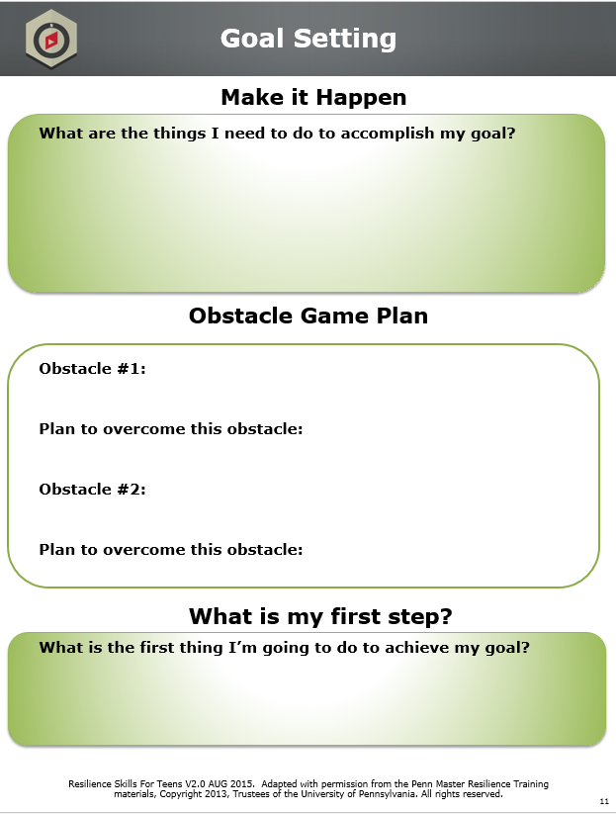
Workbook Activity (page 11):
Make it Happen
Resilience Skills For Teens V2.0 AUG 2015. Adapted with permission from the Penn Master Resilience Training materials, Copyright 2013, Trustees of the University of Pennsylvania. All rights reserved.
Notes:
Instructor Notes:
Activity (Low-Tech)
Have students write down at least five things they need to do to reach their goal.
Have a couple students share what they need to accomplish in order to reach their goal.

Slide 28
Obstacle Game Plan
What is standing in my way?
What can I do about it?
Obstacle Game Plan
Obstacle #1:
My grade in science is not as good as it could be
Plan:
I can ask my teacher to stay after school for extra help and see if I can do extra credit assignments to bring my grade up
Resilience Skills For Teens V2.0 AUG 2015. Adapted with permission from the Penn Master Resilience Training materials, Copyright 2013, Trustees of the University of Pennsylvania. All rights reserved.
Notes:
Slide Builds
Instructor Notes:
Explain the importance of identifying obstacles you may face with your goal and having a plan to deal with those obstacles.
Review example on the slide.
Key Points:
Reinforce personal “ownership” of the plan as well as their responsibility to overcome the obstacles that they meet along the way. Remind them that others are available to help them achieve their successes.
Knowing potential obstacles helps you come up with your Goal Setting plan.
Because obstacles are an inevitable part of pursuing goals, maintaining motivation requires planning for obstacles that we can expect to face.

Slide 29
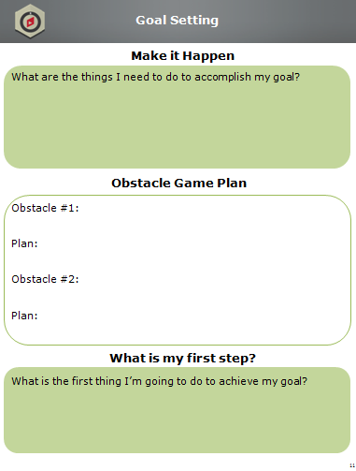
Workbook Activity (page 11):
Obstacle Game Plan
Resilience Skills For Teens V2.0 AUG 2015. Adapted with permission from the Penn Master Resilience Training materials, Copyright 2013, Trustees of the University of Pennsylvania. All rights reserved.
Notes:
Instructor Notes:
Activity (Low-Tech)
Have students identify two obstacles they may face as they pursue their goal and develop a plan for overcoming those obstacles.
Have several students share an obstacle and their plan for overcoming it.

Slide 30
Take the First Step
What is the first step toward accomplishing your goal?
My First Step:
I will turn in all my homework assignments and study for all of my tests this week.
Resilience Skills For Teens V2.0 AUG 2015. Adapted with permission from the Penn Master Resilience Training materials, Copyright 2013, Trustees of the University of Pennsylvania. All rights reserved.
Notes:
Slide Builds
Instructor Notes:
Explain the importance of putting a goal into action and taking the first step.
Review example on the slide.
Key Points:
If you really want to achieve the goal you set for yourself, you should do something each day to move you closer to your goal, even if it’s a small step. Your first step gets this process going.

Slide 31
Workbook Activity (page 11):
What is my first step?
Resilience Skills For Teens V2.0 AUG 2015. Adapted with permission from the Penn Master Resilience Training materials, Copyright 2013, Trustees of the University of Pennsylvania. All rights reserved.
Notes:
Instructor Notes:
Activity (Low-Tech)
Have students identify the first thing they are going to do to reach their goal. Instruct students to try to be specific (e.g., look up 5 colleges this weekend, practice free throws for one hour this weekend, set up an appointment with my guidance counselor next week, etc.).
Have several students share their first step with the group.

Slide 32




Activity:
Make Your Goal Real
Magazine clippings activity/drawings/pictures
How will you remind yourself of your goal every day?
Where will you post your goal?
Resilience Skills For Teens V2.0 AUG 2015. Adapted with permission from the Penn Master Resilience Training materials, Copyright 2013, Trustees of the University of Pennsylvania. All rights reserved.
Notes:
Instructor Notes:
Activity (Low-Tech)
Give students time to make their goal come to life. The goal of this activity is for students to find/create images that relate to their goal. Some options include:
Bring in magazines or have students bring in magazines to clip out pictures that relate to their goal
Have students draw a picture related to their goal
If the students have laptops, allow them to search for images related to their goal
Discuss with students ways they can remind themselves of their goal every day (e.g., change their computer/phone background, set reminders on phone, write goal on bathroom mirror, etc.).
Discuss with students where they can post their goal (e.g., locker, bedroom mirror, athletic equipment, etc.).
Emphasize the need to routinely take time and reflect on your plan and the goals you established to achieve it. As part of the reflection, review your expectations and assess your progress towards achieving the goal.
After reflecting, refine and adjust your plan as needed to achieve your goal.

Slide 33
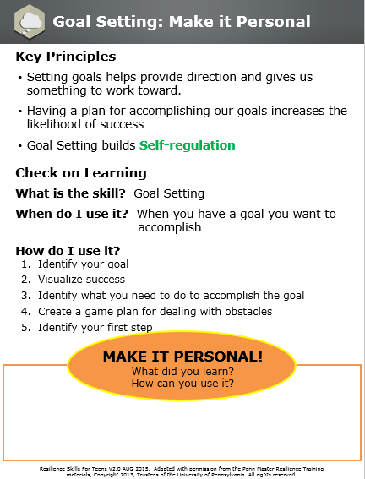
Workbook Activity (page 12):
Make it Personal
Resilience Skills For Teens V2.0 AUG 2015. Adapted with permission from the Penn Master Resilience Training materials, Copyright 2013, Trustees of the University of Pennsylvania. All rights reserved.
Notes:
Instructor Notes:
Review the Key Principles (if time permits).
Reflection (Low-Tech)
Students write down what they learned and how they can use it or apply it to their own lives.

Slide 34
4) ATC Cover Page
Resilience Skills For Teens V2.0 AUG 2015. Adapted with permission from the Penn Master Resilience Training materials, Copyright 2013, Trustees of the University of Pennsylvania. All rights reserved.
Notes:
Rationale: The ATC Model, originally developed by Dr. Albert Ellis, highlights the link between Thoughts and Emotions/Reactions. You use the ATC model to identify the Activating Event, your Heat-of-the-Moment Thoughts, and the Consequences your Thoughts generate.
Objective: Identify your Thoughts about an Activating Event and the Consequences of those Thoughts so you can have greater control over your Emotions and Reactions.
Unit Overview and Recommended Timing:
Resilience Training for Teens,
Unit 4: ATC

Slide 35
4) ATC Key Terms
Resilience Skills For Teens V2.0 AUG 2015. Adapted with permission from the Penn Master Resilience Training materials, Copyright 2013, Trustees of the University of Pennsylvania. All rights reserved.
Notes:
Activating Event The “A” in the ATC model; the who, what, when, where; a situation (challenge, adversity, or positive event) that triggers Thoughts, Emotions, and Reactions
Thoughts The “T” in the ATC model; what you say to yourself in the heat of the moment during an Activating Event
Consequences The “C” in the ATC model; Emotions and Reactions that are driven by Thoughts about an Activating Event
ATC
Key Terms

Slide 36
Workbook Activity (page 13):
Hunt the Good Stuff
Hunt the Good Stuff
Optimism
Instructions: Record three good things each day. Next to each positive event that you list, write a reflection (at least one sentence) about:
- Why did this good thing happen?
- What does this good thing mean to you?
- How does this good thing make you feel?
Date:
Good Thing 1:
Reflection:
Good Thing 2:
Reflection:
Good Thing 3:
Reflection:
Resilience Skills For Teens V2.0 AUG 2015. Adapted with permission from the Penn Master Resilience Training materials, Copyright 2013, Trustees of the University of Pennsylvania. All rights reserved.
Notes:
Instructor Notes:
Activity (Low-Tech)
Begin the lesson with Hunt the Good Stuff.
Have students write down one to three good things in the Participant Workbook.
Tell students to write the good thing and the reflection (i.e., why it’s a good thing).
Ask a couple students to share their “"Good Stuff"” at the group level. Remember to emphasize that the students explain why it is a good thing to them.
Key Points:
Optimism is important for resilience.
HTGS is a skill to use daily, or at least several times a week.

Slide 37


ATC
Self-awareness
Resilience Skills For Teens V2.0 AUG 2015. Adapted with permission from the Penn Master Resilience Training materials, Copyright 2013, Trustees of the University of Pennsylvania. All rights reserved.
Notes:
Instructor Notes:
Tell students in one sentence what they will be learning.
Provide students with the resilience Core Competency the skill targets.
Key Points:
ATC is all about how our thoughts impact us.
ATC builds Self-awareness.

Slide 38
ATC Model
Activating Event
The trigger: positive, negative, big or small
Thoughts
Your interpretations of the Activating Event; what you say to yourself in the heat of the moment
Something that happened to you
Uncensored
THOUGHTS
DRIVE
CONSEQUENCES
Consequences: ER
E: Emotions
R: Reactions
What you feel
What you do
Resilience Skills For Teens V2.0 AUG 2015. Adapted with permission from the Penn Master Resilience Training materials, Copyright 2013, Trustees of the University of Pennsylvania. All rights reserved.
Notes:
Slide Builds
Instructor Notes:
Skill
Review the ATC model (note that the slide builds). Provide examples of each part of the ATC model.
Activating Event: Describe how an Activating Event is the who, what, when, and where, just the facts. Underscore that AEs can be a large adversity (death of someone they care about) or a minor issue (being grounded). Indicate that Activating Events can also be positive (graduation; winning a game). Ask the students to write SOMETHING THAT HAPPENED TO THEM in their Participant Guide.
Thoughts: Underscore that these are our Heat-of-the-Moment Thoughts, or what we say to ourselves immediately following an Activating Event. Emphasize that Thoughts drive immediate Consequences and can be helpful or unhelpful. Ask the students to underline HEAT OF THE MOMENT and write UNCENSORED in their Participant Guide.
Consequences: Cs are Emotions and Reactions; what we feel and do in reaction to our Thoughts about an Activating Event. Underscore that Emotions are feelings and Reactions are behaviors. Emphasize that Reactions can be what you do and what you don’t do (e.g., avoiding a person or situation). Ask the students to write WHAT THEY FEEL and WHAT THEY DO in their Participant Guide.
Emphasize that thoughts (not the AE) drive consequences. Have the students write THOUGHTS DRIVE CONSEQUENCES in their Participant Guide.

Slide 39
ATC Example
Activating Event
Got a B on a math test
Thoughts
Consequences: ER
E:
R:
Resilience Skills For Teens V2.0 AUG 2015. Adapted with permission from the Penn Master Resilience Training materials, Copyright 2013, Trustees of the University of Pennsylvania. All rights reserved.
Notes:
Slide Builds
Instructor Notes:
Hook (Low-Tech)
Use the slide to guide students through an ATC example. Have them complete the basic ATC model in their Participant Guide.
Ask students to generate a Thought they would have about this Activating Event.
Ask students to generate the Emotions and Reactions that will follow from the Thought.
Key Points:
Although it often feels like our Emotions and Reactions (Consequences) are driven by the situation itself (the Activating Event), in fact, our Consequences are driven by what we say to ourselves (our Thoughts) about the Activating Event.
One student could think, “Woohoo, I did awesome!” while another student could think, “I did awful, I should have gotten an A.” These Thoughts lead to completely different Consequences depending on the individual.

Slide 40
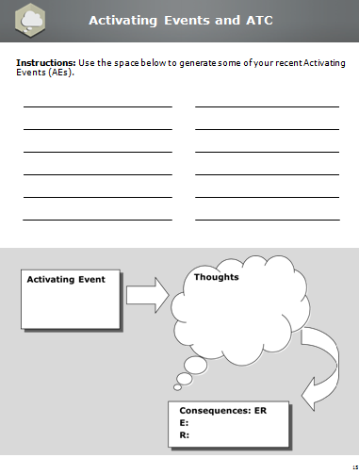
Workbook Activity (page 15):
Activating Events and ATC
Resilience Skills For Teens V2.0 AUG 2015. Adapted with permission from the Penn Master Resilience Training materials, Copyright 2013, Trustees of the University of Pennsylvania. All rights reserved.
Notes:
Instructor Notes:
Activity (Low-Tech)
Refer students to their Participant Guide.
Have students write down a variety of recent Activating Events.
Remind students that Activating Events can be positive, negative, big, or small.
Get a sample of Activating Events from students.
Have students chose an Activating Event from their list to work through the basic ATC model at the bottom of the page.
Have a couple students share their ATC.

Slide 41
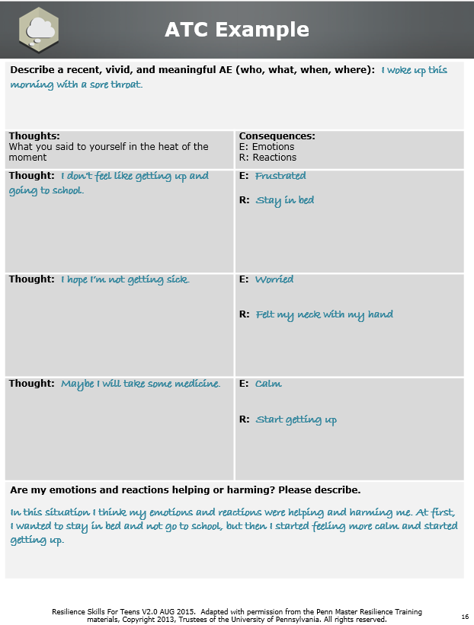
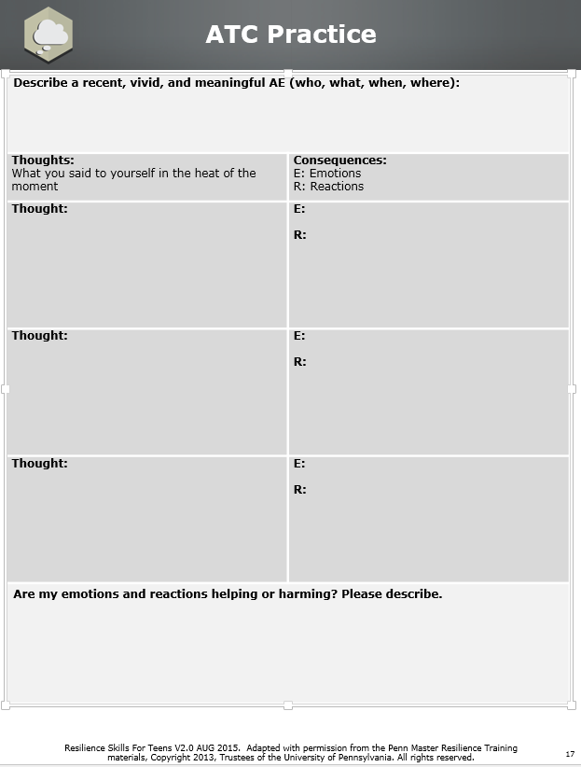
Workbook Activity (pp. 16-17):
ATC Practice
Resilience Skills For Teens V2.0 AUG 2015. Adapted with permission from the Penn Master Resilience Training materials, Copyright 2013, Trustees of the University of Pennsylvania. All rights reserved.
Notes:
Instructor Notes:
[This activity is optional depending on time.]
Activity (Low-Tech)
Refer students to their Participant Guide.
Inform students that we often have more than one Heat-of-the-Moment Thought about the AE.
Use the completed example in the Participant Guide to set up this activity.
Students will start by describing the AE in a sentence that includes just the facts. Students should chose an AE from the list they created.
Then, students complete each T-C couplet, including their Heat-of-the-Moment Thoughts and the Emotions and Reactions driven by those Thoughts. It is okay to capture the Emotions and Reactions before the Thoughts if they are more obvious or memorable to the participant.
After completing the ATC sections, students will think about whether their Emotions and Reactions were helpful or harmful and write a few sentences about what they discovered.
Following the activity, ask a couple students to share their example.
Discuss with students the importance of describing if Emotions and Reactions are helping or harming.

Slide 42

Activity:
ATC Relay
Resilience Skills For Teens V2.0 AUG 2015. Adapted with permission from the Penn Master Resilience Training materials, Copyright 2013, Trustees of the University of Pennsylvania. All rights reserved.
Notes:
Instructor Notes:
Note: This activity takes approximately one hour to prepare. More specific directions can be found in the Activity Appendix.
Activity (High Tech)
Conduct the ATC Relay Game. Allow 15 minutes for this exercise (relay and debrief)
Split class into teams of four or five students, depending on class size.
Each team will be assigned a color-coded ATC game board located at the front of the room as well as a mixed stack of 28 Activating Events, Thoughts and Consequences (Emotions and Reactions) index cards. The A-T-C cards will match the color of the team’s game board.
Student will compete against their teammates in a five minute team relay to demonstrate the skill of A-T-C.
Each team will have to accurately place as many A-T-C cards on their board as possible in FIVE minutes.
Teams will send one team member at a time to the front of the room to draw one A-T-C card and place it in the appropriate category (A, T, or C) on the magnetic board. Team members may not ask for help from their teammates.

Slide 43
Activity:
ATC Relay (continued)
Resilience Skills For Teens V2.0 AUG 2015. Adapted with permission from the Penn Master Resilience Training materials, Copyright 2013, Trustees of the University of Pennsylvania. All rights reserved.
Notes:
Instructor Notes:
Once a team member places a single A-T-C card on the board, they should return to their seat. Only then can the next team member proceed to the front of the room to draw the next card.
Once the student places the A-T-C card on the board under A, T, or C, it may not be moved by any subsequent player to approach the board.
At the end of five minutes, tally the score for each team (e.g. 2 points for each correct card, -1 point for each incorrect card).
Debrief the activity.
Key Points:
When using the skill of ATC, it is important to separate the A, T, and C.

Slide 44
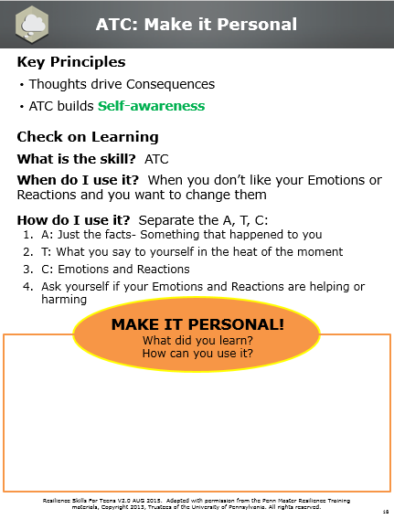
Workbook Activity (p. 18):
Make it Personal
Resilience Skills For Teens V2.0 AUG 2015. Adapted with permission from the Penn Master Resilience Training materials, Copyright 2013, Trustees of the University of Pennsylvania. All rights reserved.
Notes:
Instructor Notes:
Review the Key Principles (if time permits).
Reflection (Low-Tech)
Students write down what they learned and how they can use it or apply it to their own lives.

Slide 45
5) EM Cover Page
Resilience Skills For Teens V2.0 AUG 2015. Adapted with permission from the Penn Master Resilience Training materials, Copyright 2013, Trustees of the University of Pennsylvania. All rights reserved.
Notes:
Rationale: Energy levels impact our ability to perform in our personal and professional lives. Effectively managing our energy is possible but requires deliberate and diligent effort. Deliberate Breathing is a tool that, when used regularly, allows you to manage energy levels and facilitate optimal performance.
Objective: Modulate energy to a level that is appropriate for the task-at-hand and that allows for optimal performance.
Unit Overview and Recommended Timing:
Resilience Training for Teens,
Unit 5: Energy Management

Slide 46
5) EM Key Terms
Resilience Skills For Teens V2.0 AUG 2015. Adapted with permission from the Penn Master Resilience Training materials, Copyright 2013, Trustees of the University of Pennsylvania. All rights reserved.
Notes:
Deliberate Breathing A skill used to regulate energy levels with the intent to be efficient and effective under any circumstance; requires deliberate control of rhythmic breathing, thoughts, and consequences
Energy Management
Key Terms

Slide 47
Workbook Activity (p. 19):
Hunt the Good Stuff
Hunt the Good Stuff
Optimism
Instructions: Record three good things each day. Next to each positive event that you list, write a reflection (at least one sentence) about:
- Why did this good thing happen?
- What does this good thing mean to you?
- How does this good thing make you feel?
Date:
Good Thing 1:
Reflection:
Good Thing 2:
Reflection:
Good Thing 3:
Reflection:
Resilience Skills For Teens V2.0 AUG 2015. Adapted with permission from the Penn Master Resilience Training materials, Copyright 2013, Trustees of the University of Pennsylvania. All rights reserved.
Notes:
Instructor Notes:
Activity (Low-Tech)
Begin the lesson with Hunt the Good Stuff.
Have students write down one to three good things in the Participant Workbook.
Tell students to write the good thing and the reflection (i.e., why it’s a good thing).
Ask a couple students to share their “"Good Stuff"” at the group level. Remember to emphasize that the students explain why it is a good thing to them.
Key Points:
Optimism is important for resilience.
HTGS is a skill to use daily, or at least several times a week.

Slide 48


Energy Management
Self-regulation
Resilience Skills For Teens V2.0 AUG 2015. Adapted with permission from the Penn Master Resilience Training materials, Copyright 2013, Trustees of the University of Pennsylvania. All rights reserved.
Notes:
Instructor Notes:
Tell students in one sentence what they will be learning.
Provide students with the resilience Core Competency the skill targets.
Key Points:
Skill
Energy Management is about regulating energy levels deliberately in order to perform better, more consistently, as well as deal effectively with stress.
Energy Management builds Self-regulation.

Slide 49


Control the Controllables
What is stressing me out?
Is it a big deal or a little deal?
Can I control it?
Even if we can’t control the things that
stress us out, we can control how we
think and react about them.
We can manage our energy by
controlling OUR THOUGHTS!
Resilience Skills For Teens V2.0 AUG 2015. Adapted with permission from the Penn Master Resilience Training materials, Copyright 2013, Trustees of the University of Pennsylvania. All rights reserved.
Notes:
Instructor Notes:
Stress impacts our energy level.
Resilient individuals focus their energy on what they can control and influence and accept the things they cannot control.
Ask students how controlling our thoughts can manage our energy.
Tie controlling thoughts to the skill of ATC (i.e., because Thoughts drive Consequences, by controlling our thoughts we can influence how our body reacts).
Key Points:
By identifying what we can change, and what we can’t, we can develop a strategy to deal with those things we can change, and learn to live with those things we can’t change.
By developing a strategy for dealing with what we can control, we empower ourselves to manage those things we can change in an effective way.
We can manage our energy by controlling our thoughts.

Slide 50
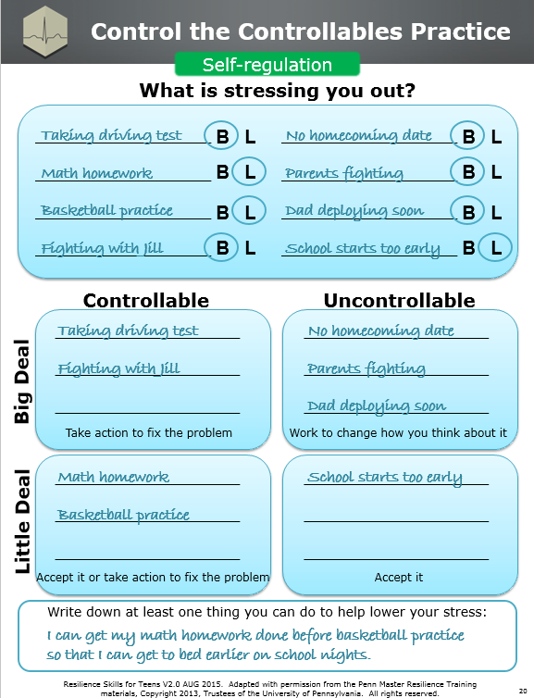
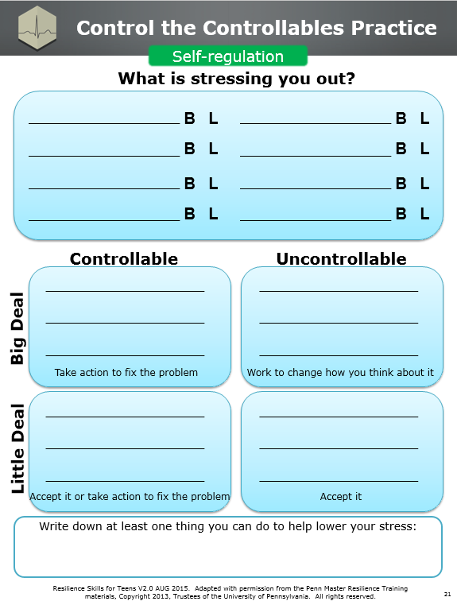
Workbook Activity (pp. 20-21):
Control the Controllables
Resilience Skills For Teens V2.0 AUG 2015. Adapted with permission from the Penn Master Resilience Training materials, Copyright 2013, Trustees of the University of Pennsylvania. All rights reserved.
Notes:
Instructor Notes:
Activity (Low-Tech)
Refer students to the Participant Workbook. This activity will bring the concept into the students’ personal worlds, and allow them to develop strategies to deal with stress.
Use the complete example in the Participant Workbook to instruct students on how to complete the activity.
Have students make a list of the things that are stressing them out. Give students some examples to consider and prompt students to include both positive and negative things (e.g., math homework, curfew, basketball practice, fighting with friends, finding a homecoming date).
Students then circle the “B” if they consider the stressor a “BIG DEAL” and the “L” if they consider the stressor a “LITTLE DEAL.”
Students then decide if their stressors are “CONTROLLABLE” or “UNCONTROLLABLE” and place them into quadrants.
Review the strategies for dealing with each quadrant (i.e. take action to fix the problem, work to change how you think about it, accept it).
Have each student write down at least one thing they can do to lower their stress.
Ask a couple students to share their strategy to lower stress with the class.
Key Points:
Taking control of your stress through actions and thoughts will help manage your energy.

Slide 51
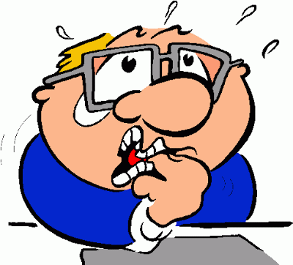

What About My Nerves?
Does Frank look ready to perform?
Frank’s “symptoms” are actually getting him ready to go!
TREMBLING/SHAKING: We shake because we need to speed up communication between the brain and body.
SWEATING: We sweat so that our body remains at the perfect temperature right from the start of the performance.
BUTTERFLIES: We feel butterflies because digestion shuts down so energy can go where it needs to go to help us perform.
Resilience Skills For Teens V2.0 AUG 2015. Adapted with permission from the Penn Master Resilience Training materials, Copyright 2013, Trustees of the University of Pennsylvania. All rights reserved.
Notes:
Slide Builds
Instructor Notes:
Ask students if Frank looks ready to perform.
Ask for some of Frank’s symptoms of nervousness. Potential answers include sweating, shaking, tension, butterflies, etc.
Explain the three symptoms of nervousness on the slide (slide builds). If students brought up other symptoms of nervousness, address those as well:
Dry Mouth: We get dry mouth because our saliva turns off so that energy used for digestion can be used to help us perform.
Rapid Breathing: We breathe more quickly to get more oxygen to our brain and body.
Increased Heart Rate: Our heart rate increases to get oxygen to our brain and muscles faster.
Digestive System: We feel nauseous or sick because our digestive system shuts down so we can use that energy to perform.
Key Points:
When we want to perform well our bodies start changing to set us up for success; nerves help us.
We often convince ourselves that nerves are bad and those Thoughts hurt our performance; remember Thoughts drive Consequences.

Slide 52
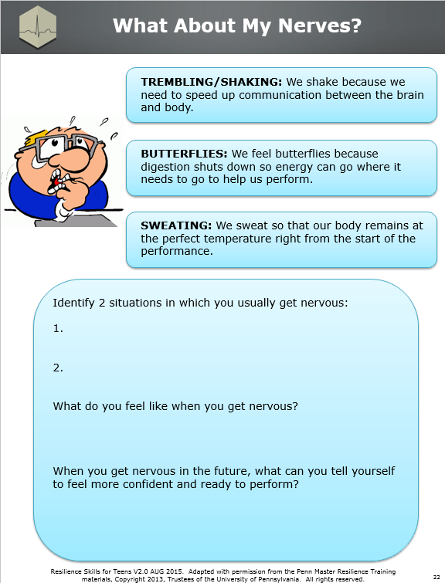
Workbook Activity (p. 22):
What About My Nerves?
Resilience Skills For Teens V2.0 AUG 2015. Adapted with permission from the Penn Master Resilience Training materials, Copyright 2013, Trustees of the University of Pennsylvania. All rights reserved.
Notes:
Instructor Notes:
Activity (Low-Tech)
Students identify two situations that make them nervous, followed by what they feel like when they get nervous. Prompt students to think about the physical reactions (like Frank) that happen to them.
Next, students identify Thoughts they can tell themselves when they get nervous to help them remain confident and perform (i.e., how they will reinterpret their nerves).
Get a few students to share how they will reinterpret their nerves.
Key Points:
Experiencing nerves is our bodies’ way of telling us we are ready to perform.
Taking control of our Thoughts will help us to perform and not let nervous symptoms, and our Thoughts about them, take control.

Slide 53

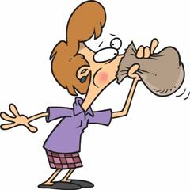

Deliberate Breathing
What’s the difference between
breathing and deliberate breathing?
3 FUNDAMENTALS
1. Control your body
Use a 5-5 count
2. Control your mind
Pick a target and cue word
3. Control your emotions
Choose how you want to feel
Note
page 23
Resilience Skills For Teens V2.0 AUG 2015. Adapted with permission from the Penn Master Resilience Training materials, Copyright 2013, Trustees of the University of Pennsylvania. All rights reserved.
Notes:
Instructor Notes:
Note: Teach each fundamental one by one. This slide includes 3 activities (one for each fundamental).
Segue into Deliberate Breathing as a technique to help you perform, deal with stress, and manage energy.
The difference between breathing and Deliberate Breathing is the use of 3 fundamentals.
Instruct students to place one hand on their stomach and one on their chest. Have students take 3 deep breaths while paying attention to which hand is moving the most. Show of hands:
Whose hand on their chest moved the most?
Whose hand on their stomach moved the most?
Who had both hands move?
Inform students that we want the hand on our stomach moving more because it means we are breathing more deeply and getting more oxygen. This brings us to our first fundamental.
Build slide to reveal first fundamental: CONTROL YOUR BODY.
Breathe low, into your diaphragm, to get a more complete breath. You should feel your stomach expand when you inhale and deflate when you exhale.
It is recommended to breathe with a 5-5 cadence (5 sec. inhale, 5 sec. exhale). If that’s difficult try 4-4. The goal is to breathe with a rhythm (length of inhale matches exhale).
Slide Builds

Slide 54
Deliberate Breathing (continued)
What’s the difference between
breathing and deliberate breathing?
3 FUNDAMENTALS
1. Control your body
Use a 5-5 count
2. Control your mind
Pick a target and cue word
3. Control your emotions
Choose how you want to feel
Note
page 23
54
Resilience Skills For Teens V2.0 AUG 2015. Adapted with permission from the Penn Master Resilience Training materials, Copyright 2013, Trustees of the University of Pennsylvania. All rights reserved.
Notes:
Instructor Notes:
6) Activity #1 (Low-Tech)
To breathe most efficiently, sit up straight and uncross your legs and arms (to facilitate circulation).
Instruct students to breathe with a 5-5 cadence. Count the first few cadences for the students. Then allow students to continue for 1 minute.
Following the activity, have students record their experience in the BODY box in their Participant Workbooks. Prompt students to include what their body felt like, what their mind felt like, and what emotions they experienced.
7) Build slide to reveal second fundamental: CONTROL
YOUR MIND.
It is important to focus your mind by narrowing your attention. We do this by picking a target to stare at and repeating a cue word of choice over and over (i.e., relax, calm, focus).
8) Activity #2 (Low-Tech)
Instruct each student to pick a target to stare at and a cue word they can repeat as they breathe. Allow students 1 minute to practice this technique.
Following the activity, have students record their experience in the MIND box in their Participant Workbooks. Prompt students to include what their body felt like, what their mind felt like, and what emotions they experienced.
9) Build slide to reveal third fundamental: CONTROL
YOUR EMOTIONS.
Depending on the intent of the breathing, performance or relaxation, prime an emotion that is going to help you (i.e., gratitude may help you relax, excitement may help you sprint).
Prime emotions with thoughts because Thoughts drive Consequences (i.e., choose a thought that will help you feel a certain emotion). You can also recall a memory and use imagery (visualization) to help create/recreate an emotion.
10) Activity #3 (Low-Tech)
Instruct students to pick an emotion they want to experience and use their thoughts and images to prime the emotion. Allow students to continue for 1 minute.
Following the activity, have students record their experience in the EMOTION box in their Participant Workbooks. Prompt students to include what their body felt like, what their mind felt like, and what emotions they experienced.
11) Following the 3 activities, get a couple students to
share their experience at the group level.

Slide 55
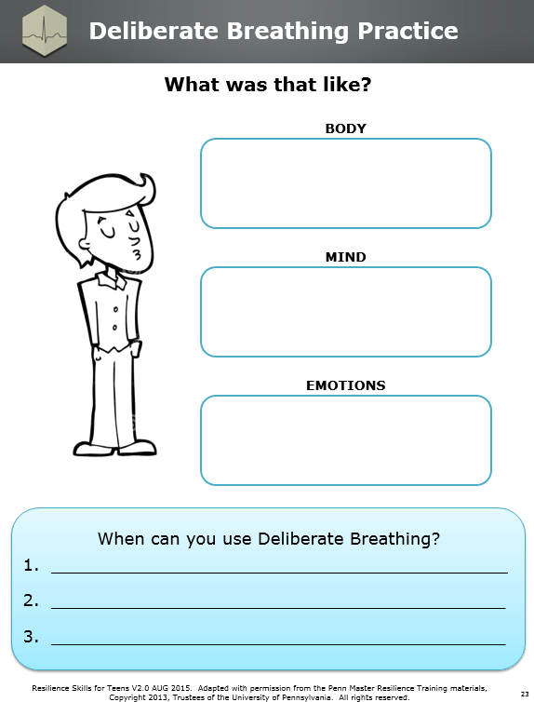
Workbook Activity (p. 23):
Deliberate Breathing Practice
Resilience Skills For Teens V2.0 AUG 2015. Adapted with permission from the Penn Master Resilience Training materials, Copyright 2013, Trustees of the University of Pennsylvania. All rights reserved.
Notes:
Instructor Notes:
Activity (Low-Tech)
Students record times they can use deliberate breathing (e.g., during a test, before shooting a free throw, when their parents are lecturing them, etc.).
Get a few students to share when they will use Deliberate Breathing.
Key Points:
Deliberate Breathing is a Self-regulation technique that includes physical, mental, and emotional components which, together, produce an immediate physical benefit.
The goal of this technique is to work towards gaining control over our Thoughts, Emotions, and physical Reactions all at once.
Deliberate Breathing is a skill that should be used daily to manage energy.

Slide 56
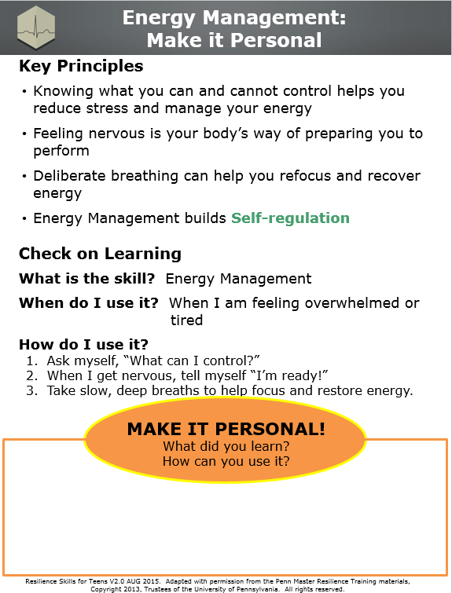
Workbook Activity (p. 24):
Make it Personal
Resilience Skills For Teens V2.0 AUG 2015. Adapted with permission from the Penn Master Resilience Training materials, Copyright 2013, Trustees of the University of Pennsylvania. All rights reserved.
Notes:
Instructor Notes:
Review the Key Principles (if time permits).
Reflection (Low-Tech)
Students write down what they learned and how they can use it or apply it to their own lives.

Slide 57
6) ATT Cover Page
Resilience Skills For Teens V2.0 AUG 2015. Adapted with permission from the Penn Master Resilience Training materials, Copyright 2013, Trustees of the University of Pennsylvania. All rights reserved.
Notes:
Rationale: Drs. Aaron Beck and Martin Seligman identified common patterns in thinking that are problematic, particularly when under stress. These Thinking Traps undermine mental toughness and performance and lead to an inaccurate understanding of the situation. You can use the Mental Cues and Critical Questions to avoid the Traps and to see the situation more accurately.
Objective: Identify and correct counterproductive patterns in thinking through the use of Mental Cues and Critical Questions.
Unit Overview and Recommended Timing:
Resilience Training for Teens,
Unit 6: Avoid Thinking Traps

Slide 58
6) ATT Key Terms
Resilience Skills For Teens V2.0 AUG 2015. Adapted with permission from the Penn Master Resilience Training materials, Copyright 2013, Trustees of the University of Pennsylvania. All rights reserved.
Notes:
Thinking Traps Overly rigid patterns in thinking that can cause people to miss critical information about a situation or an individual
Mental Cues Words or phrases that remind you what you need to do to get out of a Thinking Trap.
Critical Questions Specific questions that help avoid Thinking Traps and broaden awareness of important information
Avoid Thinking Traps
Key Terms

Slide 59
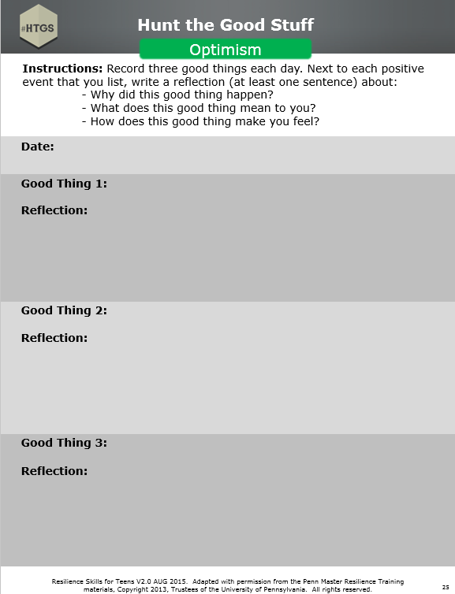
Workbook Activity (p. 25):
Hunt the Good Stuff
Resilience Skills For Teens V2.0 AUG 2015. Adapted with permission from the Penn Master Resilience Training materials, Copyright 2013, Trustees of the University of Pennsylvania. All rights reserved.
Notes:
Instructor Notes:
Activity (Low-Tech)
Begin the lesson with Hunt the Good Stuff.
Have students write down one to three good things in the Participant Workbook.
Tell students to write the good thing and the reflection (i.e., why it’s a good thing).
Ask a couple students to share their “"Good Stuff"” at the group level. Remember to emphasize that the students explain why it is a good thing to them.
Key Points:
Optimism is important for resilience.
HTGS is a skill to use daily, or at least several times a week.

Slide 60


Avoid Thinking Traps
Mental Agility
Resilience Skills For Teens V2.0 AUG 2015. Adapted with permission from the Penn Master Resilience Training materials, Copyright 2013, Trustees of the University of Pennsylvania. All rights reserved.
Notes:
Instructor Notes:
Tell students in one sentence what they will be learning.
Provide students with the resilience Core Competency the skill targets.
Key Points:
Sometimes we fall into traps with our thinking.
Avoid Thinking Traps builds Mental Agility.

Slide 61
ATC Model and Thinking Traps
Activating Event
The trigger: positive, negative, big or small
Thoughts
Your interpretations of the Activating Event; what you say to yourself
Jumping to Conclusions
Mind Reading
Me, Me, Me
Them, Them, Them
Always, Always, Always
Everything, Everything, Everything
Consequences: ER
E: Emotions
R: Reactions
Resilience Skills For Teens V2.0 AUG 2015. Adapted with permission from the Penn Master Resilience Training materials, Copyright 2013, Trustees of the University of Pennsylvania. All rights reserved.
Notes:
Instructor Notes:
Explain that Thinking Traps occur in the heat of the moment and are a part of our Thoughts in the ATC model.
Point out that because Thinking Traps are Thoughts, they drive our Consequences.
Key Points:
Thinking Traps are Thoughts in the ATC model.
Thinking Traps affect our Cs (Emotions, Reactions).
Thinking Traps can be difficult to change if you do not work at it.

Slide 62
Avoid Thinking Traps
Thinking Traps are patterns in thinking that are not flexible and can cause us to miss critical information about a situation or individual.
Resilience Skills For Teens V2.0 AUG 2015. Adapted with permission from the Penn Master Resilience Training materials, Copyright 2013, Trustees of the University of Pennsylvania. All rights reserved.
Notes:
Instructor Notes:
Skill
Review the definition of Thinking Traps.
Instruct students to underline key words NOT FLEXIBLE and MISS CRITICAL INFORMATION in their Participant Workbook.
Ask students what can happen when our thinking is not flexible and we are missing critical information.
Key Points:
Thinking Traps are common, we all fall into them.
Thinking Traps happen when our thinking is not F.A.T. (flexible, accurate, thorough).

Slide 63
What was Amanda thinking?
Resilience Skills For Teens V2.0 AUG 2015. Adapted with permission from the Penn Master Resilience Training materials, Copyright 2013, Trustees of the University of Pennsylvania. All rights reserved.
Notes:
Instructor Notes:
[This hook is optional]
Hook (High-Tech)
(Video--“Paul Potts” ).
Prebrief: Ask students to think about the following questions as they watch the video:
What was Amanda’s (the female judge) initial thought about Paul Potts, and did it change by the end of the clip?
What was Amanda’s more general belief, and did it change by the end of the clip?

Slide 64
Paul Potts Debrief
Resilience Skills For Teens V2.0 AUG 2015. Adapted with permission from the Penn Master Resilience Training materials, Copyright 2013, Trustees of the University of Pennsylvania. All rights reserved.
Notes:
Instructor Notes (cont.):
2) Debrief :
Ask students: What were the judges’ initial beliefs about Paul Potts? Did their beliefs change?
Note that most students will agree that Amanda's specific initial thought about Paul Potts changed by the end of the video. She would agree that he can sing opera. However, Amanda's general belief “people who look like that cannot sing opera” did not change.
Explain that the evidence that Amanda’s general belief did not change is that she made 2 comments about the singer: that he is a “lump of coal turning into a diamond” and a “frog that will turn into a prince.” Finding an “exception to the rule” does not mean that the underlying belief has changed.
Point out that Amanda's experience of not changing her basic belief is common for most of us. It is hard to change our beliefs, and the stronger the belief, the harder it is to change.
Tell students that we will now look at Thinking Traps and these are difficult to change because, like Amanda’s belief, they are strong patterns in how we think.
Key Points:
Thinking Traps are rigid patterns in thinking that are hard to change.
“Exception to the rule” makes it difficult to change beliefs.

Slide 65
Common Thinking Traps
Your friend tells you that he saw your girlfriend talking to someone else at a party. You think to yourself, “She is cheating on me.”
Jumping to Conclusions:
Believing one is certain about a situation despite having little or no evidence to support it
Mental Cue: Slow down
Critical Question: What is the evidence for and against my thoughts?
Resilience Skills For Teens V2.0 AUG 2015. Adapted with permission from the Penn Master Resilience Training materials, Copyright 2013, Trustees of the University of Pennsylvania. All rights reserved.
Notes:
Instructor Notes:
Read the scenario. (Note that the slide builds). Review the Thinking Trap and read the definition.
Instruct students to underline key words CERTAIN and LITTLE OR NO EVIDENCE in their Participant Workbook.
Point out that people who jump to conclusions are often impulsive in their emotions and reactions.
Ask for a show of hands: How many of you have fallen into the Jumping to Conclusions Thinking Trap?
Review the Mental Cue and Critical Question and explain their use to get out of a Thinking Trap.
Instruct students to underline EVIDENCE FOR AND AGAINST.
Key Points:
Jumping to Conclusions is number “1” of all Thinking Traps, which means that all Thinking Traps are some form of Jumping to Conclusions.
Slide Builds

Slide 66
Common Thinking Traps
You text your best friend but he is not texting back. You think to yourself, “He’s mad at me for not calling him last night.”
Mind Reading:
Assuming that you know what another person is thinking
or
Expecting another person to know what you are thinking
Mental Cue: Speak up
Critical Question: Did I express myself? Did I ask for information?
Resilience Skills For Teens V2.0 AUG 2015. Adapted with permission from the Penn Master Resilience Training materials, Copyright 2013, Trustees of the University of Pennsylvania. All rights reserved.
Notes:
Slide Builds
Instructor Notes:
Read the scenario. (Note that the slide builds). Review the Thinking Trap and read the definition.
Instruct students to underline key words ASSUMING and EXPECTING in their Participant Workbook.
Point out that Mind Reading blocks communication.
Ask for a show of hands: How many of you have fallen into the Mind Reading Thinking Trap?
Review the Mental Cue and Critical Question and explain their use to get out of a Thinking Trap.
Instruct students to underline EXPRESS and ASK.
Key Points:
The Thinking Trap of Mind Reading is common in close relationships.

Slide 67
Common Thinking Traps
There are two seconds left in regulation. Your team is down by two and you’re on the foul line. You make one of two free throws, and your team loses the game. You think to yourself, “It’s all my fault. This was a big game and I lost it for us.”
Me, Me, Me:
Believing that you are the sole cause of every problem you encounter
Blaming Yourself
Mental Cue: Look outward
Critical Question: How did others and/or circumstances contribute?
Resilience Skills For Teens V2.0 AUG 2015. Adapted with permission from the Penn Master Resilience Training materials, Copyright 2013, Trustees of the University of Pennsylvania. All rights reserved.
Notes:
Instructor Notes:
Read the scenario. (Note that the slide builds). Review the Thinking Trap and read the definition.
Instruct students to underline key words YOU, SOLE CAUSE and EVERY PROBLEM in their Participant Workbook.
Point out that Me, Me, Me causes us to blame ourselves for everything. Instruct students to write BLAMING YOURSELF next to the Me, Me, Me definition in their Participant Workbook.
Ask for a show of hands: How many of you have fallen into the Me, Me, Me Thinking Trap?
Review the Mental Cue and Critical Question and explain their use to get out of a Thinking Trap.
Instruct students to underline OTHERS AND/OR CIRCUMSTANCES.
Key Points:
It is important to look at all the possible contributing factors to a problem.
Slide Builds

Slide 68
Common Thinking Traps
You did poorly on a biology test. You think to yourself, “My teacher did not prepare me for that test one bit.”
Them, Them, Them:
Believing that other people or circumstances are the sole cause of every problem you encounter
Blaming Others
Mental Cue: Look inward
Critical Question: How did I contribute?
Resilience Skills For Teens V2.0 AUG 2015. Adapted with permission from the Penn Master Resilience Training materials, Copyright 2013, Trustees of the University of Pennsylvania. All rights reserved.
Notes:
Instructor Notes:
Read the scenario. (Note that the slide builds). Review the Thinking Trap and read the definition.
Instruct students to underline key words OTHER PEOPLE OR CIRCUMSTANCES, SOLE CAUSE, EVERY PROBLEM in their Participant Workbook.
Point out that Them, Them, Them causes us to point fingers. Instruct students to write BLAMING OTHERS next to the Them, Them, Them definition in their Participant Workbook.
Ask for a show of hands: How many of you have fallen into the Them, Them, Them Thinking Trap?
Review the Mental Cue and Critical Question and explain their use to get out of a Thinking Trap.
Instruct students to underline I.
Key Points:
It is important to stop placing blame and take responsibility for how you may have contributed to the problem.
Slide Builds

Slide 69
Demonstration
DEMO
A day in the life...
Resilience Skills For Teens V2.0 AUG 2015. Adapted with permission from the Penn Master Resilience Training materials, Copyright 2013, Trustees of the University of Pennsylvania. All rights reserved.
Notes:
Instructor Notes:
Hook (Low-Tech)
You will demonstrate how Thinking Traps can influence us.
Prepare sticky notes with situations and thoughts listed on the following page ahead of time. Use two different colors—one for the more positive interpretation (i.e., Thought A) and one for the “Them, Them, Them” interpretation (i.e., Thought B).
In advance, each pair of sticky notes should be placed next to each other across the front row of tables in the training room with some space between each pair of notes.
Explain that you will demonstrate a day in the life of a Them, Them, Them thinker.
First read the situation, e.g., “I get up in the morning and I can’t find my science book.” Then, hold up the corresponding Thought A sticky note and say, “I could think to myself...” followed by the Thought A text for that situation. Then hold up the Thought B sticky note and say, “or I could think to myself…”. After reading both Thoughts, hold up both sticky notes, asking students, “If I am a Them, Them, Them thinker, which color sticks to me (naming colors)?”
Place the Thought B sticky note somewhere on your shirt and follow the same pattern throughout the rest of the story. You should have six sticky notes attached to you by the end (all Thought Bs and all the same color sticky notes).
Continuing the story, when you arrive home and someone asks you how your day was, you explain all of the Thought B interpretations. Sticky notes should be taken off and read one by one as you retell the story of your day.

Slide 70
Demonstration … (continued)
Resilience Skills For Teens V2.0 AUG 2015. Adapted with permission from the Penn Master Resilience Training materials, Copyright 2013, Trustees of the University of Pennsylvania. All rights reserved.
Notes:
Instructor Notes:
The chart below lists the situations and thoughts to be put on sticky notes and used in the “Them, Them, Them” demonstration, as described on the previous page.
Key Points:
Emphasize how, at the end of the day, this person is more of a Them, Them, Them thinker. Think about how many sticky notes they would have in a week, a year, ten years…
Point out that these thoughts started out as choices but ended up as facts – reinforcing the pattern in his/her thoughts.
We often fall into a pattern with these Thinking Traps.

Slide 71

Common Thinking Traps
You asked your crush to the homecoming dance and she said no. You think to yourself, “Nobody likes me, I’m going to be alone forever.”
Always, Always, Always:
Believing that negative events are unchangeable and that you have little or no control over them
Time
Mental Cue: Grab control
Critical Question: What’s changeable? What can I control?
Notes
page 27
Resilience Skills For Teens V2.0 AUG 2015. Adapted with permission from the Penn Master Resilience Training materials, Copyright 2013, Trustees of the University of Pennsylvania. All rights reserved.
Notes:
Instructor Notes:
Point out that all Thinking Traps are bad, but the next two we will discuss are the most toxic. Instruct students to write TOXIC DUO above the Always, Always, Always and Everything, Everything, Everything box in their Participant Workbook.
Read the scenario. (Note that the slide builds). Review the Thinking Trap and read the definition.
Instruct students to underline key words UNCHANGEABLE and LITTLE OR NO CONTROL in their Participant Workbook.
Point out that this Thinking Trap refers to time, meaning that the bad thing is here to stay, it will never get better. Have students write TIME next to Always, Always, Always in their Participant Workbook.
Ask for a show of hands: How many of you have fallen into the Always, Always, Always Thinking Trap?
Emphasize that this is one of the most toxic Thinking Traps because it leads to helplessness and hopelessness – causes someone to give up.
Review the Mental Cue and Critical Question and explain their use to get out of a Thinking Trap.
Instruct students to underline CHANGEABLE and CONTROL.
Key Points:
Identifying where you have control is critical to resilience.
Slide Builds

Slide 72
Common Thinking Traps
You did poorly on your ACT. You think to yourself, “I’m so stupid. If I can’t even do well on this lousy test, how will I ever make it in the real world!”
Everything, Everything, Everything:
Believing that you can judge your character or someone else’s character based on a single event
or
Believing that what caused the problem is going to negatively affect many areas of your life
Domino Effect
Mental Cue: Get specific
Critical Question: What is the specific behavior
that explains the situation? What specific area of my life will be affected?
Resilience Skills For Teens V2.0 AUG 2015. Adapted with permission from the Penn Master Resilience Training materials, Copyright 2013, Trustees of the University of Pennsylvania. All rights reserved.
Notes:
Instructor Notes:
Read the scenario. (Note that the slide builds). Review the Thinking Trap and read the definition.
Point out that there are two parts to this Thinking Trap.
Instruct students to underline key words JUDGE YOUR CHARACTER OR SOMEONE ELSE’S CHARACTER, SINGLE EVENT, NEGATIVELY AFFECT MANY AREAS in their Participant Workbook.
Point out that this Thinking Trap impacts all aspects of one’s life. Instruct student to write DOMINO EFFECT next to Everything, Everything, Everything in their Participant Workbook.
Ask for a show of hands: How many of you have fallen into the Everything, Everything, Everything Thinking Trap?
Emphasize that this is one of the most toxic Thinking Traps, along with Always, Always, Always, because it leads to helplessness and hopelessness – causes someone to give up.
Review the Mental Cue and Critical Question and explain their use to get out of a Thinking Trap.
Instruct students to underline SPECIFIC BEHAVIOR and SPECIFIC AREA OF MY LIFE.
Key Points:
This Thinking Traps makes it hard for us to make changes and sort out problems.
Slide Builds

Slide 73
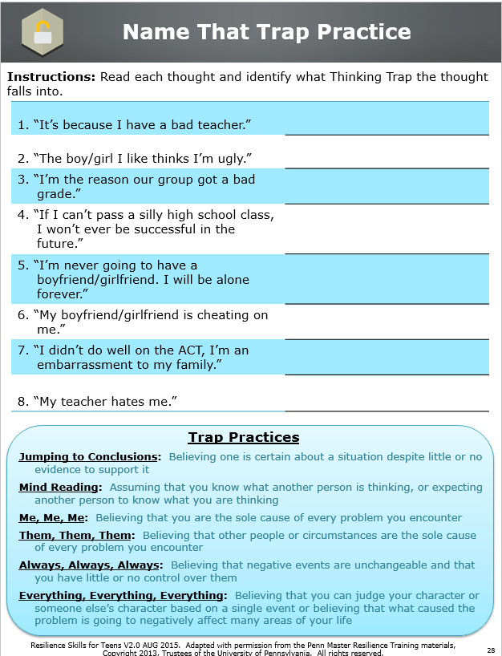
Workbook Activity (page 28):
Name That Trap Practice
Resilience Skills For Teens V2.0 AUG 2015. Adapted with permission from the Penn Master Resilience Training materials, Copyright 2013, Trustees of the University of Pennsylvania. All rights reserved.
Notes:
Instructor Notes:
Activity (Low-Tech)
Introduce the “Name that Trap” activity in the Participant Workbook.
Students will work in pairs, reading each Thought and recording which Thinking Trap each Thought falls into.
Review answers as a group.
Key Points:
One Thought can fall into multiple Thinking Traps.
Not every Thought falls into a Thinking Trap.
Answer Key:
Note: Each thought may fit multiple Thinking Traps. If a student provides an alternative, have them make a case for what they chose.
Them, Them, Them
Mind Reading
Me, Me, Me
Everything, Everything, Everything
Always, Always, Always
Jumping to Conclusions
Everything, Everything, Everything
Mind Reading

Slide 74
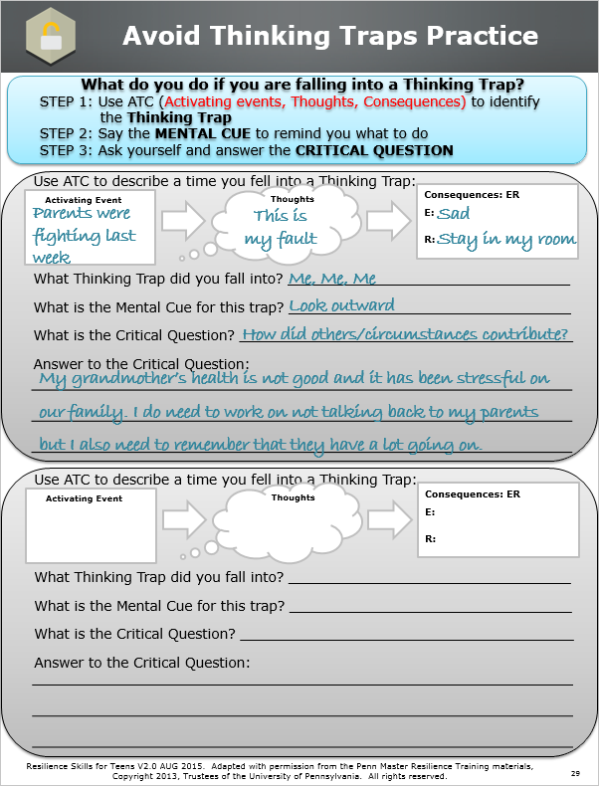
Workbook Activity (page 29):
Avoid Thinking Traps Practice
Resilience Skills For Teens V2.0 AUG 2015. Adapted with permission from the Penn Master Resilience Training materials, Copyright 2013, Trustees of the University of Pennsylvania. All rights reserved.
Notes:
Instructor Notes:
[This activity is optional]
Activity (Low-Tech)
Use the example in the Participant Workbook to instruct students on what they will be doing.
Students complete the ATC model to describe a time they fell into a Thinking Trap.
Students identify what Thinking Trap they fell into and record the Mental Cue and Critical Question for that particular Thinking Trap.
Students answer the Critical Question.
If time permits, have students share their personal example with a partner or get a couple examples from students at the group level.

Slide 75
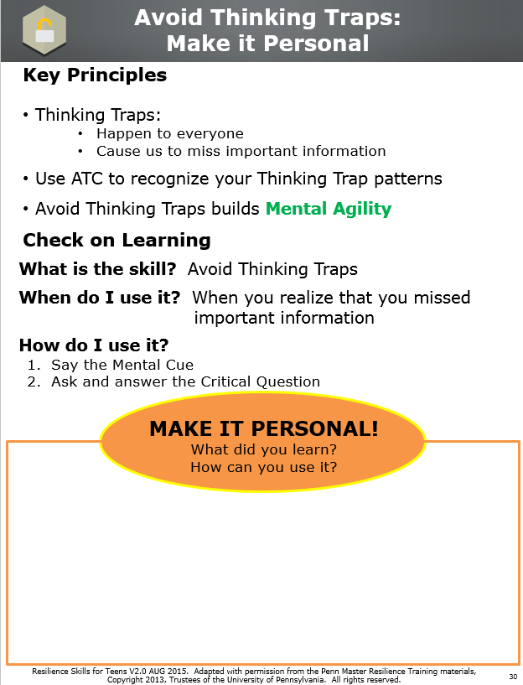
Workbook Activity (page 30):
Make it Personal
Resilience Skills For Teens V2.0 AUG 2015. Adapted with permission from the Penn Master Resilience Training materials, Copyright 2013, Trustees of the University of Pennsylvania. All rights reserved.
Notes:
Instructor Notes:
Review the Key Principles (if time permits).
Reflection (Low-Tech)
Students write down what they learned and how they can use it or apply it to their own lives.

Slide 76
7) DI Cover Page
Resilience Skills For Teens V2.0 AUG 2015. Adapted with permission from the Penn Master Resilience Training materials, Copyright 2013, Trustees of the University of Pennsylvania. All rights reserved.
Notes:
Rationale: The skill of Detect Icebergs allows you to identify core beliefs or values and determine their usefulness. Core beliefs or values may be operating when an emotion or reaction seems out of proportion to what you’re thinking in the heat of the moment.
Objective: Identify core beliefs and core values that fuel out-of-proportion emotions and reactions, and evaluate the accuracy and usefulness of these beliefs.
Note: This lesson is recommended for older age groups due to the complexity of the content; it can be considered optional when working with younger age groups. Additionally, time management for this lesson may be an issue due to the high volume of content.
Unit Overview and Recommended Timing:
Resilience Training for Teens,
Unit 7: Detect Icebergs

Slide 77
7) DI Key Terms
Resilience Skills For Teens V2.0 AUG 2015. Adapted with permission from the Penn Master Resilience Training materials, Copyright 2013, Trustees of the University of Pennsylvania. All rights reserved.
Notes:
Icebergs Core beliefs and core values that are usually connected to how we think the world “should” operate; assumptions we have about ourselves and others
Detect Icebergs
Key Terms

Slide 78
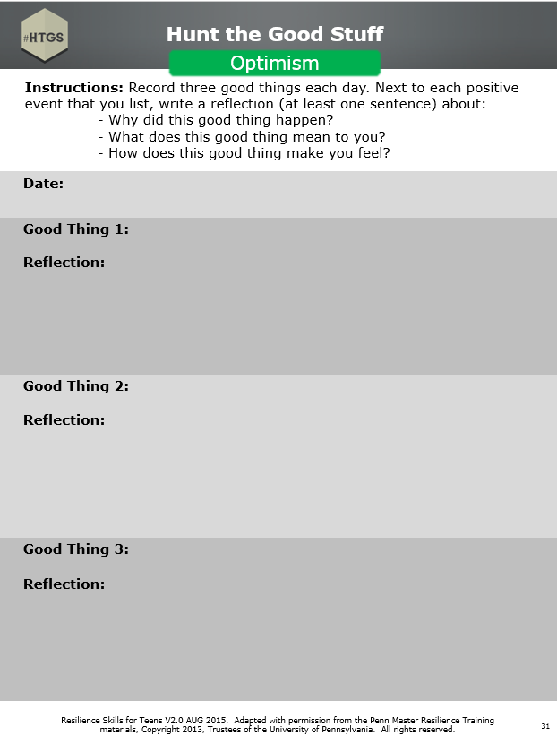
Workbook Activity (page 31):
Hunt the Good Stuff
Resilience Skills For Teens V2.0 AUG 2015. Adapted with permission from the Penn Master Resilience Training materials, Copyright 2013, Trustees of the University of Pennsylvania. All rights reserved.
Notes:
Instructor Notes:
Activity (Low-Tech)
Begin the lesson with Hunt the Good Stuff.
Have students write down one to three good things in the Participant Workbook.
Tell students to write the good thing and the reflection (i.e., why it’s a good thing).
Ask a couple students to share their “"Good Stuff"” at the group level. Remember to emphasize that the students explain why it is a good thing to them.
Key Points:
Optimism is important for resilience.
HTGS is a skill to use daily, or at least several times a week.

Slide 79


Detect Icebergs
Self-awareness
Resilience Skills For Teens V2.0 AUG 2015. Adapted with permission from the Penn Master Resilience Training materials, Copyright 2013, Trustees of the University of Pennsylvania. All rights reserved.
Notes:
Instructor Notes:
Tell students in one sentence what they will be learning.
Provide students with the resilience Core Competency the skill targets.
Key Points:
This is a skill that is used when your emotions and reactions don’t make sense; they confuse you.
Detect Icebergs builds Self-awareness.

Slide 80

Detect Icebergs
Icebergs
Core values = How things should be
Core beliefs = How things are
Heat of the moment thoughts
Aware
Icebergs
Unaware
Resilience Skills For Teens V2.0 AUG 2015. Adapted with permission from the Penn Master Resilience Training materials, Copyright 2013, Trustees of the University of Pennsylvania. All rights reserved.
Notes:
Instructor Notes:
Skill
Explain that Icebergs include both core values and core beliefs. Core values are what one aspires to, or what one believes they, the world, and others “should” be. Instruct students to write HOW THINGS SHOULD BE next to core values in their Participant Workbook.
Core beliefs are what one believes to be true about oneself, others, and the world, or the way it “is.” Instruct students to write HOW THINGS ARE next to core beliefs in their Participant Workbook.
Describe the metaphor of the iceberg picture as it applies to the skill of Detect Icebergs. Students should record the red text AWARE and UNAWARE in the Participant Workbook.
The metaphor represents awareness; Heat-of-the-Moment Thoughts are in our awareness whereas Iceberg beliefs and values are often outside our awareness.
Tell students that Heat-of-the-Moment Thoughts are what we typically identify with the ATC model.
Tell students they are still forming their core values and core beliefs.
Make clear that Icebergs are not always bad, wrong, or in need of being changed.
Key Points:
Icebergs are not fully in our awareness, but we can learn to identify them.
Slide Builds

Slide 81
Examples of Icebergs
Everyone should be treated equal.
People can’t be trusted.
You should respect authority.
I am smart.
I am ugly.
You should be grateful for what you have.
??
Resilience Skills For Teens V2.0 AUG 2015. Adapted with permission from the Penn Master Resilience Training materials, Copyright 2013, Trustees of the University of Pennsylvania. All rights reserved.
Notes:
Instructor Notes:
Review the list with students and ask students to identify two or three other Icebergs.
Key Points:
Icebergs are often broad rules for how the world SHOULD operate or how the world IS.
People have many different Icebergs, and it is important not to judge someone else’s Icebergs.

Slide 82
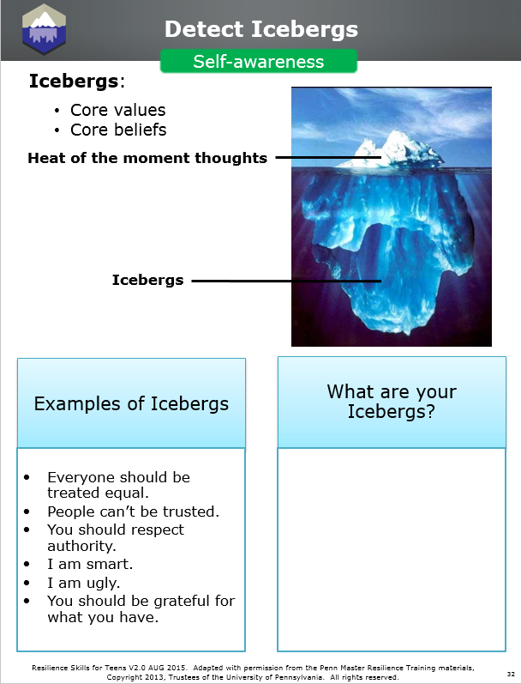
Workbook Activity (page 32):
What are your Icebergs?
Resilience Skills For Teens V2.0 AUG 2015. Adapted with permission from the Penn Master Resilience Training materials, Copyright 2013, Trustees of the University of Pennsylvania. All rights reserved.
Notes:
Instructor Notes:
Hook (Low-Tech)
Refer students to the Participant Workbook.
Remind students that not all Icebergs are bad.
Encourage students to think about the values their family teaches them and movies or books they enjoy to help them come up with Icebergs.
Students write as many of their own Icebergs as they can.

Slide 83
When do you need to detect an Iceberg?
When your emotions and reactions don’t make sense based on your heat of the moment thought
Resilience Skills For Teens V2.0 AUG 2015. Adapted with permission from the Penn Master Resilience Training materials, Copyright 2013, Trustees of the University of Pennsylvania. All rights reserved.
Notes:
Trainer Notes:
Tell students when they would need to detect an Iceberg.
Instruct students to underline DON’T MAKE SENSE in their Participant Workbook.
Key Points:
Icebergs often need to be detected if your emotions and reactions don’t make sense; they confuse you based on your Heat-of-the-Moment Thought.

Slide 84
Does Sam need to detect an Iceberg?
AE (who, what, when, where): Sam’s grade in science dropped to a C.
Thoughts: | Consequences:
Sam thinks, “I need to do better.” | E: Disappointed R: Asks teacher for extra credit opportunities
Resilience Skills For Teens V2.0 AUG 2015. Adapted with permission from the Penn Master Resilience Training materials, Copyright 2013, Trustees of the University of Pennsylvania. All rights reserved.
Notes:
Trainer Notes:
Read the scenario on the slide.
Ask students if Sam needs to detect an Iceberg and if so, have them explain why.
In this example, explain that Detect Icebergs is NOT needed because Sam’s emotions and reactions make sense based on her Heat-of-the-Moment Thought.
Key Points:
Not all strong emotions and reactions are driven by Icebergs. Sometimes our Heat-of-the-Moment Thoughts explain our strong emotions and reactions.

Slide 85
Does Joe need to detect an Iceberg?
AE (who, what, when, where): Joe’s parents told him he could not go to the basketball game with his friends.
Thoughts: | Consequences:
Joe thinks, “I really wanted to go.” | E: Intense anger R: Throws phone against the wall and breaks it
Resilience Skills For Teens V2.0 AUG 2015. Adapted with permission from the Penn Master Resilience Training materials, Copyright 2013, Trustees of the University of Pennsylvania. All rights reserved.
Notes:
Trainer Notes:
Read the scenario on the slide.
Ask students if Joe needs to detect an Iceberg and if so, have them explain why.
In this example, explain that Detect Icebergs IS needed because Joe’s emotions and reactions don’t make sense based on his Heat-of-the-Moment Thought.
Key Points:
The skill of Detect Icebergs may be helpful here so that Joe can understand why he reacted so strongly, and to evaluate his Iceberg.

Slide 86
Demonstration
DEMO
I call my “bad” friend
Resilience Skills For Teens V2.0 AUG 2015. Adapted with permission from the Penn Master Resilience Training materials, Copyright 2013, Trustees of the University of Pennsylvania. All rights reserved.
Notes:
Instructor Notes:
Complete this demonstration with someone playing the role of “bad friend.”
Instructor describes the scenario:
“I have had a “D” average in science all year and really needed to bring it up. I studied for 5 hours an “A” on the final exam. I was and earned then called to the office for a meeting with the principal and my teacher and was accused of cheating.”
Instructor walks through ATC:
AE: I was called to the principal’s office and accused of cheating on my science final exam.
T: “I can’t believe they think I cheated.”
E: Enraged
R: Heart starts racing, teeth clenched, and begin to scream and yell at the teacher and principal.
Instructor asks students if the skill of Detect Icebergs is needed.
Call “bad friend” to the front of the room.
Follow “bad friend” script on the following page.
After the demonstration, ask students if this was an effective way to figure out the Iceberg. If not, have them explain why.
Point out “why” questions.

Slide 87
Demonstration … (continued)
Resilience Skills For Teens V2.0 AUG 2015. Adapted with permission from the Penn Master Resilience Training materials, Copyright 2013, Trustees of the University of Pennsylvania. All rights reserved.
Notes:
Instructor Notes:
“Bad friend” script:
Instructor: So I’m in the office and all I keep thinking is, “I can’t believe they think I cheated!”
Bad Friend: Why do they think you cheated?”
Instructor: Because they are stupid teachers who would never believe a student could do anything good.
Bad Friend: Yeah, they are so stupid, why do you think they never want anyone to just be good?
Instructor: Who even knows, I mean, they don’t ever let anyone do ANYTHING, I mean, look at the dress code in this school, it’s so strict, it’s like they think we’re little kids.
Bad Friend: Oh yeah, so true, why the heck is our dress code so strict?
Instructor: I don’t even know, it’s so stupid, it’s like we can’t even dress ourselves. They have so many stupid rules, it’s so frustrating!
Bad Friend: Yeah really, why do they have so many stupid rules?
Instructor: Because they think we are BABIES! Man, I can’t wait to graduate, this is so dumb. Thanks for the vent session, talk to you later.
Key Points:
Why questions lead to defensiveness and stay on the surface of the problem.

Slide 88

How do you detect an Iceberg?
Use “What” questions to understand why you acted the way you did.
What’s so bad about that?
What’s the worst part of that?
What bothers me the most about that?
What’s that mean to me?
DEMO
Resilience Skills For Teens V2.0 AUG 2015. Adapted with permission from the Penn Master Resilience Training materials, Copyright 2013, Trustees of the University of Pennsylvania. All rights reserved.
Notes:
Instructor Notes:
Review the four “What” questions.
Underscore that “What” questions lead to curiosity, reflection, and openness, and “Why” questions lead to defensiveness and rationalization.
Highlight that the “What” questions on the slide are only sample questions. Any “What” questions are fine if they help guide the person deeper toward his or her Iceberg and do not keep the person focused on Heat-of-the-Moment Thoughts.
Explain that students should anchor each question with the last response. Repeat back exactly what the person said. Parrot, just like a parrot repeats back what you say.
To determine when to stop asking the “What” questions, remind students to ask themselves if the Iceberg explains the emotions and reactions.
Remind students that the person whose situation it is decides when to stop asking the “What” questions.
Demonstration (Low-Tech)
Complete the demonstration with students playing the role of “good friend.”
This demo is a slow version that gets the students practicing/learning the use of “what” questions. There will be do-overs.
Use the scenario from the previous demo (i.e., accused of cheating.)
Leave the slide with “what” questions up to help the students.
Instructor models the first what question.
Work with the students to parrot and use the “what” questions.
Point out how the what questions are going deeper towards the Iceberg.
For assistance, there is an example script on the following page.

Slide 89
How do you detect an Iceberg? (continued)
Resilience Skills For Teens V2.0 AUG 2015. Adapted with permission from the Penn Master Resilience Training materials, Copyright 2013, Trustees of the University of Pennsylvania. All rights reserved.
Notes:
Instructor Notes:
“Good Friend” Script:
Instructor: So I’m in the office and all I keep thinking is, “I can’t believe they think I cheated!”
Instructor: So what’s so bad about them thinking you cheated?
Instructor: Well, that means they don’t think I worked really hard for that grade, which I did.
Students: What’s it mean to you they don’t think you worked really hard for that grade?
Instructor: It means that I’m being punished instead of rewarded for my hard work.
Students: What bothers you the most about them punishing you instead of rewarding you for your hard work?
Instructor: Well, it’s really unfair. It just shows that they don’t trust me.
Students: What’s that mean to you that they don’t trust you?
Instructor: Well good teachers should trust that their students work hard for their grades.
Instructor models the “aha” moment and repeats the Iceberg: Good teachers should trust that their students work hard for their grades.
Key Points:
What questions lead to depth.
Based on this Iceberg, it now makes sense why the student reacted the way he/she did.

Slide 90
What do you do after you’ve detected an Iceberg?
Answer the following questions to determine if the Iceberg needs to be changed at all.
What is the Iceberg?
Is this Iceberg helping or harming me in this situation? Explain.
Does this Iceberg need to be more flexible? Explain.
Resilience Skills For Teens V2.0 AUG 2015. Adapted with permission from the Penn Master Resilience Training materials, Copyright 2013, Trustees of the University of Pennsylvania. All rights reserved.
Notes:
Instructor Notes:
Tell students that once an Iceberg is detected, the work does not stop there. It is important to ask yourself questions to determine if the Iceberg needs to be changed at all.
Review the questions on the slide.
Ask students for an example of an Iceberg that could help resilience (e.g., I should ask for help when I need it) and one that could hurt resilience (e.g., I can handle everything on my own).
Provide an example of an Iceberg that may need to be more flexible (i.e. Good students never make mistakes).
Key Points:
Students may find that an Iceberg is harming them in certain situations and it is hurting their resilience.
Students may find that their Iceberg is helping them to be resilient.
Students may find that they could be more flexible with their Iceberg.

Slide 91
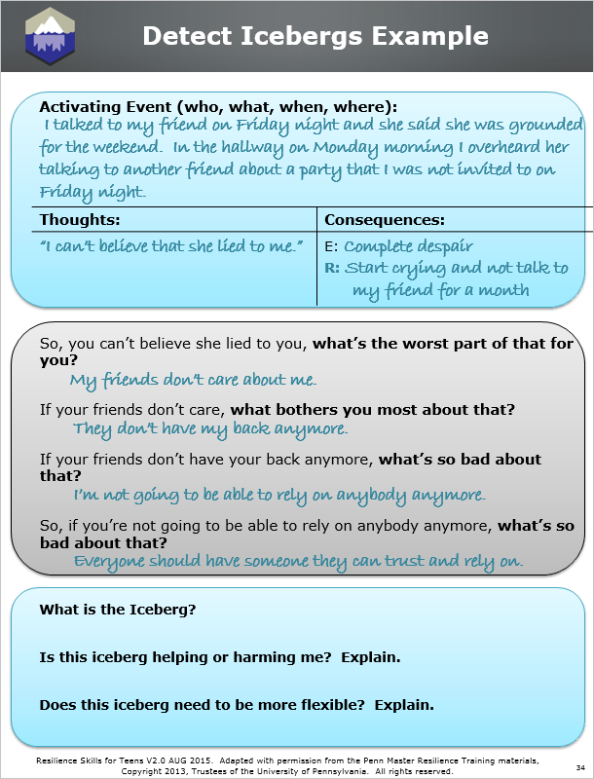
Workbook Activity (page 34):
Detect Icebergs Example
Resilience Skills For Teens V2.0 AUG 2015. Adapted with permission from the Penn Master Resilience Training materials, Copyright 2013, Trustees of the University of Pennsylvania. All rights reserved.
Notes:
Instructor Notes:
Activity (Low-Tech)
Refer students to the Participant Workbook. (p.34)
Review the practice example.
Students work to complete the questions on the bottom of the page.
Ask one to two students to share what they put for each question.
Key Points:
In this particular example, the Iceberg may need to be more flexible. Just because she was not invited to the party, does not necessarily mean she cannot trust and rely on her friend.

Slide 92
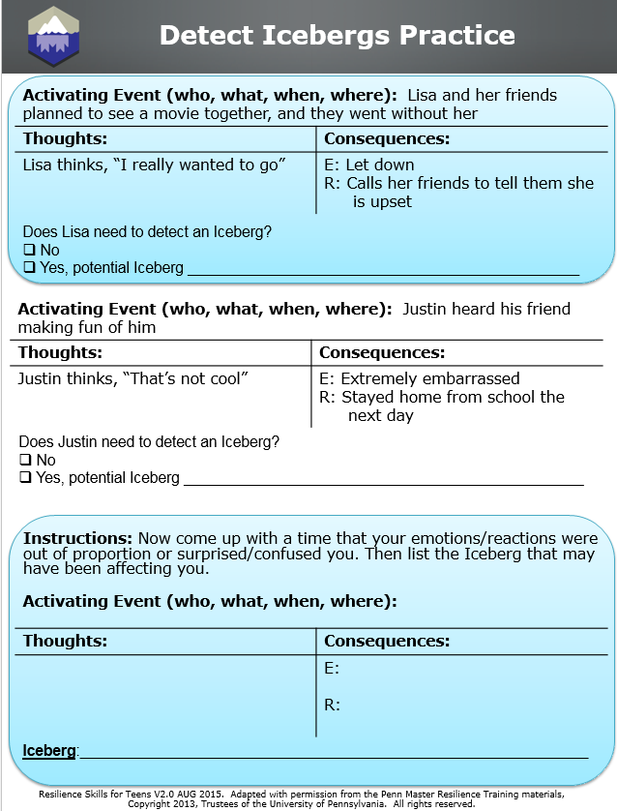
Workbook Activity (p. 35):
Detect Icebergs Practice
Resilience Skills For Teens V2.0 AUG 2015. Adapted with permission from the Penn Master Resilience Training materials, Copyright 2013, Trustees of the University of Pennsylvania. All rights reserved.
Notes:
Instructor Notes:
[This activity is optional]
Activity (Low-Tech)
Refer students to the Participant Workbook. (p.35)
Instruct students to first complete the two practice examples at the top of the page. Based on the scenario, students will need to chose if an Iceberg needs to be detected. If they choose yes, they will need to identify a potential Iceberg.
Students will then complete a personal example.
If students have trouble coming up with a good learning example, encourage students to think about situations when:
They are confused by their reaction.
They are stuck when making a seemingly obvious decision.
They can’t get over something.
Their positive reaction is out of proportion to the Thought (e.g., they are unusually moved by something).
They have a pet peeve.
Once students complete the ATC portion, encourage them to either ask themselves the what questions or pair up with a partner to detect their Iceberg.
Once an Iceberg is identified, the student writes it down in the space allotted. Students should check whether the Iceberg they identified helps to make sense of their initial emotions and reactions.
Students can then discuss with a partner if the Iceberg is helping or harming them and if it’s not flexible enough.

Slide 93
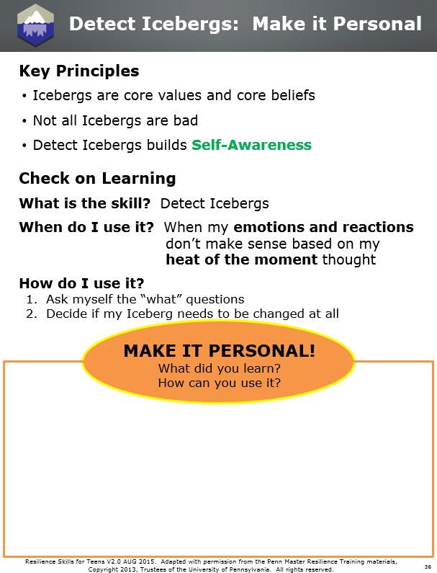
Workbook Activity (page 36):
Make it Personal
Resilience Skills For Teens V2.0 AUG 2015. Adapted with permission from the Penn Master Resilience Training materials, Copyright 2013, Trustees of the University of Pennsylvania. All rights reserved.
Notes:
Instructor Notes:
Refer students to the Participant Workbook. (p.36)
Review the Key Principles (if time permits).
Reflection (Low-Tech)
Students write down what they learned and how they can use it or apply it to their own lives.

Slide 94
8) CB Cover Page
Resilience Skills For Teens V2.0 AUG 2015. Adapted with permission from the Penn Master Resilience Training materials, Copyright 2013, Trustees of the University of Pennsylvania. All rights reserved.
Notes:
Rationale: The Confirmation Bias (or Velcro/Teflon Effect) interferes with problem solving because it causes people to notice the evidence that fits their thoughts and to miss the evidence that contradicts their thoughts.
Objective: Be able to define the Confirmation Bias prior to the unit on Problem Solving.
Note: This concept needs to be a separate lesson from Problem Solving due to its complexity and for timing purposes. It may be too difficult for younger age groups and, like Problem Solving, may therefore be considered as optional. However, if Problem Solving is going to be taught, this lesson must occur first to facilitate understanding.
Unit Overview and Recommended Timing:
Resilience Training for Teens,
Unit 8: Confirmation Bias

Slide 95
8) Confirmation Bias Key Terms
Resilience Skills For Teens V2.0 AUG 2015. Adapted with permission from the Penn Master Resilience Training materials, Copyright 2013, Trustees of the University of Pennsylvania. All rights reserved.
Notes:
Confirmation Bias or Velcro/Teflon Effect The tendency to notice the evidence that fits our thoughts and beliefs and to miss the evidence that contradicts our thoughts and beliefs.
Confirmation Bias
Key Terms

Slide 96
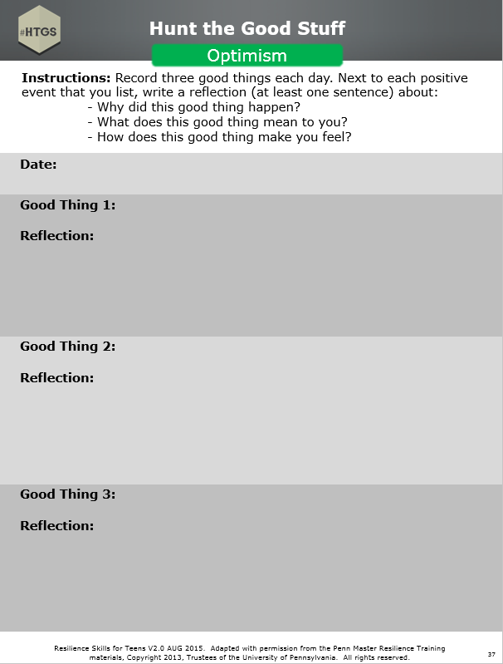
Workbook Activity (page 37):
Hunt the Good Stuff
Resilience Skills For Teens V2.0 AUG 2015. Adapted with permission from the Penn Master Resilience Training materials, Copyright 2013, Trustees of the University of Pennsylvania. All rights reserved.
Notes:
Instructor Notes:
Activity (Low-Tech)
Begin the lesson with Hunt the Good Stuff.
Have students write down one to three good things in the Participant Workbook.
Tell students to write the good thing and the reflection (i.e., why it’s a good thing).
Ask a couple students to share their “"Good Stuff"” at the group level. Remember to emphasize that the students explain why it is a good thing to them.
Key Points:
Optimism is important for resilience.
HTGS is a skill to use daily, or at least several times a week.

Slide 97


Confirmation Bias
Mental Agility
Resilience Skills For Teens V2.0 AUG 2015. Adapted with permission from the Penn Master Resilience Training materials, Copyright 2013, Trustees of the University of Pennsylvania. All rights reserved.
Notes:
Instructor Notes:
Tell students in one sentence what they will be learning.
Provide students with the resilience Core Competency the skill targets.
Key Points:
We see what we want to see.
Fighting the Confirmation Bias builds Mental Agility.

Slide 98

Video:
Awareness Test
Resilience Skills For Teens V2.0 AUG 2015. Adapted with permission from the Penn Master Resilience Training materials, Copyright 2013, Trustees of the University of Pennsylvania. All rights reserved.
Notes:
Instructor Notes:
[This clip is optional]
Hook (High-Tech)
Show the “Awareness Test” clip:
Prebrief: Show the clip without an introduction so that you don’t ruin the effect.
Debrief:
Ask how many students saw the hidden message on the cards.
Emphasize that we tend to see what we are looking for, making it hard to see the whole picture. “We see information that supports our beliefs.”
Key Points:
Our tendency to see what we are looking for
makes it hard for us to see the whole picture.

Slide 99

Confirmation Bias
We see what we are looking for
It is hard to change our minds
Resilience Skills For Teens V2.0 AUG 2015. Adapted with permission from the Penn Master Resilience Training materials, Copyright 2013, Trustees of the University of Pennsylvania. All rights reserved.
Notes:
Instructor Notes:
Explain that the Confirmation Bias is the automatic process that makes us more likely to confirm that which we already believe.
Point out that the Confirmation Bias makes it hard to change our minds.
Key Points:
Confirmation Bias affects us all; our brains automatically do this.
Most of us do not learn about the Confirmation Bias. Learning about the Confirmation Bias helps us to see the whole picture and solve problems.

Slide 100
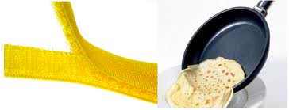
What is the
Confirmation Bias?
The Confirmation Bias causes us to:
Notice
Remember
Weight
NOT Notice
NOT Remember
NOT Weight
Resilience Skills For Teens V2.0 AUG 2015. Adapted with permission from the Penn Master Resilience Training materials, Copyright 2013, Trustees of the University of Pennsylvania. All rights reserved.
AND
Evidence that supports our thoughts and beliefs
VELCRO EFFECT
It sticks
Evidence that does NOT support our thoughts and beliefs
TEFLON EFFECT
It slides off
Notes:
Instructor Notes:
Explain the Confirmation Bias in terms of a metaphor – the Velcro/Teflon Effect.
Emphasize that evidence that fits our beliefs is like Velcro – it sticks to us.
Instruct students to underline SUPPORTS in their Participant Workbook.
At the same time our brain notices, remembers, and weights the evidence that fits our beliefs, the evidence that does NOT fit our beliefs slides off – like an egg sliding off of a Teflon pan. (Since teens may not know what Teflon is, draw their attention to the image on the slide).
Instruct students to write AND and underline NOT SUPPORT in their Participant Workbook.
State that the Confirmation Bias or Velcro/Teflon Effect is common and influences all of us.
Emphasize that Mental Agility is needed to get around the Confirmation Bias.
Key Points:
The Confirmation Bias causes us to notice evidence that fits our thoughts and beliefs and miss evidence that does not fit our thoughts and beliefs.

Slide 101
Demonstration
DEMO
“My parents hate me”
Resilience Skills For Teens V2.0 AUG 2015. Adapted with permission from the Penn Master Resilience Training materials, Copyright 2013, Trustees of the University of Pennsylvania. All rights reserved.
Notes:
Instructor Notes:
Hook (Low-Tech)
Instructor prepares a flipchart that is made to look like a television.
All 8 pieces of evidence from the belief, “My parents hate me” are written on sticky notes and posted on the flipchart (TV screen). Evidence that supports the belief is in one color and evidence that does not support the belief is in another color. Look at the following page for the list of evidence to prepare sticky notes.
The instructor looks at the “TV” and sticks all of the evidence that supports his/her belief onto themselves.
Instructor says, “I know the Confirmation Bias is affecting my ability to see the whole picture. I have a lot of evidence to make my belief even stronger, but I need to see if there’s evidence on another side. Let me call a friend to help me out.”
Call up a student to help be your friend (to make this demo faster, use another instructor)
Instructor reads a piece of evidence that supports their belief “My parents hate me” (e.g., They took my phone away).
The friend must then find and read evidence on the “TV” that does not support the belief (e.g., They threw me a surprise birthday party). The instructor then sticks that evidence onto them.
Continue until all sticky notes are stuck onto the instructor.
Instructor thanks his/her friend and starts to reflect on the new evidence.
Debrief the demonstration using the questions on the following page.

Slide 102
Demonstration … (continued)
DEMO
“My parents hate me”
Resilience Skills For Teens V2.0 AUG 2015. Adapted with permission from the Penn Master Resilience Training materials, Copyright 2013, Trustees of the University of Pennsylvania. All rights reserved.
Notes:
Instructor Notes:
Debrief Questions:
Why was all the evidence seen on the “TV” but not when the instructor gathered evidence?
How did the friend help the instructor to fight the Confirmation Bias?
Is it easy to see both sides of the story?

Slide 103
It is important to remember
The Confirmation Bias is
  not intentional
  not in our awareness
The stronger the belief, the stronger the Confirmation Bias
The Confirmation Bias operates on both positive and negative thoughts
  “I am smart.”
  “I am not smart.”
Resilience Skills For Teens V2.0 AUG 2015. Adapted with permission from the Penn Master Resilience Training materials, Copyright 2013, Trustees of the University of Pennsylvania. All rights reserved.
Notes:
Instructor Notes:
We are unaware that the Confirmation Bias is operating; we don’t do this on purpose.
The Confirmation Bias tends to be stronger for core beliefs (Icebergs) like, “x group of people are lazy” or “I’m a great athlete,” than it is for Heat-of-the-Moment thoughts like “it’s hot outside today” or “I need a haircut.”
Confirmation Bias can operate on both positive thoughts and negative thoughts. Either way, it can undermine resilience because it causes you to miss information and makes it hard to see situations accurately.
Key Points:
The Confirmation Bias is not in our awareness. That is why it’s an important concept to learn.
Slide Builds

Slide 104
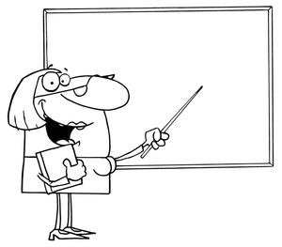
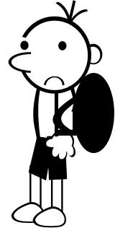
“I’m not smart”
That’s partially correct
I’m wrong
Resilience Skills For Teens V2.0 AUG 2015. Adapted with permission from the Penn Master Resilience Training materials, Copyright 2013, Trustees of the University of Pennsylvania. All rights reserved.
Notes:
Instructor Notes:
Use an example to review each of the ways the Confirmation Bias works.
Because of the Confirmation Bias, we are likely to interpret unclear information as supportive of our thoughts and beliefs.
Example: Student who believes “I am not smart”
Ask the students: When the teacher says the student’s answer is partially correct (build slide), what does the student hear?
The student only hears “I’m wrong” (build slide).
Slide Builds

Slide 105

“I’m not smart”
List of classes
AP Physics
Advanced Math
Basic Science
Resilience Skills For Teens V2.0 AUG 2015. Adapted with permission from the Penn Master Resilience Training materials, Copyright 2013, Trustees of the University of Pennsylvania. All rights reserved.
Notes:
Slide Builds
Instructor Notes:
Use an example to review each of the ways the Confirmation Bias works.
Because of the Confirmation Bias, we don’t actively seek evidence that counters our thoughts and beliefs.
Example: Student who believes “I am not smart”
Ask the students: Which course are they likely to take?
Basic Science (build slide)

Slide 106

“I’m not smart”
Social Studies
A+
English
D+
Resilience Skills For Teens V2.0 AUG 2015. Adapted with permission from the Penn Master Resilience Training materials, Copyright 2013, Trustees of the University of Pennsylvania. All rights reserved.
Notes:
Slide Builds
Instructor Notes:
Use an example to review each of the ways the Confirmation Bias works.
Because of the Confirmation Bias, we weight evidence for and against our thoughts differently.
Example: Student who believes “I am not smart”
The student gets an A+ on a Social Studies assignment and a D+ on an English paper. He weights the English teacher’s grade more heavily, telling himself, “that teacher knows me better and my Social Studies teacher gives good grades to everybody” (build slide).

Slide 107

“I’m not smart”
List of classes
AP Physics
Advanced Math
Basic Science
I’m wrong
A+
D+
I’m not smart!
Resilience Skills For Teens V2.0 AUG 2015. Adapted with permission from the Penn Master Resilience Training materials, Copyright 2013, Trustees of the University of Pennsylvania. All rights reserved.
Notes:
Slide Builds
Instructor Notes:
Use an example to review each of the ways the Confirmation Bias works.
Because of the Confirmation Bias, once we find evidence that supports our thoughts or beliefs, we tend to stop gathering evidence.
Example: Student who believes “I am not smart”
At the end of the day, the student has all the evidence they need to confirm the fact that they are not smart; there is no need to think about the good things that happened that day (build slide).
Key Points:
The Confirmation Bias or Velcro/Teflon Effect causes us to notice evidence that fits our thoughts and beliefs and miss evidence that contradicts our thoughts and beliefs.
All of these processes lead us to miss critical information and make it hard to see situations accurately.
The Confirmation Bias gets in the way of processing information accurately.

Slide 108

“I am smart”
That’s partially correct
I’m right!
Resilience Skills For Teens V2.0 AUG 2015. Adapted with permission from the Penn Master Resilience Training materials, Copyright 2013, Trustees of the University of Pennsylvania. All rights reserved.
Notes:
Instructor Notes:
Remind students that the Confirmation Bias operates off of both positive and negative thoughts and beliefs.
Quickly walk students through the example.
When the teacher says, “That’s partially correct” (build slide), the student with the belief of “I am smart,” is going to hear, “I’m right” (build slide).
Slide Builds

Slide 109
“I am smart”
List of classes
AP Physics
Basic Math
Basic Science
Resilience Skills For Teens V2.0 AUG 2015. Adapted with permission from the Penn Master Resilience Training materials, Copyright 2013, Trustees of the University of Pennsylvania. All rights reserved.
Notes:
Slide Builds
Instructor Notes:
Quickly walk students through the example.
A student with the belief “I am smart,” is going to take the most difficult classes (build slide).

Slide 110
“I am smart”
Social Studies
A+
English
D+
Resilience Skills For Teens V2.0 AUG 2015. Adapted with permission from the Penn Master Resilience Training materials, Copyright 2013, Trustees of the University of Pennsylvania. All rights reserved.
Notes:
Slide Builds
Instructor Notes:
Quickly walk students through the example.
A student with the belief “I am smart,” weights the Social Studies teacher’s comments more heavily, telling herself, “that teacher knows me better and is a good teacher, my English teacher is lazy and gives everyone bad grades” (build slide).

Slide 111
“I am smart”
List of classes
AP Physics
Basic Math
Basic Science
I’m right!
A+
D+
I am smart!
Resilience Skills For Teens V2.0 AUG 2015. Adapted with permission from the Penn Master Resilience Training materials, Copyright 2013, Trustees of the University of Pennsylvania. All rights reserved.
Notes:
Slide Builds
Instructor Notes:
Quickly walk students through the example
At the end of the day, a student with the belief “I am smart,” has all the evidence to confirm the belief.
Ask students why it is a bad thing when the Confirmation Bias operates off of positive beliefs.
Point out that this student may be missing the things she is not doing well. The intent is not to change her belief, it is to make sure she is seeing an accurate picture.
Key Points:
The Confirmation Bias operates off of both positive and negative beliefs.

Slide 112
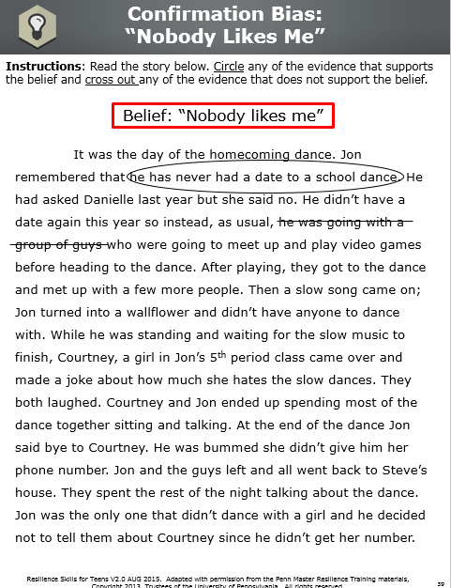
Workbook Activity (page 39):
“Nobody Likes Me”
Resilience Skills For Teens V2.0 AUG 2015. Adapted with permission from the Penn Master Resilience Training materials, Copyright 2013, Trustees of the University of Pennsylvania. All rights reserved.
Notes:
Instructor Notes:
Activity (Low-Tech)
Have students complete the Confirmation Bias exercise in the Participant Workbook. Instruct them to read the story. Students should circle any evidence that supports the belief, “Nobody likes me,” and cross out any evidence that does not support the belief.
Debrief the activity by having a participant read the story without saying any of the information that was crossed out. Show how the Confirmation Bias caused Jon to miss critical information and remember the events of the day completely differently.
Key Points:
The Confirmation Bias is not in our awareness. That is why it’s an important concept to learn.

Slide 113
Fight the
Confirmation Bias
  Write down your thought or belief
  Ask yourself questions to see both sides
  Ask others to help you see what you are missing
Resilience Skills For Teens V2.0 AUG 2015. Adapted with permission from the Penn Master Resilience Training materials, Copyright 2013, Trustees of the University of Pennsylvania. All rights reserved.
Notes:
Instructor Notes:
Review the strategies for fighting the Confirmation Bias or Velcro/Teflon Effect.
Underscore the difficulty of asking fair questions. The tendency is to ask leading questions such as: “How many times did you get a bad grade?” or “How often did you get a question wrong in class?”
Examples of fair questions are: “How did you do on the tests over the last year?” or “What percentage of questions do you answer correctly?”
Emphasize that asking others to help you evaluate the accuracy of a thought is helpful because they can help you gather evidence you are missing. Let students know that who they pick to help them is important. You don’t want to pick someone who shares your belief.

Slide 114
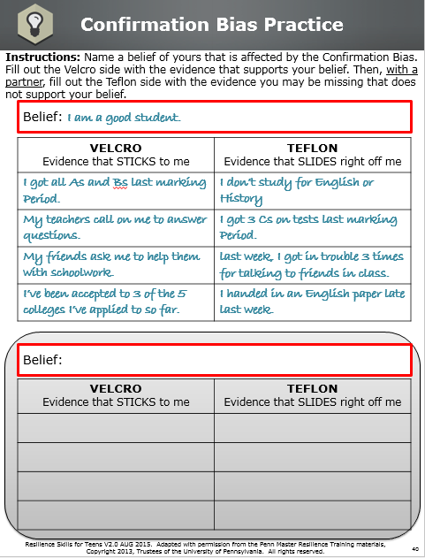
Workbook Activity (page 40):
Confirmation Bias Practice
Resilience Skills For Teens V2.0 AUG 2015. Adapted with permission from the Penn Master Resilience Training materials, Copyright 2013, Trustees of the University of Pennsylvania. All rights reserved.
Notes:
Instructor Notes:
[This activity is optional]
Activity (Low-Tech)
Use the example in the Participant Workbook (p.40) to instruct students on what they will be doing.
Students will choose a belief of their own that the Confirmation Bias is operating on.
Students will then list all of the evidence that supports their belief.
Students will partner up and ask fair questions to each other to find evidence that does not support their belief.
Debrief the practical exercise by asking students what they understand better about the Confirmation Bias after applying it to a personal belief. Ask students what they learned.
Key Points:
There are strategies you can use to fight the Confirmation Bias or Velcro/Teflon Effect.
These strategies help you to see the situation accurately.

Slide 115
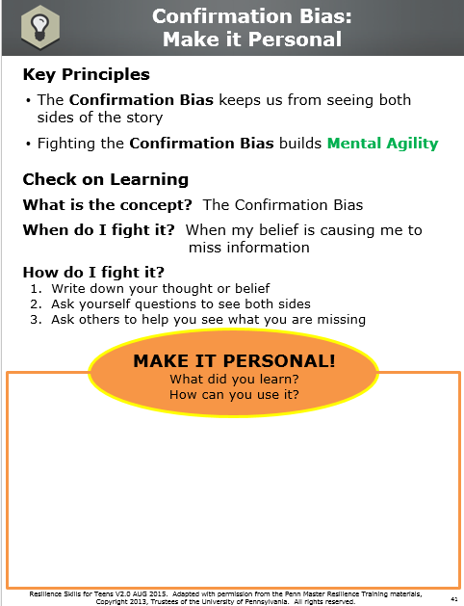
Workbook Activity (page 41):
Make it Personal
Resilience Skills For Teens V2.0 AUG 2015. Adapted with permission from the Penn Master Resilience Training materials, Copyright 2013, Trustees of the University of Pennsylvania. All rights reserved.
Notes:
Instructor Notes:
Review the Key Principles (if time permits).
Activity found in Refer to Participants Workbook (p.41)
Reflection (Low-Tech)
Students write down what they learned and how they can use it or apply it to their own lives.

Slide 116
9) PS Cover Page
Resilience Skills For Teens V2.0 AUG 2015. Adapted with permission from the Penn Master Resilience Training materials, Copyright 2013, Trustees of the University of Pennsylvania. All rights reserved.
Notes:
Rationale: People often waste time and energy on problems because they have not accurately identified the causes of problems. The Confirmation Bias or Velcro/Teflon Effect interferes with problem solving because it causes people to notice the evidence that fits their thoughts and to miss the evidence that contradicts their thoughts.
Objective: Accurately identify what caused the problem and identify solution strategies.
Note: This is an optional lesson. Only teach this lesson if your students have a firm understanding of the Confirmation Bias and you believe your group will understand the complexity of the worksheet.
Unit Overview and Recommended Timing:
Resilience Training for Teens,
Unit 9: Problem Solving

Slide 117
9) PS Key Terms
Resilience Skills For Teens V2.0 AUG 2015. Adapted with permission from the Penn Master Resilience Training materials, Copyright 2013, Trustees of the University of Pennsylvania. All rights reserved.
Notes:
Problem Solving A skill used to accurately identify what caused the problem and identify solution strategies
Problem Solving
Key Terms

Slide 118
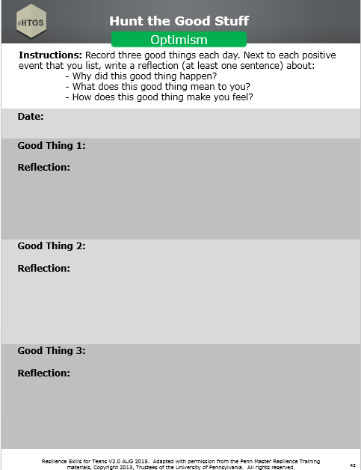
Workbook Activity (page 42):
Hunt the Good Stuff
Resilience Skills For Teens V2.0 AUG 2015. Adapted with permission from the Penn Master Resilience Training materials, Copyright 2013, Trustees of the University of Pennsylvania. All rights reserved.
Notes:
Instructor Notes:
Activity (Low-Tech)
Begin the lesson with Hunt the Good Stuff.
Have students write down one to three good things in the Participant Workbook.
Tell students to write the good thing and the reflection (i.e., why it’s a good thing).
Ask a couple students to share their “"Good Stuff"” at the group level. Remember to emphasize that the students explain why it is a good thing to them.
Key Points:
Optimism is important for resilience.
HTGS is a skill to use daily, or at least several times a week.

Slide 119
Problem Solving
Mental Agility
Resilience Skills For Teens V2.0 AUG 2015. Adapted with permission from the Penn Master Resilience Training materials, Copyright 2013, Trustees of the University of Pennsylvania. All rights reserved.
Notes:
Instructor Notes:
Tell students in one sentence what they will be learning.
Provide students with the resilience Core Competency the skill targets.
Key Points:
In order to solve a problem we need to understand it first and fight the Confirmation Bias.
Problem Solving builds Mental Agility.

Slide 120
Review:
What is the Confirmation Bias? (page 43):
The Confirmation Bias causes us to:
Notice
Remember
Weight
NOT Notice
NOT Remember
NOT Weight
Resilience Skills For Teens V2.0 AUG 2015. Adapted with permission from the Penn Master Resilience Training materials, Copyright 2013, Trustees of the University of Pennsylvania. All rights reserved.
AND
Evidence that supports our thoughts and beliefs
VELCRO EFFECT
It sticks
Evidence that does NOT support our thoughts and beliefs
TEFLON EFFECT
It slides off
Resilience Skills For Teens V2.0 AUG 2015. Adapted with permission from the Penn Master Resilience Training materials, Copyright 2013, Trustees of the University of Pennsylvania. All rights reserved.
Notes:
Instructor Notes:
Use the slide to review the key points of the Confirmation Bias.
Instruct students to write NOTICE, REMEMBER, WEIGHT on both the Velcro and Teflon sides in their Participant Workbook.
Instruct students to write STICKS and SLIDES OFF on both the Velcro and Teflon sides in their Participant Workbook.
Have students write in their Participant Workbook (p. 43) how they believe the Confirmation Bias affects their ability to solve a problem. Get a couple students to share their answer.
Key Points:
The Confirmation Bias causes us to notice evidence that fits our thoughts and beliefs and miss evidence that does not fit our thoughts and beliefs.
The Confirmation Bias makes it hard for us to see problems accurately and solve them. We may only be seeing our side of the story.

Slide 121
Problem Solving
PROBLEM SOLVING =
PROBLEM UNDERSTANDING
I’m not getting along with one of my friends
I’m getting grounded a lot
My parents won’t trust me to stay out with friends
I haven’t made the starting team
My grade is bad in math class
Resilience Skills For Teens V2.0 AUG 2015. Adapted with permission from the Penn Master Resilience Training materials, Copyright 2013, Trustees of the University of Pennsylvania. All rights reserved.
Notes:
Instructor Notes:
In order to solve a problem we need to understand it first.
Read the examples of problems, and prompt students to begin thinking of some of the problems they currently have.
Slide Builds

Slide 122
Step 1:
What’s the problem you’re trying to solve?
OBJECTIVE
Describe the problem:
  Who, what, when, where
My grade is bad in math class
Resilience Skills For Teens V2.0 AUG 2015. Adapted with permission from the Penn Master Resilience Training materials, Copyright 2013, Trustees of the University of Pennsylvania. All rights reserved.
Notes:
Instructor Notes:
Read the title of the step.
Ask students to write down the key word OBJECTIVE next to Step 1 in their Participant Workbook.
Explain why the key word is important to the Problem Solving Model:
One needs to be able to accurately and objectively describe the problem before they can start to solve it.
Read the example on the slide.
Key Points:
Emphasize that they already have practice describing problems objectively from the “A” of the ATC model.
Slide Builds

Slide 123
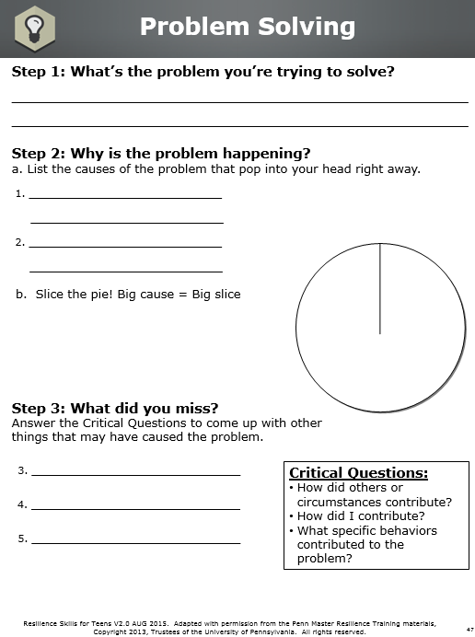
Workbook Activity (page 47):
Step 1
Resilience Skills For Teens V2.0 AUG 2015. Adapted with permission from the Penn Master Resilience Training materials, Copyright 2013, Trustees of the University of Pennsylvania. All rights reserved.
Notes:
Instructor Notes:
Have students write down a personal example of a problem they would like to use to work through the Problem Solving model.
Make sure that students use appropriate kinds of problems for the skill of Problem Solving. The following are criteria for good examples:
Good examples often involve other people.
Students have some control over the problem.
Students have time to think about the problem (i.e., it doesn’t require an immediate fix).
Good examples are complex enough to have multiple causes.
The scenario might be an example of a recurring problem.
The scenario is a problem the participant is dealing with him or herself (i.e., it’s not someone else’s problem).
Students might also think about a goal they are having trouble achieving. They can use that as a problem to solve (e.g., Why am I not improving my free throw percentage?).

Slide 124

Step 2:
What is the problem happening?
WHY
a. Causes of the problem that pop into your head right away
I’m stupid
I have a lousy teacher
1
b. Slice the pie
2
Resilience Skills For Teens V2.0 AUG 2015. Adapted with permission from the Penn Master Resilience Training materials, Copyright 2013, Trustees of the University of Pennsylvania. All rights reserved.
Notes:
Slide Builds
Instructor Notes:
Read the title of the step.
Ask students to write down the key word WHY next to Step 2 in their Participant Workbook.
Explain why the key word is important to the Problem Solving Model:
In order to solve the problem, one needs to identify the initial thoughts about why the problem occurred.
Describe the process of identifying Heat-of-the- Moment Thoughts.
Tell the students that when problems arise, most of us have immediate thoughts that pop into our heads about what caused the problem. These thoughts can be inaccurate and incomplete, and when they are, it’s difficult to solve a problem effectively.
Read the example on the slide.
Explain to students that the pie is sliced based on how much each factor is contributing to the problem. In this example “I have a lousy teacher” is a larger contributing factor.
Key Points:
When a problem happens we have immediate thoughts about what caused the problem and those thoughts are sometimes inaccurate or incomplete.
We need to be accurate in our understanding of the causes of problems in order to effectively solve problems.

Slide 125
Workbook Activity (page 47):
Step 2
Resilience Skills For Teens V2.0 AUG 2015. Adapted with permission from the Penn Master Resilience Training materials, Copyright 2013, Trustees of the University of Pennsylvania. All rights reserved.
Notes:
Instructor Notes:
Have students write down their 1-2 Heat-of-the-Moment Thoughts about what caused their problem and slice their pie based on how much they think each factor is contributing to the problem.
Activity in Participants Workbook. (p.47)

Slide 126
Step 3:
What did you miss?
FLEXIBILITY
Answer the Critical Questions to come up with other things that may be causing the problem
3. My teacher moves fast through the material
4. I don’t study as much as I should
5. I did not turn in 2 homework assignments
Resilience Skills For Teens V2.0 AUG 2015. Adapted with permission from the Penn Master Resilience Training materials, Copyright 2013, Trustees of the University of Pennsylvania. All rights reserved.
Notes:
Instructor Notes:
Read the title of the step.
Ask students to write down the key word FLEXIBILITY next to Step 3 in their Participant Workbook.
Explain why the key word is important to the Problem Solving Model:
In order to solve the problem, one needs to use the Critical Questions to identify the additional factors that might have caused the problem that were missed initially.
Remind students that the Critical Questions come from the skill of Avoid Thinking Traps.
Review the three Critical Questions that are particularly helpful in identifying the causes of problems.
Read the example on the slide.
Key Points:
The Critical Questions will help you notice information about what caused the problem that you didn’t notice initially.
Slide Builds

Slide 127
Workbook Activity (page 47):
Step 3
Resilience Skills For Teens V2.0 AUG 2015. Adapted with permission from the Penn Master Resilience Training materials, Copyright 2013, Trustees of the University of Pennsylvania. All rights reserved.
Notes:
Instructor Notes:
Have students use the Critical Questions to identify other potential contributing factors to the problem.
Depending on your group, students can either pair up or work independently.

Slide 128

Step 4:
What’s the evidence?
ACCURACY
Fight the Confirmation Bias
Find evidence for and against all of the causes
Evidence For: | Evidence Against:
1. My grade is low | 1. I have As in all my other classes
2. No evidence | 2. A lot of my friends are passing and he makes time after school to help students.
3. We went through 2 chapters in one week | 3. We spent extra time on chapter 6 because students were confused
4. I chose to go to the movies with a friend this weekend instead of studying | 4. I studied for an hour the night before the last test
5. I did not turn in 2 assignments. | 5. 20 assignments have been turned in on time.
Resilience Skills For Teens V2.0 AUG 2015. Adapted with permission from the Penn Master Resilience Training materials, Copyright 2013, Trustees of the University of Pennsylvania. All rights reserved.
Notes:
Instructor Notes:
Read the title of the step.
Ask students to write down the key word ACCURACY next to Step 4 in their Participant Workbook.
Explain why the key word is important to the Problem Solving Model:
In order to solve the problem, one needs to accurately identify the true causes of the problem.
Fight the Confirmation Bias by weighing the evidence for and against how much each possible cause (identified in Steps 2 and 3) contributed to the problem.
Review tips for fighting the Confirmation Bias.
Read the example on the slide.
Explain what factors will receive a check mark after fighting the Confirmation Bias.
Key Points:
Working with a partner on this step is helpful in fighting the Confirmation Bias, unless they share your thought or belief.
Slide Builds

Slide 129
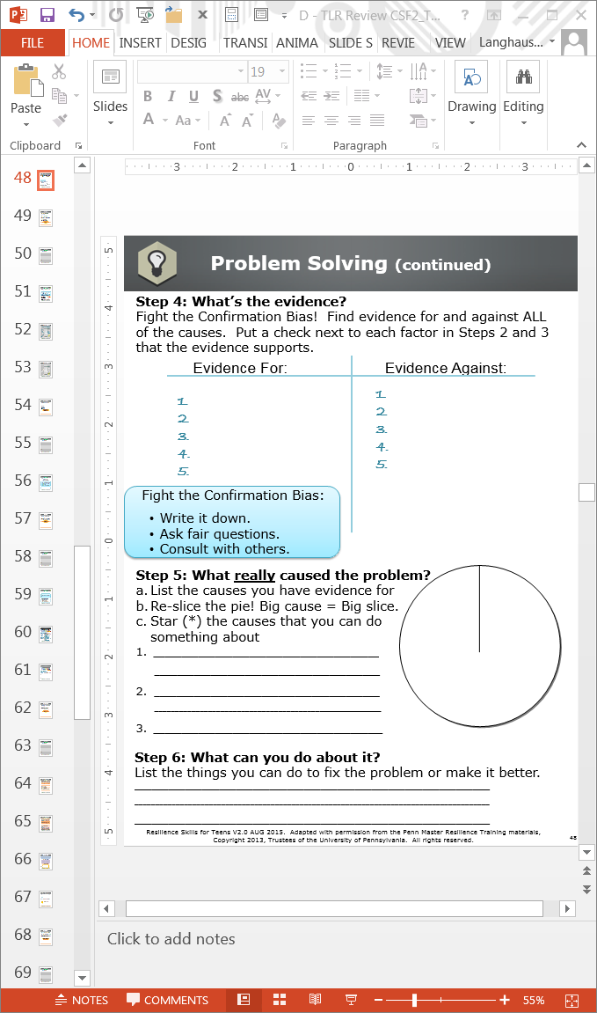
Workbook Activity (page 48):
Step 4
Resilience Skills For Teens V2.0 AUG 2015. Adapted with permission from the Penn Master Resilience Training materials, Copyright 2013, Trustees of the University of Pennsylvania. All rights reserved.
Notes:
Instructor Notes:
Have students fight the Confirmation Bias for each of their contributing factors from Steps 2-3.
Remind students that after they look at all the evidence, they will place a check mark next to the factors from Steps 2-3 that are ACTUALLY contributing factors to the problem.
Depending on your group, students can either pair up or work independently.

Slide 130

Step 5:
What really caused the problem?
CLARITY & CONTROL
a. List the causes you have evidence for
3. My teacher moves fast through the material
4. I don’t study as much as I should
5. I did not turn in 2 homework assignments
b. Re-slice the pie!
c. Star the causes
you can do
something about
3
5
4
*
*
Resilience Skills For Teens V2.0 AUG 2015. Adapted with permission from the Penn Master Resilience Training materials, Copyright 2013, Trustees of the University of Pennsylvania. All rights reserved.
Notes:
Slide Builds
Instructor Notes:
Read the title of the step.
Ask students to write down the key words CLARITY and CONTROL next to Step 5 in their Participant Workbook.
Explain why the key word is important to the Problem Solving Model:
In order to solve the problem, one needs to know what factors are actually causing the problem and identify which causes one can influence, leverage, or control.
Read the example on the slide.
Explain the purpose of re-slicing the pie. The new pie chart reflects the actual causes of the problem.
Let students know the purpose of starring the causes they can do something about. It is important to focus efforts on the factors they can influence.
Key Points:
An accurate understanding of the problem allows us to plan out solution strategies.
Knowing what you can and cannot control is an important resilience strategy. Resilient people focus on the things they can control and manage their thoughts about the things they cannot control.

Slide 131
Workbook Activity (page 48):
Step 5
Resilience Skills For Teens V2.0 AUG 2015. Adapted with permission from the Penn Master Resilience Training materials, Copyright 2013, Trustees of the University of Pennsylvania. All rights reserved.
Notes:
Instructor Notes:
Have students write down the factors that are ACTUALLY contributing to their problem (factors they placed a check mark next to). Refer to Participants Workbook (p.48)
Instruct students to re-slice the pie and place a star next to the factors they can influence/control.
Depending on your group, students can either pair up or work independently.

Slide 132
Step 6:
What can you do about it?
POSITIVE CHANGE
Come up with strategies for solving the problem
- I can devote more time to studying
- I can ask the teacher if I can turn in the assignment late and get partial credit or ask for potential extra credit opportunities
- If things are going fast I can ask questions for clarification or let the teacher know I am struggling to keep up
Resilience Skills For Teens V2.0 AUG 2015. Adapted with permission from the Penn Master Resilience Training materials, Copyright 2013, Trustees of the University of Pennsylvania. All rights reserved.
Notes:
Slide Builds
Instructor Notes:
Read the title of the step.
Ask students to write down the key words POSITIVE CHANGE next to Step 6 in their Participant Workbook.
Explain why the key word is important to the Problem Solving Model:
In order to solve the problem, one needs to identify the actions one will take to help solve the problem.
Explain to students that the strategies should be based off of the factors they can control.
Read the example on the slide.
Key Points:
Focusing on factors you can control or influence will help to generate realistic solutions.

Slide 133
Workbook Activity (page 48):
Step 6
Resilience Skills For Teens V2.0 AUG 2015. Adapted with permission from the Penn Master Resilience Training materials, Copyright 2013, Trustees of the University of Pennsylvania. All rights reserved.
Notes:
Instructor Notes:
Have students write down strategies for solving the problem, focusing on the factors they can control and/or influence.
Depending on your group, students can either pair up or work independently.
Refer to Participants Workbook (p. 48).

Slide 134
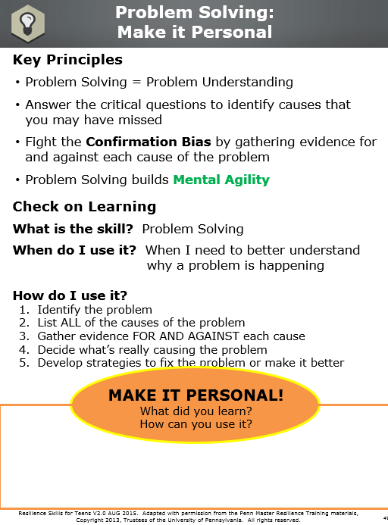
Workbook Activity (page 49):
Make it Personal
Resilience Skills For Teens V2.0 AUG 2015. Adapted with permission from the Penn Master Resilience Training materials, Copyright 2013, Trustees of the University of Pennsylvania. All rights reserved.
Notes:
Instructor Notes:
Review the Key Principles (if time permits). Refer to Participants Workbook (p.49)
Reflection (Low-Tech)
Students write down what they learned and how they can use it or apply it to their own lives.

Slide 135
10) PIIP Cover Page
Resilience Skills For Teens V2.0 AUG 2015. Adapted with permission from the Penn Master Resilience Training materials, Copyright 2013, Trustees of the University of Pennsylvania. All rights reserved.
Notes:
Rationale: Catastrophizing leads people to waste critical energy ruminating about the irrational worst case outcomes of a situation. Catastrophizing creates high levels of anxiety, decreases focus, increases helplessness, and it prevents people from taking purposeful action. The goal of Put It In Perspective is to lower anxiety so that one can accurately assess a situation and deal with it.
Objective: Stop catastrophic thinking, reduce anxiety, and improve problem solving by capturing the Worst Case thoughts, generating the Best Case thoughts, identifying the Most Likely outcomes of a situation, and developing a plan to deal with the Most Likely outcomes.
Unit Overview and Recommended Timing:
Resilience Training for Teens,
Unit 10: Put It In Perspective (PIIP)

Slide 136
10) PIIP Key Terms
Resilience Skills For Teens V2.0 AUG 2015. Adapted with permission from the Penn Master Resilience Training materials, Copyright 2013, Trustees of the University of Pennsylvania. All rights reserved.
Notes:
PIIP Put It In Perspective, or PIIP, is a skill used to stop catastrophic thinking, reduce anxiety, and improve problem solving by capturing worst case thoughts, generating best case thoughts, identifying the most likely outcomes of a situation, and developing a plan to deal with the most likely outcomes
Catastrophizing Wasting critical energy ruminating about the irrational worst case outcomes of a situation, which prevents you from taking purposeful action, leads to downward spirals, creates high anxiety, decreases focus, and increases helplessness
Put It In Perspective
Key Terms

Slide 137
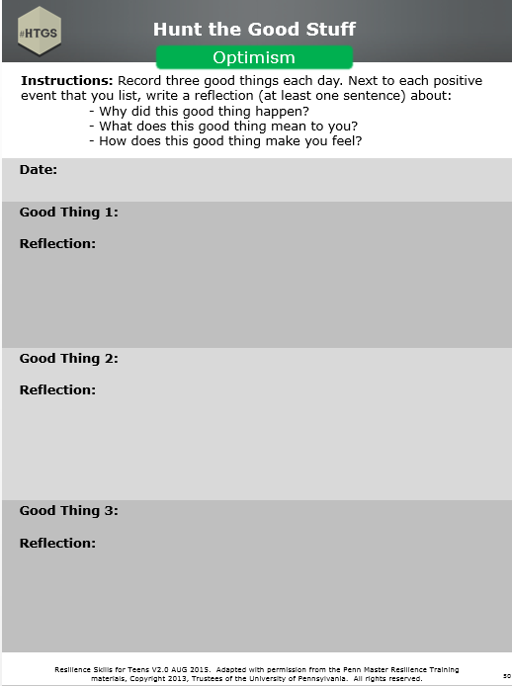
Workbook Activity (page 50):
Hunt the Good Stuff
Resilience Skills For Teens V2.0 AUG 2015. Adapted with permission from the Penn Master Resilience Training materials, Copyright 2013, Trustees of the University of Pennsylvania. All rights reserved.
Notes:
Instructor Notes:
Activity (Low-Tech)
Begin the lesson with Hunt the Good Stuff.
Have students write down one to three good things in the Participant Workbook.
Tell students to write the good thing and the reflection (i.e., why it’s a good thing).
Ask a couple students to share their “Good Stuff” at the group level. Remember to emphasize that the students explain why it is a good thing to them. Refer to Participants Workbook (p.50).
Key Points:
Optimism is important for resilience.
HTGS is a skill to use daily, or at least several times a week

Slide 138


Put It In Perspective
Optimism
Resilience Skills For Teens V2.0 AUG 2015. Adapted with permission from the Penn Master Resilience Training materials, Copyright 2013, Trustees of the University of Pennsylvania. All rights reserved.
Notes:
Instructor Notes:
Tell students in one sentence what they will be learning.
Provide students with the resilience Core Competency the skill targets.
Key Points:
This skill is for when we can’t stop thinking worst case thoughts.
Put It In Perspective builds Optimism.

Slide 139
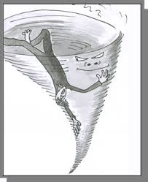

3 Styles of Catastrophizing
Catastrophizing can be:
Downward Spiral
DEMOS
Scattershot
Circling
PREVENTS PURPOSEFUL ACTION
Resilience Skills For Teens V2.0 AUG 2015. Adapted with permission from the Penn Master Resilience Training materials, Copyright 2013, Trustees of the University of Pennsylvania. All rights reserved.
Notes:
Instructor Notes:
Skill
Review the points on the slide.
Describe the three styles of Catastrophizing and how the images relate to each style.
Downward spiral: An Activating Event occurs and your brain starts to tell a story that gets increasingly negative and unlikely, causing you to get more and more anxious as the story goes on. Your brain is like a “runaway train.”
Scattershot: An Activating Event occurs and you start thinking about many disconnected, worst case thoughts.
Circling: An Activating Event occurs and your thoughts about one bad outcome keep repeating. The thoughts do not necessarily get more negative, but they continue to occur repetitively.
Define purposeful action as the process of taking steps to address the Activating Event.
Demonstrate the three styles of Catastrophizing following the demonstration instructions on the following page. Use teen examples so the students can better relate.
Following the demonstration ask for a show of hands: How many of you have catastrophized before? How many of you know someone who catastrophizes?
Slide Builds

Slide 140
3 Styles of Catastrophizing (continued)
Catastrophizing can be:
Downward Spiral
DEMOS
Scattershot
Circling
PREVENTS PURPOSEFUL ACTION
Resilience Skills For Teens V2.0 AUG 2015. Adapted with permission from the Penn Master Resilience Training materials, Copyright 2013, Trustees of the University of Pennsylvania. All rights reserved.
Notes:
Instructor Notes:
Hook (Low-Tech)
Demonstrate all three styles of catastrophizing.
Starting with downward spiral, describe the Activating Event aloud, and then demonstrate the catastrophic thoughts. After each demonstration, describe what happens physiologically, and how you’re unable to take purposeful action. Each demonstration should follow the below guidelines:
Downward spiral: The demonstration should last 30-40 seconds and contain at least 6 thoughts. The body movements should mimic the experience of Catastrophizing (e.g., pacing, wringing hands).
Scattershot: The demonstration should last about 30 seconds.
Circling: The demonstration should last about 15 seconds.
Sample Teen Examples:
Downward Spiral
AE: Failed history mid-term
“Oh crap, I’m going to fail this class.”
“I’m never going to graduate.”
“How will I ever get a job?”
“My parents are going to kick me out.”
“I’m going to be a bum on the street.”
“I’ll turn to a life of crime.”
“No one will love me.”
“I’ll die alone.”
Scattershot
AE: Found out my family is PCSing
“OMG, not again, I’m going to be alone forever.”
“But what about my friends here at [Fort Knox]?”
“Everyone is going to think I’m such a loser.”
“Why me? It’s like my parents hate me.”
“I’m going to have to get a new job.”
“I’ll never make new friends.”
“New schools are so hard in the middle of the year!”
“I’m probably going to fail out of high school, maybe I
should drop out.”
“What am I going to do?”
Circling
AE: Lost my parents’ car keys or Dented the car
“Oh no! My parents are going to kill me”
“My parents are going to be so mad.”
“They will never let me drive again.”
(Continue to circle around these 3 thoughts)
Key Points:
Catastrophizing is when a person is lost in his or her head, and the thoughts are not reality-based.
Catastrophic thoughts cause anxiety and prevent purposeful action.
When we see others catastrophize we often laugh or feel disgust but for the person catastrophizing it is serious and anxiety filled.

Slide 141
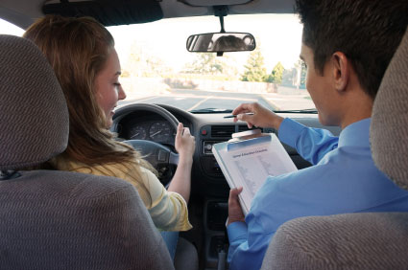
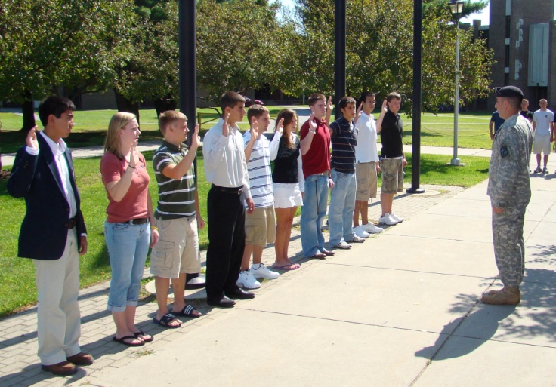






Situations That May Cause
Catastrophizing
Resilience Skills For Teens V2.0 AUG 2015. Adapted with permission from the Penn Master Resilience Training materials, Copyright 2013, Trustees of the University of Pennsylvania. All rights reserved.
Notes:
Instructor Notes:
Hook (Low-Tech)
Review what triggers catastrophic thinking. Use the images on the slide for examples.
When something is unclear (e.g., parent says “call me” in a text message).
Something you value is at stake (e.g., failed a test).
You’re run down or tired (e.g., didn’t get much sleep after studying all night).
You already fear the situation (e.g., parent deploying).
Your first time doing something (e.g., first day at a new school).
Ask if students have any triggers they want to add.

Slide 142
PIIP Steps: Order Matters
The goal of PIIP is to lower anxiety
1
Step 1: Describe the Activating Event
2
4
3
Step 2: Capture the Worst Case thoughts
Step 4: Identify Most Likely outcomes
Step 3: Generate Best Case thoughts
5
Step 5:
Develop a Plan for dealing with the most likely outcomes
Notes
page 50
Resilience Skills For Teens V2.0 AUG 2015. Adapted with permission from the Penn Master Resilience Training materials, Copyright 2013, Trustees of the University of Pennsylvania. All rights reserved.
Notes:
Trainer Instructors:
Tell students we will be going over the steps of Put It Into Perspective. Emphasize that order is very important.
Point out the goal of PIIP and instruct students to underline LOWER ANXIETY in their Participant Workbook.
The skill always starts with describing the AE.
Then, you must Capture the Worst Case thoughts, Generate the Best Case thoughts, and Identify the Most Likely outcomes. Capturing the Worst Case then generating the Best Case (in that order) “jolts” people out of their anxiety so they are better able to identify the accurate Most Likely outcomes of a situation.
Point out that Best Case thoughts are highly unlikely to actually happen.
Point out that the Most Likely outcomes may not all be positive, but identifying them allows one to Develop a plan.
The final step is to Develop a plan for dealing with the Most Likely outcomes.
Key Points:
When using the skill of PIIP, always follow the order of the five steps:
Describe the AE
Capture Worst Case thoughts
Generate Best Case thoughts
Identify Most Likely outcomes
Develop a plan
Slide Builds

Slide 143
Demonstration
DEMO
A parent’s upcoming deployment
Resilience Skills For Teens V2.0 AUG 2015. Adapted with permission from the Penn Master Resilience Training materials, Copyright 2013, Trustees of the University of Pennsylvania. All rights reserved.
Notes:
Flip
Chart
Instructor Notes:
[This demonstration is optional, do if time permits. If time does not permit, follow the example in the Participant Workbook, shown on next slide.]
Demonstration (Low-Tech)
Prepare a flip chart that looks exactly like the blank PIIP Practical Exercise ahead of time.
This demonstration should take approximately 12 minutes.
Facilitate Step 1: Describe the Activating Event: “I got home from school and my parent told me that he/she just found out that he/she is deploying.”
Facilitate Step 2: Capture the Worst Case thoughts (flip chart on the left side):
The demonstration tends to work best with a downward spiral example, but if the style changes to scattershot during the demonstration, name what has happened and proceed with the demonstration. Circling does not make for a good demonstration.
Emphasize the logic of using the verb “Capture.”
Point out that catastrophic thoughts feel real in the moment. Proof that they feel real is that our bodies react strongly (e.g., anxiety, hands sweating, heart racing, confused thinking, agitation, etc.).
Use the question “And then what happens?” until the group stops generating ideas. Record the Worst Case thoughts on the left side of the flip chart.
Ask students about their mood, focus, and energy after reviewing Step 2.

Slide 144
Demonstration … (continued)
DEMO
A parent’s upcoming deployment
Resilience Skills For Teens V2.0 AUG 2015. Adapted with permission from the Penn Master Resilience Training materials, Copyright 2013, Trustees of the University of Pennsylvania. All rights reserved.
Notes:
Instructor Notes:
7) Facilitate Step 3: Generate Best Case thoughts (flip chart on the right side):
Best Case does not have to be equally as outrageous as the Worst Case, but does need to be very unlikely so that it changes the emotion from negative to positive.
If students have difficulty coming up with unlikely Best Case thoughts, remind them that the Negativity Bias may be preventing them from thinking about potentially positive events.
8) Ask students about their mood, focus, and energy after reviewing Step 3. Highlight that positive emotions help a person to calm down so they can think more clearly.
9) Facilitate Step 4: Identify Most Likely outcomes (flip chart in the middle):
Encourage students to include other people, long-term and short-term outcomes, and emotions and behaviors, not just events (e.g., “I’ll feel down, want to avoid friends”).
Point out that the Most Likely outcomes can include both positive and negative potential outcomes.
10) Ask students about their mood, focus, and energy after reviewing Step 4.
11) Facilitate Step 5: Develop a Plan:
Ask students to name three to five action steps they can take to deal with the Most Likely outcomes.
Make sure to have brief plans for dealing with any feelings identified in the Most Likely outcomes (e.g., Deliberate Breathing, exercise, talk to my parents).

Slide 145

Workbook Activity (page 52):
Put it in Perspective Example
Resilience Skills For Teens V2.0 AUG 2015. Adapted with permission from the Penn Master Resilience Training materials, Copyright 2013, Trustees of the University of Pennsylvania. All rights reserved.
Notes:
Flip
Chart
Instructor Notes:
[This activity is optional, complete if the demonstration was not completed]
Activity (Low-Tech)
Walk through the completed PIIP example in the Participant Workbook (p.52) with interaction from the students.
Facilitate Step 1: Describe the Activating Event: “It’s the middle of the school year and my parents told me that we are moving in two months.”
Facilitate Step 2: Capture the Worst Case thoughts
Ask the students what style of catastrophizing is displayed in this example (Downward Spiral).
Emphasize the logic of using the verb “Capture.”
Point out that catastrophic thoughts feel real in the moment. Proof that they feel real is that our bodies react strongly (e.g., anxiety, hands sweating, heart racing, confused thinking, agitation, etc.).
Ask students about their mood, focus, and energy after reviewing Step 2.

Slide 146
Put it in Perspective Example (continued)
Resilience Skills For Teens V2.0 AUG 2015. Adapted with permission from the Penn Master Resilience Training materials, Copyright 2013, Trustees of the University of Pennsylvania. All rights reserved.
Notes:
Instructor Notes:
7) Facilitate Step 3: Generate Best Case thoughts:
Best Case does not have to be equally as outrageous as the Worst Case, but does need to be very unlikely so that it changes the emotion from negative to positive.
Ask students what makes generating Best Case thoughts so difficult (Negativity Bias).
8) Ask students about their mood, focus, and energy after reviewing Step 3. Highlight that positive emotions help a person to calm down so they can think more clearly.
9) Facilitate Step 4: Identify Most Likely outcomes:
Point out in this step it is important to include other people, long-term and short-term outcomes, and emotions and behaviors, not just events (e.g., “I’ll feel down, want to avoid friends”).
Point out that the Most Likely outcomes can include both positive and negative potential outcomes.
10) Ask students about their mood, focus, and energy after reviewing Step 4.
11) Facilitate Step 5: Develop a Plan:
Ask students if they can come up with any additional plans.
Make sure to have brief plans for dealing with any feelings identified in the Most Likely outcomes (e.g., Deliberate Breathing, exercise, talk to my parents).

Slide 147

Workbook Activity (page 53):
Put it in Perspective Practice
Resilience Skills For Teens V2.0 AUG 2015. Adapted with permission from the Penn Master Resilience Training materials, Copyright 2013, Trustees of the University of Pennsylvania. All rights reserved.
Notes:
Instructor Notes:
Activity (Low-Tech)
Refer students to the Participant Workbook.(p.53)
This setup should take approximately 5 minutes.
Students work with a partner.
Partners decide whose situation they will work through first.
The first partner describes his or her Activating Event on the Practical Exercise.
Then, the partners work to Capture the first partner’s Worst Case thoughts. The second partner should ask questions to help Capture the Worst Case thoughts (i.e., “and then what happens” or “what else”).
Next, the second partner helps the first partner Generate the Best Case thoughts until he or she is jolted out of Catastrophizing by generating some positive emotion.
Then, the second partner helps the first partner Identify the Most Likely outcomes, making sure to include other people, long-term and short-term outcomes, and emotions and behaviors.
Finally, the second partner helps the first partner Develop a plan for dealing with the Most Likely outcomes, including plans for dealing with any feelings identified in the Most Likely outcomes.
Once the first partner has completed his or her Practical Exercise, the partners switch roles and the first partner coaches the second partner through his or her situation following the same instructions.

Slide 148

Workbook Activity (page 54):
Make it Personal
Resilience Skills For Teens V2.0 AUG 2015. Adapted with permission from the Penn Master Resilience Training materials, Copyright 2013, Trustees of the University of Pennsylvania. All rights reserved.
Notes:
Instructor Notes:
Review the Key Principles (if time permits). Participants workbook (p.54)
Reflection (Low-Tech)
Students write down what they learned and how they can use it or apply it to their own lives.

Slide 149
11) MG Cover Page
Resilience Skills For Teens V2.0 AUG 2015. Adapted with permission from the Penn Master Resilience Training materials, Copyright 2013, Trustees of the University of Pennsylvania. All rights reserved.
Notes:
Rationale: Mental Games are used to regulate emotion and energy levels and enable critical thinking and optimal performance. They help to refocus one’s thinking on the task at hand.
Objective: Change the focus away from, or compartmentalize, counterproductive thinking to enable greater concentration and focus on the task at hand.
Note: This is a short unit. If time permits, this unit should be taught in conjunction with Unit 12: Real-Time Resilience.
Unit Overview and Recommended Timing:
Resilience Training for Teens,
Unit 11: Mental Games

Slide 150
11) MG Key Terms
Resilience Skills For Teens V2.0 AUG 2015. Adapted with permission from the Penn Master Resilience Training materials, Copyright 2013, Trustees of the University of Pennsylvania. All rights reserved.
Notes:
Mental Games A skill used to change the focus away from counterproductive thinking to enable greater concentration and focus on the task at hand
Mental Games
Key Terms

Slide 151

Workbook Activity (age. 55):
Hunt the Good Stuff
Resilience Skills For Teens V2.0 AUG 2015. Adapted with permission from the Penn Master Resilience Training materials, Copyright 2013, Trustees of the University of Pennsylvania. All rights reserved.
Notes:
Instructor Notes:
Activity (Low-Tech)
Begin the lesson with Hunt the Good Stuff.
Have students write down one to three good things in the Participant Workbook.
Tell students to write the good thing and the reflection (i.e., why it’s a good thing).
Ask a couple students to share their “"Good Stuff"” at the group level. Remember to emphasize that the students explain why it is a good thing to them.
Key Points:
Optimism is important for resilience.
HTGS is a skill to use daily, or at least several times a week
Note:
If Mental Games is taught in conjunction with Real-Time Resilience, Hunt the Good Stuff only needs to be conducted once at the start of the block of instruction.

Slide 152


Mental Games
Self-regulation
Resilience Skills For Teens V2.0 AUG 2015. Adapted with permission from the Penn Master Resilience Training materials, Copyright 2013, Trustees of the University of Pennsylvania. All rights reserved.
Notes:
Instructor Notes:
Tell students in one sentence what they will be learning.
Provide students with the resilience Core Competency the skill targets.
Key Points:
This skill is a fun way to get re-focused.
Mental Games builds Self-regulation.

Slide 153



Mental Games
Mental games are used as a quick distraction from counterproductive (unhelpful) thoughts that are interfering with a task at hand (something you’re about to do)
Mental Games must:
  Engage your full attention
  Be challenging and fun
  Be done within a few minutes
1,000
-7
???
Notes
page 55
Resilience Skills For Teens V2.0 AUG 2015. Adapted with permission from the Penn Master Resilience Training materials, Copyright 2013, Trustees of the University of Pennsylvania. All rights reserved.
Notes:
Instructor Notes:
Explain that Mental Games are used when you cannot stay focused and your thoughts are distracting you from a task at hand (i.e., something you need to do).
Define counterproductive thoughts as unhelpful. Instruct students to write UNHELPFUL in their Participant Workbooks.
Point out that this skill is used when there is a task at hand. Instruct students to write down SOMETHING YOU’RE ABOUT TO DO in their Participant Workbooks.
Review the three criteria of Mental Games:
Engage your full attention so you do not have distracting thoughts going on at the same time
Be challenging and fun so that it takes your full attention and does not create more distracting thoughts
Be done in a few minutes because there is a task at hand (i.e., something you need to do)
Instruct students to underline FULL ATTENTION, CHALLENGING, FUN and FEW MINUTES in their Participant Workbook.
Key Points:
We will teach you some Mental Games and, with the criteria described, you can generate your own.

Slide 154

Workbook Activity (page 56):
Create Your Own Mental Game
Resilience Skills For Teens V2.0 AUG 2015. Adapted with permission from the Penn Master Resilience Training materials, Copyright 2013, Trustees of the University of Pennsylvania. All rights reserved.
Notes:
Instructor Notes:
Hook (Low-Tech)
Describe each of the Mental Games in the Participant Workbook. (p.56)
Pick a few Mental Games to demonstrate with the students’ involvement:
Math games
Alphabet games
Categories games
Alphabet backwards
Lyrics- use caution with the musical lyrics example to ensure they are not disruptive or offensive
Positive Imagery
Activity (Low-Tech)
Ask students to pair up and think of other Mental Games they could use when they need to re-focus. Have students record games in their Participant Workbook.
Debrief the skill by asking students which Mental Games they think they will use and identify when Mental Games will be useful for them.
Key Points:
It is important to choose a game that’s right for you. For example, if math games make you frustrated, it will likely decrease your focus.

Slide 155

Workbook Activity (page 57):
Make it Personal
Resilience Skills For Teens V2.0 AUG 2015. Adapted with permission from the Penn Master Resilience Training materials, Copyright 2013, Trustees of the University of Pennsylvania. All rights reserved.
Notes:
Instructor Notes:
Review the Key Principles (if time permits). Refer to Participants Workbook (p.57)
Reflection (Low-Tech)
Students write down what they learned and how they can use it or apply it to their own lives.

Slide 156
12) RTR Cover Page
Resilience Skills For Teens V2.0 AUG 2015. Adapted with permission from the Penn Master Resilience Training materials, Copyright 2013, Trustees of the University of Pennsylvania. All rights reserved.
Notes:
Rationale: Counterproductive thoughts sometimes interfere with the ability to effectively engage with the task at hand. Real-Time Resilience is used to lower anxiety and to enhance a person’s attention and positive attitude.
Objective: Shut down counterproductive thinking to enable greater concentration and focus on the task at hand.
Unit Overview and Recommended Timing:
Resilience Training for Teens,
Unit 12: Real-Time Resilience (RTR)

Slide 157
12) RTR Key Terms
Resilience Skills For Teens V2.0 AUG 2015. Adapted with permission from the Penn Master Resilience Training materials, Copyright 2013, Trustees of the University of Pennsylvania. All rights reserved.
Notes:
Real-Time Resilience A skill used to shut down counterproductive thinking, enabling greater concentration and focus on the task at hand
Real-Time Resilience
Key Terms

Slide 158

Workbook Activity (page 58):
Hunt the Good Stuff
Resilience Skills For Teens V2.0 AUG 2015. Adapted with permission from the Penn Master Resilience Training materials, Copyright 2013, Trustees of the University of Pennsylvania. All rights reserved.
Notes:
Instructor Notes:
Activity (Low-Tech)
Begin the lesson with Hunt the Good Stuff.
Have students write down one to three good things in the Participant Workbook.
Tell students to write the good thing and the reflection (i.e., why it’s a good thing).
Ask a couple students to share their “"Good Stuff"” at the group level. Remember to emphasize that the students explain why it is a good thing to them.
Key Points:
Optimism is important for resilience.
HTGS is a skill to use daily, or at least several times a week

Slide 159


Real-Time Resilience
Optimism
Resilience Skills For Teens V2.0 AUG 2015. Adapted with permission from the Penn Master Resilience Training materials, Copyright 2013, Trustees of the University of Pennsylvania. All rights reserved.
Notes:
Instructor Notes:
Tell students in one sentence what they will be learning.
Provide students with the resilience Core Competency the skill targets.
Key Points:
This skill is a way to get rid of unhelpful thoughts as they happen.
Real-Time Resilience builds Optimism.

Slide 160


Real-time Resilience
Internal skill
Use it to fight counterproductive thoughts
Use for tasks at hand
Unhelpful
Something you’re about to do
Resilience Skills For Teens V2.0 AUG 2015. Adapted with permission from the Penn Master Resilience Training materials, Copyright 2013, Trustees of the University of Pennsylvania. All rights reserved.
Notes:
Instructor Notes:
Skill
Make it clear that RTR is an internal skill used to challenge your own counterproductive thinking; it happens in your head.
Define counterproductive thoughts as unhelpful (slide builds). Instruct students to write UNHELPFUL in their Participant Workbooks.
Point out that this skill is used when there is a task at hand (slide builds). Instruct students to write down SOMETHING YOU’RE ABOUT TO DO in their Participant Workbook.
This skill is used to get “back in the game” to help you stay focused and perform.
Key Points:
Real-Time Resilience helps you to stop unhelpful thinking so you can get back to what you need to do and be on top of your game mentally.
Real-Time Resilience is an internal skill.
Slide Builds

Slide 161






When would you use
Real-Time Resilience?
Resilience Skills For Teens V2.0 AUG 2015. Adapted with permission from the Penn Master Resilience Training materials, Copyright 2013, Trustees of the University of Pennsylvania. All rights reserved.
Notes:
Instructor Notes:
Encourage students to use this skill when their thoughts are preventing them from performing at their best.
Use RTR when there is something you’re about to do.
Using the pictures on the slide, provide a couple examples of when students would use RTR:
About to take a test
About to give a presentation
On the starting blocks before a race
Before driving/driver’s test
About to start a gaming competition
Lead a group discussion about other times students could use RTR.

Slide 162



Sentence Starters
Use evidence:
  That’s not (completely) true because….
Generate Optimism:
  A more optimistic way of seeing this is...
Put It In Perspective:
  The most likely thing (to happen) is …
  and I can …
Resilience Skills For Teens V2.0 AUG 2015. Adapted with permission from the Penn Master Resilience Training materials, Copyright 2013, Trustees of the University of Pennsylvania. All rights reserved.
Notes:
Instructor Notes:
Fight back against counterproductive/unhelpful thoughts using evidence, thinking optimistically, and putting the situation in perspective.
Review the three sentence starters with the students.
Fighting back against unhelpful thoughts is difficult; sentence starters will help us to fight back stronger.
Key Points:
The three Sentence Starters help structure your thinking so that you craft effective Real-Time Resilience responses.
Slide Builds

Slide 163
Demonstration
DEMO
Real-Time Resilience
Resilience Skills For Teens V2.0 AUG 2015. Adapted with permission from the Penn Master Resilience Training materials, Copyright 2013, Trustees of the University of Pennsylvania. All rights reserved.
Notes:
Instructor Notes:
Hook (Low-Tech)
For this demonstration, instructors can create an example or use the example on the following page.
Instructors have five volunteers come up to the front of the room.
Each volunteer is given a numbered note card with a counterproductive thought. Tell students that the volunteers will act like the counterproductive part of your brain by saying unhelpful thoughts you might think in the heat of the moment.
The student with the note card marked number 1 will read their thought first. The instructor responds modeling the use of the sentence starters. After the response, the instructor stops to ask the students to identify whether the instructor used evidence, Optimism or perspective.
Repeat the process with each counterproductive thought.
Debrief the demonstration asking students what they noticed about the responses.
Key Points:
RTR uses Evidence, Optimism, and Put It In Perspective to combat unhelpful thinking.
With practice, responses become accurate and fast.

Slide 164
Demonstration … (continued)
DEMO
Real-Time Resilience
Resilience Skills For Teens V2.0 AUG 2015. Adapted with permission from the Penn Master Resilience Training materials, Copyright 2013, Trustees of the University of Pennsylvania. All rights reserved.
Notes:
Instructor Notes:
Example:
Task at hand: About to take a math test

Slide 165

Pitfalls
  Dismissing the grain of truth
  “Nuh-uh”
  Minimizing the situation
  “Who cares”
  Rationalizing or excusing one’s contribution to a problem
  “Blame game”
  Weak responses
  “Meh”
Resilience Skills For Teens V2.0 AUG 2015. Adapted with permission from the Penn Master Resilience Training materials, Copyright 2013, Trustees of the University of Pennsylvania. All rights reserved.
Notes:
Instructor Notes:
Teach the Pitfall responses. For example, the task at hand is you’re about to give a presentation in front of your class.
Dismissing the grain of truth: students write “NUH-UH” in their Participant Workbooks.
Counterproductive Thought: I’m not prepared to do this.
Pitfall: I am totally prepared.
Minimizing the situation: students write “WHO CARES” in their Participant Workbooks.
Counterproductive Thought: The teacher and students won’t understand.
Pitfall: Who cares if they don’t understand!
Rationalizing or excusing one’s contribution to a problem: students write “BLAME GAME” in their Participant Workbooks.
Counterproductive Thought: The teacher will ask me questions I can’t answer.
Pitfall: That’s because she is a bad teacher and gave me bad materials.
Weak responses: students write “MEH” in their Participant Workbooks.
Counterproductive Thought: I’m going to blow this presentation.
Pitfall: No, my pre fine.
Slide Builds

Slide 166
Pitfalls (continued)
Resilience Skills For Teens V2.0 AUG 2015. Adapted with permission from the Penn Master Resilience Training materials, Copyright 2013, Trustees of the University of Pennsylvania. All rights reserved.
Notes:
Instructor Notes:
Emphasize that Pitfalls are problematic because they keep us from fighting counterproductive thoughts.
call a do-over and craft a stronger response. Weak responses are responses that lack data and “oomph”.
Tell students to use the “gut check” (we feel the power of the response in our bodies) to determine whether or not they’re falling into a Pitfall. What may sound like a Pitfall to others may pass that individual’s “gut check.”
Key Points:
Pitfalls are common, if they happen,

Slide 167
Name That Pitfall
“It doesn’t really matter anyway.”
Minimizing the situation
“I am completely ready for this.”
Dismissing the grain of truth
“I would have gotten a good grade if the teacher liked me.”
  Rationalizing one’s contribution to a
  problem
Resilience Skills For Teens V2.0 AUG 2015. Adapted with permission from the Penn Master Resilience Training materials, Copyright 2013, Trustees of the University of Pennsylvania. All rights reserved.
Notes:
Instructor Notes:
Activity (Low-Tech)
At the large group level, students choose what Pitfall the response falls into (slide builds).
Slide Builds

Slide 168


Workbook Activity (pages 61-62):
Real-Time Resilience Practice
Resilience Skills For Teens V2.0 AUG 2015. Adapted with permission from the Penn Master Resilience Training materials, Copyright 2013, Trustees of the University of Pennsylvania. All rights reserved.
Notes:
Instructor Notes:
Activity (Low-Tech)
Have students turn to their Participant Workbooks. (p.61-62)
Use the completed example in the Participant Workbook to help explain the activity.
Students will partner up for this activity and complete one partner’s exercise in full before switching.
Set up the activity in the Participant Workbook using the instructions on the following page.
Following the activity, debrief with students their experience with the sentence starters, RTR responses, and Pitfalls.
Note:
Students should be responding with the sentence starters throughout the activity.

Slide 169
Workbook Activity:
Real-Time Resilience Practice (continued)
Resilience Skills For Teens V2.0 AUG 2015. Adapted with permission from the Penn Master Resilience Training materials, Copyright 2013, Trustees of the University of Pennsylvania. All rights reserved.
Notes:
Instructor Notes:
Remind students what a task at hand is and have each student choose a task at hand to use for the activity. Have all students write down their task at hand. Refer to the completed example.
Instruct students to write down five counterproductive thoughts in the left column under list five thoughts. Refer to completed example (give students 2-3 minutes to write down their thoughts).
After each student records five counterproductive thoughts, they switch books with a partner.
Partners decide whose activity they will work through first.
If Partner 1 goes first, Partner 2 reads the first counterproductive thought to Partner 1. Partner 1 responds using a sentence starter.
Partner 2 writes down the response given by Partner 1 under the column labeled Practice Real-Time Resilience. Refer to the completed example.
After recording the response, the partners code the response together and check off either E, O, or P. Refer to the completed example.
If the response is a Pitfall, students circle the response; then the partners work together to write down a stronger RTR response.
Repeat this process for all five counterproductive thoughts. Complete all five thoughts for Partner 1 before switching to Partner 2. Follow the same steps for Partner 2.
Instruct the students to take back their own books once both partners have completed the activity.
Note:
These are difficult instructions to follow. Before the students get started, remind them that if they get lost they can follow the flowchart at the top of the page.

Slide 170

Workbook Activity (page 63):
Make it Personal
Resilience Skills For Teens V2.0 AUG 2015. Adapted with permission from the Penn Master Resilience Training materials, Copyright 2013, Trustees of the University of Pennsylvania. All rights reserved.
Notes:
Instructor Notes:
Review the Key Principles (if time permits). Refer to Participants Workbook (p.63)
Reflection (Low-Tech)
Students write down what they learned and how they can use it or apply it to their own lives.

Slide 171
13) CS Cover Page
Resilience Skills For Teens V2.0 AUG 2015. Adapted with permission from the Penn Master Resilience Training materials, Copyright 2013, Trustees of the University of Pennsylvania. All rights reserved.
Notes:
Rationale: Drs. Chris Peterson and Martin Seligman identified the Character Strengths that are valued in nearly every culture. They identified a total of twenty-four Character Strengths that appear to be universal. Knowing one’s Character Strengths facilitates optimal performance and builds engagement.
Objective: Identify Character Strengths in yourself to recognize who you are at your best.
Note: It is helpful if students complete the VIA survey for this lesson, this can be done in or out of class depending on your schedule. The survey takes approximately 25-30 minutes to complete (look for specific details in Instructor Notes). There is an alternative if time does not permit the taking of the VIA (detailed in Instructor Notes).
Unit Overview and Recommended Timing:
Resilience Training for Teens,
Unit 13: Character Strengths: Knowing Yourself

Slide 172
13) CS Key Terms
Resilience Skills For Teens V2.0 AUG 2015. Adapted with permission from the Penn Master Resilience Training materials, Copyright 2013, Trustees of the University of Pennsylvania. All rights reserved.
Notes:
Signature Character The top, or most prominent, of your Character Strengths
Strengths
Character Strengths
Key Terms

Slide 173

Workbook Activity (page 63):
Hunt the Good Stuff
Resilience Skills For Teens V2.0 AUG 2015. Adapted with permission from the Penn Master Resilience Training materials, Copyright 2013, Trustees of the University of Pennsylvania. All rights reserved.
Notes:
Instructor Notes:
Activity (Low-Tech)
Begin the lesson with Hunt the Good Stuff.
Have students write down one to three good things in the Participant Workbook.
Tell students to write the good thing and the reflection (i.e., why it’s a good thing).
Ask a couple students to share their “"Good Stuff"” at the group level. Remember to emphasize that the students explain why it is a good thing to them.
Key Points:
Optimism is important for resilience.
HTGS is a skill to use daily, or at least several times a week

Slide 174


Character Strengths:
Knowing Yourself
Strengths of Character
Resilience Skills For Teens V2.0 AUG 2015. Adapted with permission from the Penn Master Resilience Training materials, Copyright 2013, Trustees of the University of Pennsylvania. All rights reserved.
Notes:
Slide Builds
Instructor Notes:
Tell students in one sentence what they will be learning.
Provide students with the resilience Core Competency the skill targets.
Ask students how often they think about what they are bad at or what others do better than them. Use these questions to lead into the “what’s right with you?” discussion.
Instruct students that these next two lessons will be discussion based and there will be an “adult” feel to the conversation. There are no right or wrong answers, just good discussion.
Key Points:
Character Strengths: Knowing Yourself is about knowing who you are at your best.
Character Strengths: Knowing Yourself builds Strengths of Character.

Slide 175

Character Strengths
Your top Character Strengths are called your Signature Character Strengths.
We use our Signature Character Strengths most comfortably.
All 24 won’t be your Signature Character Strengths.
Resilience Skills For Teens V2.0 AUG 2015. Adapted with permission from the Penn Master Resilience Training materials, Copyright 2013, Trustees of the University of Pennsylvania. All rights reserved.
Notes:
Instructor Notes:
Skill
You can strengthen your effectiveness in a variety of performances (e.g., school, sports, social, family) by knowing and using your top Character Strengths.
Inform students that they will be discussing who they are in relation to the 24 Character Strengths.
Out of those 24 Character Strengths, you will have top Character Strengths called Signature Character Strengths. Those are the strengths you use most comfortably.
All 24 strengths will not be your Signature Character Strengths because some of them contradict each other.
Activity (Low-Tech)
Instruct students to find some blank space in their Participant Workbook and to sign their name with their dominant hand.
Next, instruct students to sign their name again, but with their non-dominant hand.
Use this quick activity to illustrate that Signature Character Strengths are like signing with your dominant hand, it’s comfortable and easy.
Key Points:
Signature Character Strengths are strengths that are natural and comfortable for us to use.

Slide 176


Character Strengths Definitions
(pages 65-66)
Resilience Skills For Teens V2.0 AUG 2015. Adapted with permission from the Penn Master Resilience Training materials, Copyright 2013, Trustees of the University of Pennsylvania. All rights reserved.
Notes:
Instructor Notes:
Hook (Low-Tech)
Have students turn to their Participant Workbooks and look over the definition list of all the Character Strengths.
Explain what the term “Signature Character Strengths” means: one’s top Character Strengths.
With the use of the definitions, have students complete the “What are your Signature Strengths?” workbook activity on the next page to determine their Signature Strengths.
OR
Hook (High-Tech)
[This is the preferred method]
Before class, students should complete the VIA (Values in Action) Strength Survey for Children from University of Pennsylvania. Learners between ages 13-18 are able to register themselves (under 13 requires parental registration). [http://www.authentichappiness.sas.upenn.edu/entry.aspx?rurl=addchild.aspx%3Fcid%3D0%26turl%3D%2FTests%2FSameAnswers_t.aspx%3Fid%3D314]
Based on their VIA results, have students complete the activity on the next page.

Slide 177

Workbook Activity (page 67):
What are your Signature
Character Strengths?
Resilience Skills For Teens V2.0 AUG 2015. Adapted with permission from the Penn Master Resilience Training materials, Copyright 2013, Trustees of the University of Pennsylvania. All rights reserved.
Notes:
Instructor Notes:
Activity (Low-Tech)
Using the definitions of the Character Strengths and the VIA (if completed), have students answer the questions to determine their Signature Character Strengths.
Have students list their Signature Strengths at the bottom of page 66, in the Participants Workbook.

Slide 178
Character Strengths
Your bottom Character Strengths are not used as frequently as your Signature Character Strengths (and they might be weaknesses).
You can develop Character Strengths that you value.
Resilience Skills For Teens V2.0 AUG 2015. Adapted with permission from the Penn Master Resilience Training materials, Copyright 2013, Trustees of the University of Pennsylvania. All rights reserved.
Notes:
Instructor Notes:
Discuss the points on the slide.
Generate a discussion about what Character Strengths might be at the bottom of their list and whether they are “lesser strengths” or weaknesses. Provide an example of a “lesser strength” vs. a weakness (e.g., Forgiveness and Mercy as a “lesser strength” looks different than Forgiveness and Mercy as a weakness). It is up to the individual to decide which it is.
Instruct students to place a “W” next to the strengths they consider weaknesses for themselves either on the definitions pages or their VIA.
Ask students to review their Character Strengths list and put a “V” next to the Character Strengths that they value but that do not show up near the top of their lists either on the definitions pages or their VIA.
Certain strengths are easier to develop than others (e.g., Optimism). If there is a value a student wants to put into action more frequently, note that doing so requires effort
Key Points:
With effort, you can develop Character Strengths that you value.

Slide 179

Activity:
Post Your Signature Strengths
Resilience Skills For Teens V2.0 AUG 2015. Adapted with permission from the Penn Master Resilience Training materials, Copyright 2013, Trustees of the University of Pennsylvania. All rights reserved.
Notes:
Instructor Notes:
Activity (Low-Tech)
Note: This activity works best with groups of twenty or more. If you are working with a smaller group, you can instead create a spreadsheet of the Character Strengths and ask participants to write their names under the appropriate columns.
Prior to class, post twenty-four flipcharts/pieces of paper around the room, each one labeled with the name of a Character Strength.
Distribute at least six sticky notes to each participant. Participants will write their names on, and post, as many sticky notes as they have top Character Strengths (i.e., however many fulfill the criteria for Signature Character Strengths).
Instruct students to post their sticky notes on the respective Character Strengths charts.
When the students are done posting, tally up the number for each strength (it is easiest to have someone tally numbers while the instructor continues to teach).
Use the flipcharts to bring up a discussion on what strengths are high as a group and low as a group. Make sure the discussion is specific and students include WHY they agree or disagree.
The goal of this activity is a great discussion centered around strengths.
Note: The discussion on what they posted can take place before or after the activity on the following page.

Slide 180

Workbook Activity (page 68):
Character Strengths Discussion
Resilience Skills For Teens V2.0 AUG 2015. Adapted with permission from the Penn Master Resilience Training materials, Copyright 2013, Trustees of the University of Pennsylvania. All rights reserved.
Notes:
Trainer Instruction:
Activity (Low-Tech)
Instruct students to turn to their Participant Workbooks.
Give students a few minutes to record some notes for each question. The discussion is more important than the notes for this activity.
Next, have students discuss their responses with the people around them, using the questions as prompts.
Debrief the exercise by asking students what they learned about themselves and their Character Strengths.

Slide 181


 | U.S. Adults (n= 84,000)
Appreciation of excellence and beauty | 9
Bravery and valor | 16
Capacity to love and be loved | 6
Caution, prudence, and discretion | 22
Citizenship, teamwork, and loyalty | 14
Creativity, originality, ingenuity | 10
Curiosity and interest in the world | 8
Fairness, equity, and justice | 2
Forgiveness and mercy | 17
Gratitude | 4
Honesty, authenticity, and justice | 3
Hope, Optimism, and future-mindedness | 18
Humor and playfulness | 7
Industry, diligence, and perseverance | 19
Judgment, critical thinking, and open-mindedness | 5
Kindness and generosity | 1
Leadership | 13
Love of learning | 15
Modesty and humility | 23
Perspective (wisdom) | 11
Self-control and Self-regulation | 24
Social Intelligence | 12
Spirituality, sense of purpose, and faith | 20
Zest, enthusiasm, and energy | 21
Character Strengths in the
Adult Population
KEY
Top 5 strength
Bottom 5 strength
Park, Peterson,
& Seligman, 2006
Resilience Skills For Teens V2.0 AUG 2015. Adapted with permission from the Penn Master Resilience Training materials, Copyright 2013, Trustees of the University of Pennsylvania. All rights reserved.
Notes:
Instructor Notes:
[This slide is optional but lends itself to great discussion. If time permits, the slide is recommended.]
Inform students that this is the ranking for 84,000 U.S. Adults that took the VIA survey.
The top five strengths are highlighted in yellow. Discuss as a large group the top strengths and whether they agree with/disagree with them and WHY.
The bottom five strengths are highlighted in red. Discuss as a large group the bottom strengths and whether they agree with/disagree with them and WHY.
The goal of this slide is to have a great discussion.

Slide 182
 | U.S. Adults (n= 84,000) | U.S. Youth (n= 250)
Appreciation of excellence and beauty | 9 | 19
Bravery and valor | 16 | 13
Capacity to love and be loved | 6 | 3
Caution, prudence, and discretion | 22 | 21
Citizenship, teamwork, and loyalty | 14 | 4
Creativity, originality, ingenuity | 10 | 6
Curiosity and interest in the world | 8 | 9
Fairness, equity, and justice | 2 | 7
Forgiveness and mercy | 17 | 22
Gratitude | 4 | 1
Honesty, authenticity, and justice | 3 | 18
Hope, Optimism, and future-mindedness | 18 | 8
Humor and playfulness | 7 | 2
Industry, diligence, and perseverance | 19 | 14
Judgment, critical thinking, and open-mindedness | 5 | 16
Kindness and generosity | 1 | 5
Leadership | 13 | 20
Love of learning | 15 | 11
Modesty and humility | 23 | 17
Perspective (wisdom) | 11 | 15
Self-control and Self-regulation | 24 | 24
Social Intelligence | 12 | 12
Spirituality, sense of purpose, and faith | 20 | 23
Zest, enthusiasm, and energy | 21 | 10
Character Strengths in the
Adult and Youth Populations
Park, Peterson,
& Seligman, 2006
Peterson, 2006
Resilience Skills For Teens V2.0 AUG 2015. Adapted with permission from the Penn Master Resilience Training materials, Copyright 2013, Trustees of the University of Pennsylvania. All rights reserved.
Notes:
Instructor Notes:
[This slide is optional but lends itself to great discussion. If time permits, the slide is recommended.]
Inform students that this is the ranking for U.S. Youth compared to U.S. adults.
The top five strengths are highlighted in yellow. Discuss as a large group the top strengths and whether they agree with/disagree with them and WHY.
The bottom five strengths are highlighted in red. Discuss as a large group the bottom strengths and whether they agree with/disagree with them and WHY.
Discuss the differences between adults and youth.
Compare the youth results on the slide to the posted strengths of your group in the classroom.
The goal of this slide is to have a great discussion.

Slide 183

Workbook Activity (page 69):
Make it Personal
Resilience Skills For Teens V2.0 AUG 2015. Adapted with permission from the Penn Master Resilience Training materials, Copyright 2013, Trustees of the University of Pennsylvania. All rights reserved.
Notes:
Instructor Notes:
Review the Key Principles (if time permits). Refer to Participants Workbook (p.69)
Reflection (Low-Tech)
Students write down what they learned and how they can use it or apply it to their own lives.

Slide 184
14) CS-CL Cover Page
Resilience Skills For Teens V2.0 AUG 2015. Adapted with permission from the Penn Master Resilience Training materials, Copyright 2013, Trustees of the University of Pennsylvania. All rights reserved.
Notes:
Rationale: Drs. Chris Peterson and Martin Seligman identified the Character Strengths that are valued in nearly every culture. They identified a total of twenty-four Character Strengths that appear to be universal. Character Strengths, in addition to skills and talents, can be used to overcome challenges and to strengthen leadership.
Objective: Use Character Strengths in yourself and in others to overcome challenges, increase team effectiveness, and strengthen leadership.
Unit Overview and Recommended Timing:
Resilience Training for Teens,
Unit 14: Character Strengths: Using Your Strengths With Others

Slide 185
14) CS-CL Key Terms
Resilience Skills For Teens V2.0 AUG 2015. Adapted with permission from the Penn Master Resilience Training materials, Copyright 2013, Trustees of the University of Pennsylvania. All rights reserved.
Notes:
Shadow Side A way in which a Character Strength can get one into trouble or cause difficulty
Signature Character The top, or most prominent, of your Character Strengths
Strengths
Character Strengths
Key Terms

Slide 186

Workbook Activity (page 70):
Hunt the Good Stuff
Resilience Skills For Teens V2.0 AUG 2015. Adapted with permission from the Penn Master Resilience Training materials, Copyright 2013, Trustees of the University of Pennsylvania. All rights reserved.
Notes:
Instructor Notes:
Activity (Low-Tech)
Begin the lesson with Hunt the Good Stuff.
Have students write down one to three good things in the Participant Workbook. (p.70)
Tell students to write the good thing and the reflection (i.e., why it’s a good thing).
Ask a couple students to share their “"Good Stuff"” at the group level. Remember to emphasize that the students explain why it is a good thing to them.
Key Points:
Optimism is important for resilience.
HTGS is a skill to use daily, or at least several times a week

Slide 187


Character Strengths:
Using Your Strengths With Others
Strengths of Character
Resilience Skills For Teens V2.0 AUG 2015. Adapted with permission from the Penn Master Resilience Training materials, Copyright 2013, Trustees of the University of Pennsylvania. All rights reserved.
Notes:
Instructor Notes:
Tell students in one sentence what they will be learning.
Provide students with the resilience Core Competency the skill targets.
Key Points:
Character Strengths can also be used with others to help overcome challenges and in leadership.
Character Strengths: Using Your Strengths With Others builds Strengths of Character.

Slide 188

The Shadow Side of
Character Strengths
The SHADOW SIDE of Character Strengths
  Using a Character Strength too much
  Wrong time, wrong place, wrong context
  Using a Character Strength to manipulate others
  Making others feel like their Character Strengths are not good enough
  Using your Character Strength in a way that makes others feel bad
Resilience Skills For Teens V2.0 AUG 2015. Adapted with permission from the Penn Master Resilience Training materials, Copyright 2013, Trustees of the University of Pennsylvania. All rights reserved.
Notes:
MRT Instructor Notes:
Hook (Low-Tech)
Ask participants if their Character Strengths have ever gotten them into trouble (e.g., offending someone because of top Character Strengths of Honesty, Authenticity, and Genuineness or Humor and Playfulness).
Review each shadow side and provide an example of each.
Explain that it is important to be aware of the shadow sides of your Character Strengths and the problems they can cause, particularly in relationships.
Hook (High-Tech)
[This clip is optional]
Prior to discussing the points on the slide, show the Geico “Honest Abe” commercial as an example of a shadow side.
Follow the Low-Tech points above after showing the video.
Key Points:
The best of who we are, our Signature Character Strengths, can often get us into trouble and impact our performance and our relationships.
Slide Builds

Slide 189

Workbook Activity (page 71):
The Shadow Side
Resilience Skills For Teens V2.0 AUG 2015. Adapted with permission from the Penn Master Resilience Training materials, Copyright 2013, Trustees of the University of Pennsylvania. All rights reserved.
Notes:
Instructor Notes:
Activity (Low-Tech)
Students get into small groups and discuss questions about shadow sides.
The discussion is more important than taking a lot of notes.
Following the small group discussion, have some students discuss the shadow sides of their strengths at the large group level and what they intend to do to minimize them.
Discuss with students how shadow sides impact their relationships.

Slide 190
Character Strengths and Teams
How could you use Character Strengths in a team challenge?
Resilience Skills For Teens V2.0 AUG 2015. Adapted with permission from the Penn Master Resilience Training materials, Copyright 2013, Trustees of the University of Pennsylvania. All rights reserved.
Notes:
Instructor Notes:
Skill
Lead a brief group discussion with students about how Character Strengths can impact a team challenge (e.g., school project, sports teams, family challenges, etc.).

Slide 191


Workbook Activity (pages 71-72):
Challenges and Teams
Resilience Skills For Teens V2.0 AUG 2015. Adapted with permission from the Penn Master Resilience Training materials, Copyright 2013, Trustees of the University of Pennsylvania. All rights reserved.
Notes:
Instructor Notes:
Activity (Low-Tech)
Refer students to their Participant Workbooks.
Use the completed example to explain the activity.
Put students into groups of 3-4.
Give each group a card with a challenge on it. Example challenges can be found on the following page. Use the challenges given or create challenges that are relevant to your group.
Students will first choose goals they want to accomplish for this challenge (reference completed example).
Students will then discuss as groups how they can leverage their SIGNATURE STRENGTHS to overcome the challenge as a team (reference completed example).
Following the activity, have a couple groups share at the large group level.
Key Points:
Teams become more effective at overcoming challenges when they leverage each others’ Signature Strengths.

Slide 192
Workbook Activity (pages 71-72):
Challenges and Teams (continued)
Resilience Skills For Teens V2.0 AUG 2015. Adapted with permission from the Penn Master Resilience Training materials, Copyright 2013, Trustees of the University of Pennsylvania. All rights reserved.
Notes:
Instructor Notes:
Activity (Low-Tech)
Example Challenges:
One of your close friends is moving to another state and is having a hard time with it. You and your friends want to throw a going away party.
You and a committee have to plan the homecoming dance.
Your teammate is struggling to stay eligible for sports. You decide to get the team to help him/her out.
Community service with other JROTC Cadets. You have to set up a tent for an upcoming parade.
You and some friends want to start a small business that helps benefit your community by raising money for park renovations, after school programs, etc.
You have been selected by your school to create a campaign for bullying awareness.
You are in charge of planning this year’s talent show.
A family in the school had their house burn down last week. They need the school’s help and support.
Your best friend’s parent has been deployed for 6 months and you notice he/she has been distant from your group of friends.

Slide 193
Character Strengths:
What We Know
Knowing your Signature Character Strengths helps you bring the best of yourself to any situation
Shadow Sides of Character Strengths can get us into trouble if we are not careful
Using Character Strengths to overcome team challenges boosts energy and helps everyone be successful
Great Leaders rely on their Character Strengths to make them successful
Resilience Skills For Teens V2.0 AUG 2015. Adapted with permission from the Penn Master Resilience Training materials, Copyright 2013, Trustees of the University of Pennsylvania. All rights reserved.
Notes:
Instructor Notes:
Note: This slide is optional and meant to serve as a transition between strengths in challenges and strengths in leadership.
Quickly go over the points on the slide highlighting what the group has covered so far.
Ask students if they have any questions/comments.

Slide 194
Character Strengths and Leadership
How can a person use their Character Strengths to make them a great leader?
Resilience Skills For Teens V2.0 AUG 2015. Adapted with permission from the Penn Master Resilience Training materials, Copyright 2013, Trustees of the University of Pennsylvania. All rights reserved.
Notes:
Instructor Notes:
Skill
Note: The leadership discussion is optional based on group and time. This discussion is particularly beneficial for students in leadership roles (JROTC, sports teams, committees, upperclassmen, etc).
Lead a brief group discussion with students about how Character Strengths can make them great leaders.

Slide 195


Workbook Activity (pages 74-75):
A Great Leader
Resilience Skills For Teens V2.0 AUG 2015. Adapted with permission from the Penn Master Resilience Training materials, Copyright 2013, Trustees of the University of Pennsylvania. All rights reserved.
Notes:
Instructor Notes:
Activity (Low-Tech)
Note: This activity is an optional activity meant to be completed with the leadership discussion.
Refer students to the Participant Workbook (p. 74-75 and review the example.
Ask students to work with someone sitting near them.
3. Direct students to identify a person that is/was a great leader and then discuss the questions in the activity. This can be a personal example or someone they admire from afar.
Students record the name of a great leader on the line at the top of the page.
Students discuss questions 1-3 with a partner and record their answers in their Participant Workbooks.
When debriefing the conversation, highlight the Character Strengths that were identified in the chosen leaders' leadership styles and ask the students to share what they learned from the people they identified.
Ask students to think about who would choose them as their great leader (i.e., sibling, teammate, etc.).
Ask them to consider what it will take to be identified as a great leader in the future.

Slide 196

Workbook Activity (page 76):
Make it Personal
Resilience Skills For Teens V2.0 AUG 2015. Adapted with permission from the Penn Master Resilience Training materials, Copyright 2013, Trustees of the University of Pennsylvania. All rights reserved.
Notes:
Instructor Notes:
Review the Key Principles (if time permits). Refer to Participants Workbook (p.76)
Reflection (Low-Tech)
Students write down what they learned and how they can use it or apply it to their daily lives.

Slide 197
15) AC Cover Page
Resilience Skills For Teens V2.0 AUG 2015. Adapted with permission from the Penn Master Resilience Training materials, Copyright 2013, Trustees of the University of Pennsylvania. All rights reserved.
Notes:
Rationale: Different styles of communicating can facilitate or hinder interpersonal problem solving. Many individuals, especially teens, communicate heavily through social media and texting. It is important to know limitations and consequences of social media/texting communication versus face-to-face communication.
Objective: Know the pros and cons of communicating through social media/texting and discuss what types of conversations should be discussed face-to-face using Assertive Communication and the IDEAL model (Part 2).
Note: This lesson is intended to serve as a hook to Unit 15B: Assertive Communication (Part 2).
Unit Overview and Recommended Timing:
Resilience Training for Teens,
Unit 15A: Assertive Communication (Part 1): Social Media/Texting

Slide 198
15) AC Key Terms
Resilience Skills For Teens V2.0 AUG 2015. Adapted with permission from the Penn Master Resilience Training materials, Copyright 2013, Trustees of the University of Pennsylvania. All rights reserved.
Notes:
Social Media Alternative forms of communication, usually electronic, where users share information, ideas, personal messages, and other content (e.g., Facebook, Snapchat, Twitter, Instagram, etc.).
Assertive Communication (Part 1)
Key Terms

Slide 199

Workbook Activity (page 77):
Hunt the Good Stuff
Resilience Skills For Teens V2.0 AUG 2015. Adapted with permission from the Penn Master Resilience Training materials, Copyright 2013, Trustees of the University of Pennsylvania. All rights reserved.
Notes:
Instructor Notes:
Activity (Low-Tech)
Begin the lesson with Hunt the Good Stuff.
Have students write down one to three good things in the Participant Workbook.
Tell students to write the good thing and the reflection (i.e., why it’s a good thing).
Ask a couple students to share their “"Good Stuff"” at the group level. Remember to emphasize that the students explain why it is a good thing to them.
Key Points:
Optimism is important for resilience.
HTGS is a skill to use daily, or at least several times a week

Slide 200


Assertive Communication (Part 1):
Social Media/Texting
Connection
Resilience Skills For Teens V2.0 AUG 2015. Adapted with permission from the Penn Master Resilience Training materials, Copyright 2013, Trustees of the University of Pennsylvania. All rights reserved.
Notes:
Instructor Notes:
Tell students in one sentence what they will be learning.
Provide students with the resilience Core Competency the skill targets.
Key Points:
This lesson is all about communicating through social media and texting. Are you communicating in a way that helps or hurts relationships?
Assertive Communication (Part 1): Social Media/Texting builds Connection.

Slide 201

Workbook Activity (page 78):
Communication
Resilience Skills For Teens V2.0 AUG 2015. Adapted with permission from the Penn Master Resilience Training materials, Copyright 2013, Trustees of the University of Pennsylvania. All rights reserved.
Notes:
Instructor Notes:
Hook (Low-Tech)
Have students work in small groups (3-4) to list all the ways they communicate, including social media. Examples may include:
Twitter
Instagram
Whats App
Students record answers in their Participant Workbooks. (p.78)
Have students share what they came up with and prompt students to write down forms of communication they use that they heard from another group.
Next, instruct students to slice the pie in their Participant Workbooks according to how often they use each form of communication they listed. Have students color in the slices of the pie that are forms of social media/texting. Use the completed example as a reference.
Note:
Chances are, most students communicate primarily through social media/texting; that is why it is important to take time to talk about those specific forms of communication.

Slide 202
Communication and ATC
Activating Event
Thoughts
Consequences
E: Emotions
R: Reactions
Resilience Skills For Teens V2.0 AUG 2015. Adapted with permission from the Penn Master Resilience Training materials, Copyright 2013, Trustees of the University of Pennsylvania. All rights reserved.
Notes:
Instructor Notes:
Provide a quick refresher of the ATC model using the slide.
Activating events can often be the messages we receive from others; those messages cause us to have thoughts, and those thoughts drive consequences.

Slide 203

Social Media and ATC
Activating Event
(Message)
Thoughts
Consequences
(Emotion and Reaction)
@yourname thought we were friends #betrayed
E:
R:
I can’t believe I let my best friend down
sad
cry
Resilience Skills For Teens V2.0 AUG 2015. Adapted with permission from the Penn Master Resilience Training materials, Copyright 2013, Trustees of the University of Pennsylvania. All rights reserved.
Notes:
Instructor Notes:
This is an example of how receiving a message via social media can be an Activating Event. If this example is not relevant to your teens, adjust the example on this slide and the following slide accordingly.
Read the tweet above (AE).
Build the slide and explain the Thought and Consequences.
Note:
Twitter is a form of social media. The [@yourname] refers to a twitter handle, your twitter name that people see when they search for you, follow you, or want to mention you in a tweet. [#betrayed] refers to a hashtag. People place hashtags so anyone who searches for a particular hashtag can see their tweet. If thousands/millions of people use the same hashtag, that topic is considered “trending”.
Slide Builds

Slide 204
Social Media and ATC
Activating Event
(Message)
Thoughts
Consequences
(Emotion and Reaction)
@yourname thought we were friends #betrayed
E:
R:
What is she talking about?
confused
text my friend
Resilience Skills For Teens V2.0 AUG 2015. Adapted with permission from the Penn Master Resilience Training materials, Copyright 2013, Trustees of the University of Pennsylvania. All rights reserved.
Notes:
Slide Builds
Instructor Notes:
This is an example using the same AE, but with a different Thought driving different Consequences.
Build the slide and explain the Thought and Consequences.
This slide is intended to show how people can react differently to the same AE (i.e., message).
Key Points:
The messages you send are going to be interpreted by others. The messages may not be interpreted as you intended.

Slide 205

Workbook Activity (page 79):
Social Media/Texting and ATC
Resilience Skills For Teens V2.0 AUG 2015. Adapted with permission from the Penn Master Resilience Training materials, Copyright 2013, Trustees of the University of Pennsylvania. All rights reserved.
Notes:
Instructor Notes:
Activity (Low-Tech)
Have students complete the ATC model for each AE (i.e., message).
Instruct students to pick a message they received recently to complete the blank ATC model at the bottom of the page.
Use student examples to illustrate how powerfully messages, tweets, texts, etc. can influence our emotions and reactions.
Discuss a variety of examples for “YOU’RE CRAZY” and “We need to talk…”. Based on responses, tie back to Thinking Traps and catastrophizing.

Slide 206

Workbook Activity (page 80):
Benefits and Problems
Resilience Skills For Teens V2.0 AUG 2015. Adapted with permission from the Penn Master Resilience Training materials, Copyright 2013, Trustees of the University of Pennsylvania. All rights reserved.
Notes:
Instructor Notes:
Activity (Low-Tech)
Since social media messages and texting can have such a powerful impact on us, it’s important to discuss the benefits of communicating through social media/texting, as well as the problems with communicating through social media/texting.
Have students work in small groups to discuss and record both benefits and problems in their Participant Workbook. (p.80)
Debrief activity by getting a variety of responses from students. Flipchart responses.
Flip
Chart

Slide 207

Workbook Activity (page 81):
When and When Not to Use
Resilience Skills For Teens V2.0 AUG 2015. Adapted with permission from the Penn Master Resilience Training materials, Copyright 2013, Trustees of the University of Pennsylvania. All rights reserved.
Notes:
Flip
Chart
Instructor Notes:
Activity (Low-Tech)
After discussing benefits and problems, have students work in small groups to discuss what is OK to discuss through social media/texting and what is NOT OK to discuss through social media/texting. Students record answers in their Participant Workbook. (p. 81)
Debrief activity by getting a variety of responses from students. Flipchart responses.

Slide 208

Workbook Activity (page 82):
Make it Personal
Resilience Skills For Teens V2.0 AUG 2015. Adapted with permission from the Penn Master Resilience Training materials, Copyright 2013, Trustees of the University of Pennsylvania. All rights reserved.
Notes:
Instructor Notes:
Activity (Low-Tech)
Instruct students to complete the questions in the blue box on their own.
Ask for 1-2 student examples; make sure the examples given are appropriate.
Ask for a show of hands: How many of you should have had your conversations face-to-face?
Let students know that the next lesson is about having those difficult conversations face-to-face in a way that protects your relationship with that person.
Reflection (Low-Tech):
Students write down what they learned and how they can use it or apply it to their own lives.

Slide 209
15) AC Cover Page
Resilience Skills For Teens V2.0 AUG 2015. Adapted with permission from the Penn Master Resilience Training materials, Copyright 2013, Trustees of the University of Pennsylvania. All rights reserved.
Notes:
Rationale: Different styles of communicating can facilitate or hinder interpersonal problem solving. Aggressive, Passive, and Assertive Communication are styles—not personality types—that can be developed; the IDEAL model is a method that facilitates Assertive Communication.
Objective: Communicate clearly and with respect. Use the IDEAL model to communicate in a Confident, Clear, and Controlled manner.
Unit Overview and Recommended Timing:
Resilience Training for Teens,
Unit 15B: Assertive Communication (Part 2)

Slide 210
15) AC Key Terms
Resilience Skills For Teens V2.0 AUG 2015. Adapted with permission from the Penn Master Resilience Training materials, Copyright 2013, Trustees of the University of Pennsylvania. All rights reserved.
Notes:
Assertive Communication A skill used to communicate clearly and with respect by using the IDEAL model to communicate in a Confident, Clear, and Controlled manner
Assertive Communication (Part 2)
Key Terms

Slide 211

Workbook Activity (page 82):
Hunt the Good Stuff
Resilience Skills For Teens V2.0 AUG 2015. Adapted with permission from the Penn Master Resilience Training materials, Copyright 2013, Trustees of the University of Pennsylvania. All rights reserved.
Notes:
Instructor Notes:
Activity (Low-Tech)
Begin the lesson with Hunt the Good Stuff.
Have students write down one to three good things in the Participant Workbook.
Tell students to write the good thing and the reflection (i.e., why it’s a good thing).
Ask a couple students to share their “"Good Stuff"” at the group level. Remember to emphasize that the students explain why it is a good thing to them.
Key Points:
Optimism is important for resilience.
HTGS is a skill to use daily, or at least several times a week

Slide 212
Assertive Communication
Connection
Resilience Skills For Teens V2.0 AUG 2015. Adapted with permission from the Penn Master Resilience Training materials, Copyright 2013, Trustees of the University of Pennsylvania. All rights reserved.
Notes:
Instructor Notes:
Skill
This lesson is about having tough conversations face-to-face; communicating clearly and with respect.
It is important to be flexible in the way that you communicate; resilience involves being flexible.
Key Points:
Flexibility is key for effective communication.
Assertive Communication builds Connection.

Slide 213

Workbook Activity (page 84):
What makes communication effective?
Resilience Skills For Teens V2.0 AUG 2015. Adapted with permission from the Penn Master Resilience Training materials, Copyright 2013, Trustees of the University of Pennsylvania. All rights reserved.
Notes:
Instructor Notes:
Hook (Low-Tech)
Refer students to the top section of the workbook page in their Participant Workbooks. (p.84)
In small groups, students discuss what makes communication effective and record their answers.
Once students have completed the activity, ask for a sample of their responses. Possible responses include:
Respecting the other person
Non-verbal cues such as eye contact, body posture, and listening
Verbal cues such as tone of voice and vocabulary
Ask students to describe what they share - the more specific the better (e.g., if student says tone of voice, ask them to describe effective tone).
Flip
Chart

Slide 214
Demonstration
DEMO
Aggressive Communication
Resilience Skills For Teens V2.0 AUG 2015. Adapted with permission from the Penn Master Resilience Training materials, Copyright 2013, Trustees of the University of Pennsylvania. All rights reserved.
Notes:
Instructor Notes:
Refer students to the Participant Workbook.(p.84)
Students will be seeing three different demonstrations (Aggressive, Passive, and Assertive).
After each demonstration, students will answer two questions; what are the descriptors of the style and, if you communicate this way, what does the other person think about you?
Activity (Low-Tech)
Identify an adult to do the demonstration with you and assign roles: Person 1 initiates Aggressive Communication and Person 2 responds.
The Aggressive Communication demonstration should have the following qualities:
Body language: takes up more room; distance between them is too close; gestures such as pointing
Voice: loud; sarcastic
Message: uses “you” and blaming; exaggerates, using words such as “always” and “never;” does not ask for the other person’s point of view
Other person’s response: could be intimidated; could fight back; problem does not get resolved
Suggested Demonstration Topics: Asking a parent to borrow the car or go somewhere with friends; talking to a friend about a message they posted online about you; talking to a teacher about a grade; asking a coach for more playing time, etc.
Slide Builds

Slide 215
Workbook Activity (page 84):
Aggressive Communication
Resilience Skills For Teens V2.0 AUG 2015. Adapted with permission from the Penn Master Resilience Training materials, Copyright 2013, Trustees of the University of Pennsylvania. All rights reserved.
Notes:
Instructor Notes:
Activity (Low-Tech)
After the demonstration, ask participants to complete the Aggressive column of the activity in their Participant Workbooks.(p.84)
Provide students with some examples:
Descriptors: loud, invading personal space, etc.
What other person thinks about you: You’re mean, you don’t care about the other person, etc.
Get a few students to share what they identified and discuss.
Ask students if this was an effective way to communicate and if the problem got resolved.

Slide 216
Demonstration
DEMO
Passive Communication
Resilience Skills For Teens V2.0 AUG 2015. Adapted with permission from the Penn Master Resilience Training materials, Copyright 2013, Trustees of the University of Pennsylvania. All rights reserved.
Notes:
Instructor Notes:
Activity (Low-Tech)
Keep the same topic and adult from the previous demonstration. For this demonstration: Person 1 initiates Passive Communication and Person 2 responds.
The Passive Communication demonstration should have the following qualities:
Body language: poor eye contact; slumping; distance between them is too far
Voice: stammering; low volume
Message: never really figure out what the problem is; backs down
Other person’s response: might take control of the conversation; might get annoyed that the message is so unclear or taking too long; problem does not get resolved
Slide Builds

Slide 217
Workbook Activity (page 84):
Passive Communication
Resilience Skills For Teens V2.0 AUG 2015. Adapted with permission from the Penn Master Resilience Training materials, Copyright 2013, Trustees of the University of Pennsylvania. All rights reserved.
Notes:
Instructor Notes:
Activity (Low-Tech)
After the demonstration, ask participants to complete the Passive column of the activity in their Participant Workbooks.
Provide students with some examples:
Descriptors: quiet, no eye contact, etc.
What other person thinks about you: What you have to say is not important, etc.
Get a few students to share what they identified and discuss.
Ask students if this was an effective way to communicate and if the problem got resolved.

Slide 218
Demonstration
DEMO
Assertive Communication
Resilience Skills For Teens V2.0 AUG 2015. Adapted with permission from the Penn Master Resilience Training materials, Copyright 2013, Trustees of the University of Pennsylvania. All rights reserved.
Notes:
Instructor Notes:
Activity (Low-Tech)
Keep the same topic and adult from the previous demonstrations. For this demonstration: Person 1 initiates Assertive Communication and Person 2 responds.
The Assertive Communication demonstration should have the following qualities:
Body language: good posture; confident; good eye contact; moderate amount of distance
Voice: even tone
Message: Okay to express annoyance or irritation, but controlled; asks if it is a good time to talk; asks for the other person’s point of view; holds the other person accountable; solution to the problem is concrete and collaborative
Other person’s response: might apologize for whatever part they played in the problem; receptive to the conversation; friendship/relationship is maintained; agrees to the solution, though problem may not be 100% resolved in this conversation
Slide Builds

Slide 219
Workbook Activity (page 84):
Assertive Communication
Resilience Skills For Teens V2.0 AUG 2015. Adapted with permission from the Penn Master Resilience Training materials, Copyright 2013, Trustees of the University of Pennsylvania. All rights reserved.
Notes:
Instructor Notes:
Activity (Low-Tech)
After the demonstration, ask participants to complete the Assertive column of the activity.
Provide students with some examples:
Descriptors: confident, asked questions, etc.
What other person thinks about you: that you care about the situation, etc.
Get a few students to share what they identified and discuss.
Ask students if this was an effective way to communicate and if the problem got resolved.

Slide 220
Assertive Communication:
The 3 Cs
Confident: You believe in your ability to handle the situation and are composed.
Clear: The message is easy to understand and is not exaggerated.
Controlled: You are “tracking” the other person and adjust yourself if necessary.
Resilience Skills For Teens V2.0 AUG 2015. Adapted with permission from the Penn Master Resilience Training materials, Copyright 2013, Trustees of the University of Pennsylvania. All rights reserved.
Notes:
Instructor Notes:
The 3Cs are the critical ingredients of Assertive Communication.
Review points on the slide, having students underline the key words in their Participant Workbooks.
Emphasize that the goal of this unit is to increase students’ flexibility when communicating so that they are able to choose and use the style of communication that is most appropriate in any given situation.
Key Points:
Assertive Communication is Confident, Clear, and Controlled.
Slide Builds

Slide 221
IDEAL Model
I =
D=
E=
A=
L=
IDENTIFY and understand the problem
Use the skills you have already learned
Before you talk
DESCRIBE the problem objectively and accurately
Just the facts
Minimize exaggeration
EXPRESS your concerns and how you feel (when appropriate)
“I” rather than “you”
Minimize exaggeration
ASK the other person for his/her perspective and then ASK for reasonable change
“What” and “How” questions, not “Why” questions
Work towards win-win
LIST the positive outcomes that will occur if the person makes the agreed upon change
Start with positive and use negative, if necessary
Resilience Skills For Teens V2.0 AUG 2015. Adapted with permission from the Penn Master Resilience Training materials, Copyright 2013, Trustees of the University of Pennsylvania. All rights reserved.
Notes:
Instructor Notes:
Skill
Introduce the IDEAL model for Assertive Communication. This model helps the communicator stay Confident, Clear, and Controlled.
Review the points on the slide and discuss (slide builds). Use the tips for IDEAL on the following page.
Use the completed IDEAL model in the Participant Workbook (p. 85) as an example to reinforce the tips for IDEAL.
Key Points:
The IDEAL Model can help you to craft an assertive conversation.
These are talking points, not a script.
Slide Builds

Slide 222
IDEAL Model (continued)
I =
D=
E=
A=
L=
IDENTIFY and understand the problem
Use the skills you have already learned
Before you talk
DESCRIBE the problem objectively and accurately
Just the facts
Minimize exaggeration
EXPRESS your concerns and how you feel (when appropriate)
“I” rather than “you”
Minimize exaggeration
ASK the other person for his/her perspective and then ASK for reasonable change
“What” and “How” questions, not “Why” questions
Work towards win-win
LIST the positive outcomes that will occur if the person makes the agreed upon change
Start with positive and use negative, if necessary
Resilience Skills For Teens V2.0 AUG 2015. Adapted with permission from the Penn Master Resilience Training materials, Copyright 2013, Trustees of the University of Pennsylvania. All rights reserved.
Notes:
Instructor Notes:
Tips for IDEAL:
“I”
Underscore that the “I” in IDEAL is internal. This is your homework before communicating anything.
Students should use other skills they have already learned during this step; ATC, check for Thinking Traps, Detect Icebergs, etc.
Have students write BEFORE YOU TALK in their Participant Workbooks.
“D”
Objective, just the facts, draws from the skill of ATC.
Emphasize the importance of being specific and recent in the description of the problem. This helps ground the conversation in something both parties can address.
“E”
Emphasize that it is important to express your concerns about the problem, but it may not always be appropriate to express your feelings.
It is important to say “I” rather than “you” so the other person does not get defensive, and you do not fall into the Mind Reading Thinking Trap.
Emphasize the importance of not exaggerating. Exaggerating causes the other person to say, “I do not do that all the time!” and the conversation gets off track.
“A”
Point out that “What” and “How” questions draw from the skill of Detect Icebergs, helping the conversation to get to the deeper issue and stay on track. “Why” questions can lead to defensiveness.
Example of reasonable change: “Be more respectful of me, if you do say something disrespectful, own up to it and apologize” versus “never say an unkind thing again.”
A win-win is how both parties will benefit if the agreed upon changes are made (e.g., our friendship will be stronger).
“L”
Emphasize that rewards work better than punishments, so naming a positive outcome is typically more effective than threatening a negative outcome.

Slide 223


Workbook Activity (pages 86-87):
IDEAL Model
Resilience Skills For Teens V2.0 AUG 2015. Adapted with permission from the Penn Master Resilience Training materials, Copyright 2013, Trustees of the University of Pennsylvania. All rights reserved.
Notes:
Instructor Notes:
Activity (Low-Tech)
Refer students to their Participant Workbooks.(p. 85-87)
Students write a few sentences describing a specific situation in which they could apply the IDEAL model.
Students individually fill out the IDEAL model, recording some notes about what they are going to say at each step. Remind students that this is not a script, but rather talking points.
Students partner up and quickly describe their scenarios to each other.
Students role play their scenario with a partner using the Assertive communication style. The first partner uses their IDEAL talking points while the second partner plays the role of the person the first partner is communicating with in the scenario.
The second partner should respond as he or she actually would if he or she were approached with that communication style.
Once the first partner’s scenario is complete, the partners pause for a couple minutes to discuss how the role play went.
The partners then switch roles, and role play the second partner’s scenario following the same instructions.
Debrief activity with students asking them about their experience with the activity.
Emphasize that, in most cases, Assertive Communication will keep relationships strong.

Slide 224

Workbook Activity (page 88):
Make it Personal
Resilience Skills For Teens V2.0 AUG 2015. Adapted with permission from the Penn Master Resilience Training materials, Copyright 2013, Trustees of the University of Pennsylvania. All rights reserved.
Notes:
Instructor Notes:
Review the Key Principles (if time permits). Refer to Participants Workbook (p.88)
Reflection (Low-Tech)
Students write down what they learned and how they can use it or apply it to their own lives.

Slide 225
16) EP/ACR Cover Page
Resilience Skills For Teens V2.0 AUG 2015. Adapted with permission from the Penn Master Resilience Training materials, Copyright 2013, Trustees of the University of Pennsylvania. All rights reserved.
Notes:
Rationale: As Dr. Carol Dweck’s work suggests, Effective Praise builds mastery because it focuses on the strategy or the process the individual used to bring about a good outcome.
Objective: Use Effective Praise to build mastery and winning streaks.
Note: This is a companion unit to Unit 17: Active Constructive Responding, but can be taught separately.
Unit Overview and Recommended Timing:
Resilience Training for Teens,
Unit 16: Effective Praise

Slide 226
16) EP/ACR Key Terms
Resilience Skills For Teens V2.0 AUG 2015. Adapted with permission from the Penn Master Resilience Training materials, Copyright 2013, Trustees of the University of Pennsylvania. All rights reserved.
Notes:
Effective Praise A skill used to build mastery and winning streaks by naming the specific strategy, effort, or skill that led to the good outcome
Effective Praise
Key Terms

Slide 227

Workbook Activity (page 89):
Hunt the Good Stuff
Resilience Skills For Teens V2.0 AUG 2015. Adapted with permission from the Penn Master Resilience Training materials, Copyright 2013, Trustees of the University of Pennsylvania. All rights reserved.
Notes:
Instructor Notes:
Activity (Low-Tech)
Begin the lesson with Hunt the Good Stuff.
Have students write down one to three good things in the Participant Workbook.
Tell students to write the good thing and the reflection (i.e., why it’s a good thing).
Ask a couple students to share their “"Good Stuff"” at the group level. Remember to emphasize that the students explain why it is a good thing to them.
Key Points:
Optimism is important for resilience.
HTGS is a skill to use daily, or at least several times a week

Slide 228


Effective Praise
Connection
Resilience Skills For Teens V2.0 AUG 2015. Adapted with permission from the Penn Master Resilience Training materials, Copyright 2013, Trustees of the University of Pennsylvania. All rights reserved.
Notes:
Instructor Notes:
Tell students in one sentence what they will be learning.
Provide students with the resilience Core Competency the skill targets.
Key Points:
This skill is about how to give someone or yourself praise when they or you do something that deserves praise.
Effective Praise builds Connection.

Slide 229
Effective Praise
I am the captain of my basketball team and lately we have been struggling to come together as a team. Last night at our game things finally went right!
DEMO
Effective Praise
Resilience Skills For Teens V2.0 AUG 2015. Adapted with permission from the Penn Master Resilience Training materials, Copyright 2013, Trustees of the University of Pennsylvania. All rights reserved.
Notes:
Instructor Notes:
Skill
Ask students what effective criticism is.
Demonstrate the use of Effective Praise, following the demonstration instructions below.
Activity (Low-Tech)
Read the scenario on the slide (or come up with a scenario more relevant to your group).
Tell students you will be giving two forms of praise and they will need to point out which is more effective and why.
Demonstrate an example of ineffective praise (e.g., good job guys, bring it in).
Demonstrate an example of Effective Praise (e.g., “Good job guys. Last night in the game we were communicating during plays and everyone supported each other whether they were on the court or on the sidelines).
Discuss which form of praise was more effective and why.
Slide Builds

Slide 230
Effective Praise
Effective Praise names the specific strategy, effort, or skill that led to the good outcome.
Effective Praise:
  Builds Optimism
  Enables winning streaks
Builds confidence
Resilience Skills For Teens V2.0 AUG 2015. Adapted with permission from the Penn Master Resilience Training materials, Copyright 2013, Trustees of the University of Pennsylvania. All rights reserved.
Notes:
Instructor Notes:
Skill
Point out that we often skip the process, strategy, and behavior that led to the good outcome. This type of praise does not communicate how the person brought about the positive outcome.
Students underline SPECIFIC STRATEGY, EFFORT, OR SKILL in their Participant Workbooks.
Review the benefits of Effective Praise:
Builds Optimism
Enables winning streaks
Builds confidence
Students write BUILDS CONFIDENCE in their Participant Workbooks.
Discuss how students can give themselves Effective Praise to build confidence.
Key Points:
Effective Praise names the specific strategy, effort, or skill that led to the good outcome.
Effective Praise can build confidence in yourself and others.
Slide Builds

Slide 231
Activity:
Practicing Effective Praise
Your little sister learned the piano piece she has been working on for months.
Your dad who likes to coach me from the sidelines at practice AND on the way home finally wasn’t so overbearing.
You aced a test.
Resilience Skills For Teens V2.0 AUG 2015. Adapted with permission from the Penn Master Resilience Training materials, Copyright 2013, Trustees of the University of Pennsylvania. All rights reserved.
Notes:
Instructor Notes:
Discuss examples of when to use Effective Praise.
For each example on the slide, have a student at the large group level provide an example of how they would respond using Effective Praise.
Ask students for other situations in which they could use Effective Praise.
If time permits, ask students for examples of Effective Praise they have given and have received. Ask other students to point out what made the examples effective.
Slide Builds

Slide 232

Workbook Activity (page 90):
Effective Praise
Resilience Skills For Teens V2.0 AUG 2015. Adapted with permission from the Penn Master Resilience Training materials, Copyright 2013, Trustees of the University of Pennsylvania. All rights reserved.
Notes:
Instructor Notes:
Activity (Low-Tech)
Refer students to the Participant Workbook.(p.90)
Have students identify someone in their life that deserves praise (teacher, friend, teammate, sibling, coach, etc.) and record an example of Effective Praise. Students can also pick themselves for this activity.
Have a couple students share their examples.
Have students write down in their Participant Workbooks how Effective Praise builds Connection.
Get a couple students to share what they wrote.

Slide 233

Workbook Activity (page 91):
Make it Personal
Resilience Skills For Teens V2.0 AUG 2015. Adapted with permission from the Penn Master Resilience Training materials, Copyright 2013, Trustees of the University of Pennsylvania. All rights reserved.
Notes:
Instructor Notes:
Review the Key Principles (if time permits). Participants Workbook (p. 91)
Reflection (Low-Tech)
Students write down what they learned and how they can use it or apply it to their own lives.

Slide 234
17) ACR Cover Page
Resilience Skills For Teens V2.0 AUG 2015. Adapted with permission from the Penn Master Resilience Training materials, Copyright 2013, Trustees of the University of Pennsylvania. All rights reserved.
Notes:
Rationale: Dr. Shelly Gable’s work demonstrates the effects of sharing a positive experience with others and the effect that the other person’s response to our positive experience has on our relationship. Only Active Constructive Responses enhance the well-being of both parties.
Objective: Using Active Constructive Responding builds stronger relationships with those we care about.
Note: This unit is a companion to Unit 16: Effective Praise, but can be taught separately.
Unit Overview and Recommended Timing:
Resilience Training for Teens,
Unit 17: Active Constructive Responding (ACR)

Slide 235
17) ACR Key Terms
Resilience Skills For Teens V2.0 AUG 2015. Adapted with permission from the Penn Master Resilience Training materials, Copyright 2013, Trustees of the University of Pennsylvania. All rights reserved.
Notes:
ACR Active Constructive Responding is a skill used to respond to others to build strong relationships when they talk about positive experiences or describe a success; shows authentic interest and elaborates the experience to make the person feel validated and understood, leading to stronger relationships.
Active Constructive Responding (ACR)
Key Terms

Slide 236

Workbook Activity (page 92):
Hunt the Good Stuff
Resilience Skills For Teens V2.0 AUG 2015. Adapted with permission from the Penn Master Resilience Training materials, Copyright 2013, Trustees of the University of Pennsylvania. All rights reserved.
Notes:
Instructor Notes:
Activity (Low-Tech)
Begin the lesson with Hunt the Good Stuff.
Have students write down one to three good things in the Participant Workbook.(p. 92)
Tell students to write the good thing and the reflection (i.e., why it’s a good thing).
Ask a couple students to share their “"Good Stuff"” at the group level. Remember to emphasize that the students explain why it is a good thing to them.
Key Points:
Optimism is important for resilience.
HTGS is a daily skill.

Slide 237
Active Constructive Responding
Connection
Resilience Skills For Teens V2.0 AUG 2015. Adapted with permission from the Penn Master Resilience Training materials, Copyright 2013, Trustees of the University of Pennsylvania. All rights reserved.
Notes:
Instructor Notes:
Tell students in one sentence what they will be learning.
Provide students with the resilience Core Competency the skill targets.
Key Points:
How you respond to good news impacts your relationships.
Active Constructive Responding builds Connection.

Slide 238

Workbook Activity (p. 93):
Other People Matter
Resilience Skills For Teens V2.0 AUG 2015. Adapted with permission from the Penn Master Resilience Training materials, Copyright 2013, Trustees of the University of Pennsylvania. All rights reserved.
Notes:
Instructor Notes:
Hook (Low-Tech)
Refer students to the Participant Workbook.(p.93)
Remind students how important relationships are to resilience and that other people matter.
Have students make a list of important people in their lives.
Tell students to keep those people in mind when learning about this skill.

Slide 239
Four Styles of Responding
 | Constructive | Destructive
Authentic interest
Elaborates the experience
Squashing the event
Negative focus
Active
Distracted, understated support
Conversation fizzles out
Ignoring the event
Changing the conversation to another topic
Passive
Notes
page 91
Resilience Skills For Teens V2.0 AUG 2015. Adapted with permission from the Penn Master Resilience Training materials, Copyright 2013, Trustees of the University of Pennsylvania. All rights reserved.
Notes:
Instructor Notes:
Skill
Describe the four typical styles of responding when someone shares good news and instruct students to listen closely to each style and begin to think about which is most common for them.
Briefly explain what is meant by good news and tie to Hunt the Good Stuff.
Review the four cells, noting the key descriptors of each style (note that the slide builds beginning with the Passive Constructive cell and working counterclockwise).
Emphasize that a key word in the Active Constructive box is authentic. It’s not cheerleading; it’s about helping the other person relive the positive event.
Have students underline AUTHENTIC in their Participant Workbooks. (p. 93)
Explain that Active Constructive Responding helps the sharer enjoy the good experience longer.
Key Points:
ACR furthers the conversation in an authentic way.
ACR is the only style of responding that builds strong relationships.
Note: Instructors will conduct a demonstration of the four styles of responding on the following slides. Two people are required for each demonstration. Demonstration Instructions specific to each responding style are included on each demonstration slide.
Slide Builds

Slide 240
Demonstration:
Passive Constructive
 | Constructive | Destructive
Active
Passive
DEMO
Resilience Skills For Teens V2.0 AUG 2015. Adapted with permission from the Penn Master Resilience Training materials, Copyright 2013, Trustees of the University of Pennsylvania. All rights reserved.
Notes:
Instructor Notes:
Activity (Low-Tech)
Prepare a scenario and act out the Passive Constructive demonstration with another instructor/adult.
Use the following guidelines for the Passive Constructive demonstration:
Responder might be distracted, looking at cell phone or computer
One or 2 word responses (e.g., “That’s great”)
Sharer might keep trying once or twice but gets discouraged or annoyed
After the demonstration, the group names the box that the person responding fell into and the instructor reveals the key phrase (i.e., Conversation Killer).
Students write CONVERSATION KILLER in their Participant Workbooks. (p. 93)
After the demonstration, ask the students to describe how the sharer of the good news likely feels when responded to in the Passive Constructive style. For example, the sharer feels unimportant, misunderstood, embarrassed, or guilty.
Point out the body language displayed during the demonstration.
Slide Builds

Slide 241
Demonstration:
Passive Destructive
 | Constructive | Destructive
Active
Passive
Conversation Killer
DEMO
Resilience Skills For Teens V2.0 AUG 2015. Adapted with permission from the Penn Master Resilience Training materials, Copyright 2013, Trustees of the University of Pennsylvania. All rights reserved.
Notes:
Instructor Notes:
Activity (Low-Tech)
Using the same scenario, act out the Passive Destructive demonstration.
Use the following guidelines for the Passive Destructive demonstration:
Can illustrate that the person’s good news reminds them of their own good news or their own problem
Can be that the person changes the topic to something random (e.g., what’s for dinner, weekend plans, etc.)
Sharer tries once or twice to refocus the conversation, but gets confused or angry
After the demonstration, the group names the box that the person responding fell into and the instructor reveals the phrase (i.e., Conversation Hijacker).
Students write CONVERSATION HIJACKER in their Participant Workbooks. (p.93)
After the demonstration, ask the students to describe how the sharer of the good news likely feels when responded to in the Passive Destructive style. For example, the sharer feels confused, guilty, or disappointed.
Point out the body language displayed during the demonstration.
Slide Builds

Slide 242
Demonstration:
Active Destructive
 | Constructive | Destructive
Active
Joy Thief
DEMO
Passive
Conversation Killer
Conversation Hijacker
Resilience Skills For Teens V2.0 AUG 2015. Adapted with permission from the Penn Master Resilience Training materials, Copyright 2013, Trustees of the University of Pennsylvania. All rights reserved.
Notes:
Instructor Notes:
Activity (Low-Tech)
Using the same scenario, act out the Active Destructive demonstration.
Use the following guidelines for the Active Destructive demonstration:
Goal is not usually to be a jerk, but to demonstrate concern for the other person by pointing out all of the problems in their good news
Might point out problems, safety concerns, “Have you thought of…,” or how the news affects the responder
Sharer might start to agree with the responder and decide that the good news is not so good after all
Sharer might get angry that the person is not sharing in their joy
After the demonstration, the group names the box that the person responding fell into and the instructor reveals the phrase (i.e., Joy Thief).
Students write JOY THIEF in their Participant Workbooks. (p.95)
After the demonstration, ask the students to describe how the sharer of the good news likely feels when responded to in the Active Destructive style. For example, the sharer feels ashamed, embarrassed, guilty, or angry.
Point out the body language displayed in the demonstration.
Slide Builds

Slide 243
Demonstration:
Active Constructive
 | Constructive | Destructive
Active
Joy Thief
DEMO
Passive
Conversation Killer
Conversation Hijacker
DEMO
Resilience Skills For Teens V2.0 AUG 2015. Adapted with permission from the Penn Master Resilience Training materials, Copyright 2013, Trustees of the University of Pennsylvania. All rights reserved.
Notes:
Instructor Notes:
Activity (Low-Tech)
Using the same scenario, act out the Active Constructive demonstration.
Use the following guidelines for the Active Constructive demonstration:
Responder needs to stay authentic—he or she should only be a cheerleader if it’s natural
Can show interest with curiosity, especially if the responder does not know much about the good news he or she is hearing
Do at least 4-5 back-and-forth interchanges
Body language is close, good eye contact
Sharer shows increasing joy as the conversation goes on
After the demonstration, the group names the box that the person responding fell into and the instructor reveals the phrase (i.e., Joy Multiplier).
Students write JOY MULTIPLIER in their Participant Workbooks. (p.95)
After the demonstration, ask the students to describe how the sharer of the good news likely feels when responded to in the Active Constructive style. For example, the sharer feels validated and understood.
Ask the students to describe how using ACR will likely impact the relationship.
Point out the body language displayed in the demonstration.
Point out that ACR is the only style in gold because it is the only style that strengthens relationships.
Slide Builds

Slide 244


FAQ
What if you don’t care about the news?
Resilience Skills For Teens V2.0 AUG 2015. Adapted with permission from the Penn Master Resilience Training materials, Copyright 2013, Trustees of the University of Pennsylvania. All rights reserved.
Notes:
Instructor Notes:
Ask students if they should use ACR if they don’t care about the news.
In response to this question, ACR is about authentic interest in the person, not the news. Mention that ACR can be easier if you are interested in the news, but authentic interest in the person is most important.
Point out that even when we care about the other person, we often fail to be active and constructive in how we respond. Point out that this might be hard for some people because sharing in another person’s joy can make us feel uncomfortable.
Ask students if they have any other questions.

Slide 245


Workbook Activity (pages 94-95):
ACR Awareness
Resilience Skills For Teens V2.0 AUG 2015. Adapted with permission from the Penn Master Resilience Training materials, Copyright 2013, Trustees of the University of Pennsylvania. All rights reserved.
Notes:
Instructor Notes:
Activity (Low-Tech)
Refer students to the Participant Workbook.
Use the complete example in the Participant Workbook (p.94-96) to instruct students on how to complete the activity.
Students reflect and capture how important people in their life RESPOND TO THEM.
Then, students reflect on HOW THEY RESPOND to the important people in their life.
Students capture what they learned from this exercise.
After the students have completed the activity, ask for a few to share what they recorded and what they learned about their communication style.
Discuss with students what it’s like when they do not receive ACR.
Show of hands: ask students how many of them found that they are not always using ACR with the people they care about the most.
Key Points:
Many people find that those individuals closest to them are often in boxes other than the ACR box.

Slide 246

Workbook Activity (page 97):
Make it Personal
Resilience Skills For Teens V2.0 AUG 2015. Adapted with permission from the Penn Master Resilience Training materials, Copyright 2013, Trustees of the University of Pennsylvania. All rights reserved.
Notes:
Instructor Notes:
Review the Key Principles (if time permits).
Reflection (Low-Tech)
Students write down what they learned and how they can use it or apply it to their own lives.

