Slide 1
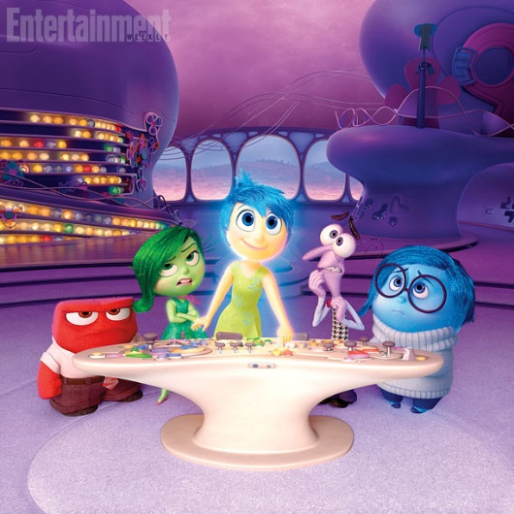





Mission Control Page for:
Name:_________Age______

Slide 2
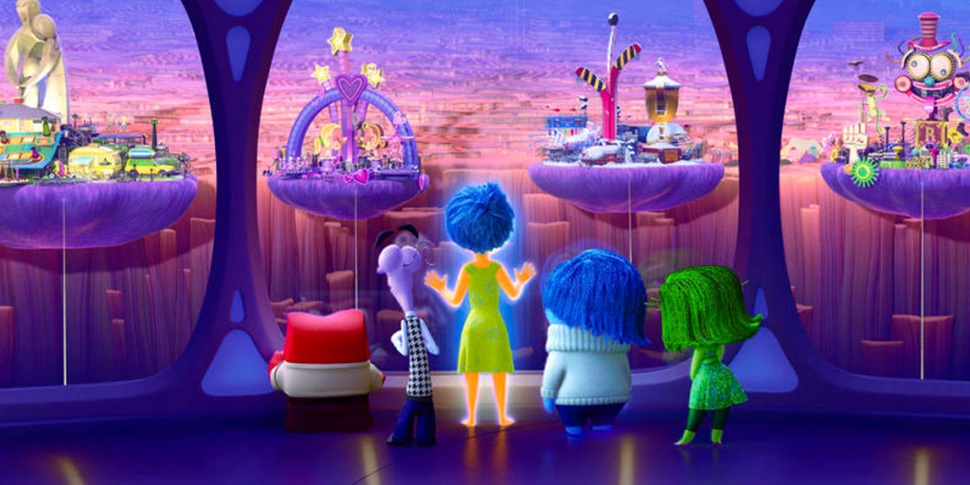
_____
______________
Islands of Personality

Slide 3
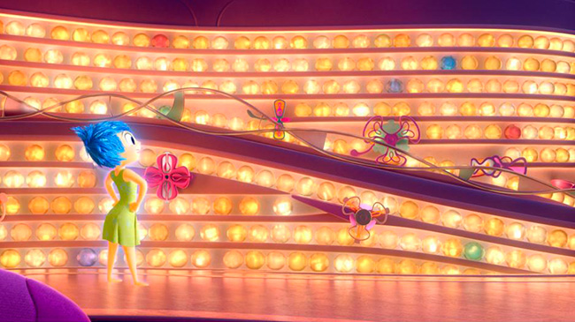
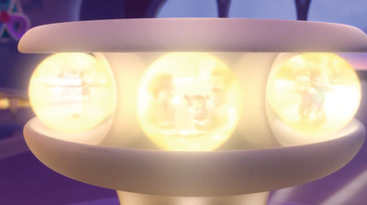
Core Memories and
Memories

