Slide 1
FAD-FMEA
Functional Analysis Diagrams- assisted FMEA processes

Slide 2
What is FMEA?
Failure Mode and Effects Analysis (FMEA) is a systematic, cross-disciplinary process, aiming to identify and address any potential failure modes (ways in which the product or process can fail to deliver its intended functions) within a product design or process
Based on the Systems’ Engineering approach, FMEA involves the Functional Decomposition of a product or process in order to identify the ways in which a system can fail and evaluate the criticality of these failures. FMEA can be conducted at high level (e.g., the product) or lower levels (e.g., a sub-system). The FMEA process steps are as follows:
Define primary components and functions
Identify their Potential Failure Modes, severity and occurrence
Identify Detection Controls
Identify Failure Mode criticality (Calculate RPN)
Re-design to reduce RPN values

Slide 3
Why conducting FMEA?
Initially developed for the Defence and Aerospace industries in the 1950s, FMEA processes are nowadays included in standard quality processes such as the Advanced Product Quality Planning (APQP) and the Production Part Approval Process (PPAP)
FMEA can be conducted independently or as part of APQP/PPAP during product/process design or redesign processes
FMEA processes can reduce the Time to Market and improve product quality when conducted early in the design process

Slide 4
Who is involved with FMEA?
FMEA processes require the input of all actors involved with the product. An example of these actors can be:
Market Research or Customer representative
Quality Assurance
Design Engineering (Mechanical/ Electrical/ Software)
Production Engineering
Service/ maintenance
Logistics
The FMEA team should be diverse enough and include all product stakeholders, while small enough to minimise disruption.

Slide 5
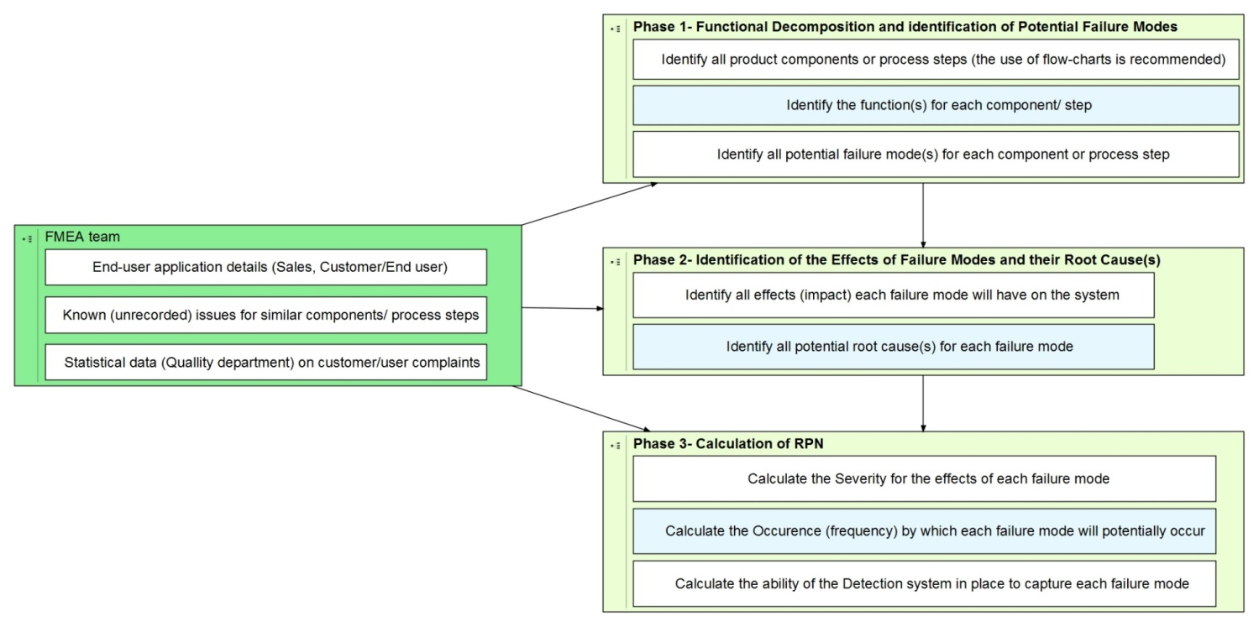
FMEA: How is it done?

Slide 6
FMEA: How is it normally done?

Slide 7
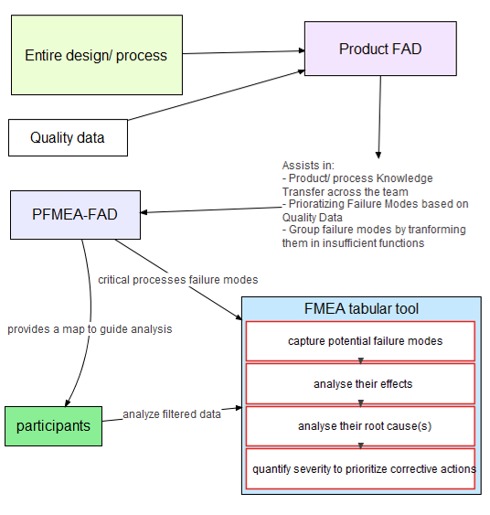
What is FAD-FMEA?
FAD-FMEA was developed to optimise the recourse-efficiency of the FMEA process, and in particular, its initial phase
The FAD-FMEA process involves the development of FAD models of the system in liaison with the FMEA team, before the FMEA sessions
The FAD models provide an intuitive communication platform, assisting the team members to contribute
FAD-FMEA

Slide 8
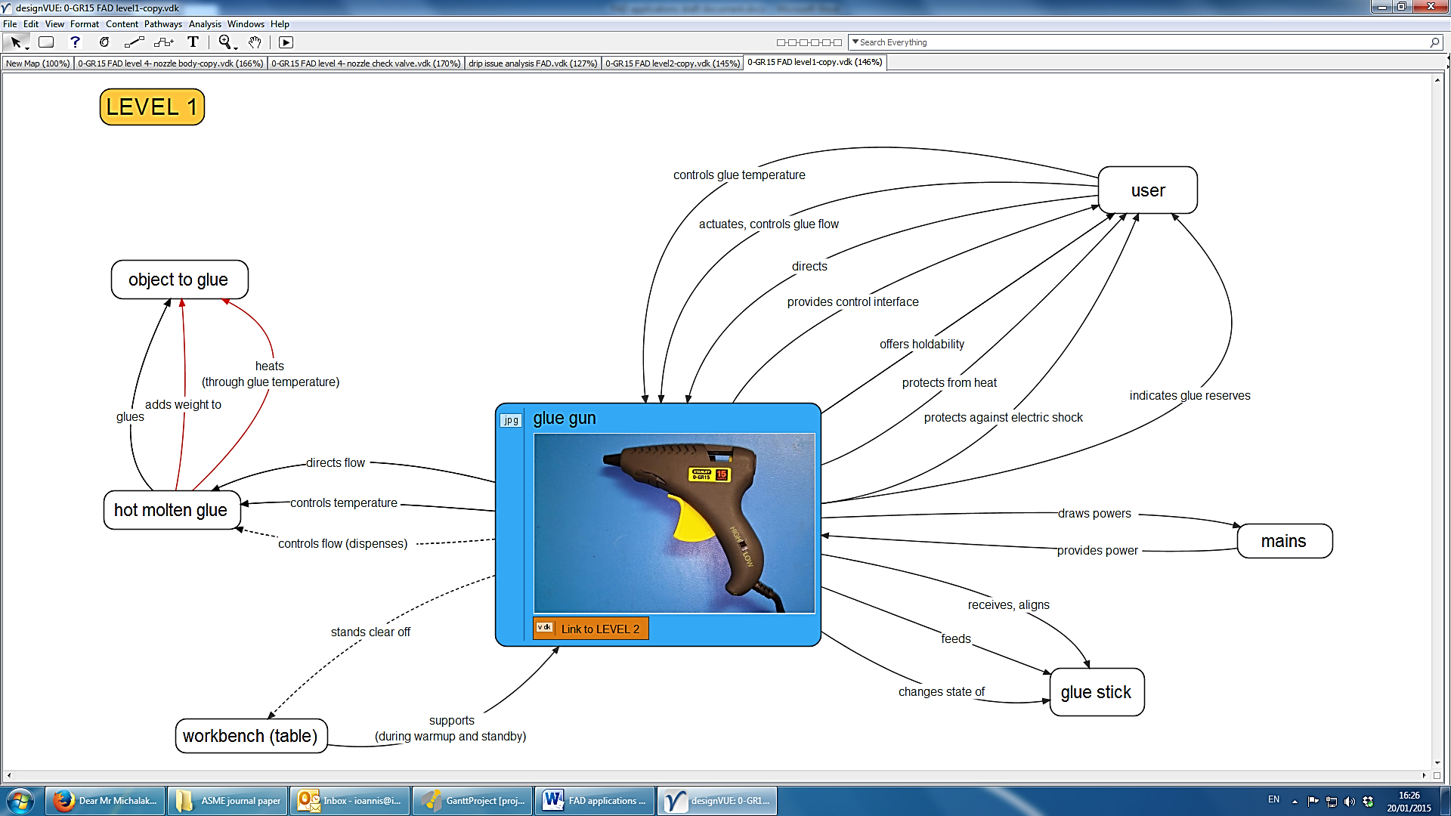
FAD-FMEA process example: Glue gun
Develop a FAD model of the product at “Level 1”, showing its functional interactions with its environment

Slide 9
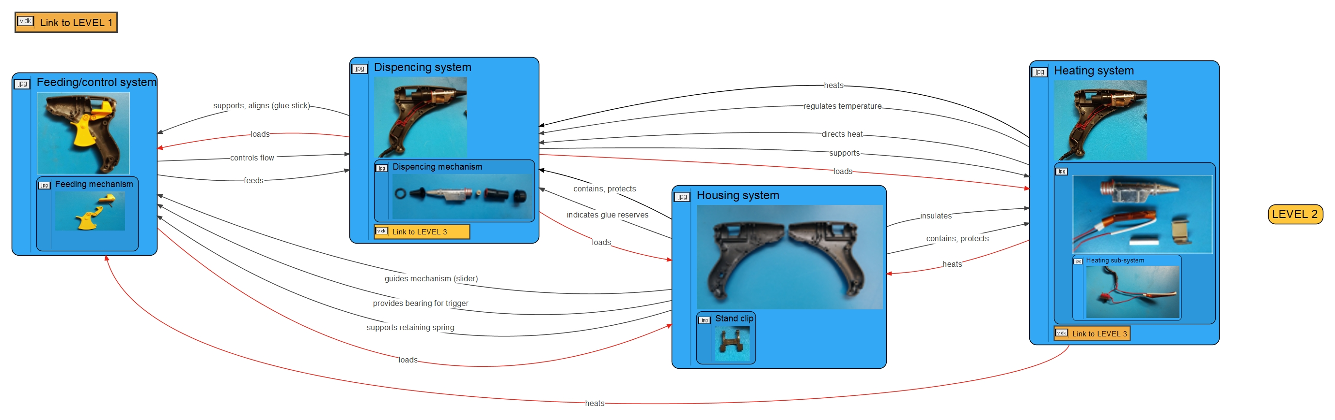
FAD-FMEA process example : Glue gun
Develop a FAD model of the product at “Level 2”, showing the primary sub-systems and their functional interactions

Slide 10
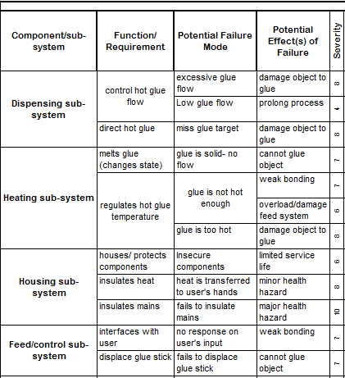
FAD-FMEA process example : Glue gun
Use the FAD models to populate the FMEA sheet at sub-system level with potential failure modes, effects and severity. Market Research/ customer representatives should be present at this stage.

Slide 11
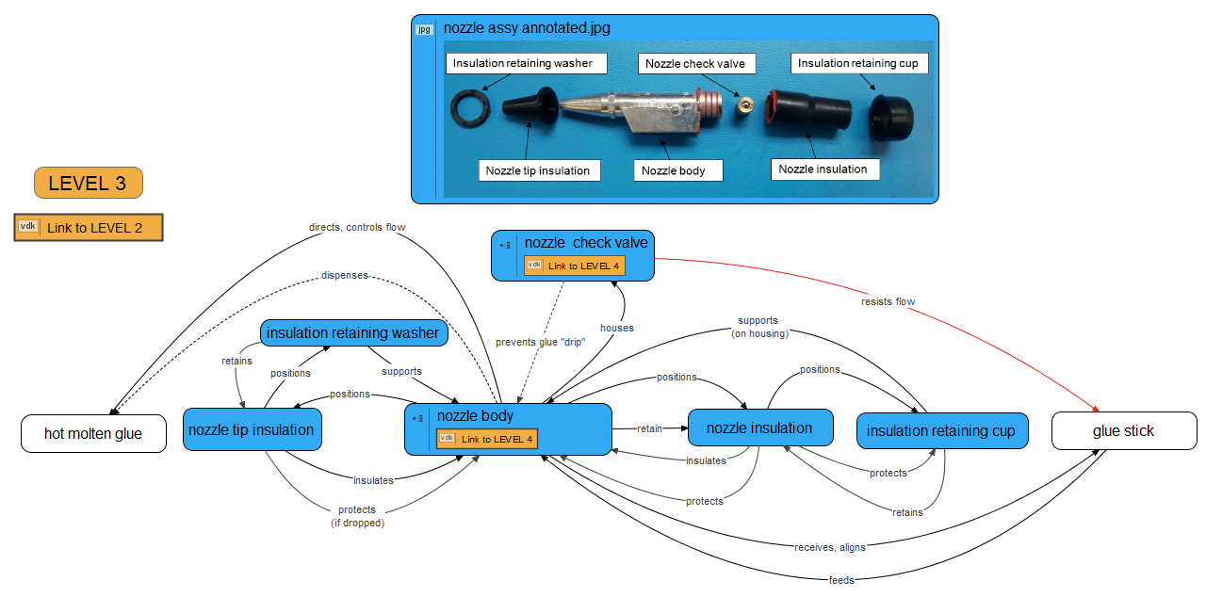
FAD-FMEA process example : Glue gun
Populate the potential causes, occurrence, prevention/detection controls and detection to calculate the Risk Priority Number (RPN) for each failure mode.
Quality Assurance and Engineering representatives should be present at this stage.
FAD models at lower levels can greatly assist identifying potential causes as well as determining the recommended actions

Slide 12
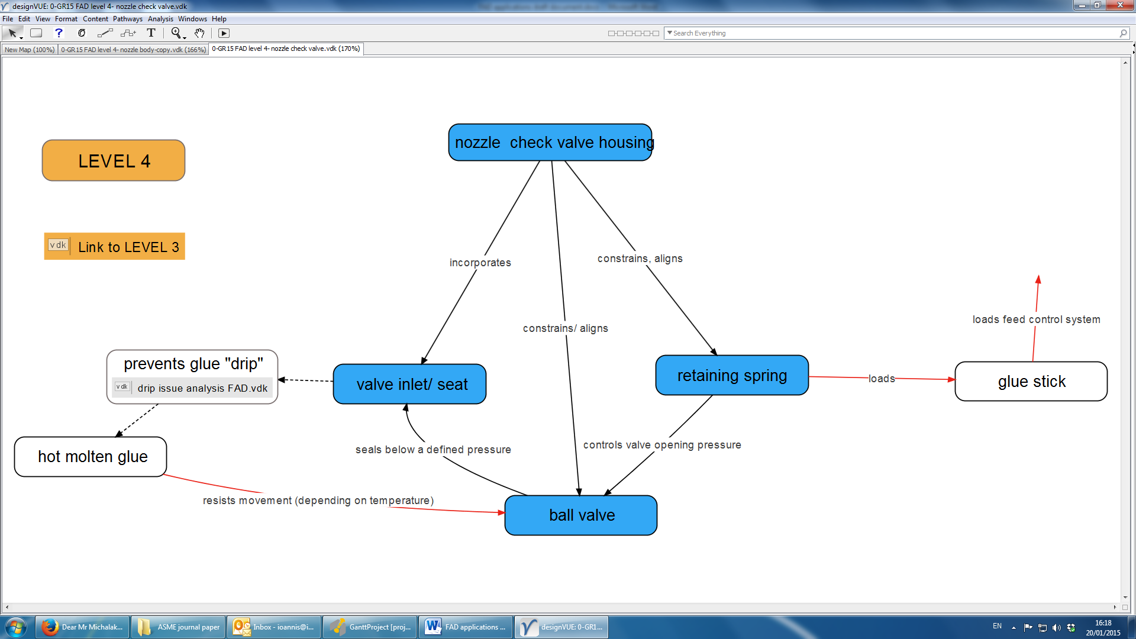
FAD-FMEA process example : Glue gun
The recommended actions, completion date and responsivity are populated for failure modes with high RPN values*. The RPN values are re-calculated after the actions are complete. Functional models at lower levels can significantly assist with the investigation and re-design
 |  | Action Results
Recommended Action | Responsibility and Target Completion Date | Action Taken | Severity | Occurrence | Detection | RPN
* There is no universally accepted threshold for RPN. However, values above 100 or the highest three are normally actioned

Slide 13
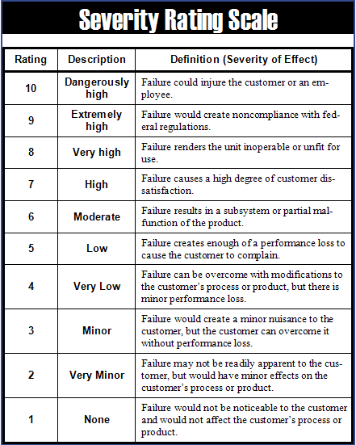
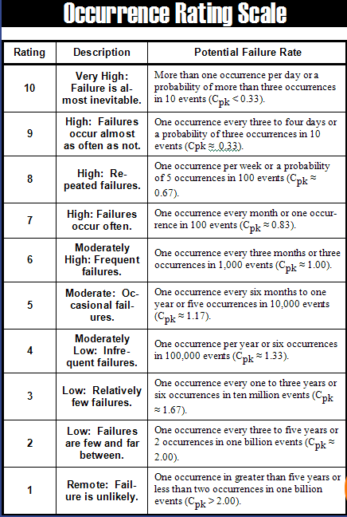
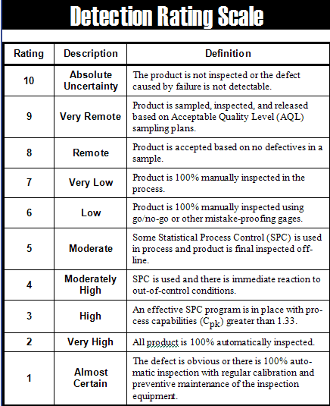
Resources

Slide 14
Resources
MIL-STD. MIL-STD- 1629A- Procedures for performing a Failure Mode, Effects and Criticality Analysis. Washington, DC: Department of Defense, United States of America; 1980.
Tague NR. The quality toolbox: Milwakee: ASQ Quality Press.; 2005.
Michalakoudis I, Childs PR, Aurisicchio M, Pollpeter N, Sambell N, editors. Using Functional Analysis Diagrams As a Design Tool. ASME 2014 International Mechanical Engineering Congress & Exposition; 2014; Montreal, Canada: ASME.
Michalakoudis, I., Childs, P., Aurisicchio, M. & Harding, J. (2016) Using functional analysis diagrams to improve product reliability and cost. Advances In Mechanical Engineering, 8(12), 1-11.
asq.org. Failure Mode and Effects Analysis: asq.org; 2016 [Available from: http://asq.org/learn-about-quality/process-analysis-tools/overview/fmea.html.
Kmenta S, Finch P, Ishii K. Advanced failure modes and effects analysis of complex processes. ASME Design Engineering Technical Conference, Design for Manufacturing Conference: ASME; 1999.

