Slide 1
Using Functional Analysis Diagrams for Production Reliability and Cost Optimizations
Dr Ioannis Michalakoudis, CEng
Presented at the International Conference on Applied Innovation 2016 (ICASI) in Okinawa, Japan
Published under the IEEE Explore and the Sage “Advances in Mechanical Engineering” journal https://journals.sagepub.com/doi/full/10.1177/1687814016685223

Slide 2
FMEA Approach
Define application primary functions
Identify their Potential Failure Modes
Identify Failure Mode criticality (Define RPN)
Re-design
to reduce criticality
FMEA processes can be used for products or processes to identify and address any potential failure modes (ways in which the product or process may become dysfunctional or non-functional).

Slide 3
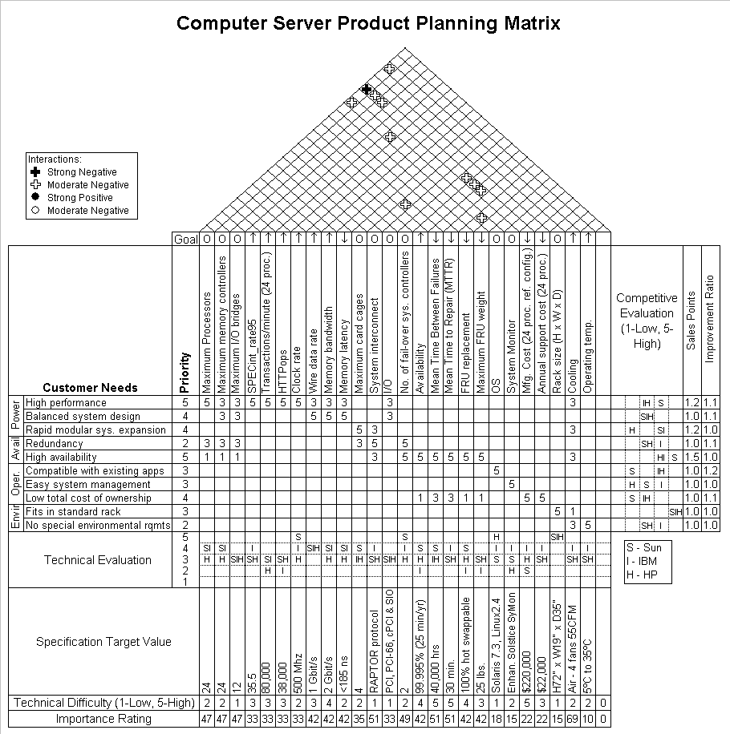
Value Engineering
Define
application primary functions
Analyse the functions of product components
Use a Quality Function Deployment tool to evaluate each component function in relationship to the primary functions
Value Engineering (VE) / Value Analysis (VA) is an interdisciplinary quantitative approach that focuses on improving the effectiveness and efficiency of the functions of a product, process, or organization.

Slide 4
FMEA / VE Issues
Lack of cross-disciplinary communication and system’s understanding
Process complexity
Cost of process
Failure mode and effects analysis (FMEA) and value engineering (VE) currently equip the ‘‘toolbox’’ of many major quality management systems.
Due to their cross-functional collaborative nature, both FMEA and VE processes are considerably resource-intensive, and for this reason, their use is often limited to large organizations.

Slide 5
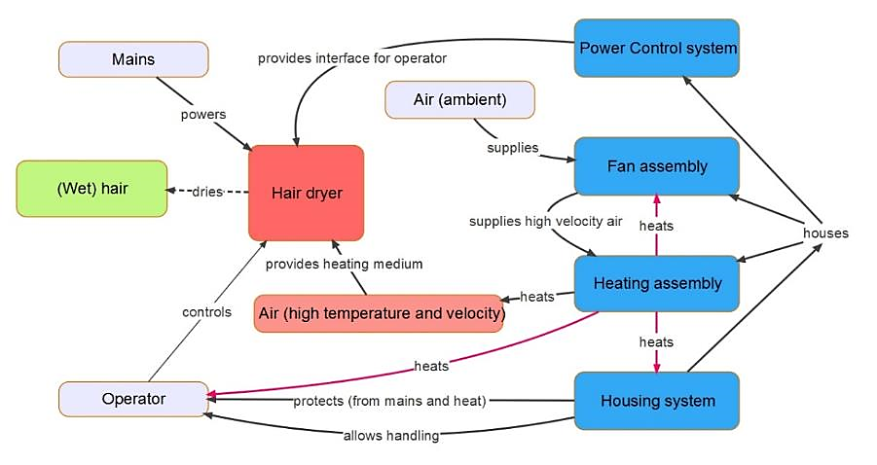
FAD – Hairdryer example
The Functional Analysis Diagram (FAD) method is one of the Functional modelling methods available. The FAD model above illustrates the main elements of a hair-dryer system and their functional interactions.
Studies indicate that FAD models can assist with communicating technical functions with cross disciplinary teams.

Slide 6
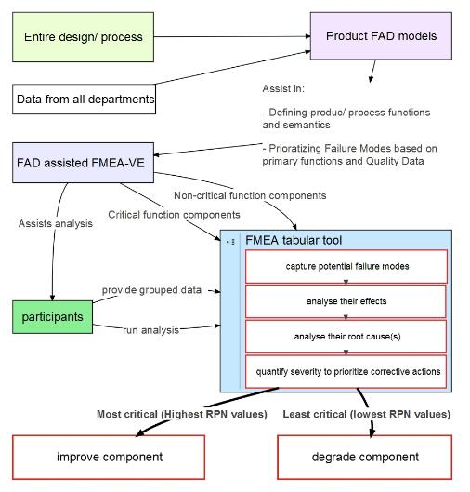
Proposed Methodology
This methodology proposed the use of FAD models to assist with identifying the primary product functions for the first phase of both FMEA and VE processes.

Slide 7
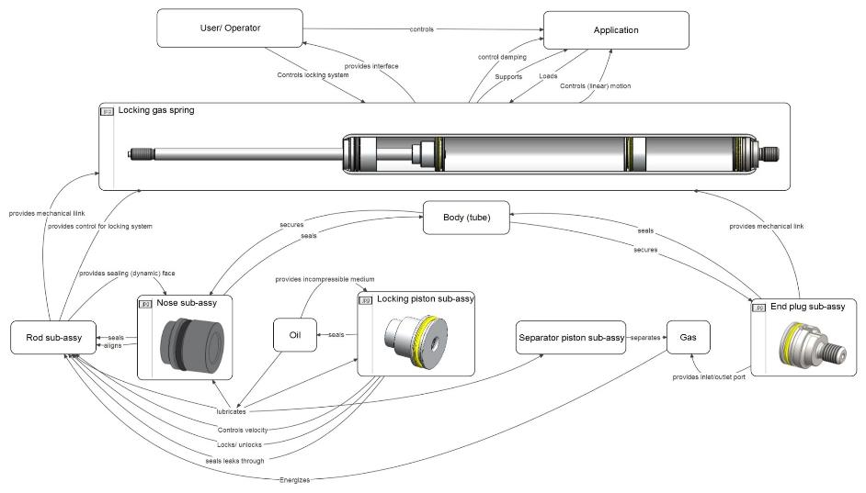
Case Study – FAD of a Gas Spring
This above model was developed for conducting FMEA and VE at a UK-based manufacturing SME

Slide 8
Results - Qualitative
Participant Survey

Slide 9
Results - Quantitative
7% machining time reduction
10% quality cost reduction
2 critical parts were captured and addressed
75% efficiency in comparison to standard FMEA processes conducted in the same organization
The results were compared with those of a traditional FMEA process conducted in the same organisation for a similar product

Slide 10
Conclusions
The case study validated the methodology’s feasibility claims
The process yielded a 75% resource-efficiency improvement in comparison to FMEA alone

