Slide 1
Knowledge Management
By
Khawaja Asif Mushtaq
Member & Expert KM Standard Development Committee ISO 30401
Imdadullah Khan
Practitioner KM
Contact at kh_asif@hotmail.com

Slide 2
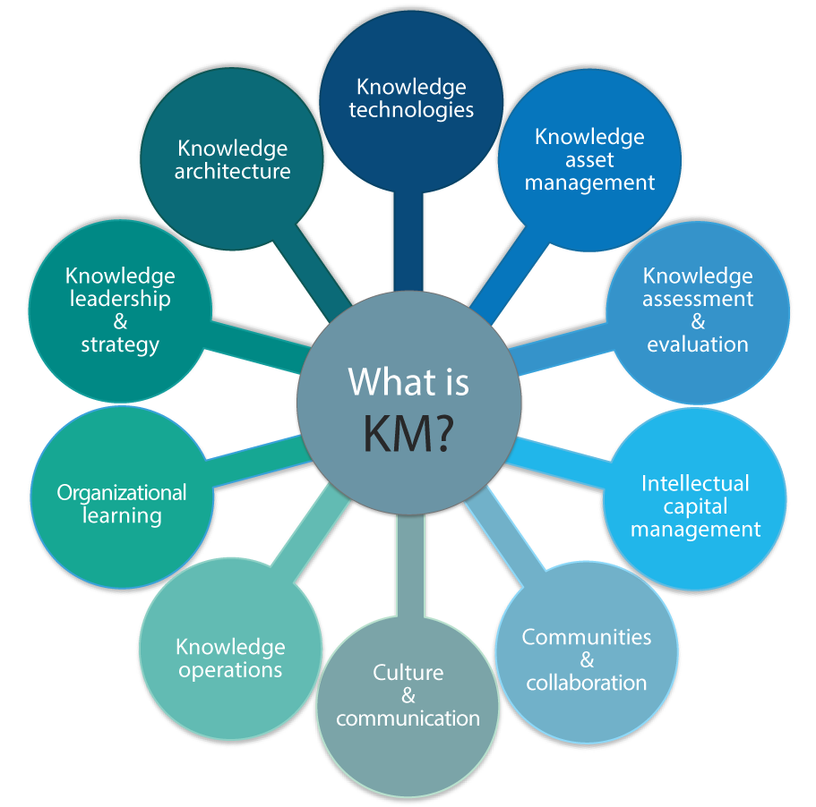
Knowledge Management

Slide 3
Knowledge Management
KM is "the process of capturing, developing, sharing, and effectively using organizational knowledge focused on processes, it is simply a way to make the best use of knowledge.
Consciously and comprehensively gather, organize, share and analyze its knowledge in terms of resources, documents and people skills."
Knowledge management is the process of applying a systematic approach to the capture, structuring, management, and dissemination of knowledge throughout an organization to work faster, reuse best practices, and reduce costly rework from project to project (Nonaka and Takeuchi, 1995;

Slide 4
KM describes an organization strategy to get the knowledge of its workers out of their heads and into an information storage and retrieval system where it can be used and reused.
Tacit knowledge is the beliefs, attitudes skills capabilities, and expertise that an individual use to perform specific task.
Knowledge management consists of “ leveraging intellectual assets to enhance organizational performance.”( Stankosky 2008 )

Slide 5
Knowledge Management
Tacit Knowledge
Explicit Knowledge
Knowledge
Tacit
This type of knowledge exists in people’s heads, not articulated or documented
Explicit
This type of knowledge can be
Processed by information system
Codified and recorded
Archived and protected
Information
Data

Slide 6
History & Background
1970
KM emerged as a term in management sciences.
1980
KM related articles began to appear in journals and books.
1990
KM introduced as a discipline in Universities.
A number of firms had began in-house KM programs.
The international KM Network (IKMN) went online.

Slide 7
KM Principles
KM must address, roles, process, technology and governance.
Connecting people, collecting and organizing content for access.
KM address push & pull (supply & demand of knowledge)

Slide 8
Partner disciplines of KM
Human resource – especially human resource development
Organizational development
Information & data management.
Information security.
Risk management and governance
Record management
IT management
Internal & corporate communication
Milton, lambe, The knowledge manager’s handbook

Slide 9
KM Process
Collect Identify
Classify
Organize/Store
Create
Share/Disseminate
Use/Exploit
Access
Knowledge
Repository

Slide 10
Seven Levers
Customer Knowledge - the most vital knowledge
Knowledge in Products - ‘smarts’ add value
Knowledge in People - but people ‘walk’
Knowledge in Processes - know-how when needed
Organizational Memory - do we know what we know?
Knowledge in Relationships - richness and depth
Knowledge Assets - intellectual capital

Slide 11
Significance of KM
Knowledge assets have often become more important to companies than financial and physical assets and are often the only way for a company to distinguish itself from its competitor & gain competitive advantage
When workers leave an enterprise, their knowledge goes with them. KM captures their knowledge in a form that can be shared with other workers and especially future workers.
It externalizes Institutional Memory and it aims to optimize Knowledge Transfer which means passing along skills

Slide 12
The goal of KM is to improve organizational capabilities through better use of the organization’s individual and collective knowledge resources. (skills, capabilities, experience, routines, norms and technologies)
Effective KM using more collective and systematic processes, it will also reduce tendency to ‘repeat the same mistakes.
Effective KM can dramatically improve quality of products and/or services

Slide 13
Use of knowledge does not consume it.
Transferal of knowledge does not result in losing it.
Knowledge is abundant, but the ability to use it is scarce.
Much of an organization’s valuable knowledge walks out the door at the end of the day.
KM reduce the corporate amnesia.

Slide 14
AFAQ KM Model
Nonaka and Takeuchi Four modes of knowledge conversion.
1. From tacit knowledge to tacit knowledge: the process of socialization.
2. From tacit knowledge to explicit knowledge: the process of externalization.
3. From explicit knowledge to explicit knowledge: the process of combination.
4. From explicit knowledge to tacit knowledge: the process of internalization.

Slide 15
Tacit to Tacit : The process of socialization.
Tacit Knowledge is transferred verbal discussion from one person to another.
1. Peer Learning in cross functions.
2. Knowledge Café. (Honda)
A structured conversational process for knowledge sharing in which groups of people discuss a topic at several tables, with individuals switching tables periodically and getting introduced to the previous discussion at their new table.
To access the organization's collective intelligence
To gain mutual understanding of a complex issue
To gain a deeper understanding of other people’s perspectives

Slide 16
Tacit to explicit: Externalization.
Tacit knowledge is documented.
Case Studies (with in organization)
Best practices
Interviews (professionals, customers, stakeholders)
After Action Review. AAR.(compare expectations with results & try to find the reason of difference )
Five item questionnaire is commonly used to get a insight of the problem.

Slide 17
5. A3 Report. (TOYOTA).
To find the failure of project, and improvement. A specific problem is selected and identified the cause of failure through seven questions on A3 paper.
6. Retrospection: (Huawei)
A team meeting after the end of project to identified and analyze the learning points through discussion and dialoged and documented for future.

Slide 18
Explicit to Explicit: the process of Combination.
The process of recombining discrete pieces of explicit knowledge into a new form.
Synthesis in the form of a review report, a trend analysis, a brief executive summary, or a new database to organize content.
No new knowledge is created, it is a new combination or representation of existing explicit knowledge.
We categorize and combine concepts, or when we convert explicit knowledge into a new medium such as a computer-based tutorial.

Slide 19
Explicit to Tacit: the process of internalization.
Internalization is strongly linked to “learning by doing.”
New knowledge is used by employees, and reframe it within their own existing tacit knowledge.
In the internalization knowledge has once again become tacit knowledge.
1. Training session (teach lesson learned)
2. Develop software for knowledge repository, and give access for concern employees

Slide 20
For example, General Electric has developed a system of documenting all customer complaints in a database that can be accessed by all its employees. This system allows the employees to find answers to new customers’ questions much more quickly because it facilitates the sharing of employees’ experiences in problem solving. This system helps the workers to internalize others’ experiences in answering questions and solving problems.

Slide 21
Thanks

