Slide 1

Invisible Balance Sheet
The concept of invisible balance sheet was introduced by
Erick Seviby in 1988
The concept of Invisible Balance Sheet is about the abstrct factors which have a great contribution in organization’s life

Slide 2
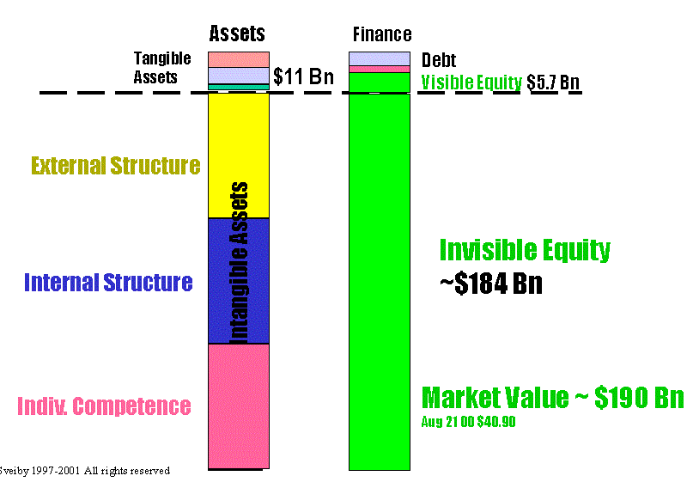

Slide 3
Concept of Three Families
Internal Structure
Consists of patents, concepts, models, computer and administrative systems
External Structure
Consists of relationships with customers and suppliers, brand names, trademarks and reputation, or "image”
Individual Competences
People’s ability to act in various situations. It includes skill, education, experience, values and social skills.

Slide 4
Measuring Internal Structure
1. Investments in the Internal Structure
Investments in new methods and systems. Such investments are indications of a build up of the internal structure.
2. Customers that Contribute to Internal Structure
customers that improve the internal structure of the company is an important variable, because it adds to the growth of the asset.

Slide 5
3. Sales of New Products and Services
Innovation and new products/services is one of the most common indicators in high-tech industries.
It is placed under "Internal Structure because the processes for developing products and services are parts of the internal structure.

Slide 6
4. Proportion of Support Staff
Proportion of support staff of the total number of employed indicates efficiency of the internal structure. A change in the proportion indicates whether the efficiency is improving or not
5. Support Staff Turnover
The turnover should be kept in a band, just like the turnover rate for professionals. lower turnover for professionals is preferable. The turnover should be in between 3 - 7%.

Slide 7
6. Values and Attitude Measurements
measuring the attitude of the market to the company, you can get a picture of employees" attitudes to their place of work. If those attitudes are favorable, they contribute consciously or unconsciously to enhancing the company´s image among its customers.
7. Age of the Organization
An old organization is generally more stable than a new one. Signs like

Slide 8
8 Rookie Ratio" and Seniority
Rookie Ratio is defined as number of people with less than 2 years employment.
A high percentage of "rookies" in the organization is a sign of less stability and less efficiency.

Slide 9
Measuring External Structure
1. Intangible Revenues
Most customers contribute much more than money. They can be used as references, they spread the image. Their feedback is a source for developing new products and services. It is called Intangible Revenues.
2. Organic Growth
Organic growth, i.e. increase in billings with income from acquisitions deducted, is a measure of how well your business concept is received by the market

Slide 10
3. Image enhancing customers
Industry give valuable to customers that endorse products are a much more effective sales force than our own and gives more image than any advertising campaign.
4. Sales to new customers
The proportion of sales to customers younger than a year tells how good we are at penetrating new segments. An alternative is sales to new markets.

Slide 11
5. Profitability per Customer
Customer profitability should be monitored as a routine. You should categorize costs and revenues to enable you to calculate the control figure profitability per customer. This is a much more valuable criterion than profitability per product or market segment.

Slide 12
6. Sales per Customer
Sales per customer is defined as total sales divided by the total number of customers.
Since selling more to the same customer is usually easier and less costly than finding a new customer this ratio tells how efficient your company’s existing network of customers.
An effort to expand the sales per customers should therefore be more profitable

Slide 13
7. Satisfied Customers Index
Measuring the degree of customer satisfaction is perhaps the best way to get an early indication of whether results are about to improve or deteriorate
8. Proportion of Big Customers
The proportion of big customers tells you how dependent your company is on the favor of a few major customers. If the degree of dependence is great, your position is weak and so is your structure.

Slide 14
9. Age Structure
Age structure can also provide interesting information. The longer customers have been with you, the better your relations with customers.
10. Win/Loss Index
Companies that make a lot of their business from tenders, can calculate a simple index by comparing how many of their quotations that were successful with how many that they lost.

Slide 15
11. Devoted Customers Ratio
How much of the sales come from customers older than five years? This is an indication of how devoted the customers are and therefore a sign of stability.
12. Frequency of Repeat Orders
Another measure of customer satisfaction is the frequency of repeat orders. A high frequency indicates that customers are satisfied with the company.

Slide 16
Measuring Competence
1. Number of Years in the Profession
A simple and useful measure of competence is the total number of years that professionals have worked in their profession
2. Level of Education
The level of education of Professionals affects the assessment of the quality of their competence and thus the knowledge company´s ability to achieve future success.

Slide 17
3. Competence Turnover
By comparing the competence of people who have left the company with those of new recruits
4. Competence-Enhancing Customers
Professionals spend most of their time working for customers, customers demands and priorities give chance for competence enhancement.

Slide 18
5. Diversity
Gender diversity has been shown to enhance innovation
6. Training and Education Costs
In knowledge companies, which depend so heavily on the knowledge and competence of their employees, competence development through regular work on assignments for customers and R&D projects.

Slide 19
7. Proportion of Professionals in the Company
A key indicator of efficiency is the proportion of professionals in the firm; the number of professionals, divided by the total number of employees.
8. Value Added per Employee
Value added per employee is a better measure of ability to produce than, say, turnover or profit per employee.

Slide 20
9. Value Added per Professional
In knowledge companies, value added per professional can be regarded as the "purest" measure of ability to produce economic value.
10. Profit per Professional or per Employee
Profit per employee is a useful term if you can correct for excess salaries

Slide 21
12. Professionals Turnover Rate
Staff turnover is generally regarded as an indicator of stability. A very low turnover (below 5%) suggests a stable. A very high turnover rate (above 20%) usually suggests that people are dissatisfied.

