Slide 1
Quota Club International of Valdosta
Our Year in Review

Slide 2
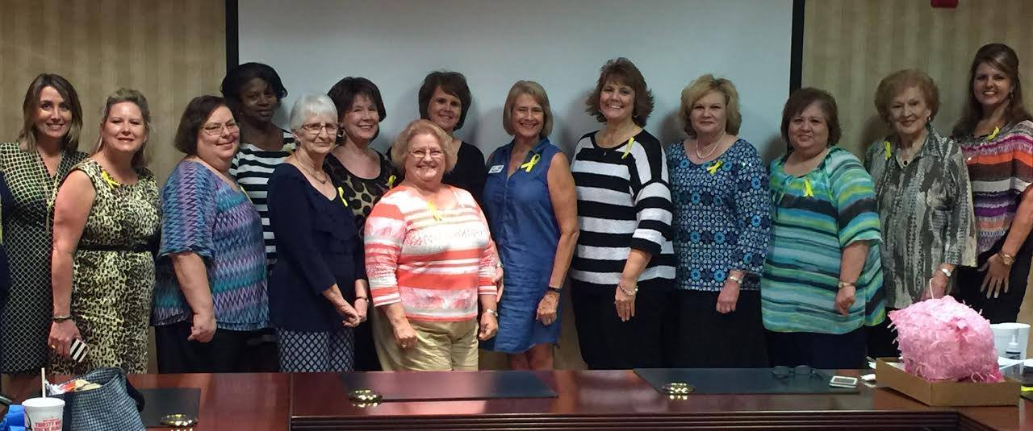
Some of our current members!

Slide 3
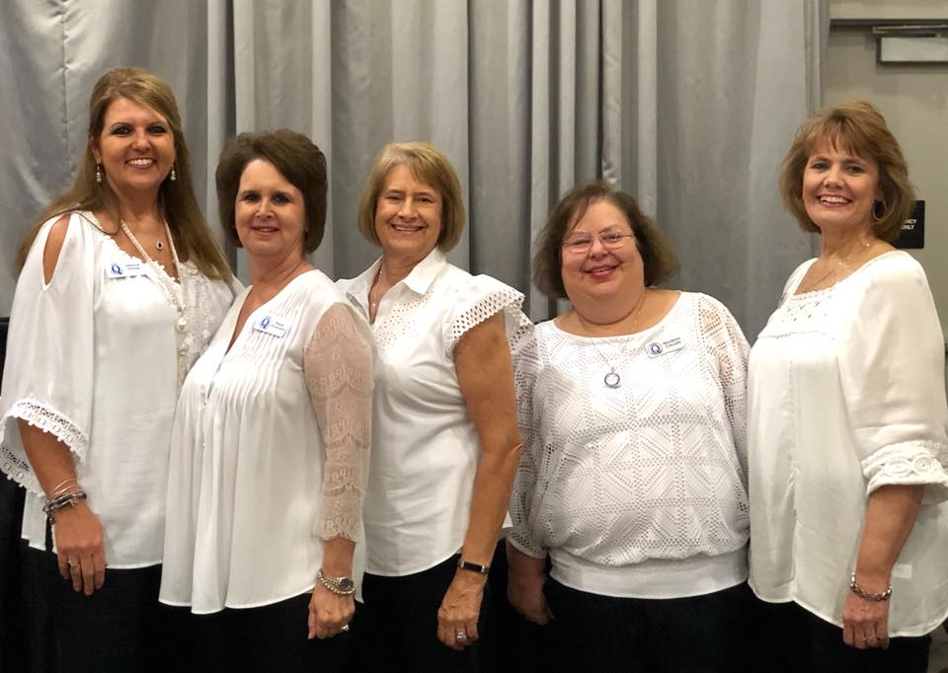
23rd Annual Taste of Valdosta

Slide 4
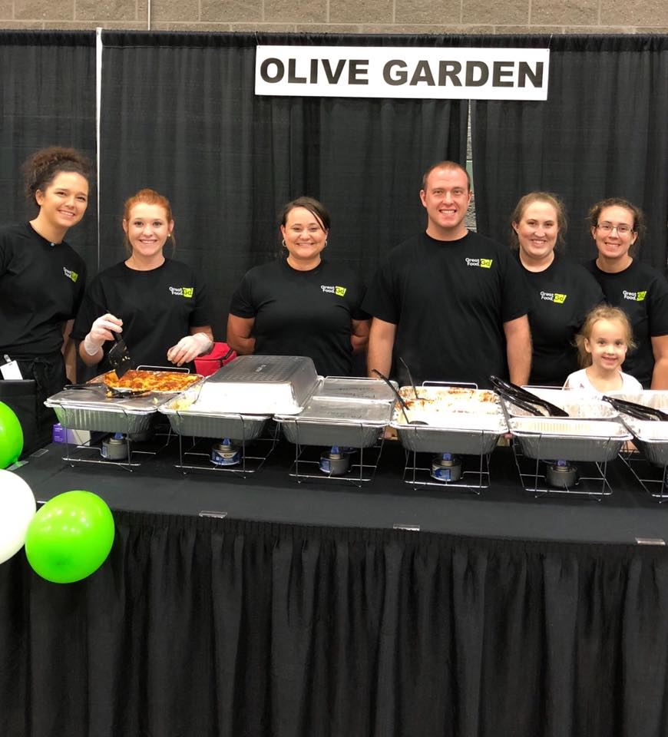
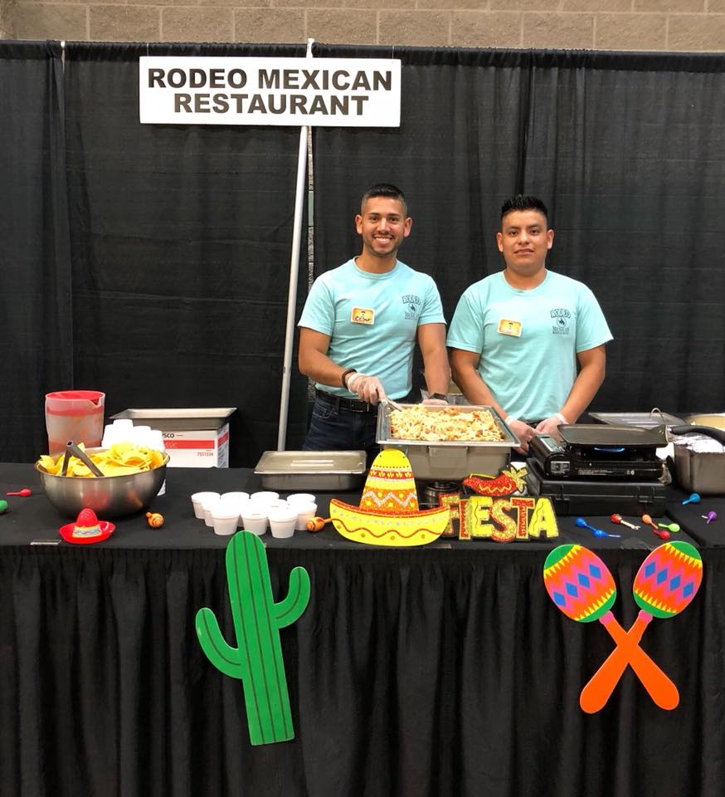

Slide 5
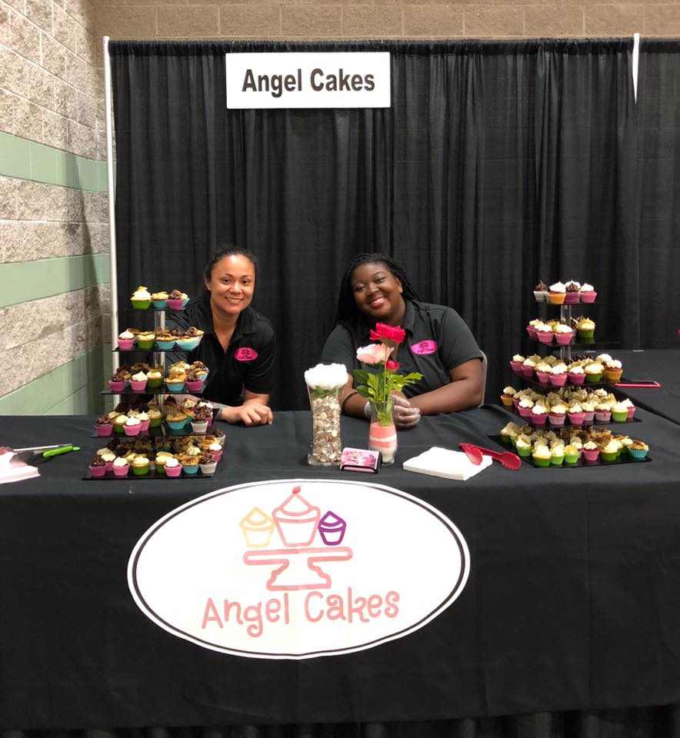
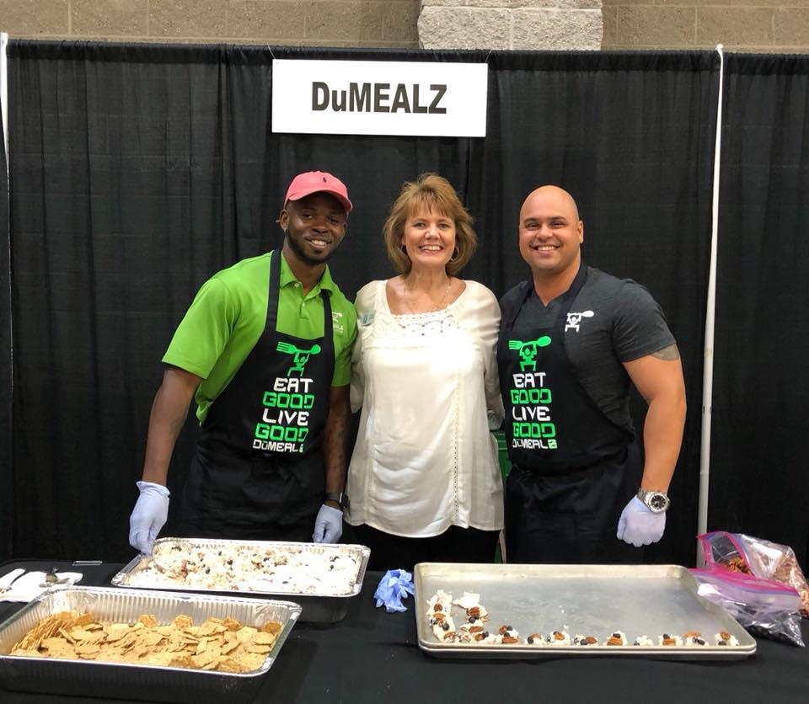

Slide 6
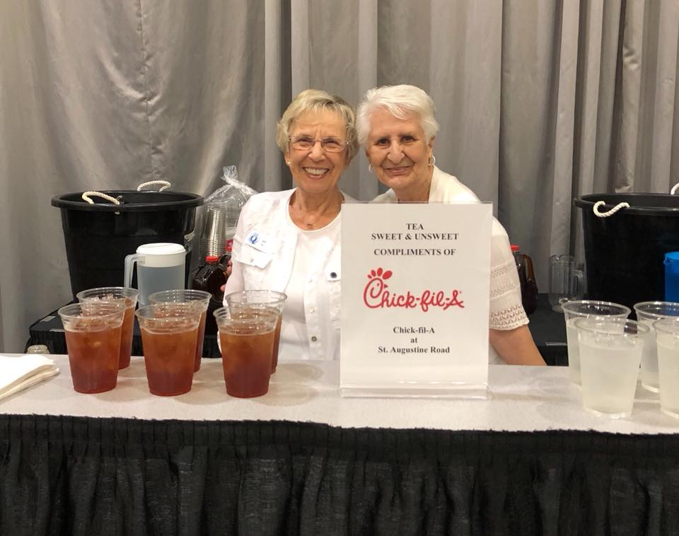

Slide 7
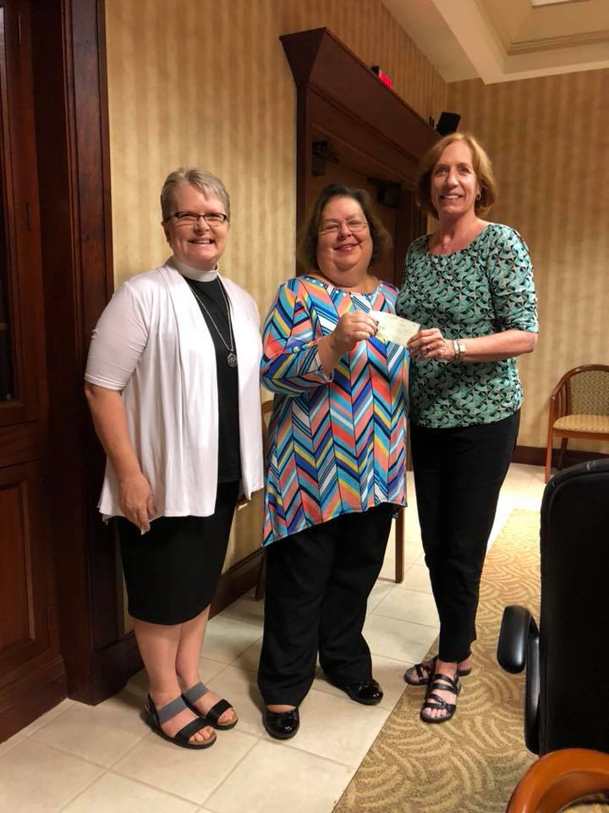
Presentation of Taste Funds:
$8,500 check to Break Bread Together

Slide 8
Break Bread Together is Valdosta's official Meals on Wheels Affiliate, feeding senior citizens who don't have the money or ability to get food for themselves. The meal BBT provides may be the only food these people get each day. The volunteer who delivers the meal may be the only human contact these seniors receive each day. BBT currently feeds 36 senior citizens with 48 on a wait list.

Slide 9
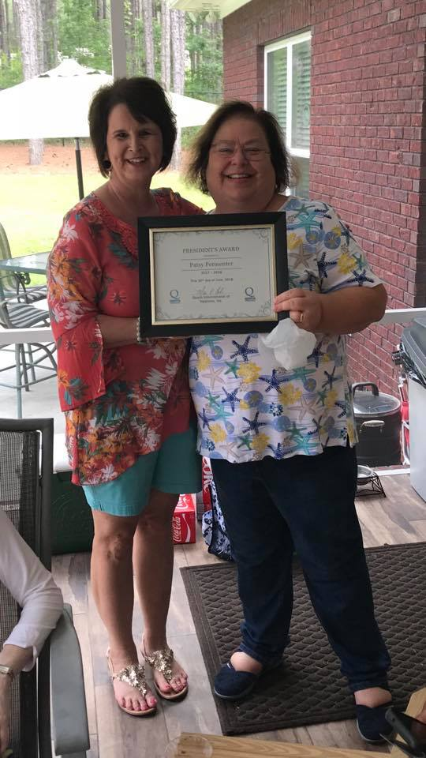
Quota Social/Award Presentations
President's Award presented to Patsy Permenter by Club President, Maureen Collins.
Notes:
June 2018

Slide 10
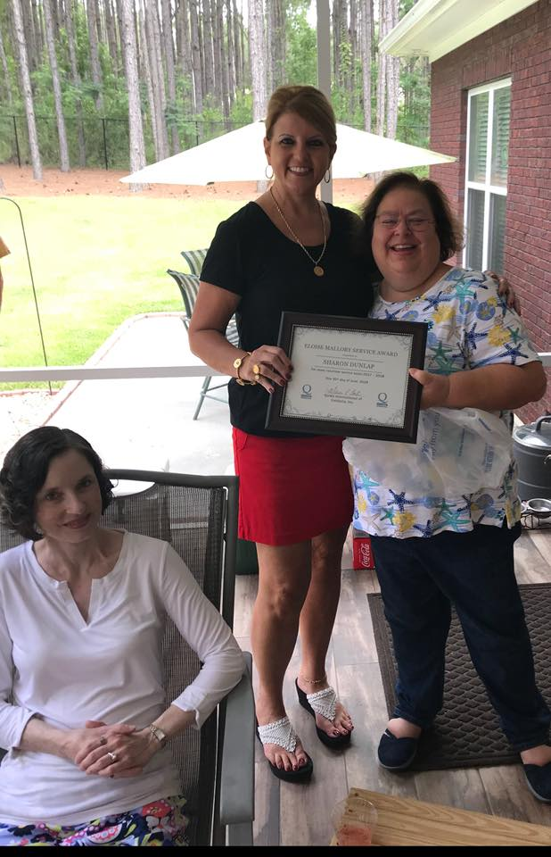
Eloise Mallory Service Award presented to Sharon Dunlap by Club President, Maureen Collins, for most volunteer service hours 2017 - 2018.

Slide 11
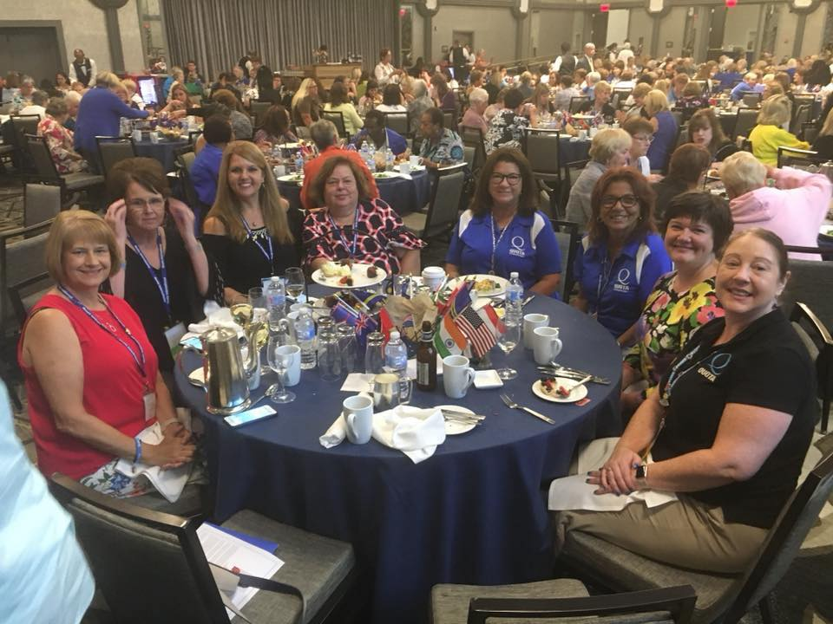
Quota National Convention

Slide 12
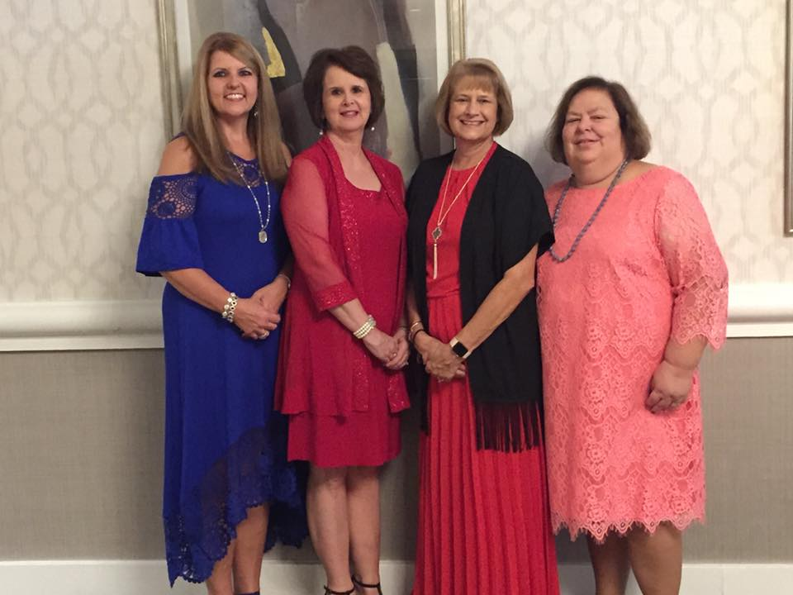
Installation Banquet

Slide 13
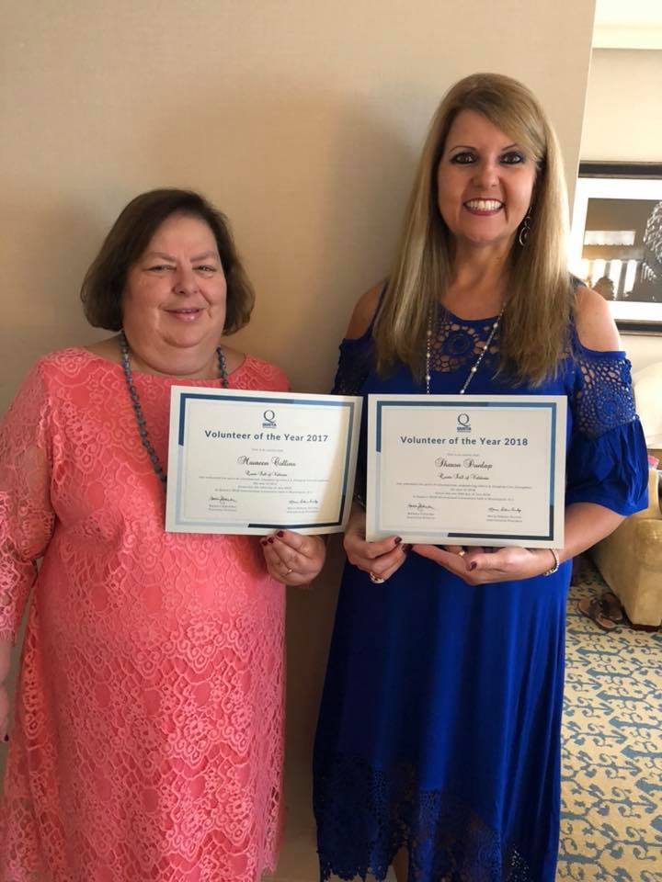
Volunteer of the Year 2017, Maureen Collins. Volunteer of the Year 2018, Sharon Dunlap

Slide 14
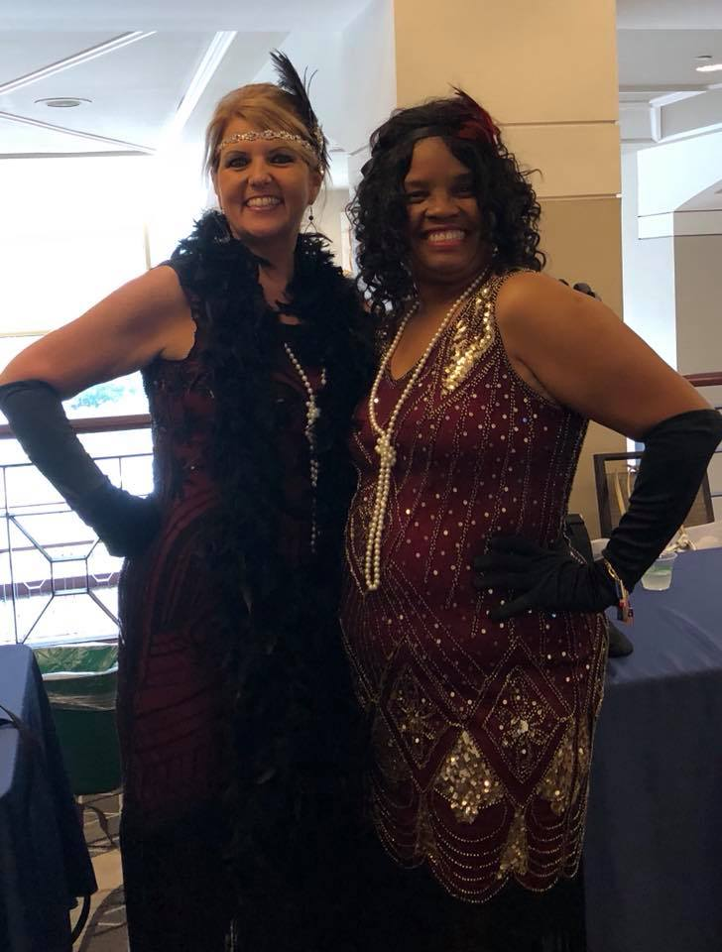
Sharon with our new President-Elect, Dr. Carol Patin from Baton Rouge, LA

Slide 15
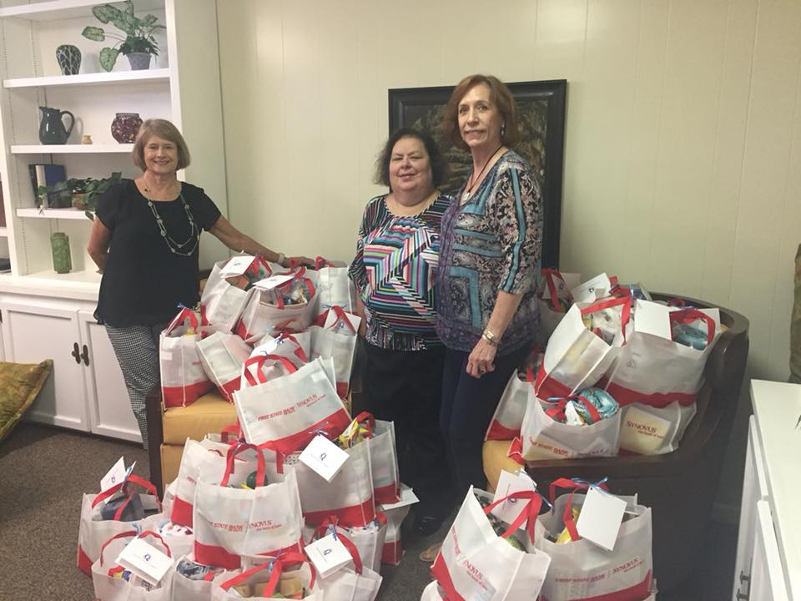
When the recipients receive their meal provided by “Break Bread” on Grandparents Day, they will also receive a gift bag from our Quota Club in honor of this special day. Gift bags include light bulbs, toilet tissue, bars of soap, lotion, toothpaste, Kleenex tissue, Fig Newtons, pudding, fruit cups, Word Search books, lap blanket, note pads & pens
Notes:
September 2018

Slide 16
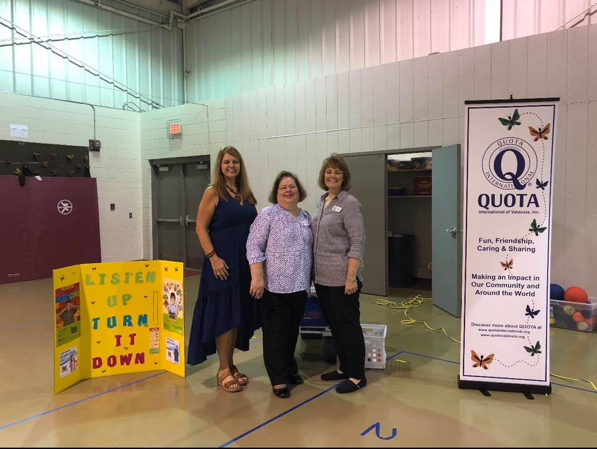
Listen Up, Turn it Down!

Slide 17
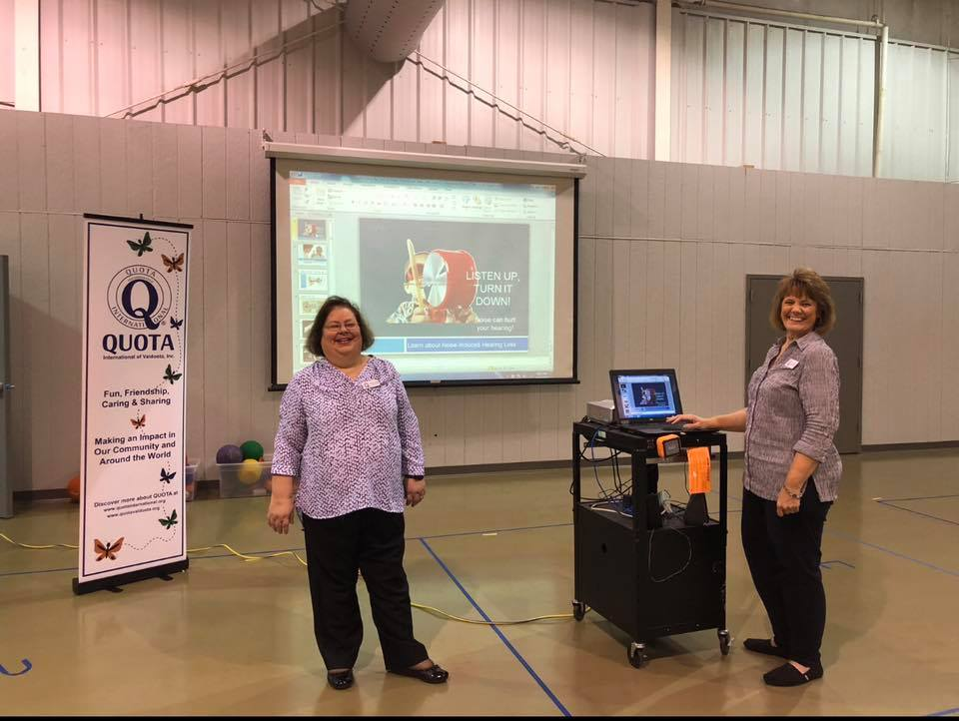
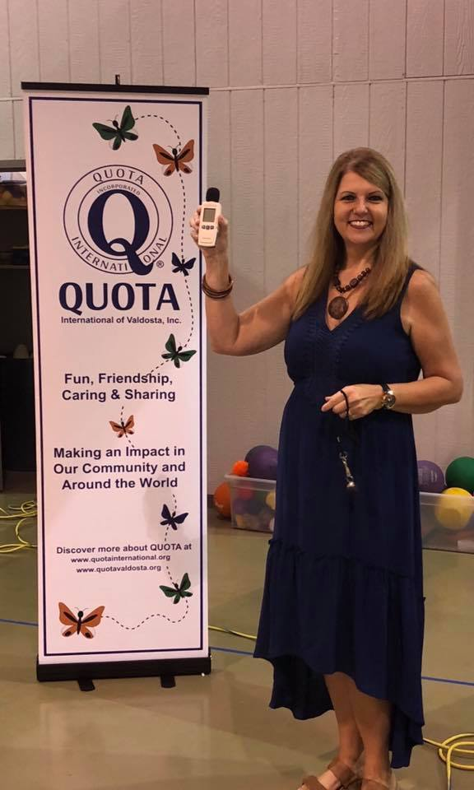

Slide 18
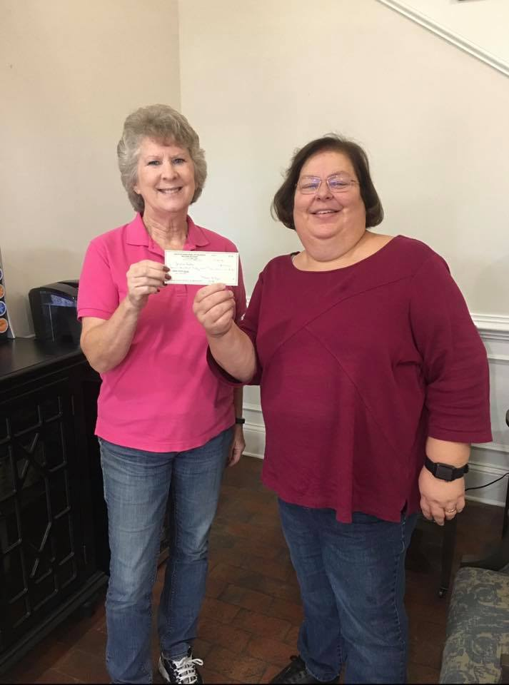
President Maureen Collins presenting check to Leslie Jacobs with Jacob’s Ladder to help offset some of the expenses of taking riders to the Special Olympics.

Slide 19
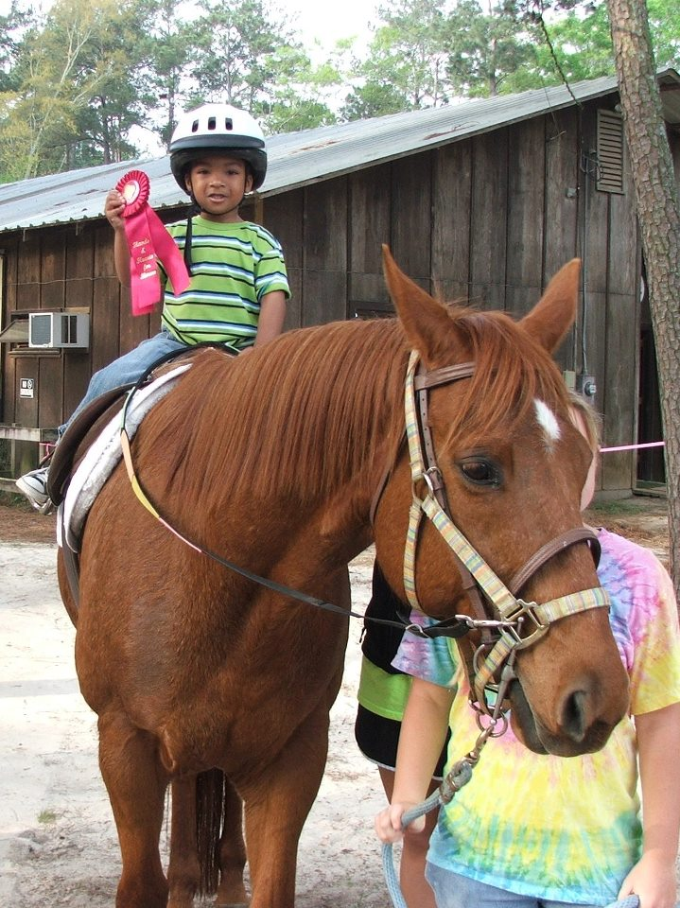

Slide 20
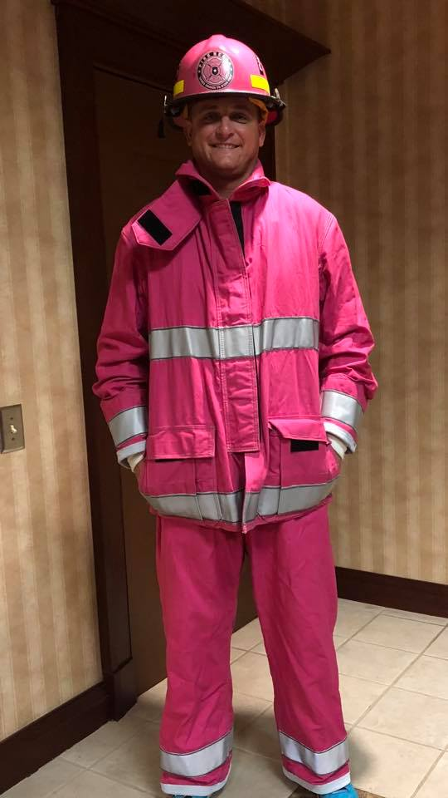
“Our Pink Fireman”
Sgt. Darren Williams, with the City of Valdosta Fire Department, spoke to our Club about the wonderful organization, “Pink Heals”. Darren is the President of Pink Heals VALDOSTA. Pink Heals supports people, not causes.

Slide 21
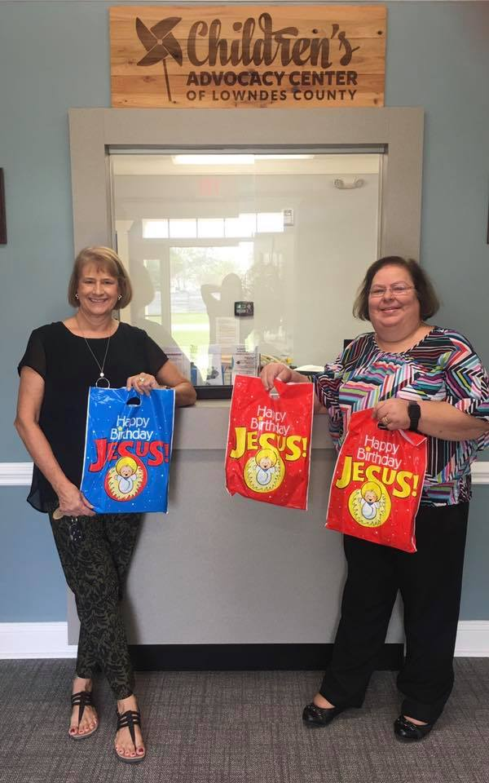
Our Club filled and donated 100 Christmas Bags for the children served by the Children’s Advocacy

Slide 22
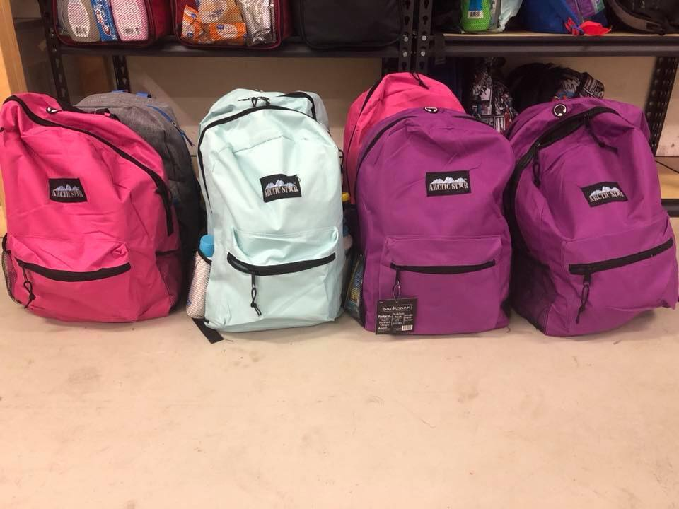
Donated Journey Bags to
Called to Care

Slide 23
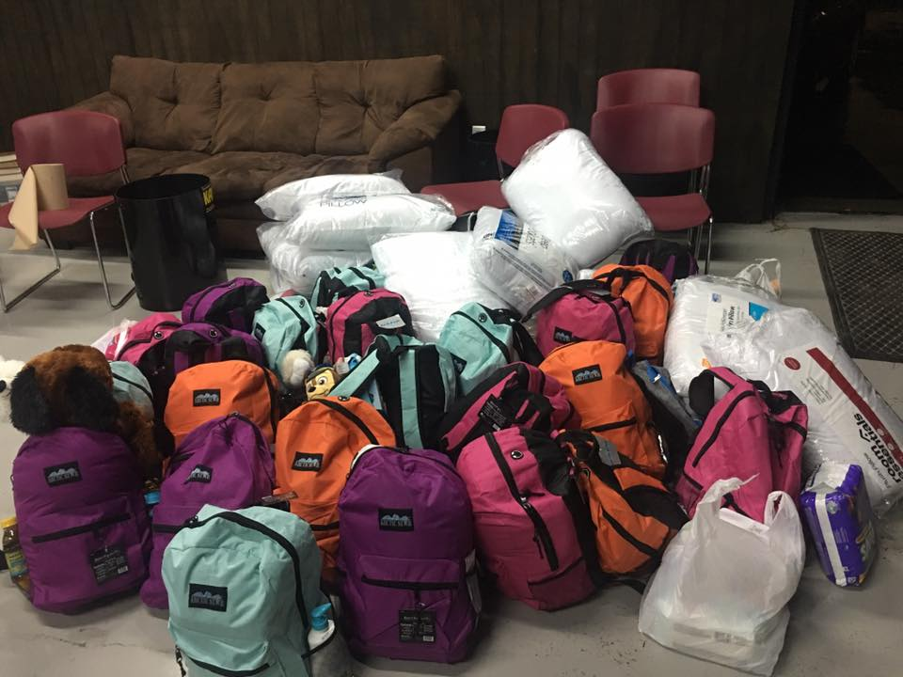

Slide 24
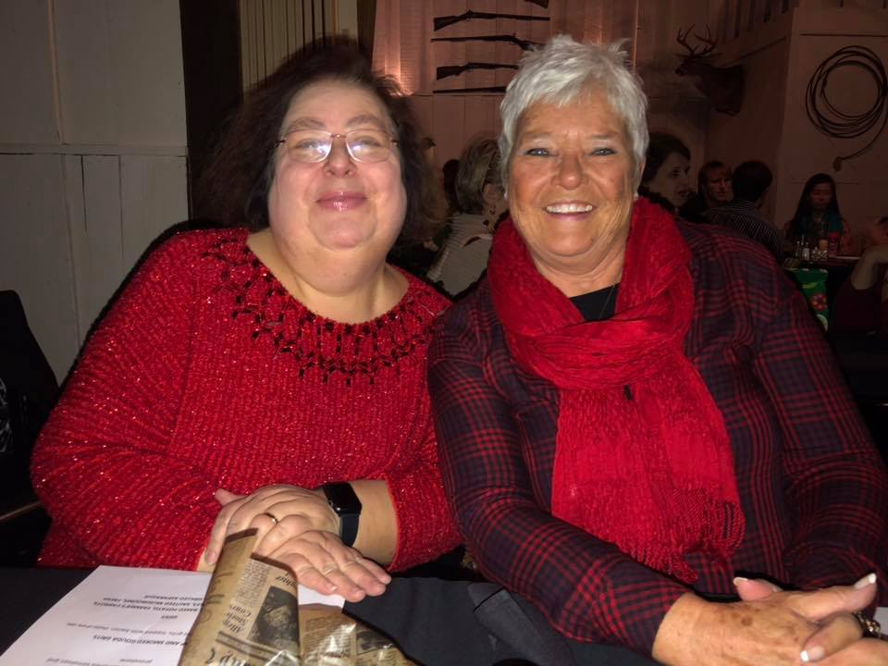
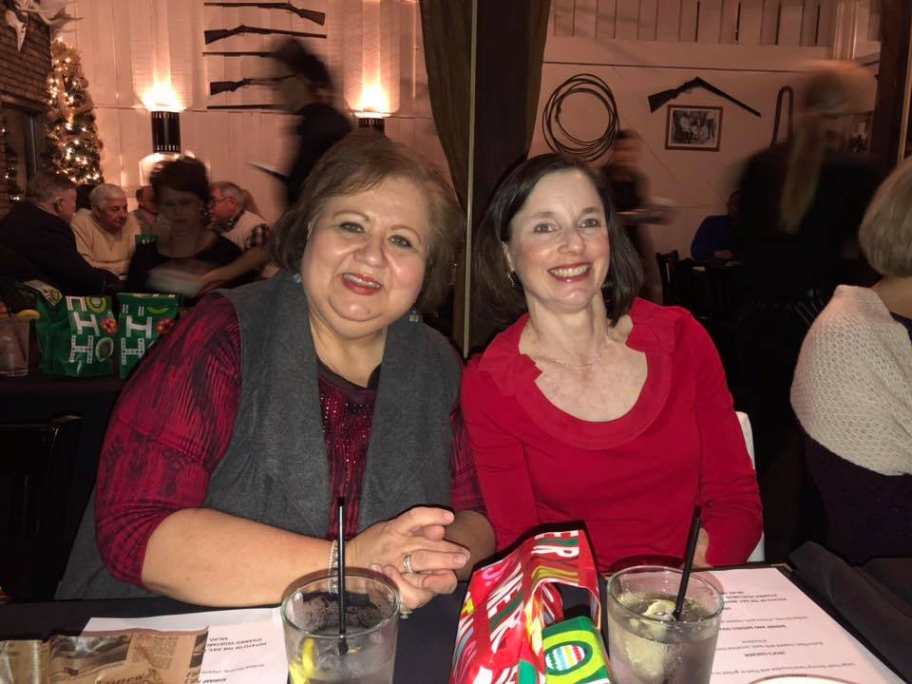
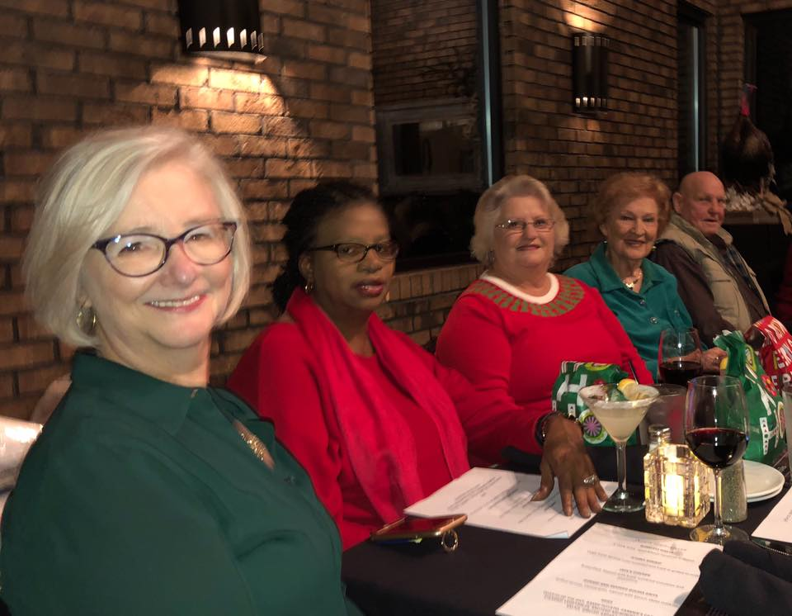
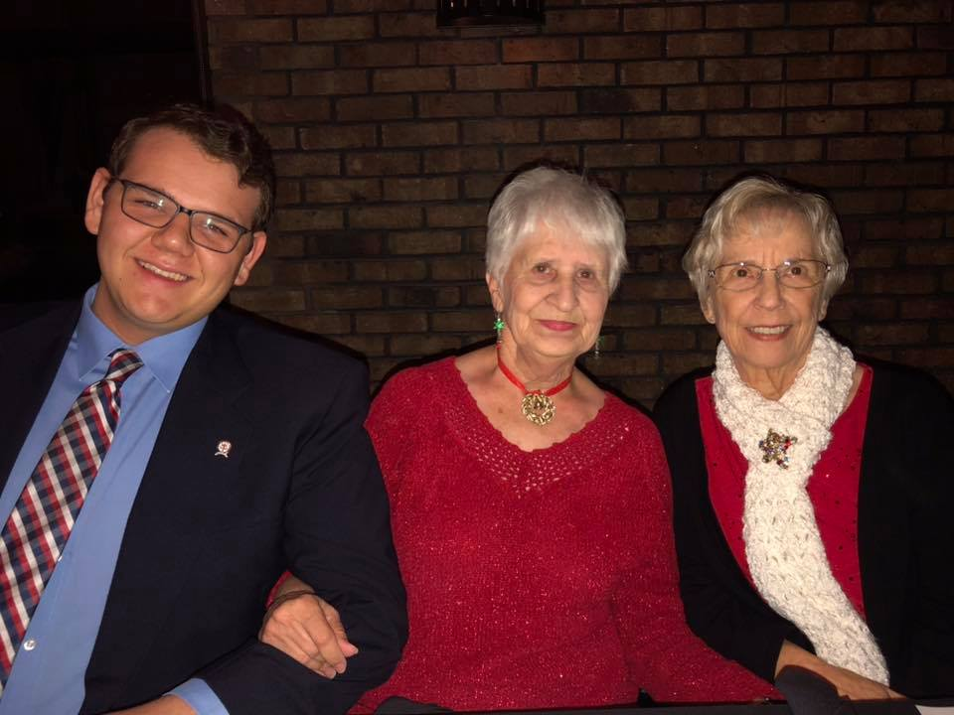
2018 Christmas Party

Slide 25
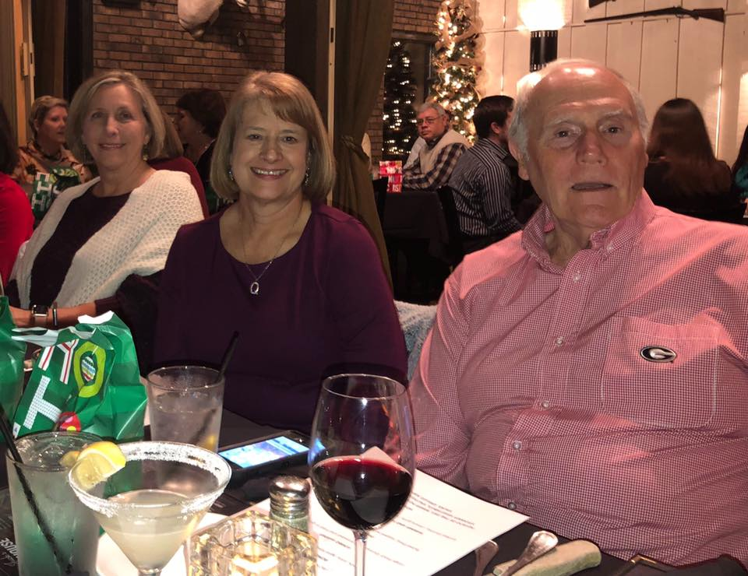
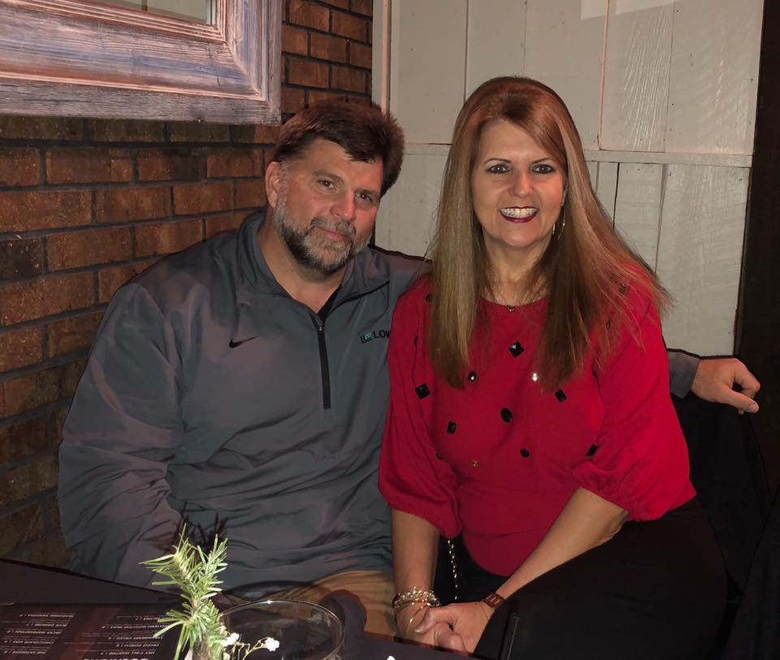

Slide 26
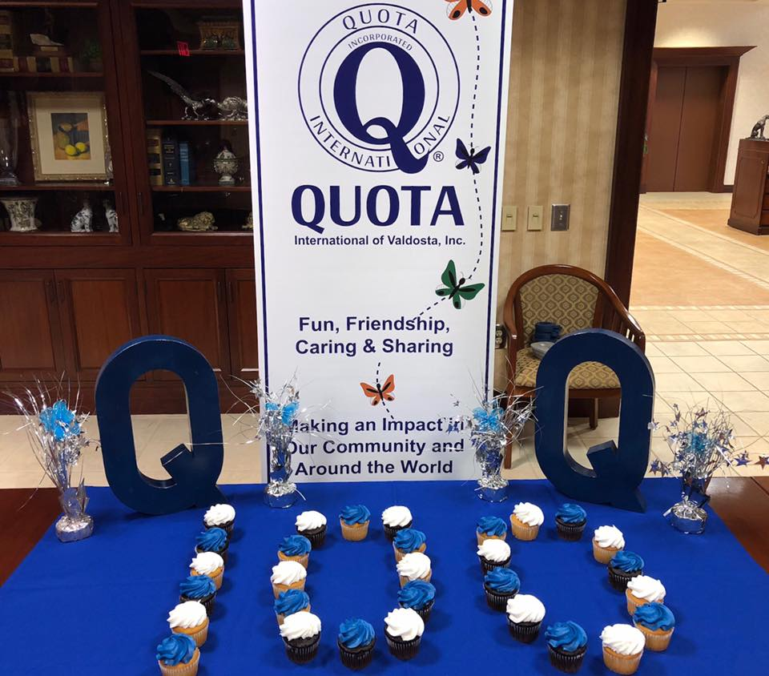
Celebrating Quota’s 100 Years

Slide 27
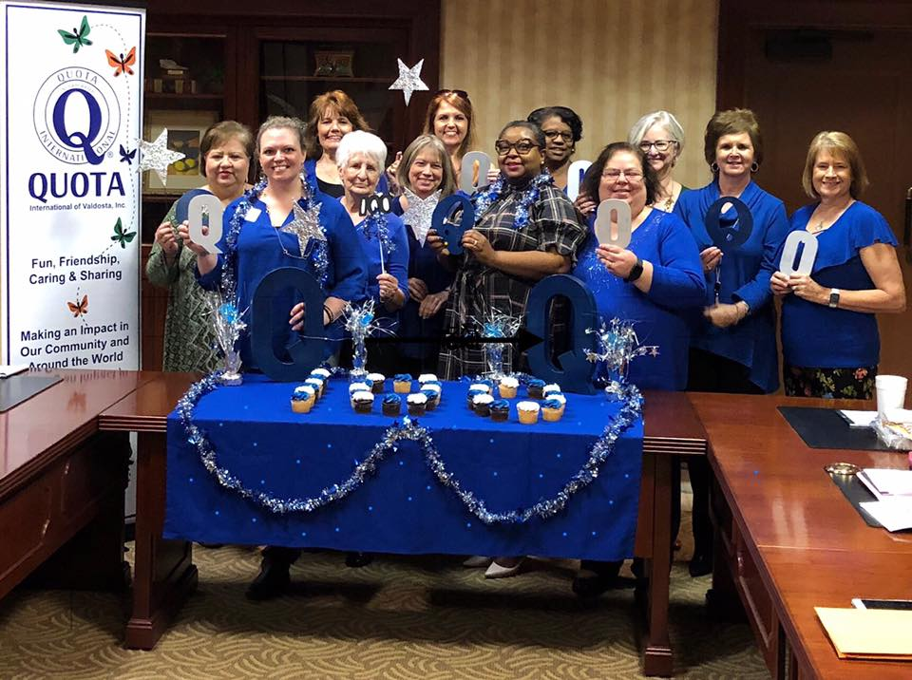

Slide 28
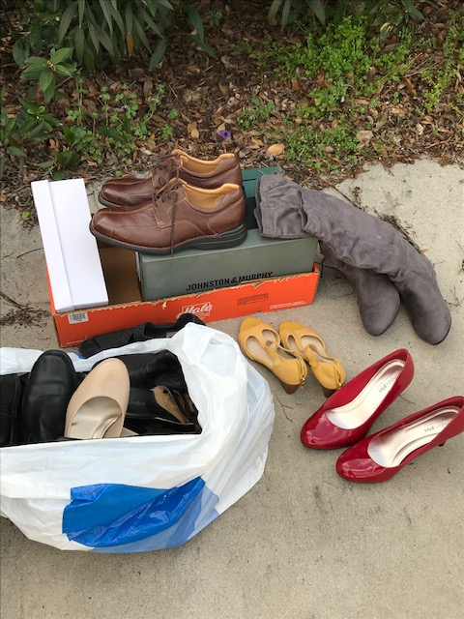
Quota Cares
Living Bridges Ministry – Soles for the Soul
Shoes are taken to third world countries to set people up with shoes businesses. The shoe business creates an income for a family and gives them a hand up out of their poverty and into self sufficient living.

Slide 29
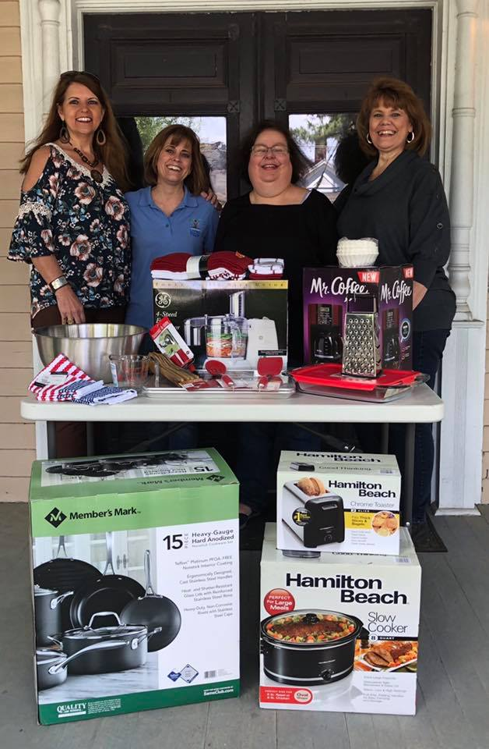
Quota Cares – Living Bridges Ministry
Donated Kitchen Items to be used for the Healthy Eating and Cooking classes

