Slide 1
President’s Report
Quota International
of
Coral Springs/Parkland

Slide 2
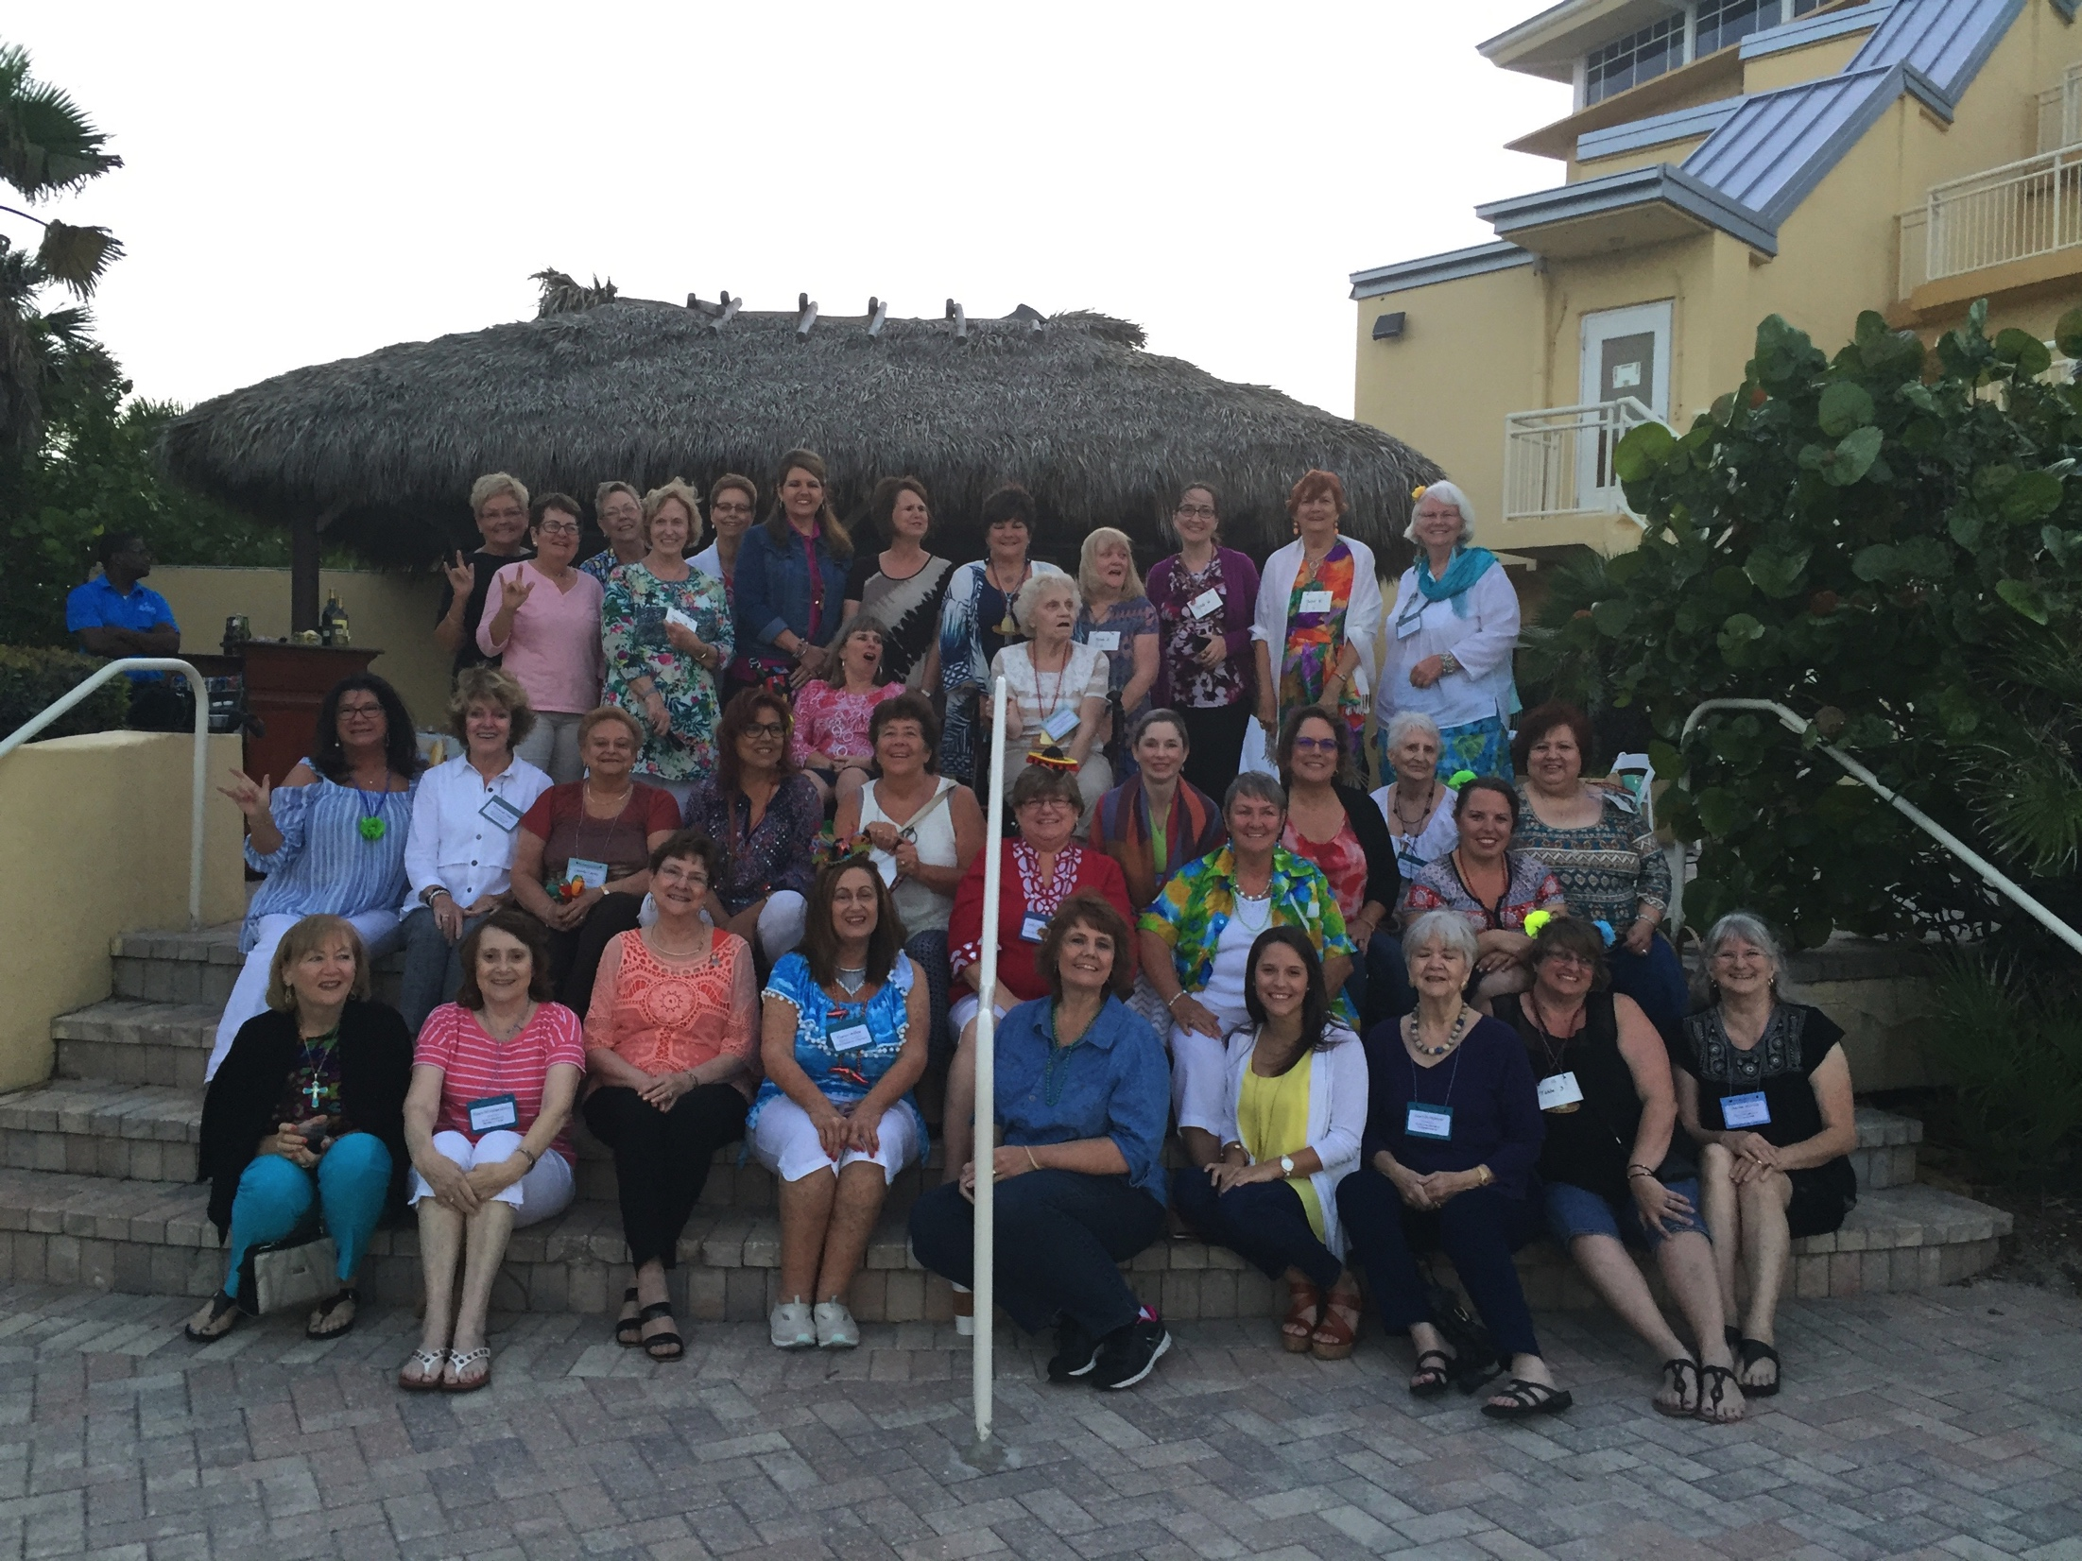
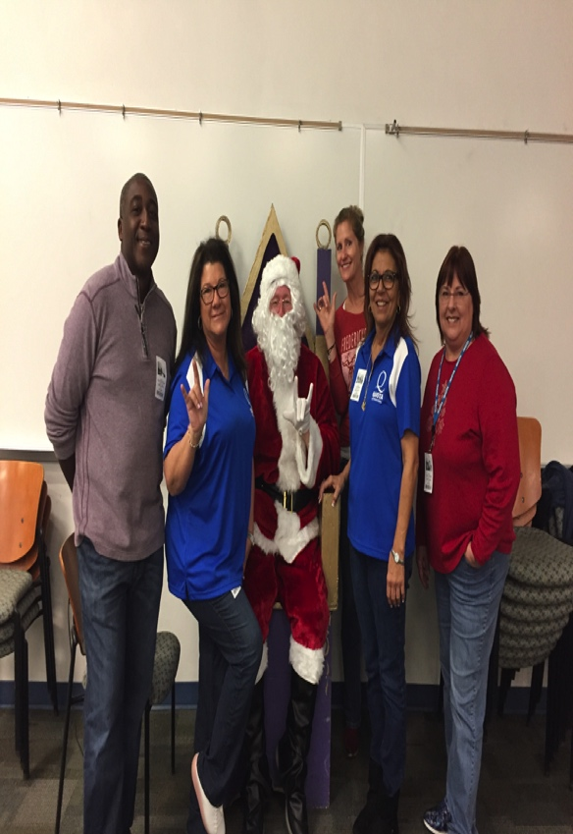
Quota International of Coral Springs/Parkland
Quota International Region 8 Meeting April 26-28, 2019

Slide 3
What Didn’t Work:
*Membership Drives
*Donations
Future Difficulties:
*QI 501c3

Slide 5
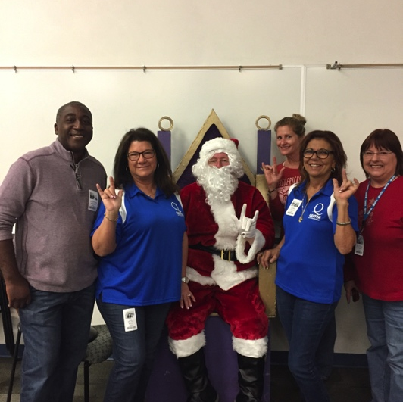
What Worked…
Fundraisers & Service Projects!
Quota International of Coral Springs/Parkland

Slide 6
Main Fundraiser:
5th Annual Joint Fashion Show Luncheon with Kiwanis

Slide 7
A Deaf Expo
Lakeland, Florida
60+ Venders
4000+ Tickets
Helps to Support and Empower the Deaf Community…
Awareness & Network
QI of CS/P
Donates
Raffle Prizes

Slide 8
Signing Santa
Preschool – High School
~
Santa
Frosty
Gingerbread Man
But first, Donuts!

Slide 9
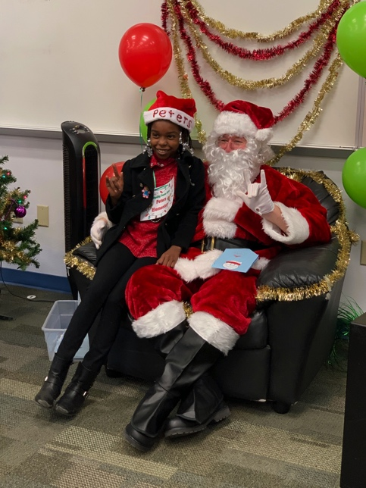
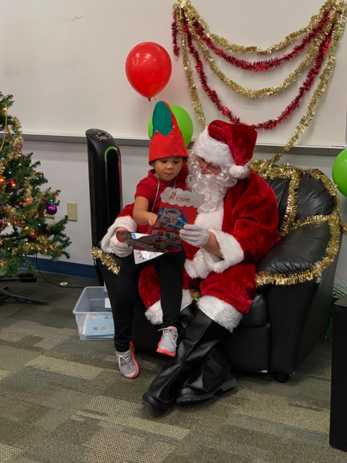
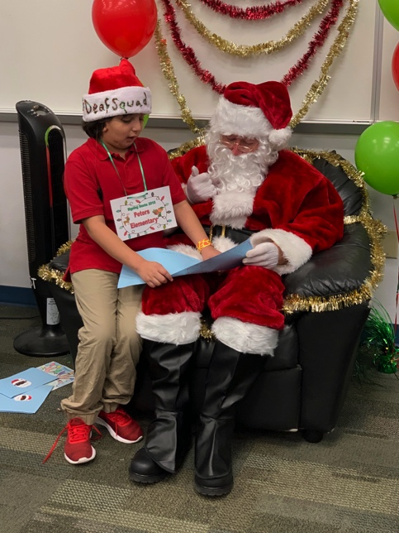
Students get to talk to Santa in their language…

Slide 11
Each student received a Wendy’s Frosty Tag

Slide 13
Recommendation
QI of Coral Springs/Parkland would like to recommend that R8 consider sponsoring Camp Endeavor in some way in 2020 with monies raised from Club Basket Raffle sales at the Region 8 Meeting next year.
Info:
www.CampEndeavorFL.org
Facebook: Sertoma Camp Endeavor

Slide 14
Which row do you pick?

