Slide 1
Quota Club International of Azalea City

Slide 2
News
Azalea City Quota Club had a good year in 2018. Even though we had lower membership than we hoped for, we were still able to help others. We did our annual ham sale in October and as we expected that fundraiser did well. We also added one other fundraiser for 2018. This fundraiser was aimed at getting more community involvement and name recognition for Quota Club. The event was a fall decoration contest for local businesses. We called the event “Spirit of the Season”. Businesses were encouraged to decorate the fronts of their businesses in fall décor that reflected their business type. This event also did very well. We anticipate continuing both of these fundraisers in the future.

Slide 3

October Ham Sale

Slide 4

Spirit of the Season - A Fall Decoration Contest

Slide 5
We were able to help the school system, The Haven, The Pines and B.A.C.A. (biker’s against child abuse) with the funds we raised. We are looking forward to helping others in 2019. We are actively recruiting new members to help us in the efforts of Quota Club. Lastly, we are very proud of our Junior Club that continues to amaze us in their dedication to help others. This club is located at Lighthouse Christian School and they are thriving.

Slide 6
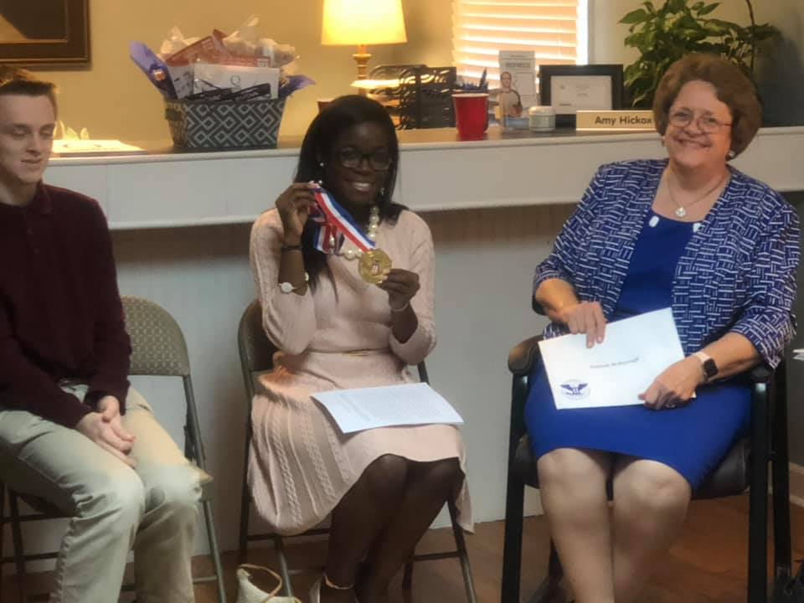
Lighthouse Baptist Jr. Quota Club
Recognizing Jr.
Members for the Academic Accomplishments

Slide 7
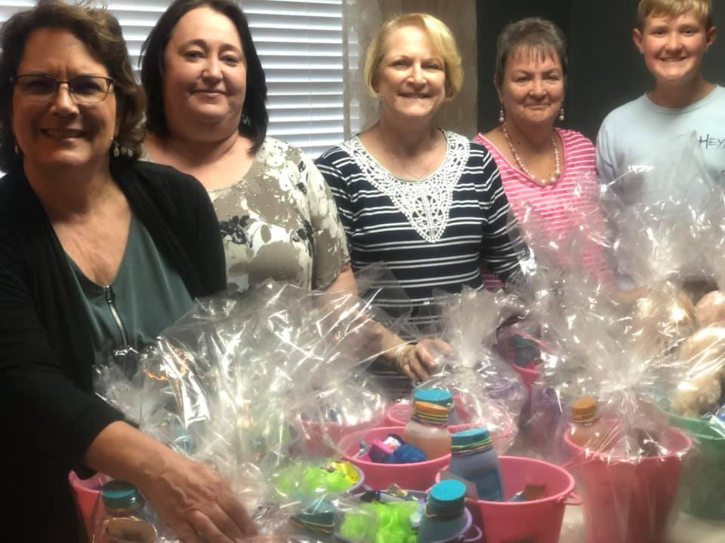
Easter Baskets for The Haven
The Haven is a non-profit organization that provides 24 hour temporary shelter and services to victims of domestic violence and sexual assault.
It is the goal at The Haven to provide victims with the necessary information, resources, support, a protected head start, and supportive follow up to complete the transition out of a
violent
lifestyle into successful independent living.

Slide 8
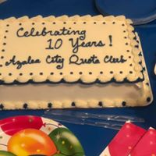
Azalea City Celebrates 10 Years

Slide 9
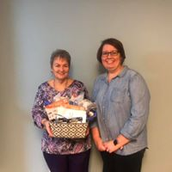
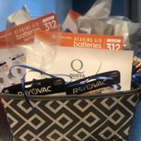
One Year Supply of Hearing Aid Batteries Donated to the Local School Systems

