Slide 1
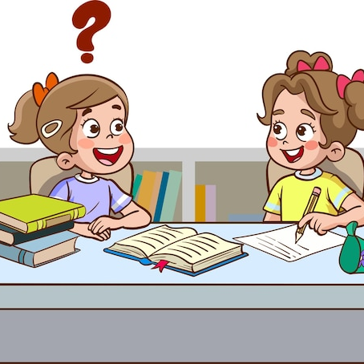
Maze practice
Grade 6 Access
Unit 8-9 Term 3
Grammar and vocabulary

Slide 2
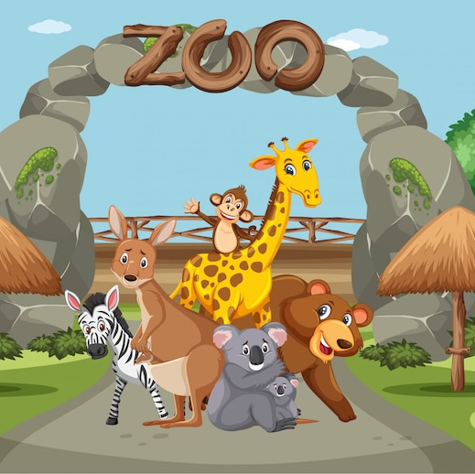
1. A Day at the Zoo
Last weekend, we (1) (a) go / (b) went / (c) goes to the zoo with my uncle. It was a sunny day, and the animals (2) (a) were / (b) are / (c) is very active. My sister (3) (a) can / (b) cans / (c) could see the monkeys swinging from tree to tree. “Wow! This place is amazing,” I (4) (a) said / (b) say / (c) saying. You should (5) (a) bring / (b) brings / (c) brought your camera to take some pictures!

Slide 3
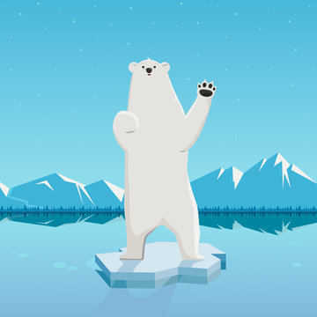
2. Exploring Polar Animals
Polar animals (1) (a) can / (b) could / (c) may live in very cold places. For example, polar bears (2) (a) cans / (b) can / (c) could swim for long distances in icy water. Last year, I (3) (a) watch / (b) watched / (c) watches a documentary about penguins. It (4) (a) is / (b) was / (c) were very interesting! If you visit the Arctic, (5) (a) don’t / (b) can’t / (c) always wear light clothes.

Slide 4

3. My Uncle’s Modern House
My uncle lives in a (1) (a) few / (b) really / (c) quiet modern house. It has big windows and solar panels on the roof. You (2) (a) could / (b) can / (c) cans see the mountains from the living room! Last summer, we (3) (a) stay / (b) stays / (c) stayed there for a weekend. My cousins and I (4) (a) plays / (b) play / (c) played in the garden and had fun. You should (5) (a) visit / (b) visited / (c) visits it one day!

Slide 5
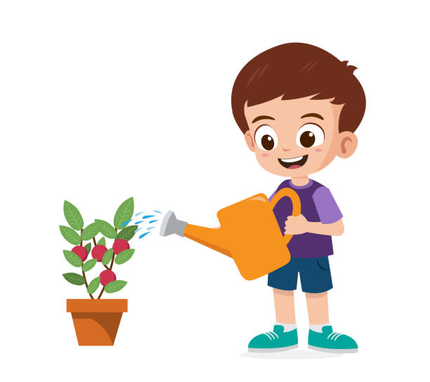
4. Science and Plants
In science class, we (1) (a) learn / (b) learned / (c) learns about how plants grow. Our teacher said plants (2) (a) can’t / (b) can / (c) will grow without sunlight and water. Last week, I (3) (a) plant / (b) planted / (c) planting a seed in a cup. After three days, I (4) (a) see / (b) saw / (c) seed a small sprout! If you want to try, you (5) (a) don’t / (b) must / (c) never water it every day.

Slide 6
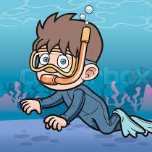
5. Life Under the Ocean
The ocean is home to many animals. Some fish (1) (a) can / (b) could / (c) cans glow in the dark! Last summer, I (2) (a) go / (b) went / (c) goes snorkeling for the first time. I (3) (a) sees / (b) saw / (c) see a sea turtle swimming slowly. “This is the best trip ever,” I (4) (a) say / (b) said / (c) saying. If you go to the beach, (5) (a) don’t / (b) can / (c) never touch unknown animals.

Slide 7
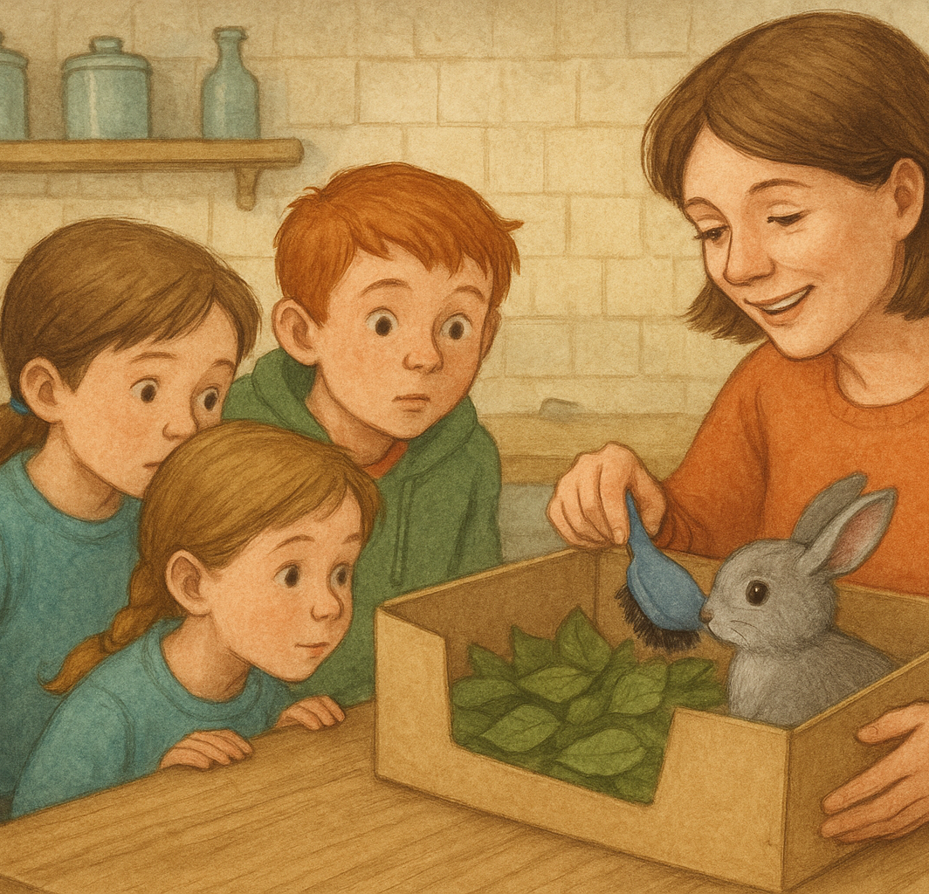
6. The rabbit
Yesterday my friends and I 1 (A. walked B. walk C. walking) through the quiet forest near our village. Suddenly, we heard a rustling sound in the thick bushes beside the path. We pushed some branches away and saw a small grey rabbit. Its fluffy 2 (A. foot B. ear C. tail) was shaking, and it couldn’t move.
“We 3 (A. can B. has C. did) take it home and look after it,” I said.
At home, Mum put the rabbit in a box lined with soft 4 (A. stones B. leaves C. bottles). Then she smiled and said, “5 (A. Brush B. Brushed C. Brushing) the rabbit gently every day, and it will soon be healthy.”

