Slide 1

Inference and justification practice
Grade 6 Access
Unit 8-9 Term 3
Reading

Slide 2

Salama is a 13-year-old girl from Al Ain who loves animals. While other kids wanted toys, she always asked to visit the animal shelter. At age 10, she adopted her first pet—a white rabbit named Lulu. Salama cleaned Lulu’s cage every morning and read stories to her after school.
Two years later, Salama found a weak orange kitten on the street. She took it home, fed it warm milk, and named it Dana. At first, Lulu was scared of Dana and stayed in her cage. Salama didn’t push them to be friends. Instead, she spent time with both, gave them treats, and spoke softly. After a few weeks, they began to play and now rest near each other while Salama does homework.
Salama dreams of becoming a vet. She says animals don’t speak, but “if you listen carefully, they’ll still tell you how they feel.”
Why do you think Salama didn’t try to force Lulu and Dana to be friends right away?
What parts of the text support your answer to the inference question?

Slide 3
Inference Question:
Why do you think Salama didn’t try to force Lulu and Dana to be friends right away?
Possible Answers:
She wanted them to feel safe and not scared.
She knew animals need time to get used to each other.
She was patient and careful with both pets.
Justification Question:
What parts of the text support your answer to the inference question?
Possible Answers:
“Salama didn’t push them to be friends.”
“She spent time with both, gave them treats, and spoke softly.”
“After a few weeks, they began to play...”
These lines show she was patient and gentle, not rushing the animals.

Slide 4
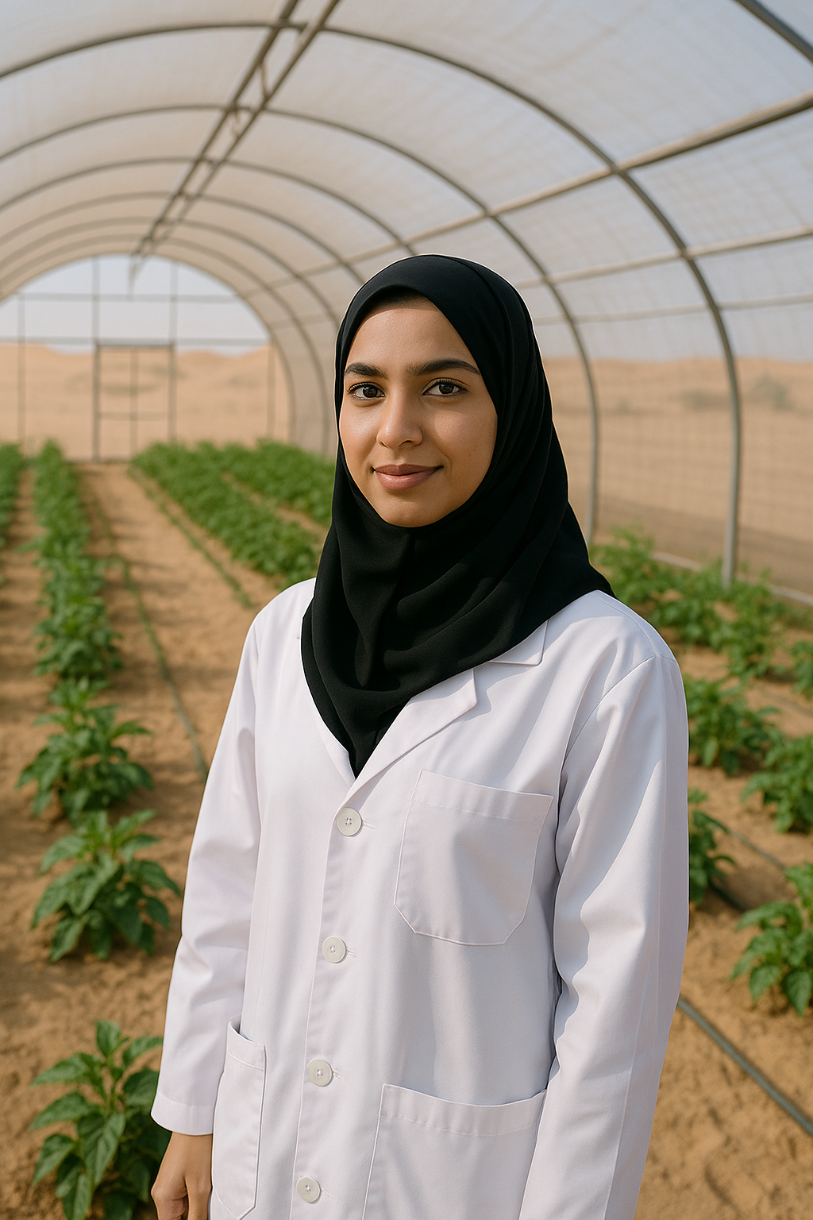
Dr. Fatima Al Kaabi is a young Emirati scientist who is changing the future of agriculture in the UAE. Growing up, she always loved science and nature. When she was a child, she used to plant flowers and vegetables in her backyard, even though the desert soil made it difficult. Today, she works to solve problems related to food and farming in dry climates.
Dr. Fatima leads a team of researchers who study how to grow plants in harsh environments. One of their projects uses smart greenhouses, where plants can grow with little water and without soil. Her team also works with solar panels, which provide clean energy to help the plants grow. These greenhouses are important because they allow food to grow even in the dark, cloudy days of winter.
Many farmers in the UAE have started using Dr. Fatima’s methods. This is not just good for the environment — it also helps people see that science can bring real change to their lives. Thanks to her work, desert areas are slowly turning green, and the UAE is becoming more self-sufficient in food production.
Why do you think Dr. Fatima’s work is important for the UAE?
Which parts of the text helped you understand why her work matters?

Slide 5
1. Inference Question:
Why do you think Dr. Fatima’s work is important for the UAE?
Possible Answers:
Because she helps grow food in the desert where it’s hard to plant things.
Because her work helps farmers use less water and energy.
Because she is making it easier for the UAE to produce its own food.
Because she is finding new ways to grow plants in difficult conditions.
2. Justification Question:
Which parts of the text helped you understand why her work matters?
Possible Answers:
The part that says “Her team also works with solar panels, which provide clean energy to help the plants grow.”
The sentence “Thanks to her work, desert areas are slowly turning green.”
When it says “Many farmers in the UAE have started using Dr. Fatima’s methods.”
The idea that her work “helps people see that science can bring real change to their lives.”

Slide 6
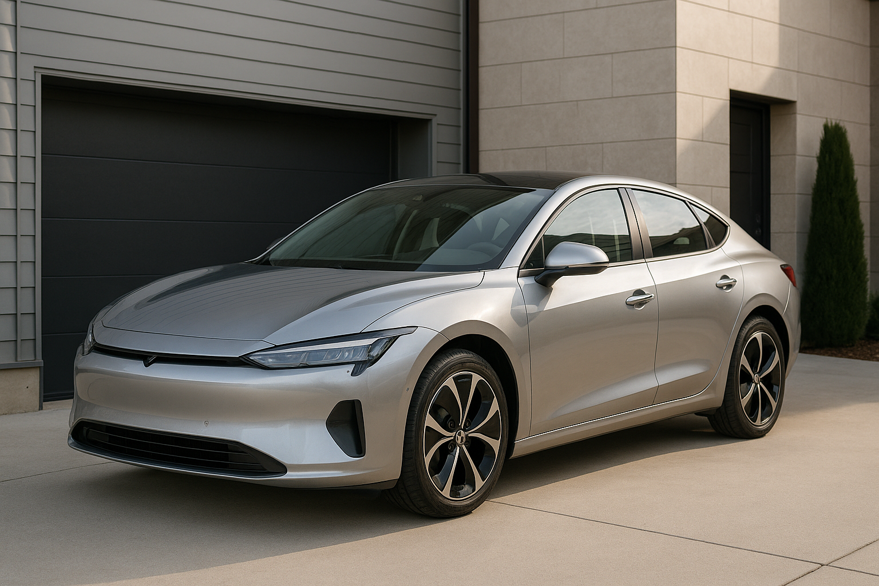
My uncle and aunt recently bought a new car, and it’s really impressive. It’s a modern electric vehicle with many advanced features like a touchscreen dashboard, automatic parking, and voice control. They were both very interested in buying a car that is eco-friendly because they care about the environment.
The car is not only practical but also beautiful. It has a sleek design with shiny silver paint and comfortable leather seats. Whenever they drive it, people often stop and admire the car’s elegant appearance.
My uncle told me that besides being beautiful, the car helps them save money on fuel and reduces pollution. My aunt enjoys how quiet and smooth the ride is, which makes their daily commute much more pleasant.
Why do you think my uncle and aunt chose an electric car instead of a traditional gasoline car?
Explain how different parts of the text show that my uncle and aunt care about the environment.

Slide 7
Inference question:
Why do you think my uncle and aunt chose an electric car instead of a traditional gasoline car?
Possible answers:
Because they care about the environment and want to reduce pollution.
Because electric cars are more modern and have advanced features they like.
Because they want to save money on fuel.
Justification question:
Explain how different parts of the text show that my uncle and aunt care about the environment.
Possible answers:
The text says they were “interested in buying a car that is eco-friendly,” which means they want to protect nature.
The car is electric, so it “reduces pollution” compared to gasoline cars.
They want to “save money on fuel,” which shows they are choosing a cleaner, more sustainable option.

Slide 8
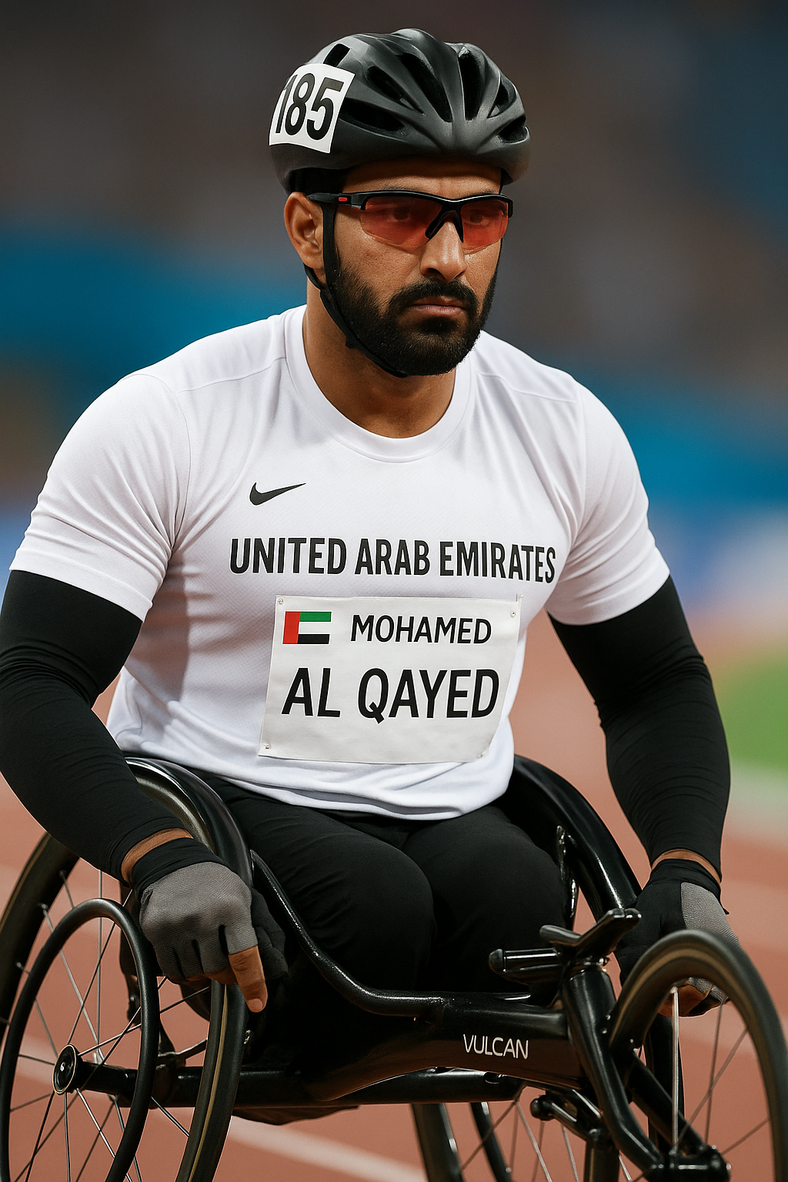
The Paralympic Games are a special sports event for athletes with disabilities. These games show the world that true strength is not only about muscles, but also about courage and determination. Many athletes who join the Paralympic Games had to survive very difficult times in their lives.
One inspiring example is the Emirati athlete Mohamed Al Qayed. He was born with a disability that affects his legs. But this never stopped him from dreaming. With hard work and support from his family, he became one of the fastest wheelchair racers in the world. His speed on the track shows his amazing power and will.
In the 2016 Rio Paralympic Games, Mohamed won a bronze medal in the 800-meter wheelchair race. He trained for many years to reach this level. His strength and focus helped him win against many other strong athletes from around the world.
Not all athletes at the Paralympic Games use wheelchairs. Some are deaf, some are blind, and others have lost arms or legs. But they all share one thing: they never give up. They keep training and working hard, showing what humans can do even with big challenges.
Why do you think Mohamed Al Qayed is considered an inspiring athlete?
Which parts of the text help you understand why Mohamed Al Qayed is inspiring? Explain your answer using at least two pieces of information from the text.
Picture generated by AI

Slide 9
Inference Question:
Why do you think Mohamed Al Qayed is considered an inspiring athlete?
Possible Answers:
Because he didn’t give up even though he has a disability.
He worked hard and became one of the fastest wheelchair racers.
He survived a difficult life and still won a medal.
He shows that strength is not only about the body but also about the mind.
Justification Question:
Which parts of the text help you understand why Mohamed Al Qayed is inspiring? Explain your answer using at least two pieces of information from the text.
Possible Answer:
The text says he was born with a disability but still had big dreams.
It also says he trained for many years and won a bronze medal.
He showed speed and strength on the track.
The text says he had to survive difficult times and still became a champion.

Slide 10
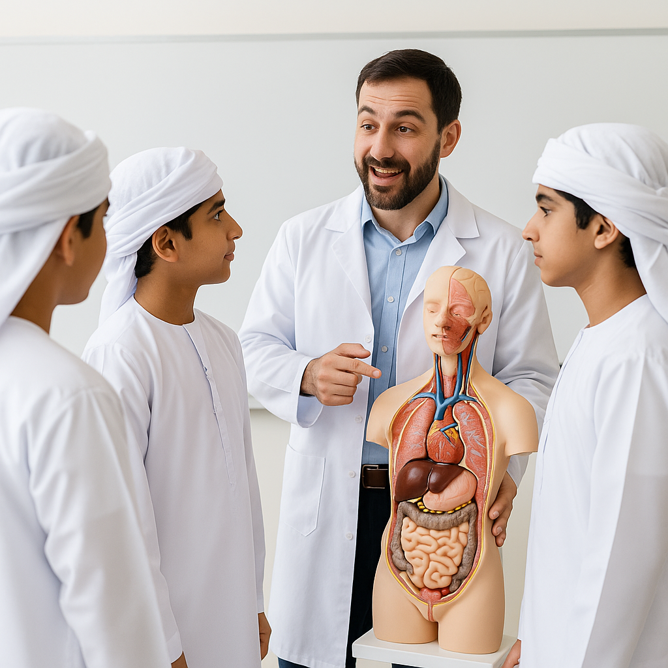
Today in science class, our teacher, Mr. Adam, taught us about the heart and how it works. He showed us a model of the human body and explained that the heart is a strong muscle. It pumps blood through our bodies every second.
Mr. Adam told us that blood carries important things like oxygen to all parts of the body. He said, “Without oxygen, your body cannot work properly.” We learned that when we run or play sports, our heart beats faster. This is because our muscles need more oxygen.
We also talked about temperature. Mr. Adam explained that when we are sick, our body temperature goes up. That means our body is fighting germs. The heart and blood help carry white cells that protect us.
At the end of the lesson, we watched a video showing how the heart pumps blood and keeps the body alive. I liked this lesson because I learned how amazing the human body is.
Why do you think the heart beats faster when you play sports?
Which parts of the text helped you understand your answer?

Slide 11
Inference Question:
Why do you think the heart beats faster when you play sports?
Possible Answer:
Because the muscles need more oxygen, so the heart works harder to send more blood with oxygen to the body.
Justification Question:
Which parts of the text helped you understand your answer?
Possible Answer:
The part that says, “when we run or play sports, our heart beats faster. This is because our muscles need more oxygen.” And also the part that says, “blood carries important things like oxygen to all parts of the body.”

