Slide 1
English Final Exam Review
Grade 8 BTS Term 2
ALL ACTIVITY ANSWERS ARE AT THE END

Slide 2
Table of Contents
Click on the box to go to the slide.
Exam Summary
MAZE Practice 1
Writing Review
MAZE Practice 2
Writing Practice
Keywords Review
Grammar Review
Reading Comprehension
Grammar Practice
All Activity Answers

Slide 3
Exam Overview
Table of Contents
Date March 13-21th 2024

Slide 4
Writing Exam (Paper)
Table of Contents
5 minutes
2 SENTECES!
Part 1
Write your opinion.
10 minutes
4 CIRCLES!
Part 2
Write your plan for your essay.
40 minutes
10 SENTENCES!
Part 3
Write your essay (introduction, body and conclusion).
10 minutes
2 SENTENCES EACH!
Part 4
Read a text and answer 2 questions using evidence from the text.

Slide 5
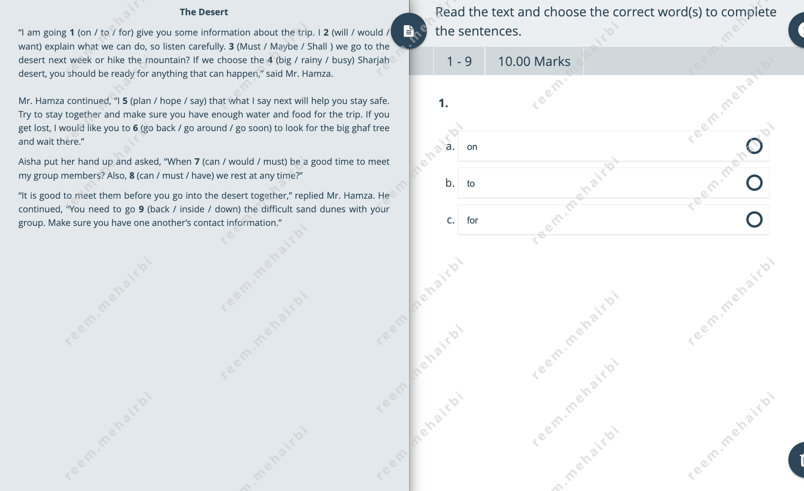
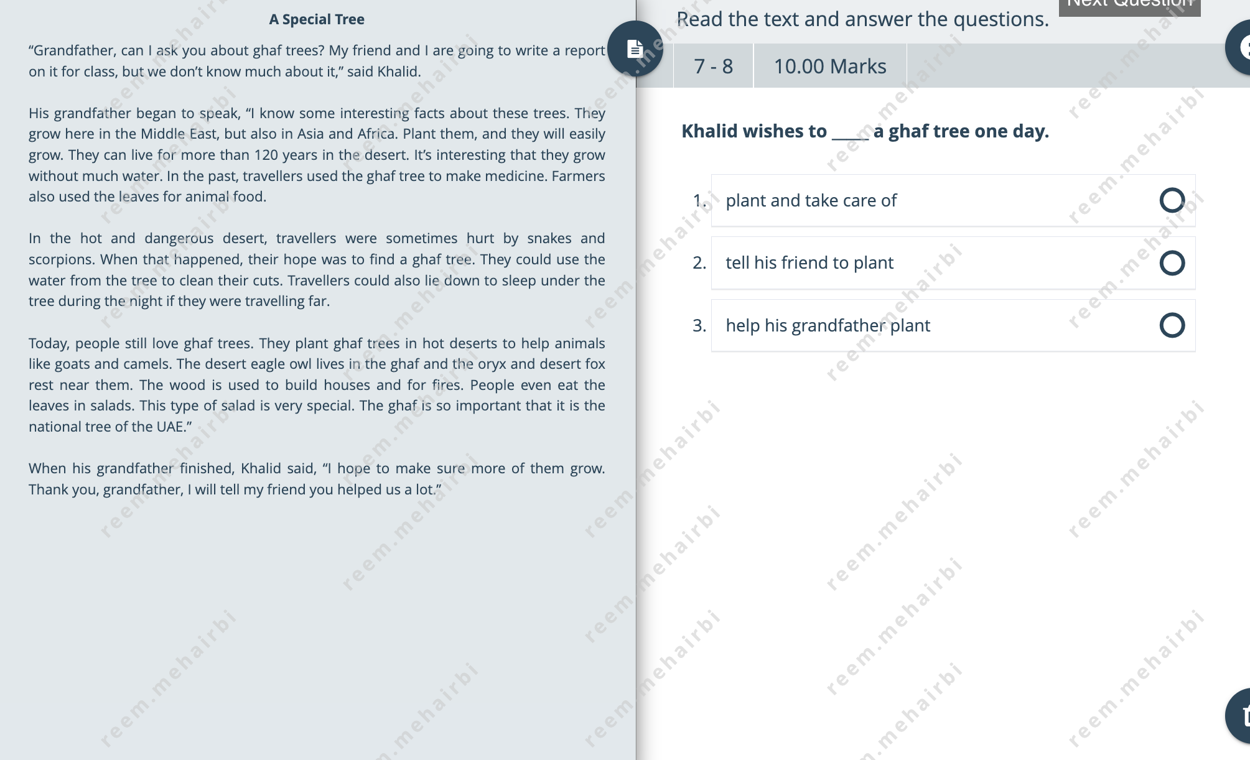
Reading Exam (Online)
Table of Contents
Parts 5 & 6
MAZE Assessment - Choose the word that completes the sentence.
Parts 7 & 8
Read the questions and find the answers in the Text #1.
Part 9
Read the questions and find the answers in the Text #2.

Slide 6
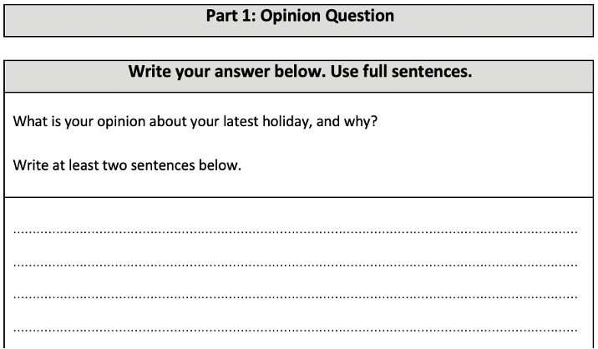
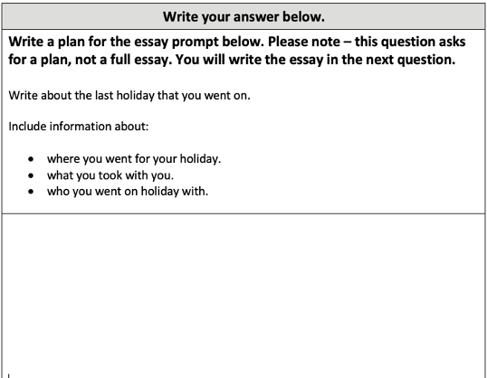
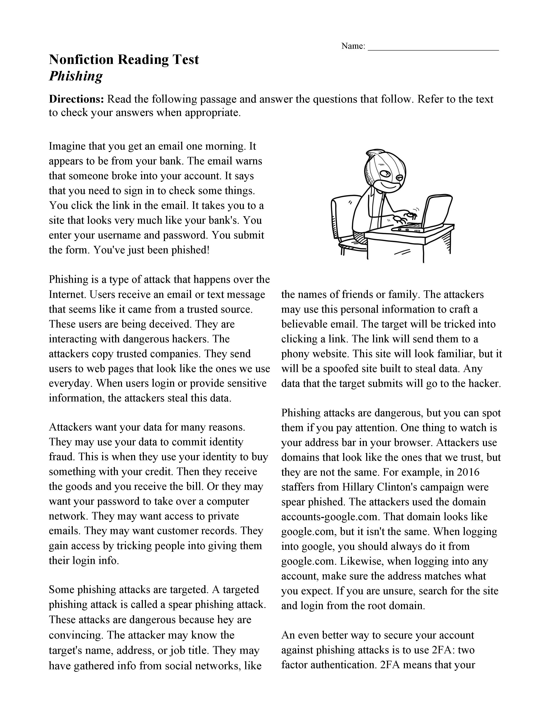
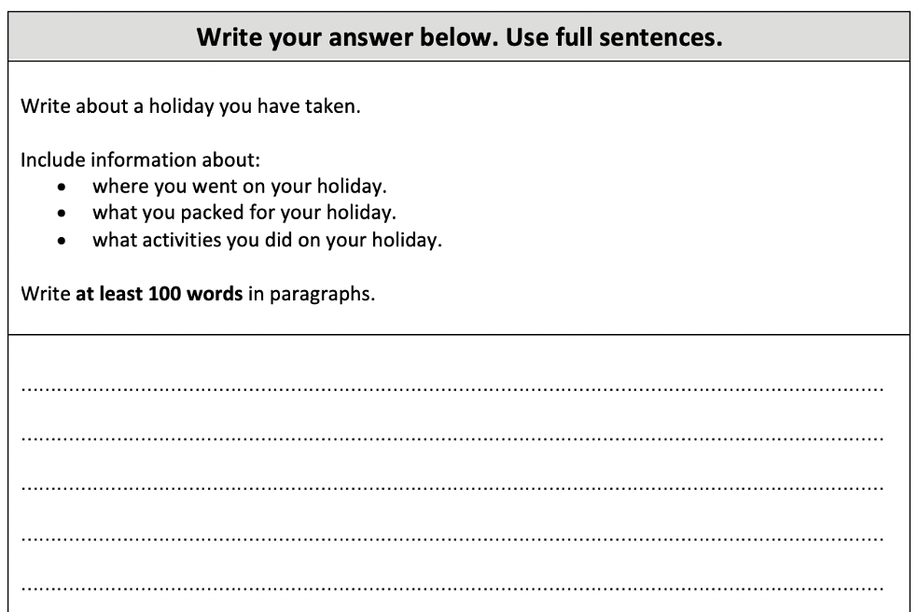
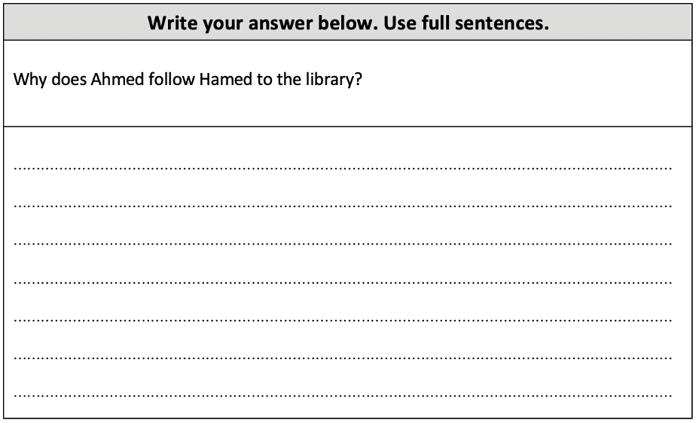
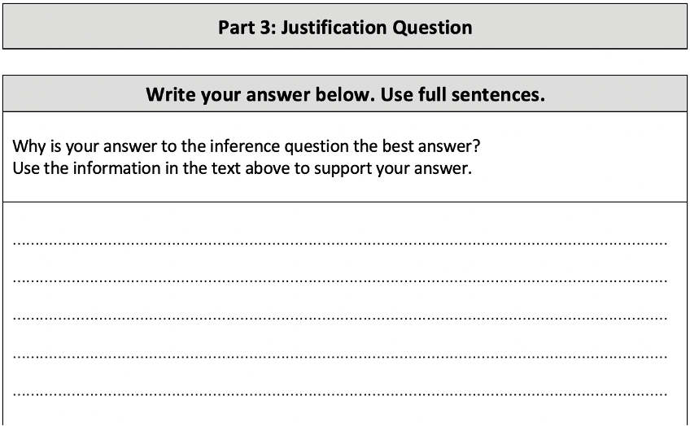
Remember! We are practicing for your exam!
Table of Contents
Writing an Essay
writing an opinion, planning and essay
Reading Comprehension
answering a question, justifying your answer
Two sentences ONLY!
Two sentences ONLY!

Slide 7
Types of Short Answer Questions
Opinion
Inference
Justification
Your ideas.
Your ideas.
From the text
What you think or believe.
Use your understanding of the text to give an answer.
Explain why you chose this answer with evidence from the text.

Slide 8
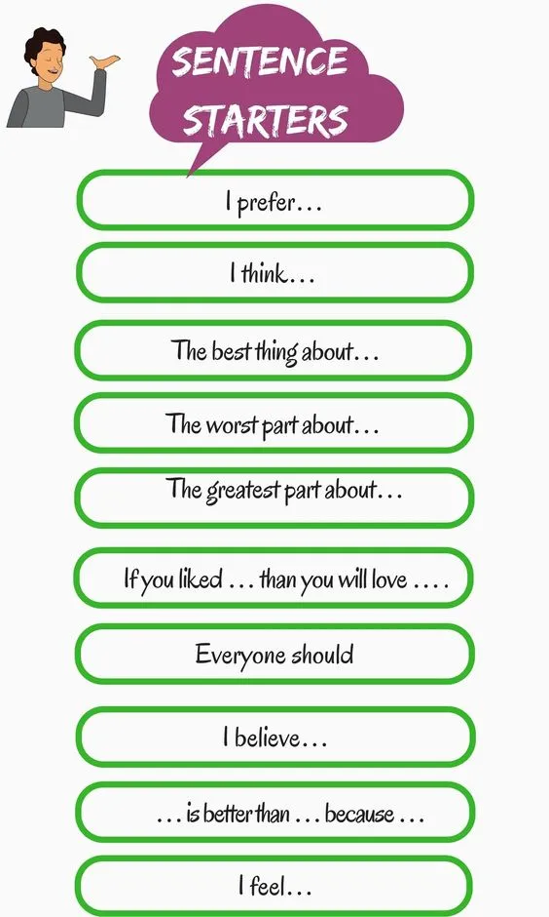
Opinion
What is your opinion about having school in Ramadan? Write two sentences and explain.
_____________________________________
_____________________________________
_____________________________________
_____________________________________
I believe it is a terrible idea. Ramadan is made for prayer and fasting we should not be in school.
I prefer we stay at home. So we can focus on our prayers, reading Quran and donating to the needy.
Your ideas.
What is your opinion about learning English? Write two sentences and explain.
_____________________________________
_____________________________________
_____________________________________
_____________________________________
What you think or believe.
Learning English is actually a good idea. Since most jobs require English.

Slide 9
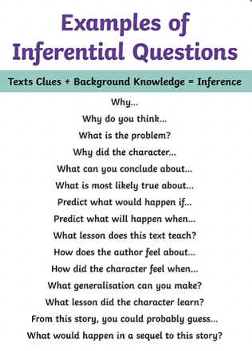
Inference
When Jake was ten, he was really good at doing magic tricks. He liked showing off his tricks to his friends and family, surprising them with how clever he was. One day, he wanted to show even more people what he could do, so he joined a talent show. When he got on stage, everyone was amazed when he made a coin disappear and then reappear in someone's hand.
Your ideas.
What do you think made Jake want to be a magician when he was so young?
_____________________________________
_____________________________________
_____________________________________
_____________________________________
Use your understanding of the text to give an answer.

Slide 10
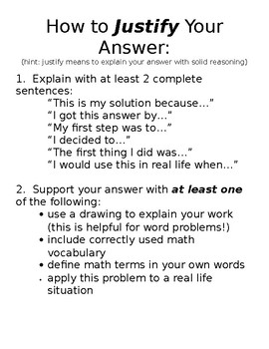
Justification
Once there was a girl named Lily who loved to read books under the oak tree in her backyard. One day, she found a magical book hidden in the attic that transported her to different worlds with every turn of the page. As she embarked on thrilling adventures, she wondered if the book had always been there waiting for her to discover it. What made Lily decide to explore the attic and find the book?
From the text
What made Lily decide to explore the attic and find the book?
_____________________________________
_____________________________________
_____________________________________
_____________________________________
Explain why you chose this answer with evidence from the text.
piece of evidence from the text.

Slide 11
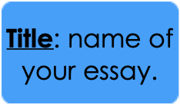
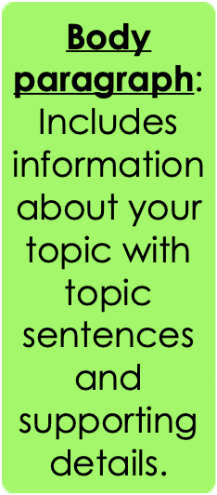
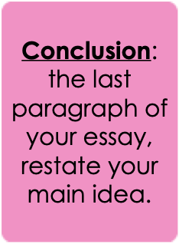
What are the parts of an essay?
Table of Contents
Are video games a good way to keep fit?
Nowadays, many teenagers have got video consoles at home and they often like playing active video games. These are good for you for a number of reasons.
First of all, I think that active video games are a good way to keep fit. There are lots of different types of exercise you can do such as basketball, water-skiing and dance and, what's more, you can play them in the comfort of your own home. 11n my opinion, these games are fun and interactive because you can play them with friends and, if you play online, you don't need to be in the same place as your friend to play. In addition, you can play them whenever you want. Some people think that it's better to do exercise outside in the fresh air. Although this is true, it's actually difficult to play outside when it's raining or very hot so video games are a good alternative.
To sum up, I believe that video games are a fun and social way to keep fit. I think they are a good option when you can't play outside and they might encourage people to do more exercise.

Slide 12
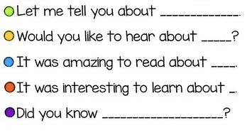
Introduction
Table of Contents
Are video games a good way to keep fit?
Nowadays, many teenagers have got video consoles at home and they often like playing active video games. These are good for you for a number of reasons.
First of all, I think that active video games are a good way to keep fit. There are lots of different types of exercise you can do such as basketball, water-skiing and dance and, what's more, you can play them in the comfort of your own home. 11n my opinion, these games are fun and interactive because you can play them with friends and, if you play online, you don't need to be in the same place as your friend to play. In addition, you can play them whenever you want. Some people think that it's better to do exercise outside in the fresh air. Although this is true, it's actually difficult to play outside when it's raining or very hot so video games are a good alternative.
To sum up, I believe that video games are a fun and social way to keep fit. I think they are a good option when you can't play outside and they might encourage people to do more exercise.
Introduction Starters

Slide 13
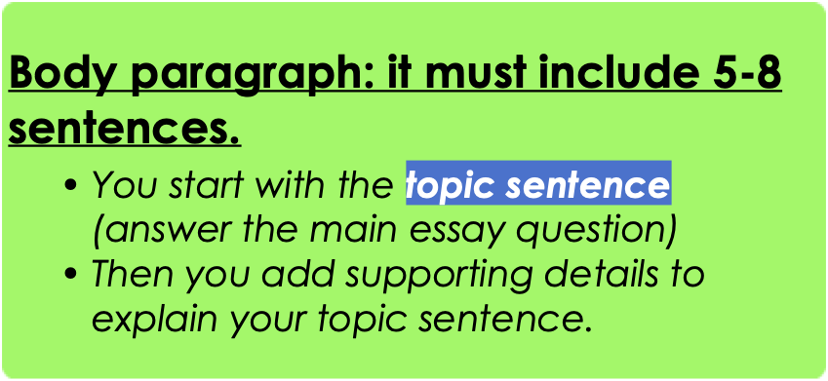
Body Paragraph
Table of Contents
Are video games a good way to keep fit?
Nowadays, many teenagers have got video consoles at home and they often like playing active video games. These are good for you for a number of reasons.
First of all, I think that active video games are a good way to keep fit. There are lots of different types of exercise you can do such as basketball, water-skiing and dance and, what's more, you can play them in the comfort of your own home. In my opinion, these games are fun and interactive because you can play them with friends and, if you play online, you don't need to be in the same place as your friend to play. In addition, you can play them whenever you want. Some people think that it's better to do exercise outside in the fresh air. Although this is true, it's actually difficult to play outside when it's raining or very hot so video games are a good alternative.
To sum up, I believe that video games are a fun and social way to keep fit. I think they are a good option when you can't play outside and they might encourage people to do more exercise.
topic sentence
topic sentence
supporting detail 1
supporting detail 2
supporting detail 3
supporting details
supporting detail 4

Slide 14
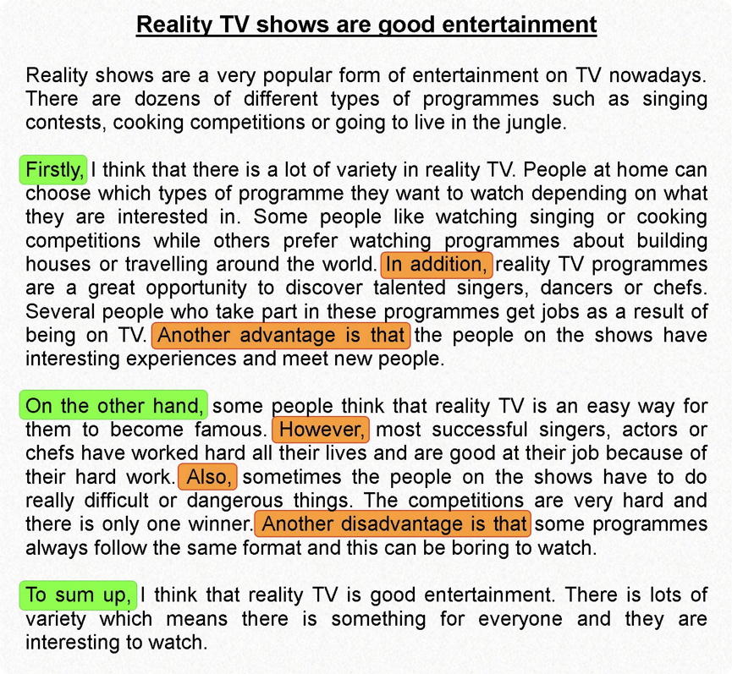
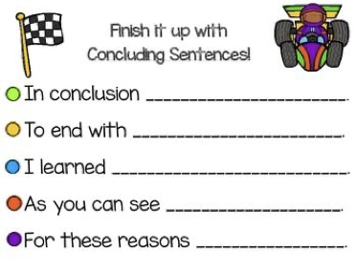
Conclusion
Table of Contents

Slide 15
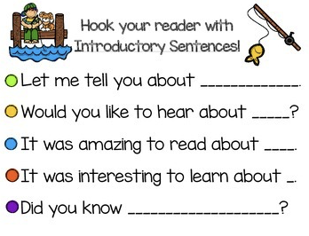
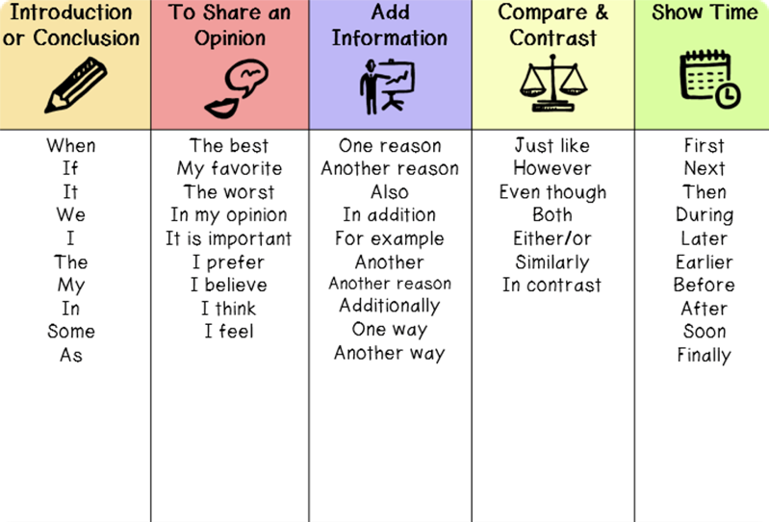
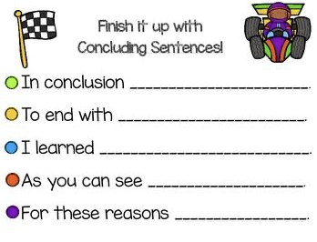
Sentence Starters
Table of Contents
Missss can I use and or because to start my sentenceeee?
NO!
Missss how can I start my sentennceee?

Slide 16
Part 1: Opinion
Table of Contents

Slide 17
Part 2: Plan (A)
Table of Contents

Slide 18
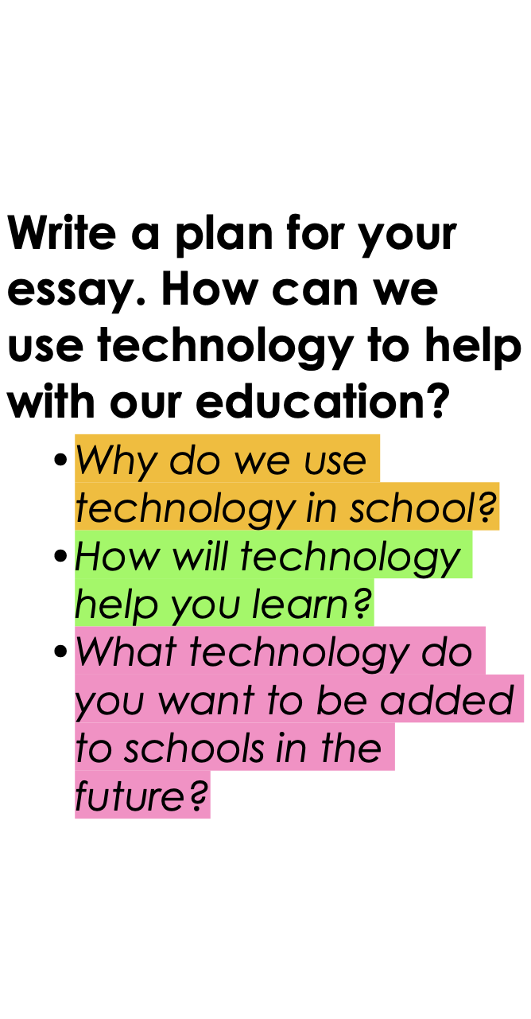
Part 2: Plan (B)
Table of Contents
Use this to plan for the essay on the next page.

Slide 19
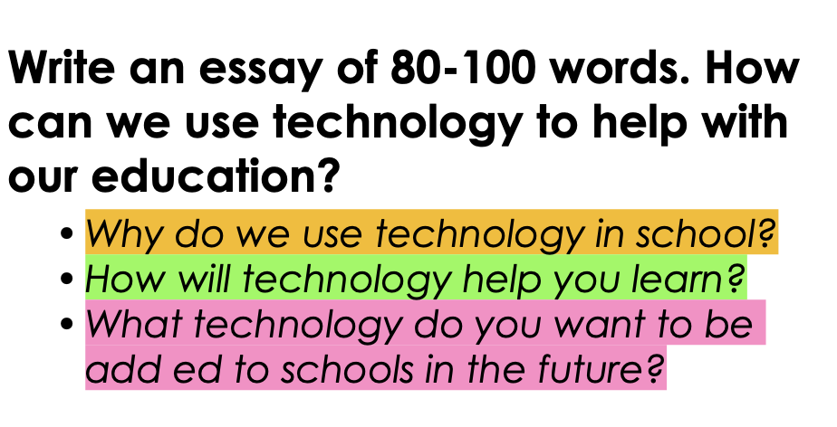
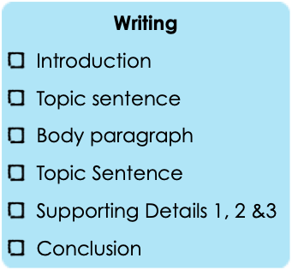
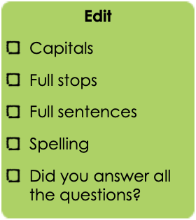
Part 3: Essay
Table of Contents
TECHNOLOGY IN SCHOOL AND EDUCTAION ONLY!!

Slide 20
Part 4: Inference & Justification
Table of Contents
Hamed loved going to the library after school. He liked reading books there. One day, he went to find new stories. But he saw Ahmed, a boy from his class, sneaking around. Hamed felt strange. Why was Ahmed following him? He tried to ignore it and kept looking at books. But Ahmed kept following him, trying to stay hidden. Hamed got worried and asked Ahmed why he was following. Ahmed looked nervous and said he just wanted to see what Hamed was reading. Hamed wasn't sure if he believed Ahmed. But he decided to show him some books anyway. To his surprise, Ahmed seemed interested in them.

Slide 21
Grammar Practice
Table of Contents
Grade 8 BTS Term 2

Slide 22
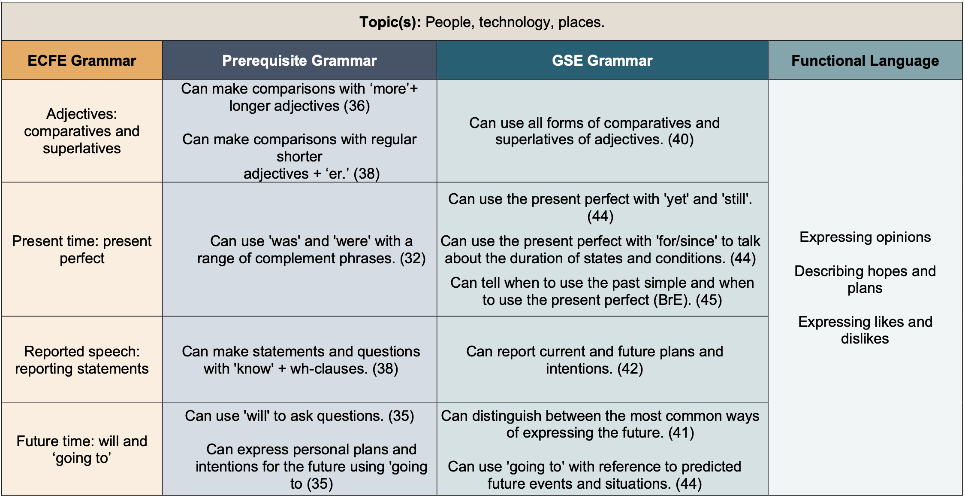
Grammar Topics
Table of Contents

Slide 23
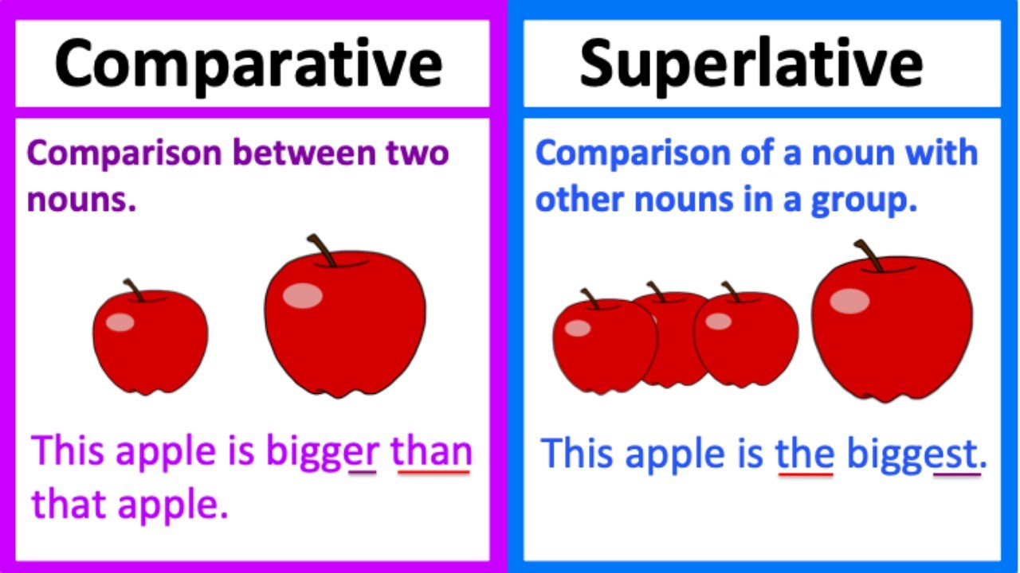
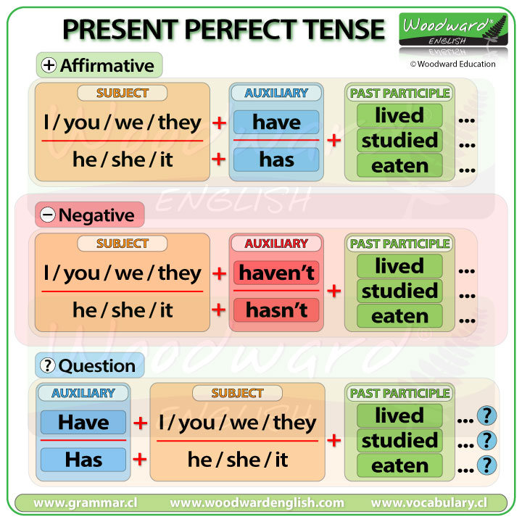
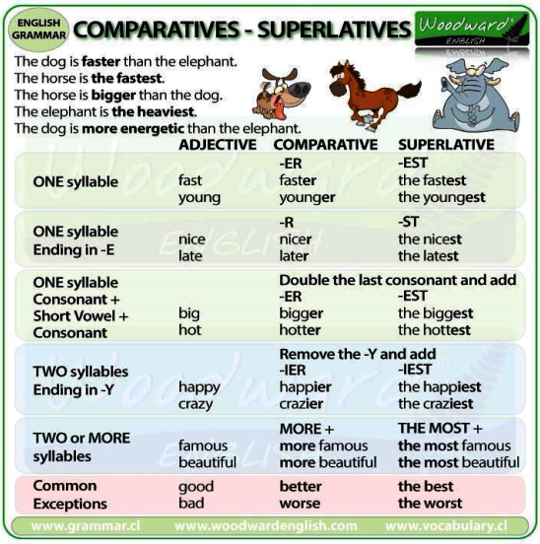
Grammar Topics 1
Table of Contents
Comparatives & Superlatives
Present Perfect Verbs

Slide 24
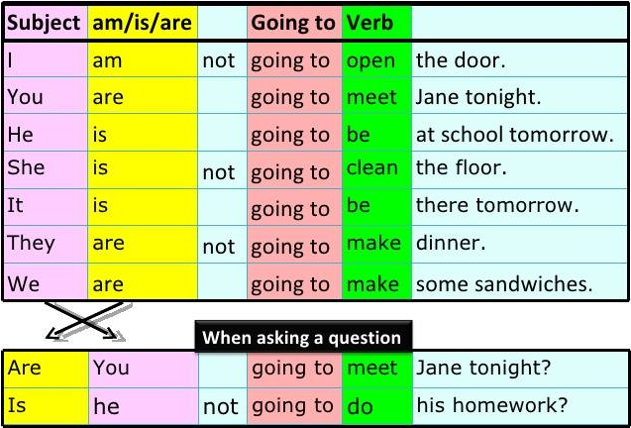
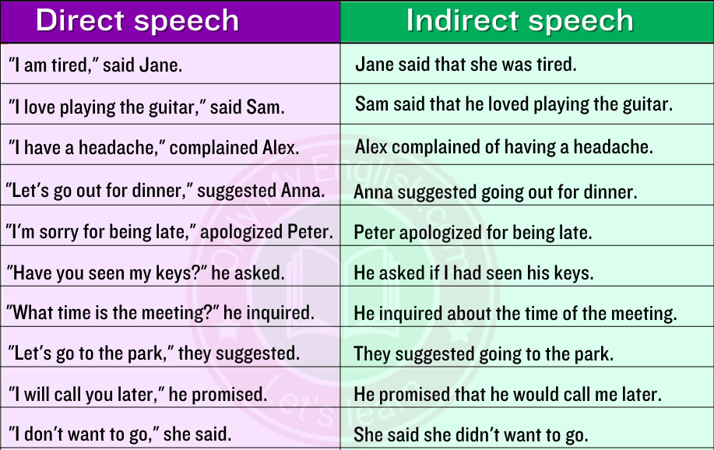
Grammar Topics 2
Table of Contents
Reported Speech (Indirect)
Future Time (going to)

Slide 25
Comparatives & Superlatives
Table of Contents
Adjectives used to compare things (fast, faster, fastest).
Kasim bought the most expensive car in the showroom. He drove the car on the longest road in the UAE and damaged the engine.
Meaning | The person bought a car that was higher in price than any other car. He drove the car on a very long road, and it broke down.
Grammatical structure | Adjectives: superlatives subject + verb + the + superlative adjective + rest of sentence
Usage | Superlatives are used to compare things in quantity (how many of something) and quality (how good something is), (the biggest, the smallest, the fastest, the highest). We usually use -est when it’s a one or two syllable adjective. We use most with longer adjectives.
Other examples | Saleh is the fastest student in his class because he trains every day. Mariam works in the biggest digital company in the UAE. Helma has the most exciting job in her family, but she works a lot.
Activity: Fill in the blanks using the comparative or superlative for each adjectives.
Tom is __________ than Dave. (fast)
John is __________ than me. (tall)
Barry is the __________ in the class. (noisy)
A whale is the __________ animal in the ocean (big)
A flower is _____________ than a leaf (beautiful)
The arctic is the __________ place on earth. (cold)
The Nile is the __________ river in the world. (long)
A desert is __________ than a jungle. (dry)
Cambodia is __________ than England. (hot)
I am taller than my brother. The book was more exciting than the film.
Meaning | The speaker is comparing his height with his brother’s, books with films and TV with cinema.
Grammatical structure | Adjectives: comparatives subject + (to be) + comparative + than + noun as + (adjective/adverb) + as
Usage | We use comparatives to compare the same quality in two things. We use a comparative followed by ‘than’. To form a comparative, we usually use –er for one or two syllable adjectives (smaller) while more is used for longer adjectives (more successful).
Other examples | The new smartphone is as expensive as a new computer. The job interview was more difficult than the actual work. Maitha was more excited to buy a new car than to travel to Europe.
Grammar Link 1
Grammar Link 2

Slide 26
Present Perfect
Table of Contents
verbs that talk about something that happened at some point in the past.
I have studied English. He has missed the bus.
Meaning | The speaker has studied English at some point in the past. The man did not get on the bus in time.
Grammatical structure | Present perfect ‘have / has’ + past participle
Usage | We can use present perfect to describe a personal experience that occurred at an unspecified point in the past. We can also use it to refer to personal experiences from an unspecified point in the past up until the time of speaking e.g. I have tried kunafa.
Other examples | I have eaten lunch. She has run away. Have you seen this movie?
Activity: Choose the correct word to complete the sentence.
1. Sarah _____ her homework already.
a) do
b) did
c) has done
2. We _____ a new puppy.
a) get
b) got
c) have gotten
3. Tom _____ to the new movie that just came out.
a) has gone
b) goes
c) go
4. My family _____ a fun vacation last summer.
a) have
b) had
c) has had
5. They _____ many books from the library.
a) read
b) reads
c) have read
Grammar Link

Slide 27
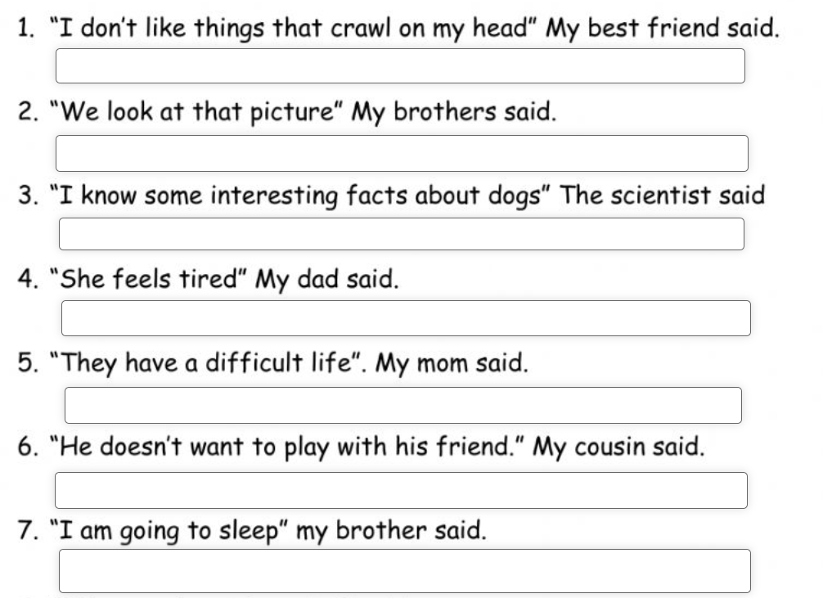
Reported Speech
Table of Contents
Sentences that tell you what someone said.
My sister told me that the film would be released next week.
Meaning | The speaker’s sister had told him/her in a previous conversation when the film is available.
Grammatical structure | Reported speech for present and future plans Subject + verb + that + noun clause
Usage | We use reported statements to repeat what someone had previously said. Reported statements use ‘that’ and a tense that is ‘backshifted’ (one step further into the past than the original speech). In the example above, the direct speech would be, “The film will be released next week.” When we report it, we backshift ‘will’ to ‘would’.
Other examples | Maryam reported that the company would be giving pay rises. My mother said that she could take us to the show. The manager said that the Dubai Opera House would be closed for a week.
Activity: Rewrite the sentences using reported speech.
She said that she doesn’t like things that crawl on her head.
Grammar Link

Slide 28
Future Time (going to)
Table of Contents
Sentences that tell you what someone said.
It’s going to rain tomorrow.
Meaning | The speaker is predicting that the weather in the future will be wet.
Grammatical structure | Future time (going to) subject + (to be) + going to + infinitive
Usage | In this case, ‘going to’ is used with the verb ‘to be’ and the infinitive of the main verb to talk about predicted future events and situations.
Other examples | They are going to win the competition next week. We are going to have a lot of fun at the restaurant later. He is going to get a good score in his exam.
Activity 1: Answer the questions using ‘going to’ in the answer.
What time are you going to go to bed tonight?
_______________________________________________________
What time are you going to get up tomorrow?
_______________________________________________________
What are you going to do after class?
_______________________________________________________
What are you going to do tomorrow morning?
_______________________________________________________
Where are you going to go on the weekend?
_______________________________________________________
I am going to bed at 9 P.M.
Grammar Link

Slide 29
MAZE Assessment Practice 1
Table of Contents
Activity: Fill in the blanks with the correct option to complete the passage.
Once upon a time, in a land far, far away, there lived a group of animals who were always the (1) __________ (happier/ happiest/ more happy). One day, the wise old owl, who was (2) __________ (wiser/ wise/ most wise) than anyone else in the forest, gathered all the animals to share some news. "I have (3) __________ (saw/ see/ seen) something amazing," said the owl, "I have seen a tree taller than any other tree in the forest!" The animals were excited and wanted to see this tree for themselves. So, they all decided to go on a journey to find it.
On their journey, they encountered many obstacles, but they never gave up. The rabbit was the (4) __________ (fastest/ more fast/ fast) runner, and he led the group through the thick forest. The squirrel was the (5) __________ (energetic/ most energetic/ energeticer) of them all, climbing trees and searching for clues. Finally, after many days of searching, they stumbled upon the tree. It was indeed the (6) __________ (tallest/ more tall/ tall) tree they had ever seen!
The animals were filled with joy and couldn't wait to tell everyone about their adventure. The wise old owl declared, "This journey has been the (7) __________ (exciting/ most exciting/ more exciting) of all our adventures!" And the animals agreed that they would never forget this day. From that day forward, they lived happily ever after, cherishing the memories of their incredible journey.
Use this link to look up words you don’t understand: https://kids.britannica.com/kids/browse/dictionary

Slide 30
MAZE Assessment Practice 2
Table of Contents
On the weekend we are ( going / go / going to ) visit the National Aquarium in Abu Dhabi. We bought our tickets online because it will be ( cheap / cheaper / cheapest ) than buying them at the aquarium. I ( have not / has not / had not ) been to an aquarium before. My friend ( said / said that / says ) she never saw so many animals before!
Some animals are ( dangerous / dangerouser / more dangerous ) than others. That is why you should always be careful when you see an animal you ( haven’t / hasn’t / hadn’t ) seen before. There are animals like the black footed cat which are ( deady / deadly / deadlier ) than lions! Other animals like the domestic cat, which is the ( friendliest / more friendlier / friendly ).
( Have / Has / Had ) you ever been on a hike? We all went on a hike at Mount Tambourine. The place was one of the ( beautiful / most beautiful / beuatifulest ) places I’ve ever seen! It’s home to many animals. You might see animals there if you’re lucky. Before we went on the hike the guide gave us some ( well / good / better ) advice to stay safe. Luckily, we had such a good guide so we didn’t face any danger.
Use this link to look up words you don’t understand: https://kids.britannica.com/kids/browse/dictionary

Slide 31
Keywords Review
Table of Contents
Grade 8 BTS Term 2
Keywords to help with the essay writing!

Slide 32
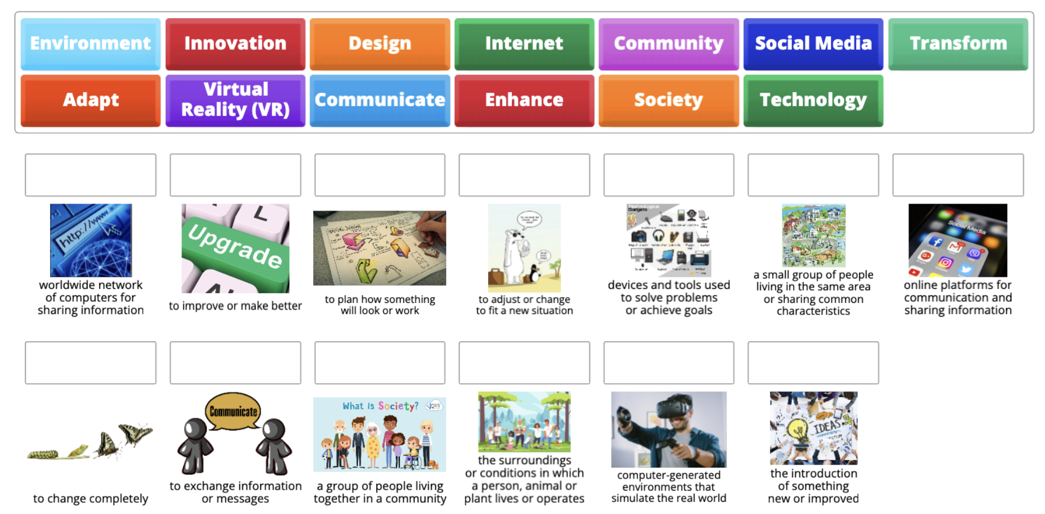
Table of Contents
Keywords Link

Slide 33
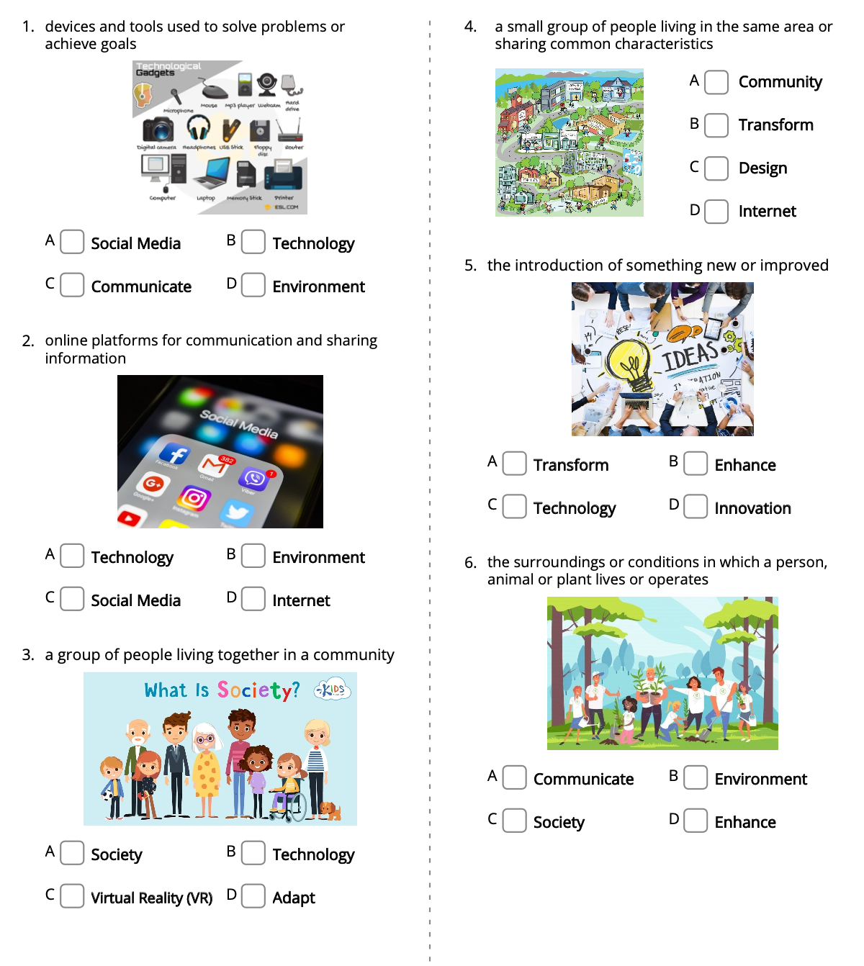
Keywords Activity

Slide 34
Reading Comprehension
Table of Contents
Grade 8 BTS Term 2

Slide 35
Reading Tips
Table of Contents
Always read the questions before the text.
Look for keywords in the question, the same word will help you find the answer in the text.
When reading the text, skip some words that you don’t understand - it’s okay!
Make sure you choose the answer you found in the text.
Read the text again to check your answers.
Don’t submit without checking all your answers.

Slide 36
Table of Contents
Always make sure to highlight where you found the answer in the text to know that your answer is correct.
Desert Life
Living in the desert usually means extreme heat and dry, arid conditions. There are different types of deserts. Some deserts have more plant life than other deserts. The largest desert in the world is the Sahara Desert. This desert covers over a million square miles of land.
Like all deserts, the Sahara has very little vegetation. However, there are some plants that have learned to grow without very much rain. Cacti are examples of plants that can live for almost a year without rain. When a cactus does receive rain, it produces beautiful and striking flowers.
Many of the animals that live in the desert are the same color as the environment. These sand-colored animals often burrow into the sand to avoid the extreme heat. Many of these animals are nocturnal animals, which means they feed and are active mostly during the night. When there is a severe drought, many of these animals sleep to save water and their need for food.
Camels are another type of animal commonly found in the Sahara Desert. The camel is able to go for a week without any drinking water. The camel's hump serves as food storage. A camel will drink up to 16 gallons of water at one time.
Activity: Answer the questions using the text. Highlight your answer.
Why are desert animals nocturnal?
The sun is too bright during the day.
They are trying to avoid the extreme heat.
The water comes at night.
They are able to move faster.
According to the passage, why are camels good animals for working in the desert?
There is no specific reason listed.
They work together to help each other in extremely hot conditions.
They are able to store food and water and go without water for a long time.
They have always been used in the desert.
What is the main idea of the passage?
to show how camels store food and water
to list the types of animals found in the desert
to explain what plant life and animal life is like in the desert
to show how cacti can survive a drought
What do animals that live in the desert have in common?
They are all reptiles.
They are all nocturnal animals.
They have learned to adapt to the heat.
They are brightly-colored animals.
Use this link to look up words you don’t understand: https://kids.britannica.com/kids/browse/dictionary

Slide 37
Table of Contents
Always make sure to highlight where you found the answer in the text to know that your answer is correct.
Better to Give
There once was a forest of trees. Each tree wanted the reputation of being the most beautiful tree. Each tree wanted to be admired by all the others. When the storms came, the trees were careful to make sure that their branches were protected. When the woodsmen came through the forest, each tree would camouflage itself to keep from being chopped down. The competition was stiff.
One day, a fox came running through the forest. The fox was being chased by a group of dogs and hunters. The fox was in need of a place to hide. All the trees denied entrance to its branches. That is except for one tree.
As the fox ran by, the tree whispered, “Climb in. Hide here!”
“But what about your branches?” asked the fox breathlessly, “Won't they be ruined?”
“How can they be ruined by helping another?” asked the tree as it closed the lower branches up around the fox.
The hunters and their dogs raced on by. After awhile, the fox came out. He thanked the tree and hurried on his way.
That night, as the tree watched the moon rise, it invited birds and squirrels to build homes in its branches. All the other trees were stunned, but soon noticed how happy the little tree was. It wasn’t long before all the trees in the forest were covered with little animals. They too had learned the joy in serving others.
Activity: Answer the questions using the text. Highlight your answer.
Why are desert animals nocturnal?
The sun is too bright during the day.
They are trying to avoid the extreme heat.
The water comes at night.
They are able to move faster.
What is the meaning of the word camouflage as used in this passage?
curious
mask
glare
mantle
What is the moral to the story?
Give in order to learn from others.
Raise up a standard for others to follow.
It is better to give than receive.
Setting a good example is usually painful.
After reading this story, explain how the story shows that helping others is better than helping ourselves. _________________________________________________________
_________________________________________________________
_________________________________________________________
Use this link to look up words you don’t understand: https://kids.britannica.com/kids/browse/dictionary

Slide 38
Table of Contents
Always make sure to highlight where you found the answer in the text to know that your answer is correct.
Education Today
Education in the present is an exciting and important part of our lives. Let's explore what it's like to learn and grow in the world today.
In the past, students mostly learned from books and teachers in a classroom. But today, education has become more diverse and interesting. We use computers, tablets, and even smartphones to help us learn. These tools make learning fun and interactive. We can watch educational videos, play educational games, and even connect with teachers and students from around the world online.
One fantastic thing about education now is that it's not just about memorizing facts. We learn how to think critically, solve problems, and work as a team. These skills will help us in our future jobs and everyday life.
Another exciting part of modern education is that it's tailored to each student. Some students might be interested in science, while others love art or music. In today's classrooms, teachers help students follow their passions and explore their interests.
Moreover, we learn about the world's different cultures and the importance of being kind and respectful to everyone. Education today is not just about facts; it's about creating better individuals and a better world.
So, in the present, education is like a big adventure. We have so many tools, opportunities, and ways to learn, and it's up to us to make the most of them. Remember, education is not just about school; it's about learning throughout our lives and becoming the best version of ourselves.
Activity: Answer the questions using the text.
How is education today different from the past?
a) It's all about memorizing facts.
b) It uses computers and smartphones.
c) It only happens in a classroom with books.
What important skills do students learn in modern education?
a) Memorizing facts and taking tests.
b) Critical thinking, problem-solving, and teamwork.
c) Making friends in the classroom.
Based on the text, why is education said to be tailored to each student today?
a) Because students can choose whatever they want to study.
b) Because students must follow a strict curriculum.
c) Because teachers help students explore their interests.
What do we understand about the role of modern education in creating a better world from the text?
a) Modern education only cares about facts.
b) Modern education doesn't aim to create better individuals.
c) Modern education aims to create better individuals and a better world.
Why is it mentioned that education is not just about memorizing facts?
a) Because memorizing facts is more important than critical thinking.
b) Because memorizing facts doesn't help in everyday life.
c) Because critical thinking and problem-solving are crucial for the future.
How does education today encourage students to explore their interests?
a) By forcing all students to study the same subjects.
b) By allowing students to choose their favorite subjects.
c) By removing all technology from the classroom.
Use this link to look up words you don’t understand: https://kids.britannica.com/kids/browse/dictionary

Slide 39
Activity Answers
Table of Contents
Grade 8 BTS Term 2

Slide 40
Table of Contents
Opinion
What is your opinion about having school in Ramadan? Write two sentences and explain.
_____________________________________
_____________________________________
_____________________________________
_____________________________________
I believe it is a terrible idea. Ramadan is made for prayer and fasting we should not be in school.
ANSWERS
Your ideas.
What is your opinion about learning English? Write two sentences and explain.
_____________________________________
_____________________________________
_____________________________________
_____________________________________
Learning English is actually a good idea. Since most jobs require English.
What you think or believe.

Slide 41
Table of Contents
Inference
When Jake was ten, he was really good at doing magic tricks. He liked showing off his tricks to his friends and family, surprising them with how clever he was. One day, he wanted to show even more people what he could do, so he joined a talent show. When he got on stage, everyone was amazed when he made a coin disappear and then reappear in someone's hand.
ANSWERS
Your ideas.
What do you think made Jake want to be a magician when he was so young?
_____________________________________
_____________________________________
_____________________________________
_____________________________________
Use your understanding of the text to give an answer.
I think Jake wants to be a magician because when he was younger he saw a magic show. He grew up and wanted to have is own magic show.

Slide 42
Table of Contents
Justification
Samantha loved animals and dreamed of being a veterinarian one day. One afternoon, she found a stray kitten hiding in the bushes near her house. She gently coaxed the scared kitty out and took it home. She gave it food, water, and lots of love. The next day, Samantha took the kitten to the animal shelter to get it checked by the vet.
ANSWERS
From the text
What made Lily decide to explore the attic and find the book?
_____________________________________
_____________________________________
_____________________________________
_____________________________________
Explain why you chose this answer with evidence from the text.
Samantha brought the kitten to the animal shelter to get it the medical care it needed. She cared a lot about the kitten's health and wanted to make sure it was in good hands.
piece of evidence from the text.

Slide 43
Part 1: Opinion
Table of Contents
ANSWERS
In opinion my last holiday was amazing. I went to the beach and spent most of my time swimming.

Slide 44
Part 2: Plan (A)
Table of Contents
ANSWERS
I went to the beach house.
Last Holiday
I went with my family and friends.
I took my book, swim suit and headphones.

Slide 45
Part 2: Plan (B)
Table of Contents
To help make learning easier.
ANSWERS
Technology & Education
Use platforms and websites to do my work.
Use this to plan for the essay on the next page.
VR rooms should be added in schools.

Slide 46
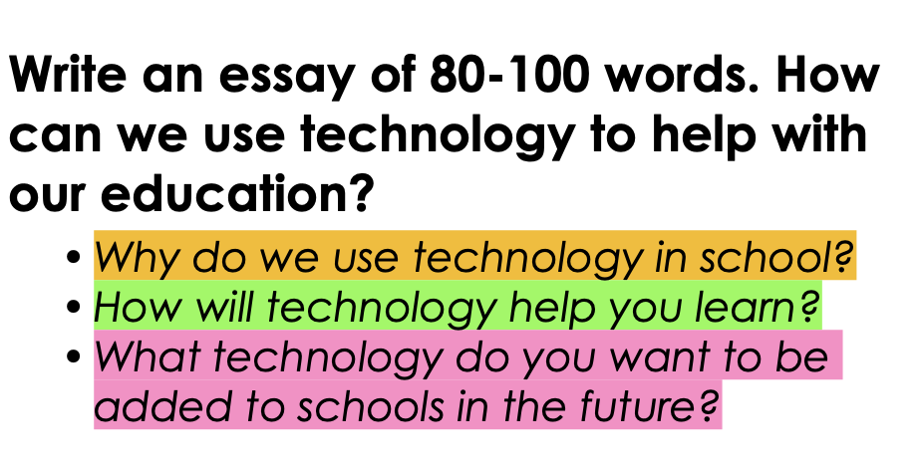
Part 3: Essay
Table of Contents
Technology & Education
Technology can help with our education in many ways. We can use educational apps and games to make learning more fun and engaging. Technology can even help us communicate with teachers and classmates online to ask questions and collaborate on projects.
We use technology in school because it can make learning more efficient and effective. Students can also access information and resources from around the world right from their desks. Technology helps us stay connected and engaged in our studies. Technology will help me learn by allowing me to access a variety of resources and tools to support my learning. I can watch educational videos, take online quizzes, and use interactive simulations to better understand difficult concepts. Technology will also help me stay organized with my assignments and deadlines.
In the future, I would like to see more virtual reality tools added to schools to immerse students in different subjects and make learning even more interactive and engaging.
ANSWERS
TECHNOLOGY IN SCHOOL AND EDUCTAION ONLY!!

Slide 47
Part 4: Inference & Justification
Table of Contents
Hamed loved going to the library after school. He liked reading books there. One day, he went to find new stories. But he saw Ahmed, a boy from his class, sneaking around. Hamed felt strange. Why was Ahmed following him? He tried to ignore it and kept looking at books. But Ahmed kept following him, trying to stay hidden. Hamed got worried and asked Ahmed why he was following. Ahmed looked nervous and said he just wanted to see what Hamed was reading. Hamed wasn't sure if he believed Ahmed. But he decided to show him some books anyway. To his surprise, Ahmed seemed interested in them.
Ahmed follows Hamed to the library because he wants to read books. He want to know more about the library and which books to pick.
ANSWERS
I think my answer is the best because Ahmed just wanted to see what Hamed was reading. In the end Hamed showed him some books and Ahmed looked interested.

Slide 48
Parts of Speech
Table of Contents
Sort the words in the correct column.
he | scary | they | swimming
shiny | Shamsa | Zayed University | car
small | sneaked | is | yellow
table | people | ate | her
ANSWERS
Noun | Pronoun | Verb | Adjective
table Shamsa people Zayed University car | he they her | sneaked is ate swimming | shiny small scary yellow

Slide 49
Comparatives & Superlatives
Table of Contents
Adjectives used to compare things (fast, faster, fastest).
Kasim bought the most expensive car in the showroom. He drove the car on the longest road in the UAE and damaged the engine.
Meaning | The person bought a car that was higher in price than any other car. He drove the car on a very long road, and it broke down.
Grammatical structure | Adjectives: superlatives subject + verb + the + superlative adjective + rest of sentence
Usage | Superlatives are used to compare things in quantity (how many of something) and quality (how good something is), (the biggest, the smallest, the fastest, the highest). We usually use -est when it’s a one or two syllable adjective. We use most with longer adjectives.
Other examples | Saleh is the fastest student in his class because he trains every day. Mariam works in the biggest digital company in the UAE. Helma has the most exciting job in her family, but she works a lot.
Activity: Fill in the blanks using the comparative or superlative for each adjectives.
Tom is __________ than Dave. (fast)
John is __________ than me. (tall)
Barry is the __________ in the class. (noisy)
A whale is the __________ animal in the ocean (big)
A flower is ______________ than a leaf (beautiful)
The artic is the __________ place on earth. (cold)
The Nile is the __________ river in the world. (long)
A desert is __________ than a jungle. (dry)
Cambodia is __________ than England. (hot)
ANSWERS
faster
taller
noisiest
biggest
more beautiful
coldest
I am taller than my brother. The book was more exciting than the film.
Meaning | The speaker is comparing his height with his brother’s, books with films and TV with cinema.
Grammatical structure | Adjectives: comparatives subject + (to be) + comparative + than + noun as + (adjective/adverb) + as
Usage | We use comparatives to compare the same quality in two things. We use a comparative followed by ‘than’. To form a comparative, we usually use –er for one or two syllable adjectives (smaller) while more is used for longer adjectives (more successful).
Other examples | The new smartphone is as expensive as a new computer. The job interview was more difficult than the actual work. Maitha was more excited to buy a new car than to travel to Europe.
longest
drier
hotter
Grammar Link 1
Grammar Link 2

Slide 50
Present Perfect
Table of Contents
verbs that talk about something that happened at some point in the past.
I have studied English. He has missed the bus.
Meaning | The speaker has studied English at some point in the past. The man did not get on the bus in time.
Grammatical structure | Present perfect ‘have / has’ + past participle
Usage | We can use present perfect to describe a personal experience that occurred at an unspecified point in the past. We can also use it to refer to personal experiences from an unspecified point in the past up until the time of speaking e.g. I have tried kunafa.
Other examples | I have eaten lunch. She has run away. Have you seen this movie?
Activity: Choose the correct word to complete the sentence.
1. Sarah _____ her homework already.
a) do
b) did
c) has done
2. We _____ a new puppy.
a) get
b) got
c) have gotten
3. Tom _____ to the new movie that just came out.
a) has gone
b) goes
c) go
4. My family _____ a fun vacation last summer.
a) have
b) had
c) has had
5. They _____ many books from the library.
a) read
b) reads
c) have read
ANSWERS
Grammar Link

Slide 51
Reported Speech
Table of Contents
Sentences that tell you what someone said.
My sister told me that the film would be released next week.
Meaning | The speaker’s sister had told him/her in a previous conversation when the film is available.
Grammatical structure | Reported speech for present and future plans Subject + verb + that + noun clause
Usage | We use reported statements to repeat what someone had previously said. Reported statements use ‘that’ and a tense that is ‘backshifted’ (one step further into the past than the original speech). In the example above, the direct speech would be, “The film will be released next week.” When we report it, we backshift ‘will’ to ‘would’.
Other examples | Maryam reported that the company would be giving pay rises. My mother said that she could take us to the show. The manager said that the Dubai Opera House would be closed for a week.
Activity: Rewrite the sentences using reported speech.
ANSWERS
She said that she doesn’t like things that crawl on her head.
They said that they looked at that picture.
The scientist said that he knew some interesting facts about dogs.
My dad said that she felt tired.
My mom said that they had a difficult life.
My cousin said that he doesn’t want to play with his friends.
My brother said that he was going to sleep.
Grammar Link

Slide 52
Future Time (going to)
Table of Contents
Sentences that tell you what someone said.
It’s going to rain tomorrow.
Meaning | The speaker is predicting that the weather in the future will be wet.
Grammatical structure | Future time (going to) subject + (to be) + going to + infinitive
Usage | In this case, ‘going to’ is used with the verb ‘to be’ and the infinitive of the main verb to talk about predicted future events and situations.
Other examples | They are going to win the competition next week. We are going to have a lot of fun at the restaurant later. He is going to get a good score in his exam.
Activity 1: Answer the questions using ‘going to’ in the answer.
What time are you going to go to bed tonight?
_______________________________________________________
What time are you going to get up tomorrow?
_______________________________________________________
What are you going to do after class?
_______________________________________________________
What are you going to do tomorrow morning?
_______________________________________________________
Where are you going to go on the weekend?
_______________________________________________________
ANSWERS
I am going to go to bed at 9:30 P.M.
I am going to go to get up at 5:45 A.M.
I am going to go to read my book after class.
I am going to get ready for school.
I am going to go to the beach.
Grammar Link

Slide 53
MAZE Assessment Practice 1
Table of Contents
Activity: Fill in the blanks with the correct option to complete the passage.
Once upon a time, in a land far, far away, there lived a group of animals who were always the (1) __________ (happier/ happiest/ more happy). One day, the wise old owl, who was (2) __________ (wiser/ wise/ most wise) than anyone else in the forest, gathered all the animals to share some news. "I have (3) __________ (saw/ see/ seen) something amazing," said the owl, "I have seen a tree taller than any other tree in the forest!" The animals were excited and wanted to see this tree for themselves. So, they all decided to go on a journey to find it.
On their journey, they encountered many obstacles, but they never gave up. The rabbit was the (4) __________ (fastest/ more fast/ fast) runner, and he led the group through the thick forest. The squirrel was the (5) __________ (energetic/ most energetic/ energeticer) of them all, climbing trees and searching for clues. Finally, after many days of searching, they stumbled upon the tree. It was indeed the (6) __________ (tallest/ more tall/ tall) tree they had ever seen!
The animals were filled with joy and couldn't wait to tell everyone about their adventure. The wise old owl declared, "This journey has been the (7) __________ (exciting/ most exciting/ more exciting) of all our adventures!" And the animals agreed that they would never forget this day. From that day forward, they lived happily ever after, cherishing the memories of their incredible journey.
ANSWERS
Use this link to look up words you don’t understand: https://kids.britannica.com/kids/browse/dictionary

Slide 54
MAZE Assessment Practice 2
Table of Contents
On the weekend we are ( going / go / going to ) visit the National Aquarium in Abu Dhabi. We bought our tickets online because it will be ( cheap / cheaper / cheapest ) than buying them at the aquarium. I ( have not / has not / had not ) been to an aquarium before. My friend ( said / said that / says ) she never saw so many animals before!
Some animals are ( dangerous / dangerouser / more dangerous ) than others. That is why you should always be careful when you see an animal you ( haven’t / hasn’t / hadn’t ) seen before. There are animals like the black footed cat which are ( deady / deadly / deadlier ) than lions! Other animals like the domestic cat, which is the ( friendliest / more friendlier / friendly ).
( Have / Has / Had ) you ever been on a hike? We all went on a hike at Mount Tambourine. The place was one of the ( beautiful / most beautiful / beuatifulest ) places I’ve ever seen! It’s home to many animals. You might see animals there if you’re lucky. Before we went on the hike the guide gave us some ( well / good / better ) advice to stay safe. Luckily, we had such a good guide so we didn’t face any danger.
ANSWERS
Use this link to look up words you don’t understand: https://kids.britannica.com/kids/browse/dictionary

Slide 55
Keywords Activity on
Table of Contents
ANSWERS
Internet
Enhance
Design
Adapt
Technology
Community
Social Media
Transform
Communicate
Society
Environment
Virtual Reality
Innovation
Keywords Link

Slide 56
Keywords Activity
Table of Contents
ANSWERS

Slide 57
Table of Contents
Always make sure to highlight where you found the answer in the text to know that your answer is correct.
Desert Life
Living in the desert usually means extreme heat and dry, arid conditions. There are different types of deserts. Some deserts have more plant life than other deserts. The largest desert in the world is the Sahara Desert. This desert covers over a million square miles of land.
Like all deserts, the Sahara has very little vegetation. However, there are some plants that have learned to grow without very much rain. Cacti are examples of plants that can live for almost a year without rain. When a cactus does receive rain, it produces beautiful and striking flowers.
Many of the animals that live in the desert are the same color as the environment. These sand-colored animals often burrow into the sand to avoid the extreme heat. Many of these animals are nocturnal animals, which means they feed and are active mostly during the night. When there is a severe drought, many of these animals sleep to save water and their need for food.
Camels are another type of animal commonly found in the Sahara Desert. The camel is able to go for a week without any drinking water. The camel's hump serves as food storage. A camel will drink up to 16 gallons of water at one time.
Activity: Answer the questions using the text. Highlight your answer.
Why are desert animals nocturnal?
The sun is too bright during the day.
They are trying to avoid the extreme heat.
The water comes at night.
They are able to move faster.
According to the passage, why are camels good animals for working in the desert?
a. There is no specific reason listed. b. They work together to help each other in extremely hot conditions. c. They are able to store food and water and go without water for a long time.
d. They have always been used in the desert.
What is the main idea of the passage?
to show how camels store food and water
to list the types of animals found in the desert
to explain what plant life and animal life is like in the desert
to show how cacti can survive a drought
What do animals that live in the desert have in common?
They are all reptiles.
They are all nocturnal animals.
They have learned to adapt to the heat.
They are brightly-colored animals.
ANSWERS
Use this link to look up words you don’t understand: https://kids.britannica.com/kids/browse/dictionary

Slide 58
Table of Contents
Always make sure to highlight where you found the answer in the text to know that your answer is correct.
Better to Give
There once was a forest of trees. Each tree wanted the reputation of being the most beautiful tree. Each tree wanted to be admired by all the others. When the storms came, the trees were careful to make sure that their branches were protected. When the woodsmen came through the forest, each tree would camouflage itself to keep from being chopped down. The competition was stiff.
One day, a fox came running through the forest. The fox was being chased by a group of dogs and hunters. The fox was in need of a place to hide. All the trees denied entrance to its branches. That is except for one tree.
As the fox ran by, the tree whispered, “Climb in. Hide here!”
“But what about your branches?” asked the fox breathlessly, “Won't they be ruined?”
“How can they be ruined by helping another?” asked the tree as it closed the lower branches up around the fox.
The hunters and their dogs raced on by. After awhile, the fox came out. He thanked the tree and hurried on his way.
That night, as the tree watched the moon rise, it invited birds and squirrels to build homes in its branches. All the other trees were stunned, but soon noticed how happy the little tree was. It wasn’t long before all the trees in the forest were covered with little animals. They too had learned the joy in serving others.
Activity: Answer the questions using the text. Highlight your answer.
What is the meaning of the word camouflage as used in this passage?
curious
mask
glare
mantle
What is the moral to the story?
Give in order to learn from others.
Raise up a standard for others to follow.
It is better to give than receive.
Setting a good example is usually painful.
After reading this story, explain how the story shows that helping others is better than helping ourselves. _________________________________________________________
_________________________________________________________
_________________________________________________________
ANSWERS
The story shows that when we help others we get a feeling of joy. Just like the tree helping the fox to stay safe.
Use this link to look up words you don’t understand: https://kids.britannica.com/kids/browse/dictionary

Slide 59
Table of Contents
Always make sure to highlight where you found the answer in the text to know that your answer is correct.
Education Today
Education in the present is an exciting and important part of our lives. Let's explore what it's like to learn and grow in the world today.
In the past, students mostly learned from books and teachers in a classroom. But today, education has become more diverse and interesting. We use computers, tablets, and even smartphones to help us learn. These tools make learning fun and interactive. We can watch educational videos, play educational games, and even connect with teachers and students from around the world online.
One fantastic thing about education now is that it's not just about memorizing facts. We learn how to think critically, solve problems, and work as a team. These skills will help us in our future jobs and everyday life.
Another exciting part of modern education is that it's tailored to each student. Some students might be interested in science, while others love art or music. In today's classrooms, teachers help students follow their passions and explore their interests.
Moreover, we learn about the world's different cultures and the importance of being kind and respectful to everyone. Education today is not just about facts; it's about creating better individuals and a better world.
So, in the present, education is like a big adventure. We have so many tools, opportunities, and ways to learn, and it's up to us to make the most of them. Remember, education is not just about school; it's about learning throughout our lives and becoming the best version of ourselves.
Activity: Answer the questions using the text.
How is education today different from the past?
a) It's all about memorizing facts.
b) It uses computers and smartphones.
c) It only happens in a classroom with books.
What important skills do students learn in modern education?
a) Memorizing facts and taking tests.
b) Critical thinking, problem-solving, and teamwork.
c) Making friends in the classroom.
Based on the text, why is education said to be tailored to each student today?
a) Because students can choose whatever they want to study.
b) Because students must follow a strict curriculum.
c) Because teachers help students explore their interests.
What do we understand about the role of modern education in creating a better world from the text?
a) Modern education only cares about facts.
b) Modern education doesn't aim to create better individuals.
c) Modern education aims to create better individuals and a better world.
Why is it mentioned that education is not just about memorizing facts?
a) Because memorizing facts is more important than critical thinking.
b) Because memorizing facts doesn't help in everyday life.
c) Because critical thinking and problem-solving are crucial for the future.
How does education today encourage students to explore their interests?
a) By forcing all students to study the same subjects.
b) By allowing students to choose their favorite subjects.
c) By removing all technology from the classroom.
ANSWERS
Use this link to look up words you don’t understand: https://kids.britannica.com/kids/browse/dictionary

