Slide 1

How to stay safe online
Student/ Khaled Al Hosani
Grade 8/3

Slide 2


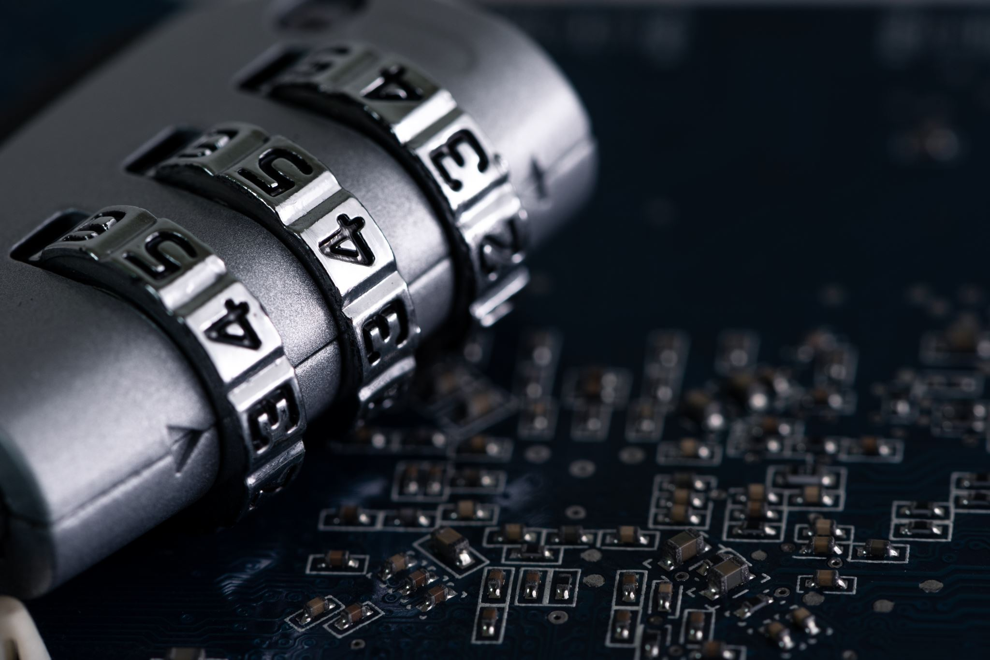
1- Create a strong and easy-to-remember password
Passwords that combine letters and numbers.

Slide 3

2- Change your password on a regular basis
It’s a good idea to change your password every month.

Slide 4

3. Learn to spot fake emails and websites
Criminals use them to con people into giving away passwords and bank details – the technical word is ‘phishing’.

Slide 5

4- Keep personal information personal.
Hackers can use social media profiles to figure out your passwords and answer those security questions in the password reset tools. Lock down your privacy settings and avoid posting things like birthdays, addresses, mother’s name, etc. Be wary of requests to connect from people you do not know.

Slide 6
Thank you

