Slide 1

Why
Build an Airplane?

Slide 2
The Whys of Building Your Own Airplane
Lisa Turner
Airventure 2019
Copyright 2019. Lisa Turner. All Rights Reserved. This material may not be used without permission.

Slide 3
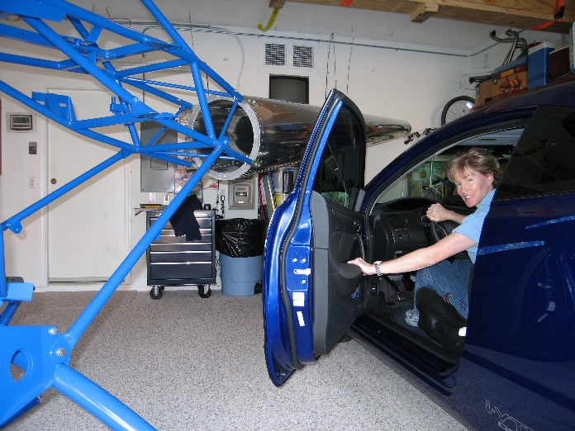
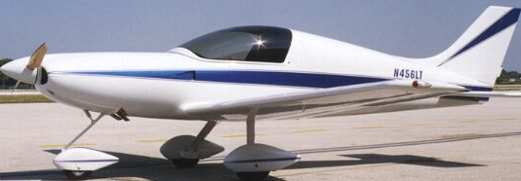
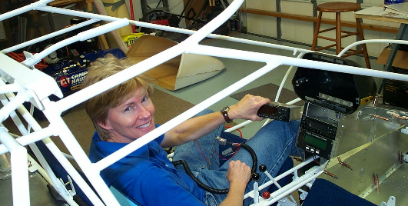
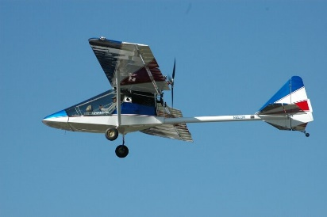
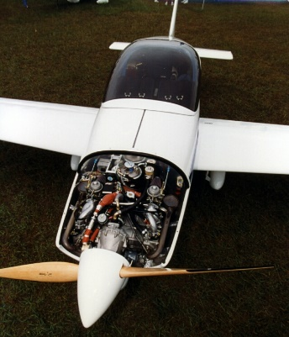
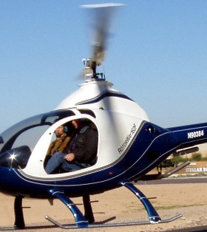
Who am I?
Lisa Turner
EAA . . . 20+ years
Tech Counselor, Flight Advisor
A&P, Private Pilot, AB-DAR
Homebuilt Aircraft Council
Email me at Lisa@lisaturner.com
Notes:
Background

Slide 4
Why Build an Airplane?
Lots of HOW . . .
Buy why?
Notes:
Get audience involved

Slide 5
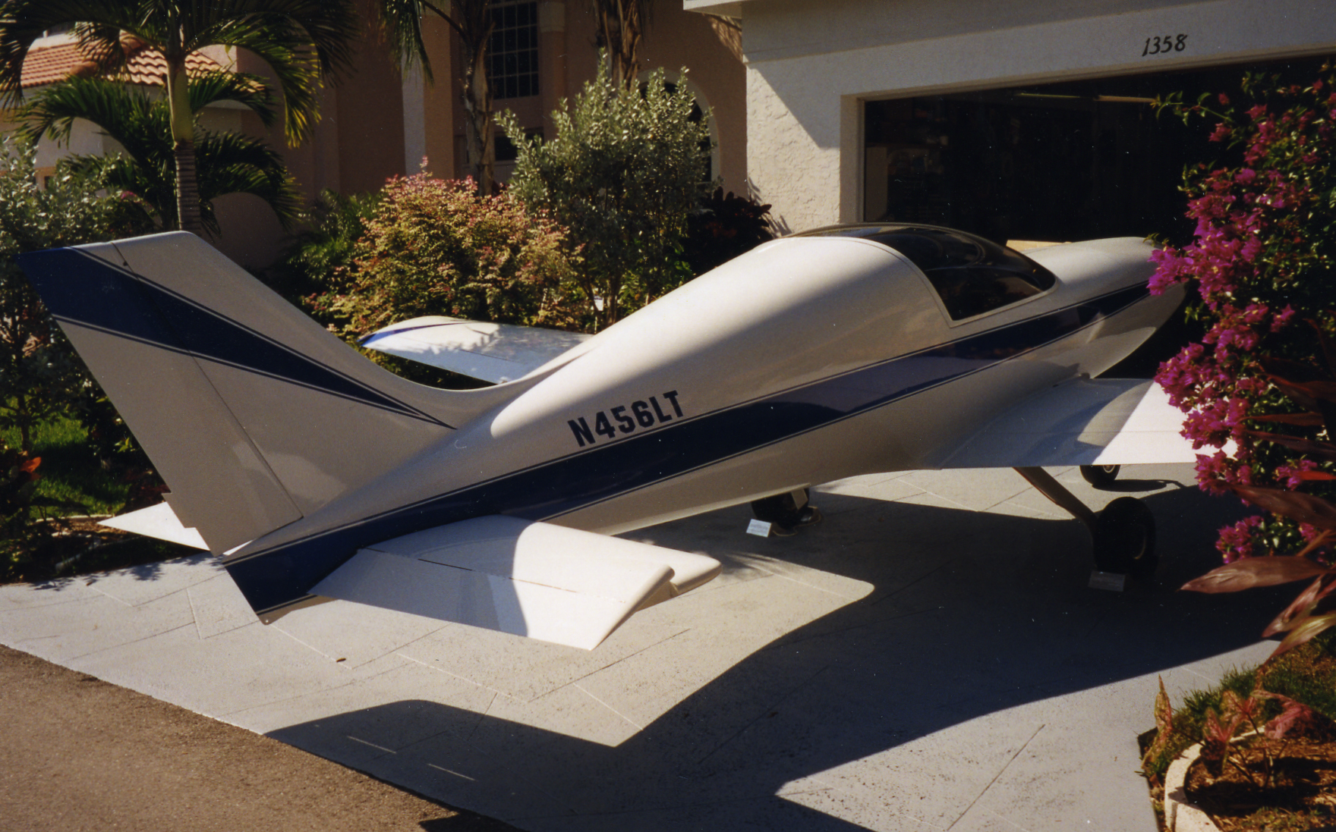
WHY #1: So you can tell the Homeowners’ Association that they have no rule that says you can’t park your airplane in your driveway.
Notes:
For fun: You can park your airplane in your driveway in a community that has a homeowner’s association and they will not have a rule to cover it.

Slide 6
Some of the Not So Good Whys
I love flying
I want to save money
I want everything new
I want to fly in my own airplane soon
I want to impress my neighbors
Notes:
Spend some time talking about why each one of these reasons might not be the BEST reason for building your own airplane. The audience will come up with some great reasons.

Slide 7
Tell Me Your Whys
?
Notes:
On the white board, write down about six of the WHYS that the audience comes up with. Don’t judge these but get full explanations.

Slide 8
My Why
?
Notes:
Ask the audience if its ok to share your personal stories.

Slide 9

Notes:
TRANSPORTATION!

Slide 10
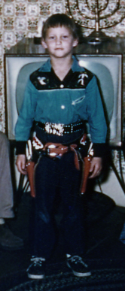
Notes:
Lisa at ?? 9 ??? Tomboy do you think????

Slide 11
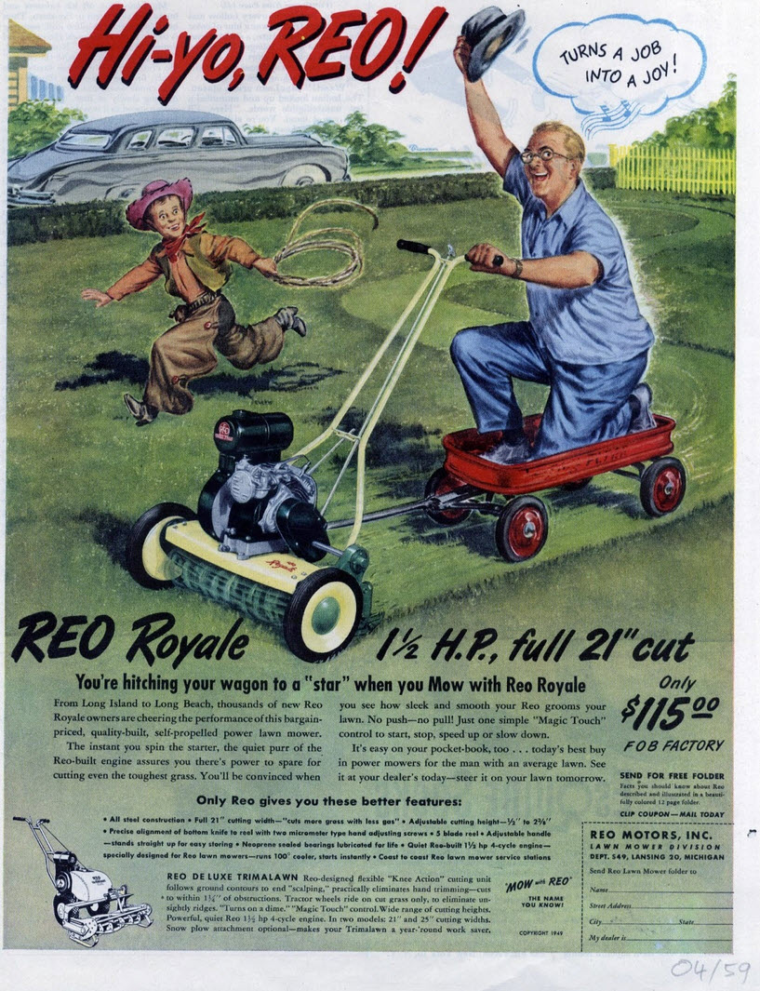
Notes:
When a nine year old sees this in a magazine you can guess what is next.

Slide 12
Notes:
Tell the lawn mower and wagon story.
Lisa is 11 years old.
Next, I pulled my red wagon out and lined it up with the back of the mower. I took the wagon handle and placed it low on the back of the mower. I sat down next to the mower and tried to determine where to tie the handle. I realized I had to tie the rope around and across the lower bars. I wrapped the short section of white cotton rope around both bars and then around the crosspiece, bringing a section through the wagon handle. I did my best at a square knot which I tied as a granny knot and then deliberately undid it, re-routing the rope under-over to make the square knot. I never could figure out why I couldn’t tie the square knot first since every time I tried it, it turned out as a granny knot. Maybe it was because I was left handed.
I tested my tandem arrangement by climbing in the wagon and kneeling. I grabbed the dual handle assembly to see if I could turn it, but there was no way of finding out until the wagon was under way. I would just have to test it.
So far, so good.
Next, I would start the mower and pull the lever to get it moving. I would have to jump in to my wagon while it was moving. I didn’t think this would be a problem; the mower was so slow.
A trickle of apprehension stopped me and I sat down in the wagon. Was there something I was missing? I was planning on riding down to the end of the street, a cul de sac, and coming back. Would I hurt the mower? Would my wagon overturn?
No, it would be fine.
I grabbed the pull cord and yanked. The cord wouldn’t move at all. What was I doing wrong? I pulled harder. The cord moved about 3 inches. I pulled again. Three inches. When I watched my brother start the mower, it looked easy! Disappointment soaked my excitement.
“Lisa what are you doing,” came a voice from behind me. Startled, I turned to see Will, my friend who lived across the street.
“You scared me!” I said.
“What are you doing with that lawn mower?” Will said.
“Don’t tell anyone, Will.”
“How can I tell anyone if I don’t know what you are doing?” Will was 2 years older than me, but with the same slim build as mine. His shock of blonde hair flopped across his forehead and stuck up straight on the top of his head looking like he just woke up.
“I’m trying to start this thing.”
“Uh oh.” Will saw the red wagon. “You’re gonna get in trouble with that.”
“Don’t tell!”
“I won’t! I won’t! But someone is going to see you for sure.”
“Will, here, come on, I can’t start it, the pull cord is stuck or something. What do you think is wrong with it?” I grabbed the pull cord and yanked. The cord came out 2 inches from the top of the engine case and stopped.
“Oh boy, will I get in trouble.” Will looked carefully at the choke lever, and switches. “Well, for one thing, if you had started it, you wouldn’t have gone very far. The fuel selector is set to OFF.”
He moved the switch to ON. “Stand back,” Will said as he struggled with the pull cord. It came all the way out and the engine turned over but did not start.
“Wow!” I exclaimed. “How did you do that?”
Will pulled the cord a second time, faster. The engine sounded like it was going to catch. On the fourth pull, the Toro roared to life. Will grinned and said something to me, but I couldn’t hear it. Debris from under the mower was redistributing itself across the driveway.
“Thanks!” I shouted as I jumped in my wagon. I pulled the traction engage lever to the first stop and the mower moved forward with a jerk. The rope went taut and away I went, down the driveway towards the street.
Will stood at the end of the driveway, shaking his head in disbelief.
The mower had picked up speed on the driveway slope and I had just enough room to turn the wide Toro into the street.
My trepidation gave way to jubilance. I yelled out “Wow!” and looked down the street. The mower was chewing up leaves and small stones on the pavement, and dust and pebbles spewed from the discharge chute. The machine was so loud I couldn’t hear anything else.
I looked at the power lever and thought about moving it to “2” to go faster and then thought better of it. This was great, this was just great.
I heard shouting behind me over the roar of the mower. I looked back up the street and saw Mr. Hunter, a neighbor, come running down his driveway behind me.
My red wagon-mower powered tandem rig was too slow to outrun Mr. Hunter. I thought about putting in more power to escape.
“Hey! Hey, hey,” said Mr. Hunter as he caught up with me.
“Stop! Stop! Stop! He said.
“Hey, hey, hey!” Mr. Hunter’s eyes bulged wide with consternation.
I wondered if Mr. Hunter always said things in threes. I pulled the power lever to stop. The mower’s forward motion stopped so fast I fell forward in my wagon and almost fell over into the street. I hit my knee on the side of the red wagon and winced.
Mr. Hunter reached me and grabbed my arm and the mower handle. He looked at the handle and pushed the lever to OFF. The engine sputtered and died.
Oh gee, great, how am I going to get this thing started again.
“This is dangerous!” said Mr. Hunter. “Do your parents know where you are?” His eyes were wide with panic. His breath came in spurts as he blurted the words.
I sat in my red wagon, quiet, my knee throbbing. I did not know what to say. This is always what happened, I just couldn’t figure out what to say or do when confronted with a strange adult.
William came running down the street, stopping in front of us.
“Will, you need to help this little girl get back to her house with this.”
Mr. Hunter turned back towards me.
“Are your parents home?”
“Um, my mom is home.”
“Where is your dad?”
“I don’t have a dad.”
“What do you mean you don’t have a dad?”
“He is not with us anymore.”
“Oh, I’m sorry!”
“No, I mean he lives in the city, he left us to be with someone else.”
“You mean he divorced your mom.”
“Yes, that’s it.”
“Ok, well, look, Will can help you get this back home. This not safe. See the blades under that cover?”
“He pointed to the mower casing.”
I looked at the mower blades.
“The blades are always going, and if the machine overturns and hits you, it would be a very bad accident. It could even kill you. Will you promise not to do this again?”
“OK, I said. I looked down at the street and the areas of grass debris scattered about.
Not.
I couldn’t wait to get home, to get away, to stop being in trouble. My plan was perfect, except for Mr. Hunter having nothing else to do on a Saturday morning than to prevent a little girl from experimenting with machinery.
I got out of the red wagon painfully, trying not to show I had bruised my knee. William and I untied the wagon and he pushed the mower and I pulled the wagon back up the street to the house. Mr Hunter stood in the middle of the street, watching us, shaking his head.
I hope he doesn’t call Mom.
Well, you got out of that pretty good,” said Will.
“Yeah, well if Mr. Hunter had more interesting things to do inside his house instead of running out here to stop me it would have been better. I was just getting going. I was going to continue to the turnaround circle and the end of the street and then come back up this way.”
“It was kind of fun, huh?”
“Great! It was great! Will, we need to make a machine that runs with an engine but it’s safe and you and I can fit in it and go exploring.”
“Just buy a motorized cart, a go cart, I’ve seen them,” said William, throwing his hands in the air. “You’re making things too complicated.”
“No, no, no. How am I going to buy a go cart? They must be at least a hundred dollars. Second, what fun is that? The fun part is making it.”
Will looked at me and laughed. His blue eyes danced with amusement in a calming way.
We reached my driveway. I looked around to see if anyone was looking at us. The neighborhood was quiet and it looked like only Mr. Hunter had discovered my bad deed. Mr. was no longer in the street watching us.
Come over to my house, Lisa. Let’s play in the fort after we put this back in your garage. Hopefully no one will know what you did.”
“Me? You helped!”
“I was afraid you were going to say that.”
I hope Mr. Hunter doesn’t tell Mom.
We put the mower and the wagon back in the garage in the corner. I looked around. Except for the morning songbirds, the neighborhood was quiet, awaiting the hustle and bustle of weekend chores.
I sighed. Back to the drawing board.

Slide 13

Notes:
Tell the story of going to the guidance office and asking to attend shop class . . . Hard to build an airplane in sewing class. . . 1960s.
I walked to the school guidance counselor’s office and stood in the doorway. It was lunch time and the administrators were not there with only the Guidance Counselor, Mr. Sterling, sitting at his desk to the right of the entrance. I waited for Mr. Sterling to look up.
“Can I help you?” he said.
I entered the office and stopped in front of the desk. Paper piles were arranged neatly across the front and the rest of the space was filled with pens, paperclips, calendars, and books.
“Oh, you’re the new student here aren’t you? What is your name?”
“Lisa Turner,” I said.
“Oh. Sue Turner’s daughter?”
“Um, Step Daughter.”
“Step-daughter? Ok. How can I help you?”
I was nervous. I had thought up this plan to talk to the guidance counselor about my classes but now, in the office, I was not feeling as brave as I had when I wrote down my plan in private. What was I thinking?
Go ahead you thought it up, go ahead.
“Uh, I would like to take the shop class. Can I add the shop class to my schedule Mr. Sterling?”
Good. Good. You got it out. Calm down.
Mr. Sterling put his pen down on the desk and leaned back in his chair. The old wooden chair creaked as he shifted his weight and the springs squeaked in strain.
A little oil would help that awful noise.
Mr. Sterling cocked his head and looked perplexed. Are you saying you want to take the boy’s shop class?”
“Yes, I am.” Now I felt like I was jumping over a cliff. I had gone too far. Why was I here? What was I thinking? Will Mr. Sterling get mad at me? Will he tell my teachers that I am a troublemaker?
“Hmm,” he muttered, leaning even farther back in his chair. The springs complained again as he rotated slightly in the old chair. I watched as Mr. Sterling pursed his lips and then began tapping the end of his pen on the blotter in front of him. I felt my nerve slipping away, my confidence turning to mush.
“Here, Lisa, sit down here a minute.” Mr. Sterling waved to the polished wood chair in front of his desk. I sat down. I was half the size of the chair and I felt small. I placed my books in my lap and began fiddling with the book strap.
I am trapped. What did I get myself into.
I looked at Mr. Sterling.
“I’ve never had a girl ask to take shop class. This sets a precedent. I’ll have to bring this up with Mr. Cliquinnoi, the school principle. Don’t you like your home economics class?”
I pushed my books strap around on the top of my textbooks. I took a deep breath.
Lisa, you thought this up. Now is your chance. Just say what you’re thinking.
“It’s not that I don’t like home economics. It’s that I want to learn mechanics, and wood working, and how to use tools. Those things are interesting; I’m sure the cooking and sewing are going to be useful, but I’ll never learn about engines in home econ.”
Mr. Sterling looked troubled. He frowned slightly and rubbed his temple. He kept twirling his pen in his right hand.
“Well, if I can get Mr. Cliquinnoi to agree . . . you’d still need to take home economics in addition to the shop class. I don’t know what your grade average is, but I’ll look it up. You’ve got to maintain a B average or I can’t let you use a study hall to attend shop.”
Keep going Lisa keep going.
“My grade average is a B now – 86 – I’ll give it more attention – I’ll make sure it does not slip down.”
“Lisa, let me look into this, and I’ll talk to Mr. C. I’ll let you know what we decide, ok? I also need to talk to the shop teacher – Mr. Gerace. Don’t get your hopes up, but I will do what I can.”
The meeting had come to an end. Mr. Sterling got up from his creaking wood chair with some effort and placed his pen on the desk. He extended his large bony hand and I reached out to grasp it. His grip was light and short. I think he though he would crush my little 13 year hand. I still haven’t figured out why some people never learn how to shake hands with a firm, full grip. My mother showed me what a handshake should be when I was 9; if she were here she would call Mr. Sterling’s handshake deficient.
“Thank you,” I said as I turned to leave in relief. I held out the little hall pass that Mr. Sterling would have to initial to let my homeroom teacher know I was “legally” out of study hall seeing the guidance counselor. Rules. He initialed and passed back to me. I headed for the door. I stopped at the door and summoned up some of the courage that was flowing back in.
“Mr. Sterling, can I ask another question?”
“What would that be?” I was stretching Mr. Sterling’s patience.
“Can boys take home economics?”
I saw just a hint of a smile on Mr. Sterling’s face for the first time. It was mixed with some exasperation.
“There you go again, Lisa, asking a question I never got before.”
“Well, I mean, I was just wondering. I’m sure that the boys might be needing some of the skills the girls are learning – I mean, not making dresses, but the cooking and sewing would be useful.”
Now Mr. Sterling was actually smiling at me. I wasn’t sure if he was inwardly making fun of me. But I didn’t care about that. I had a chance of making it into shop class, and that’s all I cared about at the moment. I felt excited and relieved. I had put a plan together and summoned the confidence to talk to Mr. Sterling. Mr. Sterling was the second most important person in the school administration. And now he was going to talk to the most important person – the principal.
“Thank you,” I said as I turned to go. I had already used up 20 minutes of my study hall and I needed to ponder Plan B if Plan A didn’t work.
* *
Several days later Mr. Gerace, the science teacher who was also the shop teacher, walked up to my desk in Biology just before the class began.
“I don’t know how you did it, but you got yourself in to my shop class.” he said to me, smiling a broad smile. “This is a first. A girl in shop class.”
My jaw dropped. “Are you serious?” I replied. I knew Mr. Gerace to have a good sense of humor, and I hoped he was not kidding with me.
“You bet serious.” Class is at 2pm Tuesdays and Wednesdays, I hear they are letting you out of study hall as long as your grades hold up.”
I didn’t know what to say. I could scarcely pay attention as Mr. Gerace began the lecture. I had gotten myself into shop class.

Slide 14
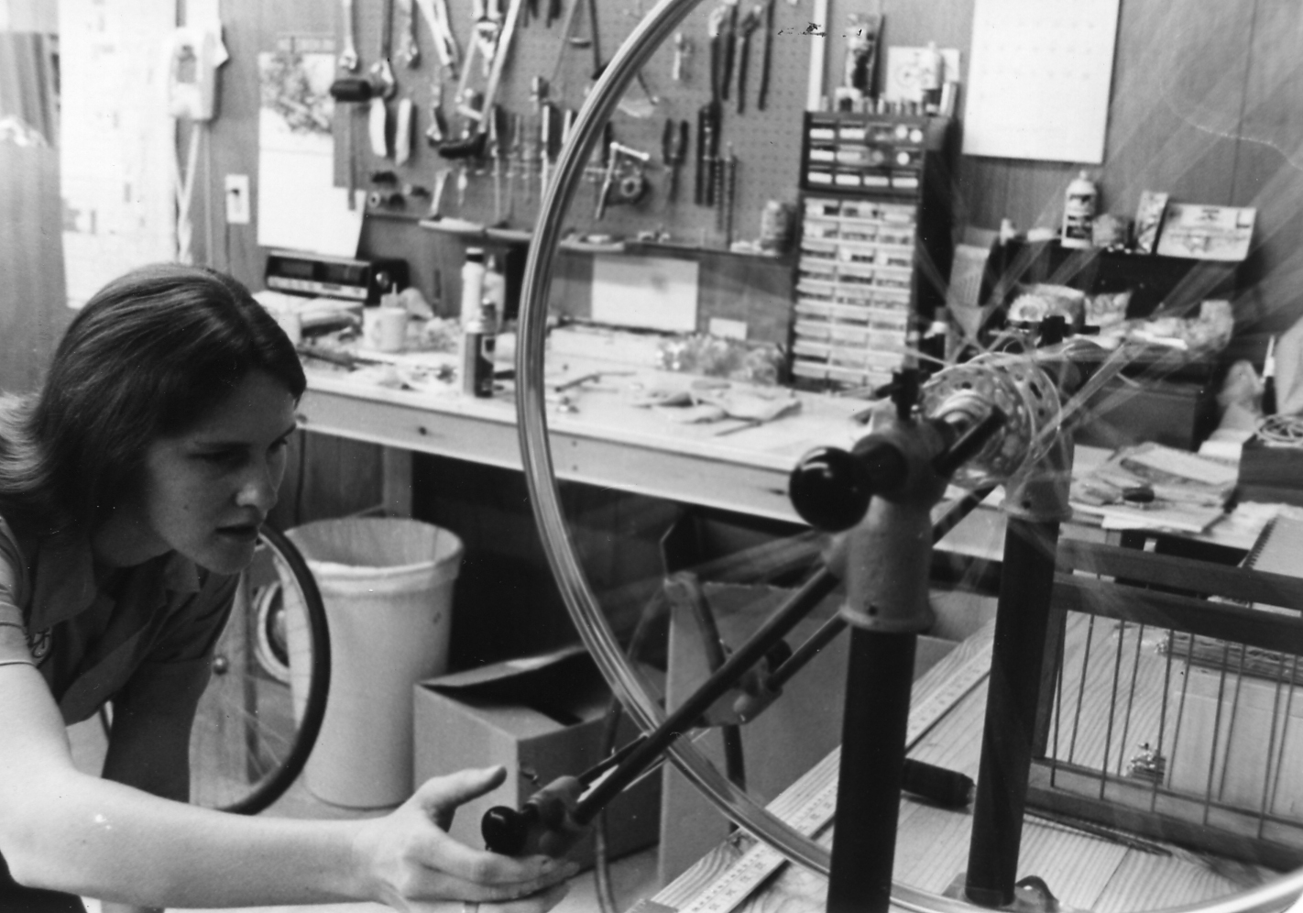
Notes:
After college . . . . Opened a bicycle shop.

Slide 15
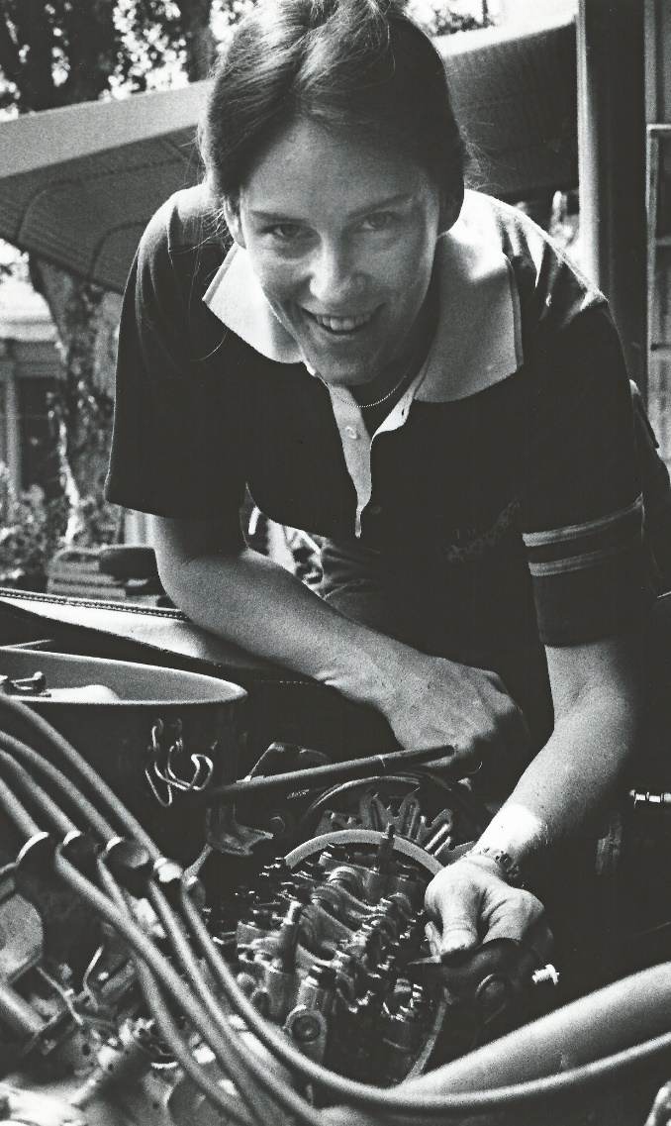
Notes:
Engines

Slide 16

The Flying Dream
Notes:
Get feedback from the audience. Who has had the flying dream? Usually 50%. Ask them to describe.
I did too. What it is like.

Slide 17
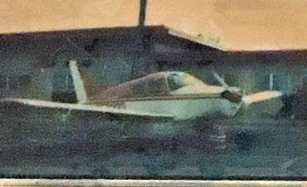
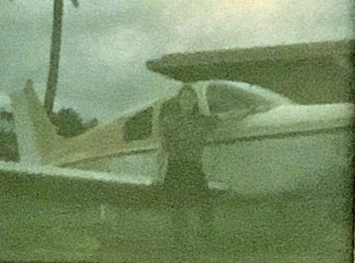
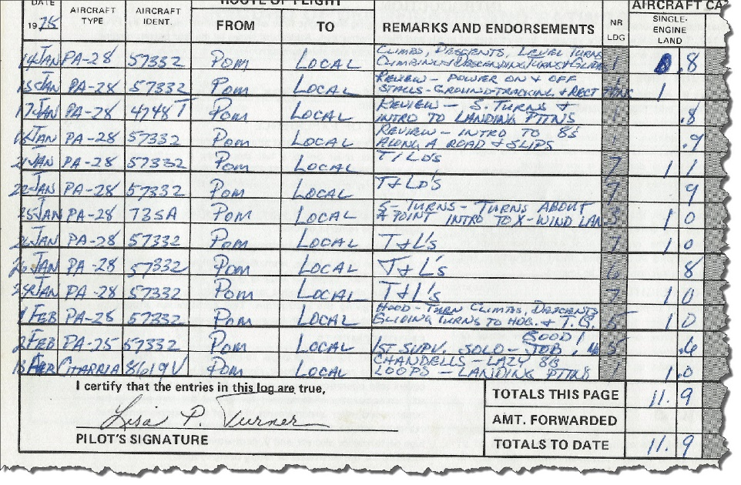
1975
Notes:
Flying start.

Slide 18
Twenty years later . . .
Notes:
Sometimes there are interruptions! Like career, family, etc.

Slide 19
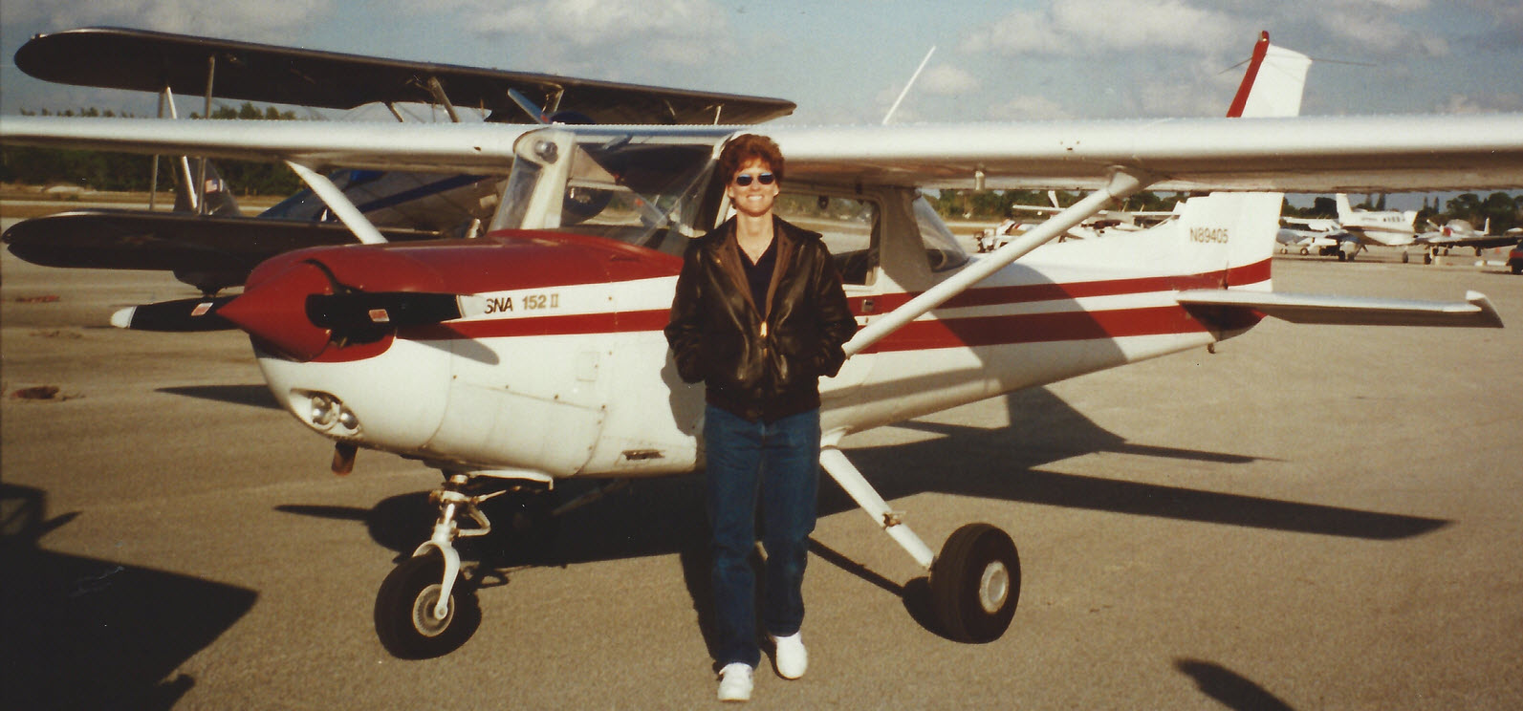
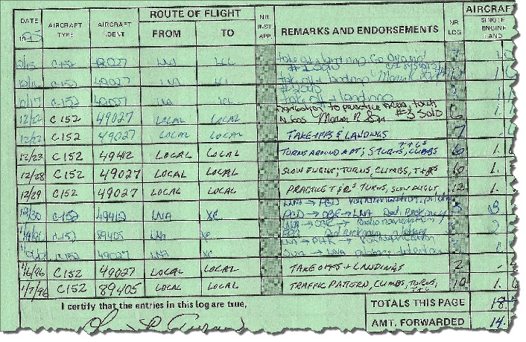
1995
Notes:
Finally got my license.

Slide 20
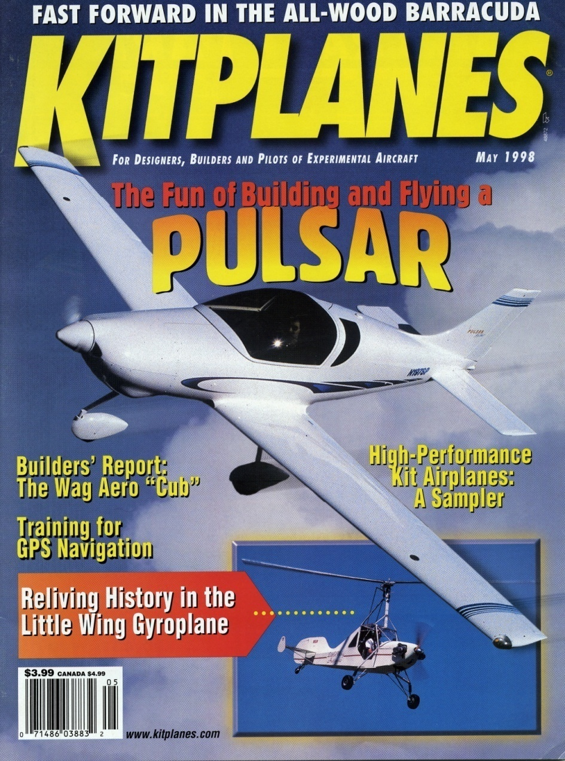
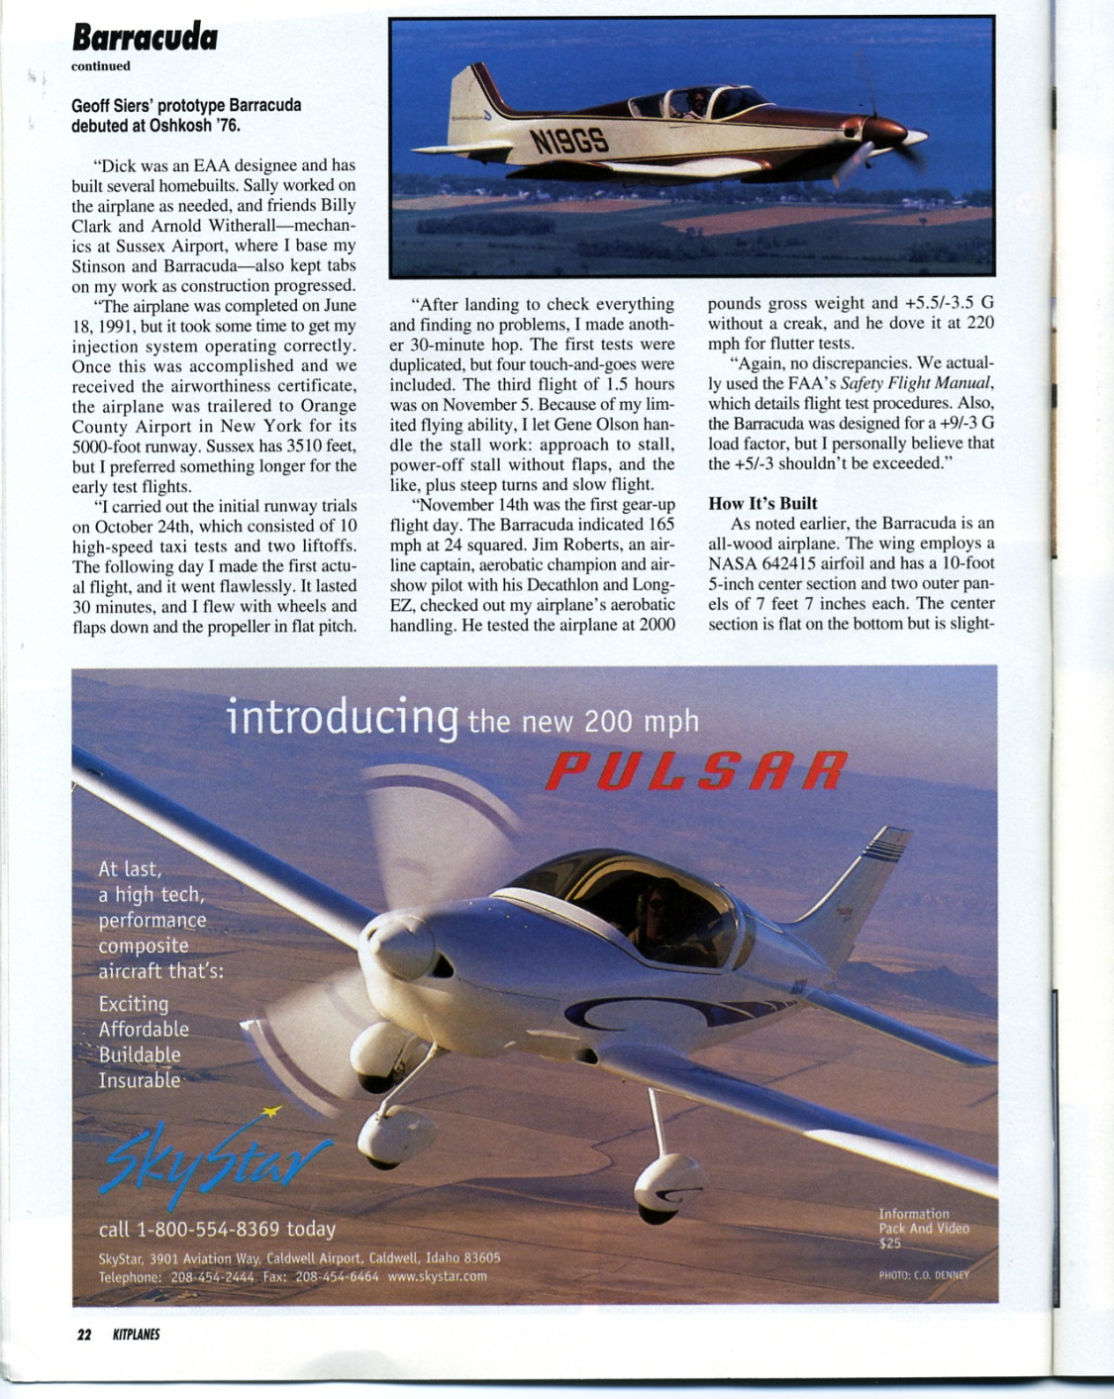
Notes:
Should I buy a 152 . . . . Or???? Went to Sun N Fun . . . . Candy store.

Slide 21
Guess what happened?

Slide 22
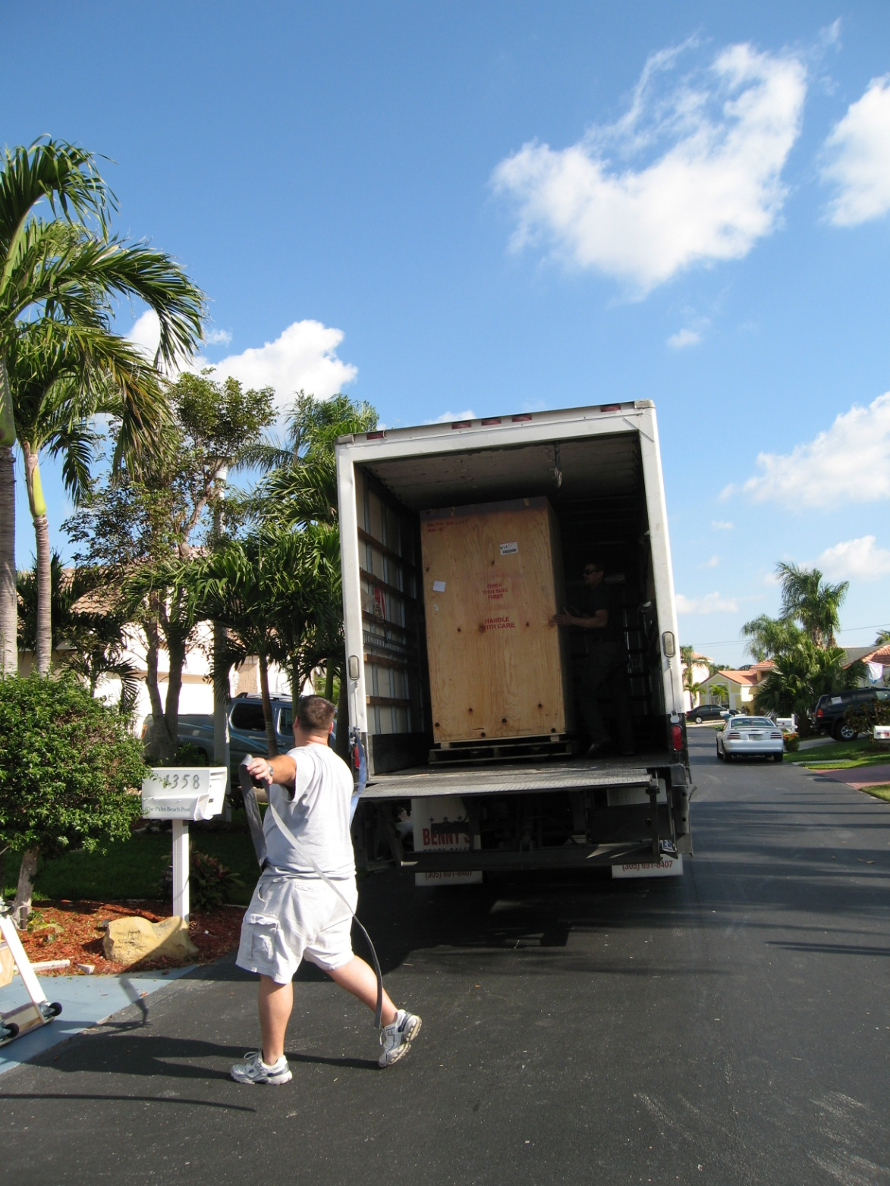
Notes:
Pulsar showed up!

Slide 23
My Whys Were . . .
Loved getting my hands on things
Loved being able to choose
Enjoyed building process. . .

Slide 24
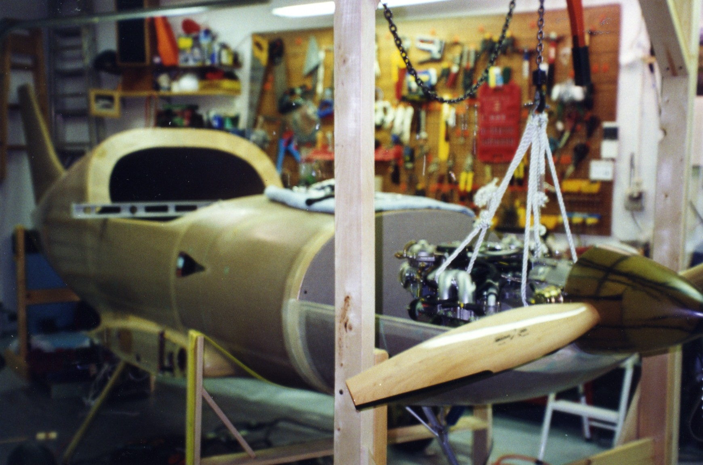
Notes:
One or 2 car garage all you need.

Slide 25
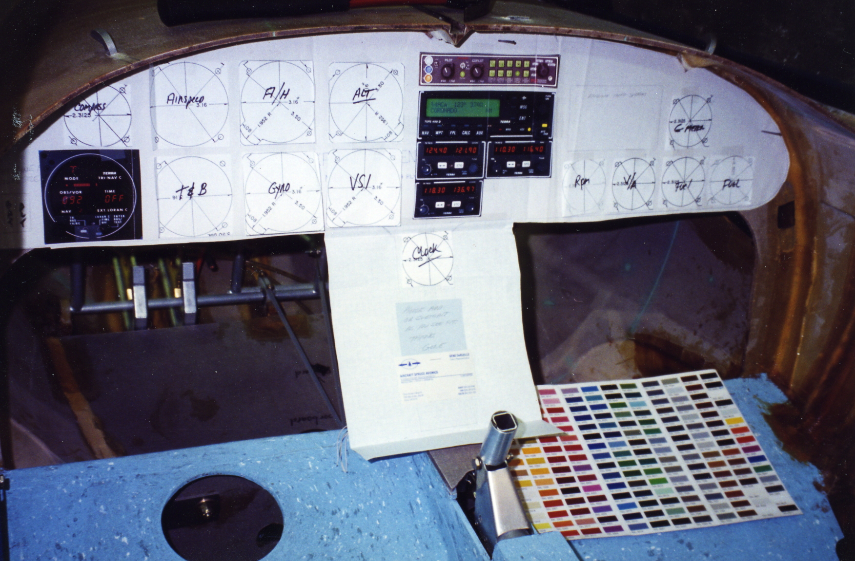
Notes:
First, get in the airplane and make engine noises. !
Panel Design

Slide 26
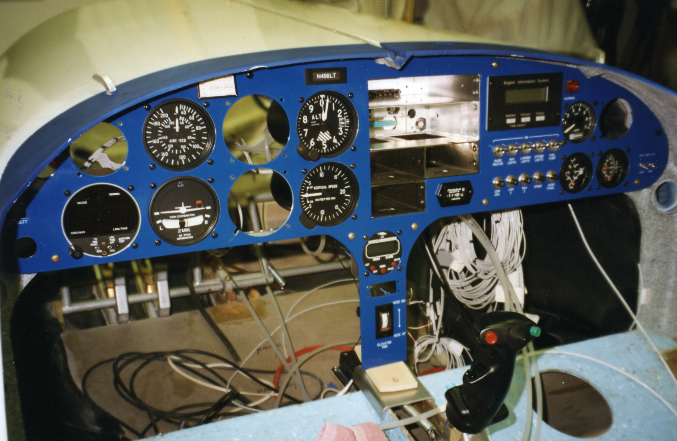
Notes:
Most fun (for me) – panel and design and install the harness – IFR.

Slide 27
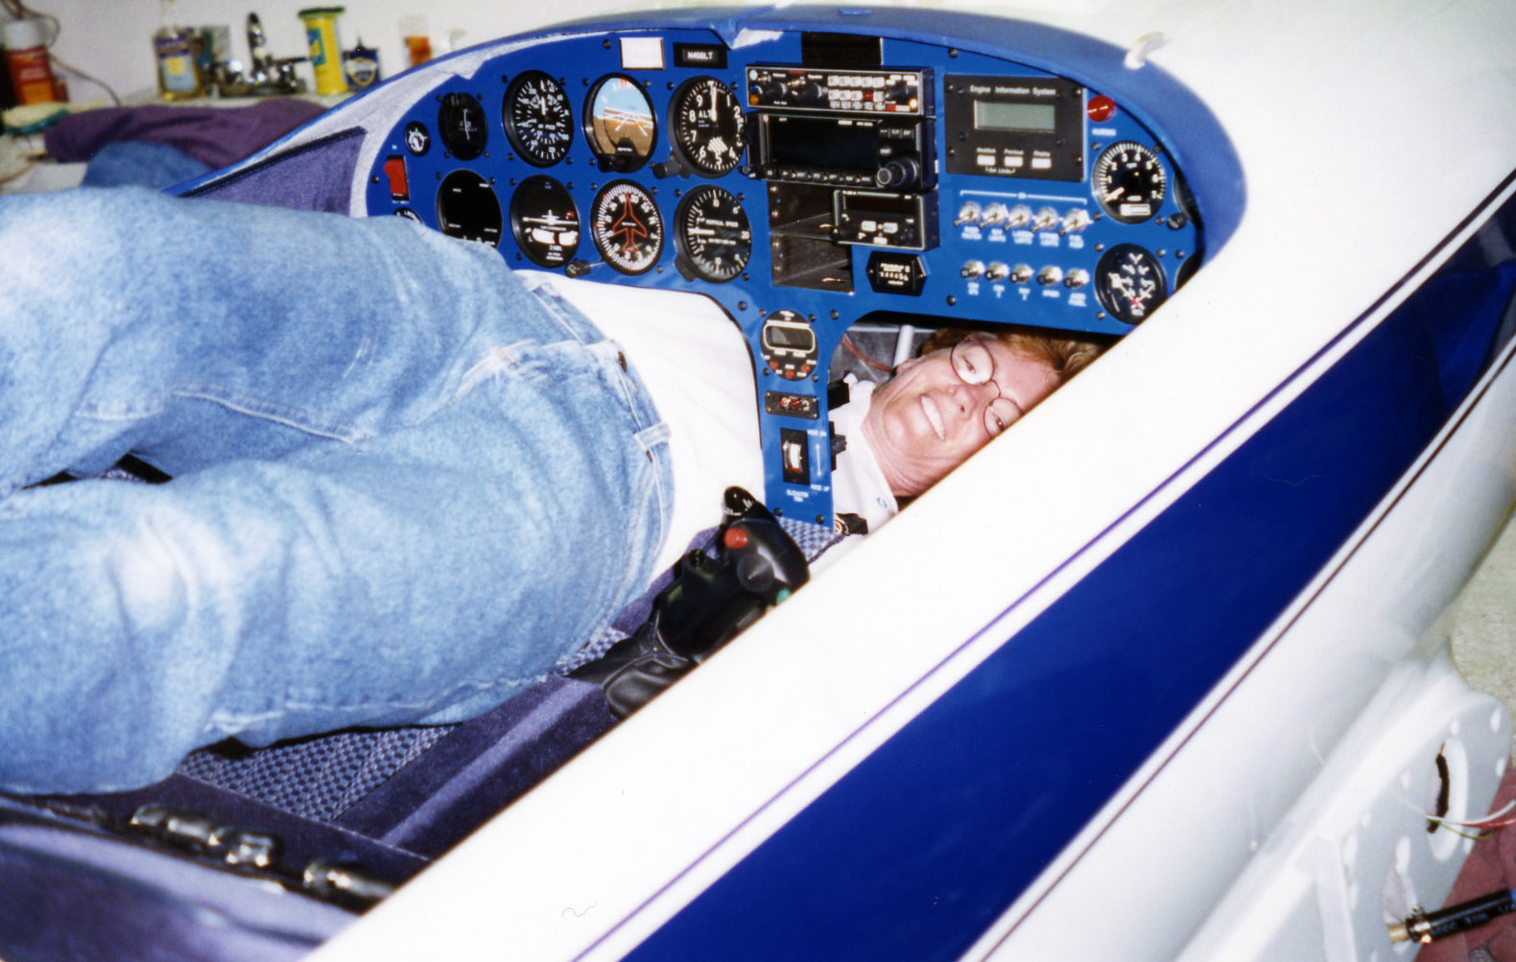
Notes:
Getting behind the panel was fun . . . Final hookups

Slide 28
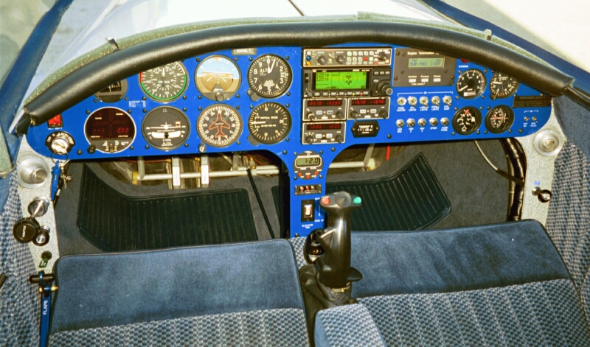
Notes:
Results

Slide 29
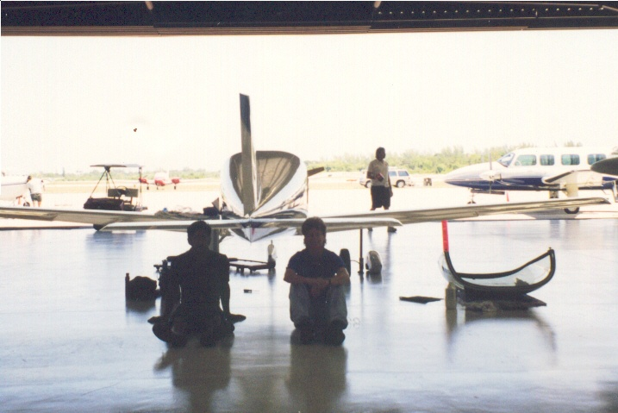
Notes:
Getting ready for first flight.

Slide 30
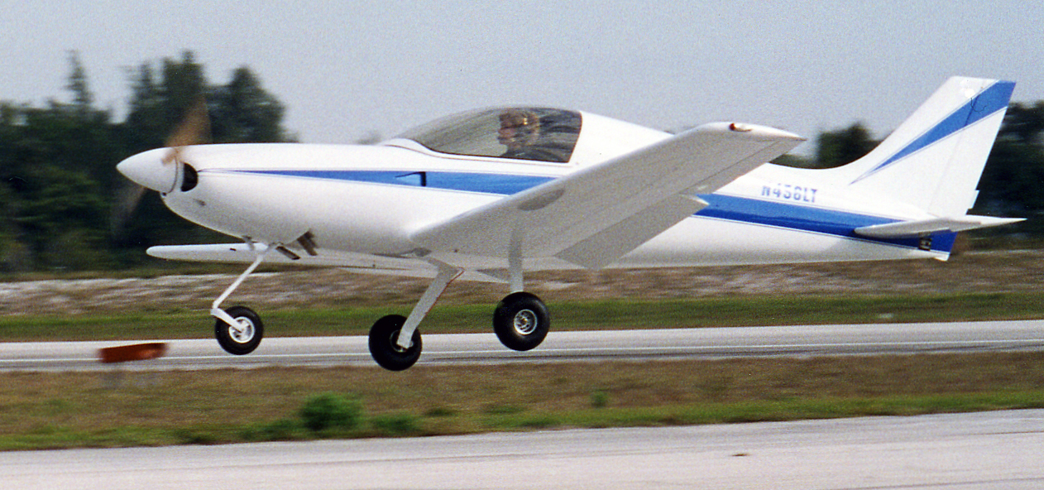
Notes:
There is nothing in the world like your first flight in an airplane that you built.

Slide 31
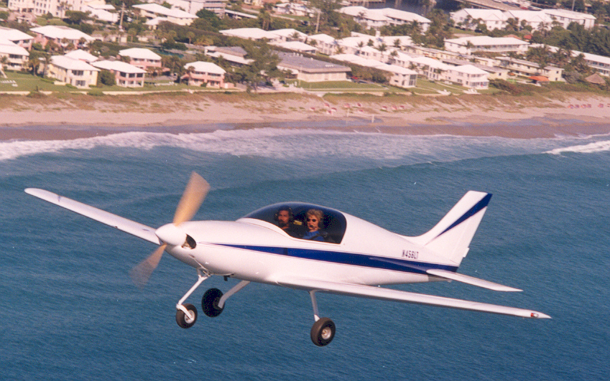
Notes:
After Phase 1, passengers delight

Slide 32
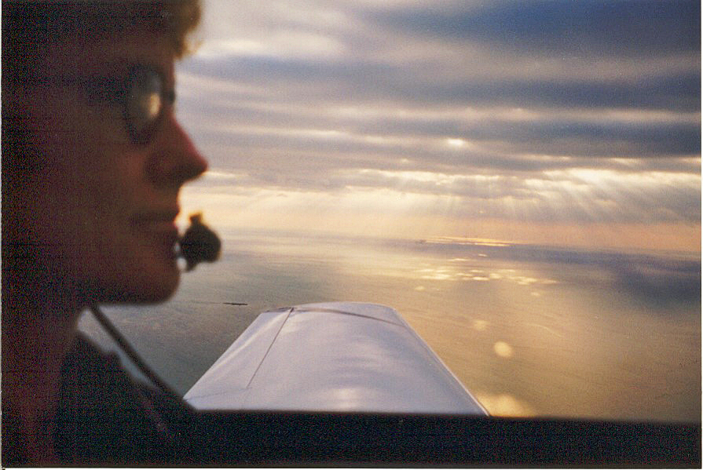
Notes:
Joy and happiness in your own craft

Slide 33
More Whys . . .
Loved flying my own craft
Loved photographing my childhood home
Loved visiting family

Slide 34
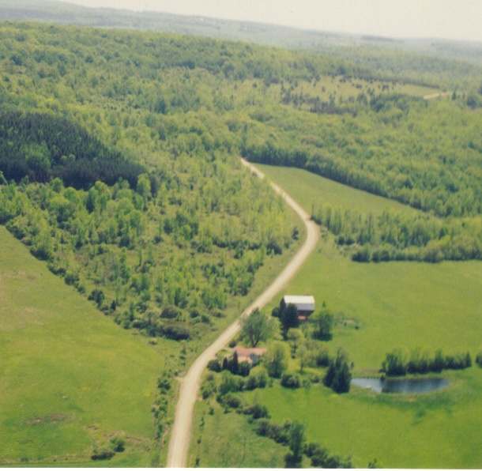
Notes:
Flying over the old family farm in western New York

Slide 35

Notes:
Flight into Trenton (Bar Harbor), Maine, to visit family

Slide 36
The Biggest Whys. . .
Confidence
Happiness
Sharing it with you

Slide 37
Whys from other workshops:
Passionate about creating/working on things
Want something that expresses my individuality
Love design and experimenting
Want a project that whole family can work on

Slide 38
“When we are motivated by goals that have deep meaning, by dreams that need completion, by pure love that needs expressing, then we truly live life."
- Greg Anderson

Slide 39
Here are some more whys for why YOU should build and fly your own airplane
You will learn how to prioritize
You will learn how to set and achieve goals
It will make your aviation relationships even more meaningful

Slide 40
You can use the same tools and techniques no matter what you want to achieve

Slide 41

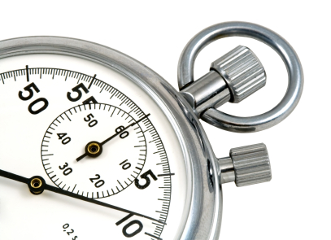
Competing Priorities . . .

Slide 42

How many of you have a list of goals or bucket list items?
How many of you have them written down somewhere?

Slide 43
Top 3
Notes:
Have class come up with their own

Slide 44
Brian Tracy, author of “Goals!” says that less than 3% of the population has written goals with a target date

Slide 45
WARNING!
THIS IS NOT EASY!
You will need to prioritize ruthlessly
You will need to give up other things on your list, for now
You will need to spend time, effort, and yes, money, achieving your goal
Is it worth it?
YOU get to decide. . .

Slide 46
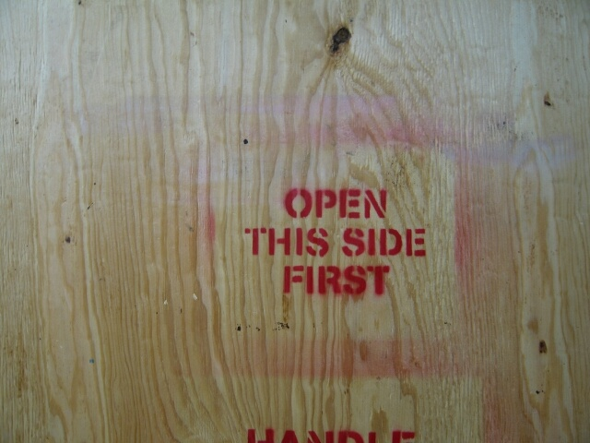

Slide 47
Why – What - How
Write it down in detail, with start date and completion date. You have just jumpstarted your brain’s goal achievement center.
Identify the obstacles you will face. Write them down.
Identify the solutions you will devise to overcome the obstacles.
Visualize yourself choosing, building, testing, and flying your personal aircraft every night as you fall asleep.

Slide 48
Here’s what you’ll get:
An ongoing flow of pride and satisfaction from your build – especially if it takes a while
An expansion of happiness and confidence
An enriched sense of creativity and accomplishment
You’ll become a great goal setter and planner
You have the joy of going places and having total strangers come up to you with a grin
You’ll be able to share your expertise with others

Slide 49
Who said this?
“Whether you believe you can do a thing or not, you are right”

Slide 50
Who said this?
“Whether you believe you can do a thing or not, you are right”
- Henry Ford

Slide 51

Nuts and Bolts
Resources for Success
EAA Sportair Workshops
Building and Restoring Clubs
EAA Technical Counselors and Flight Advisors
Forums
Local EAA Chapters and Builders
AirVenture and Sun N Fun
Books and Magazines
Airshows
Trade Schools
Identify a Mentor

Slide 52
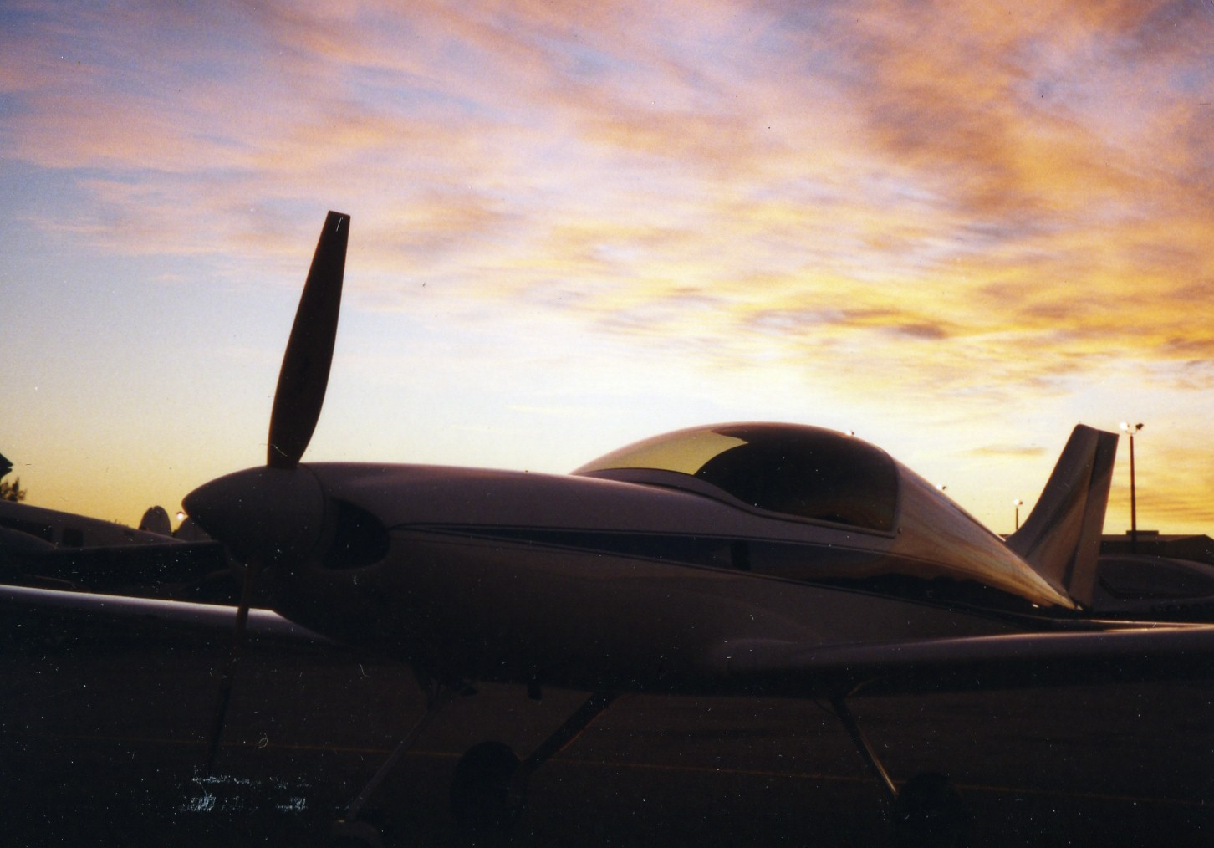
Questions?

Slide 53
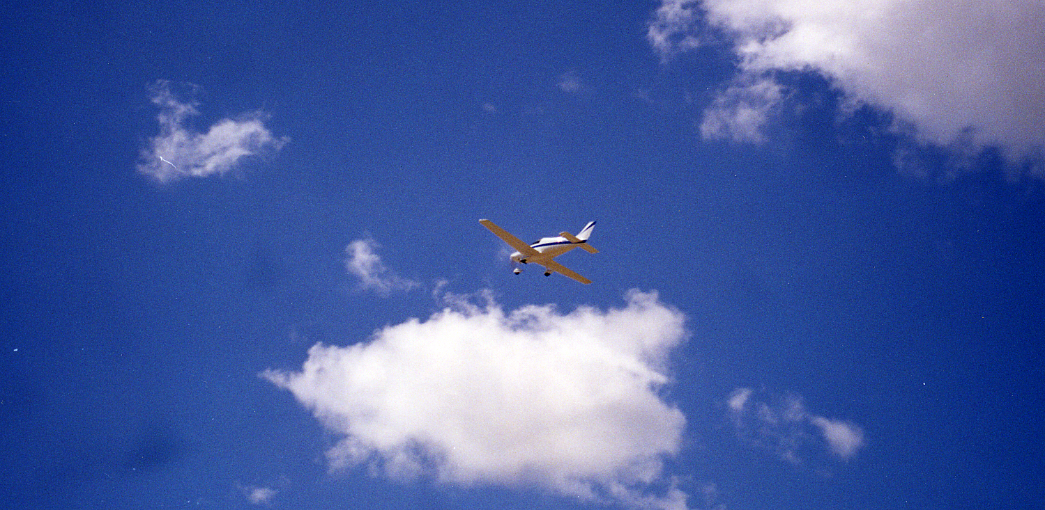
Copyright 2019. All Rights Reserved. This material may not be used without permission.
Than
Thank you!
Copyright 2019. Lisa Turner. All Rights Reserved. This material may not be used without permission.

