Slide 1

PHONEME BLENDING ACTIVITY
m
i
d
Change any letter
to make nonsense
words. The student
will point to each
letter, sound it out,
and then blend the
sounds together.
The pink cards
are vowels
or vowel teams.
Pull the arrow
to blend the sounds.
Or, move it to the right
to highlight ending rimes.
The white cards are
consonants or
consonant digraphs.

Slide 2
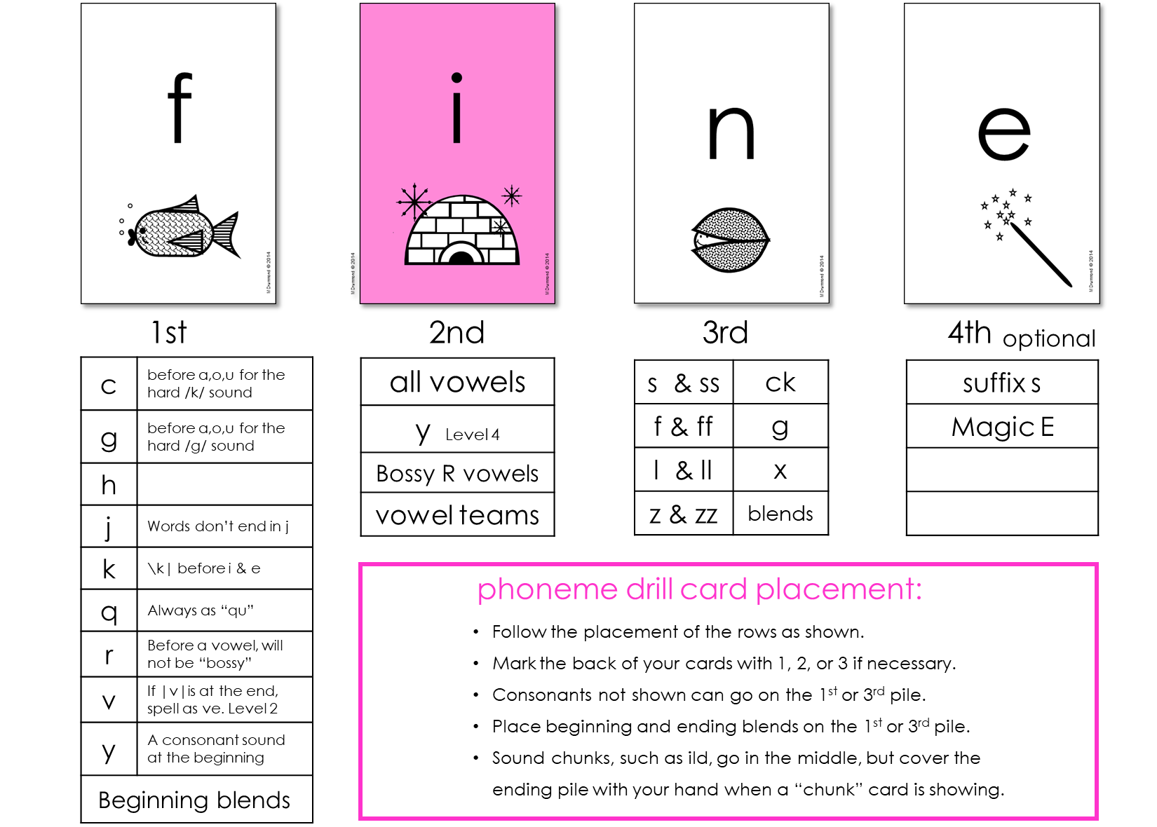
PHONEME BLENDING DRILL
suggested card placement
Place most consonants in either the fist or third location. Some consonants may cause confusion or break orthographic rules if misplaced, so please follow the recommendations above. Also, note the unique characteristics or advanced pronunciations in that location.
LiteraSee CONCEPTS ILLUSTRATED MDRUMMOND © 2018

Slide 3
letter sounds
L1.1A Consonants and Digraphs:
Sounds of letters that are made by hitting your lips, teeth, tongue, or mouth.
TEACH CONSONANTS IN THIS ORDER (left to right, in order of difficulty):
p | b | t | d | f | v | h
th | m | n | k | g | r | l
sh | w | z | j | ch | c | ck
x | wh | qu | y | s /s/ | s /z/
L1.1B Vowels:
Sounds of letters that are made without hitting your lips, teeth, tongue, or mouth.
The sounds are made by the shape of the mouth and lips.
TEACH SHORT VOWELS IN THIS ORDER (to space similar sounding vowels):
a | i | o | u | e
LiteraSee concepts illustrated MDrummond © 2015

Slide 4
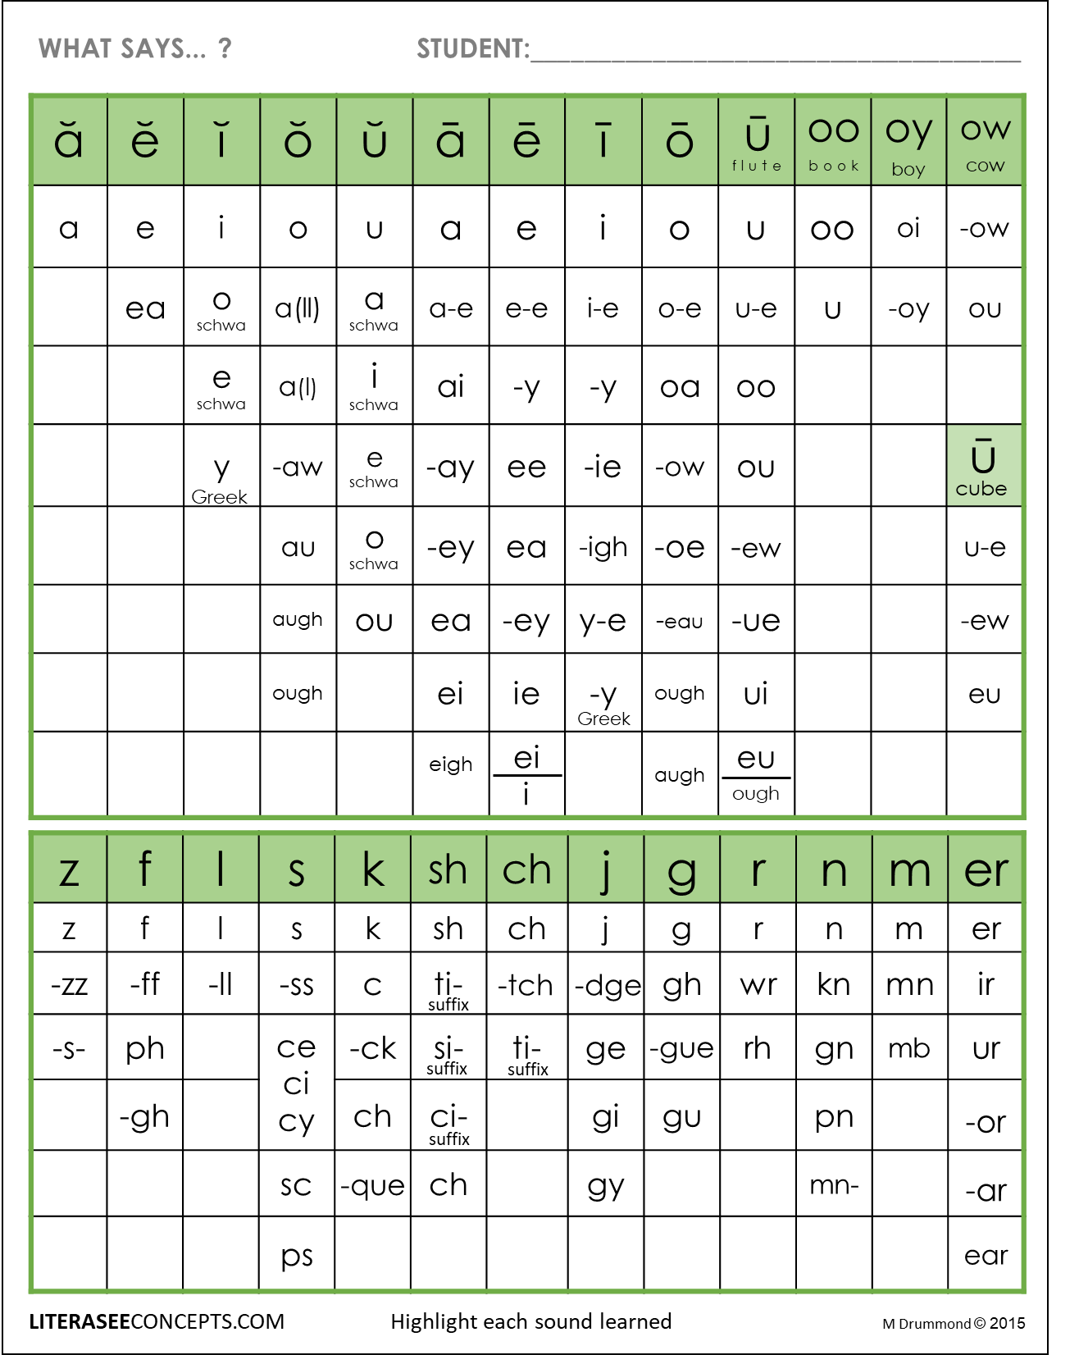
What Says...? Student:
KEEP TRACK OF THE PHONEMES LEARNED
Click on the sound
at the top. Pull down the bottom dot to highlight each spelling learned.
Copy and paste the square below if you need to highlight a particular spelling.

Slide 5
t
a
d
CVC: short vowels, vowel teams, consonant digraphs or trigraphs

Slide 6
t
ay
Ending vowel teams

Slide 7
s
o
t
e
Magic E

Slide 8
g
a
r
k
R-Controlled

Slide 9
b
l
i
g
Beginning Blends

Slide 10
p
e
n
d
Ending Blends

