Slide 1
Bug Brother by Pete Johnson
Lesson 5
19.1.21

Slide 4
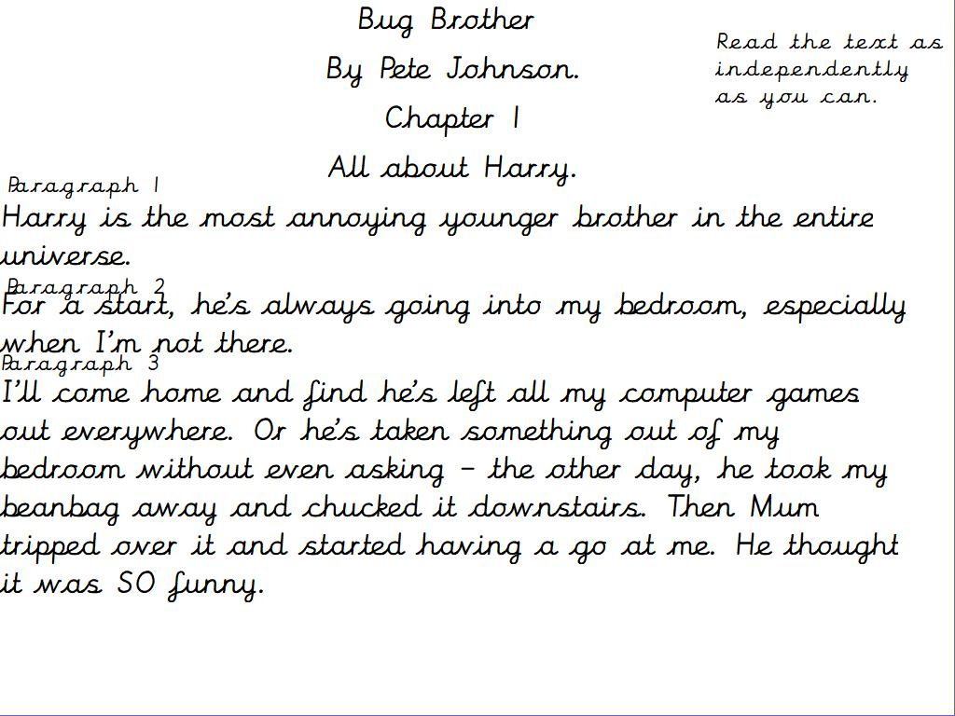

Slide 5
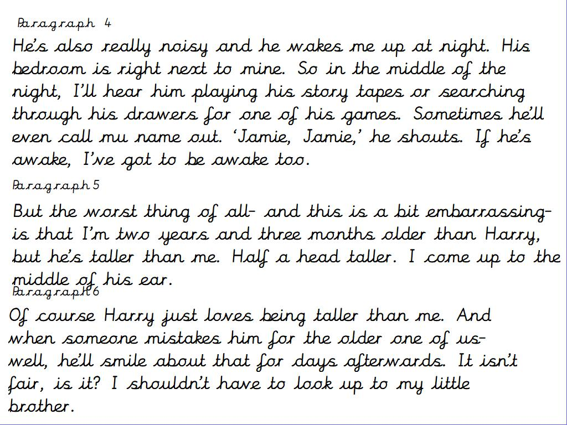

Slide 6
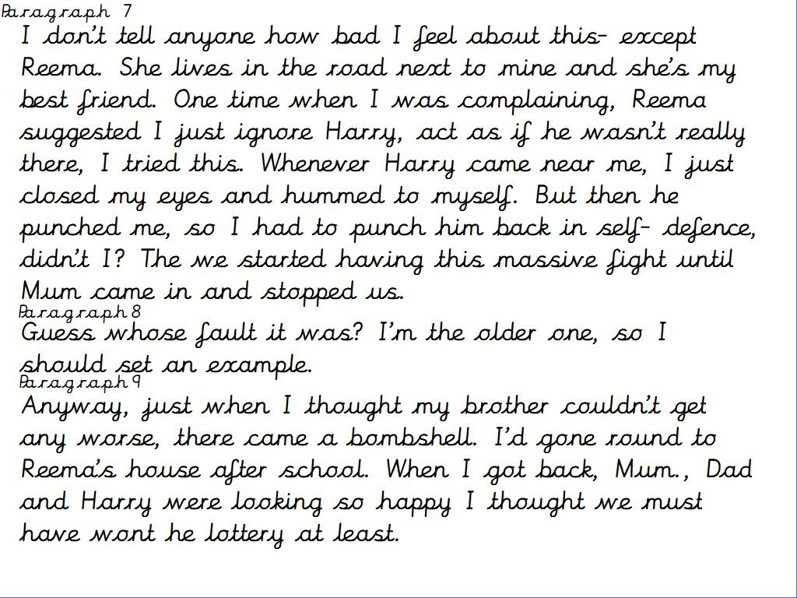

Slide 7
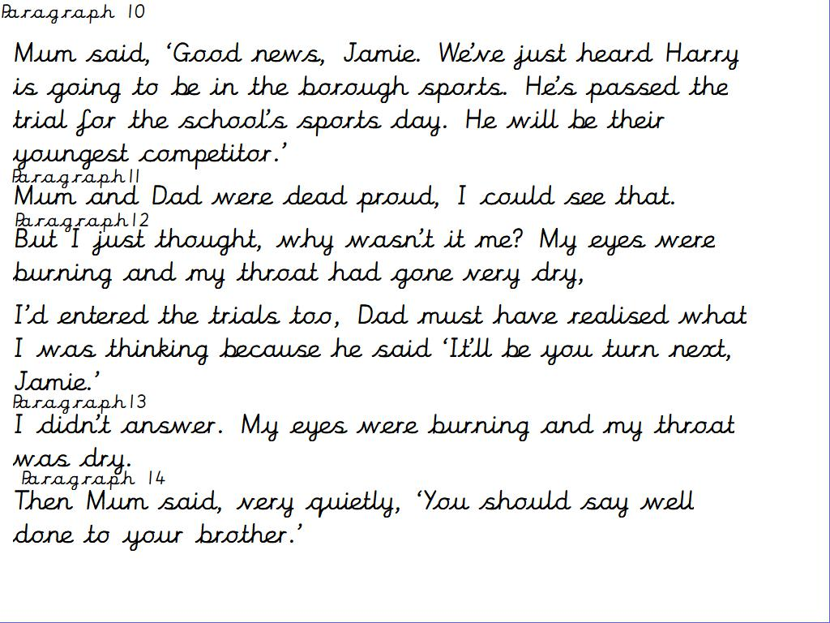

Slide 8
