Slide 1
Reading Mastery A Mystery Woman
20.1.21
Lesson One

Slide 6
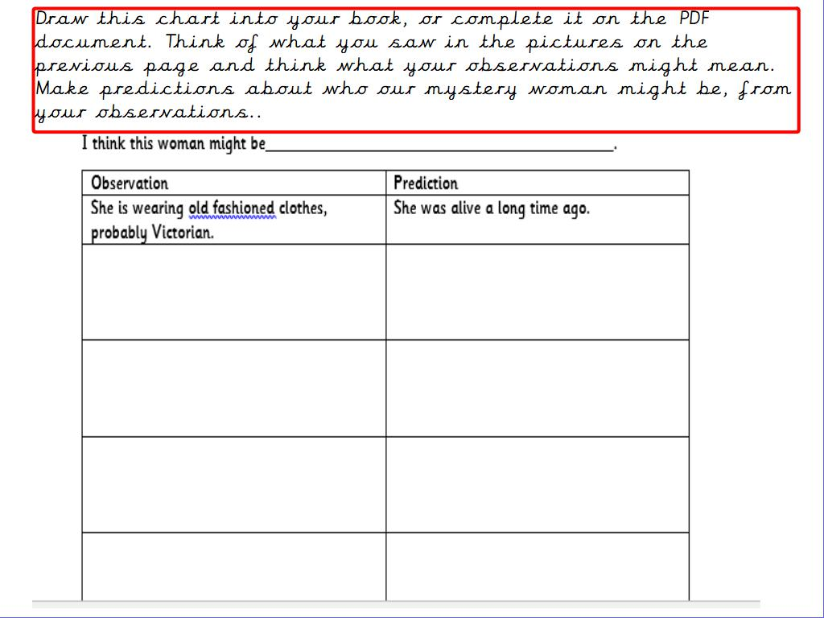

Slide 8
