Slide 1
the
to

Slide 2
I
go
no

Slide 3
into he
she
we

Slide 4
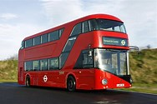
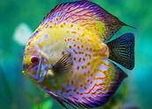
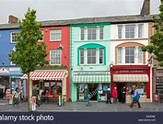
Can you read these sentences?
I can go on the bus.
Can he see the fish?
We go to the shops.

