Slide 12
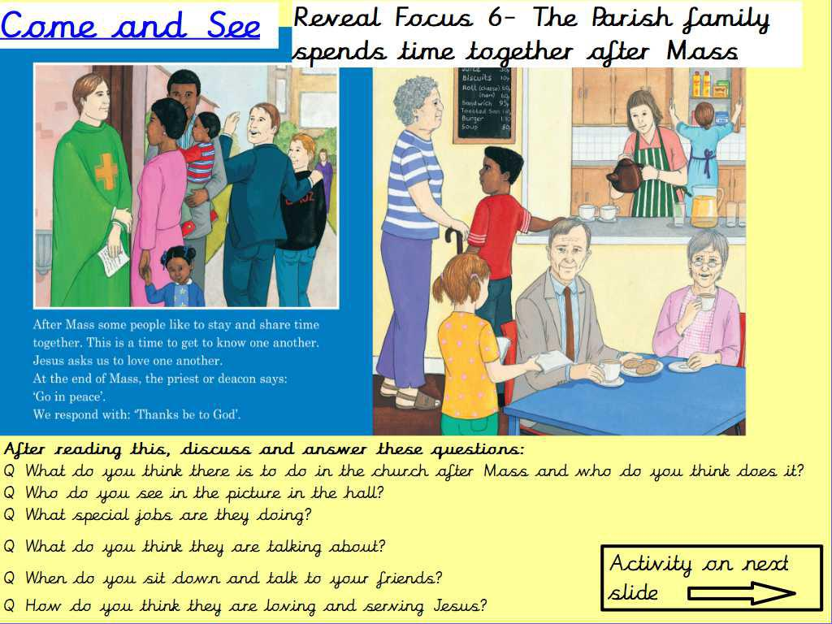

Slide 13
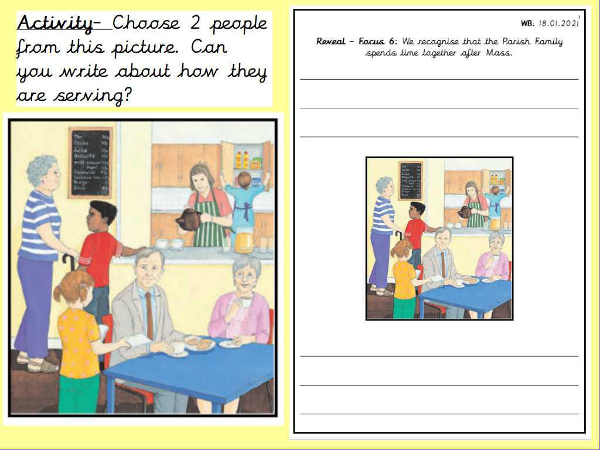

Slide 16
Listen to the extract and try to read along with it.

