Slide 1
Transition to secondary school
If you are unable to print or type into the word documents, write your answers on a piece of paper!
To start, play this slideshow from beginning
© PSHE Association 2020

Slide 2
We are learning about the feelings pupils face when moving to secondary school and ways of managing these feelings
We will be able to:
identify feelings people currently might be experiencing when finishing primary school and moving to secondary school (KS3).
recognise common causes of worry, challenges and opportunities that may be part of this transition, as well as additional challenges from school closures.
identify and evaluate the usefulness and reliability of different sources of support and information available; explain how to access them.
identify ways to positively manage the move to secondary school (KS3).
© PSHE Association 2020

Slide 3
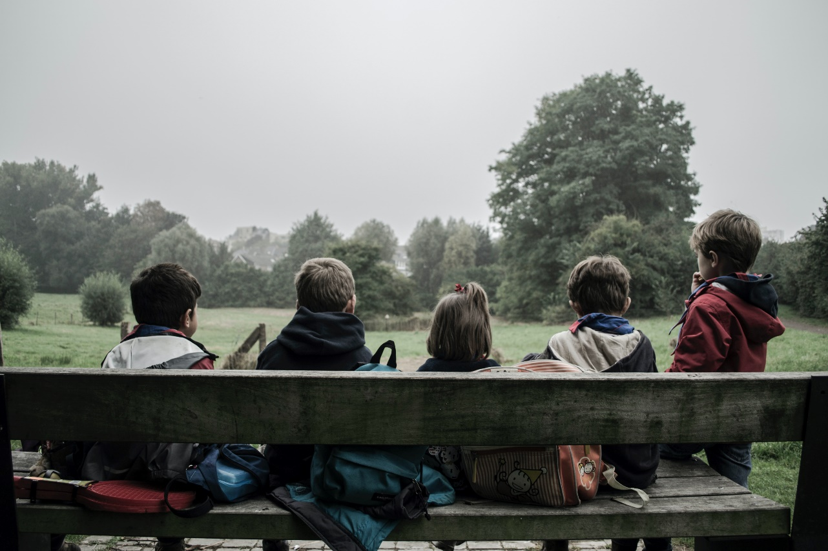
Leaving primary school
Nusrat is in Year 6 and is currently learning from home because schools are closed. She might not be able to go back to school for a while, and when she does, it might be time to start secondary school!
Nusrat is thinking about all the things she loved about her primary school. What do you think she might be missing?
Fill the thought bubble in Resource 1 with all of your ideas.
© PSHE Association 2020

Slide 4
Secondary school
Nusrat is also wondering what secondary school might be like... what questions might she have about starting a new school?
Add any questions you can think of around the picture of the school in Resource 2.
© PSHE Association 2020

Slide 5
Hopes and challenges
Nusrat has just heard on the news that schools are nearly ready to reopen, and she will soon be starting secondary school. Her dad is going to buy her new uniform and school bag online. Nusrat's really excited about going to her new school, but also a little bit worried...
What might Nusrat be excited about (hopes) and worried about (challenges)?
Brainstorm your ideas, with hopes in one colour and challenges in another.
© PSHE Association 2020

Slide 6
Hopes and challenges
Click to reveal examples of challenges
Click to reveal examples of hopes
getting lost around the new school building
not being in the same class as best friend(s)
more homework
big lunch hall and choosing a meal
don’t understand new subjects
wanting to join a club but don’t know whom to go with
not knowing the rules and getting detention
making new friends
learning about new subjects
joining different clubs and after school activities
meeting new teachers
going on different school trips
new responsibilities
Now, in a different colour, add any specific worries you think she might have because she hasn't been to school for several weeks…
© PSHE Association 2020

Slide 7
Specific worries
Click to reveal examples specific worries or challenges someone might have after not being in school for several weeks
adjusting to a school routine after not being in school for so long
remembering school rules
forgetting some of what they learnt before schools closed
being in class with others again
seeing friends again after a long time apart
missing out on induction days and end of school celebrations
© PSHE Association 2020

Slide 8
Managing challenges
There are lots of ways that the challenges of secondary school can be managed.
In Resource 3, add your ideas about how Nusrat could manage some of the challenges of secondary school to the table, thinking about what she could do at home now, e.g. look at her new school website, and what she could do in the future, e.g. talk to a teacher.
Then, click the boxes on the next slide to reveal some suggestions…
© PSHE Association 2020

Slide 9
Managing challenges
Challenge | How could Nusrat manage this challenge now? | How could Nusrat manage this challenge in the future?
Getting lost around the new school | Nusrat could look on the school website for maps, pictures or videos of what the school is like. | She could ask other pupils and teachers for help if she gets lost — everyone will understand that she is still finding her way around and that this might take time!
Not being in the same class as friends | Nusrat could try to focus on the positives. Secondary school is a great opportunity to make new friends. | She will make new friends when she gets to her new school. Everyone will be in the same position — they will all be new too!
More homework | Nusrat could find out about homework on the school website and see if there is a homework club where she could work every day too, if she needs a quiet space. | Nusrat could create a homework timetable to help plan what homework to do when — not all subjects will set homework every day.
Big lunch hall and choosing a meal | Nusrat could look on the school website for menu examples, or pictures of how the lunch hall is set up. | She could ask to meet some people from her class at lunch so they can all eat together.
Don’t understand new subjects | Nusrat could read about different subjects on the school website if she would like to find out more information about what topics she will study. | She will always be able to ask teachers for help whenever it is needed!
Not knowing the rules and getting a detention | There might be information and welcome videos on the school website to watch to find out about what a normal school day might be like. | The rules will be explained to Nusrat in the first few weeks of starting secondary school. If she is unsure of any rules, teachers and older students can be asked.
© PSHE Association 2020

Slide 10
Sources of help and support
Which sources of support would be most useful for Nusrat to talk to about her concerns?
Add any advantages or disadvantages to each source of support in the table in Resource 4. The first one has been done for you…
Then, rank the sources of support from 1-10 in order of reliability and usefulness (1 being the most useful source of support)
What could Nusrat say to start a conversation with your most highly ranked source of support?
© PSHE Association 2020

Slide 11
Need help? Click the picture to reveal some sentence starters…
Message to self!
Dear…
Good luck for starting secondary school!
Remember to …
You know that …
You can always …
Write a short uplifting message of advice to yourself. This can be opened and read on the evening before you start your new school.
Which key bits of advice are going to help you manage your thoughts and feelings so that you are ready to cope with all the opportunities and challenges of moving into Year 7?
© PSHE Association 2020
Notes:
Sentence starters:
Dear…
Good luck for starting secondary school!
Remember to …
You know that …
You can always …

Slide 12
Celebrating success
Think about the last few years of school…
For each of the below, try to come up with at least one example:
Something you are proud of
Example of progress you have made (skills, subjects, friendships etc.)
The best thing you have learnt
How you have changed between Reception and now
Something you will take forward into Year 7 (e.g. a particular skill, attitude etc.)
What could you do to celebrate your successes at primary school?
© PSHE Association 2020

Slide 13
Plan something to celebrate the end of primary school — either an idea of your own, or one of the following suggestions:
Create a time capsule of your favourite things from primary school. Save these to look back at before your first day in secondary school.
Write a letter to your primary school teacher or friends telling them the things you liked the most about being in their class this year.
Create a mood board or collage of all the things you are proudest of from Year 6. This could include pieces of work, kind things you did/said, ways you helped others or the school community, prizes or awards you won etc..
More activities

