Slide 1
Great Crosby Catholic Primary School
Login instructions and assignments
Pause the video at any time. II

Slide 2
Logging in
Open your browser and type www.office.com
or
click on the image on the school homepage www.greatcrosbycatholicprimary.com

Slide 3
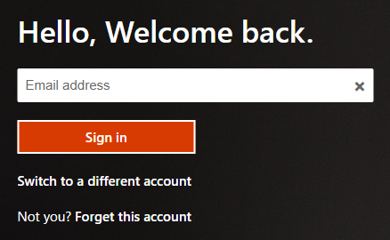
Type in the username/email address from the letter into the white box and press ‘Sign in’.
pupil@gcp.org.uk

Slide 4
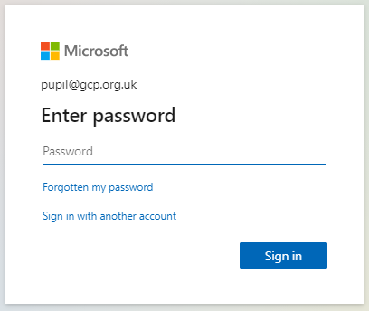
Type in the password from the letter into the white box and press ‘Sign in’.

Slide 5
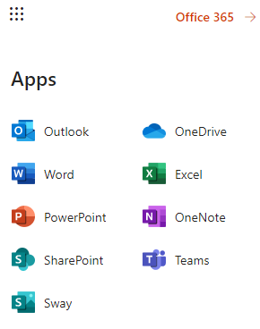
The next window has this bar on the left.
You can open Teams by clicking on the T icon.
If you can’t see the T icon click on the grid of 9 dots and click on the ‘Teams’ icon.

Slide 6
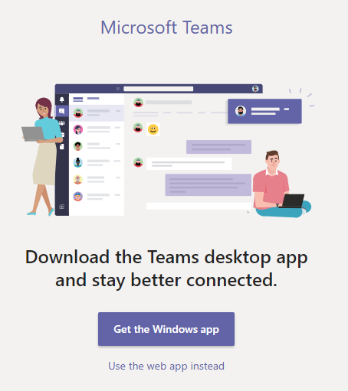
This will appear next. If you are on a PC or laptop, click on ‘Use the web app instead’.
If you are on an iPad or Apple device, please click on the blue button to download the app from the App store.
If you are using an Android device, you may need to download the app from Google Play.

Slide 7
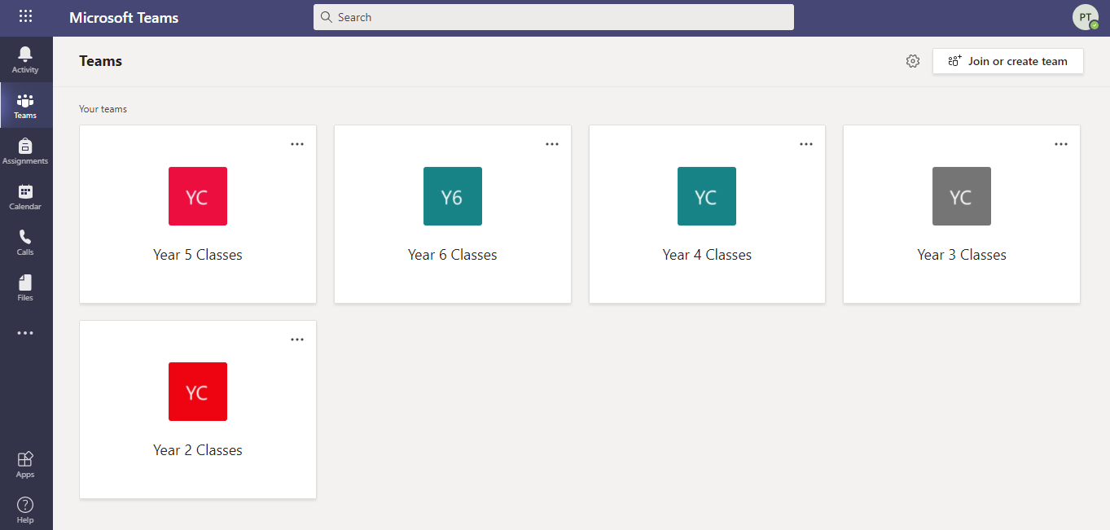
This is the main screen that will appear.
There will only be your class, so click on the square.
You will find your assignments by clicking on the ‘Assignments’ button.

Slide 8
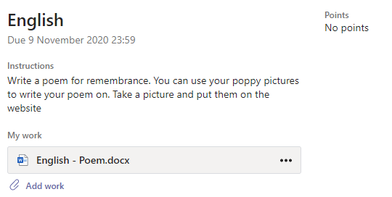
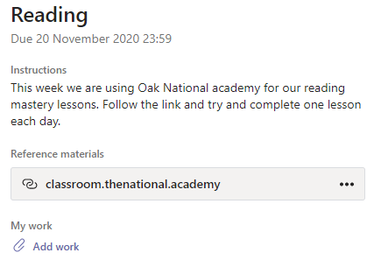
First read the instructions and check the due date!
A new function called ‘Immersive Reader’, will read the instructions for you. Click on this button:

Slide 9
If there is a Word document or PowerPoint file listed under
‘My work’ then you can open that and type into it.
It will save automatically.

Slide 10
Within PowerPoint, you can use the ‘Draw’ function
or ‘Insert’ > Text Box.
eg

Slide 11
In ‘Reference materials’, there might be a PDF document to open, a website to visit or video link to watch.

Slide 12
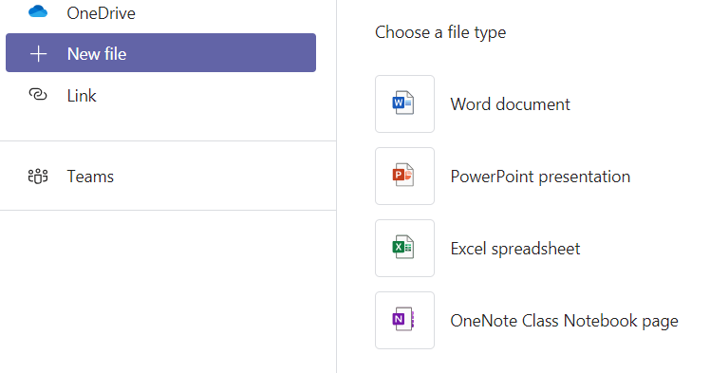
To add work yourself, click on the paper clip to ‘Add Work’.
It could be a document produced within Microsoft Teams.

Slide 13
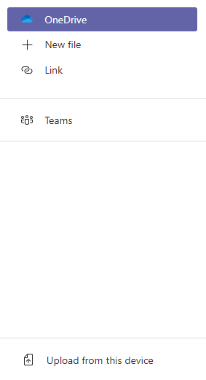
It could be a file saved on a device, like a photo or screenshot.

Slide 14
When you have finished, then you can click on ‘Hand in’.
Your teacher will be able to see what you have done and will give you feedback.
Check back for feedback by clicking on ‘Completed’.

Slide 15
If you need to contact your teacher for help,
Click on the ‘Activity’ button, then ‘Posts’.
Click on and type your message.
Remember, this is not a place for private chats with friends as all the teachers and the yeargroup can see it.

Slide 16
If you need any help with logging in, please email the school and your message will be forwarded to a member of staff.
admin.greatcrosby@schools.sefton.gov.uk
Thank you for your help and patience.

