Slide 1
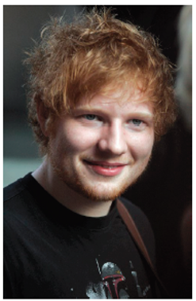
Lesson 1
L.O: I can identify key facts
L.O: I can identify the key features of a non-fiction text.
Text Talk
Ed Sheeran

Slide 2
Tell your partner: We are going to read a text called ‘Ed Sheeran’
What do you think this text is about?
I think the text is about… because...
What type of text do you think it is?
I think the text is…
What do we need to have in a report?
A good report must have...
Facts, headings, subheadings, relevant information.

Slide 3
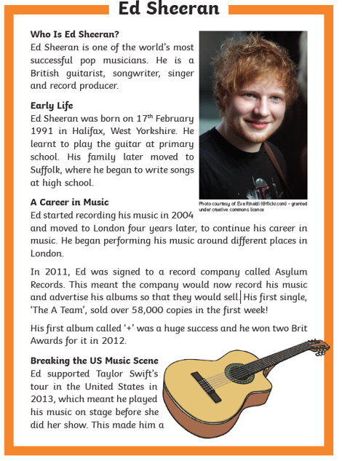

Slide 4
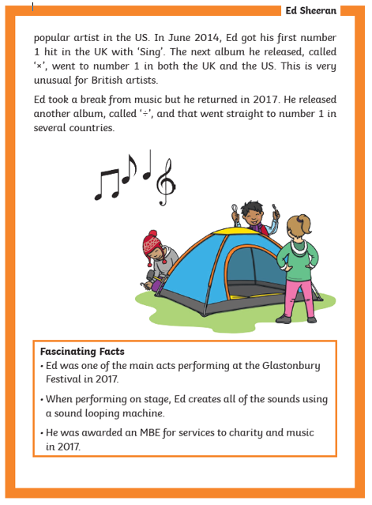

Slide 5
Tell your partner: Which one is correct?
This report gives the reader…
Facts Jokes
A story A poem
It is ___________ because it …
X
facts
Answers the questions in the subheadings.

Slide 6
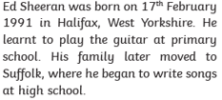
Tell your partner: True or False?
Ed Sheeran was born on 17th February 1991.
It is ___________ because it says …..
True | False
X
true
He was born on 17th February 1991

Slide 7
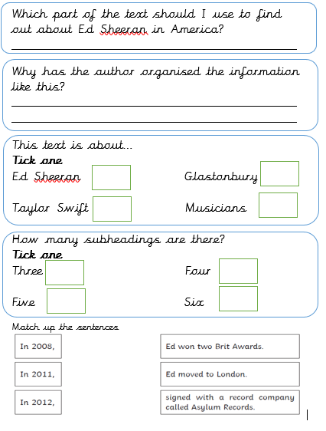
Main task
Breaking in the US Music Scene
To make it easier for the reader to find the facts / information.
X
X

Slide 8
Lesson 2
L.O: I can explain the meaning of words
Word detectives
Ed Sheeran

Slide 9
Tell your partner: How can we work out the meaning of a word?
We can use...
Read around the word
Use a dictionary
Use synonyms e.g. happy - excited
When I am reading the text, I want you to think about any words that you do not understand

Slide 12
Tell your partner
Find and copy a word that means job.
Career

Slide 13
Tell your partner
What does the word ‘success’ mean?
What word could the author use instead of ‘success?’
popular
Popular, achievement, acomplishment

Slide 14
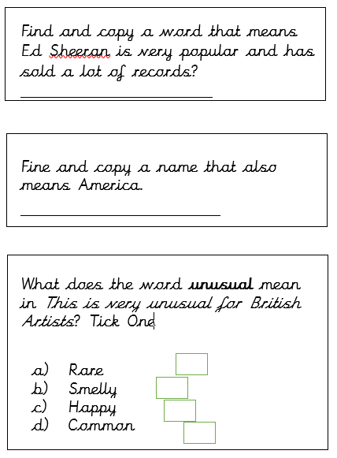
Main task
Successful
United States or US
X

Slide 15
Lesson 3
L.O: I can retrieve and record information from the text
Rapid retrieval
Ed Sheeran

Slide 16
Tell your partner: How can we retrieve information from the text?
We need to...
Read the text carefully​ Find the important information​ Pick out the information in order to answer questions

Slide 19
Tell your partner: What was Ed doing in 2004?
Recording music

Slide 20
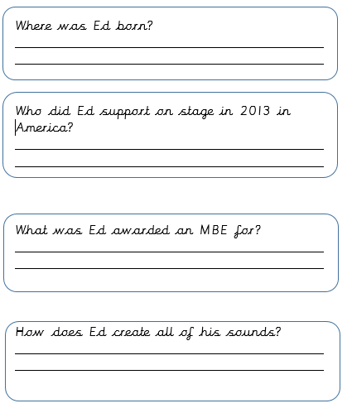
Main task
Halifax
Taylor Swift
Services to charity and music
Sound looping machine

Slide 21
Lesson 4
L.O: I can make inferences from the text
Thinking Caps
Ed Sheeran

Slide 22
Tell your partner: How can we find out specific facts.
Use clues from the text​ and make a sensible guess
Use the subheadings and images to help you locate information

Slide 25
Tell your partner:
Why do you think the author has included an image of Ed Sheeran?
To let the reader know what Ed Sheeran looks like.

Slide 26
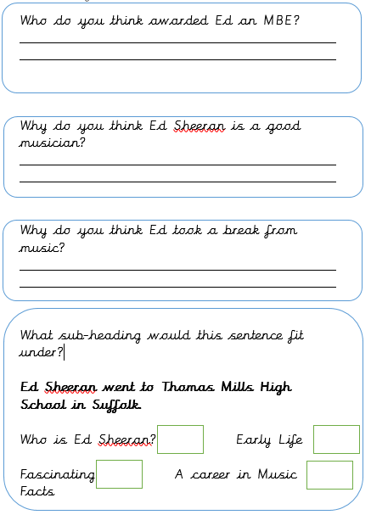
Main task
The Queen
Because the amount of albums he
has sold
To be able to write new music.
X

Slide 27
Lesson 5
L.O: I can make links to the text
Question of the Week
Ed Sheeran

Slide 30
Tell your partner:
What do you think it’s like to be a famous singer and song writer?
I think being a famous singer would be an amazing career because I think I would enjoy singing songs on a stage to lots of fans.

Slide 31
Drawing

Slide 32
Sharing answers
Choose children to read out their diary entry and share with the class.

