Slide 1
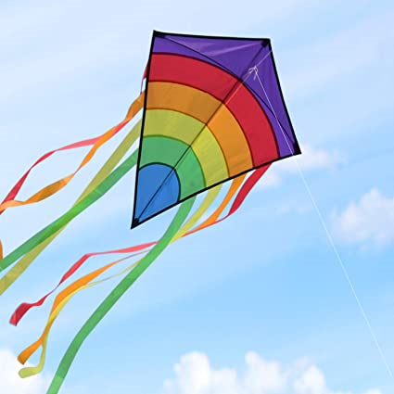
Lesson 1
Text Talk
Wind on the
Hill
By A.A.Milne

Slide 2
Steps to Success
What makes a good summarizer?
To read paragraphs carefully and say what is happening in your own words.
To use less words to summarise what you’ve read.

Slide 3
Tell your partner: We are going to read a text called ‘Wind on the Hill’
What type of text is this?
I think the text is… because...
Who is this text is about?
I think the text is about…
What are the main features of a poem?
Some poems have...
rhyme (usually the words at the end of a line), rhythm, stanzas.

Slide 4
Wind on the Hill
No one can tell me,
Nobody knows,
Where the wind comes from,
Where the wind goes.
It’s flying from somewhere
As fast as it can,
I couldn’t keep up with it,
Not if I ran.
But if I stopped holding
The string of my kite,
It would blow with the wind
For a day and a night.
And then when I found it,
Wherever it blew,
I should know that the wind
Had been going there too.
So then I could tell them
Where the wind goes…
But where the wind comes from
Nobody knows.

Slide 5
Tell your partner: Which one is correct?
What weather type is the text based on?
Wind Rain
Sun Snow
The weather type the poem is based on is the wind because it says Wind on the Hill in the title.
X

Slide 6
Tell your partner: What part of the poem do you like?
I like the part of the poem when…
because…

Slide 7
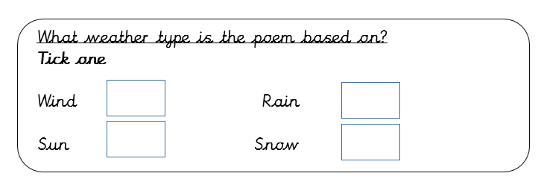
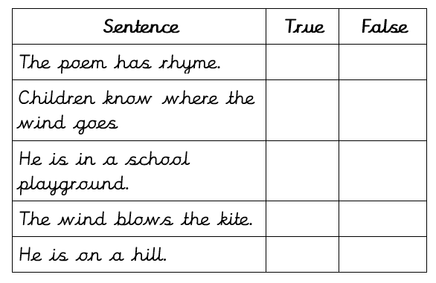
Main task
X
X
X
X
X
X

Slide 8
Lesson 2
Word detectives
Wind on the
Hill
By A.A.Milne

Slide 9
Steps to Success
How do we understand what words mean?
Read the rest of the sentence to get context.
Use synonyms to explain what the word means.
Look for parts of the word you already know. Can you make any links?
Use a dictionary to find a definition.

Slide 10
Tell your partner: How can we work out the meaning of a word?
We can use...
Read around the word
Use a dictionary
Use synonyms e.g. happy - excited
When I am reading the text, I want you to think about any words that you do not understand

Slide 11
Wind on the Hill
No one can tell me,
Nobody knows,
Where the wind comes from,
Where the wind goes.
It’s flying from somewhere
As fast as it can,
I couldn’t keep up with it,
Not if I ran.
But if I stopped holding
The string of my kite,
It would blow with the wind
For a day and a night.
And then when I found it,
Wherever it blew,
I should know that the wind
Had been going there too.
So then I could tell them
Where the wind goes…
But where the wind comes from
Nobody knows.

Slide 12
Tell your partner
Find and copy a word that means quick.
Wind on the Hill
No one can tell me,
Nobody knows,
Where the wind comes from,
Where the wind goes.
It’s flying from somewhere
As fast as it can,
I couldn’t keep up with it,
Not if I ran.
But if I stopped holding
The string of my kite,
It would blow with the wind
For a day and a night.
And then when I found it,
Wherever it blew,
I should know that the wind
Had been going there too.
So then I could tell them
Where the wind goes…
But where the wind comes from
Nobody knows.
fast

Slide 13
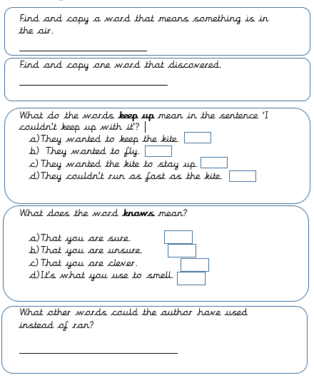
Main task
flying
found
X
X
Sprinted, jogged, dashed, raced, rushed.

Slide 14
Lesson 3
Rapid Retrieval
Wind on the
Hill
By A.A.Milne

Slide 15
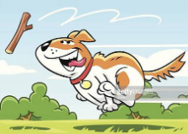
Steps to Success
What makes a good retriever of information?
Think carefully about the question. Do you know the answer already?
Scan for keywords and read around that keyword.
Check the question. Does it want you to find a single word, a phrase or put the answer in your own words?

Slide 16
Tell your partner: How can we retrieve information from the text?
We need to...
Read the text carefully​ Find the important information​ Pick out the information in order to answer questions

Slide 17
Wind on the Hill
No one can tell me,
Nobody knows,
Where the wind comes from,
Where the wind goes.
It’s flying from somewhere
As fast as it can,
I couldn’t keep up with it,
Not if I ran.
But if I stopped holding
The string of my kite,
It would blow with the wind
For a day and a night.
And then when I found it,
Wherever it blew,
I should know that the wind
Had been going there too.
So then I could tell them
Where the wind goes…
But where the wind comes from
Nobody knows.

Slide 18
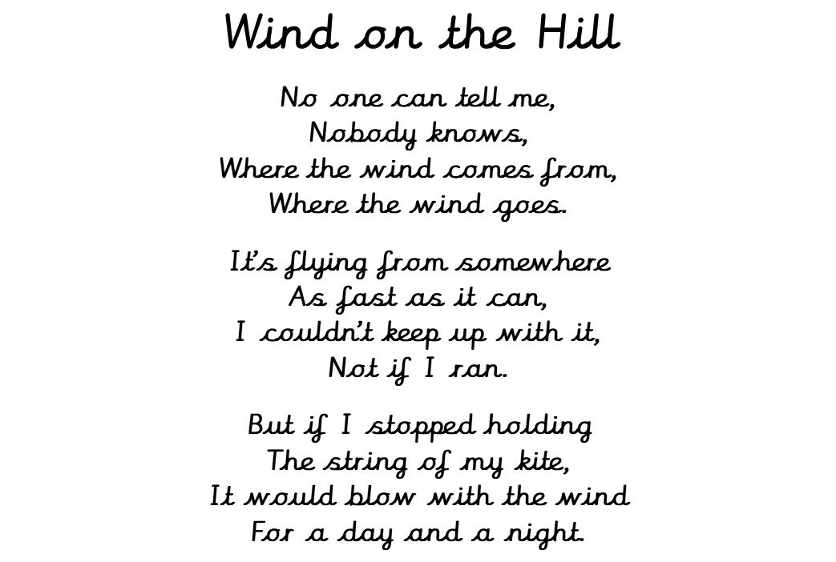
Tell your partner: How long would the kite fly for?
A day and a night.

Slide 19
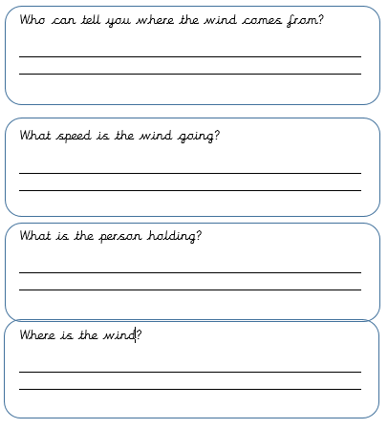
Main task
No one
As fast as it can
the string of a kite
On the hill

Slide 20
Lesson 4
Thinking Caps
Wind on the
Hill
By A.A.Milne

Slide 21
Steps to Success
How can I use inference well?
Think about what you already know about the text – characters, plot, setting.
Check what the question needs from you. Is it an opinion?

Slide 22
Tell your partner: How can we understand the characters/events in the poem?
Use clues from the text​ and make a sensible guess
Think about the setting and evets in the text
Think about how the characters are feeling

Slide 23
Wind on the Hill
No one can tell me,
Nobody knows,
Where the wind comes from,
Where the wind goes.
It’s flying from somewhere
As fast as it can,
I couldn’t keep up with it,
Not if I ran.
But if I stopped holding
The string of my kite,
It would blow with the wind
For a day and a night.
And then when I found it,
Wherever it blew,
I should know that the wind
Had been going there too.
So then I could tell them
Where the wind goes…
But where the wind comes from
Nobody knows.

Slide 24
Tell your partner:
How do you feel about the poem? Do you like it or dislike it? Use the text to help support your answer.
.

Slide 25
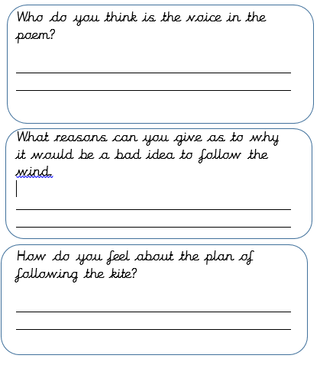
Main task
I think it is a young boy because he is flying a kite and he is wondering and curious.
You might not be able to keep up with the wind and might lose your kite.
I think that he might get lost and not be able to find his way home.

Slide 26
Lesson 5
Question of the week
Wind on the
Hill
By A.A.Milne

Slide 27
Wind on the Hill
No one can tell me,
Nobody knows,
Where the wind comes from,
Where the wind goes.
It’s flying from somewhere
As fast as it can,
I couldn’t keep up with it,
Not if I ran.
But if I stopped holding
The string of my kite,
It would blow with the wind
For a day and a night.
And then when I found it,
Wherever it blew,
I should know that the wind
Had been going there too.
So then I could tell them
Where the wind goes…
But where the wind comes from
Nobody knows.

Slide 28
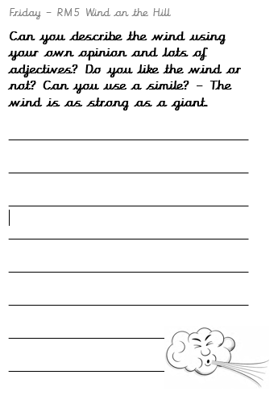

Slide 29
Sharing answers
Choose children to read out their poem and share with the class.

